Slide 1

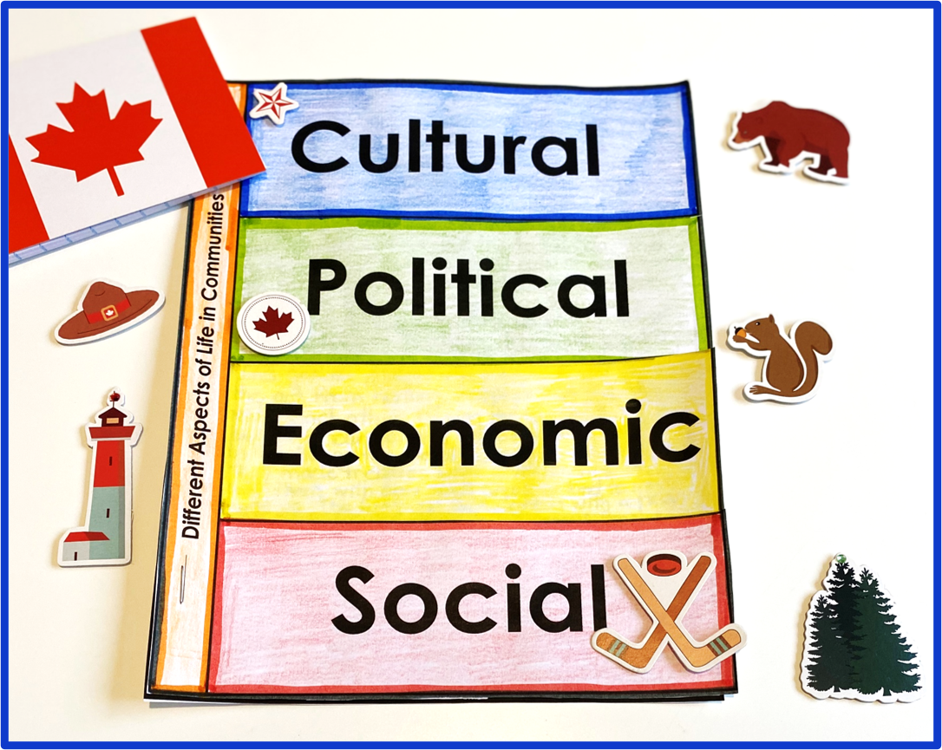

Communities in Canada
Grade 6 Ontario Social Studies
A 5-Part Bundle

Slide 2
















Resource Highlights
Full 3-Part Lesson Plans
Student Texts
Learning Goals
Variety of Communities
Inquiry Tasks
Citizenship Focus
Assessment Tools

Slide 3

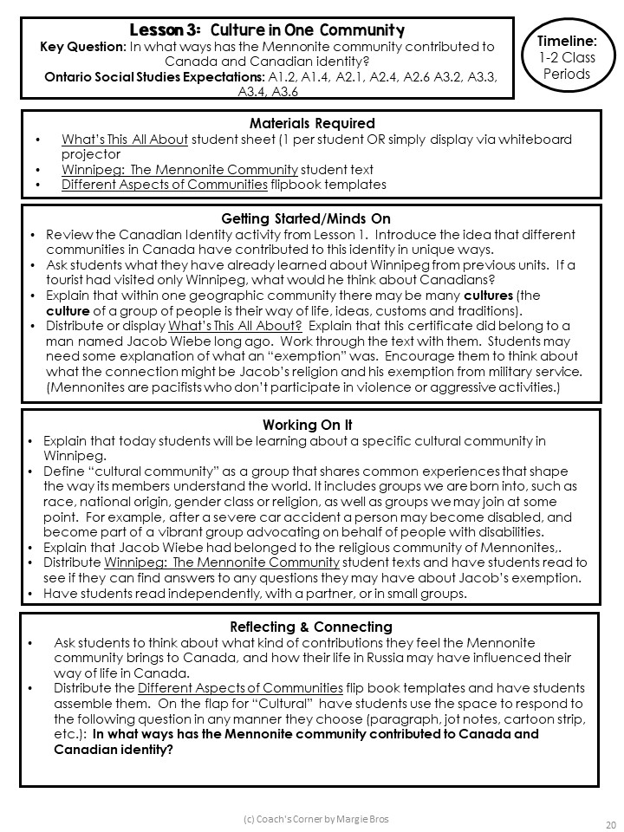
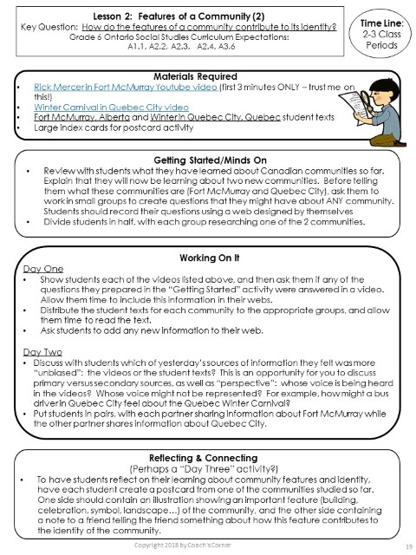
Lessons Plans
Unit Provocations

Slide 4
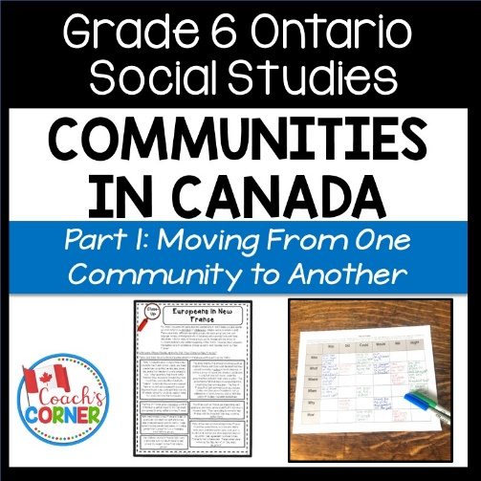
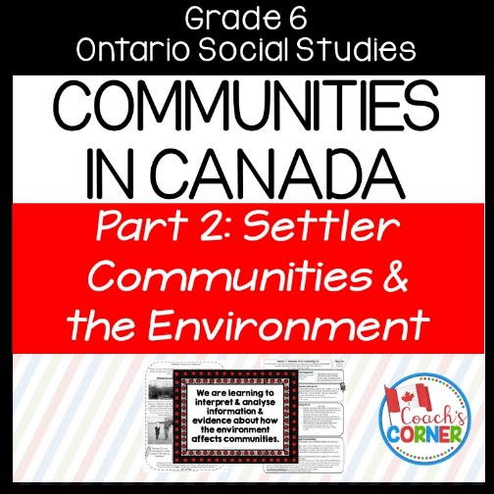


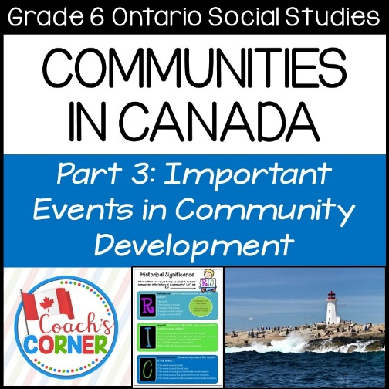


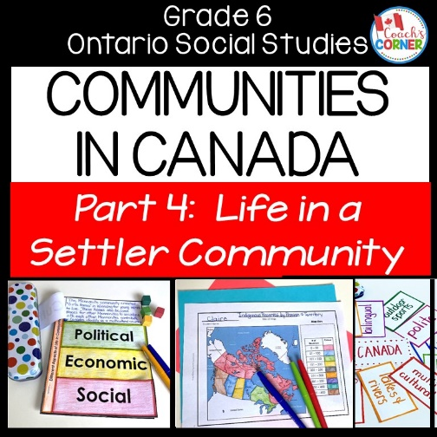
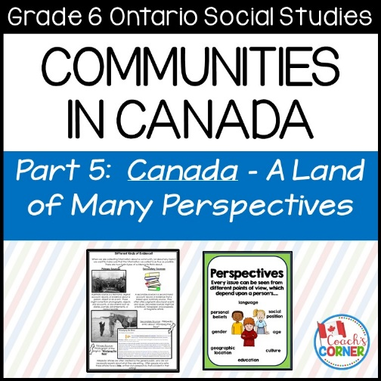

5 Parts
Each part focuses on a key question.
How do the features of a community contribute to its identity?
Printable Version
Why do people move from one country to another?
How do some events change a community?
How have different communities contributed to the evolution of Canadian identity?
Instructions & Answer Key Booklet for Digital Version
Why might an event be important to one group and not another?
Digital
Version

Slide 5

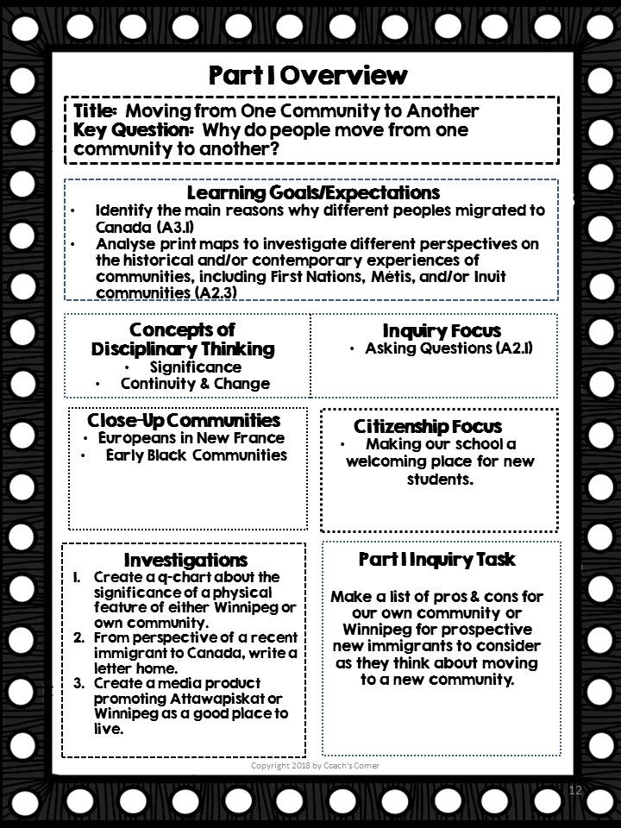
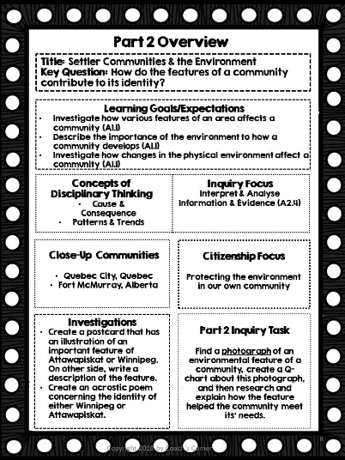
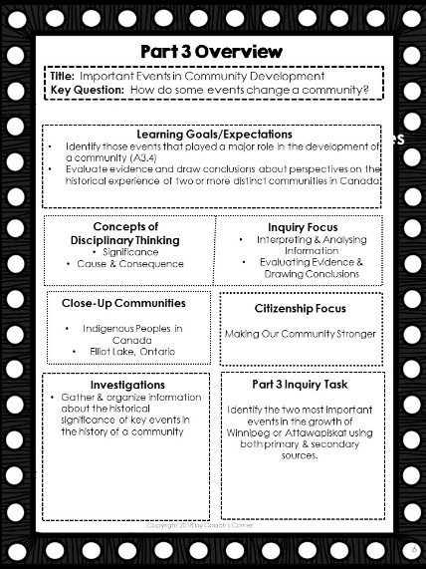
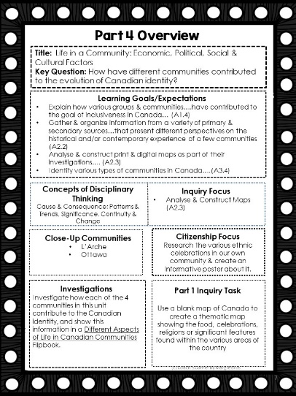
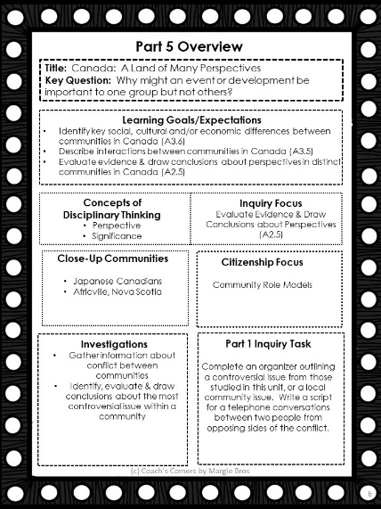
Unit Overviews

Slide 6

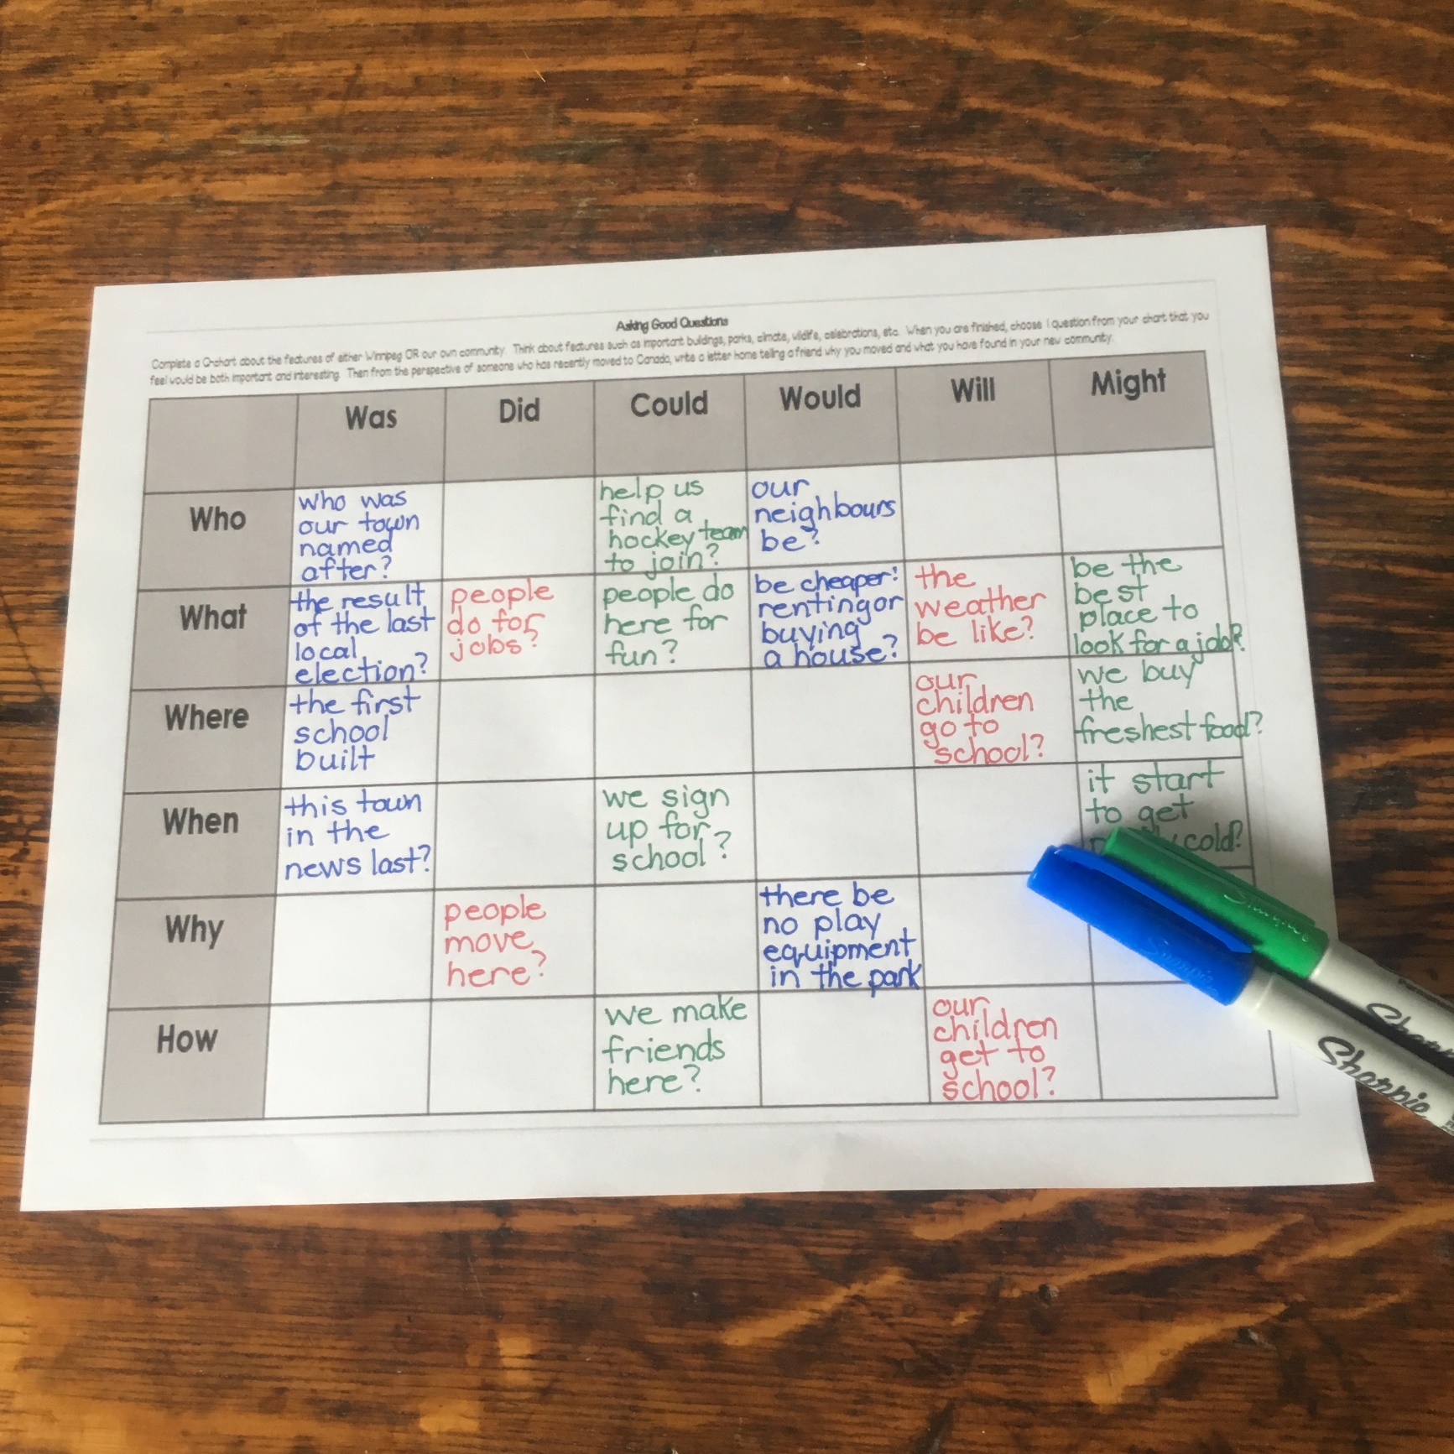
Part 1:
Moving From One Community to Another
Instructions & Answer Key Booklet for Digital Version
Digital
Version
Introduction of Attawapiskat and Winnipeg
Push & Pull Factors
Europeans in New France
Early Black Communities
Pros and Cons of a New Community

Slide 7

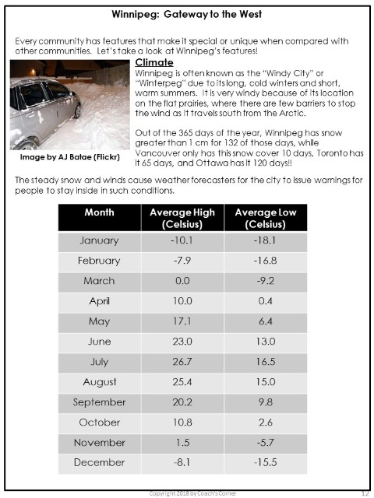
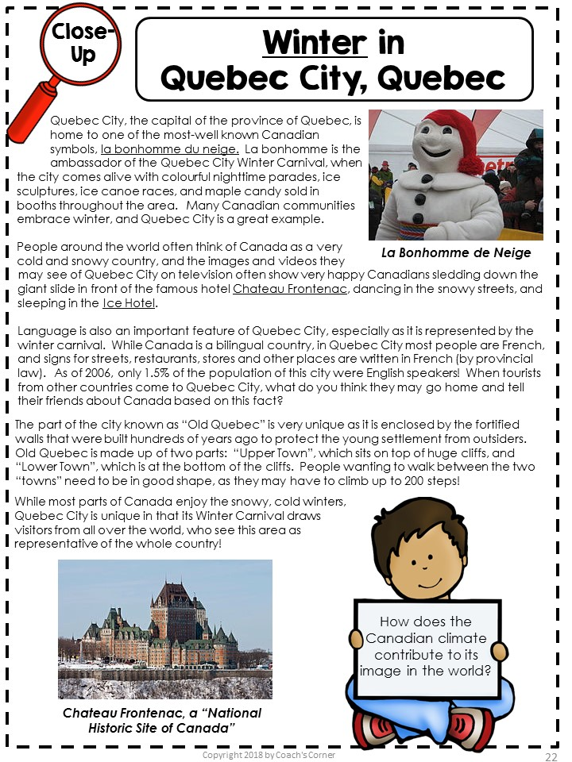
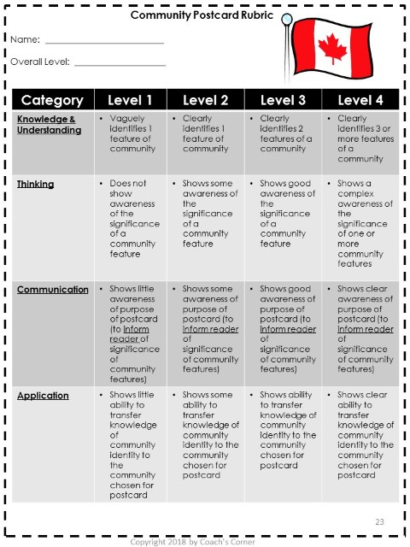
Part 2:
Settler Communities & the Environment
Instructions & Answer Key Booklet for Digital Version
Digital
Version
Community Features & Identity
Protecting the Environment in our Own Community
Close Up Communities: Quebec City & Fort McMurray

Slide 8

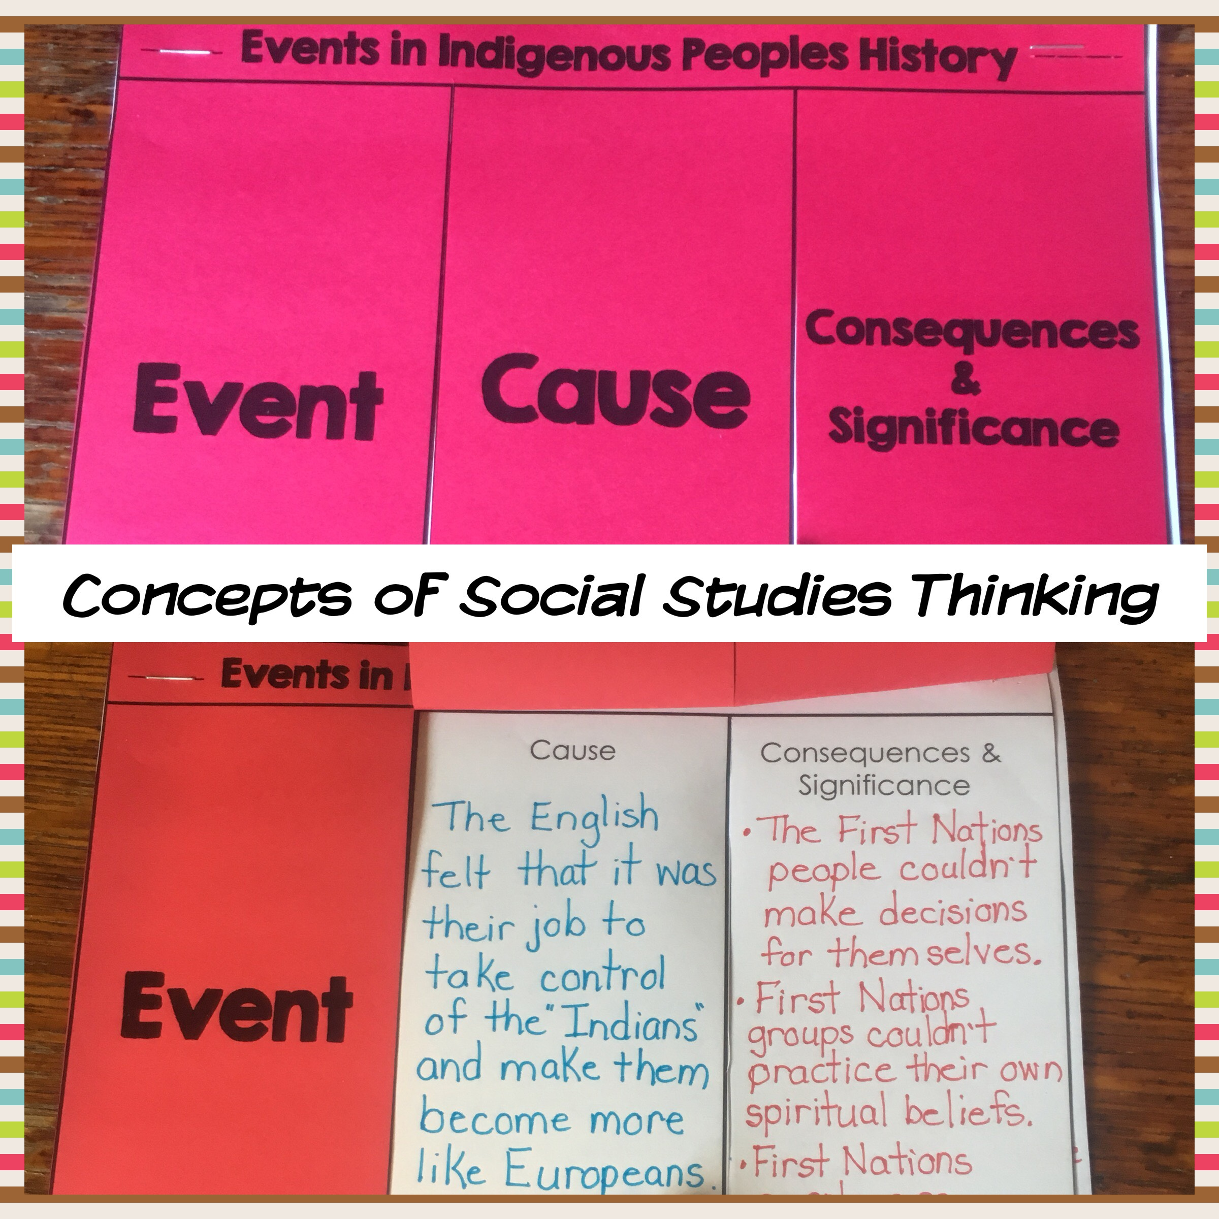
Part 3:
Important
Events in Community Development
Instructions & Answer Key Booklet for Digital Version
Digital
Version
Identifying Significant Community Events
Determining Cause & Consequence
Close-Up Communities:
  Indigenous Peoples in Canada
  Elliot Lake, Ontario

Slide 9

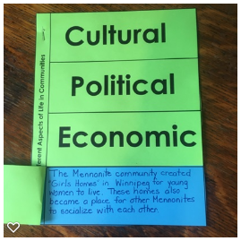
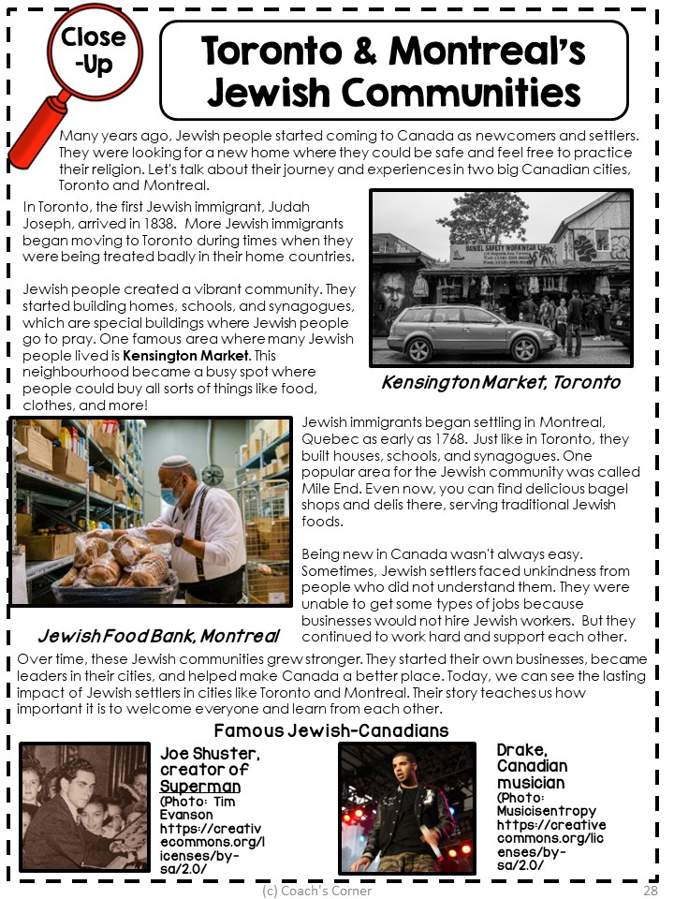

Part 4:
Life in a Settler Community
Instructions & Answer Key Booklet for Digital Version
Community Contributions to Canadian Identity
Thematic Mapping
Close-Up Communities:
    L’Arche
    Ottawa, Ontario
    NEW: Jewish Communities
Digital
Version

Slide 10

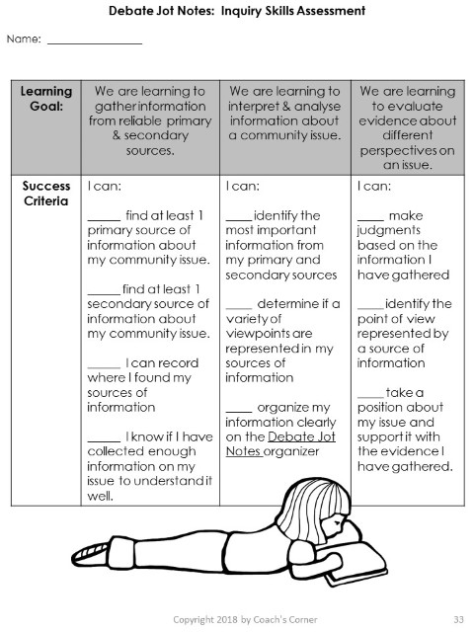
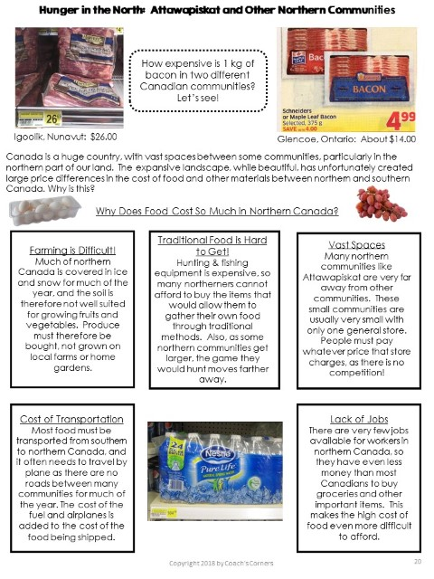
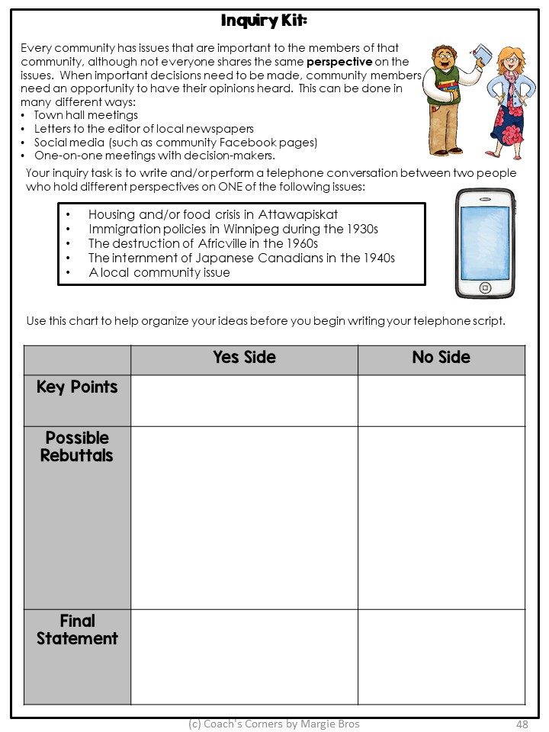
Part 5:
Canada: A Land of Many Perspectives
Instructions & Answer Key Booklet for Digital Version
Digital
Version
Focus on Evaluating Evidence
6-Day Debate Sub-Unit
Close-Up Communities:
  Japanese Canadians
  Africville, Nova Scotia

Slide 11
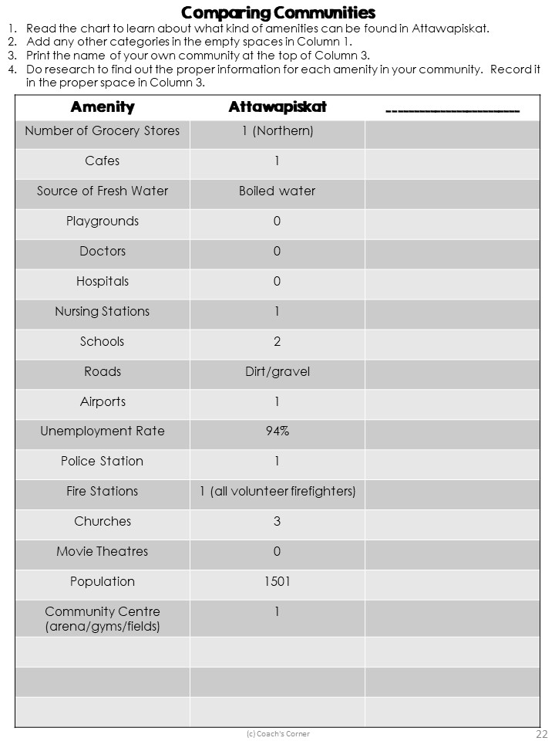
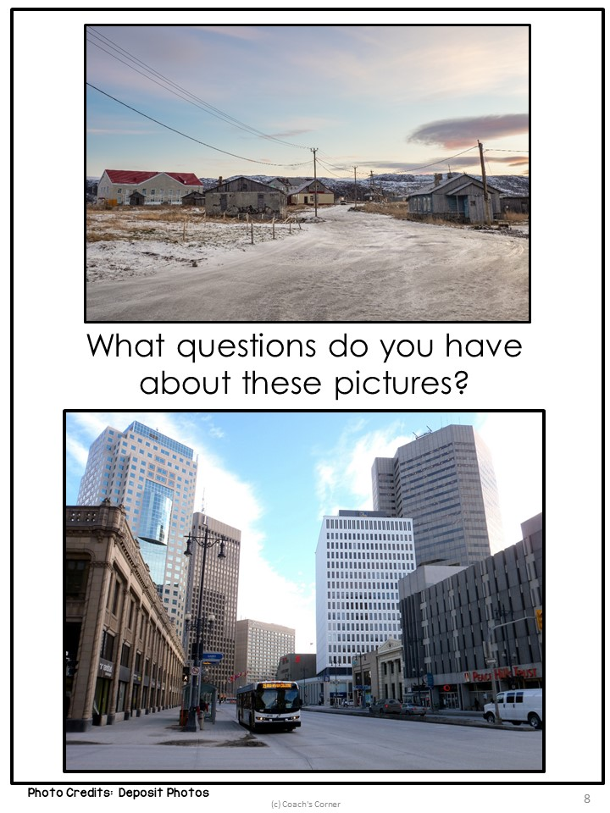
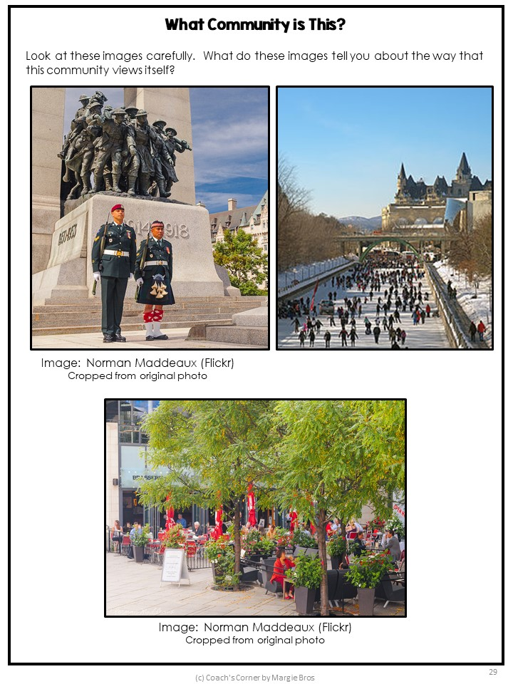
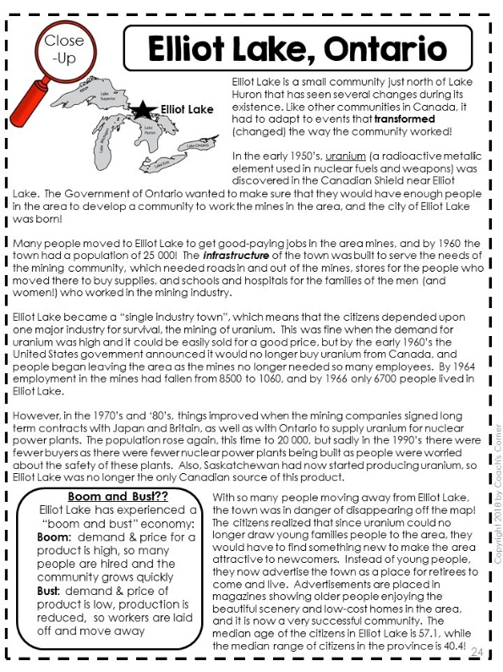
Variety of Communities
Two main communities:
Attawapiskat, Ontario
Winnipeg, Manitoba
“Close-Up” Communities:
Europeans in New France
Early Black Communities
Quebec City
Fort McMurray, Alberta
Indigenous Peoples of Canada
Elliot Lake, Ontario
L’Arche
Ottawa, Ontario
Jewish Communities in Toronto & Montreal
Japanese Canadians
Africville, Nova Scotia

Slide 12
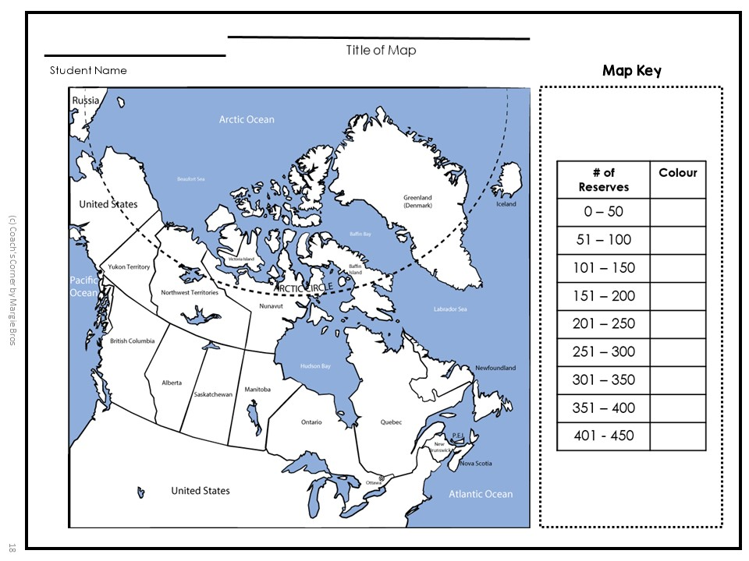
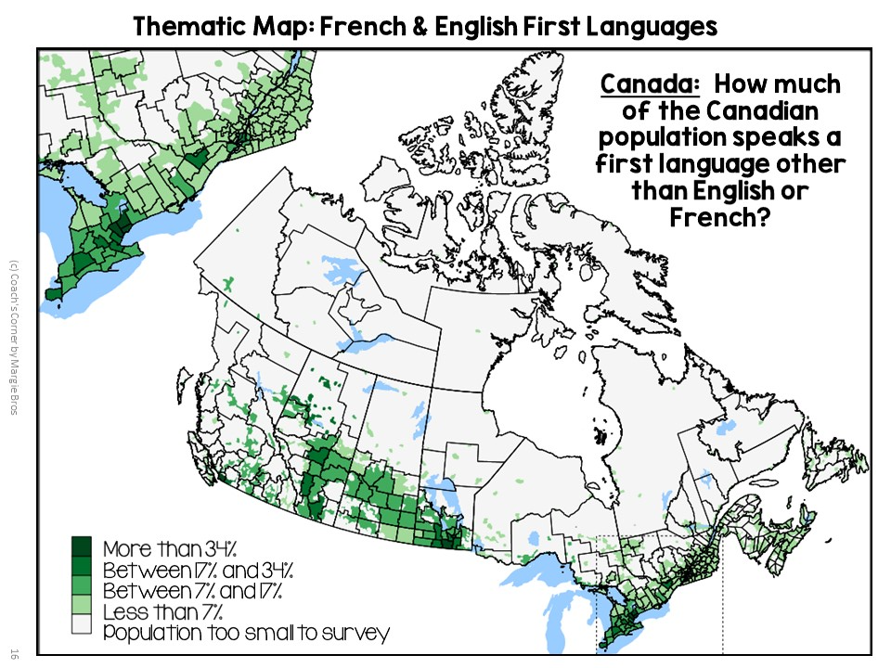

Mapping

Slide 13
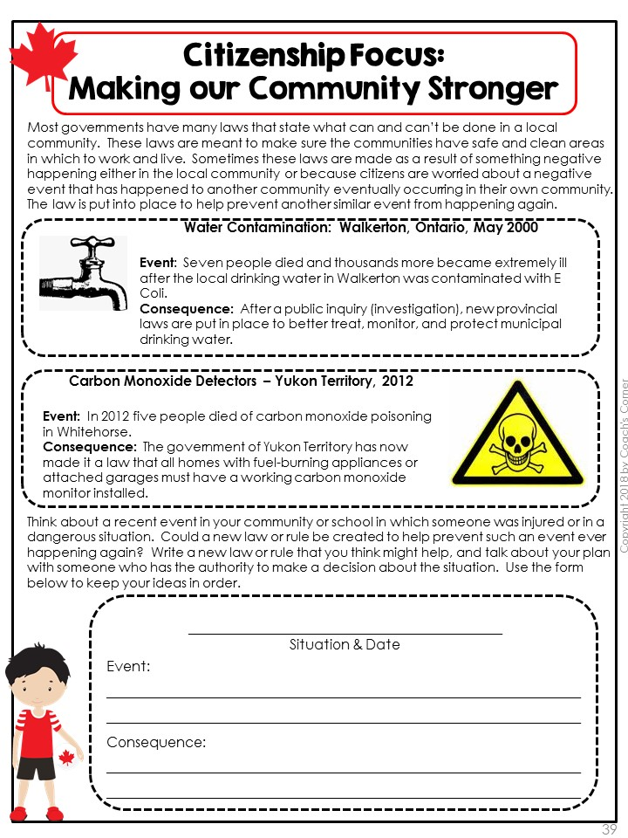
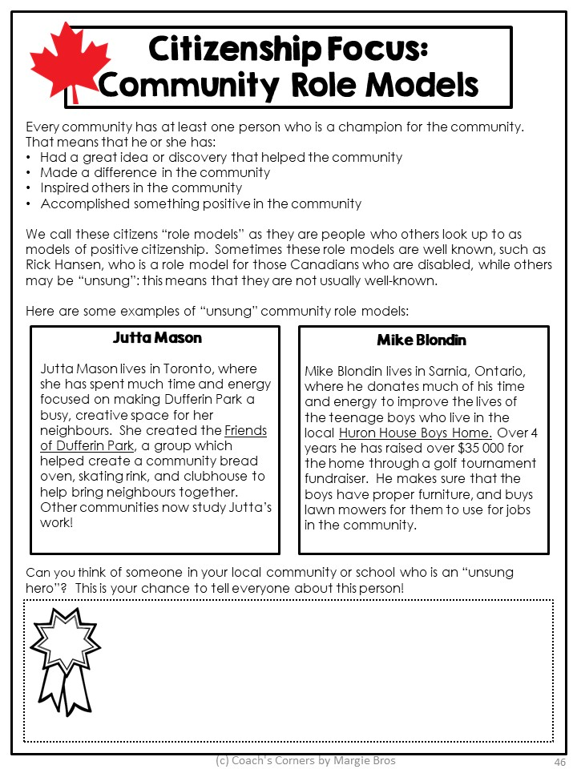
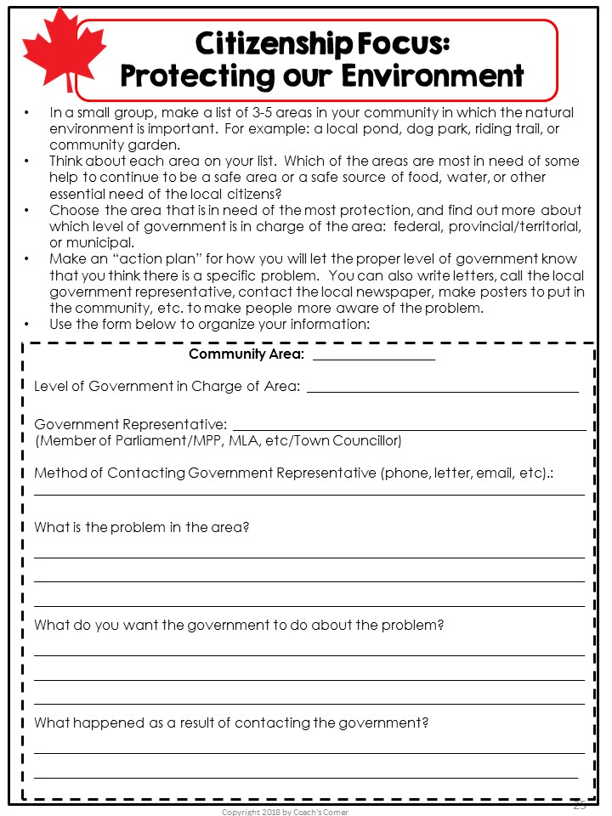
Citizenship

Slide 14
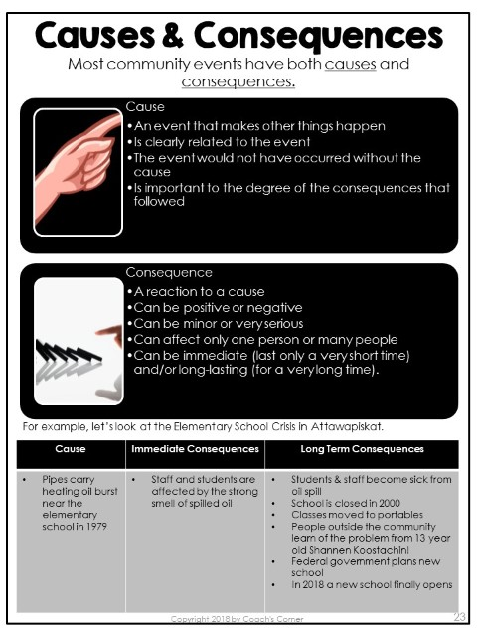
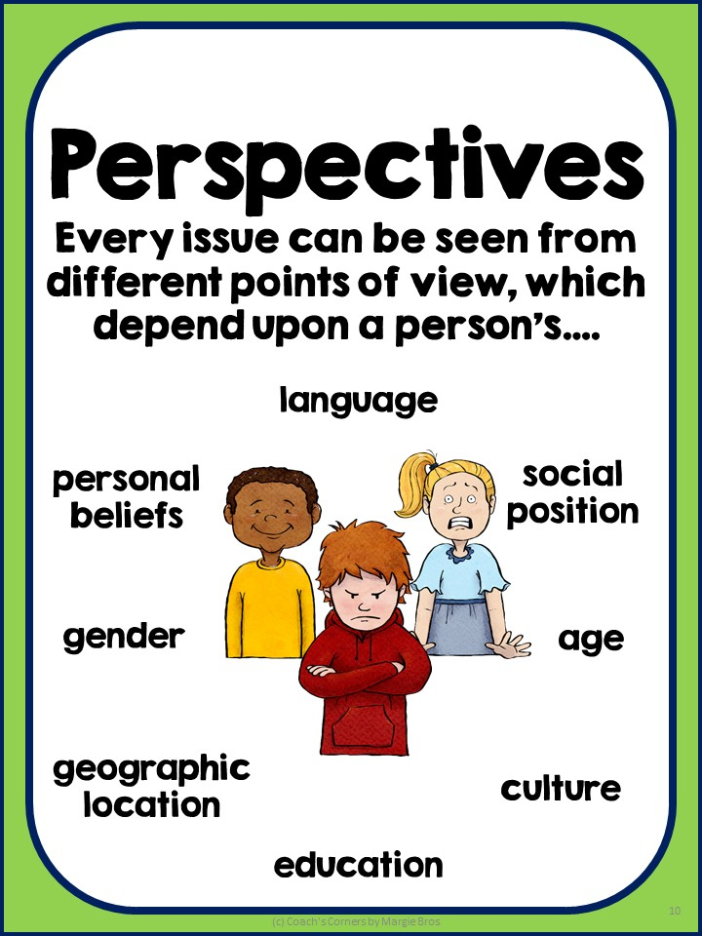
Concepts of Social Studies Thinking

Slide 15

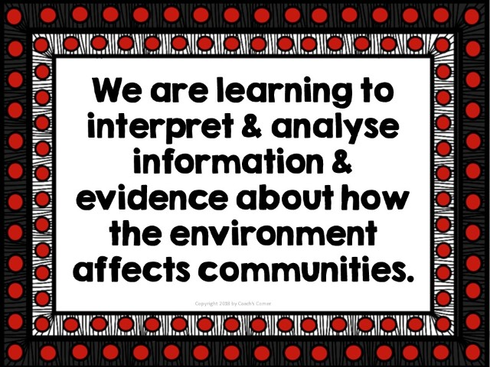
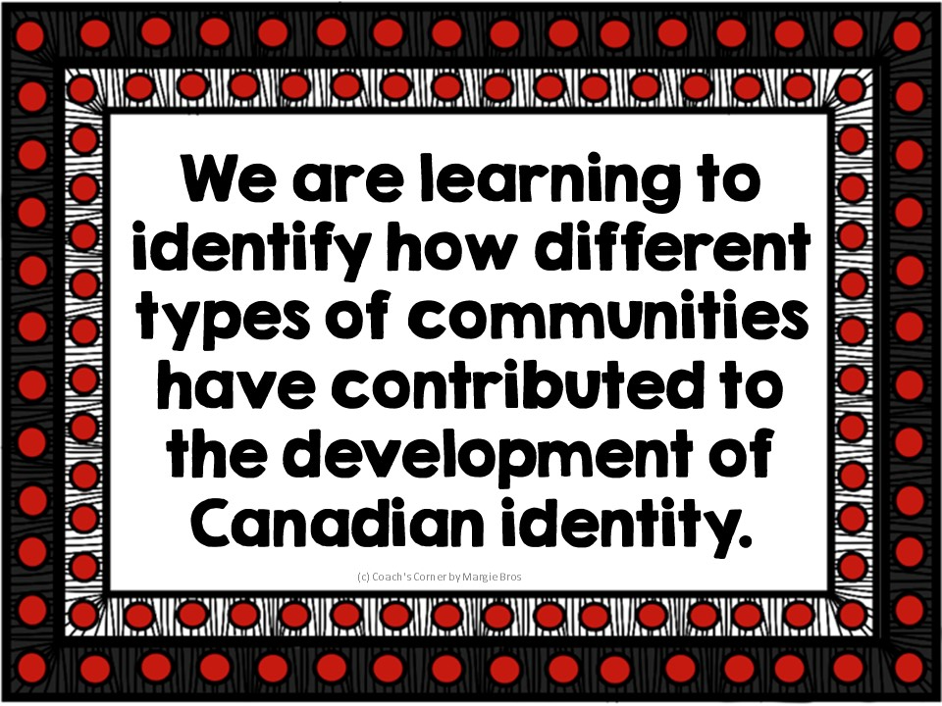
Learning Goals
Unit Provocations

Slide 16

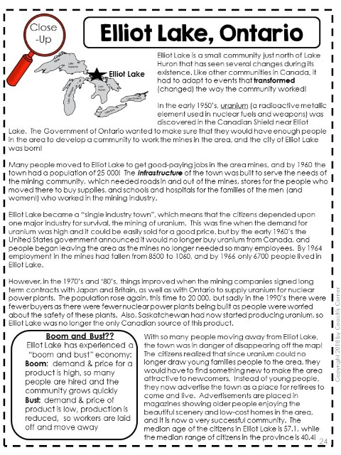


Student Tasks
Grade-Level Curriculum Text for Independent Work

Slide 17

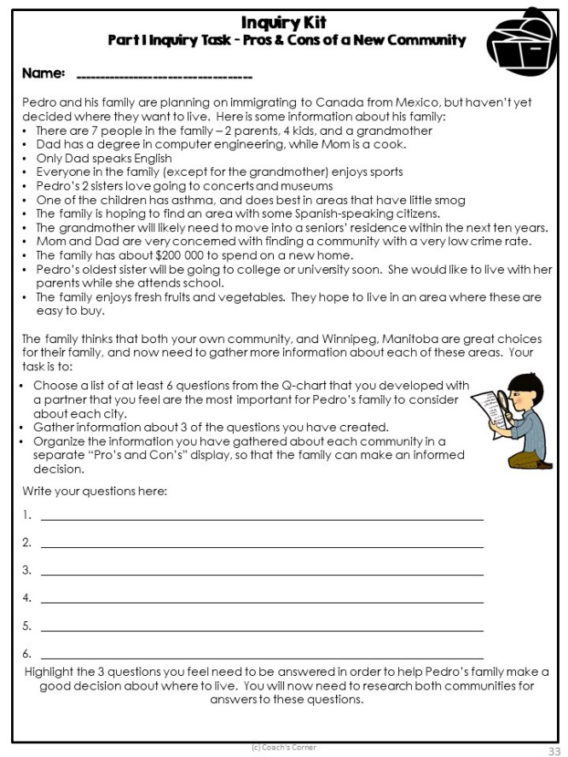
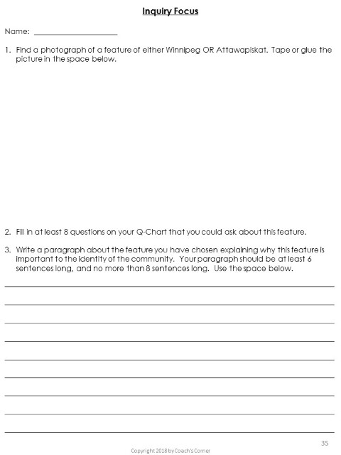
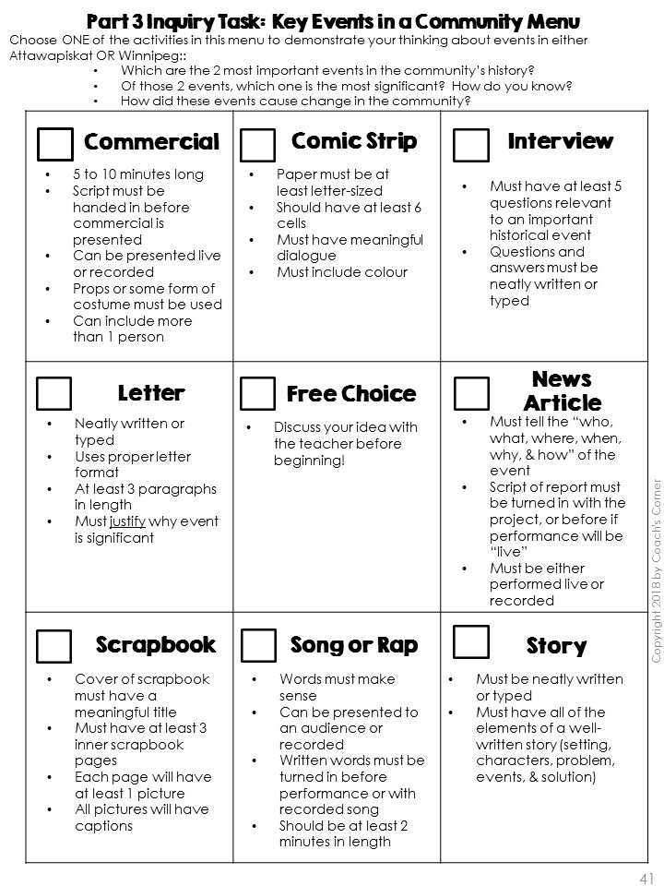

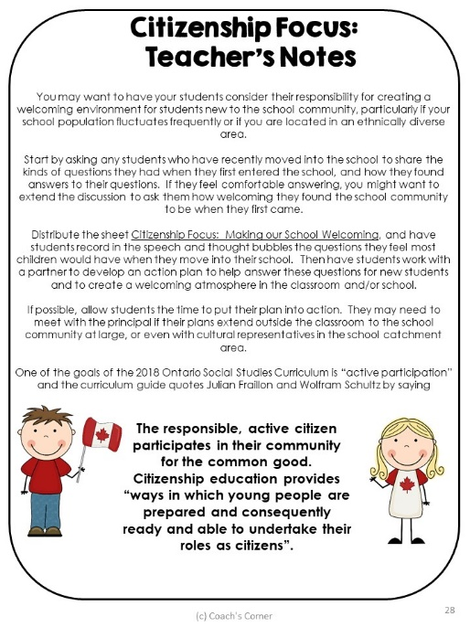
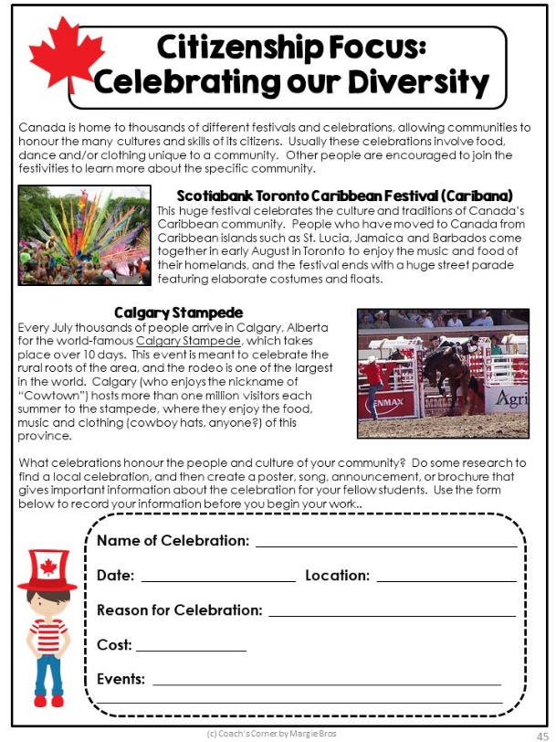
Inquiry Tasks
Unit Provocations
Citizenship Activities

Slide 18
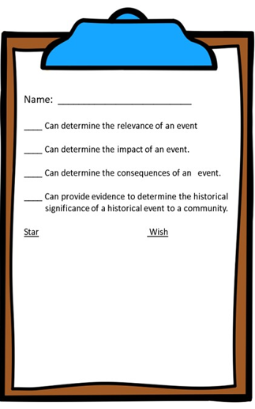
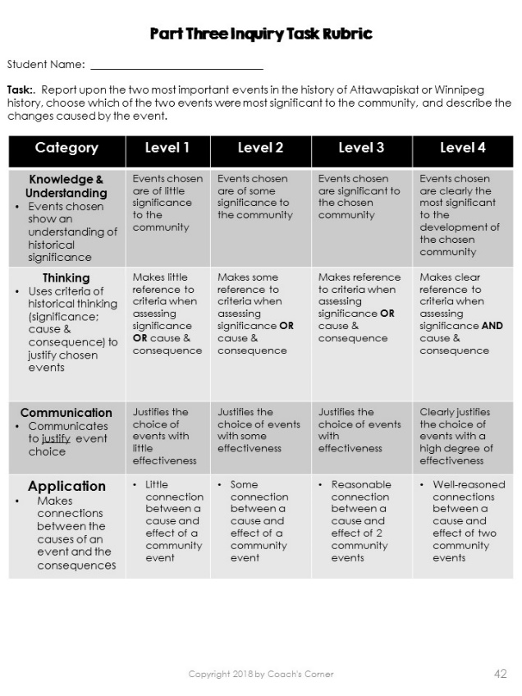
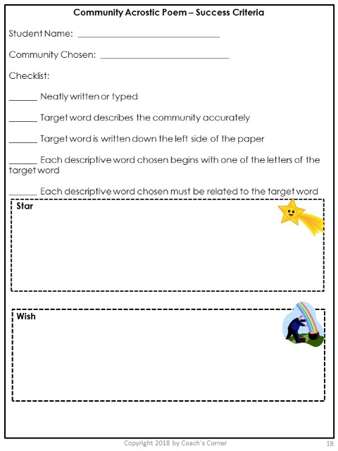
Assessment Tools

Slide 19
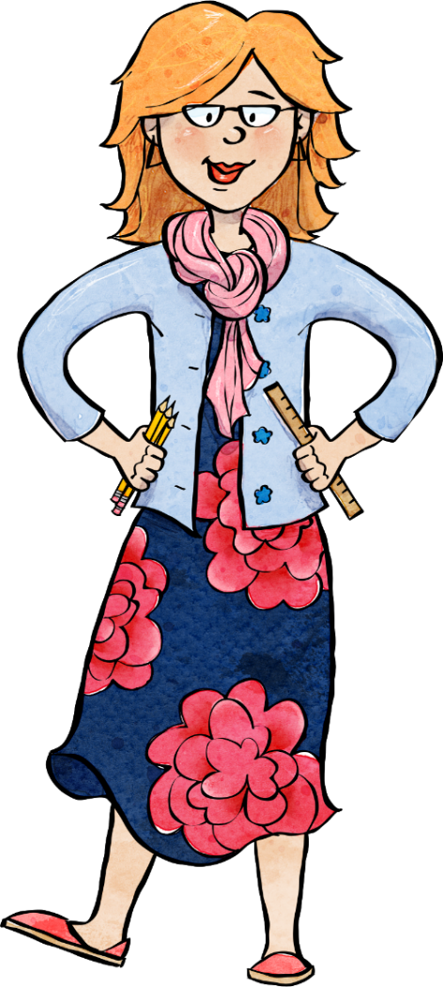

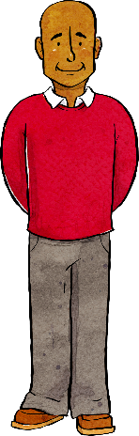

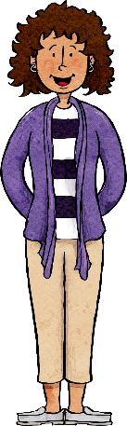

Teacher
Feedback
My students loved learning about the different communities featured!
This is a great foundation that I can easily add to. I was seriously impressed. It's the best resource I've purchased on TPT by far! Worth it!
This is a FANTASTIC resource. I have just started using it for this unit, but I can already tell, that it will be my go-to for teaching this part of the curriculum in the coming years. Teaching in Timmins, the connections to Attawapiskat are awesome…Thanks for a thorough, detailed and well thought out resource!

Slide 20

PLEASE READ!!
To get a more thorough look at what is included in this 5-part bundle, please take a moment to look at the preview files for EACH of the five components before purchasing!

