Slide 1

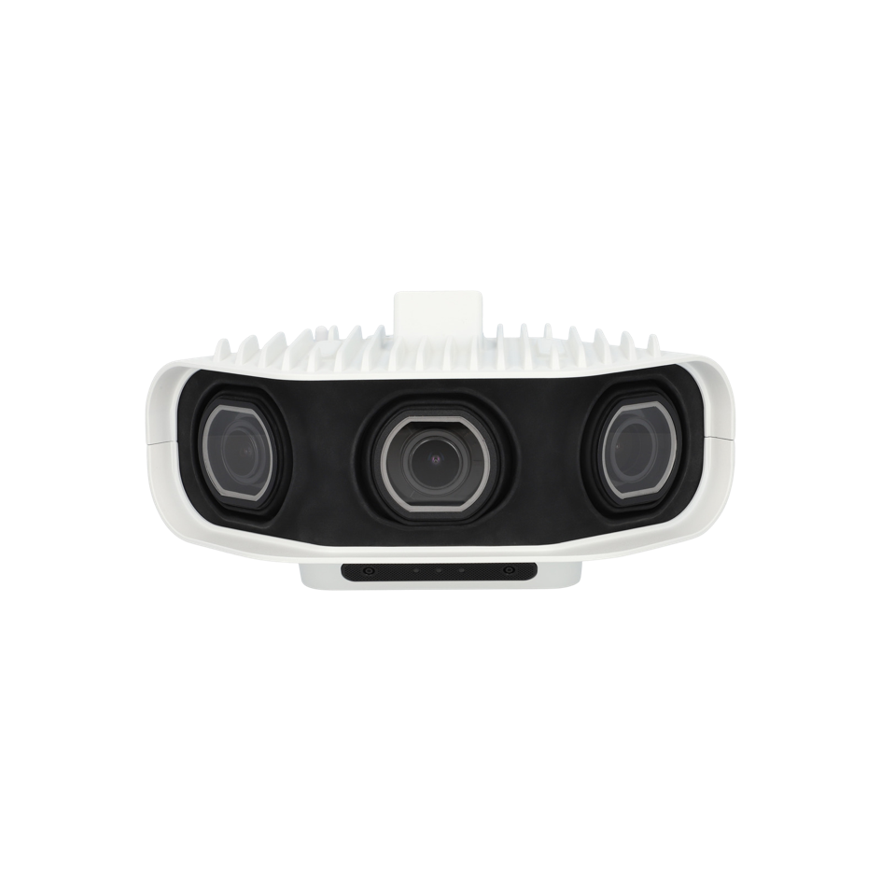




PIXELLOT SHOW S3 CAMERA SYSTEM
The Next Generation of AI Automated Sports Video Capture
BETTER QUALITY AT A BETTER PRICE
The Pixellot Show S3 Camera system is a breakthrough when it comes to value and performance. It offers superior video quality and 50% higher resolution.
Thanks to its three 10-megapixel camera array, it delivers smooth and clear footage, is immune to condensation, equipped with integrated lens heaters and supports 25/30 FPS (PAL & NTSC).
FASTER AND EASIER INSTALLATION
The system installation is easy and inexpensive thanks to its lightweight design, ergonomic handle, and single cable. Motorized horizontal servos eliminate the need for manual camera adjustments on-site. Now you can easily validate field coverage remotely from your mobile device, without the need for a laptop.
EASY MONITORING
The camera also includes a status LED for easy monitoring, reduced components, and fully integrated hardware and software.
S3 ADVANTAGES
Better video quality
Supports wide, ultra-wide, and narrow variable camera positioning
Simple installation
Streamlined operation

Slide 2
CAMERA HEAD UNIT
Dimensions (W x H x D) | 342 x 169 x 186 mm.
Weight | 3.5 kg
Power Supply | PoE+
Power Consumption | 25 W
3 X Camera
Full Resolution | 3 x 12 MP
Effective Pixels | 30 MP
Field of View (H/V) | Ultra-Wide: 180°/60° Wide: 93°/25°
Network
Interface | GigE, RJ-45, 1 Gbps Ethernet
General
Weatherproof Standard* | IP65
2 X Mic Stereo
Product | Digital Microphone
Pattern | Omni
Max SPL | 110 db.
Frequency response | 20 Hz -20 Khz
The Best Ai-automated Camera Just Got Better
Pixellot.tv for more information info@pixellot.tv

