Slide 1
Growing Ethical IT Talent in Canada
CIPS - Canadian Information Processing Society
Join Canada’s Association
of IT Professionals Today!
www.cips.ca info@cips.ca
21 March 2024

Slide 2
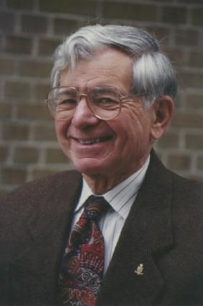
HISTORY
In September 1958 a dedicated group of data processors got together to talk about common concerns.
That conference demonstrated the value of sharing ideas, networking with fellow professionals, and learning about changes in technology
This event sparked the formation of the Computing and Data Processing Society of Canada.
In 1968 the society changed its name to the current Canadian Information Processing Society (CIPS)
Founder of CIPS and “Father of Computing in Canada” Calvin C. (Kelly) Gotlieb (1921 –2016)

Slide 3
FAST FACTS
Establishing standards and best practices for IT professionals since 1958
CIPS is an IT Federation of 10 CIPS Provincial societies that license IT professionals locally and abroad
Each CIPS Provincial Society is a community of IT Professional members, providing networking and professional development opportunities
Since 1989 the I.S.P. Designation is Canada’s only legally recognized designation for IT professionals (*BC, AB, SK, ON, NB, NS)
Since 2008 the ITCP Designation is Canada’s only internationally IP3P accredited designation for senior IT professionals

Slide 4
MISSON
Protect the public through ethical and skilled IT Professionals and practice in Canada
Develop and align IT standards for IT Professionals and Accredited programs
Increase recognition of the IT profession to Industry, Government, Academia, and Public
Develop and maintain the integrity and competence of individuals active in IT
Advance the theory and practice of IT and promote sharing of information
Establish public awareness of the potential impact and misuse of IT

Slide 5
RELATIONSHIPS
International Relationships
FEAPO (Federation of Enterprise Architects Professional Organizations)
IFIP (International Federation for Information Processing)
IP3 (The International Professional Practice Partnership)
Responsible AI Institute
Seoul Accord
SFIA (Skills Framework for the Information Age)
Corporate Partners
Electronic Recycling Association
IT World Canada
SkillsTX
Bell
Community
AAAC (Association of Accrediting Agencies of Canada)
BTM
Catalyste+
CIO Association of Canada
CS-Can | Info-Can
Data Collaboration Alliance
Digital Governance Council
DPI (The Association of Public Sector Information Professionals)
ICCP (Institute for Certification of Computing Professionals)
ICTC (Information and Communications Technology Council
Réseau ACTION TI
Technation
The Career Foundation
WYWM

Slide 6
ACCREDITATION
The CIPS Accreditation team visits universities and colleges to review their IT programs and ensure they meet educational standards and requirements
CIPS Accredited programs can be viewed at: cips.ca/accreditation
Graduates of CIPS Accredited programs are eligible for the AITP Designation and One Year of Free CIPS Candidate Membership

Slide 7
MEMBER BENEFITS
Skills Assessment and Career Planning
Certification of IT professionals
Networking opportunities
Events and Professional Development
Community Discussion Forums
Volunteer to build new skills
A niche IT Job Board
Discounts on a variety of products and services

Slide 8
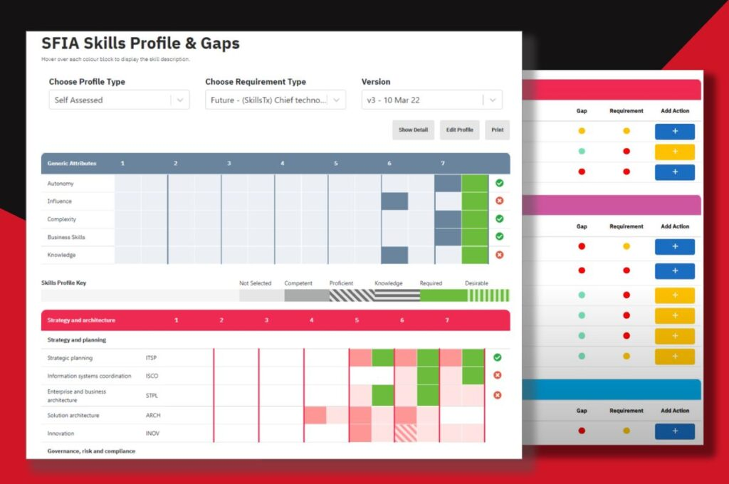
SKILLS ASSESSMENT & CAREER PLANNING
Assess your current IT skills with the international SFIA framework (Skills Framework for the Information Age)
Take a survey to discover your current skills and get a skills assessment report
Use the planner to edit and update your skills throughout the year
Set career goals and compare the skills you have to the skills you need to progress in your career
Create an action plan to develop target skills
CIPS.CA/SKILLS-ASSESSMENT

Slide 9
SFIA FRAMEWORK
120+ defined skills
SFIA defines skills and competencies required by professionals who design, develop, implement, manage and protect data and technology
detailed descriptions for more than 120 professional skills
Global footprint
180+ countries, translated into 12+ languages
An industry role comprises one or more SFIA skills
any industry role can be built from SFIA Levels of Responsibility and SFIA Professional Skills
Not just an IT Framework
Includes non-IT skills that can be used for wider industry roles and professions
Not just for large companies
SFIA can be used by large companies, SMEs, and by individuals
Can be used by countries for national skills and competency initiatives

Slide 10
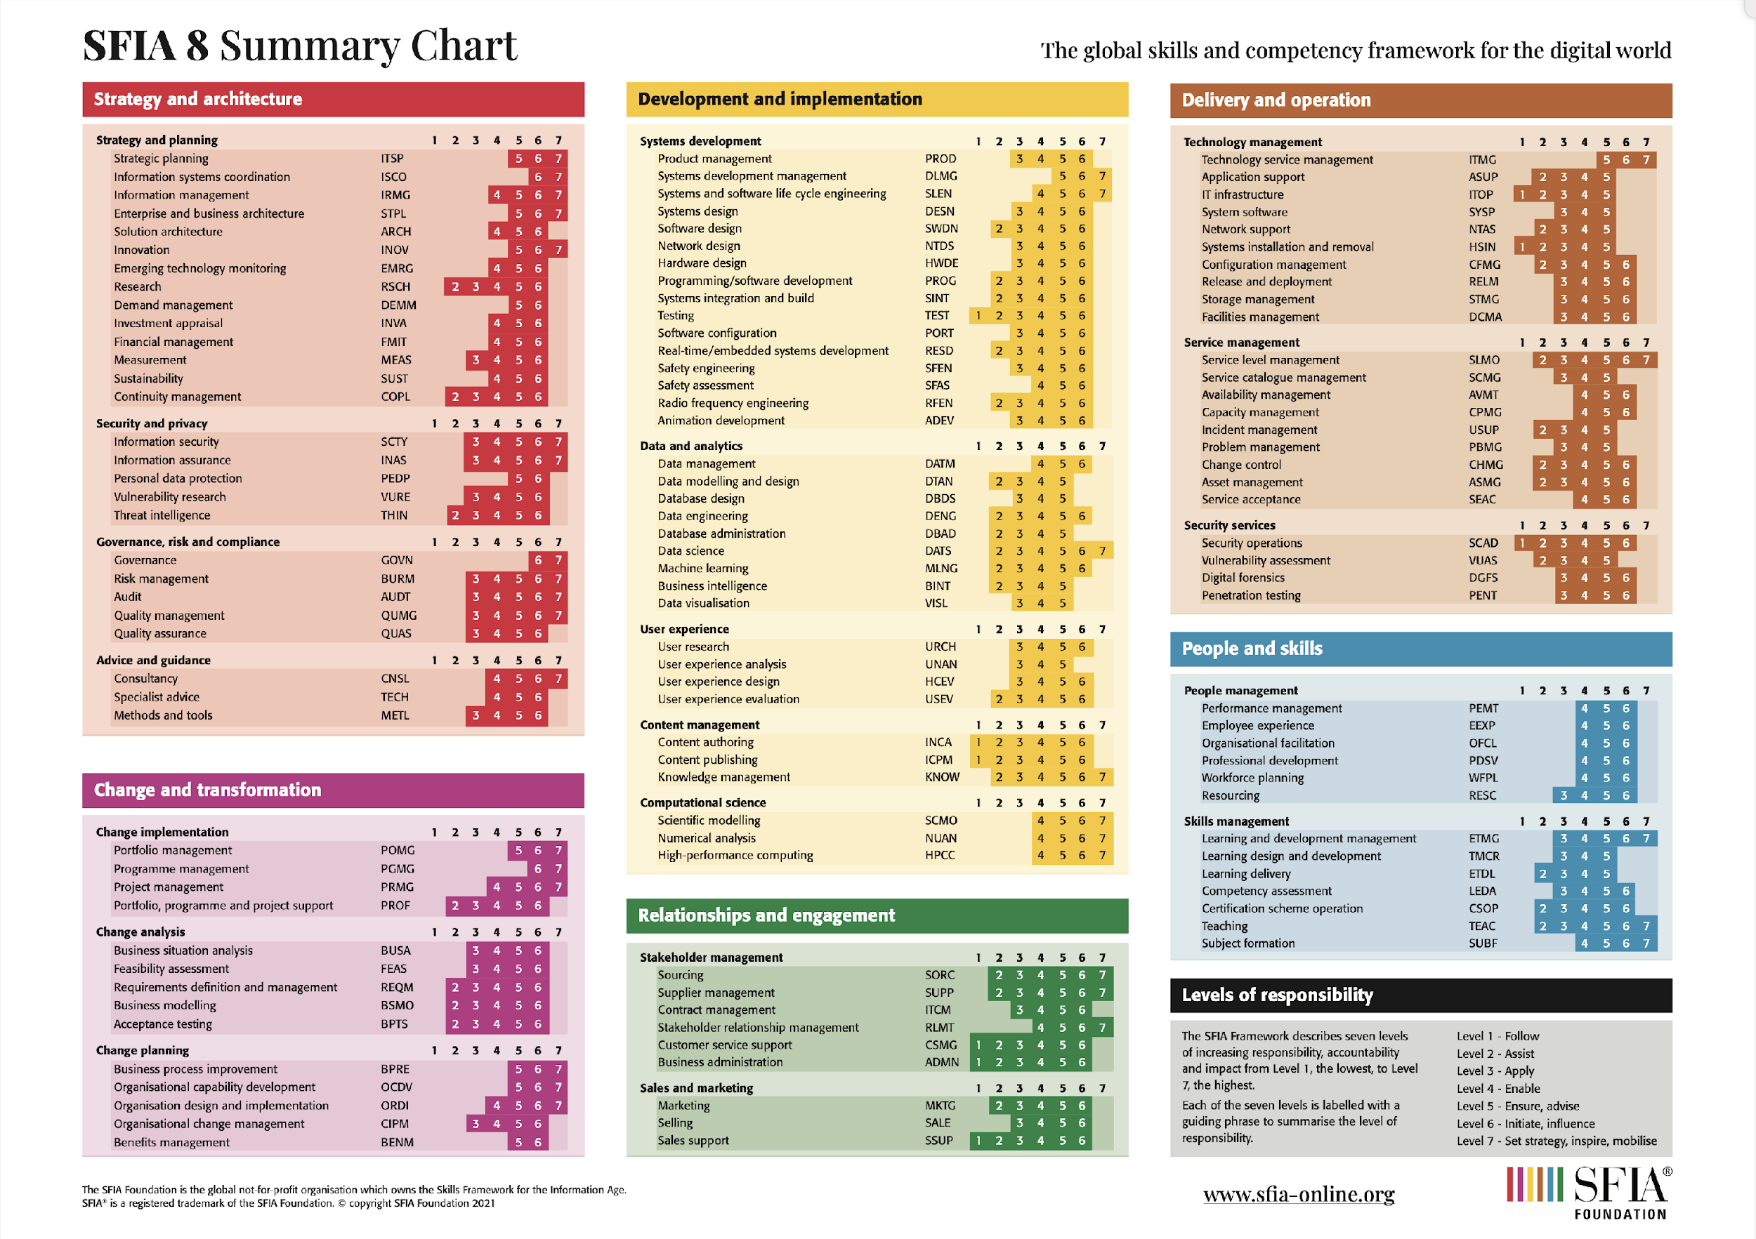
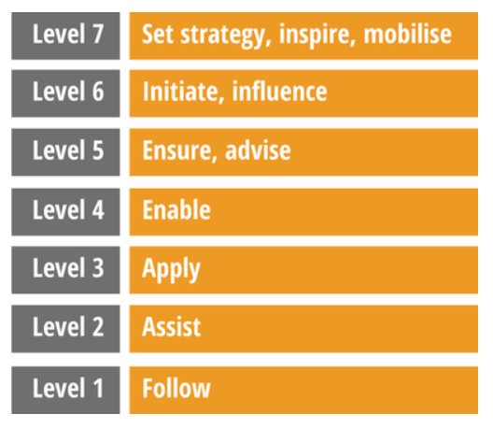
SFIA FRAMEWORK

Slide 11
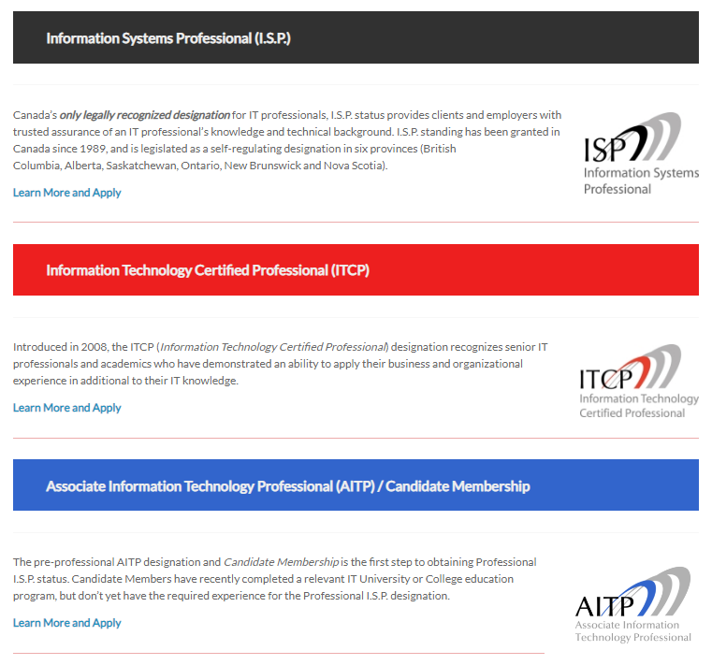
CERTIFICATION

Slide 12
CERTIFICATION
Application Requirements

Slide 13
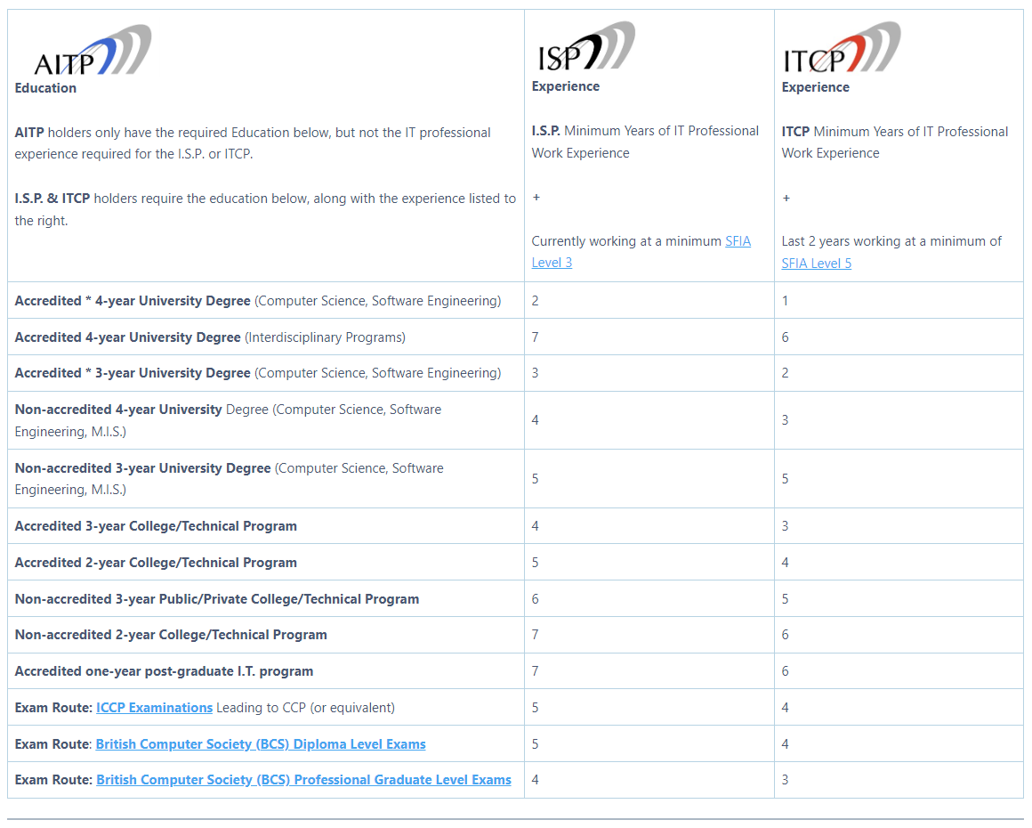
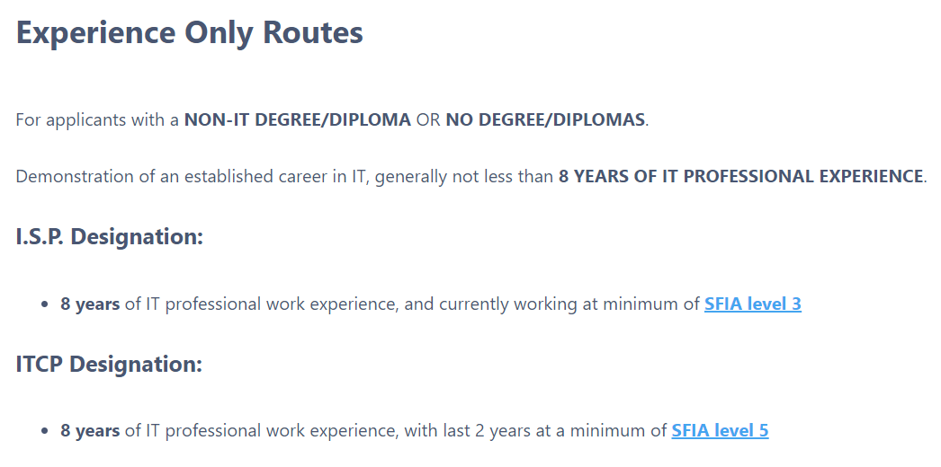
CERTIFICATION
Application Requirements

Slide 14
CODE OF ETHICS
The CIPS Ethics Exam is also required for CIPS Certification applications*
All CIPS members must agree to abide by the CIPS Code of Ethics and its ethical principles/imperatives:
Protect the Public Interest and Privacy of Information
Avoid Conflicts of Interest
Take Professional Responsibility
Contribute to the IT Profession
EXAM.CIPSRESOURCES.CA

Slide 15
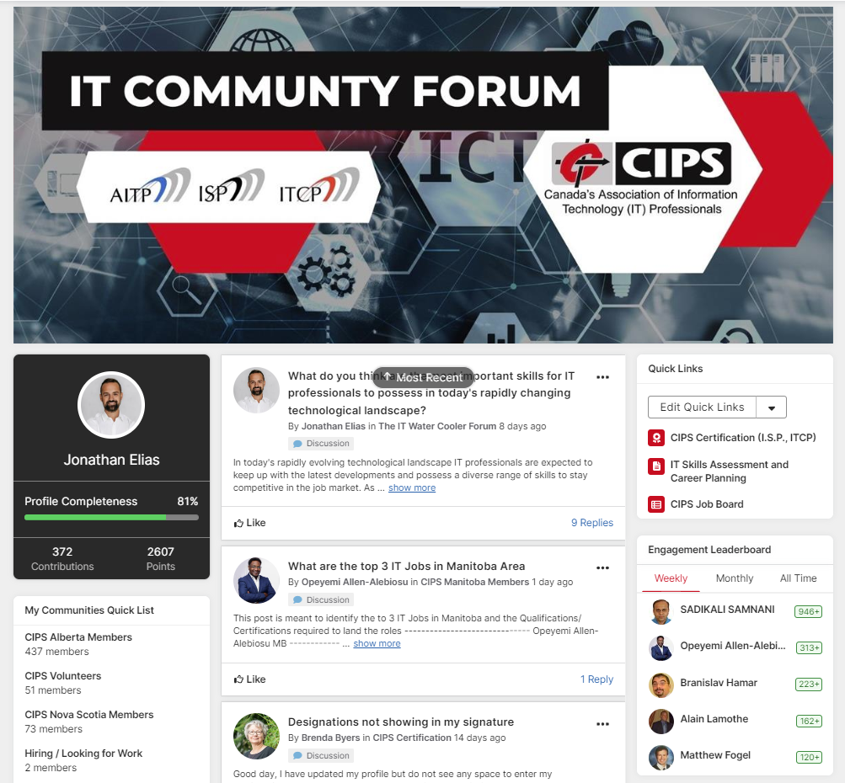
IT COMMUNITY
FORUM
Participate in a variety of discussions, network, and share knowledge and resources with members locally and around the world!
Members can engage in discussions locally within their CIPS Provincial Society communities, or with all CIPS Members in Canada and around the world in the “IT Water Cooler Forum”.
COMMUNITY.CIPS.CA
Notes:
Jonathan to explain how to access

Slide 16
EVENTS
Stay informed about IT events and professional development opportunities across Canada
Attend in-person and online events and network with other IT professionals locally or around the world
Participate in events hosted by CIPS’ Provincial societies and CIPS partners across Canada
Volunteer your time and contribute to local events and develop new skills
Access event recordings
CIPS.CA/EVENTS

Slide 17
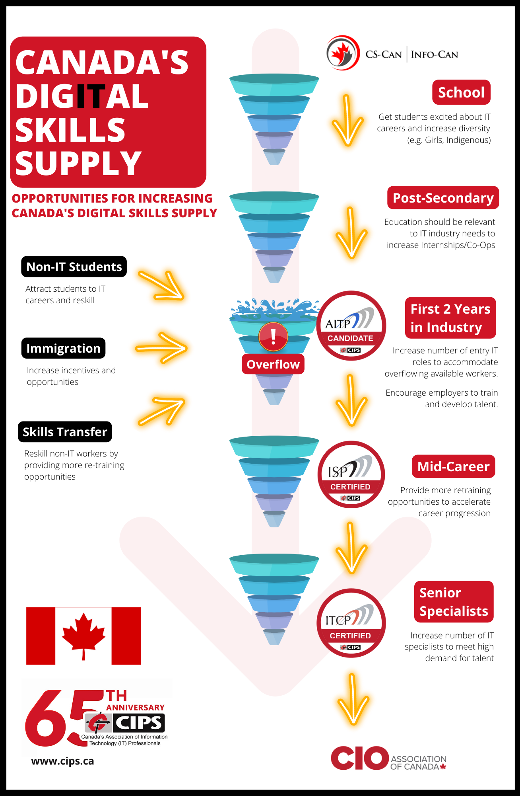
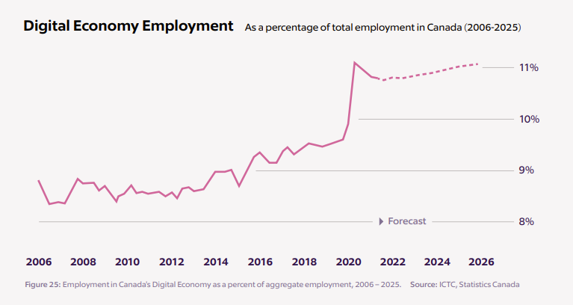
CANADA’S DIGITAL SKILLS SUPPLY SHORTAGE

Slide 18
FREE STUDENT MEMBERSHIP
Free Student Membership is available to those registered full-time in a recognized educational institution with a minimum of two full semesters or approximately 400 hours with significant computing content.
Join today and take charge of your future!

Slide 19
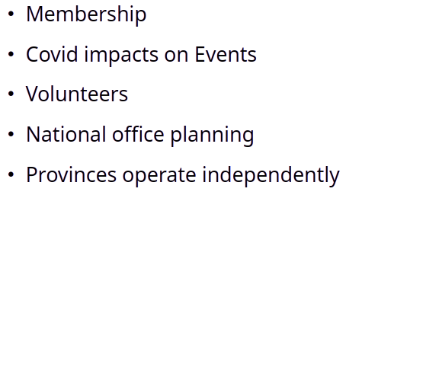

Slide 20
VISION
Grow membership
Streamline operations
Work collectively versus independently

Slide 21
NEXT STEPS
Kick off National Committees
Finance Committee
Brand and Awareness Committee
Program Committee
Membership Committee
Operational Review
Explore potential benefits of Centralized Shared Services

Slide 22
VOLUNTEER TODAY
Join your local Board
Finance Committee
Brand and Awareness Committee
Program Committee
Membership Committee
Be a mentor/mentee
Help shape the future of CIPS and the IT Profession!

Slide 23
Questions?
info@cips.ca

Slide 24
www.cips.ca
info@cips.ca

