Slide 1
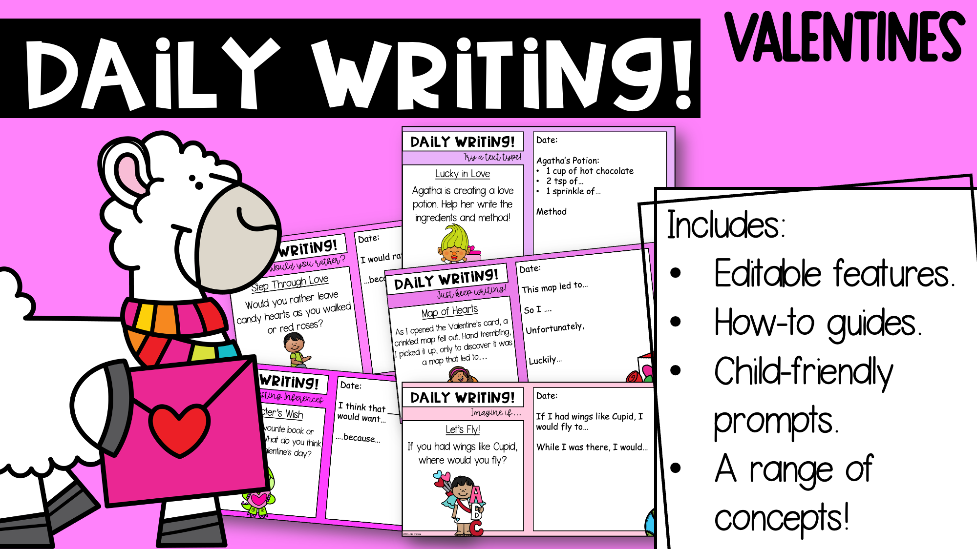

Slide 2
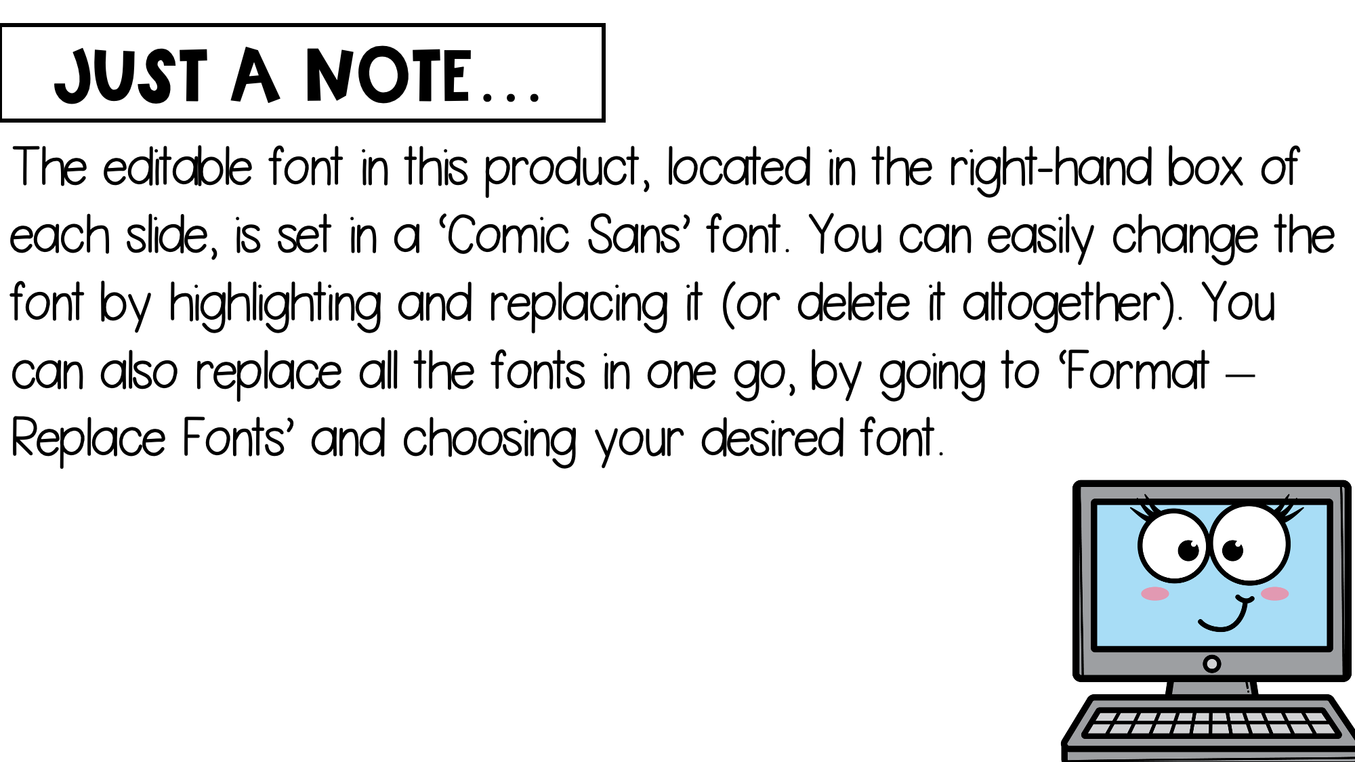

Slide 3
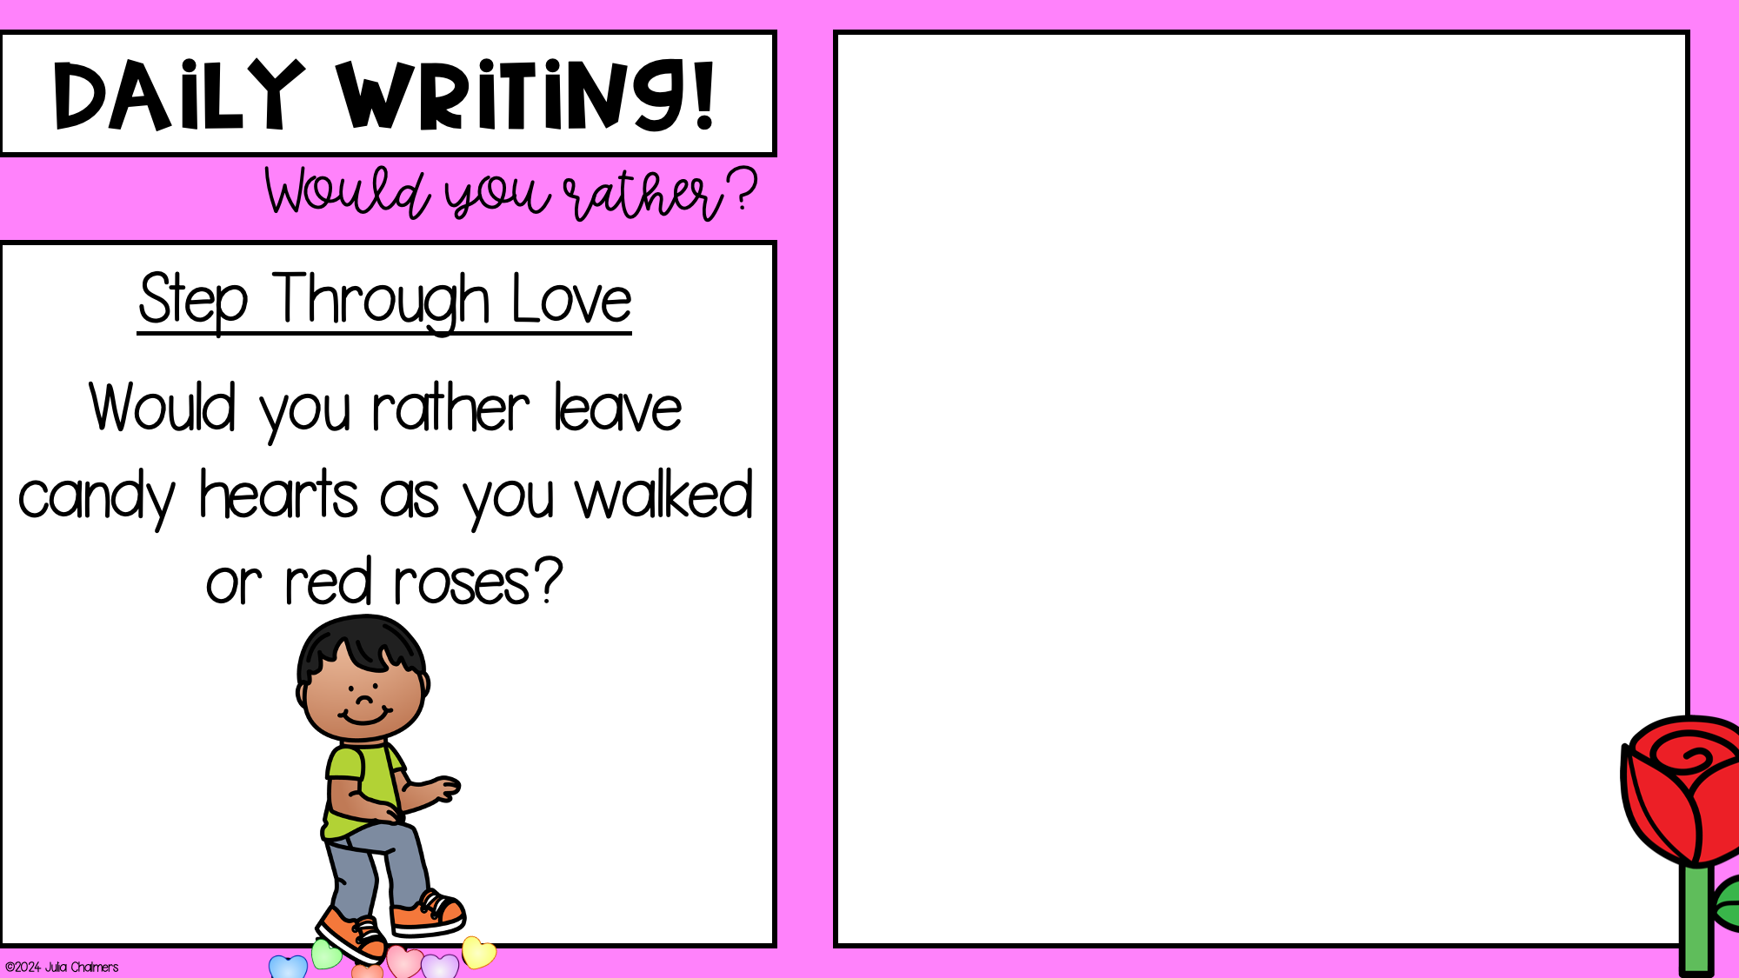
Date:
I would rather…
…because…

Slide 4
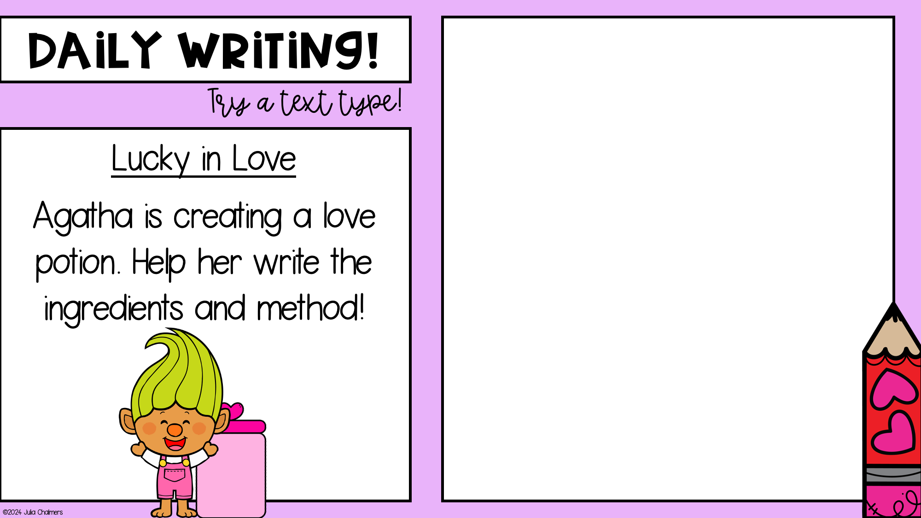
Date:
Agatha’s Potion:
1 cup of hot chocolate
2 tsp of…
1 sprinkle of…
Method

Slide 5
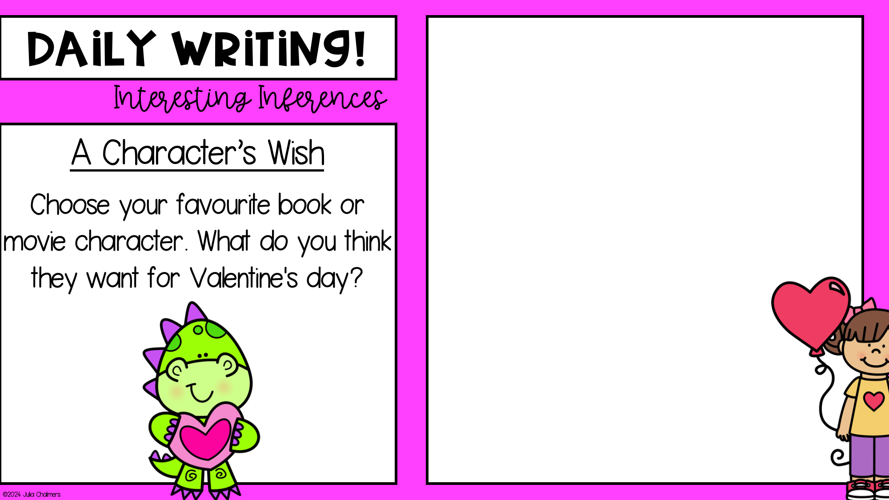
Date:
I think that ____________
would want…
….because…

Slide 6
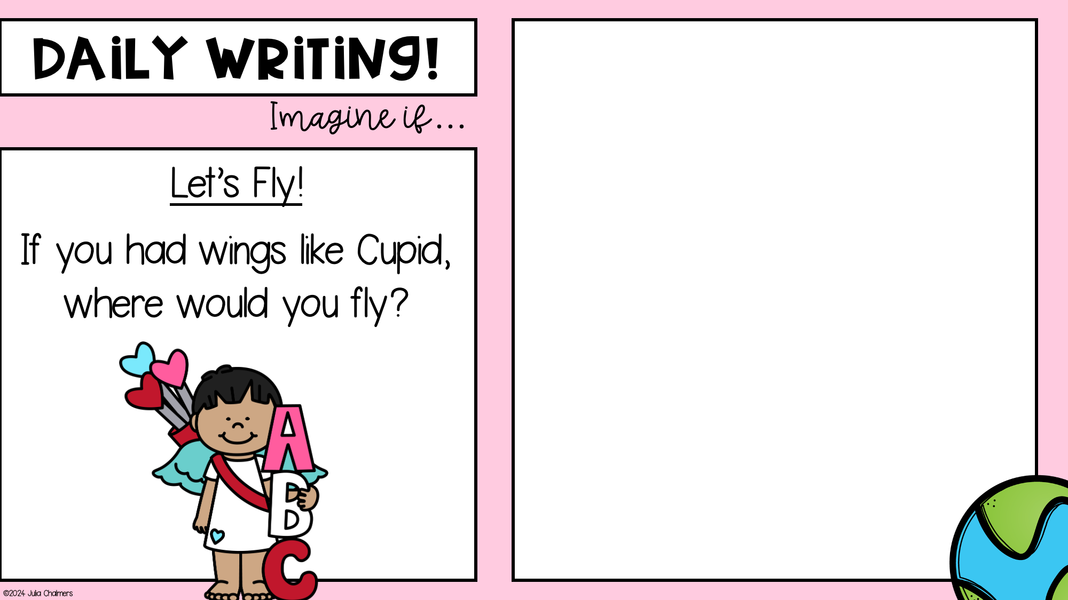
Date:
If I had wings like Cupid, I would fly to…
While I was there, I would…

Slide 7
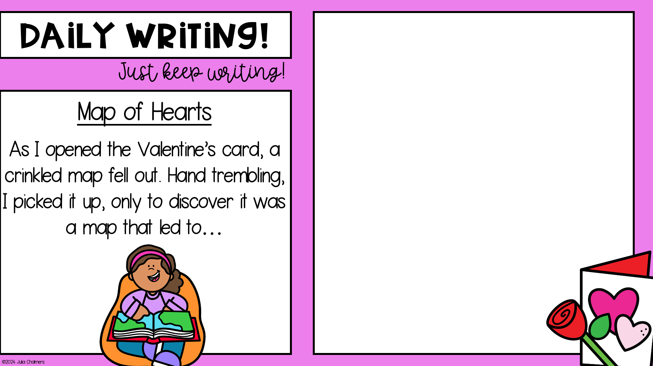
Date:
This map led to…
So I ….
Unfortunately,
Luckily…

Slide 8
