Slide 1
Los Angeles | Boston | London | paris
U.S. Banking System: Outlook for Investors
August 2017

Slide 2
Why do Banks Matter? Check the Indices….
Source: Bloomberg. As of 8/15/17. Reflects the Merrill 1-5 year Investment Grade Corporate Index (C1A0) and S&P 500.

Slide 3
State of the Industry

Slide 4
Bank Credit Spreads Have Tightened Alongside Industrials and the Basis is Now Negligible
Source: Bloomberg. As of 8/9/17. Represents the CF0V and CI0V indices.

Slide 5
Financial Stocks Performed Well in 2016….
Source: Bloomberg. As of 8/15/17

Slide 6
…. but Have Underperformed the Broader Market So Far in 2017….
Source: Bloomberg. As of 8/15/17

Slide 7
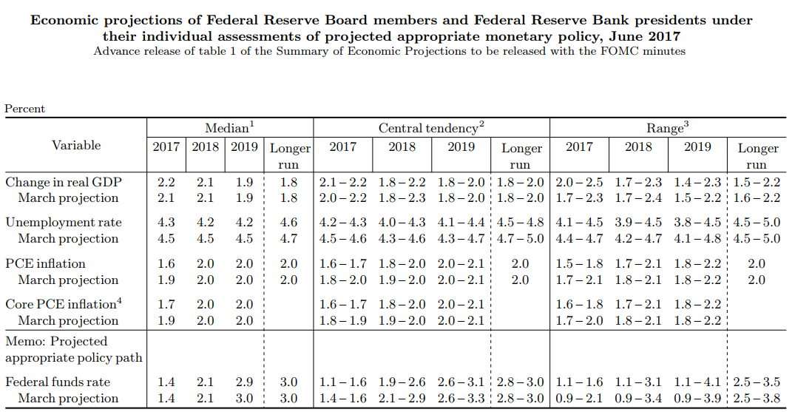
…. Despite Reasonable Growth and a Favorable Rates Outlook
Source: Bloomberg and the Federal Reserve. As of 8/2/17

Slide 8
Nominal Bank Capitalization (Equity / Assets) Has Improved Meaningfully Post-Crisis…
Source: Federal Reserve H8 filing, large domestically chartered commercial banks, seasonally adjusted.

Slide 9
…as Low Risk, Liquid Assets Have Also Increased Materially….
Source: Federal Reserve H8 filing, large domestically chartered commercial banks, seasonally adjusted.

Slide 10
…Creating Substantially Higher “Risk-Adjusted” Equity Capitalization
Source: Federal Reserve H8 filing, large domestically chartered commercial banks, seasonally adjusted.

Slide 11
Commercial Bank Net Interest Margins Should Continue Improving from Here
Source: Bloomberg, Payden & Rygel. Reflects aggregate NIM for the 25 largest U.S. listed banks.

Slide 12
Investment Banking (which underpins bank credit) Improves Amidst Low Volatility
Source: Bloomberg, Payden & Rygel. Reflects the aggregate sum of investment banking segment earnings for GS, JPM, BAC, C, DB, CS, MS, UB and U.S. based boutiques. Investment Banking segment includes sales and trading and banking fees.

Slide 13
Where Are We in the Credit Cycle?

Slide 14
Aggregate U.S. Commercial Bank Gross Loans as of June 30th, 2017
Source: Federal Reserve H.8 release, July 28th, percent change seasonally adjusted, annual rate. All commercial banks.

Slide 15
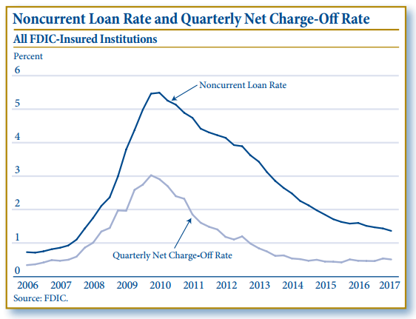
Aggregate Asset Quality Remains Benign
Source: FDIC Quarterly Banking Profile, First Quarter 2017.

Slide 16
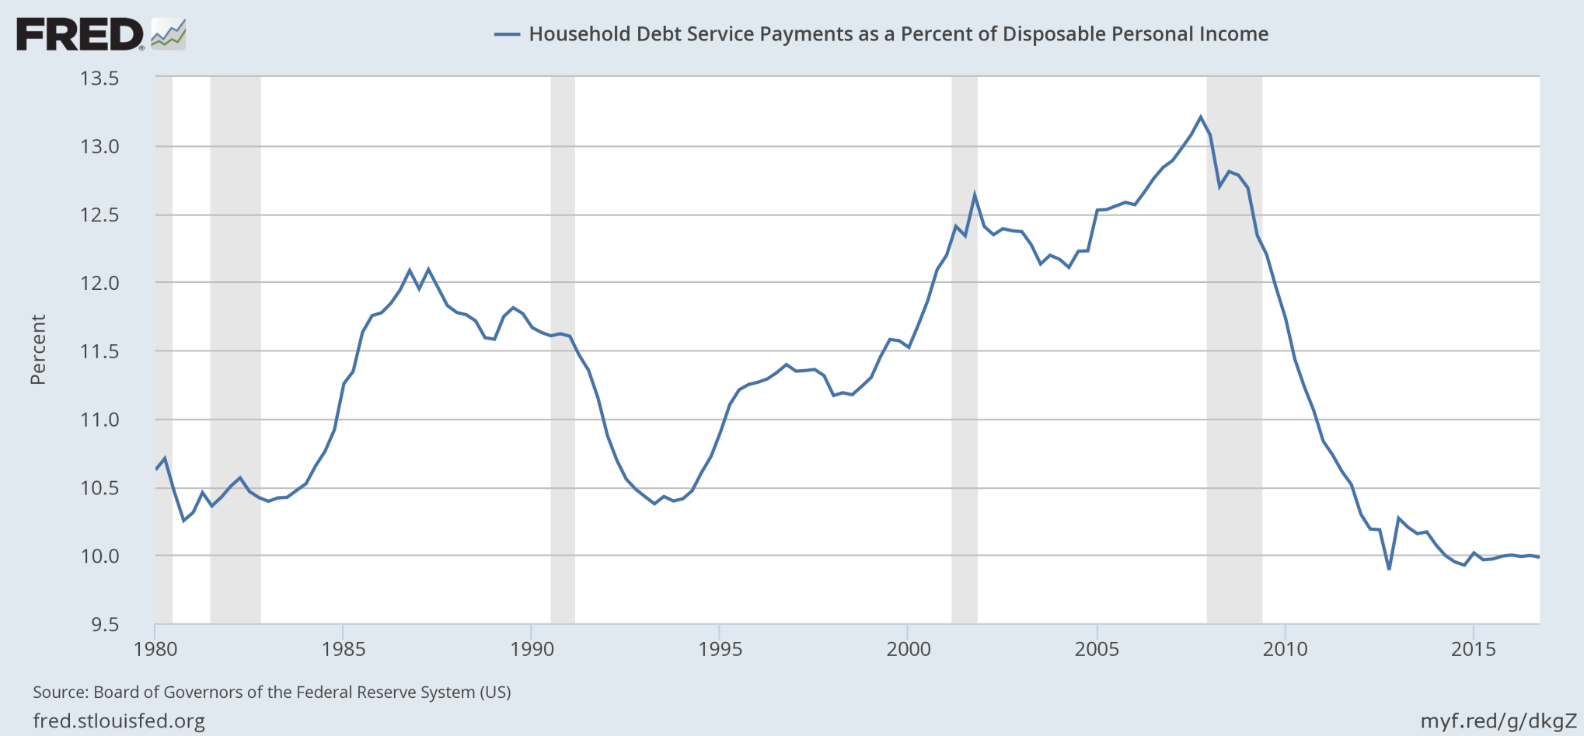
Household Debt Burden Relative to Disposable Income is Still Very Low….
Source: Board of Governors of the Federal Reserve System.

Slide 17
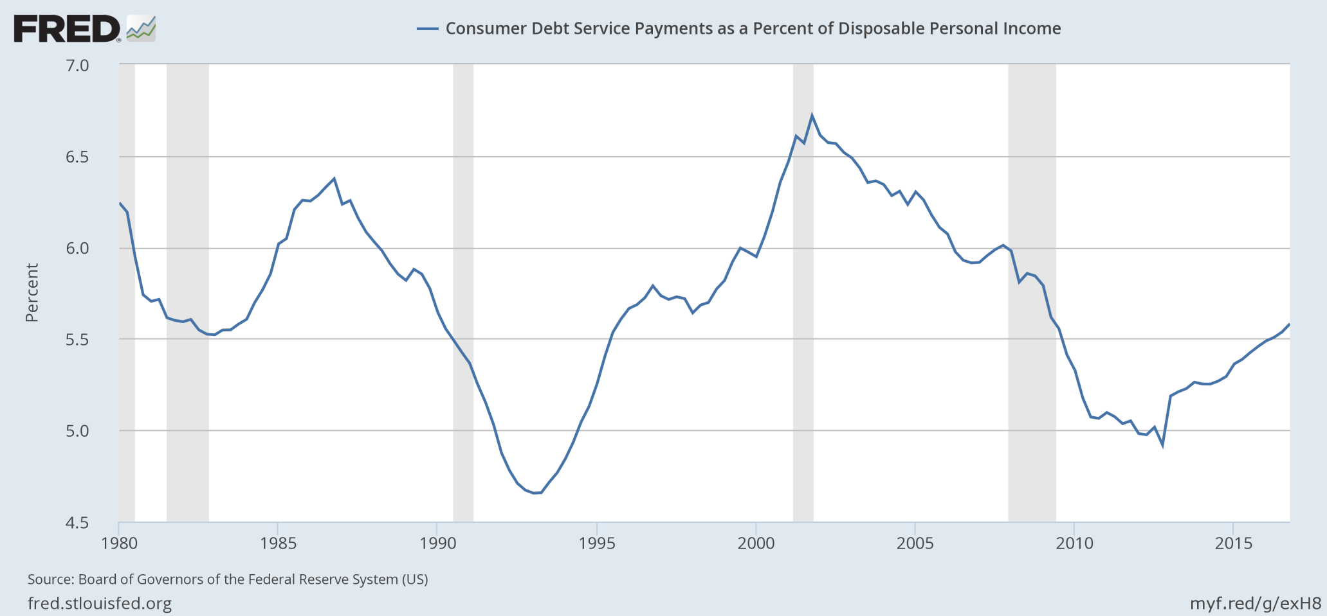
…While Consumer Debt is Up from its Lows
Source: Board of Governors of the Federal Reserve System.

Slide 18
Bank Loan Growth has been Driven Largely by Real Estate and Credit Cards
Source: Federal Reserve H.8 release, July 28th, percent change seasonally adjusted, annual rate.

Slide 19
Well-Qualified?........Great Time to Shop for a New Premium Credit Card
Bank | Bank of America Premium Rewards | JPMorgan Chase Sapphire Reserve | Citi Prestige | American Express Platinum
Annual Fee | $95 | $450 | $450 | $550
Spending needed for sign-up bonus | $3,000 / 50k | $4,000 / 50k | $7,500 / 75k | $5,000 / 60k
Bonus points on travel | 2-3.5% with bank account ($20/50/100k) | 3% | 3% | 1-5%
Bonus points on dining | 2-3.5% with bank account ($20/50/100k) | 3% | 2% | 1%
Bonus points on all other spending | 1.5-2.625% with bank account ($20/50/100k) | 1% | 1% | 1%
Travel credits/other | $100 on flight charges (club lounge uncertain) | $300 on travel | $250 on airlines; free 4th night hotel stays | $200 for Uber rides; $200 on flight charges,
Source: Wall Street Journal, August 9th, 2017 “BofA’s New Premium Rewards Card Comes With a Twist”; Company promotional material.

Slide 20
Update on Regulatory Developments

Slide 21
Jamie Dimon’s Beef….
“As a result of Dodd-Frank, we now have multiple regulatory agencies with overlapping rules and oversight responsibilities. Although the FSOC was created, it is proving to be too weak to effectively manage the overlap and complexity. We have hundreds of rules, many of which are uncoordinated and inconsistent with each other. While legislation obviously is political, we now have allowed regulation to become politicized, which we believe will likely lead to some bad outcomes.”
- Chairman & CEO Jamie Dimon, JPMorgan Chase, 2011 Annual letter to shareholders.
Source: JPM 2011 annual report ; letter to shareholders

Slide 22
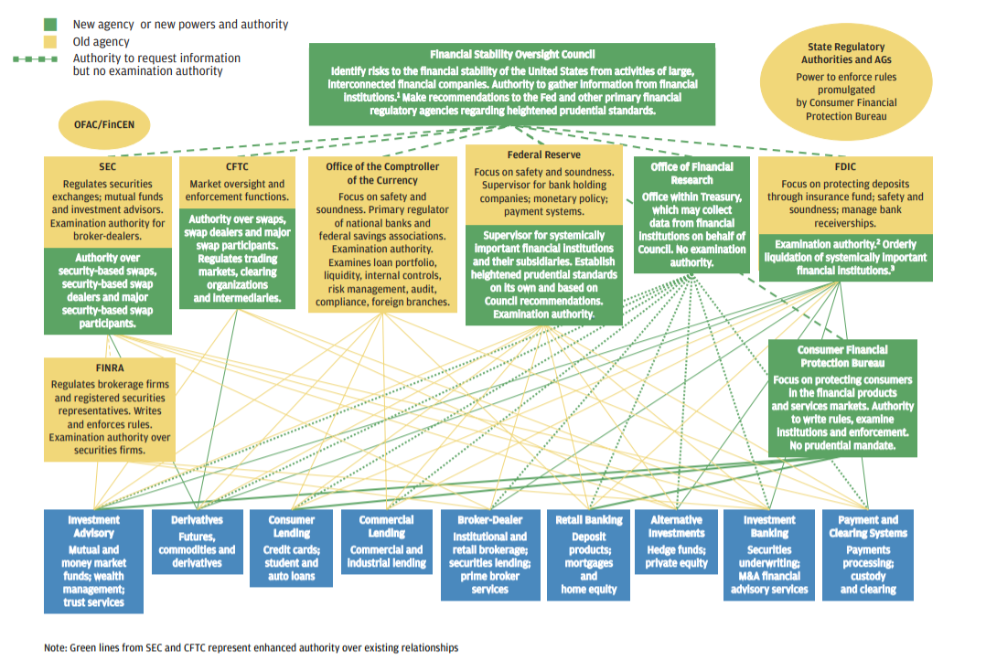
Jamie Dimon’s Beef….
Source: JPM 2011 annual report ; letter to shareholders

Slide 23
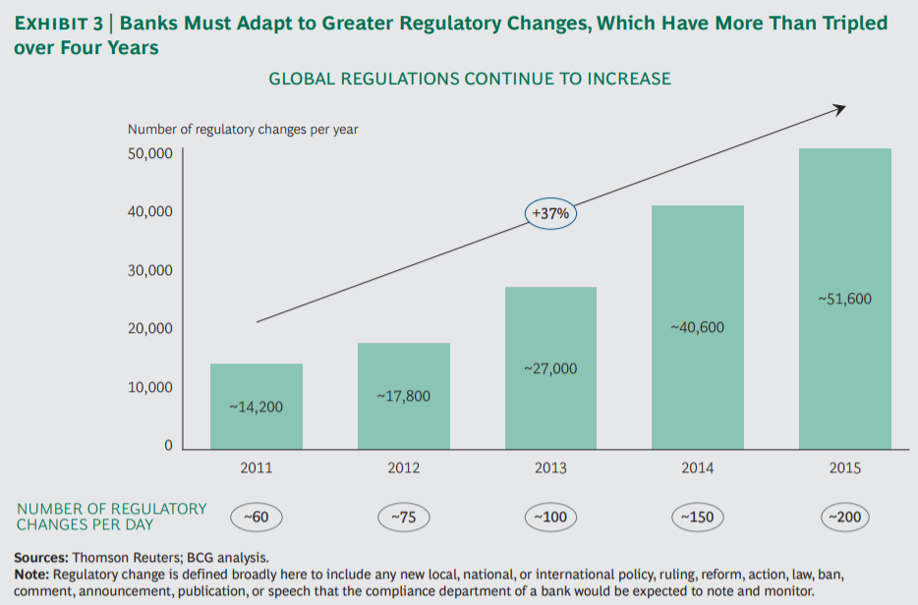
For Larger Banks, Compliance Requirements have been Accelerating…
Source: Bain Consulting Group, “Global Risk 2017: Staying the Course in Banking, March, 2017.

Slide 24
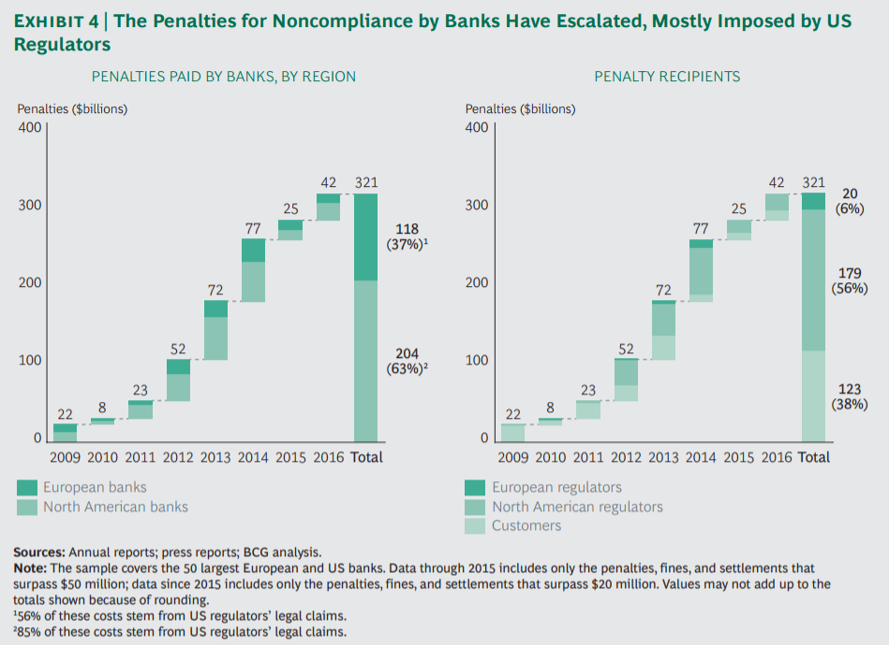
…with Extreme Consequences for Those that Break the Rules
Source: Bain Consulting Group, “Global Risk 2017: Staying the Course in Banking, March, 2017.

Slide 25
Goldman Sachs…er…Treasury Secretary Steve Mnuchin to the Rescue
This summer, the Treasury department issued a series of recommendations on financial reform in response to President Trump’s executive order on February 3rd, 2017 to identify laws, regulations and reporting requirements that inhibit banks from competing efficiently in the global context as well as to foster economic growth and vibrant financial markets.
Importantly, the Treasury issued a number of specific recommendations that do not require Congressional action and whose approval lies primarily with the Federal Reserve Board. Some of the most significant recommendations are as follows:
Loosen/expand bank balance sheets by as much as $2 trillion by relaxing key liquidity, capital and leverage requirements, several of which are currently more restrictive than G-20/Basel 3 minimums
Reassessing “unrealistically conservative” assumptions for annual CCAR stress testing exercises, which are often the constraining factor for increasing bank payout ratios to shareholders
Modifying the Volcker rule to improve a bank’s ability to hold trading inventory
Repeal/revise mortgage risk retention rules to facilitate more mortgage origination across bank channels
Improve credit availability to small businesses (including easing CRE limits and leveraged finance caps)
Simplify regulatory oversight by reducing overlap across agencies and creating more single agency accountability for key regulations (requires congressional approval)
Source: U.S. Department of the Treasury report, June 2017, “A Financial System That Creates Economic Opportunities, Banks and Credit Unions”

Slide 26
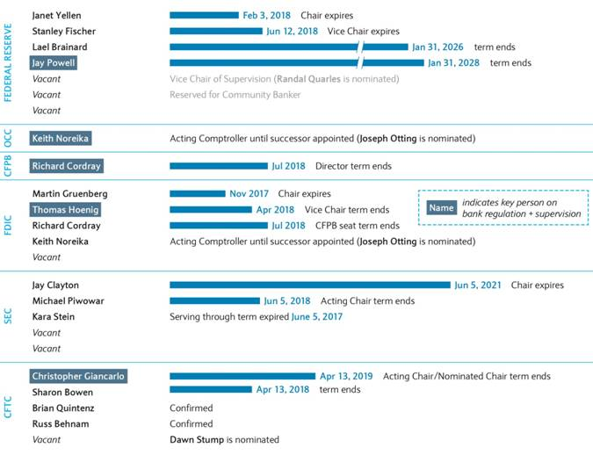
Bank Regulators are Likely to Get More “Business Friendly” over the Next Year
Source: Barclays Capital, Brian Monteleone.

Slide 27
Shadow Banking Sector and Its Impact

Slide 28
What is “Shadow Banking” ?
“The term “shadow bank” was coined in 2007 by Paul McCulley of PIMCO, a big bond fund to describe risky off-balance-sheet vehicles hatched by banks to sell loans repackaged as bonds. Today, the term is used more loosely to cover all financial intermediaries that perform bank-like activity but are not regulated as one.”
- The Economist, Feb. 2nd 2016, “How shadow banking works”
Broadly speaking, would include:
Asset managers
Hedge funds
Private equity firms
Peer-to-peer lending
Business development companies (BDCs)
Money transfer companies (PayPal / Venmo / Western Union)
Pawn shops and check cashing services
Electronic trading platforms
Securitizations

Slide 29
How Big is the Shadow Banking Market?................Pretty Big !!
Source: Payden & Rygel, Bloomberg, Federal Reserve, SIMFA, ICI, preqin. As of year end 2016 or 2H17.

Slide 30
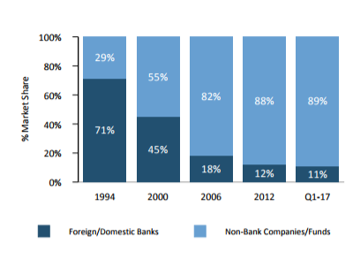
Bank Share of Global Leveraged Loans has been Declining Since Before Dodd-Frank
Global leveraged loan market share
Source: S&P LCD Leveraged Lending Review Q1-17 from ARCC investor presentation

Slide 31
FinTech / Digital Banking…..Where Do We Go from Here?

Slide 32
New Bank Branch Openings….is the U.S. “Over-Banked”?....Yes !!!
From 2005 to 2008, U.S.
banks added more new branches than there are Starbucks now !!
(12K vs. 11.2k)
Source: FDIC and Company reports.

Slide 33
Reconfiguring the Traditional Bank Branch Model
Capital One Café in Austin, Texas featuring Peet’s Coffee
Source: Company websites.

Slide 34
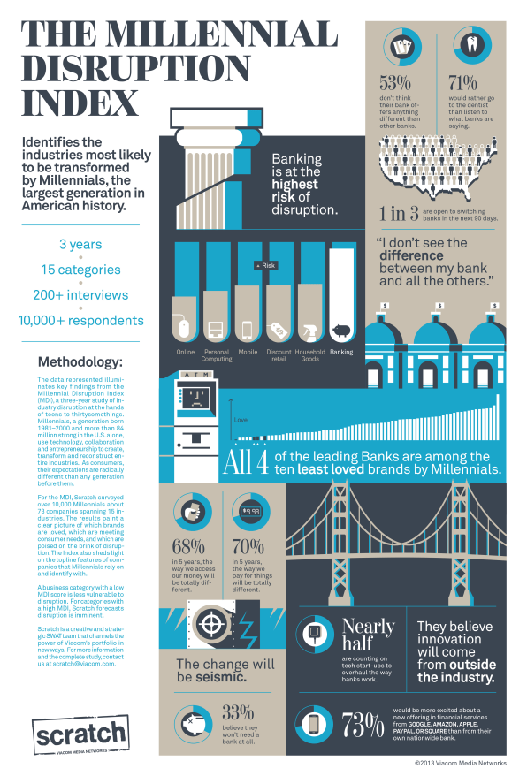
Have Your Kids Ever Actually been in a Bank?
Source: Scratch, Viacom Media Network.

Slide 35
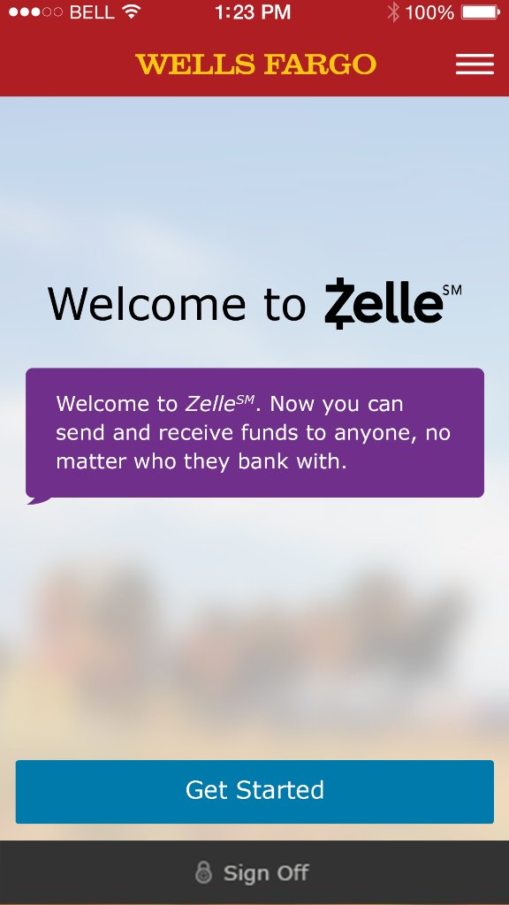
Peer to Peer (P2P) Money Transfer
Formerly clearXchange, Zelle competes with PayPal’s Venmo by offering customers of over 30 banks near-instantaneous money transfers with only an email address or phone number
Source: Company websites.

Slide 36
Bitcoin & Blockchain…..the Opportunity for Distributed Ledgers to Facilitate Exchange
What is it? At its core, blockchain allows for de-centralized exchange of a digital currency or other good, with an encrypted software allowing all parties to see and verify all sides of a transaction. No middle man or government body is needed to clear or settle trades, but the “distributed public ledger” authentication process is very data intensive and requires meaningful computing capacity.
Fears that bank accounts will become obsolete? A solution looking for a problem in many ways. Most bank accounts cost nothing and offer customer service, FDIC insurance, fast and easy account accessibility and theft protection. They also earn interest. Why give that up?
Bitcoin likely to become regulated by the SEC as it gains momentum as an investment product.
The blockchain technology that underpins bitcoin is of more immediate interest to investment banks as a way to speed up settlement of certain antiquated trading products (i.e. loan settlement)
Source: Payden & Rygel.

Slide 37
Summary and Key Takeaways
The U.S. banking sector is poised to continue top-line growth, driven largely by higher rates, single-digit loan growth and a less restrictive regulatory environment.
Asset quality remains stable, though concerns are building that the U.S. is “late-stage” in terms of general credit conditions. Consumer health remains underpinned by strength in jobs, stable home prices and low household debt burdens.
Expenses, which have been elevated for many years, are now benefiting from lower legal costs and the prospect of reduced regulatory burdens. The retail banking sector is also beginning to address its oversized physical footprint by reducing bank branches and embracing automation.
Non-regulated financial companies continue to influence the flow of credit, contributing to market excesses in certain asset classes.
Banks are ripe for disintermediation, with weak brand loyalty particularly in younger age groups. Emerging technology represents both a threat and an opportunity and bank management teams are hyper-focused on staying relevant. One of the most favorable dynamics of the financial sector is that capital can be re-allocated quickly.

Slide 38
Large Bank Key Operating Performance Metrics
Operating Metric | 2011 | 2012 | 2013 | 2014 | 2015 | 2016 | 2017 Q2
Net Income YoY % | 46.7 | 17.0 | 4.8 | 6.4 | 2.6 | 8.0 | 13.4
Net Interest Margin | 3.54 | 3.51 | 3.36 | 3.11 | 2.94 | 3.00 | 3.07
Efficiency Ratio | 65.9 | 64.7 | 64.1 | 63.8 | 63.1 | 61.4 | 60.0
Net Charge-off Ratio | 1.16 | 0.73 | 0.45 | 0.33 | 0.25 | 0.32 | 0.28
Return on Equity | 9.23 | 10.18 | 8.4 | 9.51 | 8.63 | 8.15 | 9.35
Return on Assets | 0.97 | 1.11 | 1.02 | 1.01 | 0.99 | 0.94 | 1.05
Source: Bloomberg Intelligence, North American Large Regional Banking Aggregate, Alison Williams

