Slide 1
Digital Searches in public employment investigations
Matt Love
OMAG Claims Director & Dep. General Counsel

Slide 2
4th Amendment & Employer Searches
The Right Of The People To Be Secure In Their Persons, Houses, Papers, And Effects, Against Unreasonable Searches And Seizures, Shall Not Be Violated, And No Warrants Shall Issue, But Upon Probable Cause

Slide 3
4th Amendment & Employer Searches
O’Connor v. Ortega (1987):
Warrant Requirement of the 4th Amendment does not apply to workplace searches of employers physical property.
Unreasonable searches violate the 4th Amendment.
City of Ontario v. Quon (2010): Ortega extends to digital searches and seizures by public employers.

Slide 4
4th Amendment & Employer Searches
2-Prong Test for Employment Searches:
Expectation of Privacy / Operational Realities
Reasonableness Under the Circumstances
No Expectation of Privacy = No 4th Amendment Violation
Expectation of Privacy → Test for Reasonableness

Slide 5
4th Amendment & Employer Searches
Operational Realities:
Was the area searched open to other employees?
Storage cabinets, file cabinets, unlocked drawers
Digital: Acceptable Use Policy may not be enough.
Digital: Advanced Warning may not be enough.

Slide 6
4th Amendment & Employer Searches
Reasonableness Under All the Circumstances:
Search Justified at its Inception?
Search Methods Reasonably Related to the Objectives?
Search Methods Excessive Intrusive?

Slide 7
4th Amendment & Employer Searches
Justified at Inception:
Fishing expeditions or searches based solely on curiosity can violate the 4th Amendment.
What were you investigating? What were you searching for?
Document, Document, Document.

Slide 8
4th Amendment & Employer Searches
Search Methods vs. Objective of the Search:
Objectives
Methods

Slide 9
4th Amendment & Employer Searches
Search Methods vs. Objective of the Search:
What you were searching for vs. the Objectives of the Search
Lack of Communication and Documentation can Hurt
Ask IT for Options
Document, Document, Document.

Slide 10
4th Amendment & Employer Searches
Excessively Intrusive:
Acceptable Use Policy and Warnings will be Considered
Intertwined with the Tailoring of the Methods to the Objectives
Document, Document, Document.

Slide 11
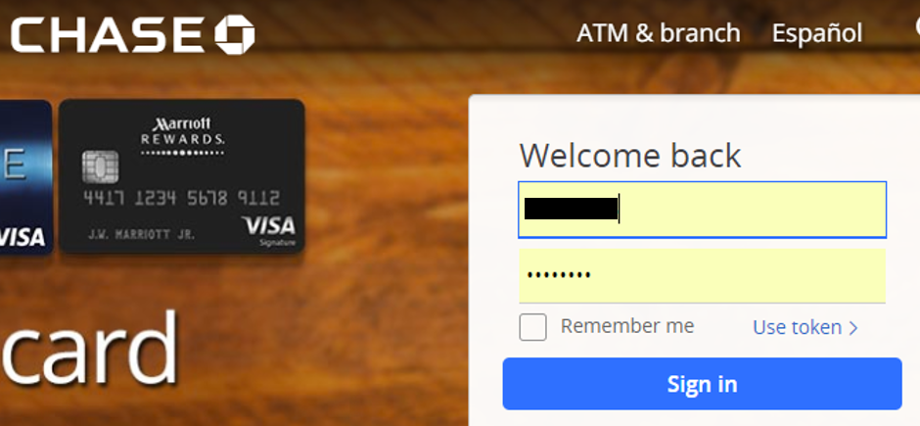
Accessing Employee Accounts

Slide 12
Stored Communications Act
It is illegal to access a persons personal email or social media account through:
Keystroke logger
Accessing stored or auto-fill passwords
Creating fake profiles to “friend” employees
Coercing 1 Employee into letting you access another Employee’s page

Slide 13
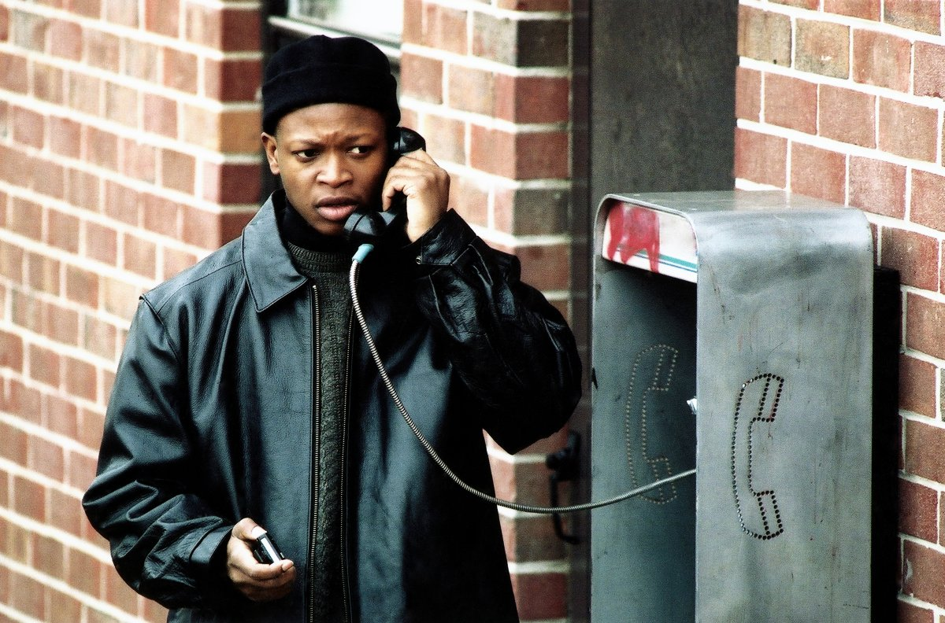
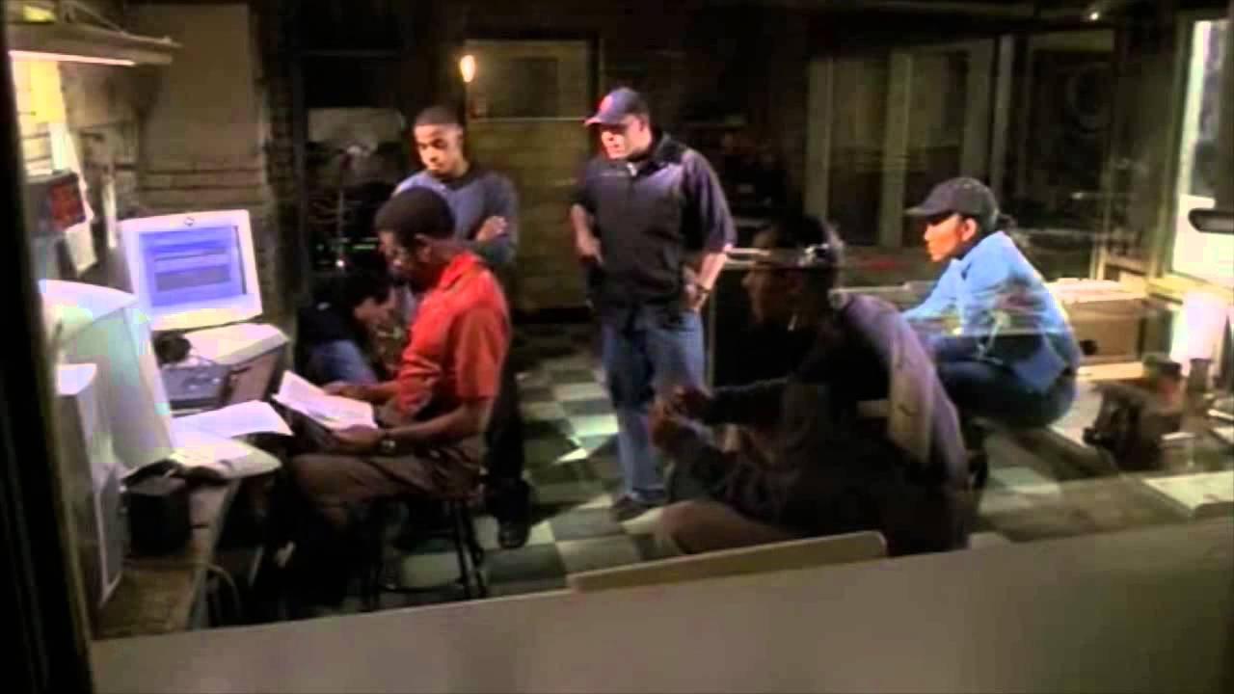
4th Amendment
From Olmstead (1928) to Katz (1967)

Slide 14
4th Amendment
1792 to 1967: Trespass
1967 to present: Expectations of Privacy
U.S. v. Jones (2012): Return of Trespass Analysis
U.S. v. Ackerman (10th Cir. 2016): Trespass extended to digital files such as emails

Slide 15
4th Amendment
Possible Impacts of Ackerman on Ortega:
None: Court will continue to use 2 prong approach
Some: Prong 1 of Ortega will be modified to ask if there was an expectation of privacy or a trespass
Huge: Ortega and the waiver of the warrant requirement will be limited to searches of employer owned records

Slide 16
4th Amendment
Possible Impacts of Ackerman on Ortega:
None: Court will continue to use 2 prong approach
Some: Prong 1 of Ortega will be modified to ask if there was an expectation of privacy or a trespass
Huge: Ortega and the waiver of the warrant requirement will be limited to searches of employer owned records

Slide 17
Suzie Paulson
OMAG General Counsel & HR Director
405.657.1444
SPaulson@omag.org
Matt Love
OMAG Dep. General Counsel & Claims Director
405.657.1417
MLove@omag.org

