Slide 1
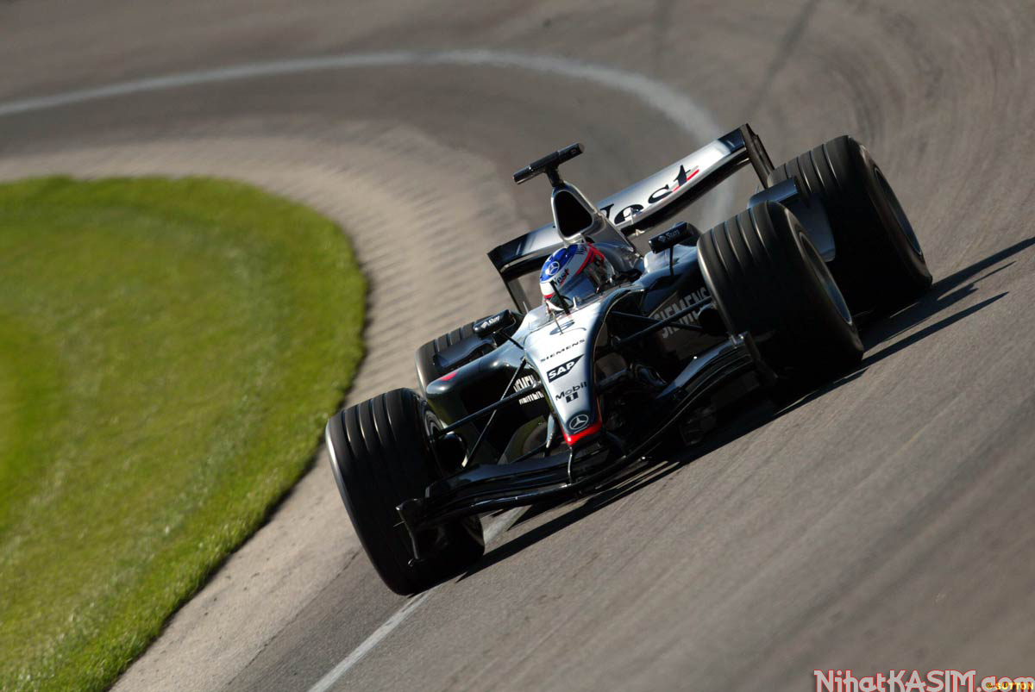
SUBJECT PRONOUNS
POSSESSIVE ADJEVTIVES
OBJECT PRONOUNS

Slide 2
PRONOUNS & ADJECTIVES
Subject pro.
Possessive adj.
Object pro
I
my
me
you
your
you
he
his
him
she
her
her
it
its
it

Slide 3
PRONOUNS & ADJECTIVES
Subject pro.
Possessive adj.
Object pro
we
our
us
you
your
you
they
their
them

