Slide 1
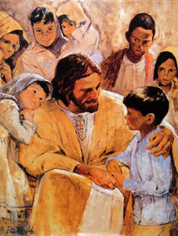
Foundations for Children
Jesus said, Let the children come to me
Matthew 19:14
“Come”
developingworkers.com
foundationsglobal.com

Slide 2
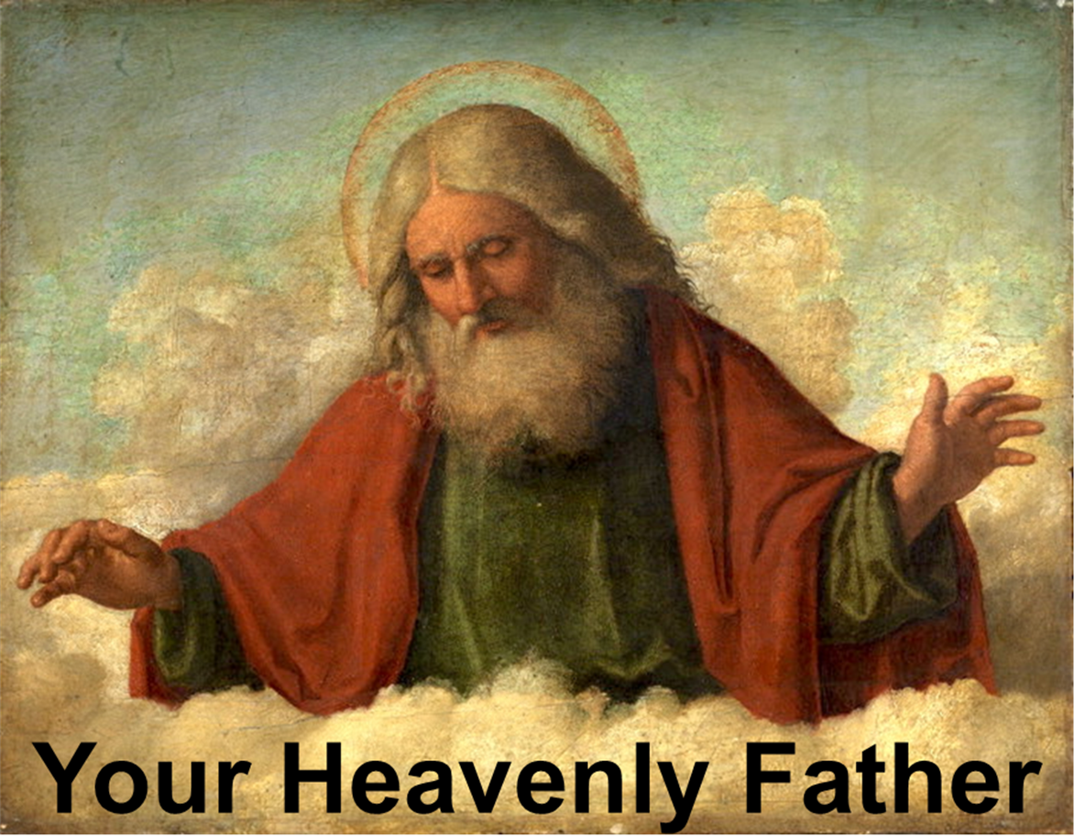
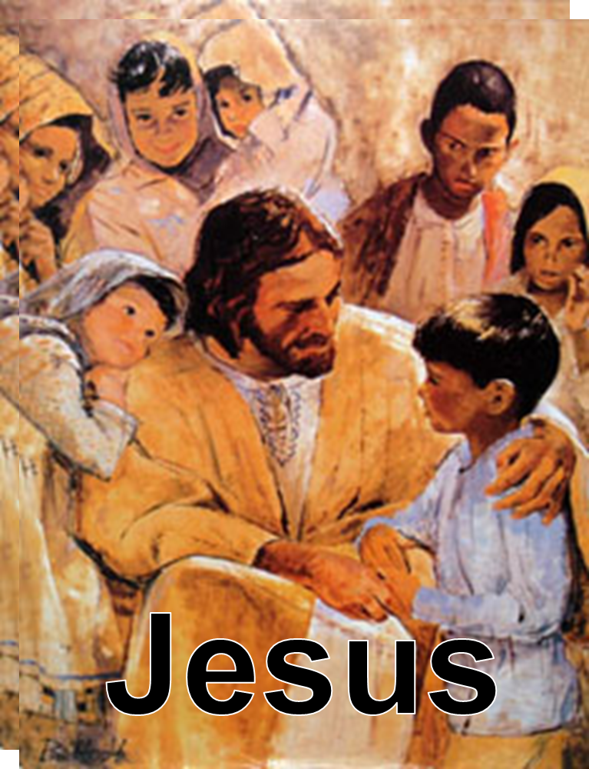
Subjects

Slide 3
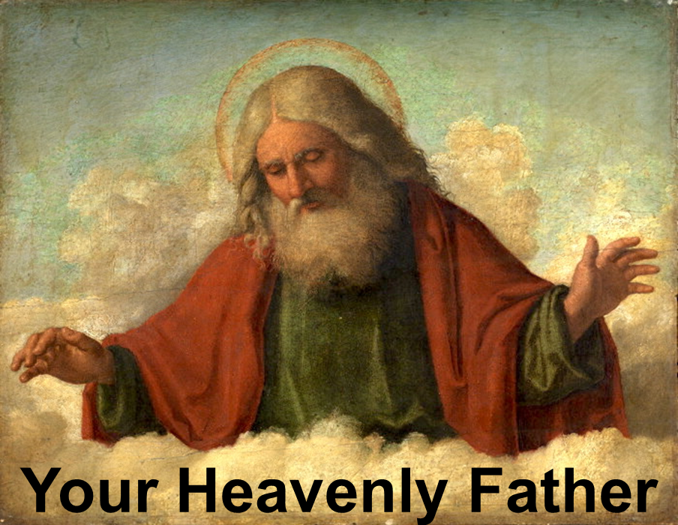

Slide 4
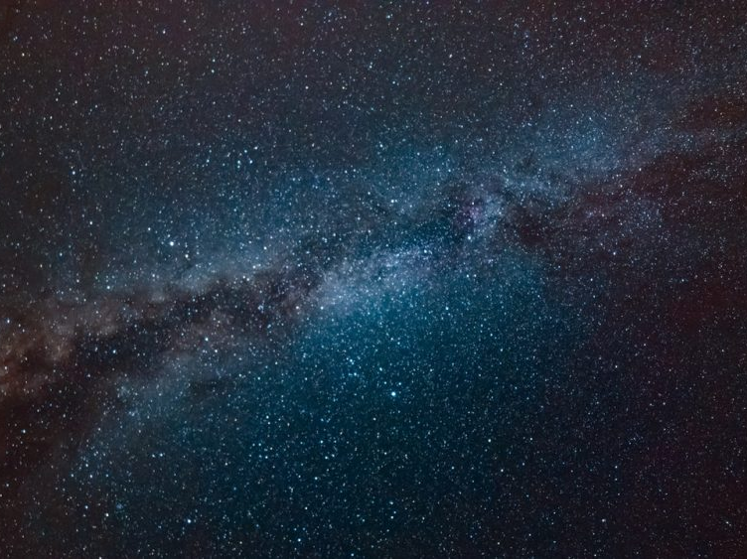
God
All of God is every place, all of the time
Past, present, and future
All of God is in the infinitesimal & the infinite
Smallest and largest
God is not limited by space and time

Slide 5
God
God knows everything
about the past, present, and future
Present
Past
Future

Slide 6
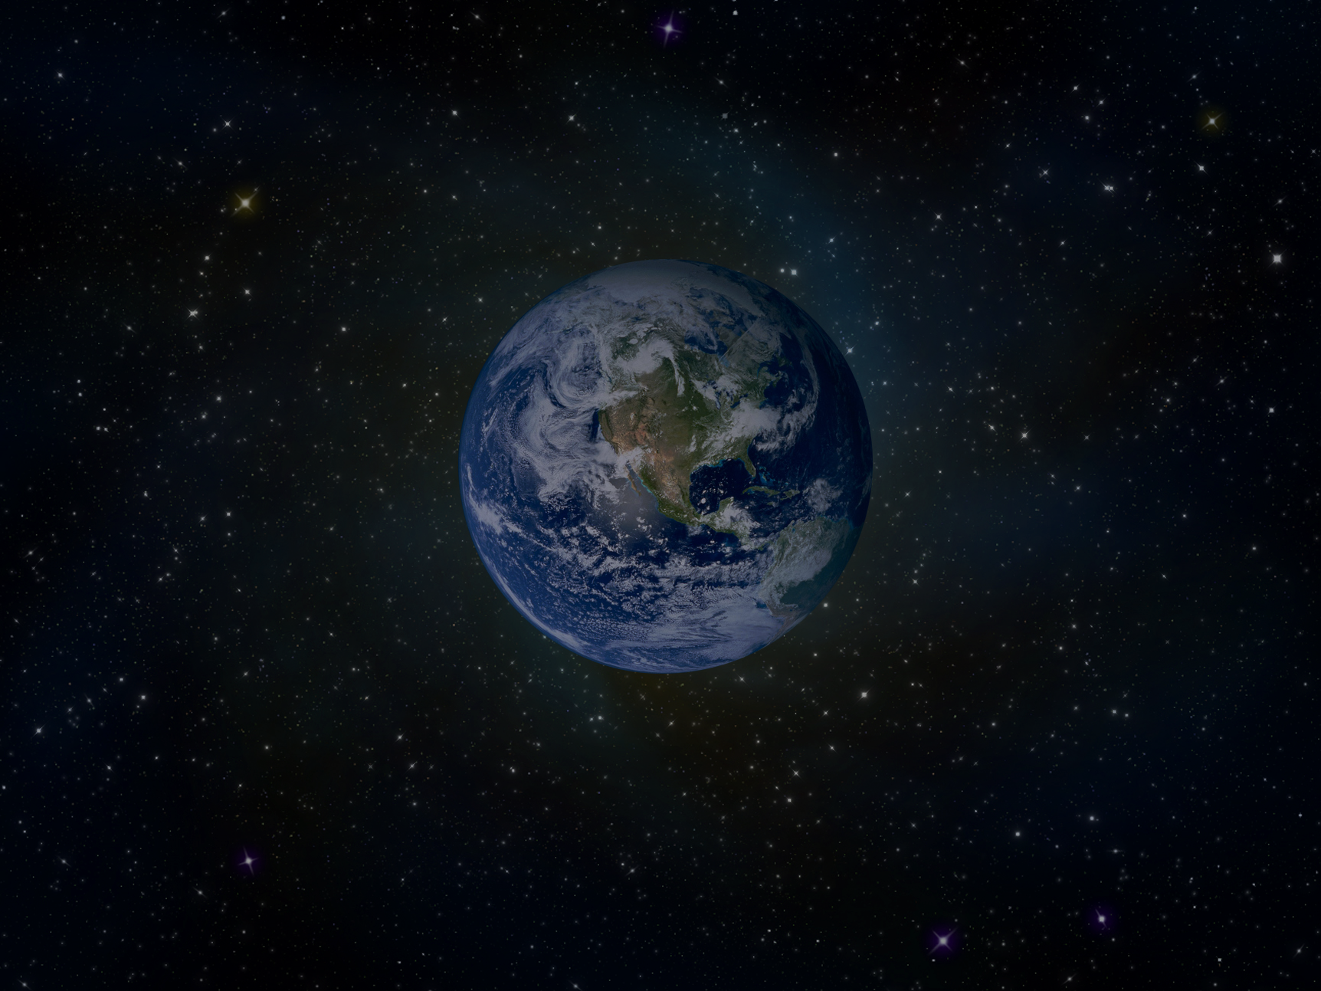
God
God created everything
The universe
The earth
Plants, animals, and people
Space and time
The infinitesimal and the infinite
The smallest and largest

Slide 7
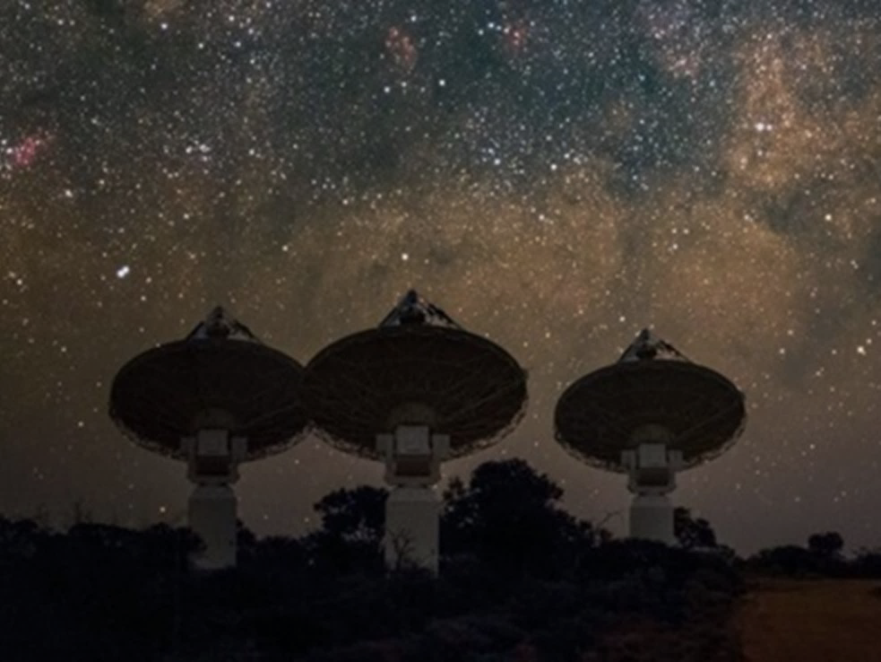
The observable universe is about 93 billion light years in diameter.
558 billion trillion miles
Astronomers think space outside of the observable universe might be an infinite expanse of what we see in the cosmos around us
A light year is a distance equal to the distance that light travels in one year, which is nearly 6 trillion miles.
The universe is big
God is bigger

Slide 8
God exists in 3 parts
Father, Son, and Holy Spirit
This is called the Trinity
The 3 in 1
They are different and the same

Slide 9
At a precise temperature and pressure,
matter can exist at the same time
as a solid, liquid, and gas.
For example, water can exist at the same time as ice, water, and water vapor.

Slide 10
Trinity
Triple Point
Father
Solid
Matter
Holy
Spirit
Son
Gas
Liquid
If created matter can exist at the same time as 3 different things,
the Creator can exist at the same time
as 3 different things

Slide 11
Characteristics of God
God is good; his love lasts forever.
In all things God works for the good
of those who love him
In what things does God work for your good?
Does this include the bad experiences in your life?
Psalm 107:1
Romans 8:28

Slide 12
Characteristics of God
I the LORD do not change.
Why is it important that God doesn’t change?
Malachi 3:6

Slide 13
Characteristics of God
God is good.
God works for my good.
God never changes.
I can trust that a good God
who never changes
and who works for the good of His children
will work for my good.
How do you feel about these facts about God?

Slide 14
God Created You
Genesis 1:26
Now we will make human beings
They will be like us and resemble us
How are we special?
They will be responsible for the Earth itself,
and every animal
What position of responsibility did God give us?

Slide 15
Psalm 139:1-4
God has examined me and knows me
God knows everything I do
God understands all my thoughts
God sees me
God knows all my actions
Even before I speak, God knows what I will say

Slide 16
How does it make you feel to know
that God knows everything about you
including your thoughts?
Why can you trust God
to know everything about you?

Slide 17
1 John 4:7-10
Love comes from God
God loved us and sent his Son to be the way by which our sins are forgiven
Sins are bad thoughts, words, and actions

Slide 18
1 John 3:1
See how much the Father has loved us!
His love is so great that we are called God's children,
How much does God love you?
Who are you to God?

Slide 19
Ephesians 1:3
Through Christ, God has blessed us with
every spiritual blessing

Slide 20
Ephesians 1:3
Examples of Spiritual Blessings
God’s love
Forgiveness
Eternal life
Peace
Prayer
God’s Word (The Bible)
God’s Spirit in us
Help in temptation

Slide 21
Ephesians 1:7
Our sins are forgiven through the sacrifice of Jesus
God forgives our sins because of his great kindness

Slide 22
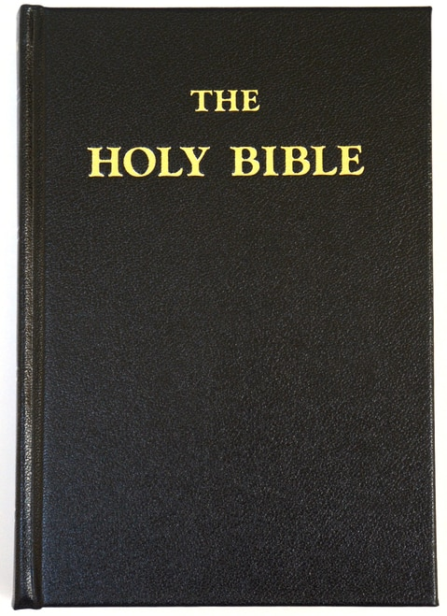
Ephesians 1:9
God revealed the mystery of his plan to us
He had decided to do this through Jesus
God reveals the mystery of His plan to us in the Bible

Slide 23
1 Corinthians 3:16
Don't you know that you are God's temple
and that God's Spirit lives in you?
You should take care of your body
because you are God’s temple

Slide 24
2 Peter 1:3
God has given us everything we need
to live our life on the earth
and to have eternal life with God

Slide 25
Lamentations 3:22,23
The constant love of God never ceases
His kindness lasts forever
These are new every morning
Great is your faithfulness

Slide 26
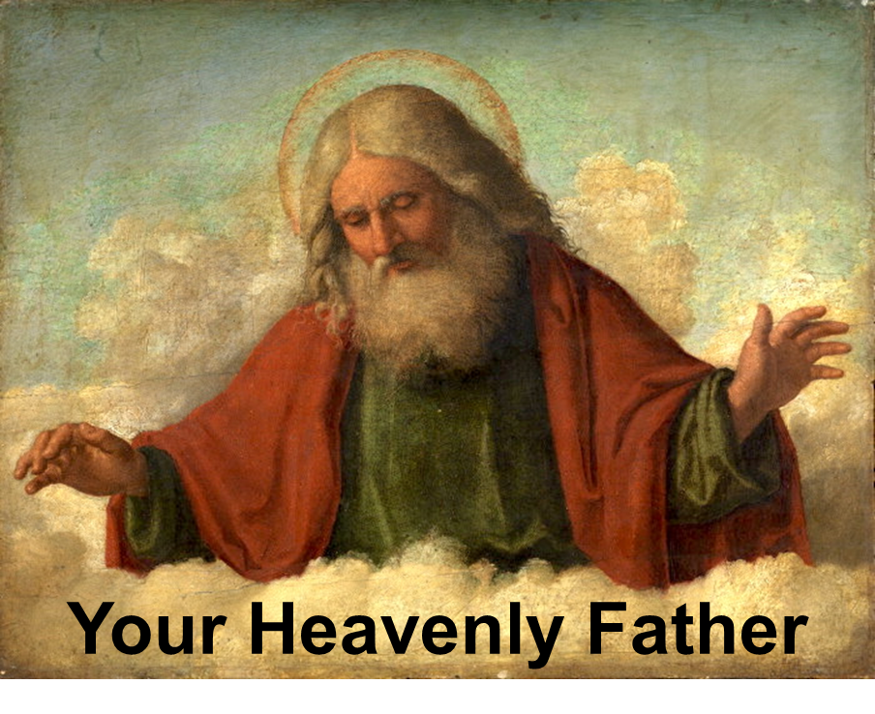
Summary
Characteristics of God
God is good
God works for your good
God never changes

Slide 27
“Your Heavenly Father” Summary
You were created to be like God
You were created to care for the earth

Slide 28
“Your Heavenly Father” Summary
God loves you
God knows you
God loves you as His child

Slide 29
“Your Heavenly Father” Summary
God’s blessings to you
Every spiritual blessing
Forgiveness
Knowledge of His will
The Holy Spirit

Slide 30
“Your Heavenly Father” Summary
God’s blessings to you
Everything you need for living on earth and and to have eternal life with God
God’s love, kindness, and faithfulness
His blessings are new every morning and they never cease

Slide 31
Jesus

Slide 32
Some say Jesus was just a great man;
others say He was just a prophet.
But Jesus claimed that He is God.
If Jesus is not God, then He is a liar

Slide 33
Jesus is entirely God and entirely man
As God He had the power to pay the penalty
for our sin by His death on the cross
for all who will believe
As a man He was able to communicate with us
and show us that He understands us

Slide 34
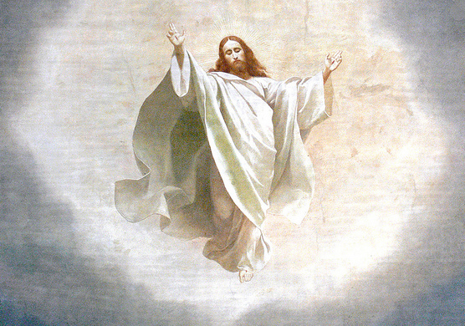
John 10:30
Jesus is God
What did Jesus say about Himself?
“I and the Father are one.”
Jesus said that He is God

Slide 35
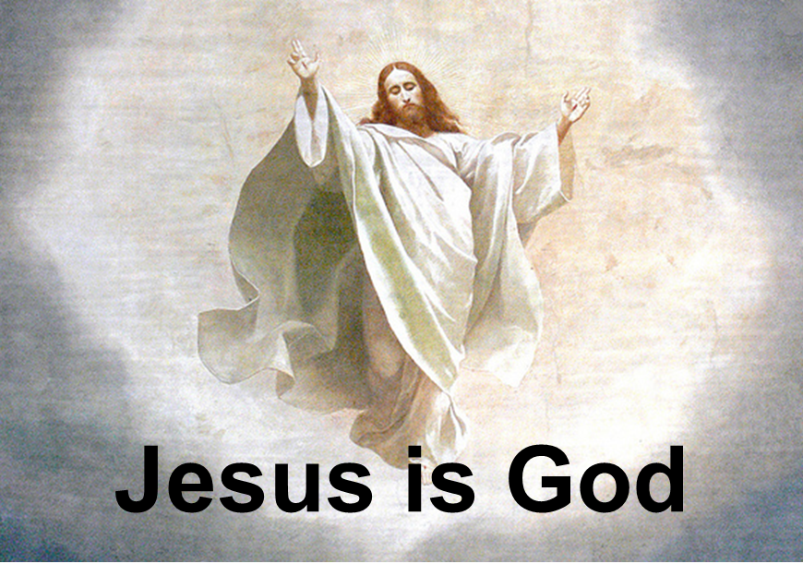
Hebrews 1:2
Jesus owns everything
Jesus made the universe

Slide 36
Hebrews 1:3
Jesus revealed the nature of God
Jesus is the exact likeness of God
Jesus holds the universe together

Slide 37
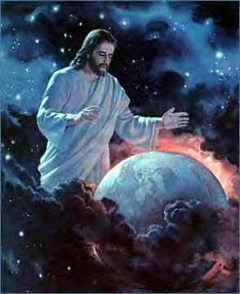
Hebrews 1:8, 10
God the Father says about Jesus
Your rule, O God, will last for ever and ever
In the beginning, O Lord,
you created the heavens and the earth
What does God the Father call Jesus?
What did Jesus do?

Slide 38
Hebrews 1:12
Jesus never changes
Jesus lives forever
Jesus has the characteristics of God

Slide 39
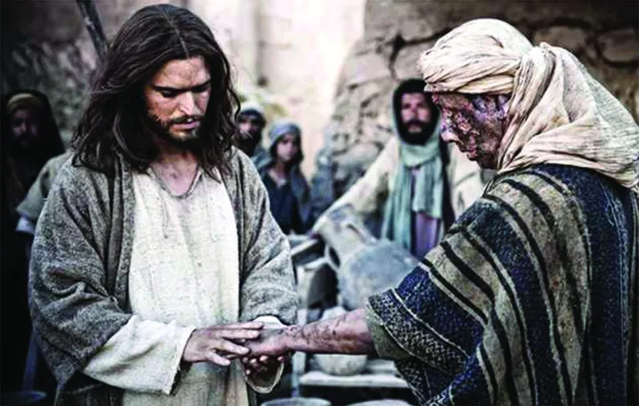
Matthew 8:3
Jesus cured a man of his leprosy

Slide 40
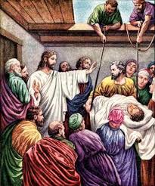
Mark 2:3-12
Jesus healed paralyzed people

Slide 41
Matthew 8:16-17
Jesus healed many sick people
Jesus shows He is God
by His supernatural power to heal people

Slide 42
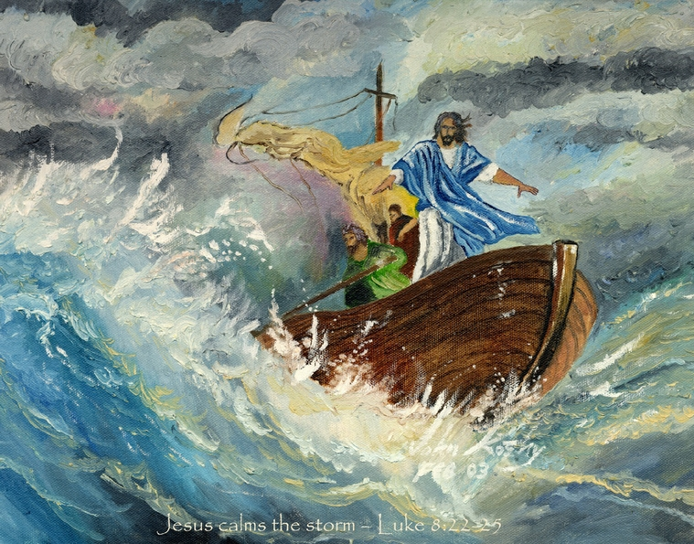
Matthew 8:23-27
Jesus calmed a storm
Jesus shows He is God
by His supernatural power over nature

Slide 43
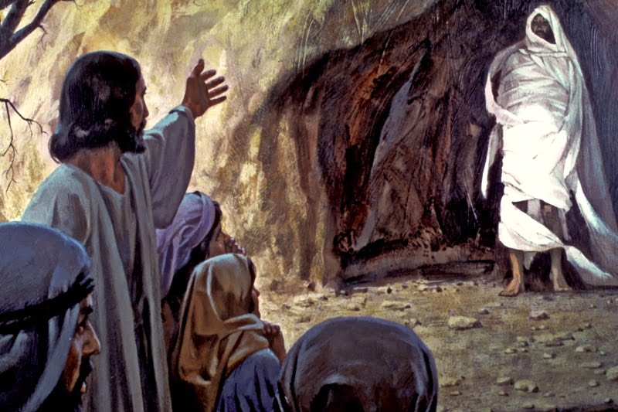
Matthew 8:23-27
Jesus brings a dead man back to life
Jesus shows He is God
by His supernatural power over death

Slide 44
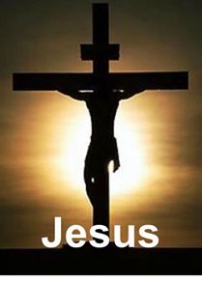
Romans 4:25
Jesus died
to pay the penalty
for our sins

Slide 45
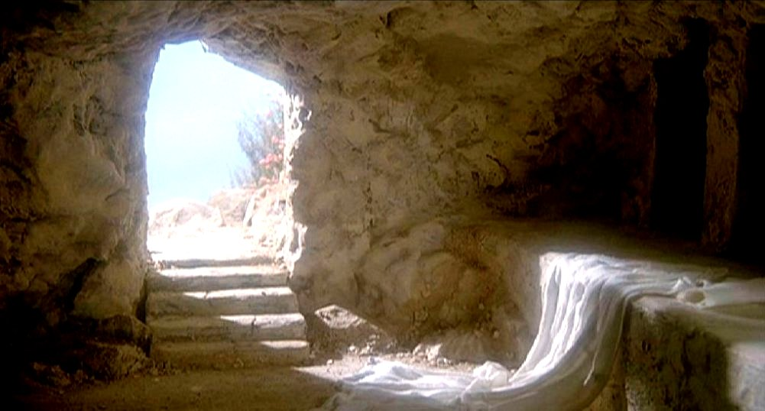
Matthew 28:5-7
Jesus rose from the dead to prove that He is God
Easter is the celebration of Jesus rising from the dead

Slide 46
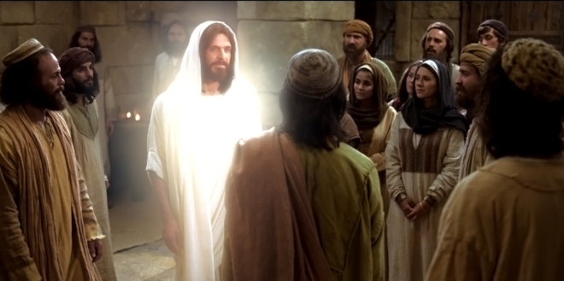
Matthew 28:16-20
Mark 16:14-15
Luke 24:33-37
John 20:19-20
1 Corinthians 15:3-7
Jesus revealed Himself to people after His death

Slide 47
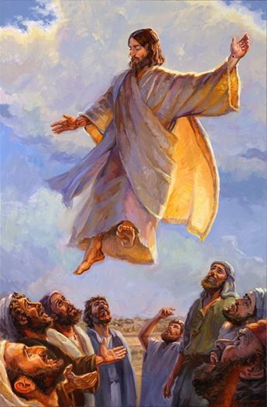
Acts 1:8-9
Jesus rose into heaven
40 days after He came alive

Slide 48
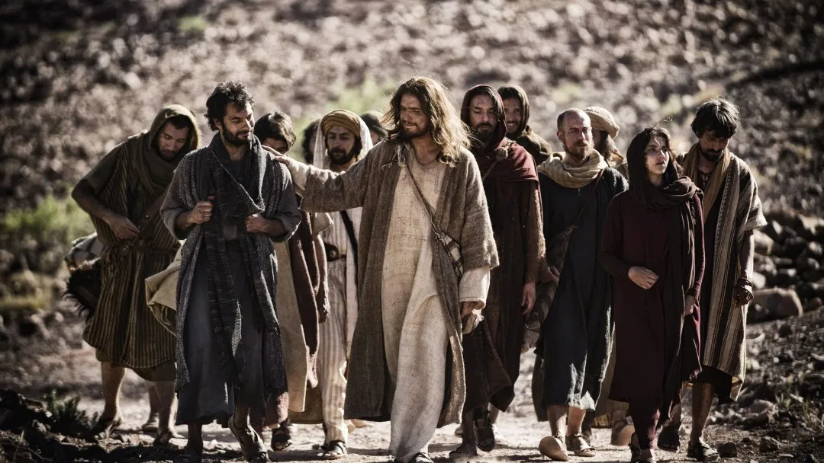
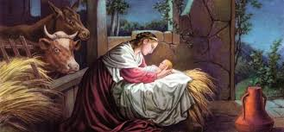
Luke 2:1-7
Jesus Was a Man
Jesus experienced birth
Christmas is the celebration of the birth of Jesus

Slide 49
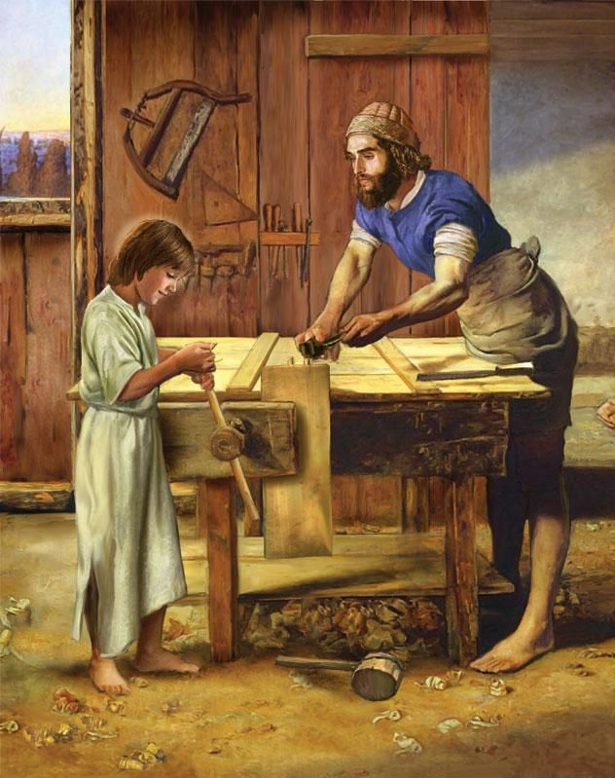
Luke 2:52
Jesus Was a Man
Jesus grew mentally, physically, spiritually, and socially
just as we do
Jesus developed as a boy

Slide 50
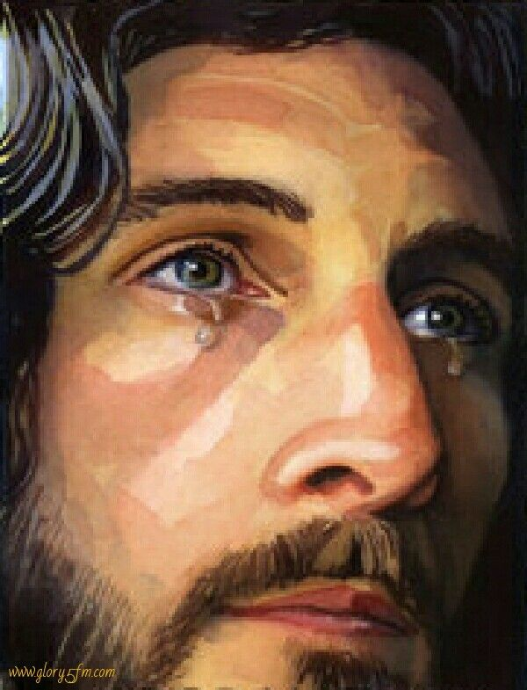
John 4:6, 7, 35
Jesus Was a Man
Jesus became tired and thirsty
Jesus became sad and wept
Jesus experienced human
physical and emotional
characteristics

Slide 51
Hebrews 2:10
Jesus Was a Man
Jesus suffered
Jesus experienced suffering
just as we do

Slide 52
Hebrews 2:11
Jesus Was a Man
Jesus calls us brothers and sisters
We are part of Jesus’ family

Slide 53
Hebrews 2:18
Jesus Was a Man
Jesus was tempted to sin
Jesus was tempted to sin just as we are,
but he didn’t sin
Temptation is the opportunity to do a bad thing
Sin is actually doing the bad thing

Slide 54
Romans 4:25
Jesus Was a Man
Jesus experienced death

Slide 55
Trinity
Triple Point
Father
Solid
Matter
Holy
Spirit
Son
Gas
Liquid
If created matter can coexist in 3 states,
the Creator can coexist in 3 states

Slide 56
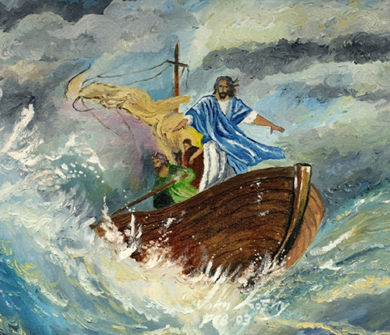
“Jesus” Summary
Jesus is God
Jesus said He was God
God the Father said He is God
Jesus created the universe
He healed and performed miracles
He lived a sinless life (Totally good)
He came alive from the dead
He rose into heaven

Slide 57
Jesus was a man
Jesus experienced birth
Jesus developed as a normal boy
He grew weary, was thirsty, and wept
He calls us brothers and sisters
He suffered and was tempted as we are
He experienced death
We know that God understands us because He became one of us

Slide 58
God created us to:
- Love us
- Live forever with God (Eternal life)
- Have a happy Life
John 3:16
John 10:10

Slide 59
In real life there is:
Hate instead of love
Death instead of eternal life
Sadness Instead of happiness
Real Life
- Hate
- Death
- Sadness
God’s Plan
- Love
- Eternal life
- Happiness
Romans 6:23
Hebrews 9:27

Slide 60
Why is real life different
from the way God created it to be lived?
The first man and woman God created chose to sin
All people since then sin
Sin separates us from God and causes all the bad things in life
Sin is to think, say and do bad things
Real Life
- Hate
- Death
- Sadness
God’s Plan
- Love
- Eternal life
- Happiness
Romans 3:23
Isaiah 53:6
Sin

Slide 61
We try many ways to get back to God
But we cannot overcome our sin
Real Life
- Hate
- Death
- Sadness
God’s Plan
- Love
- Eternal life
- Happiness
Religion
Being Good
Sin
Ephesians 2:8-9
Titus 3:5

Slide 62
God became a human who never sinned (Jesus).
Jesus took on the sin of every person for all time.
His death on a cross gives forgiveness from sin to those who believe that Jesus did this for them.
Romans 5:8
1 Peter 3:18

Slide 63
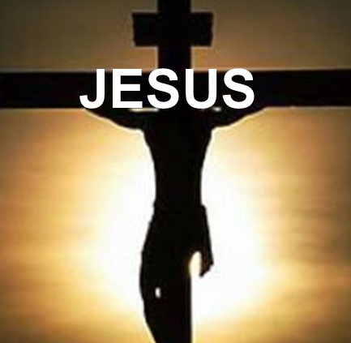
Believe Jesus died on the cross for your sins
to receive forgiveness and to live forever with God
God
- Love
- Eternal life
- Happiness
- Hate
- Death
- Sadness
Religion
Being Good
John 1:12
Revelation 3:20
Sin

Slide 64
Dear Jesus,
I am sorry for my sins.
I believe that you died on the cross for my sins.
Please come into my life, forgive me, and give me life forever with you.
Amen

Slide 65
You can know that you have eternal life with God
God gives eternal life
Eternal life is through Jesus
If you believe in Jesus, you have eternal life
John 5:24
1 John 5:11-13

Slide 66
The Holy Spirit
The Holy Spirit is represented by a dove

Slide 67
Who has the
Holy Spirit?
John 14:16
Jesus promised that God
would give us the Holy Spirit
The Holy Spirit is called Counselor and Comforter
It means “Helper”
The Holy Spirit is God

Slide 68
Who has the
Holy Spirit?
1 Corinthians 2:12
1 Corinthians 3:16
Those who believe in Jesus
have the Holy Spirit in them

Slide 69
The Role of the Holy Spirit
John 14:26
The Spirit teaches us
and reminds us of what Jesus said
What Jesus said
is in the Bible

Slide 70
The Role of the Holy Spirit
1 Corinthians 2:12
The Spirit helps us understand what God has given us
What are some things God has given us

Slide 71
The Role of the Holy Spirit
John 16:8-11
The Spirit lets people know that they sin
Sin is to think, say, and do bad things
Doing bad things makes us have a guilty conscience

Slide 72
The Role of the Holy Spirit
John 16:13
The Spirit guides us into the truth
The truth is in the Bible

Slide 73
The Role of the Holy Spirit
John 16:14
The Spirit helps us praise Jesus
by recognizing that Jesus is God

Slide 74
The Role of the Holy Spirit
Romans 8:6
When we give control of our lives
to the Holy Spirit,
He gives us a life of joy and peace

Slide 75
The Role of the Holy Spirit
Romans 8:16
Sometimes we feel unworthy
because we don’t act like God’s children,
so the Holy Spirit reminds us
that we are God’s children

Slide 76
The Role of the Holy Spirit
Romans 8:26-27
The Spirit helps us in our weakness

Slide 77
The Role of the Holy Spirit
Romans 8:26-27
Sometimes we don’t know what to pray for
Prayer is just talking with God
The Spirit prays for us according to what is best for us

Slide 78
The Role of the Holy Spirit
Romans 8:26-27
Examples of things we don’t know what to pray for:
Feeling bad
Things about ourselves and others we don’t understand

Slide 79
Your Response to the Holy Spirit
Galatians 5:16-17
All people are born with a sin nature
We all think, say, and do bad things sometimes

Slide 80
Your Response to the Holy Spirit
Galatians 5:16-17
Christians believe that Jesus died for them for the forgiveness of their sins
Christians still have their sin nature, but they also have the Holy Spirit in them

Slide 81
Galatians 5:16-17
There are two conflicting powers
in every Christian’s life

Slide 82
Galatians 5:16-17
We must choose which one is in control

Slide 83
Galatians 5:19-23
Choose to put God in control
Experience
Love, joy, peace
Patience, kindness, goodness
Faithfulness, gentleness, self-control

Slide 84
Galatians 5:19-23
When God is not in control
Experience
Hate, sadness, anger
Impatience, meanness, jealousy
Selfishness, lack of self-control

Slide 85
1 Corinthians 3:1-3
There are 2 types of Christians
Mature Christians and Immature Christians

Slide 86
1 Corinthians 3:1-3
Mature Christians
Don’t act like non-Christians
Are growing spiritually through God’s Word
Give God control of their lives

Slide 87
1 Corinthians 3:1-3
Immature Christians
Act like non-Christians
Are not growing spiritually through God’s Word
Don’t give God control of their lives

Slide 88
When we give the Holy Spirit Control of our life, we experience good things
1 Corinthians 3:1-3

Slide 89
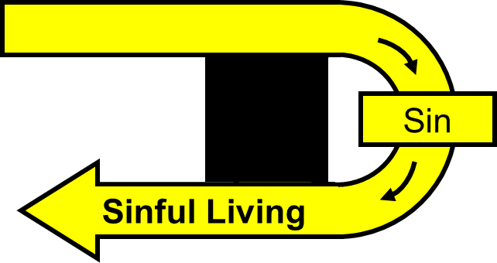
When we sin, we take control of our life away from God
Our sin nature is in control and we experience bad things
1 Corinthians 3:1-3

Slide 90
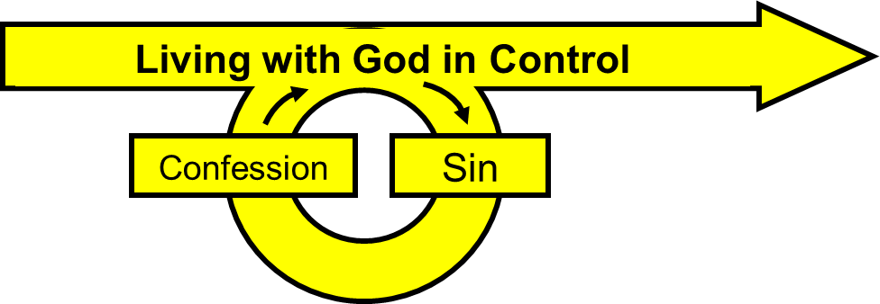
When we confess, we are giving control of our life back to God
To confess is to tell God you are sorry
God forgives you
1 Corinthians 3:1-3

Slide 91
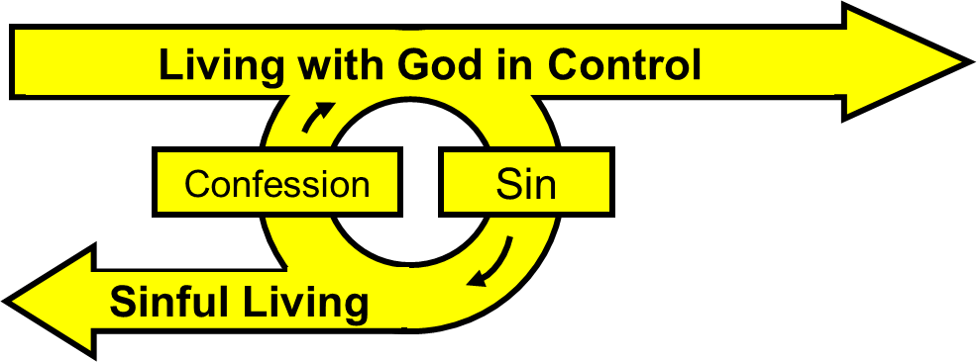
1 Corinthians 3:1-3

Slide 92
Ephesians 4:30-32
God is sad when we sin because it hurts us
Get rid of all bitterness, temper, anger, quarreling, cursing, and hatred
Be kind and sympathetic
Forgive others as God forgives you

Slide 93
Jesus promised that God would give us the Holy Spirit
Those who believe in Jesus have the Holy Spirit in them

Slide 94
The Holy Spirit:
Teaches us and reminds us of what Jesus said
Helps us understand what God has given us
Lets people know that they sin
Guides us into the truth

Slide 95
The Holy Spirit:
Helps us praise Jesus
Gives us a life of joy and peace
Reminds us that we are God’s children
Helps us in our weakness
Prays for us

Slide 96
The Holy Spirit and our sinful nature are in conflict
We must choose to allow God to control us

Slide 97
With God in control we experience good things
When God is not in control, we experience bad things

Slide 98
Mature Christians give God control of their lives
Immature Christians don’t give God control of their lives

Slide 99
When you sin, tell God you’re sorry and He will forgive you
God is sad when we sin because it hurts us
Forgive others as God forgives you

Slide 100
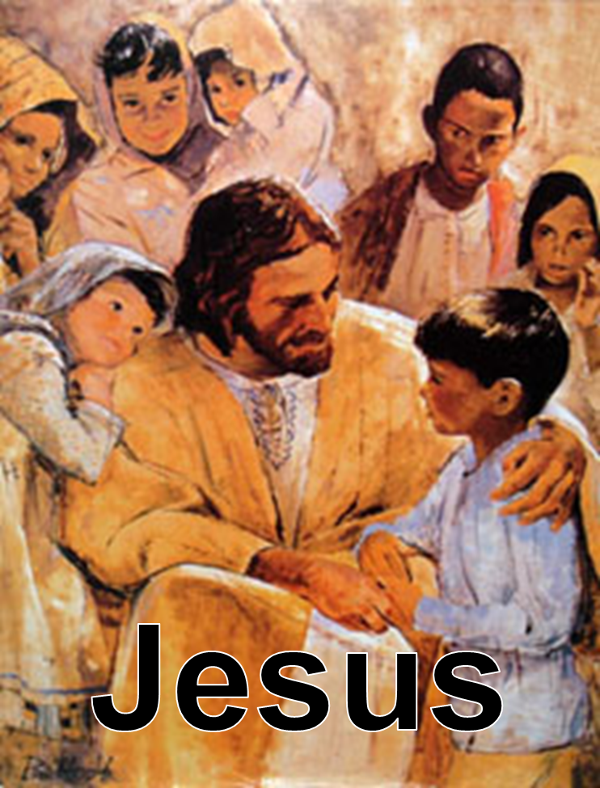
Foundations For Children
Come
Jesus said, Let the children come to me
Matthew 19:14

