Slide 1
Giving and receiving feedback
Prepared by: Karama Habli

Slide 2
What is a feedback?

Slide 3
Valuable information that one person offers to another about the impact of their actions or behavior
Without it we are limited only to our own perception

Slide 4
the “sandwich” approach

Slide 5
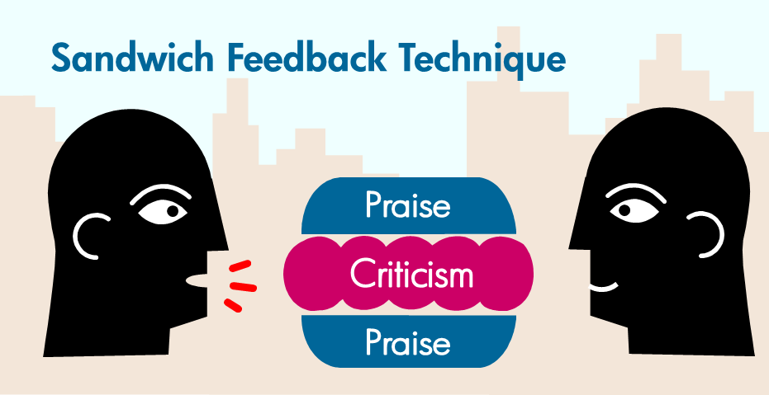
Surrounding the negative feedback with positive information and useful advice

Slide 6
it’s wise to keep the following points in mind:
Always start by saying something positive to the person. If what you’re evaluating is a dish, compliment the person on the effort that went into it. If it’s a speech, praise the person for the research.
Bring out the negative points gently. Don’t be blunt.
Always try to end with a gentle suggestion for improvement.

Slide 7
Example
“Your presentation was great. You made good eye contact, and were well prepared. You were a little hard to hear at the back of the room, but with some practice you can overcome this. Keep up the good work!” Instead of: “You didn’t speak loudly enough. However, the presentation went well.”

Slide 8
What is the difference between a bad evaluator and a good evaluator?

Slide 9
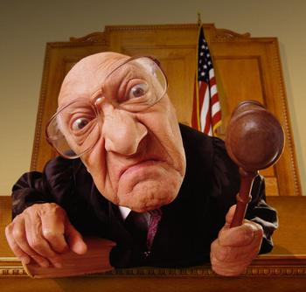
A GOOD Evaluator

Slide 10
Realistic as much as possible
Specific
Descriptive
Honest
Focusing on - points and on + points as well
Own the feedback.

Slide 11
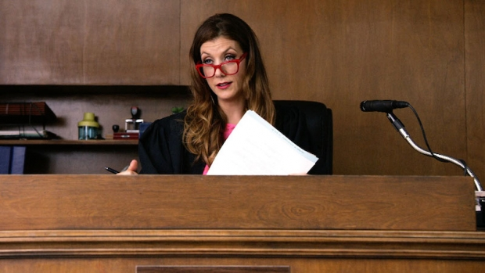
A BAD Evaluator

Slide 12
Focus on judging (Judging means to form an opinion about someone according to what you see and what you believe. People tend to judge others based on their morality or social standards, some people like judging others because that makes them feel good and more moral.)
Focus on negative points only
Focus on the person
Being rude

Slide 13
Reasons to give feedback

Slide 14
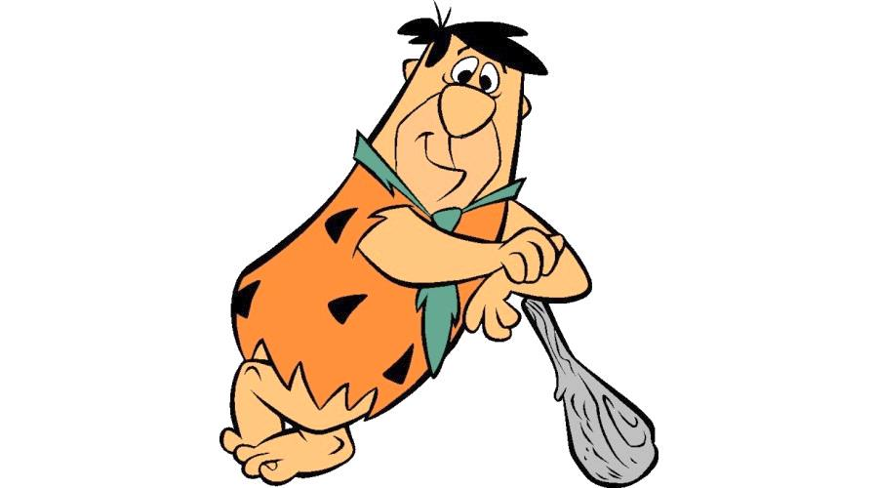
Who would you like to be most/least judged by and why ?

Slide 15
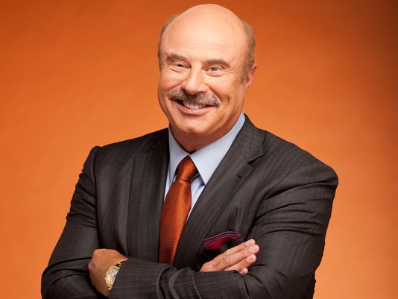
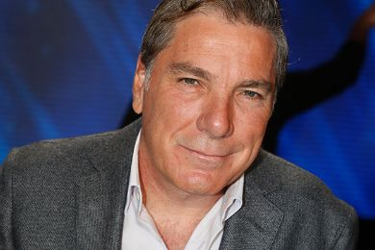
OPRAH WINFREY
DR PHIL MCGRAW
ALI JABER
Simon cowell

Slide 16
THE GOOD
THE BAD
THE HELPFUL

Slide 17
THE GOOD =
Compliments

Slide 18
Compliments are positive but they don’t tell us how to improve

Slide 19
Example
George is a fantastic developer. His design skills are amazing. His estimates are consistently bang-on. He’s fast, uses keyboard shortcuts effectively and his testsare well-named and legible. He takes ownership of problems and sees them through to the end. We need more people on the team like him!
- Joe

Slide 20
THE BAD = Criticism

Slide 21
Criticism is negative but doesn’t tell us
how to improve

Slide 22
Example
George has good technical skills, but isn’t a good tech lead. He confuses people when he talks, and none of us know how to do the things he’s asking us to. George can also be really mean sometimes when we do things he doesnt like. He really upsets Alice. He’s far too idealistic and very patronizing. He goes on and on about how great Agile is until we’ve had enough. I’m not an idiot; I’m very experienced so he doesn’t need to teach me half the things he thinks we should be doing. He also has no real grasp of how Agile works in an enterprise environment. Everything he comes up with is nice in theory but never works in practice. Everyone says I’d be much better at this than him.
- Harry

Slide 23
THE HELPFUL = Feedback

Slide 24
Feedback can be positive and/or negative
but it help us to improve
(constructive criticism)

Slide 25
Example
George’s development skills are great. It would be fantastic if he could pass on some of that wisdom. I’d like to see him take on a leadership or training position. We need a tech lead here. If he brushes up on his presentation and communication skills, I think he could do a good job.
- Sue

Slide 26
Realistic as much as possible
Specific
Descriptive
Honest
Focusing on - points and on + points as well
Own the feedback.

Slide 27
Let’s improve Harry’s feedback
George, thanks for taking on the role of tech lead. You’re passionate about Agile, your technical skills are great and I’ve learnt a lot from you.
A few times, I’ve struggled to understand what you said. For instance, when you were talking about performance testing, I was confused - it wasn’t obvious whether we were meeting our targets or not. I saw other people frowning too.
Could you maybe slow down, draw some diagrams, or give us time to ask questions? That would help me.
Like many of the team, I m still learning. Id really like to be able to do the Agile practices well. I would love you to support the people like me, and help us to improve without taking on everything all at once.

Slide 28
How to receive feedback ?

Slide 29
How can getting
feedback be like receiving a present?

Slide 30
Given with good intentions
It is packaged nicely
You can take it away with you and look at it later
You can keep it or throw it away

Slide 31
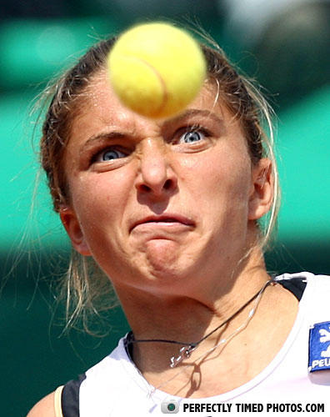
How can getting
feedback be like being hit with a tennis ball?

Slide 32
If you are not ready for it, it can hurt!
It can be competitive
It can be aggressive, too fast and too hard
You have to deal with it immediately

Slide 33
How to Receive Feedback Effectively
Be an active listener
Be open
Be respectful
Ask questions
Show appreciation.
Be aware of your responses.
Reflect and decide what to do

Slide 34
The golden rule

Slide 35
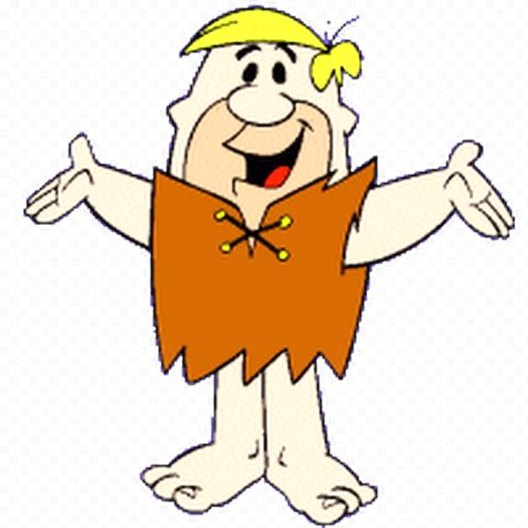
be part of the solution
not the problem

Slide 36
The golden rule of an effective feedback
is to improve and make a given situation better
A feedback must effectively present a solution

Slide 37
Constructive criticism or feedback is important, especially when it means improvement and encourages correction. It’s not the feedback but how it’s given that matters. Giving feedback gently softens the criticism. This method reinforces improved behavior, ensuring better results in the future.
Evaluation is an art. It’s a skill which is very important in our lives. How you evaluate is your decision; but since we’re a part of society, can we just say anything we think, without caring how the other person feels? Try to use the sandwich method in your daily lives. I’m sure you’ll be much happier, as will others around you.

Slide 38
WORKSHOP
The colors game

Slide 39
Feedback styles
The Saboteur
The Nice But Un-helpful
The No Feedback at all
The Helper
The negeative

