Slide 1
Разработчик презентации: Вайся Нина Анатольевна
Должность: Учитель английского языка
Место работы: Муниципальное бюджетное образовательное учреждение
«Средняя общеобразовательная школа № 13 г. Йошкар-Олы» Республика Марий Эл
Конкурсная работа: «Презентация к уроку по учебному предмету «Spotlight» в 5 классе по
Module 8. Special days. Unit1. Celebrations.

Slide 2
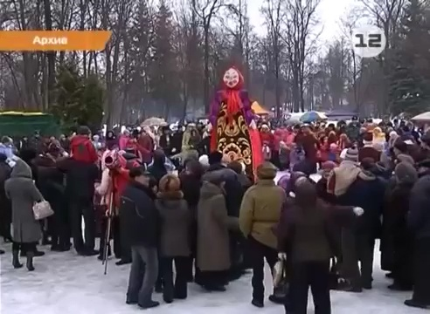
Look at the screen and watch a video episode very attentively!

Slide 3
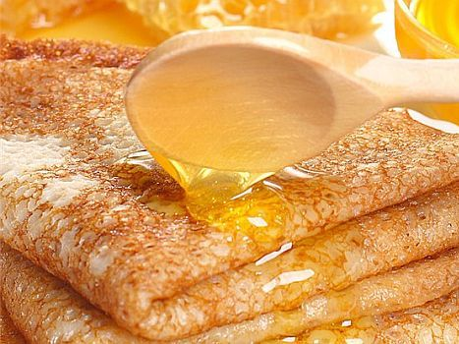
«CELEBRATION OF
MASLENITSA»

Slide 4
The aim of the lesson:
                Speak about celebrating of Maslenitsa
Do some tasks in your workbooks
Listen to the project about this festival
Sing Russian and Mari songs
Burn Lady Maslenitsa on a big bonfire with your negative thoughts.

Slide 5
Task 2. Give English equivalents to the following expressions.
Отмечать праздник
Celebrate the holidays
Любимый праздник
Favourite holiday
Во время праздника
During the festival
Весенний праздник
Spring festival
Сказать зиме до свидания
Say goodbye to winter
Добро пожаловать весне
Welcome spring
Неделя масленых блинов
A week of butter pancakes
Длиться неделю
Last for a week
В начале марта
At the beginning of March
Неделя перед Великим постом
A week before Lent

Slide 6
Task 3. Answer the following questions:
              What kind of holiday is Maslenitsa?
              How long does it last?
              When do we celebrate this festival?
              What’s the Mari for “Maslenitsa”?
              What’s the English for “Maslenitsa”?

Slide 7
Task 4. Match the numbers to the letters in the right order.
1.Dance around Maslenitsa | A.Встречать весну с хлебом и солью
2.Meet Maslenitsa with bread and salt | B.Одевать особые костюмы
3.Dress in special costumes | C.Играть в снежки
4.Have a tag-of-war in the snow | D.Кататься с горы на санках
5.Go sledging from the hill | E. Кататься на лошадях
6.Go riding the horses | F.Прыгать через костер
7.Play snowball fights | G.Перетягивать канат
8.Jump through the bonfire | H.Вести хоровод вокруг масленицы

Slide 8
Task 4. Match the numbers to the letters in the right order.
1.Burn Lady Maslenitsa on a big bonfire | A.Просить прощения друг друга
2. Eat pancakes with sour cream, jam, honey, caviar | B. Кушать блины со сметаной, с вареньем, медом, икрой
3.Forgive each other | C.Состязаться мешками
4.Set off fireworks | D.Взбираться на столб за подарком
5.Sing Mari and Russian songs | E.Пить чай с блинами
6.Climb the pole for the present | F.Петь марийские и русские песни
7.Drink tea with pancakes | G.Сжигать чучело- масленицу
8.Play with sack | H. Запускать фейерверки

Slide 9
Task5. Make up a conversation, using the word expressions from Task4.
…..
What kind of holiday is Maslenitsa?
It’s a…(неделя перед Великим Постом, неделя масленых блинов, весенний праздник, любимый праздник…)
What do you do on this festival?
I …(прошу прощения друг у друга, кушаю блины со сметаной, сжигаю чучело масленицу, катаюсь на лошадях…)
How long does it last?
It … (длится неделю)
…..

Slide 10
Check up your home task:
    describe lady Maslenitsa;
    write down some of your negative thoughts on the sheets of paper in order to get rid of them and burn them with lady Maslenitsa;

Slide 12
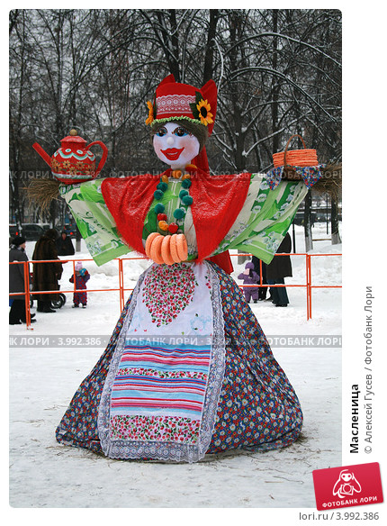
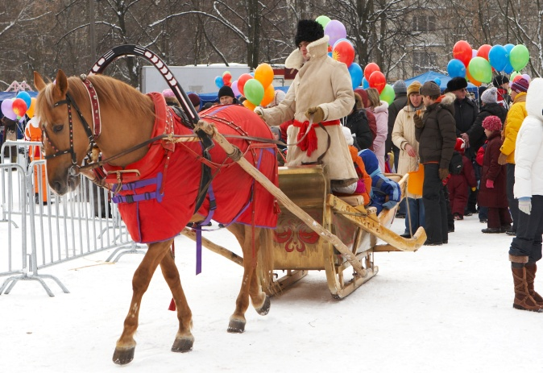
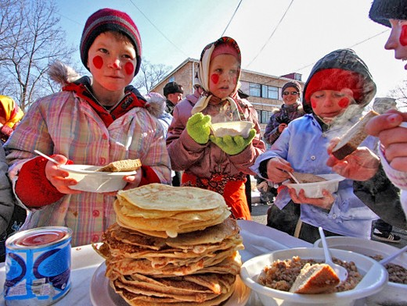
How’s there to rest?
What’s there to see ?
What’s there to eat?

Slide 13
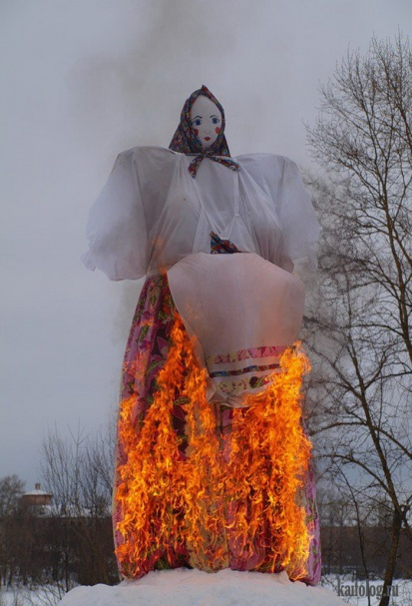
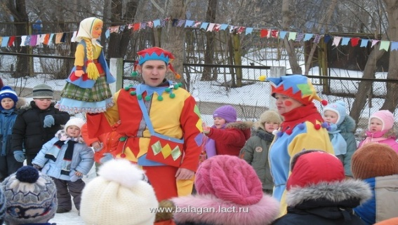
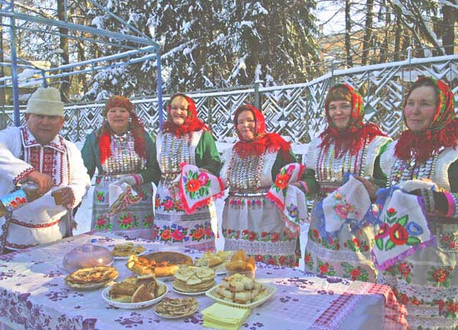
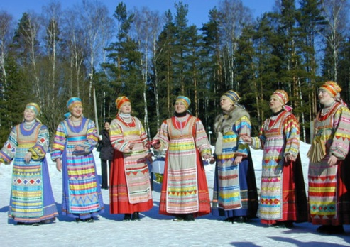
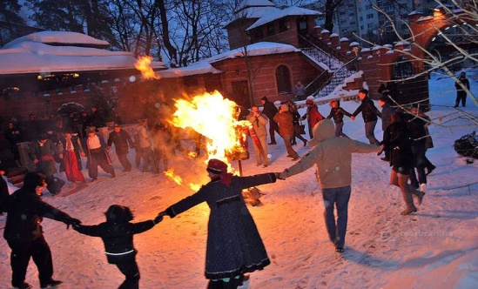
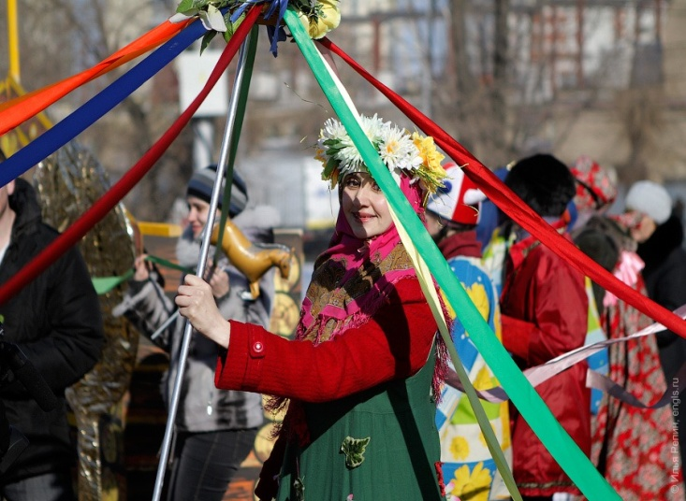
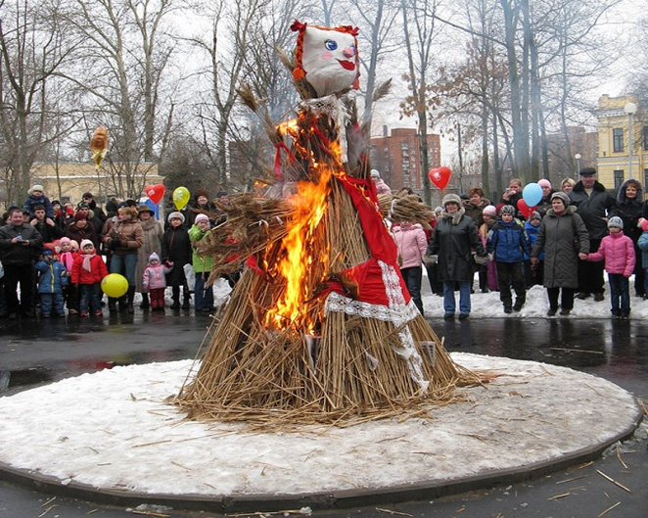
What’s there to see ?

Slide 14
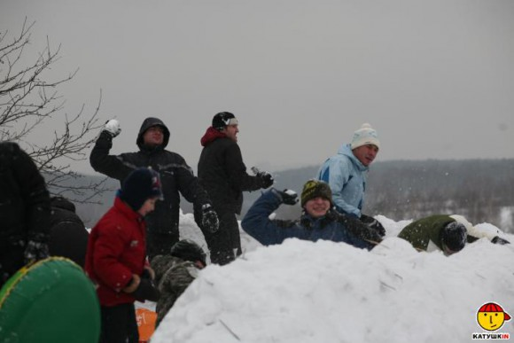
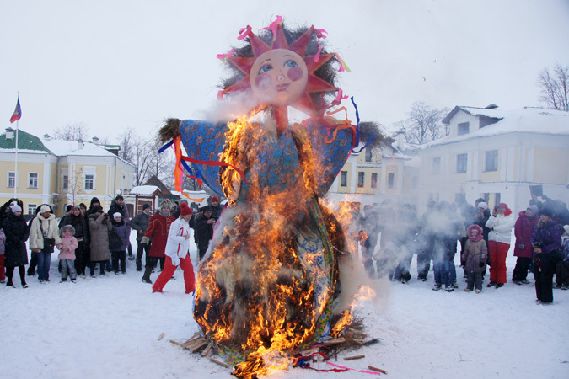
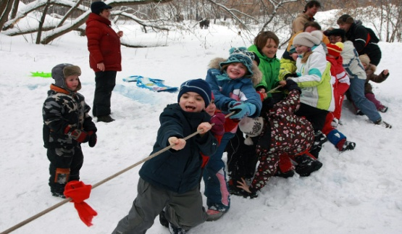
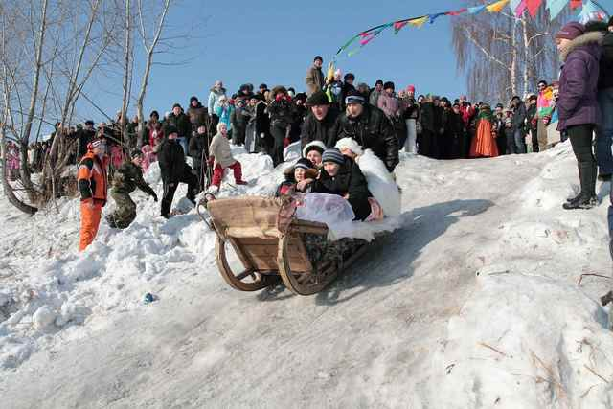
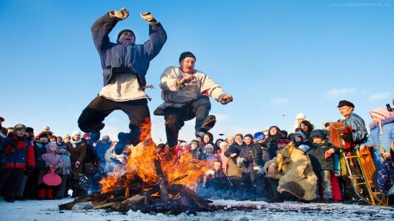
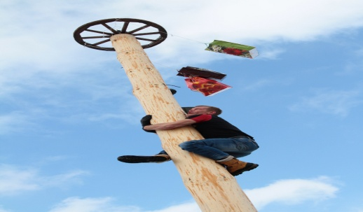
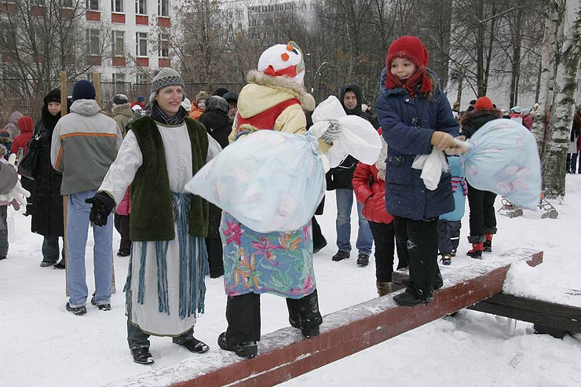
How’s there to rest ?

Slide 15
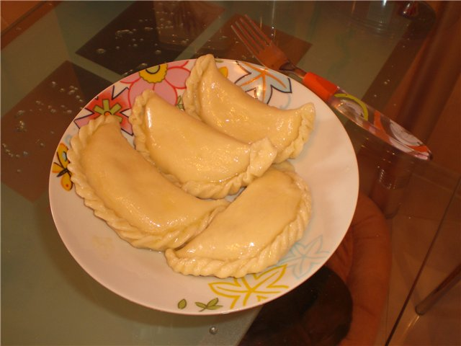
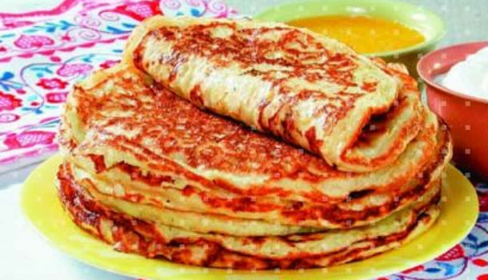
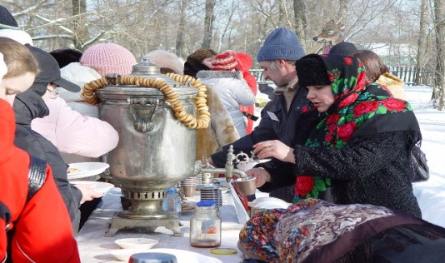
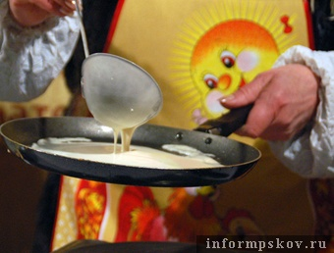
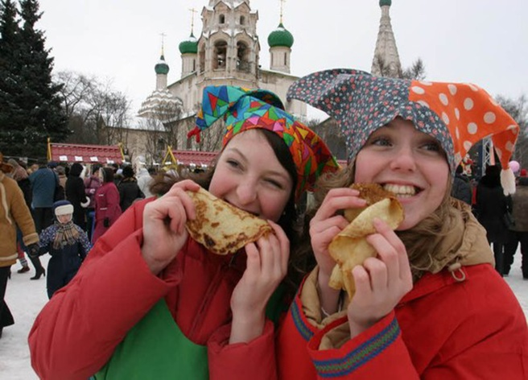
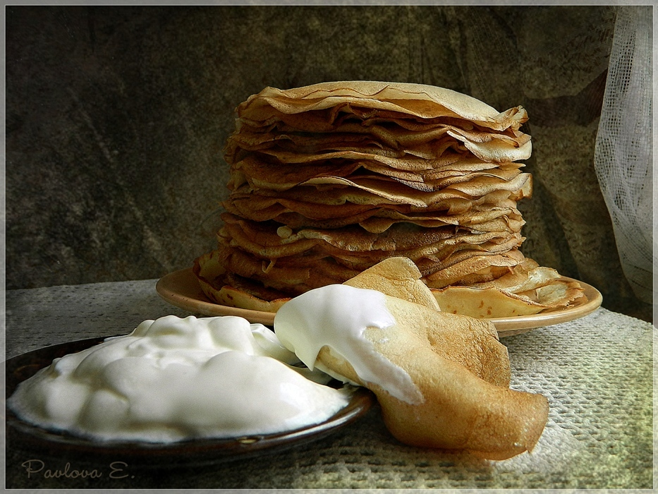
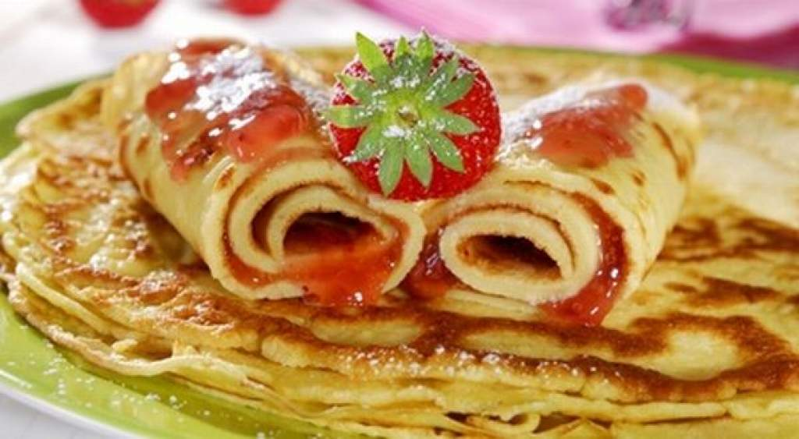
What’s there to eat ?

Slide 16
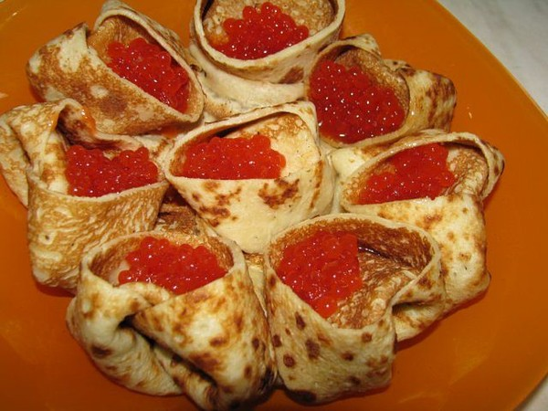
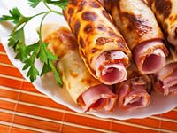
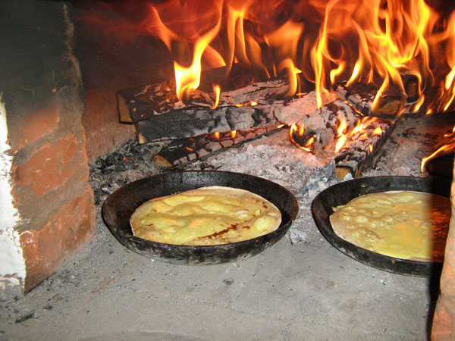
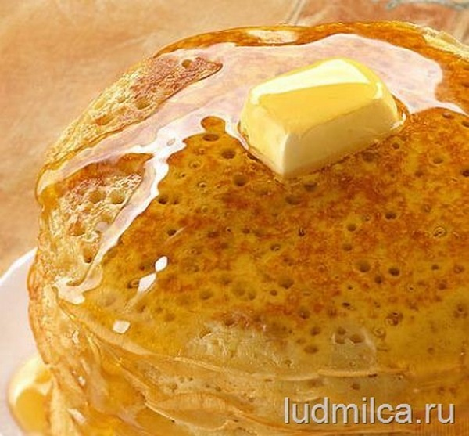
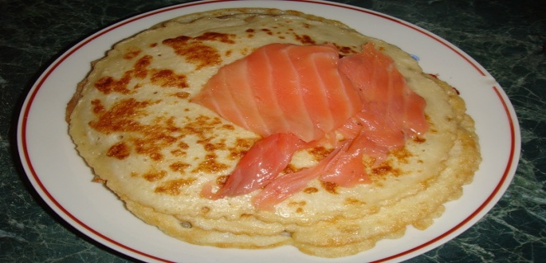
Do you like them?They’re delicious!

Slide 17
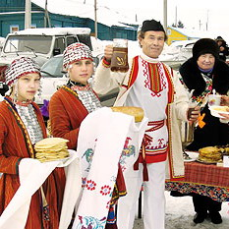
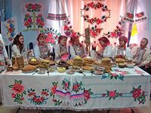
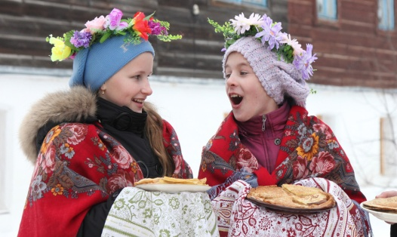
Don’t forget…!

Slide 18
Task 6. While listening to the project, read and tick the correct item.
1. This project is about…
  Рождество
  Пасха
  Масленица
2. At Maslenitsa people say:
  Thank you
  Goodbye to winter
  Good morning
3. Mari people celebrate Maslenitsa
  At the end of March
  At the beginning of February
  At the end of February
4. A typical Maslenitsa food is:
  Soup
  Pancakes
  Smash potatoes
5. Maslenitsa is sometimes called in Mari language
  Рошто
  Уарня
  Пеледыш пайрем
6. At Maslenitsa Maris watch:
  Eating coloured eggs
  Making a straw doll
  Burning lady Maslenitsa

Slide 19
Task 9. Answer the questions.
Did you enjoy the lesson?
What have you learnt from our lesson today?
Do you like this holiday? Why?
As for me I have learnt …
As for me I like this holiday, because…

Slide 20
Task 8. Listen to the song and sing along with us.
Каенат, каенат, каенат-тылзе ужаталже.
Каенат, каенат, каенат- муйын кочо там.
Каласал, каласал, каласал-кушто чын куанже?
Каласал,каласал,каласал –мые коранам.
You have gone, you have gone, you have gone
Say good bye to light moon.
You have gone, you have gone, you have gone
Sweety honey’s taste.
Will you say, will you say, will you say
Where’s real gladness?
Will you say, will you say, will you say
I will go away

Slide 21
Task 10. Do your homework:
Do task 7 in the Workbook
Write a letter to your friend about Maslenitsa.
Remember to write:
Name of the holiday;
Time of the year;
Activities;
Food;
Make up the project about Maslenitsa.

Slide 22
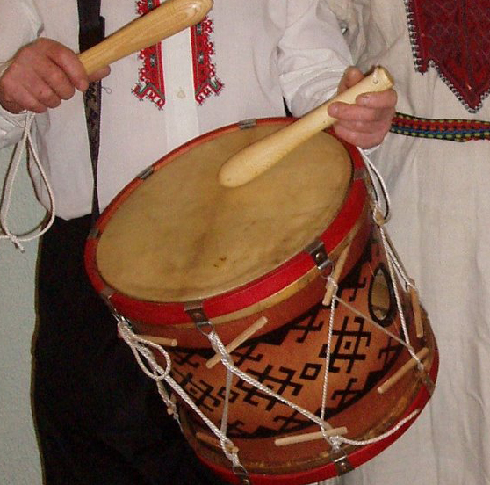
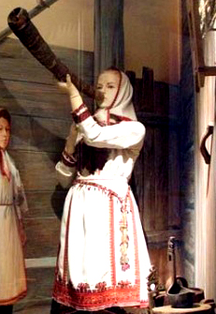
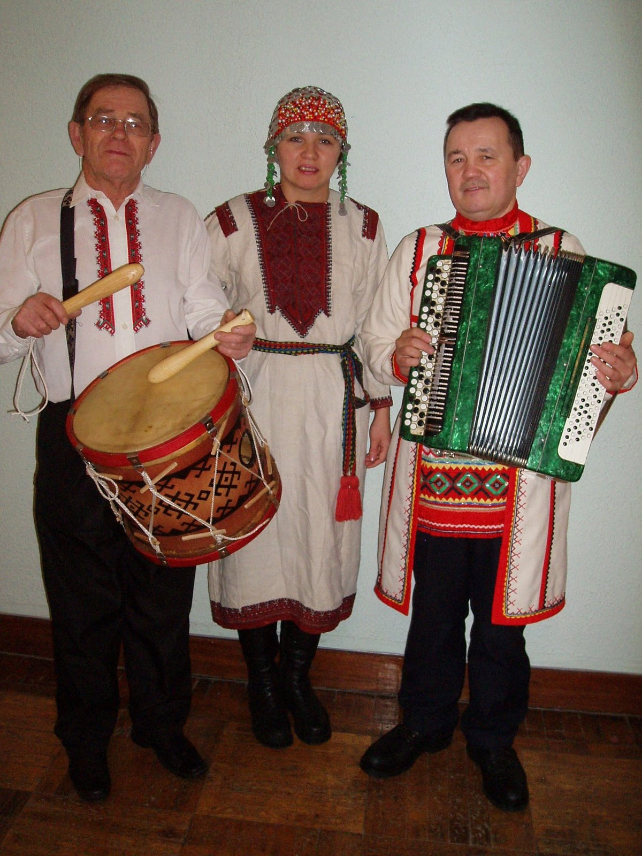
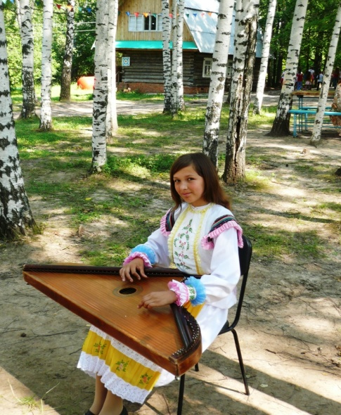
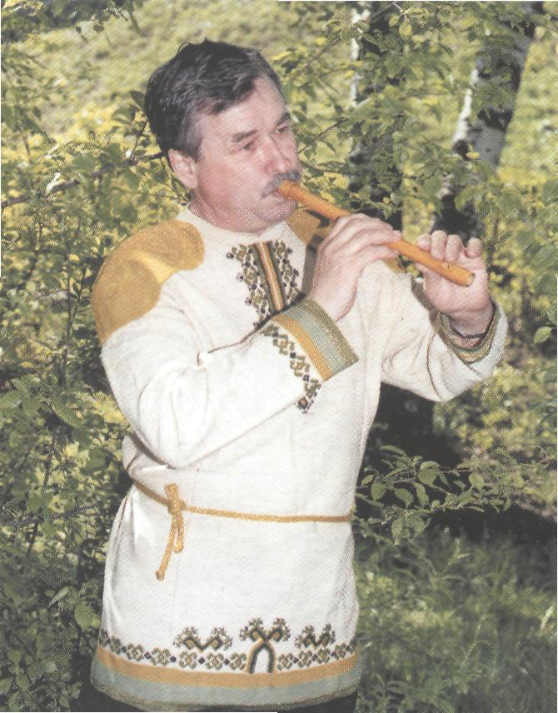
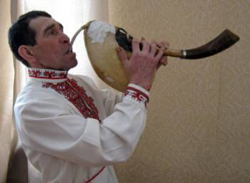
Task 7. Guess and name musical instruments.

Slide 23
Thank you for your attention

