Slide 1

UNIT 7
POPULAR ARTS
At the lesson we’ll:
review kinds of arts;
check homework;
drill grammar (Passive Voice);
do exercises on listening;
make up a dialogue;

Slide 2

KINDS OF ARTS
Music
Painting
and Drawing
Dancing
Literature
Sculpture
Cinema
Theatre
Architecture

Slide 3
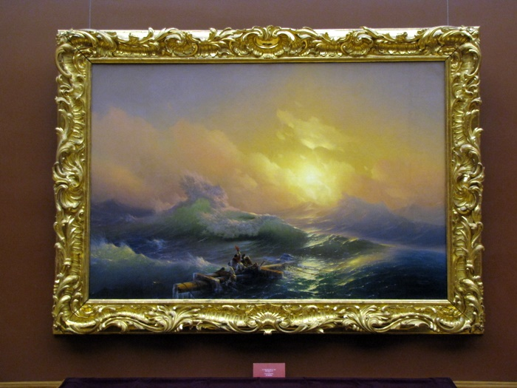
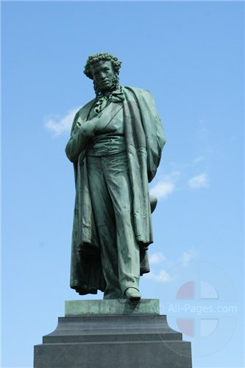
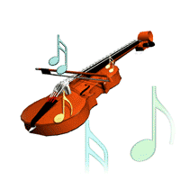
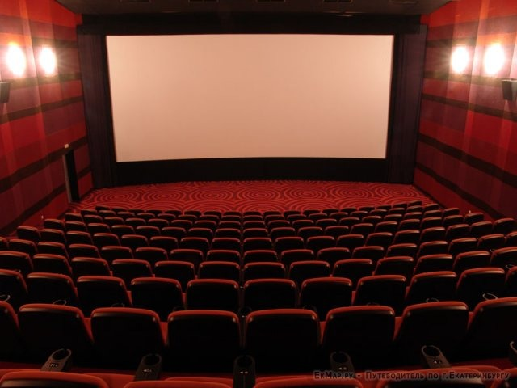
Name the object and find the most appropriate kind od arts

Slide 4
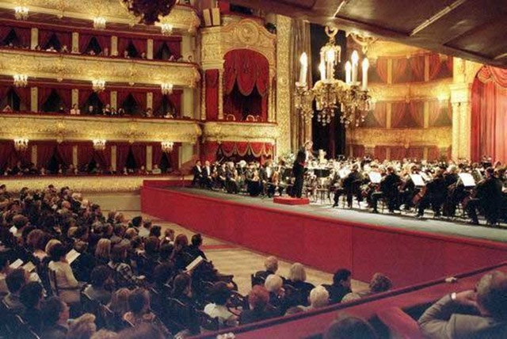
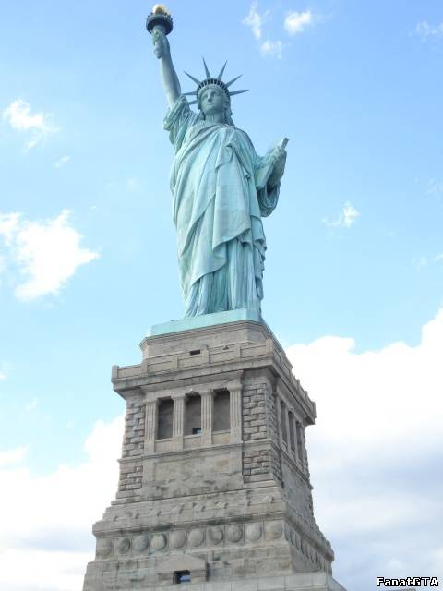

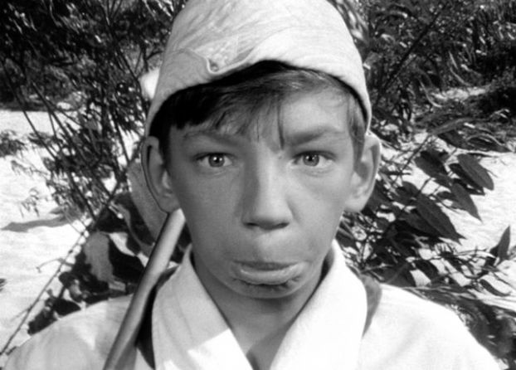

Slide 5
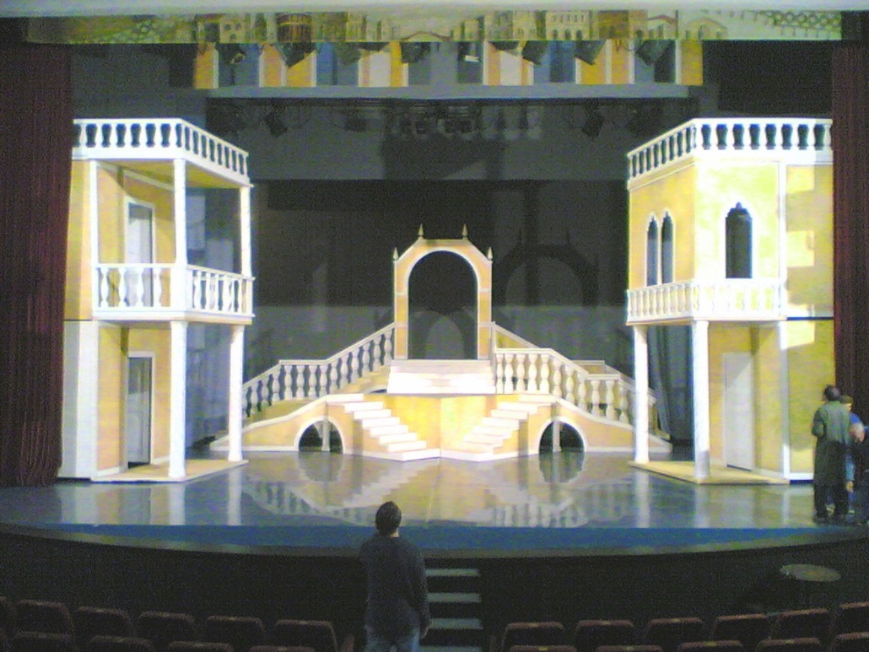
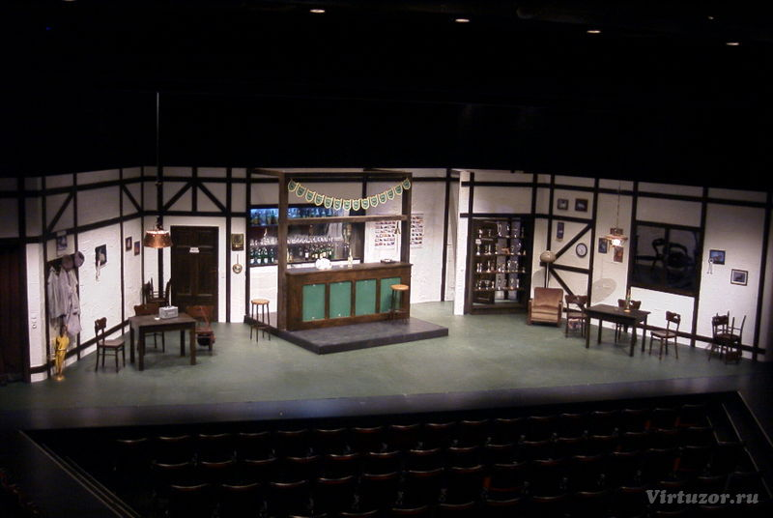
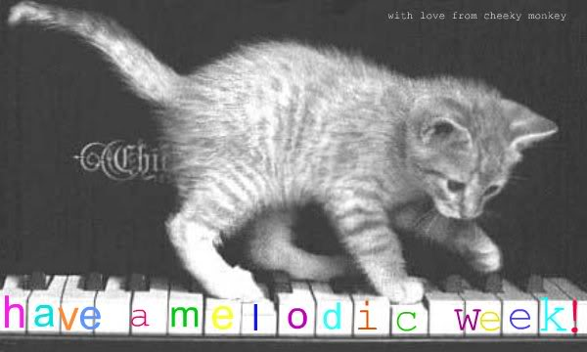

Slide 6
NAME PEOPLE’S JOBS IN ARTS.
1. Someone who writes music or plays a musical instrument is … 2. Someone who acts in plays or films is … 3. Someone who paints pictures is … 4. Someone who makes up songs or music is … 5. Someone who writes plays is … 6. Someone who plans buildings is … 7. Someone who makes statues or other shapes from metal, wood, stone etc. is … 8. Someone who dances in ballet is… 9. Someone who writes poems is … 10. Someone who sings is … | a) a poet b) a dramatist or a playwright c) a ballet dancer d) a musician e) a singer f) an architect g) an actor or an actress h) a composer i) a sculptor j) an artist

Slide 7
Passive Voice
Simple Present Passive | Simple Past Passive | (Simple)Future Passive
am / is / are + V3 | was / were + V3 | Shall / will be + V3
English is spoken here. | The letters were posted yesterday. | The information will be received next week.

Slide 8
Choose the right form of the verbs in the Passive Voice to complete the sentences.
  1. The computer (is used/was used) every day.
  2. Such films (are not made/were not made) nowadays.
  3. A new collection of sculpture (was exhibited/ will be exhibited) in the local museum next week.
  4. This theatre (will be visited/ was visited) by lots of tourists last month.
  5. The TV show (was shown/ will be shown) on television yesterday.

Slide 9
Listening
Questions:
1. When was this type of music created?
2. What musical bands were dominated over white American music?
3. When was a new radio show started by Alan Freed?
4. What musicians were mentioned in the text?

Slide 10

Open the brackets to make the sentences complete.
This theatre … (build) over 100 years ago.
Everybody … (impress) by this picture gallery next week.
Jazz is a type of music that … (create) in the United States.
I like this detective story. It … (stage) in our theatre every season.
The first instruments … (make) from the horns of animals.
This masterpiece … (know) all over the world.
The tickets for the Bolshoi Theatre performances … (buy) next week.

