Slide 1
SOME AND ANY

Slide 2
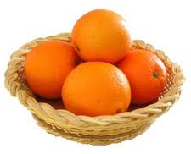
SOME AND ANY
some
We use "some" in positive sentences. We use some for both countable and uncountable nouns.
Oranges (countable and more than one).
There are some oranges in the basket.

Slide 3
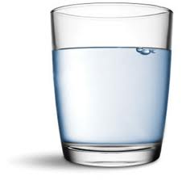
SOME AND ANY
some
We use "some" in positive sentences. We use some for both countable and uncountable nouns.
water (uncountable).
There is some water in the glass.

Slide 4
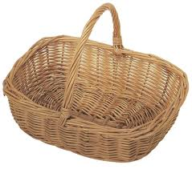
SOME AND ANY
any
We use "any" in negative sentences or questions. We use any for both countable and uncountable nouns
No oranges (countable).
There aren’t any oranges in the basket.

Slide 5
SOME AND ANY
any
We use "any" in negative sentences or questions. We use any for both countable and uncountable nouns
No oranges (countable).
Are there any oranges in the basket?

Slide 6
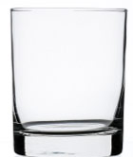
SOME AND ANY
any
We use "any" in negative sentences or questions. We use any for both countable and uncountable nouns
No water (uncountable).
There isn’t any water in the glass.

Slide 7
SOME AND ANY
any
We use "any" in negative sentences or questions. We use any for both countable and uncountable nouns
No water (uncountable).
Is there any water in the glass?

Slide 8
SOME AND ANY
any
some
COUNTABLE
COUNTABLE
UNCOUNTABLE
UNCOUNTABLE
NEGATIVE
POSITIVE
QUESTION

Slide 9
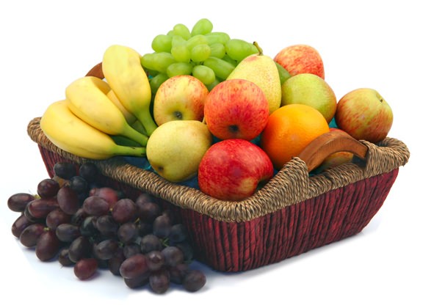
SOME AND ANY
EXERCISES:
There is some fruit in the basket.

Slide 10
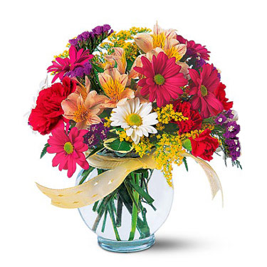
SOME AND ANY
EXERCISES:
There are some flowers in the vase.

Slide 11
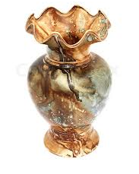
SOME AND ANY
EXERCISES:
There aren’t any flowers in the vase.
Are there any flowers in the vase?

Slide 12
SOME AND ANY
expressions with some and any
any
some
ANYBODY
SOMEBODY
ANYTHING
SOMETHING
ANYONE
SOMEONE

Slide 13
SOME AND ANY
Are there __________ students in the class?
I have got ____________ books on the table.
Have you got ___________ friends from Gebze?
There is ____________ cola in the bottle.
There isn’t __________ milk to drink.
__________ students are good at English.
I eat ________ fruit everyday..
any
EXERCISES:
some
any
some
any
Some
some

Slide 14
THANKS
Please visit
www.nihatkasim.org
To download this lesson.

