Slide 1


Animal Tissue
By:
DORA INDRIANA,S.Pd.M.Pd
SMA NEGERI 1 JEMBER.

Slide 2
Development Stages of Animal’s Embryo
- Cleavage (Division/segmentation)
- Morphogenesis
- Differentiation (embryonic tissue)

Slide 3
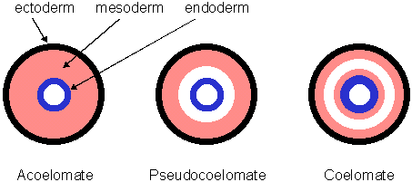
Embryonic Tissues
Ectoderm, mesoderm, and endoderm are embryonic tissues that give rise to all of the tissues, organs, and organ systems in the body.

Slide 4
Ectoderm forms the outer layer of skin and nervous system.
Mesoderm forms the muscles, connective tissues, skeleton, kidneys, and circulatory and reproductive organs.
Endoderm forms the lining of the gut, respiratory tract, and urinary bladder.
It also forms the glands associated with the gut and respiratory tract.

Slide 5
Concept Map
Animal Tissue
Epithelium
Connective
Muscle
Nervous

Slide 6
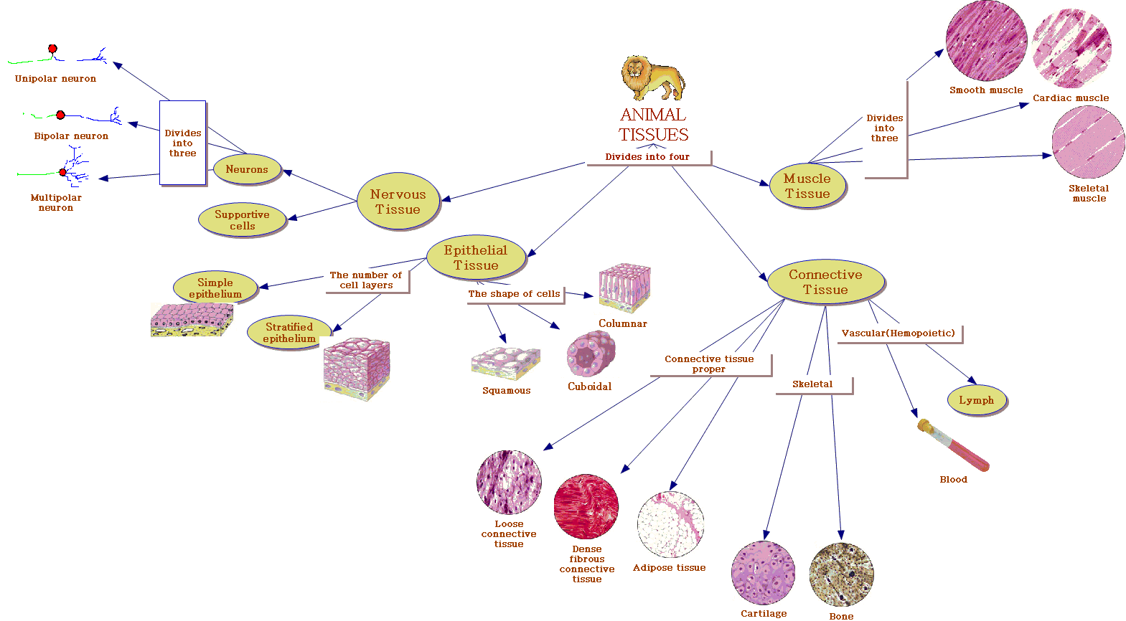

Slide 7
1. Epithelial Tissue
Epithelial tissue lies on a basement membrane
Cells within this tissue readily divide to make more cells (recover)
Does not have any vasculature
The cells within this tissue are firmly attached to each other
Protection
Secretion
Absorption
Excretion

Slide 8
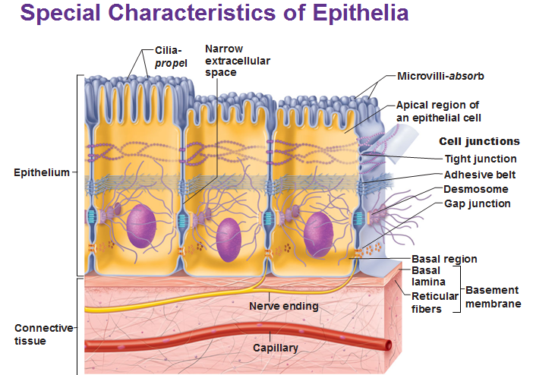

Slide 9
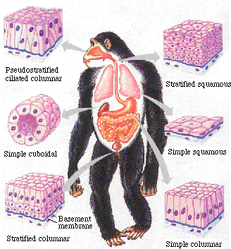
Types of Epithelial Tissue
Cell shape
  Squamous
  Cuboidal
  Columnar
Number of cell layers
  Simple
  Pseudo stratified
  Stratified
RELATE STRUCTURE TO FUNCTION!

Slide 10

a. Squamous Epithelium
Cells very thin, much wider than they are thick.
  Simple Squamous Epithelium
    Air sacs of respiratory
    Lining of blood vessels, heart and lymphatic tubes
  Stratified Squamous Epithelium
    Skin
    Vagina
    Esophagus
    Mouth

Slide 11
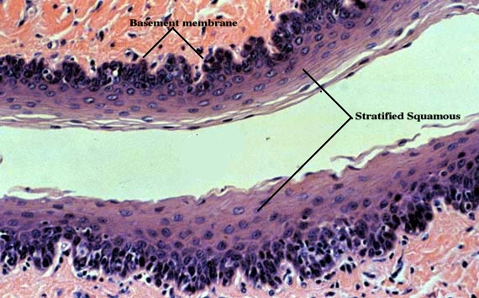
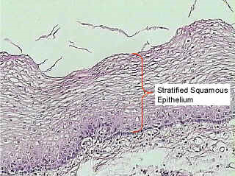
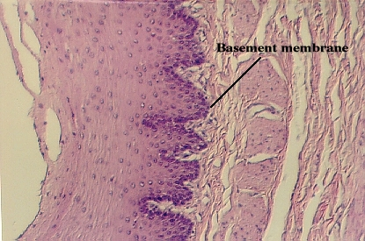

Stratified Squamous Epithelium
the human skin shown below contains stratified epithelium

Slide 12

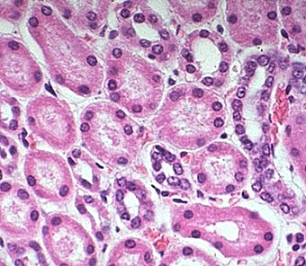
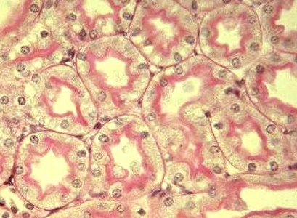
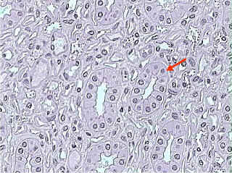
b. Cuboidal Epithelium
Cells cube shaped- secretion and absorption.
  Kidney tubules
  Duct and small glands
  Surface of ovary

Slide 13
c. Columnar Epithelium
Elongated cells, much longer than they are wide.
  Simple Columnar Epithelium
    A single layer of cells that line the digestive tract, gallbladder and excretory ducts of some glands. Has microvilli at surface for absorption.
  Stratified Columnar
  Has secretion and movement funtion. In nose, the surface of larynx, urethra
  Pseudostratified ciliated columnar epithelium
    Lines the bronchi, trachea, uterine tubes and some of the uterus. Propels mucus or reproductive cells by ciliary action.

Slide 14
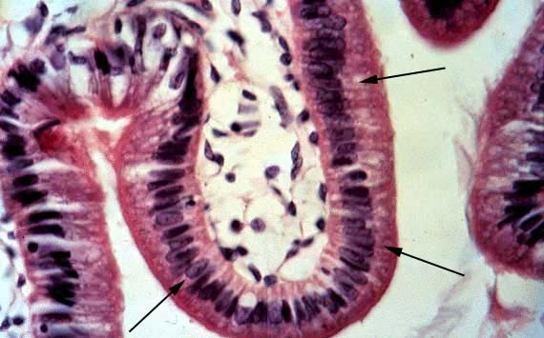
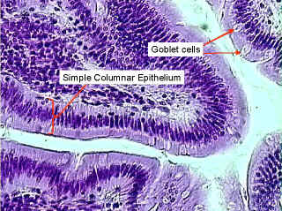
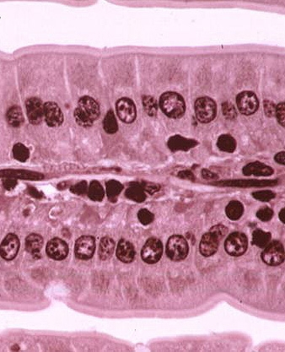
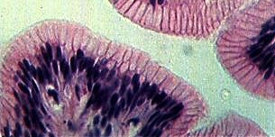
Simple Columnar epithelium
Small Intestine (Jejunum) X 200

Slide 15

Stratified Columnar
In trachea

Slide 16
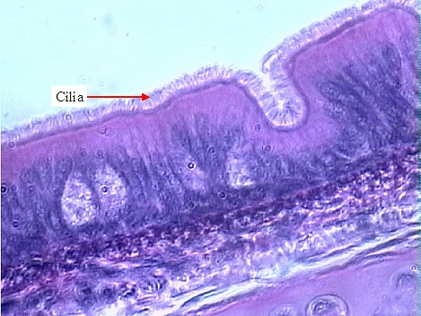
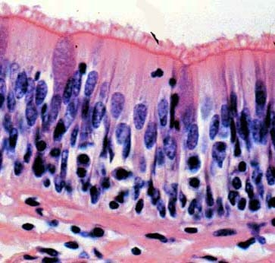
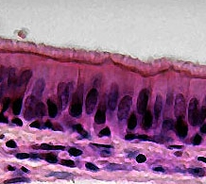
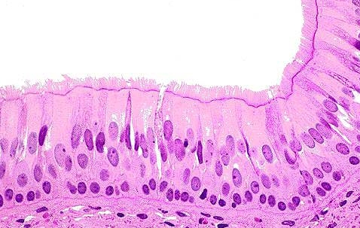
d. Pseudostratified Ciliated Columnar Epithelium

Slide 17
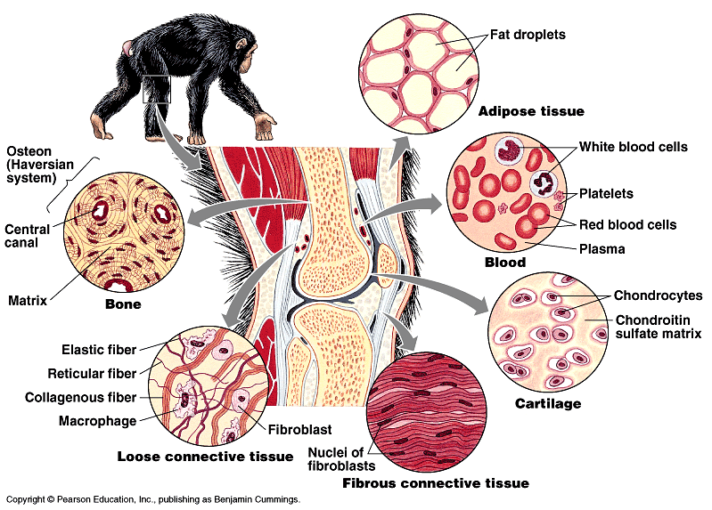
2. Connective tissue
(Framework)
Main function: binding and support other tissues
Large amount of extra-cellular matrix with fewer cells
Connective tissue cells secrete the extra-cellular matrix
Extracellular matrix consists of network of fibers in liquid, jelly-like or solid matrix

Slide 18
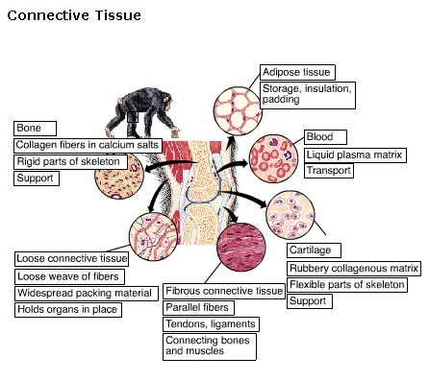

Slide 19
Connective Tissue
Characterized by the cells widely separated from each other in a matrix that is produced by the cells.
Tissue protects and supports.
Cell Matrix composed of two regions
  Ground
    Liquid (sol), Gel, Gum or solid
  Fibers
    Non-elastic (= white or Collagen)
    Elastic (= yellow fibers)

Slide 20

Types of Connective Tissue
Loose (Areolar) Connective Tissue
Dense Connective Tissue
Adipose
Cartilage
Bone
Blood

Slide 21
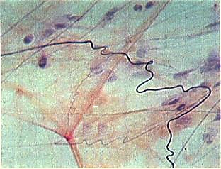
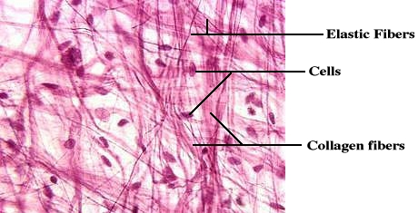
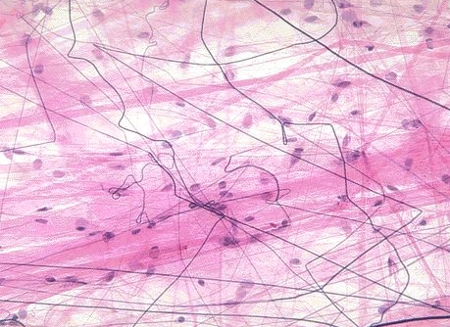
Loose Connective Tissue (Areolar)
Gel like ground with both elastic and non-elastic fibers running though the ground in many directions.
  Wraps and cushions organs
  Under the skin

Slide 22
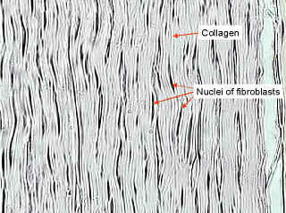
Dense (fiber)Regular Connective Tissue
Nuclei and fibers arranged in parallel rows.
  Tendons and ligaments
  Fibers mostly non-elastic

Slide 23
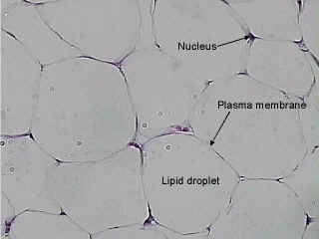
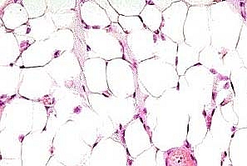
Adipose (Fat)
Function as storage cells for adipose (lipids)
Adipose cells contain a large vacuole which in the live cell contains lipids.
Cell nucleus and cytoplasm are pushed out to edge of cell membrane.

Slide 24
Cartilage
Ground of matrix is gum like.
Cells are found in Lacunae within the matrix.
Fibers may be elastic or non-elastic, or a form of non-elastic called reticular(where the non-elastic fibers of very thin)
  Hyaline Cartilage-example on the ends of bones
  Elastic Cartilage- example ear cartilage
  Non-elastic Cartilage- example nose cartilage.

Slide 25
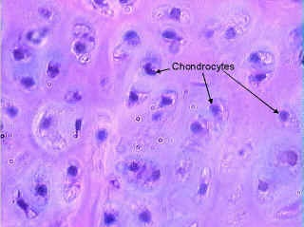
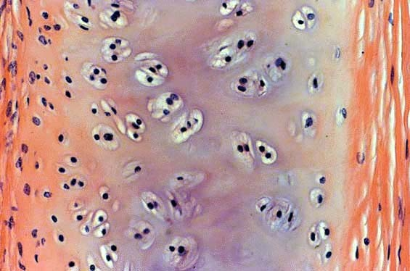
Hyaline cartilage

Slide 26
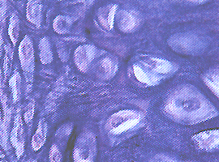
Elastic Cartilage

Slide 27
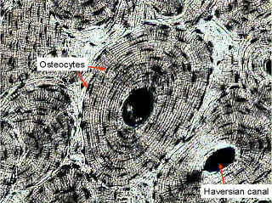
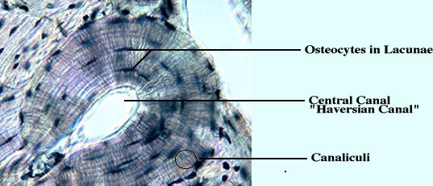
Bone
  Ground of matrix is Solid (Calcium carbonate).
  Has blood supply and nerves running through the Haversian canal systems.
Bone, dry ground human c.s. X 100

Slide 28
Vascular Tissue (Blood)
Liquid matrix = plasma
  90% water
  10%Plasma proteins, electrolytes, hormones, oxygen, glucose etc.
Formed elements
  Erythrocytes -48billion(female) to 54 billion (male) cell / ml of blood in humans. Mammals are enucleated while rest of the vertebrates they have nuclei
  Leukocytes -about 7.5 million / ml of blood
  Platelets -blood clotting

Slide 29
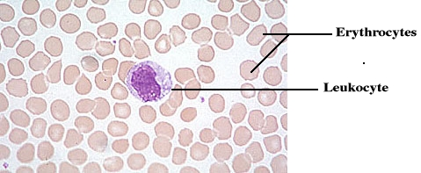
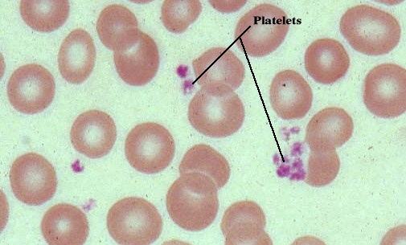
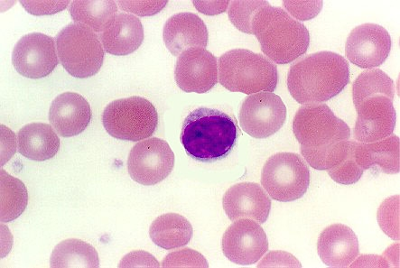
Blood

Slide 30
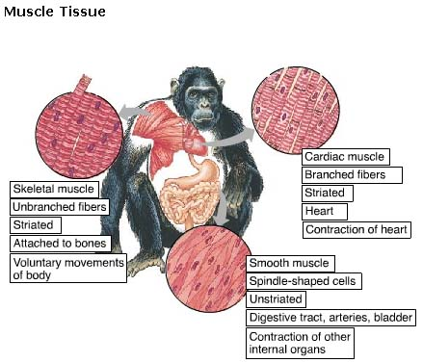
Muscle Tissue
(Movement)
Composed of long cells called muscle fibers
Contraction → movement

Slide 31

Muscle Tissue
Tissue with cells having fibers specialized for contraction.
  Skeletal Muscle (Striated, voluntary)
    Parallel elongated cells (fibers)
    multinucleated and each cell is the length of the muscle.
    Light meat, Dark meat—Slow twitch, fast twitch muscle
  Smooth Muscle (Visceral, involuntary)
    Cells are long and tapered.
    Organized into sheets of muscle.
  Cardiac Muscle
    Intercalated disc
    Myogenic
    branched

Slide 32
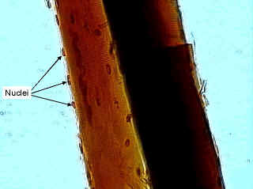
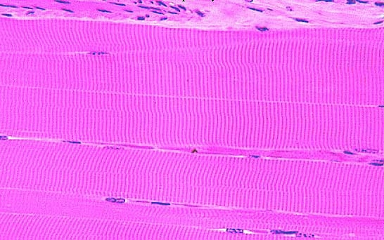
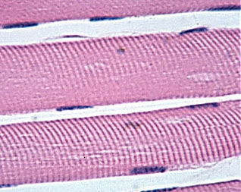
Skeletal Muscle

Slide 33
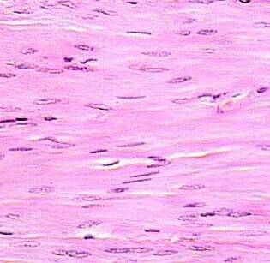
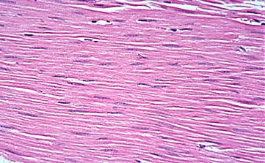
Smooth Muscle

Slide 34
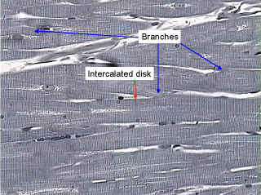
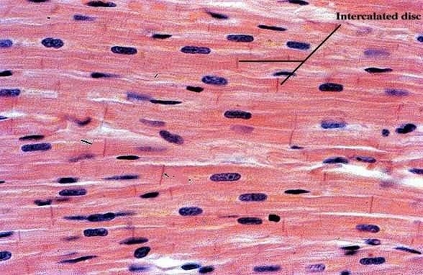
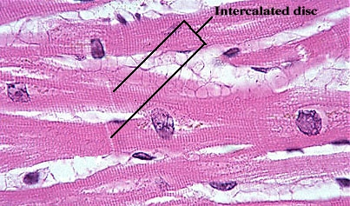
Cardiac Muscle

Slide 35
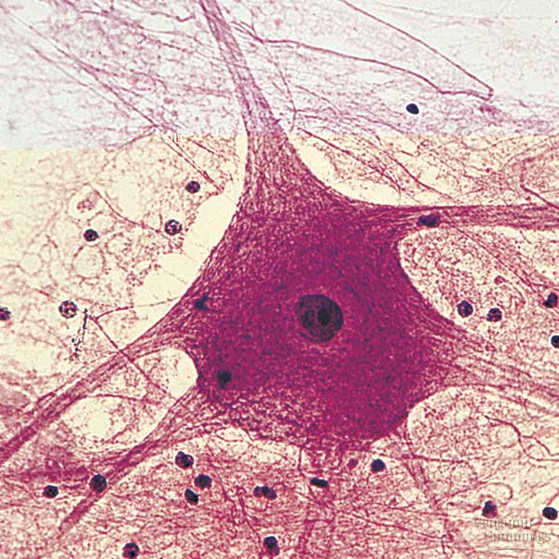
Nervous tissue (Control)
Senses stimuli and transmits signals called nerve impulses from one part of an animal to another
Consists of a cell body and long extensions called dendrites (towards cell body) and axons (towards another cell or an effectors)
Axon
Dendrite
Cell body

Slide 36
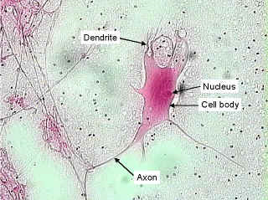
Nervous Tissue
Cells specialized to polarize and depolarize.
Cell is a neuron
Motor Neuron X 200

Slide 37
Tissue Type | Epithelial | Connective | Muscle | Nerve
Cell Shape | Flattened, cuboidal, columnar | Irregular or round | Elongated | Cell appendages branched
Cell Arrangement | Single → multilayered | Scattered in matrix | In sheets or bundles | Isolated or networked
Location | Body covering or lining organs or cavities | Supports other organs | Lining internal organs, make skeletal muscles | Concentrated in brain and spinal cord + all over the body
Surface Feature of Cells | Cilia, microvilli | - | - | -
Matrix Type | Basement membrane | Varied – protein fibers + liquid, gelatinous, firm to calcified | - | -
Matrix Amount | Minimal | Extensive | Absent | Absent
Unique Feature | No direct blood supply, except for glands | Cartilage has no blood supply | Can generate electrical signals, force and movement | Can generate electrical signal

Slide 38

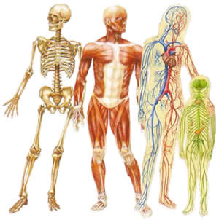
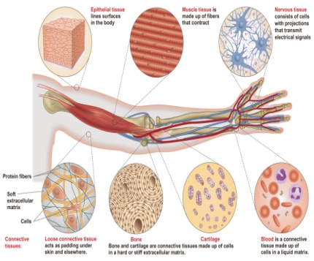


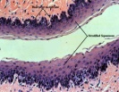
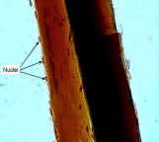
Make Your CONCLUSION!!
Mention the kinds of
animal tissues
The Function of Animal Tissues
Differences of Animal Tissues

Slide 39
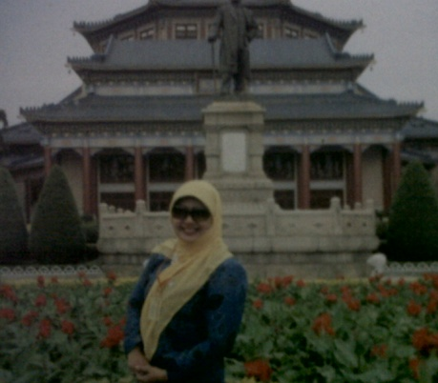
Thank You!
Our Next Meeting: About Cancer
Don’t Forget to Study!

