Slide 1
Setting Goals
SIP #1 – 11/14/19
Speaker: Pam Spinks
Director of Professional Development
1-800-234-9461 pspinks@omag.org
Notes:
Key Concept: Continuous Improvement!
Could equal = Continued Employment…

Slide 2
“Without goals and a plan to reach them, you are like a ship that has set sail with no destination.”
Notes:
Goals are objectives, plans and targets that you expect to achieve.
Without goals:
You can lose focus and energy,
You may not achieve your goals, and
You can waste your time and efforts.
In your life and work, success begins with goals.
Setting goals may be new for you, or you may have set and achieved them in the past.
Do you operate in Crisis Mode Only?
Who keeps a List?
Key Concept: Continuous Improvement!

Slide 3
Setting clearly defined goals can:
_{Give you focus}
_{Help you measure your progress}
_{Provide motivation to achieve}
Help you achieve more and fulfill your potential
_{Promote teamwork}
_{Increase morale}
_{Improve your self-confidence}
Increase your satisfaction with your job performance
Notes:
In this course, we will discuss the benefits of goal setting, how to create SMART goals using the SMART technique, and how to monitor those goals.
Using proven goal setting techniques can help you systematically plan, pursue, and move toward growth and positive outcomes in both your career and personal life. (It can also help you develop your subordinates when you develop goals with them, too. PS)
When you set and achieve your goals, you can see your accomplishments and your potential capabilities!
-----------------------------------------------
Video in LocalGovU course: Ted Talk, 4/19 Vancouver John Doerr 11:35 min.
John says: What you know doesn’t Matter. Execution Matters. Objectives & Key Results It’s all about excellent Execution..

Slide 4
Intro to SMART Goals https://www.youtube.com/watch?v=XpSOb5q1cRo
Notes:
Introduction to SMART Goals which is a step up from your To-Do-List.
Charles Duhigg - How to write SMART goals - https://www.youtube.com/watch?v=XpSOb5q1cRo
•Jan 29, 2018
2.13 Min.
It can be overwhelming to write a big goal on your to-do list. When you do, make sure you break those goals down into SMART goals: Specific, Measurable, Achievable, Realistic, and Time-bound. Once you do that, Charles Duhigg says, your productivity will skyrocket. Charles Duhigg is a Pulitzer-prize winning reporter and the author of Smarter Faster Better, about the science of productivity, and The Power of Habit, about the science of habit formation in our lives, companies, and societies. http://www.amazon.com/insights/charle... http://www.amazon.com/insights #DayOneInsights #entrepreneurship
SHOW MORE
2

Slide 5
Planning to Set Goals
Most important part of goal setting occurs before you ever start planning and implementing your goals?
Start by asking yourself questions:
What
Why
When
Who
How
Notes:
Did you know that perhaps the most important part of goal setting occurs before you ever start planning and implementing your goals?
This is when you take the time to evaluate and ask yourself,
“Why do I need to make a change, and how badly do I want it?”
As we all know, even the best plans are likely to fail without the appropriate motivation to do what it takes to see things through.

Slide 6
There are several reasons why effective goals motivate us:
They give us direction. A goal tells you what to focus on.
They energize people and tell them not to stop until the goal is accomplished.
They present a challenge. We feel a sense of accomplishment when we reach our goals.
They urge us to think outside of the box and rethink how we are working.
Notes:
PLUS - Value to you and to you as a Supervisor:
To have the best chance for success, your goal needs to hold something of value for you.
The key is to generate some of your own personal reasons to accomplish the goals set for you.
These reasons may include:
Earning the approval of your manager or supervisor
Receiving recognition by your organization
Being promoted
Earning salary increases

Slide 7
Have you ever watched a racing scull glide across the surface of a lake or river? The speed and precision that the crew is able to achieve is the result of one very basic principle: Everybody is rowing together in the same direction.
Notes:
Have you ever watched a racing scull glide across the surface of a lake or river? The speed and precision that the crew is able to achieve is the result of one very basic principle: Everybody is rowing together in the same direction.
Just like each member of the racing crew needs to time his or her rowing strokes in order to be in sync with teammates, so should every work goal you set be tied to the overall plan of your municipality.
No one is Irreplaceable,
No one is Indispensable!

Slide 8
Is your team rowing together in the same direction?
To do this, it is important that you:
Have a clear understanding of your city or town’s objectives – Be sure that you’re clear on what your city of town’s goals and vision for success are and that you align your goals with those objectives. Know how your job fits in with the “Big Picture.” Setting goals should always be a collaborative process between you and your supervisor.
Communicate with your supervisor to make sure you progress in the right direction – You may start in the right direction, but it is easier than you think to get off course. Review your goals with your supervisor regularly.
Monitor your activities – Don’t wait for someone else to tell you that you’re off course. Be sure that your efforts are moving in the same direction as the organization.
Notes:
Is your team rowing together in the same direction?
To do this, it is important that you:
Have a clear understanding of your city or town’s objectives – Be sure that you’re clear on what your city of town’s goals and vision for success are and that you align your goals with those objectives. Know how your job fits in with the “Big Picture.” Setting goals should always be a collaborative process between you and your supervisor. (And between you and your subordinates… PS)
Communicate with your supervisor to make sure you progress in the right direction – You may start in the right direction, but it is easier than you think to get off course. Review your goals with your supervisor regularly.
Monitor your activities – Don’t wait for someone else to tell you that you’re off course. Be sure that your efforts are moving in the same direction as your city or town.

Slide 9
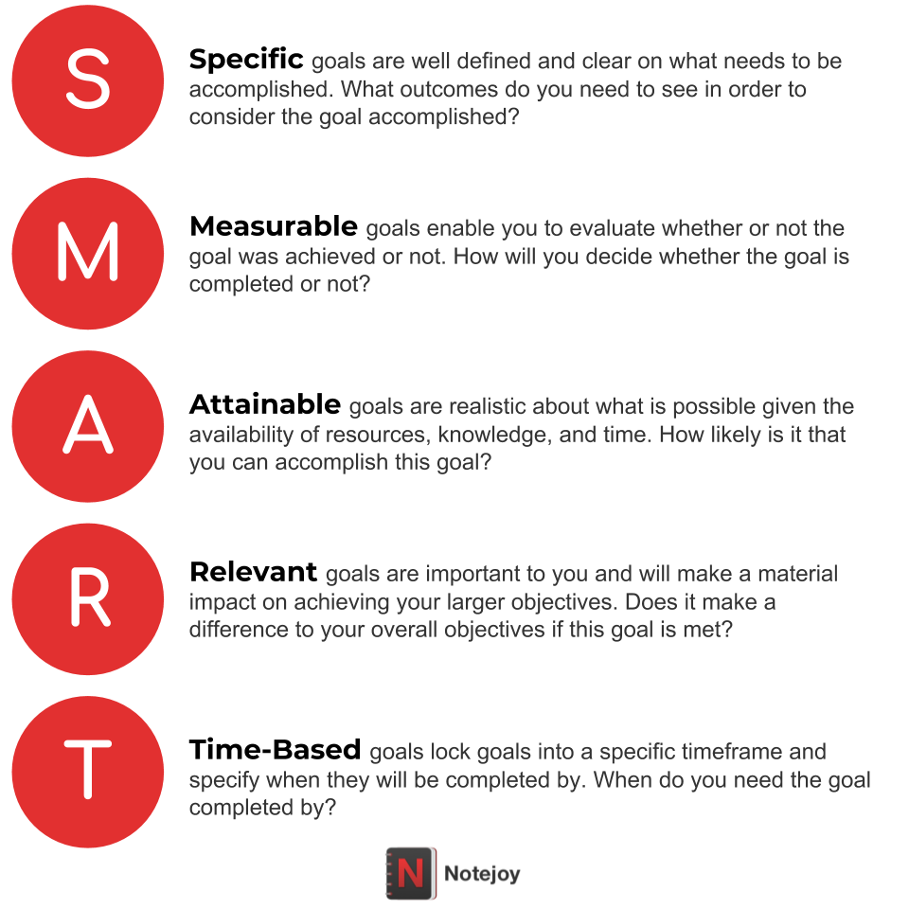
SMART Goals
Notes:
Determining effective goals can be a complex process. I recommend SMART Goals. If you want goals with substance that will help you achieve your overall objectives, here are a few things to remember when using the SMART technique.

Slide 10
https://www.youtube.com/watch?v=vKMrWsjUOZQ
Notes:
From LocalGovU Course:
In this video, we will walk through a quick animation that describes and defines SMART goals. Before you begin, think about a goal you have had for years that you have never seen through. Think about how you can apply the concept of a SMART goal to achieve it!
“Thinky Pinky” – I did not like their video.
_______________________________________
Message: Don’t Play the Game “Bring me a Rock!”
Video: Setting SMART Goals - https://www.youtube.com/watch?v=vKMrWsjUOZQ
3.38 Min.
•Apr 6, 2010
Speaker: Ed Muzio
http://www.groupharmonics.com - Ed Muzio explains the SMART criteria for setting actionable goals. Are your business goals Specific, Measurable, Attainable, Relevant, and Time-Bound? If so, you're a lot more likely to accomplish them. If you're a leader, manager, supervisor, or project manager, make sure you understand and follow the SMART acronym for goal setting. Your employees' output - and your own - will be much better off!

Slide 11
Are these good goals?
Ensure that all work is done properly.
Arrive on-time for work.
Improve work productivity.
Review and update the safety policy.
Do the performance reviews for my staff.
Prepare the Department Budget.
NO – It’s a nice Wish List…
Notes:
Are you playing the game: Bring me the Rock?

Slide 12
WHY... do most New Year’s Resolutions fail?
The resolutions are not SMART goals.
Resolution: This year, I will lose weight and get in shape.
SMART Goal: In January, I will lose 10 pounds by keeping a daily food diary and exercising 3 times each week.
Goals MUST be written down.
Notes:
From LocalGovU course:
“Think about the millions of New Year’s resolutions that never see the light of day!”
A goal is something that must be stated in very specific terms in order to achieve the desired outcome. Vague goals are very difficult, if not impossible, to attain.
Once a goal is created, you must ask yourself the following questions to help you create strategies for accomplishing that goal:
Who is going to need to be involved in achieving this goal? – Are you going to need the help of others? Whose help do you need?
What are you going to do? – Use action words such as increase, direct, organize, coordinate, lead, develop, plan or build to describe the process you will be using to achieve the desired results.
Why is this important to do at this time? – What are the factors involved that make it important to achieve the desired results at this specific point in time?

Slide 13
Example of an individual goal: Review & Update the department’s policies & procedures
SMART Goal for You:
By May 1st, I will have reviewed and updated the first 3 sections of the department’s policies & procedures.
SMART Goal For your Employees:
Matt: By April 1st, update the first section and return final draft to me.
David = 2nd Section
Terry = 3rd Section
Notes:
Long term goal: Build Budget for next fiscal year.
Goals to Department heads. Set time limits and ask for information on line items budgets and any ‘New” line items.
Short term goals: Set goals months ahead to get Department heads started building their budgets.

Slide 14
Example of a team goal:
Patch 30 potholes per week.
Collect and forward data for monthly reports by the 10th of the month following the month of the report.
Pay all accounts payable within 60 days.
Complete all police reports within 24 hours.
Complete 30 building safety inspections per month.
Schedule speakers at the Library for the next calendar year.
Notes:
Per Pam: A good way to get your direct reports started achieving goals is to set short-term goals working from a list like this for your department.
You might start the Goal Setting process with a list like this that is specific to you and your team.
Are these “measurements” reasonable in these team goals?

Slide 15
It’s your turn!
Pair up with someone.
2. Write two (2) SMART goals for yourself or one or more for your direct reports.
Be prepared to share your goal….
Are you sure it’s a SMART Goal?
Notes:
Show the SMART Goals Worksheet on the next slide…
Group Work.
Write goals you can take back with you and apply today.
Be prepared to share your goals with the group.

Slide 16
See Goals Worksheet provided.
NAME: ________________________ | Setting S.M.A.R.T. Goals |  |  | DATE: __________________
1) SPECIFIC | 2) MEASURABLE | 3) ATTAINABLE | 4) RELEVANT | 5) TIME-BOUND | COMMENTS
Goal (Be Specific) | How will you measure the outcome? | The measurement should be a "stretch" goal, but realistic. | Why do this project? What does it accomplish for the Dept? | Set a deadline to finish or check points along the way | (Follow-up notes)
Notes:
See Goals Worksheet.

Slide 17
It’s your turn!
Pair up with someone.
2. Write two (2) SMART goals for yourself. (or one or more for your direct reports)
Be prepared to share your goal….
Are you sure it’s a SMART Goal?
Notes:
Show the SMART Goals Worksheet on the next slide…
Group Work.
Write goals you can take back with you and apply today.
Be prepared to share your goals with the group.

Slide 18
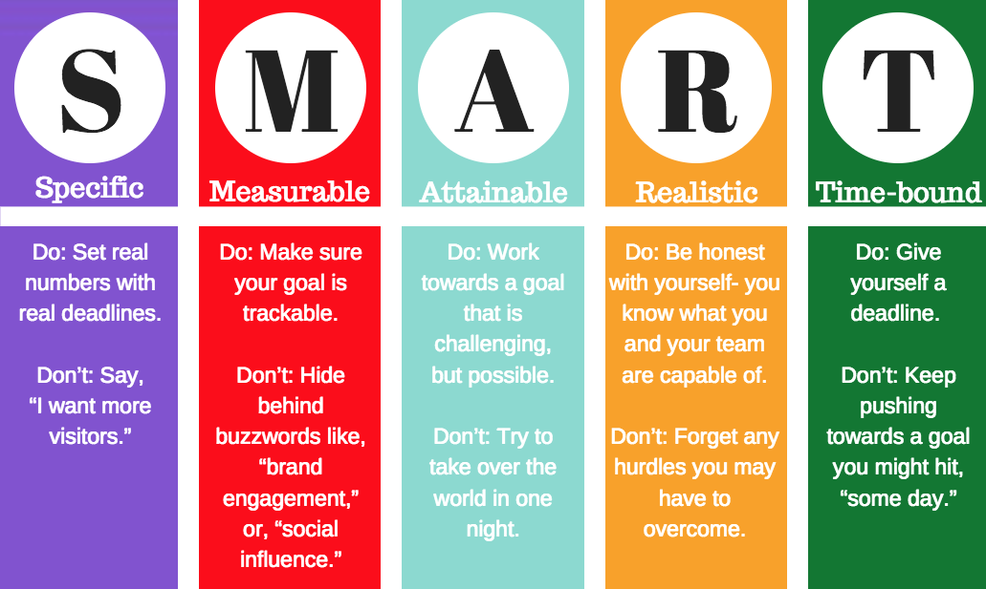
Notes:
Here is a reminder of what the Acronym SMART stands for. Refer to this as you complete your worksheet.

Slide 19
Guidelines to select the right goals
Pick two to three goals to focus on.
You can’t do everything at once, neither can your employees.
Pick the goals with the greatest relevance. Focus on the goals that tie most closely to your city’s (or department’s) mission.
Periodically revisit the goals and update them as necessary. (Daily is good.)
Make Notes throughout the Year…
Notes:
Pick two to three goals to focus on.
You can’t do everything at once, neither can your employees.
Pick the goals with the greatest relevance.
Focus on the goals that tie most closely to your organization’s (department’s) mission.
Periodically revisit the goals and update them as necessary. (Daily is Good…)

Slide 20
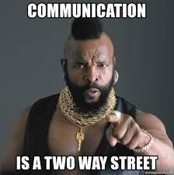
Setting Goals with your employees
Make sure the goals are written down.
Always have one-on-one, face-to-face meetings with your employees to introduce, discuss and assign goals.
Gain the commitment of your employees to the successful accomplishment of their goals.
Call your team together to introduce team-related goals.
Agreement = Buy-In
Notes:
Communicating to your employees
Make sure the goals are written down.
Always have one-on-one, face-to-face meetings with your employees to introduce, discuss and assign goals.
Gain the commitment of your employees, individually or on teams, to the successful accomplishment of their goals.
Call your team together to introduce team-related goals.
After employees embark on goals, regularly monitor their progress to ensure that they’re on track and help them overcome any problems. [Have them report to you.]

Slide 21
Short Term Goals, too
Goals should be set to move you toward an end result. To ensure that this happens, it is critical that you create both short-term and long-term goals.
The benefit to setting short-term goals you can accomplish along the way (usually in the near future) is increased reward and motivation. They help you reach long-term goals one step at a time. They should complement and reinforce your long-term goals.
You should review your goals regularly, even daily, to stay focused on the correct path.
Notes:
It is important that you put your goals in writing. Writing out your goals demonstrates your commitment to achieving them.
Each goal should be broken down into bite-sized tasks that will help you meet the goal. Not only does this make the tasks easier to complete, but there is also a sense of accomplishment each time you check off a task from your list. You should also track your goals by keeping strong documentation of your progress toward each goal to show your manager how and when each task was accomplished.
________________________________
Goals should be set to move you toward an end result. To ensure that this happens, it is critical that you create both short-term and long-term goals.
The benefit to setting short-term goals you can accomplish along the way (usually in the near future) is increased reward and motivation. They help you reach long-term goals one step at a time. They should complement and reinforce your long-term goals.
You should review your goals regularly, even daily, to stay focused on the correct path.

Slide 22
Continuous Improvement
Goals are the means of growth and improvement. Well-planned and executed goals are more likely to succeed. Some important aspects of goal setting at work are:
Building motivation and self-efficacy
Tying goals to those of your organization
Developing SMART goals
Setting short-term and long-term goals
Writing them down
Assessing resources
Making time to plan and implement
Reviewing
Don’t be afraid to modify your goals when needed. The modifications may allow greater success in the end.
Notes:
Every day should start with a quick review of your goals. This will help focus energy toward the actions you need to take to reach your target.
If you are reluctant to review your progress each day (or at least regularly), chances are you have set the goal too high, or your motivation is low. This is important information. You may need to back up and review your goals and your reasons for pursuing them.
You should meet regularly with your supervisor or manager to review your goals and discuss your progress. During these meetings, you can discuss any difficulties you may be having with your progress. It is normal to find that goals and strategies may need to be revised along the way. Perspectives or company objectives may change as you encounter results you did not expect.
Don’t be afraid to modify your goals and strategies, if needed. The modifications may allow greater success in the end.

Slide 23
https://www.youtube.com/watch?v=aVstw9HYl-o
Notes:
To get better at Goal Setting, you will have to PRACTICE. Google articles on this topic. There are thousands of them…
Closing for Goal Setting – SIP #1 – 11/14/19
https://www.youtube.com/watch?v=aVstw9HYl-o
Video: Five Rules of Goal Setting: How to set SMART, Motivating Personal Goals
•Dec 22, 2014
2.39 Min.
Mind Tools Videos (Skip article referred to…)
Find out more about goal setting at: https://www.mindtools.com/goal-rules Do you know what you want to achieve by the end of the day? What are your work objectives for the year

Slide 24
Remember, most of the time you know more about the city’s business than anyone else . . .
--whole--
Notes:
Closing thoughts… Goal Setting will build your confidence with each goal met…

