Slide 1
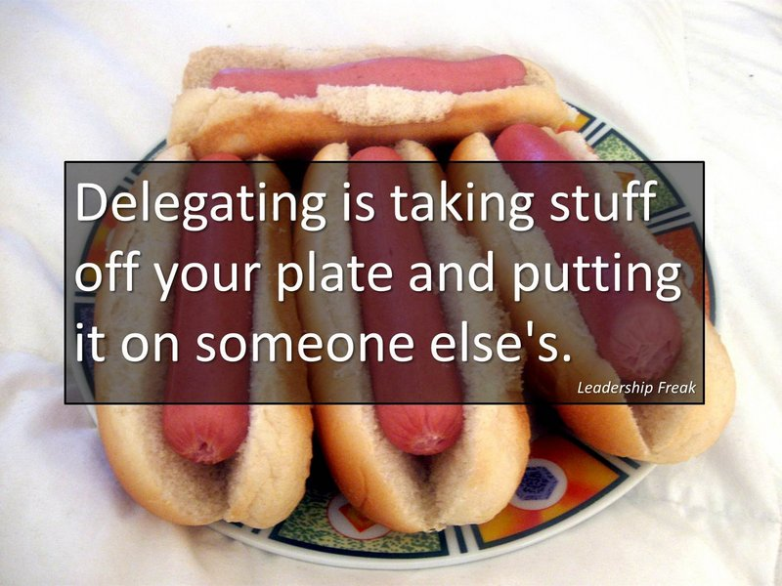
Delegating
Training for Supervisors
SIP #4
•
Notes:
"Never tell people how to do things. Tell them what to do and they will surprise you with their ingenuity." --General George Smith Patton, Jr.
"The best executive is the one who has sense enough to pick good men to do what he wants done, and self-restraint enough to keep from meddling with them while they do it." --Theodore Roosevelt
No person will make a great business who wants to do it all himself or get all the credit.
Andrew Carnegie

Slide 2
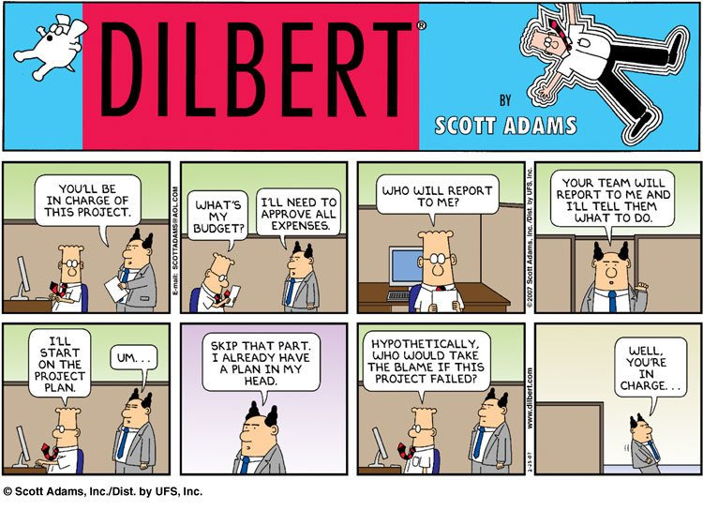

Slide 3
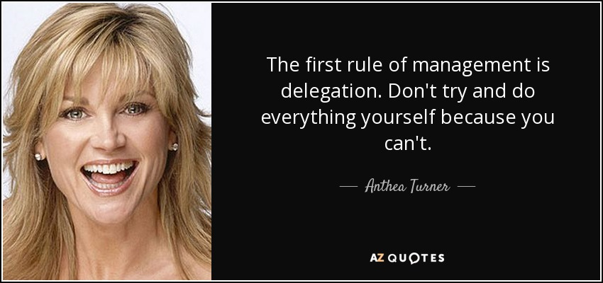
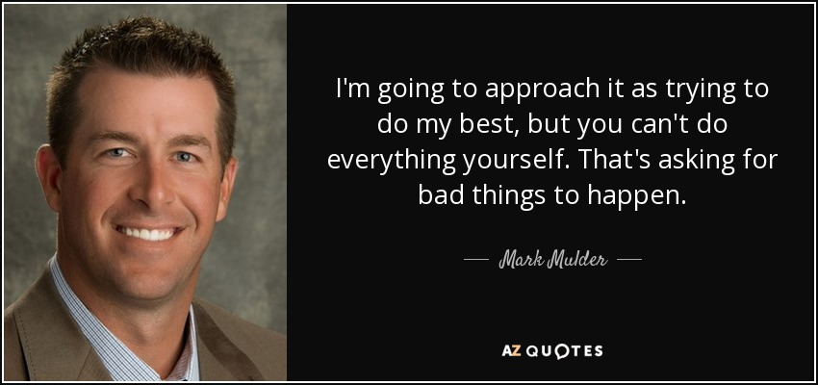

Slide 4
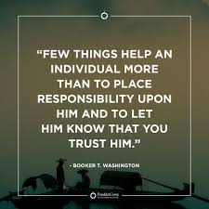

The inability to delegate is one of the biggest problems I see with managers at all levels. Eli Broad
Notes:
“Delegating work works, provided the one delegating works, too.” Robert Half, American Businessman
Successful managers with varying years of experience and at all levels of management recognize the accuracy of this statement. Faced with demanding workloads, they delegate authority to their employees. They work diligently to make sure their employees are capable of handling increased responsibility and duties and do so successfully. Effective delegation results in better trained employees, increased productivity, more motivated staff and improved retention. From SHRM

Slide 5

https://www.youtube.com/watch?v=cjlvoYPDy74

Slide 6
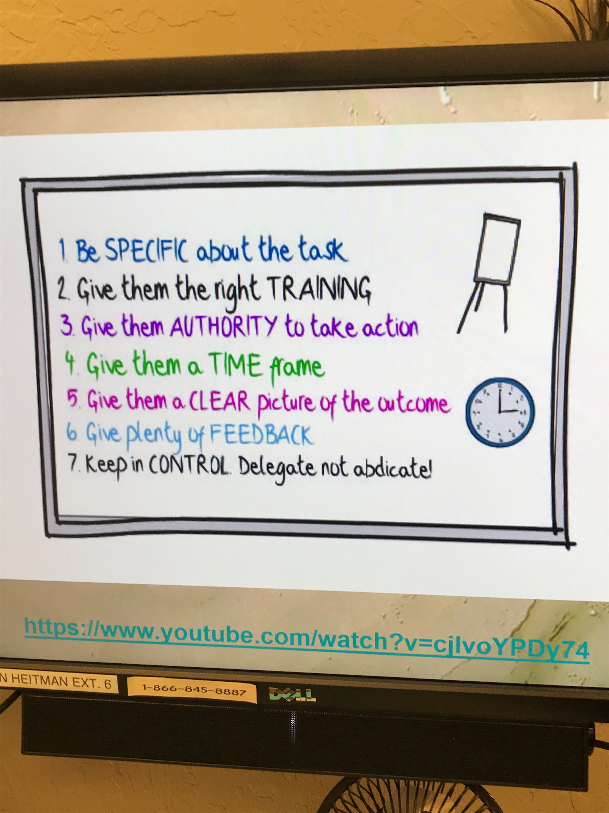

Slide 7
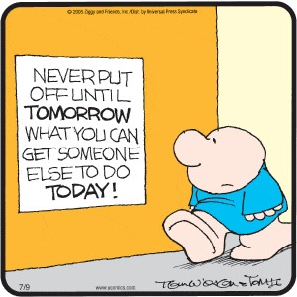
What Is Delegation?
Delegation is used to develop employees by increasing their responsibilities and instilling accountability.
Effective delegation helps to identify what others can do – if given the chance.
Notes:
Anyone who has every managed people or projects, understands the importance of good delegation skills.
Effective delegation is built off of strategy and forethought.
Leaders who delegate effectively understand the importance of knowing the people they work with.
In other words, it is important for leaders to be able to reasonably predict how another person will perform the same task as they would.
Delegation is used to develop employees by increasing their responsibilities and instilling accountability. Effective delegation helps to identify what others can do – if given the chance.

Slide 8

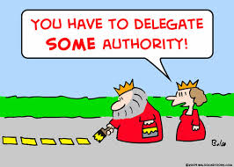
Reasons for Delegating
Frees your time to do more important items
Develops (cross trains) employees
Increased productivity
Holds employees accountable
Succession Planning
Notes:
Reasons for Delegating:
Effective delegation saves management time.
It results in better-trained employees, increased productivity, more motivated staff and improved retention.
Managers delegate:
To have work done by subordinates
Managers must be sure that employees:
Know what the manager wants
Have the appropriate authority
Know how to perform the work
To provide employee development
Employees who receive designated work gain valuable experience, knowledge and an opportunity for professional growth
Managers must devote significant amounts of time and energy to be sure employees succeed when the purpose of delegating is to provide career development.

Slide 9
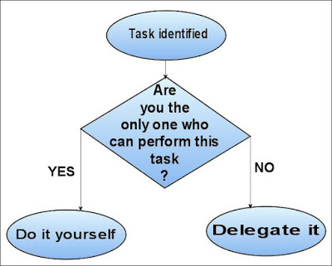
Notes:
Simplest Delegation Flow Chart.

Slide 10



Slide 11
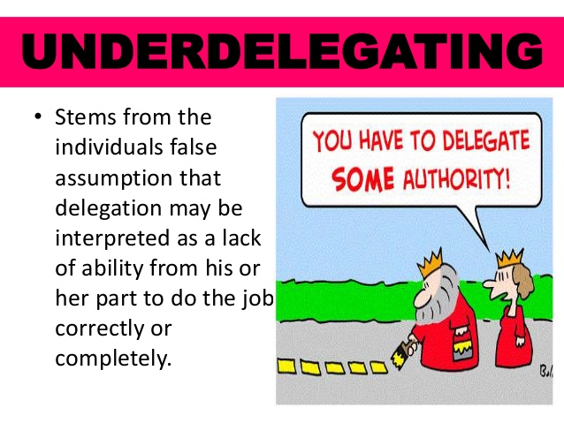
Notes:
Do you Agree with this statement

Slide 12
Myths about Delegation
Myth #1 – You can’t trust your employees to be responsible.
Myth #2 – When you delegate, you lose control of a task and its outcome.
Myth #3 – You’re the only one who has all the answers.
Myth #4 – You can do the work faster by yourself.
Notes:
#1 – If you can’t trust your employees, whom can you trust? Were you involved in the hiring? You selected the employee. To get responsible employees, you have to give responsibility.
#2 – If you delegate correctly, you don’t lose control of the task or its outcome. What you lose control of is the way that the outcome is reached. You need to let go of controlling the HOW and instead focus on the WHAT and the WHEN.
#3 – Really? Your employees are a wealth of experience and knowledge of day-to-day operations. Don’t ignore this resource. You’re paying for it, use it!
#4 – This is an Illusion. What happens when you don’t delegate, you are forever doomed to doing the task

Slide 13
Myths (continued)
Myth #5 – Delegation Dilutes your authority.
Myth #6 – The city recognizes your employees for doing a good job and not you.
Myth #7 – Delegation decreases your flexibility.
Notes:
#5 – It does the opposite, it extends your authority. The more authority you give to employees, the more authority your entire work unit has. As you grant others authority, you gain an efficient and effective workforce. You can focus on the issues that deserve your undivided attention.
#6 – Your job is to reach overall organizational or project goals through the efforts of others. Wise managers know that when their employees shine, they shine, too. When they do well, tell everyone about it. You are being primarily measured on your team’s performance.
#7 – The more people you delegate to, the more flexible you can be. Let your employees deal with the day-to-day, you deal with the “surprises”.

Slide 14
Myths (continued)
Myth #8 – Your employees are too busy.
Myth #9 – Your workers don’t see the big picture.
You have to trust your employees.
Notes:
#8 – This is a cop out! Are your employees to busy to learn something new, something that can make your job easier and boost the performance of your work unit, all at the same time? Satisfaction comes from taking on new challenges, for you and for your employees.
#9 – You need to share the big picture with your employees. Your job is to provide your employees with a vision of where you want to go and the priorities of what needs to be achieved, and then allow them to find the best way to attain those goals.
YOU HAVE TO TRUST YOUR EMPLOYEES. When you delegate tasks, you don’t automatically abdicate your responsibility for their successful completion .

Slide 15

5 Steps to Effective Delegation
Notes:
1. Know Your Employees
It is important to pay attention to the skill set and how well employees perform. Pay attention to things like verbal and written communication skills, problem solving skills, social skills, organizational skills and negotiating skills.

Slide 16
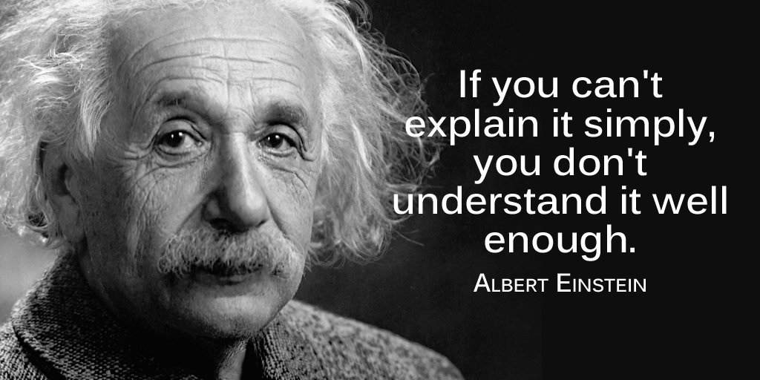
5 Steps to Effective Delegation
2. Explain The Task
Notes:
2. Explain the Task
When delegating a task, especially the first few times, help the employee think through the necessary steps to accomplish the assignment. Guide them through the process and then let them go.
For instance, if you are delegating supervisory responsibility to an employee, have coaching sessions with the employee and talk them through the important steps of managing employees.

Slide 17
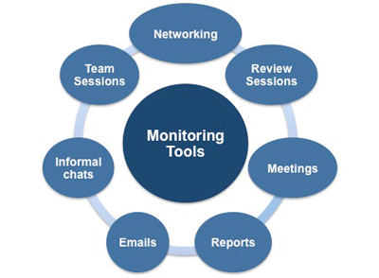
5 Steps to Effective Delegation
3. Monitor the Tasks
Notes:
3. Monitor The Tasks
When you first delegate tasks to others it is important to monitor how the employee is performing the task so that you can make needed changes or adjustments. Monitoring also helps identify any issues that may arise. Such as, the need for additional resources, task capability, etc..

Slide 18

5 Steps to Effective Delegation
4. Coach the Employee
Notes:
4. Coach The Employee
Give the employee feedback as they perform the task and take the opportunity to teach or enlighten the employee as needed. This coaching opportunity can help develop other leadership competencies.
For instance, let’s say you delegated the responsibility of planning the annual staff picnic. The employee planned the picnic but went over budget. This is a great time to teach them the discipline of budgeting limited resources.

Slide 19
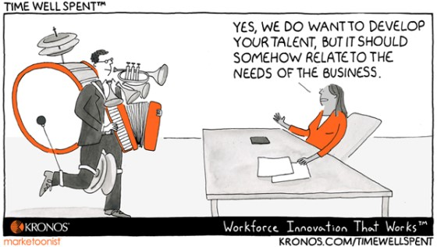
5 Steps to Effective Delegation
5. Develop The Employee
Notes:
5. Develop The Employee
As the employee demonstrates the ability to perform delegated tasks, increase their responsibility.
Keep in mind that not all employees will have the ability to take on more responsibility.
Some employees have a limit as to how much they can handle without it affecting their stress level. That is OK.
Target those employees who have the capacity, willingness and interest in growing and help them increase responsibility.
This offers them new and interesting responsibilities and allows you to focus on higher level tasks.

Slide 20
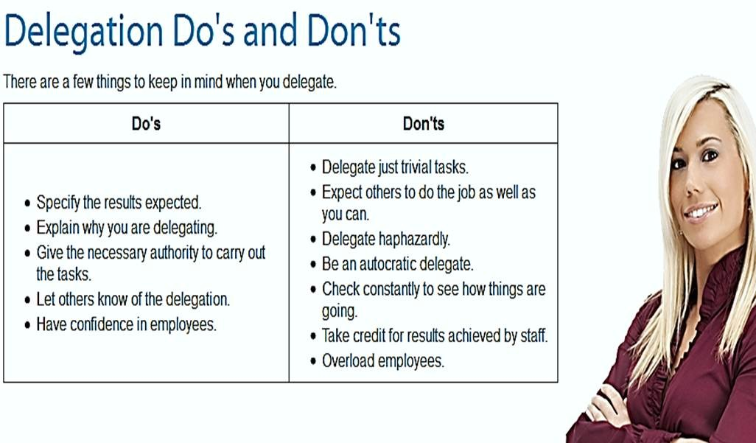

Slide 21
What Can and Cannot Be Delegated
Managers may delegate whenever they need something done by their employees and it is appropriate for their employees to complete the task or project.
Never Delegate:
Disciplining your employees
Writing your Departmental Goals
Performance Appraisals
Coaching Conversations
Confidential Tasks
Notes:
What Can and Cannot Be Delegated
Managers may delegate whenever they need something done by their employees and it is appropriate for their employees to complete the task or project.
Consider for delegation:
Any activity you used to do before being promoted to management--if you have an employee reporting to you who can do this activity now.
Tasks in which your employees have more experience than you.
Making decisions on matters that are especially important to your employees, such as rest and meal periods or team-building activities and meetings.

Slide 22


Reasons Delegation Fails
Lack of TOP management support
Failure to plan
Notes:
The main reasons delegation fails are:
Lack of TOP support – City Manager/Department Head must not only recognize the importance of delegation and support it, but must also be willing to delegate to top management team members.
Failure to plan – Managers often think it is easier to do work themselves instead of taking the time to review all their activities and determine which ones may be delegated to save their time and to help employees learn and develop.

Slide 23
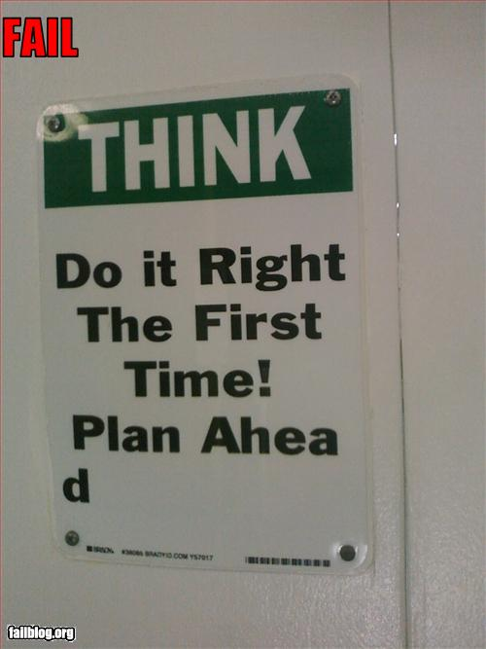
Why is it we always have time to do it over if it isn’t Right!

Slide 24
Effective Monitoring
Tailor your approach to the employee.
Diligently use a written or computer-based system for tracking the tasks that you assign to your employees.
Keep the lines of communication open.
Follow through on the agreements that you make with your employees.
Reward performance that meets or exceeds your expectations, and counsel performance that falls below your expectations.
Notes:
Effective Monitoring
Tailor your approach to the employee.
Diligently use a written or computer-based system for tracking the tasks that you assign to your employees.
Keep the lines of communication open.
Follow through on the agreements that you make with your employees.
Reward performance that meets or exceeds your expectations, and counsel performance that falls below your expectations.

Slide 25
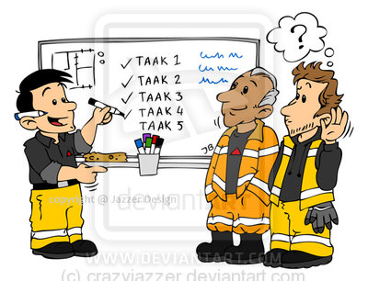
You can delegate authority, but you can never delegate responsibility for delegating a task to someone else.
If you picked the right man, fine, but if you picked the wrong man, the responsibility is yours -- not his. Richard E Krafve
Notes:
You can delegate authority, but you can never delegate responsibility for delegating a task to someone else.
If you picked the right man, fine, but if you picked the wrong man, the responsibility is yours -- not his.
Richard E. Krafve:
Was Vice President, Ford Motor Company
General Manager, Edsel Division, he helped develop the new Ford production organization, including the expansion and decentralization of company-wide manufacturing operations.

Slide 26
Delegation is the #1 skill to make effective use of your time AND to develop your employees!
Effective delegation saves management time and results in better-trained employees,
increased productivity,
more motivated staff and
improved retention.
Managers delegate to have work done by subordinates and to provide employee development.
Notes:
PS: Delegation is #1 Skill to make effective use of your time AND to develop your employees.
Effective delegation saves (YOU) management time and results in better-trained employees, increased productivity, more motivated staff and improved retention. Managers delegate to have work done by subordinates and to provide employee development.

Slide 27

Managing the Monkeys! https://www.youtube.com/watch?v=kRrXp-pLrWA
Notes:
https://www.youtube.com/watch?v=kRrXp-pLrWA

Slide 28
Delegate to get
the Monkey
Off Your Back
Watch out for Reverse Delegation!
Simple Rule: Delegate when you need something done and when someone else can do it.
Notes:
Delegate to get
the Monkey
Off Your Back

Slide 29
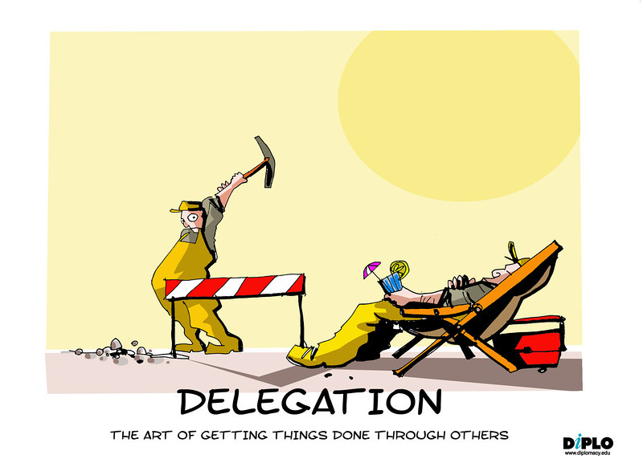
This is NOT Delegation…

