Slide 1
an introduction to Visual Analytics for Complex Network Systems
“The computer is incredibly fast, accurate, and stupid. Man is unbelievably slow, inaccurate, and brilliant. The marriage of the two is a force beyond calculation.”
– Leo Cherne (?)
Marcus Thiébaux
@ ISI/USC
2011

Slide 2
i. Exemplary problem DNS cache poisoning attack
A. Hussain, A. Viswanathan:
Multiresolution Semantic Visualization of Network Traffic
10.1.6.3
Real-NS
2
7
10.1.4.2
Victim-NS
1
3
4
5
6
8
9
network context
10.1.11.2
Attacker
Can we generate a meaningful drawing, showing semantically enhanced event traces in context?
Can we define a model for interactive exploration of this data to facilitate analytic discovery of novel events?
Does the method scale to ever larger networks?

Slide 3
DNS-CPA visualization
Challenges
Scalable network representations
Require collapsible hierarchical representations
Graph complexity aggregation methods
Temporal data
Require methods to encode concurrency, causality, ordinality…
Timelines add a whole new dimensional requirement
High-dimensional message structures & transactions
Require clever mappings of parameters to display elements
LOD, retaining key semantic information
Evaluation
How do we know visualization is useful, effective, reliable, honest?
HCI, requirements analysis
A job for
Visual Analytics…

Slide 4
ii. What is VA? Some definitions
Data Visualization
Concerned mainly with meaningful rendering of spatial data
Obvious/intrinsic representation of spatial/temporal phenomena
Information Visualization
Concerned with representing data with no intrinsic/ideal spatial organization (structured but abstract), for rendering
Apply meaningful clustering/spatializing heuristics
Map to dimensional models, glyphs, colormaps
Visual Analytics
Concerned with using visual tools [above] for analytic reasoning, in complex and data-rich problem domains (Thomas 2005)
Supporting real-time decision making: human in the diagnostic loop
HCI, Interaction, perception characteristics, visual impedance matching, cognitive efficiency, tool generality/specificity, evaluation

Slide 5
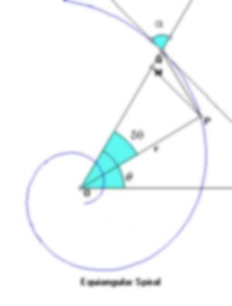
Analytics?
the application of computer technology, operational research, and statistics to solve problems
the process of obtaining optimal or realistic decisions based on existing data
data might be huge, incomplete, conflicting
"the science of analysis"
evolved from the application of computers to the interpretation of data

Slide 6
Applying Analytics
Data mining
Aggregation of trends/structure
Finding a needle in a haystack
Interactive/dynamic discovery/exploration
Drilling: overview/zoom/filter/details
Selection, sweeping, brushing
Looking for something odd
Hypothesis development & validation
Testing new codes, heuristics, parameter settings

Slide 7
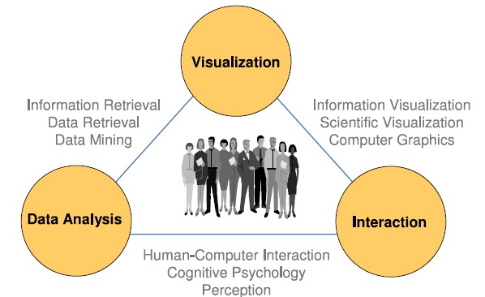
“Visual Analytics”
Keim et. al.: Visual Analytics, 2009
Coined 2005
J. Thomas, K. Cook, Illuminating the Path: Research and Development Agenda for Visual Analytics, 2005
derives from J. W. Tukey, Exploratory Data Analysis, 1977

Slide 8
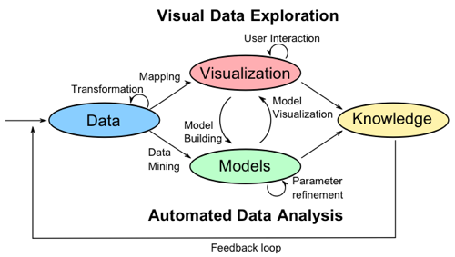
VA process
Build better understanding of problem
Build better models, better tools
(moving the development frontier forward)
Keim 2009

Slide 9
iii. VA for Network Security
View network topology
Connectivity graphs, geo-spatial, bandwidth, privilege
View communication topology
Temporal, causal, attack analysis, defense strategies
View flow patterns
Signature matching, highlighting
Behavior examination and exploration
Apply spatial reasoning
Connectivity heuristics, modular identification
Reduce visual complexity
Retaining event semantics, contextual meaning
Scalability to higher order tasks, problem complexity
Defining a feature trade-off space

Slide 10
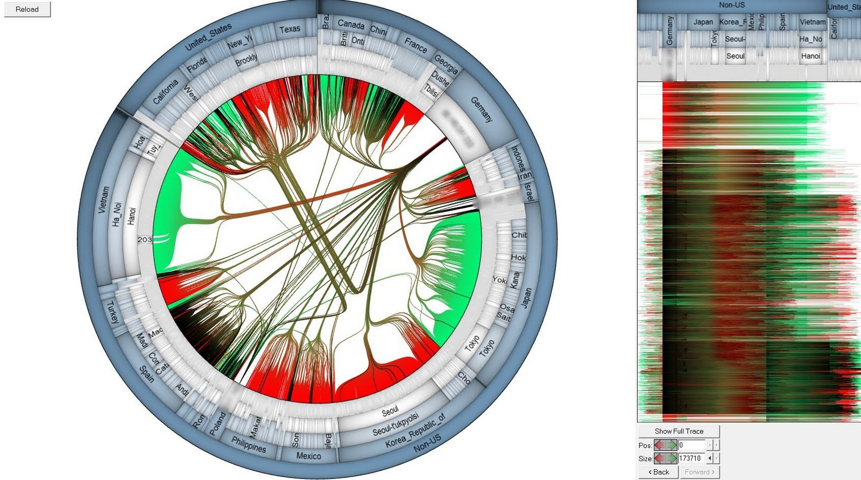
Example tool: SynerScope
Using Visual Analysis for Network Threat Detection: http://synerscope.com/
Notes:
Radial mapping of geography, parameterized hierarchical edge bundling, timeline side-bar
Analysis of an actual global attack [..]

Slide 11
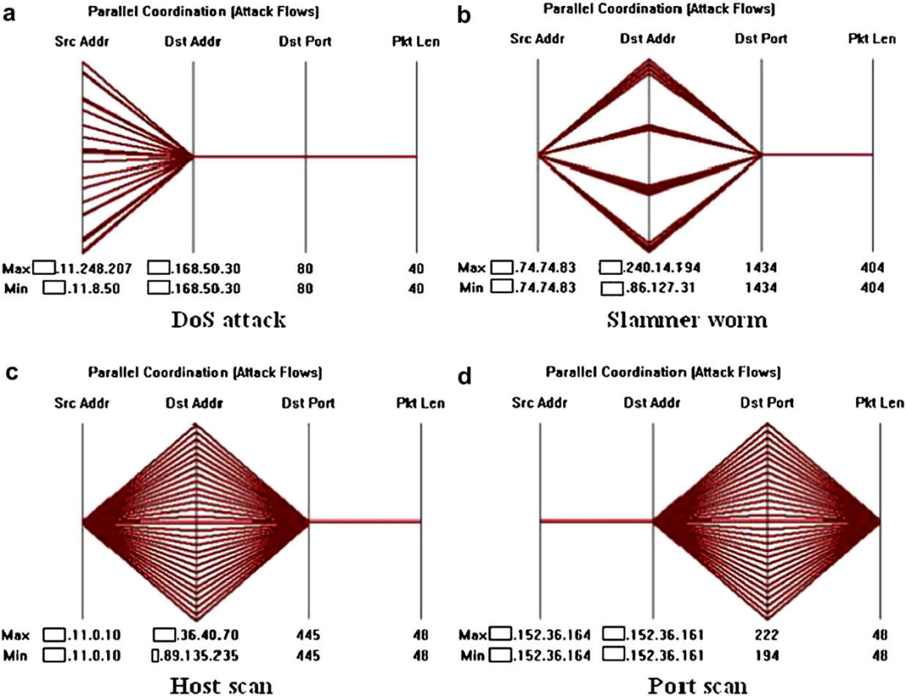
Parallel Coordinate Signatures
Portscan
Hostscan
Worm
Src-spoof DoS (single port)
Backscatter
Src-spoof DoS (multi port)
Distributed hostscan
Network directed DoS
Single-src DoS
Choi et. al.: Fast detection and visualization of network attacks on parallel coordinates, 2008
Notes:
Plotting events on axes { src, dst, port, size }
Evaluation: Comparing number of dimensions used to hit ratio: false pos/neg

Slide 12
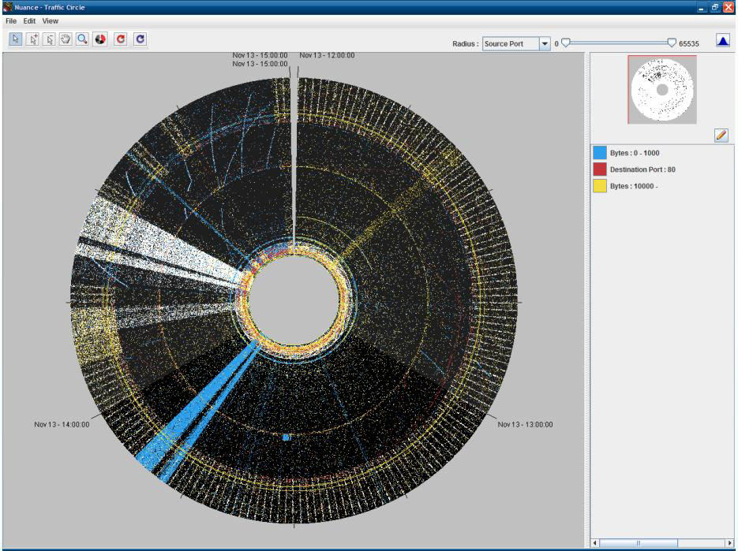
PNNL Traffic Circle
Best et. al.: Real-Time Visualization of Network Behaviors for Situational Awareness, 2010
Notes:
Radial mapping of time, color mapping of size/port
Not scalable

Slide 13
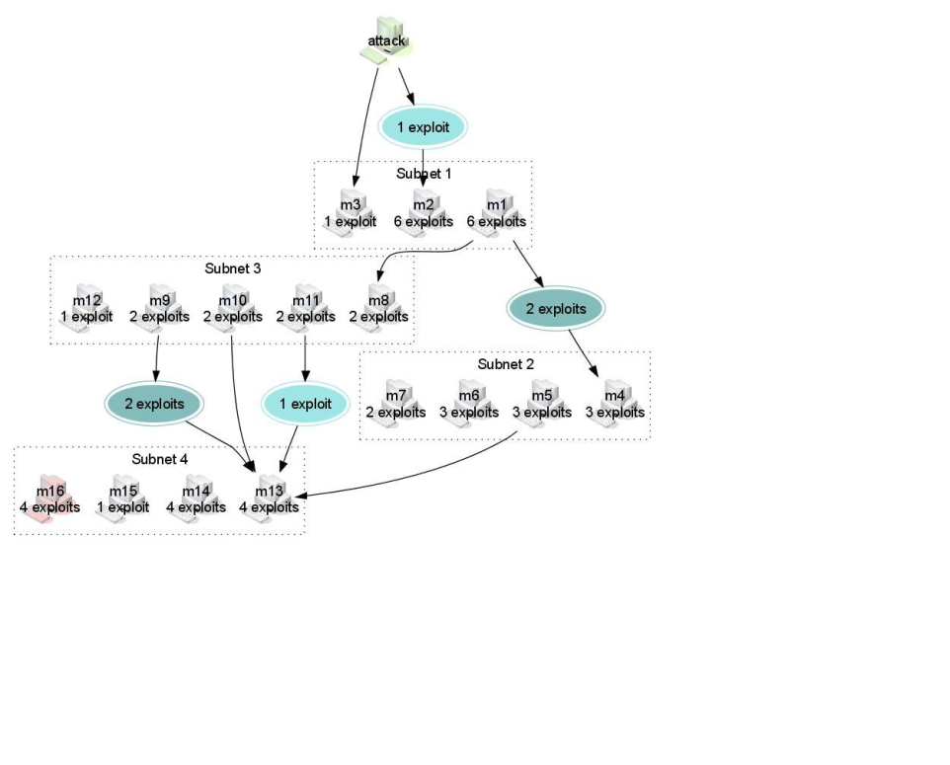
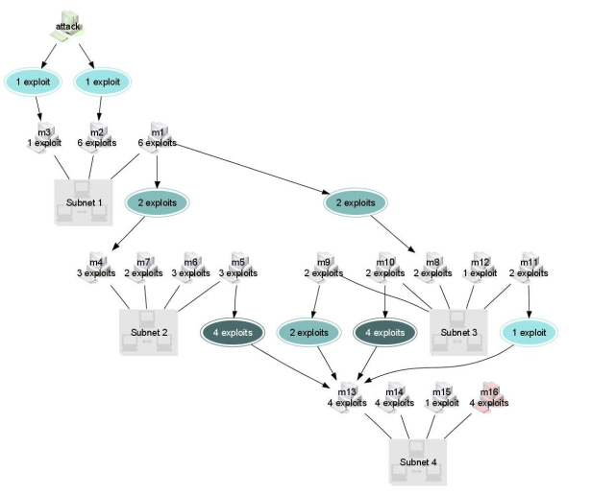
Attack Graph Aggregation
Noel et. al.: Multiple Coordinated Views for Network Attack Graphs, 2005
Finding dominators, trimming loops, semantic reduction: relevant nodes and edges
Context sensitive permutation (transmutation) techniques remain scale bound…
Notes:
Dominators: the set of nodes through which all paths must travel.
Loops: redundant backtracking
Semantics: retaining/acquiring high level meaning of event

Slide 14
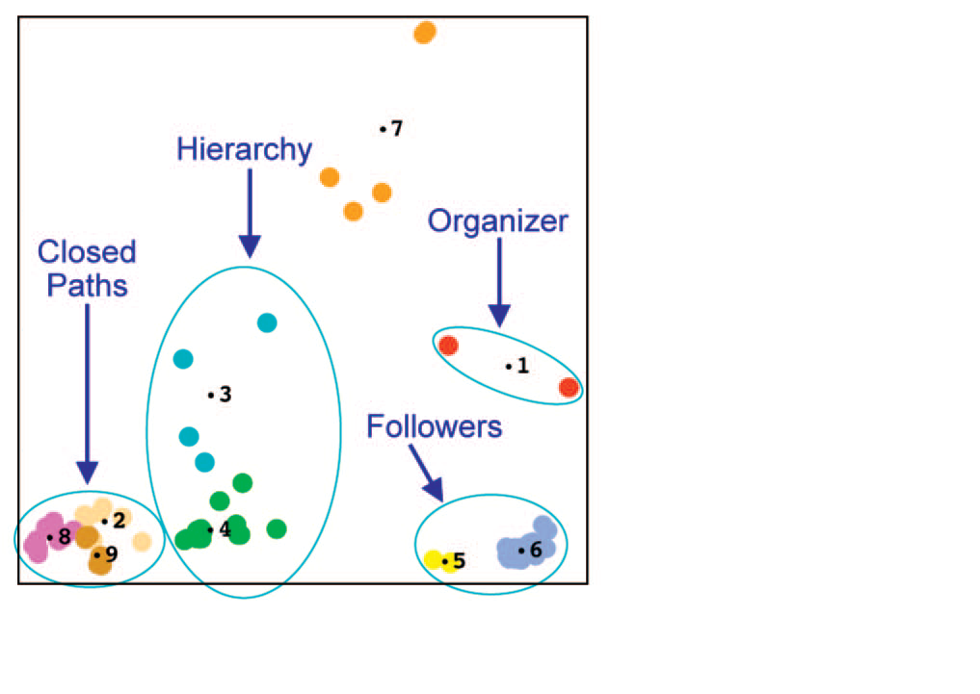
Graph Signatures
Wong et. al.: Graph Signatures for Visual Analytics, 2006
Telephone calls
Multidimensional scaling projection
Semi-automatic clustering
Notes:
A graph signature characterizes a node’s relationship to the entire network
Similarity/difference can be plotted in 2D with multi-D scaling-projection
Cluster analysis reveals structure

Slide 15
missing organizer…
Wong 2006
Notes:
The second shooter

Slide 16
PCA dimension reduction

Slide 17
Modular Reasoning
Guimera et. al.: Classes of complex networks defined by role-to-role connectivity profiles, 2006
Connectivity signatures: vocabulary for network anatomy
Metabolic network
Air transport
Protein interactome
Internet 1998

Slide 18
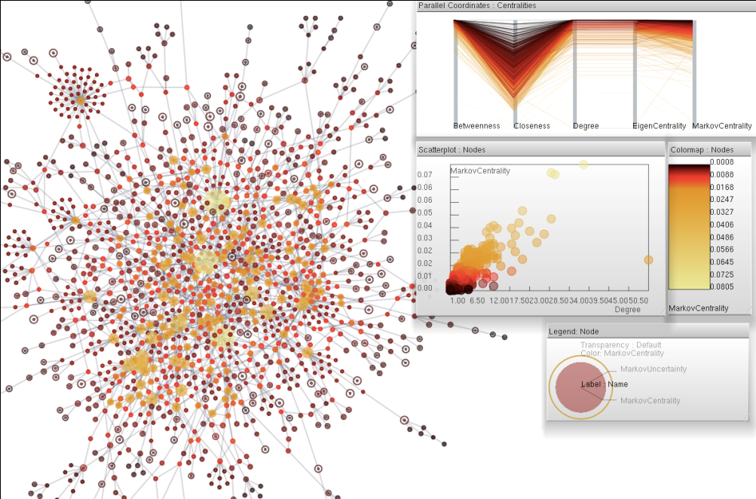
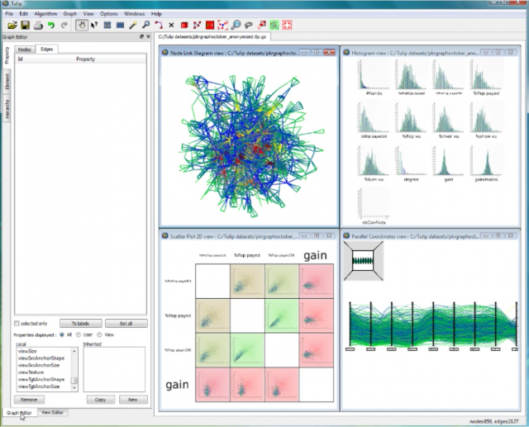
Comparative Analysis
“...using several views on the same data instead of just one is trivial. Doing it right, and providing the necessary amount of interaction, however, is not."
– Kosara et al. 2003
mashups…
Brushing: selection in one view is highlighted in other views
Cross-brushing: union, intersection

Slide 19
iv. DNS-CPA revisited
What does a DNS-CPA look like?
Temporal signature, semantic refactoring
10.1.6.3
Real-NS
2
7
time
10.1.4.2
Victim-NS
1
3
4
5
6
8
9
10.1.11.2
Attacker
context

Slide 20
DNS setting
c
Healthy access paths
c
c
good.com
DNS
c
c
c
c
c
c
c
c
c
c
c
c
DNS

Slide 21
Local attack setting
c
c
c
c
c
c
c
c
c
c
c
c
c
c
c
naughty.ru
DNS spoof
A
Attack staging

Slide 22
External attack setting
c
c
c
c
c
c
c
c
A
c

Slide 23
Temporal signature glyphs
t
Radial maps:
Perception: concentricity/eccentricity, chirality
Tunnel scroll
Generate a time-based glyph from timeline signature display
Embed in interactive glyph field
Dynamic LOD representation

Slide 24
Are we done?
add multi-touch control interface…

Slide 25
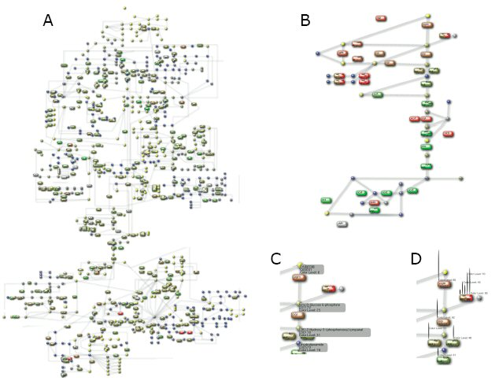
v. Requirements Analysis Case study in Biological Pathway tools
Saraiya et. al.: Visualizing biological pathways: requirements analysis, systems evaluation and research agenda, 2005
Goal: Develop research agenda to guide development of better tools
!YAT
Kono et. al: MEGU: Pathway mapping web-service based on KEGG and SVG

Slide 26
Saraiya…
Lessons learned
Insufficient domain-specific context (bio-molecular interactions)
Enormous set-up time required for meaningful operations
Can’t build on or integrate previous work
Many tedious operations to search and extract information
Lack of standardized vocabulary and symbolic conventions
Different learning curve present for each tool
Developing a common language for networks and pathways is open research
Inadequate presentation of time dynamics
General reluctance to use existing available tools without rapid insight
Must work out of box
*
*
*

Slide 27
vi. Finally…
If it works
Why does it work?
Detailed limitations?
Optimal performance range bounds?

Slide 28
Conclusion
The analytic problems posed by cybersecurity diagnostic tasks lend themselves readily to the Visual Analytic process.
High-dimensional temporal data, spatial reasoning, complexity reduction, tool evaluation
A variety of novel tools and approaches exist for comparison
What’s next?
Refine proposed DNS-CPA representation
Iterate with security researchers to develop interaction model
Build some prototypes
Generalizing to other attack signatures and types
Explore feasibility of representing complex attack strategies
Continuing the dialog
Identify new research areas that can be addressed with Visual Analytics

Slide 29
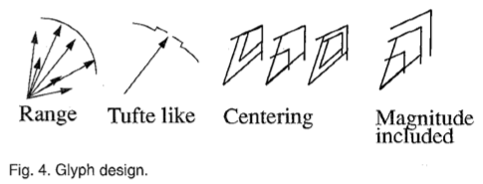
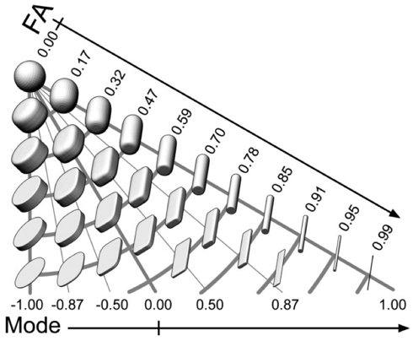
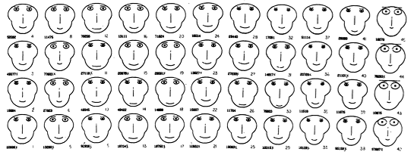
A. glyphs!
A glyph is an element of writing: an individual mark on a written medium that contributes to the meaning of what is written.
A grapheme is made up of one or more glyphs… the individual symbols of any of the world's writing systems.
The orthography of a language specifies a standardized way of using a specific writing system (script) to write the language.
For languages with relatively deep orthographies, such as English, French, Chinese, Arabic or Hebrew, new readers have a great deal more difficulty learning to decode words.
As a result, children learn to read more slowly…
Diffusion tensors can be mathematically decomposed into shape and orientation information, determined by the eigenvalues and eigenvectors, respectively.

Slide 30
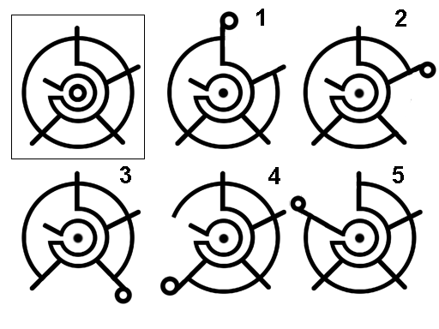
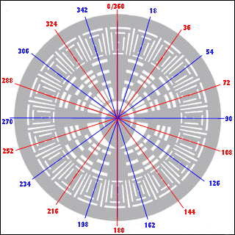
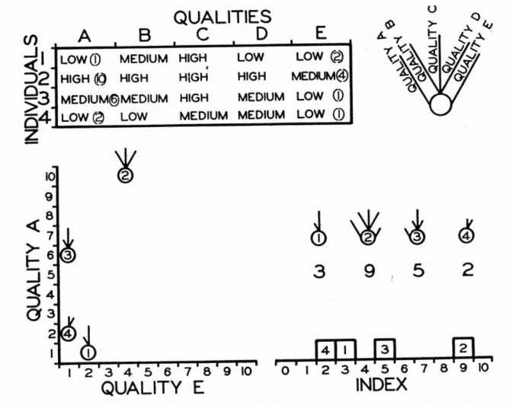
graphemes
Metroglyph: Circular glyphs, with rays to represent multivariate data.
Edgar Anderson 1957

Slide 31
B. key sources
S. Noel, S. Jajodia. Managing attack graph complexity through visual hierarchical aggregation. Proc. of the 2004 ACM workshop on Visualization and data mining for computer security, 2004.
S. Noel, M. Jacobs, P. Kalapa, S. Jajodia. Multiple Coordinated Views for Network Attack Graphs. Proceedings of the IEEE Workshops on Visualization for Computer Security, 2005.
P.Saraiya, C. North, K. Duca. Visualizing biological pathways: requirements analysis, systems evaluation and research agenda. Information Visualization, 2005.
P. C. Wong, H. Foote, G. Chin Jr., P. Mackey, K. Perrine. Graph Signatures for Visual Analytics. IEEE Transactions on Visualization and Computer Graphics, 2006.
R. Lippmann, K. Ingols, C. Scott, K. Piwowarski, K. Kratkiewicz, M. Artz, R. Cunningham. Validating and restoring defense in depth using attack graphs. Proceedings of the 2006 IEEE conference on Military communications, 2006.
R. Guimera, M. Sales-Pardo, L. A. N. Amaral. Classes of complex networks defined by role-to-role connectivity profiles. Nature Phys, 2007.
L. C. Williams, R. P. Lippmann, K. W. Ingols. An Interactive Attack Graph Cascade and Reachability Display, VIZSEC 2007.
J. Homer, A. Varikuti, X. Ou, M. A. Mcqueen. Improving Attack Graph Visualization through Data Reduction and Attack Grouping. Proc. of the 5th international workshop on Visualization for Computer Security, 2008.
D. A. Keim, F. Mansmann, A. Stoffel, and H. Ziegler. Visual Analytics. Springer, 2009. Encyclopedia of Database Systems.

Slide 32
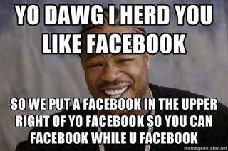
C. additional resources
What’s on your mind?
M. Krzywinski, Designing effective visualizations in the biological sciences, 2011
Information-rich versus informative displays
Limits of perceptual acuity
J. Guenther, et. al., Proposing a Multi-touch Interface for Intrusion Detection Environments, 2010
Visual Analytics task requirements
Role of Activity Theory in intrusion detection systems
M. E. Tudoreanu, Designing effective program visualization tools for reducing user’s cognitive effort, 2003
Factors that determine cognitive economy
“A situation in which both graphics and high cognitive load exist resembles one in which neither is present.”
Ok let me try. "SUP DAWG, I hear you cant hear, so I put a hearing aid in yo hearing to listen while youre listening" Ha.
-- Xzibit

Slide 33
21st Century Art History for Computer Scientists…
Visual Analytics for Complex Network Systems
<thiebaux @ isi.edu>

