Slide 1
Rangers Football Club
Be part of the journey.
Official Digital/Wifi
Betting Partner

Slide 2
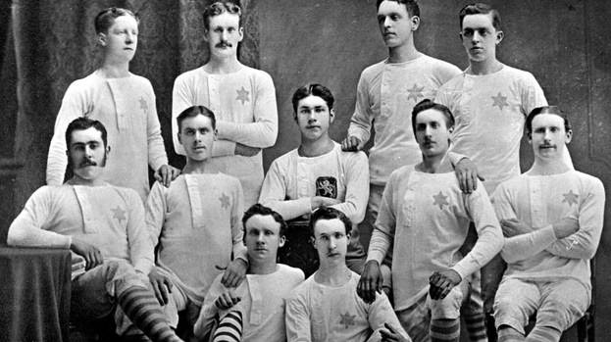
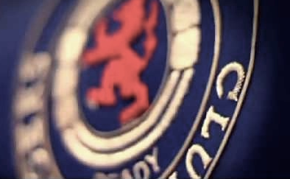
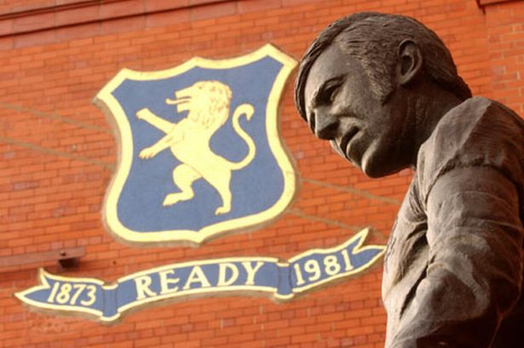
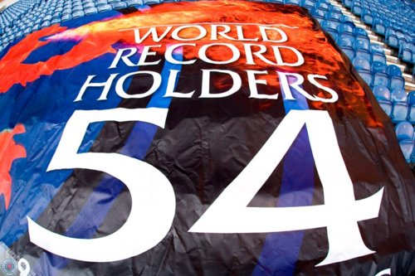
Rangers Football Club
Always ready
A name synonymous with success,
Where only the best is good enough
A club that knows where it’s going,
But never forgets where it’s been
With the world’s most loyal supporter base
Embracing victory but never fearing failure
Enduring, exciting, innovative
Key Milestones
Established 1872 with 115 trophies - a heritage longer than many other iconic football clubs
54 Scottish League Championships, a world record - 33 Scottish Cup wins and 27 Scottish League Cup wins
1 European Cup Winners’ Cup victory and three major European cup finals
Since Rangers first took part in European football the Club has appeared in 53 seasons from 58
All-time record attendance of 118, 567
The Club has won the treble on seven occasions
Rangers became the first Scottish side to reach the last 16 of the UEFA Champions League in 2005/06 and reached the final of the UEFA Cup in season 2007/08
Most supported Scottish football club - 50.38% support Rangers.
1.746 million adult football fans in UK

Slide 3
One of the world’s most successful clubs
115 trophies
115
115
102
93
63
60
55
47
39
39
27

Slide 4
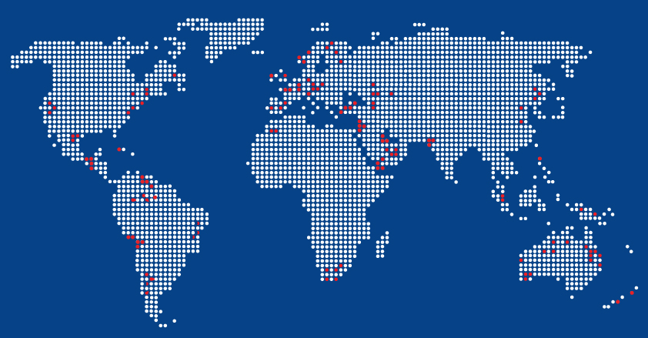
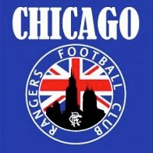
The Rangers Phenomenon
Over 5,500,000 fans worldwide
772,000+
registered on Club database
1.445m
Matchday audience - highest in Scotland
and 4th largest in the UK (2011/12)
40,000
season ticket holders on average in 5 years
- one of largest in the UK
550+
supporters clubs worldwide
32,000+
corporate guests per season

Slide 5
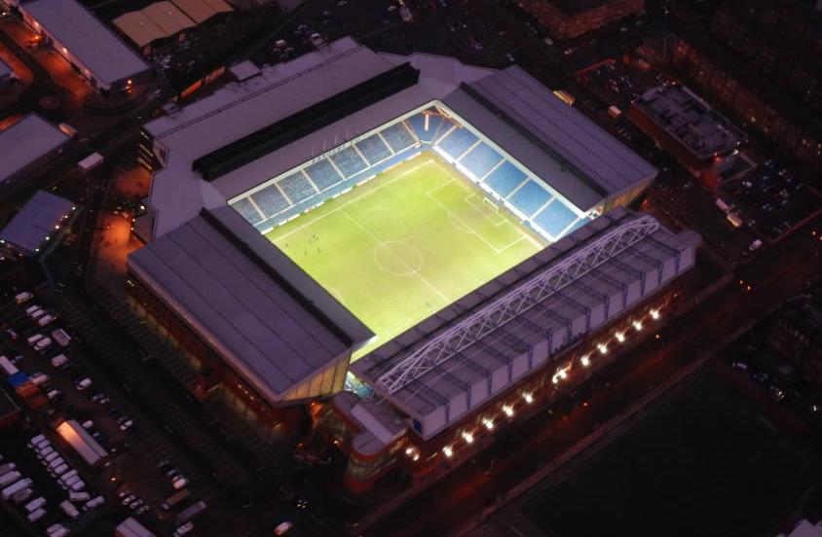
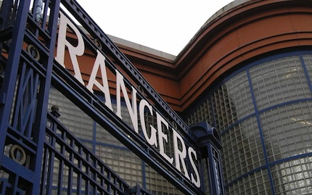
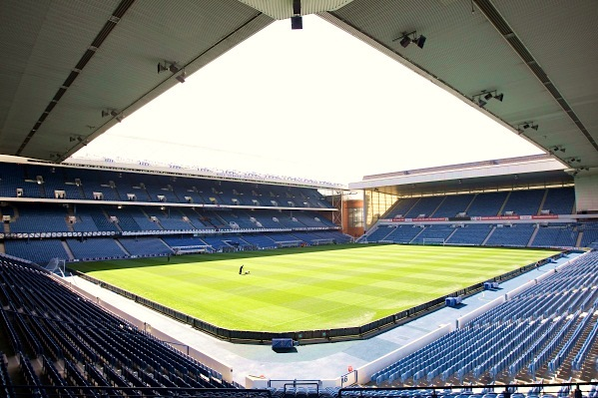
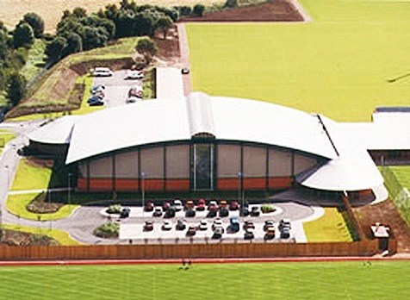
Our Homes
Ibrox Stadium
51,000 capacity
5th largest stadium in the UK
Opened 1899
Murray Park training facility
£14m state-of-the-art training centre
One of the world’s most advanced training facilities
Our Partners

Slide 6
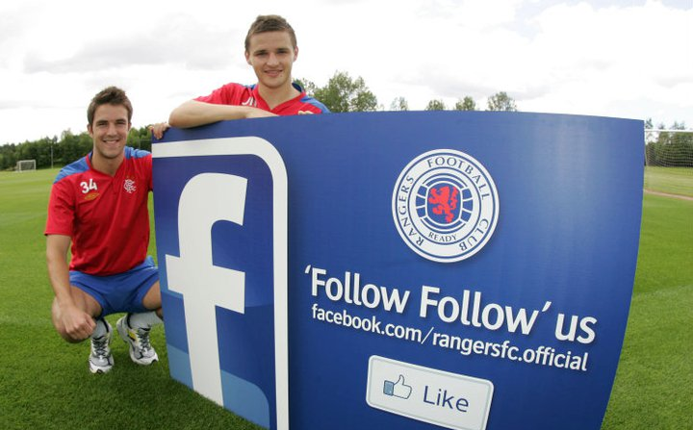
Brand Reach
Traditional Media
Saturated media coverage in both broadcasting and written press - £14.5m
Over 100m cumulative domestic audience in season 11/12
6.1m viewers in season 10/11 watched an Old Firm derby
Rangers SKY/ESPN TV audiences surpass SPL figures for July/August 12/13
Highest football viewing figures in Scotland July/August 2012
Digital Media
Club own online media rights and broadcast games overseas
rangers.co.uk: 2.9m page views per month, 475k unique
Twitter: 146k+ total followers
Facebook: 308k+ likes
1.3m views on Rangers YouTube channel since launch in July 2013
One of the largest UK football club websites
Match Day
47,617 is the 5th highest average attendance in UK in 12/13
Highest average matchday audience in Scotland
15th highest match day audience in Europe 12/13
38,000 sales for a mid-week cup match
8,679 new season ticket holders in 12/13, 99.7% increase over 11/12
Season 12/13 – Over 38,000 season ticket holders
24% increase in 12/13 u10 season ticket holders
34,500+ season ticket holders to date, projected 38,000

Slide 7
Brand Opportunities
Maximising partnerships
1.445m match-day
audience
Money can’t buy opportunities
Stadium branding
and advertising
Manager Ally McCoist
Training ground sponsorship
First team and legend endorsement
Rangers Club media portfolio
Memorabilia
Exclusive access to world class facilities
Social Media
Database access
Award winning hospitality
Award winning family strategy
Award winning CSR community programme
Youth Team Development
Penetration of overseas markets

Slide 8
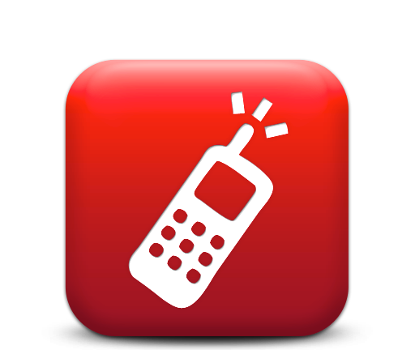
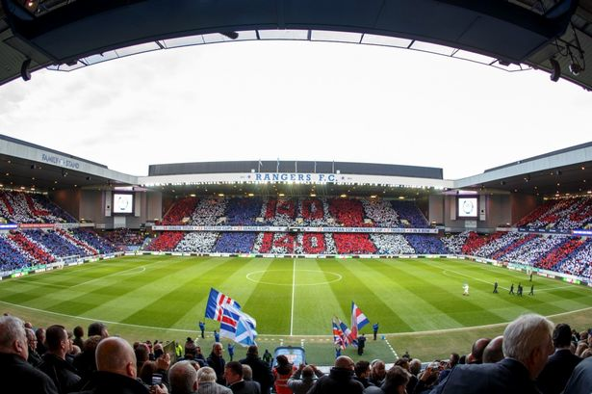
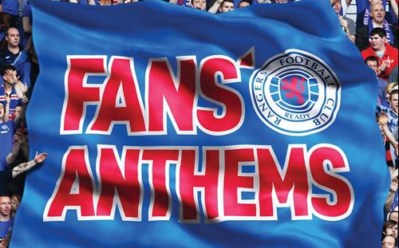
Fan Engagement
Social Media
Facebook: 308,000+ likes
Twitter: 146,000+ followers
iPhone App: 30,000 downloads
Club opt-in communications
Addresses: 445,239 contacts
Landlines: 373,723 contacts
Mobile/SMS: 201,403 contacts
Email: 255,505 addresses
3rd-party opt-in communications
Addresses: 356,825 contacts
Landlines: 256,561 contacts
Mobile/SMS: 135,708 contacts
Email: 215,144 addresses

Slide 9
Rangers Stadium Wifi
OBJECTIVES
Enhance the overall matchday experience for fans and corporates
Increase engagement and fan interaction on matchday
Improve communication with fans/members bringing them closer to the club
Enhance revenue streams and upsell to captive audience in stadium
Create new commercial partnerships e.g. betting
Gain greater customer insight
Data capture particularly in the corporate areas
Added value to existing sponsors/partners
New advertising and promotional opportunities
Develop communication between the matchday audience and the wider Rangers community worldwide

Slide 10
Rangers Stadium Wifi
Ibrox Stadium Wifi installation from September 2013
Rolling installation by stand with completion October 2013 – 51,000+ full stadium coverage
Stadium Wifi to act as portal for fans in-stadia and beyond
Improving the matchday experience, greater fan interaction and engagement driving sales to Club products/services and to our partners
The Ibrox App – Android & iOS - multi-platform
App Features
In App Betting: Integrate betting partner mobile betting platform (HTML 5)
Match Day Info: Provide the fan with the match day info they need. -Team sheets etc
Social media – Facebook and Twitter
News: RSS feeds for up to date news
One click calling for key Rangers Products: Ticket Sales / Store / Corporate
Mobile Store: products / merchandise
Food sales
Discounts and offers
Sponsors section
Fan photo upload feature
Data collection
YouTube channel integration

Slide 11
Digital/Wifi Betting Partner
WIFI BETTING
Exclusive right to provide digital betting services via the Rangers Ibrox App /in-stadia on matchday
Blocking all competitor digital sites accessible via the app/in-stadia
Driving all matchday betting activity to one partner app
Live in-play betting opportunities
Capturing digital betting customers on matchday and retaining them beyond
Promotional opportunities – free bet voucher for all app subscribers
Management information on fan engagement with betting site via wifi

Slide 12
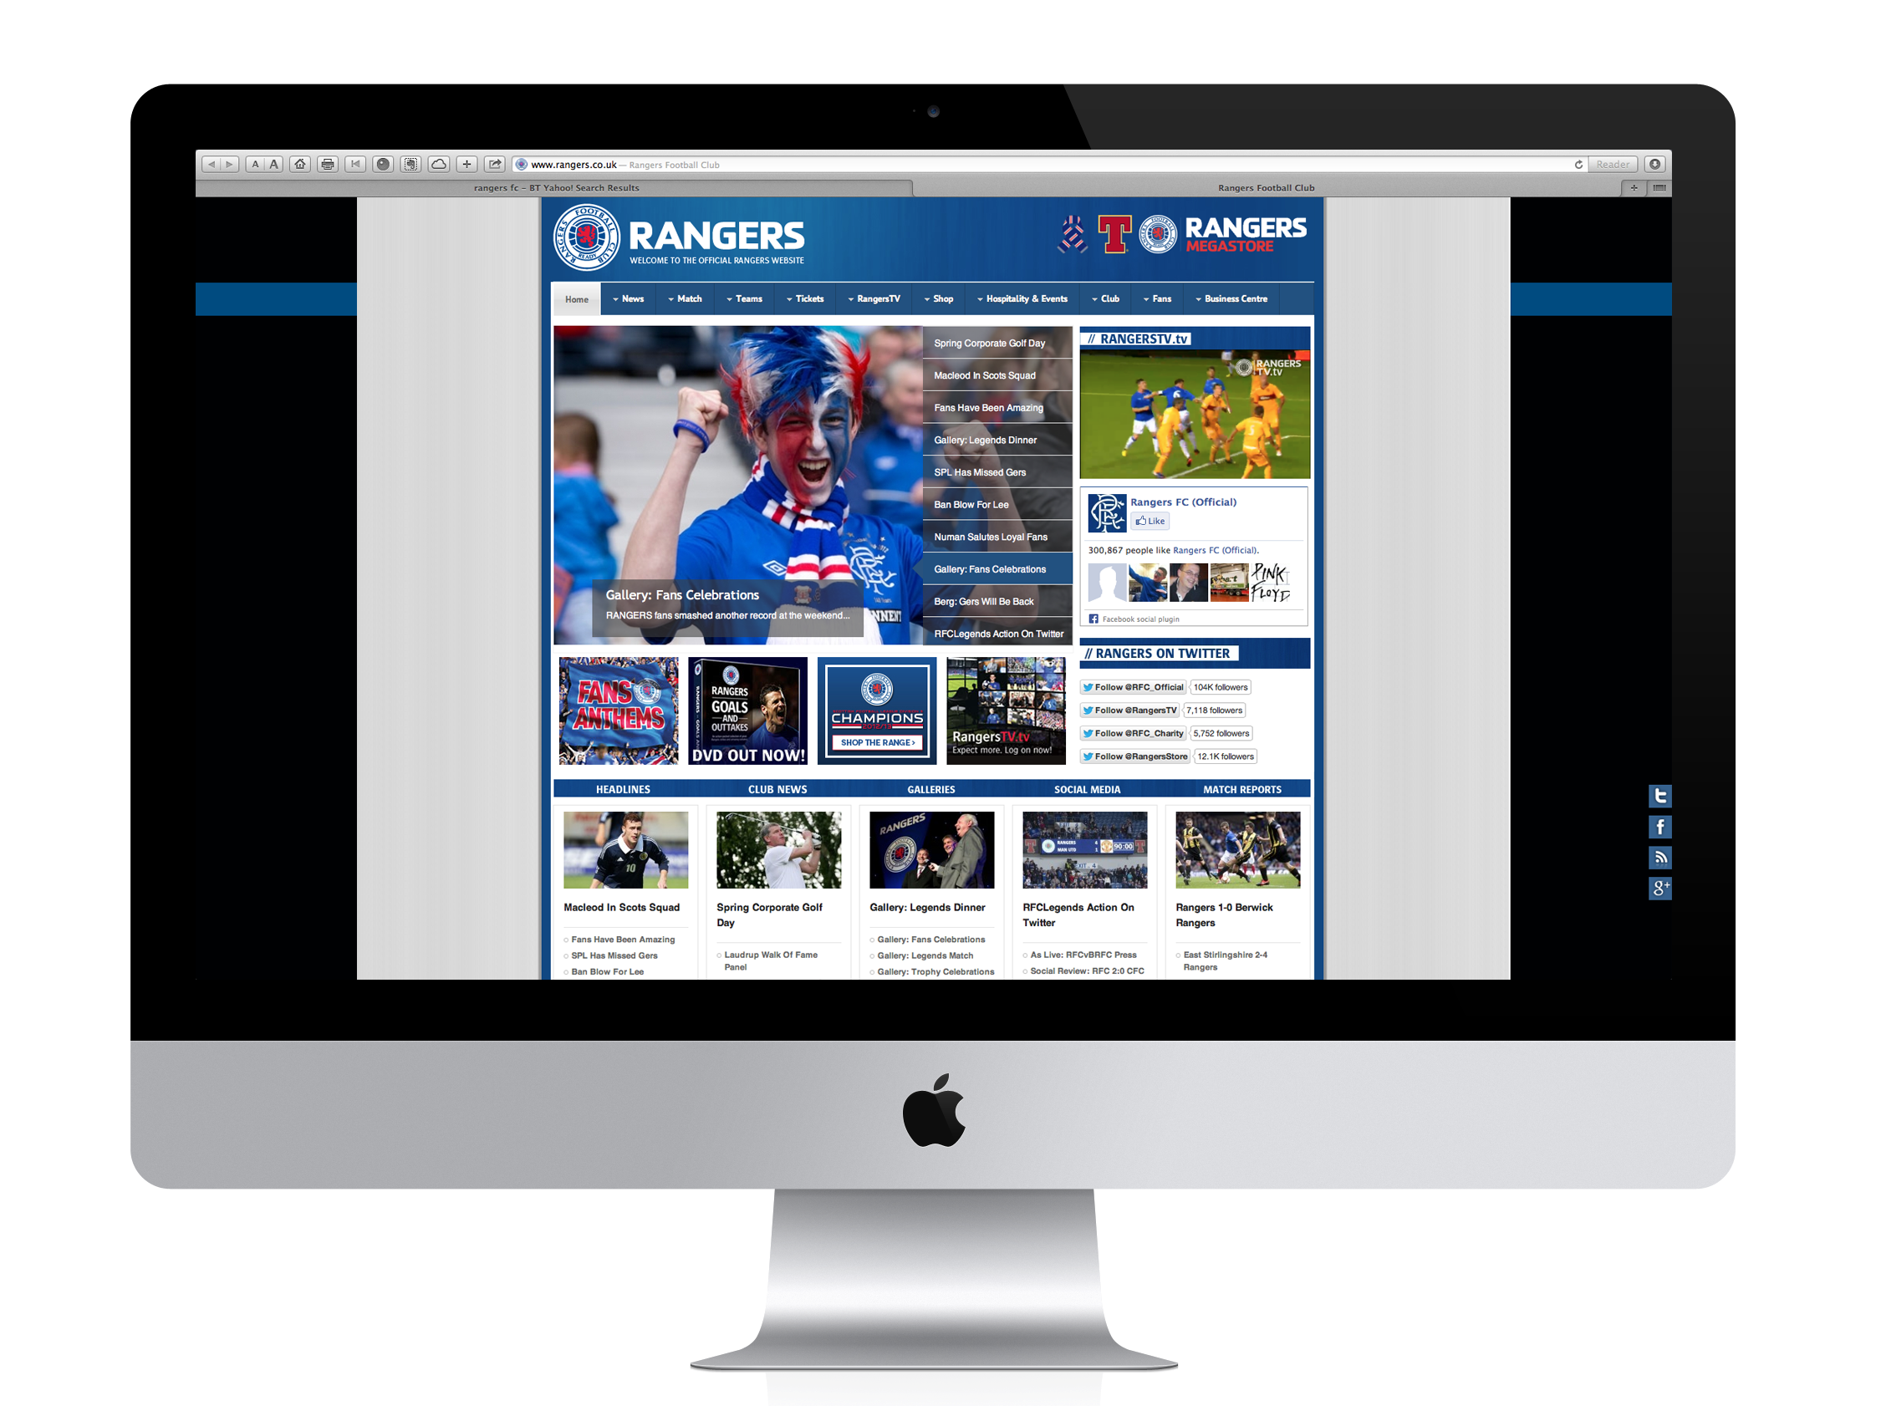
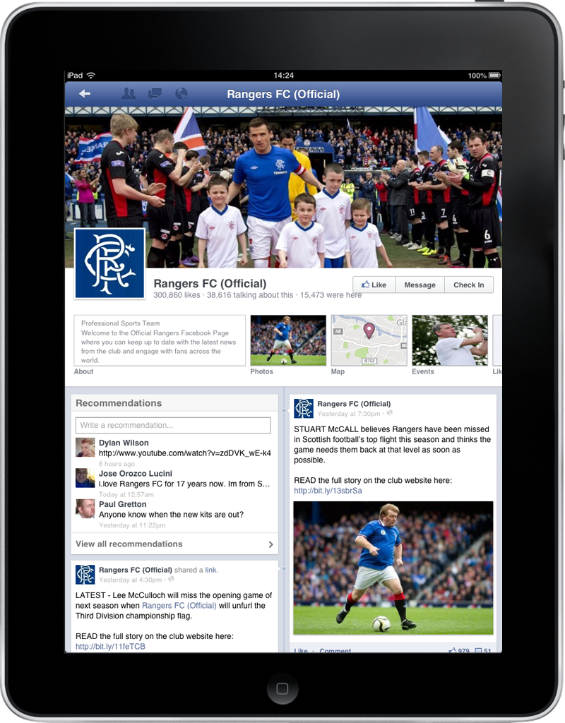
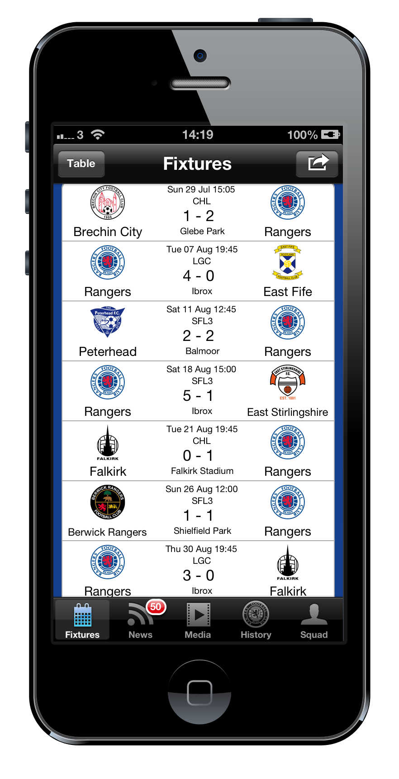
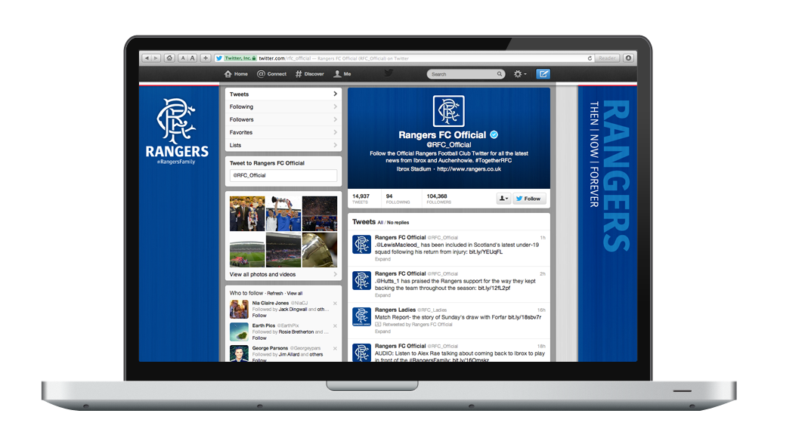
Digital Betting Partnership
Proactive 24/7

Slide 13
Digital Betting Partnership
Official Designation/Exclusivity
Official digital /on-line betting partner of Rangers Football Club
Exclusive right to provide on-line/digital betting services at Ibrox
Exclusive right to provide on-line/digital betting services on Ibrox app
Exclusive right to provide betting services via Wifi on matchday
Stadium Branding & Matchday Advertising
4 mins LED; 2 static perimeter boards
40 washroom posters
TV interview backdrop
Advert in Rangers matchday programme - all matches
Sponsors page branding in Rangers matchday programme - all matches
Digital & Social Media
Exclusive betting partner branding and betting provision on Ibrox app
4 x emails per season to the database
Home page logo, nav bar presence, fixture page button, hojme page ad prior to match and weekly BNS
Weekly post to Facebook and Twitter audience
Promotional activity on iPhone app
Other
1 x player for a launch activity
Money can’t buy – tour of Murray Park for 20 VIP’s
Hospitality and tickets

Slide 14
Rangers Football Club
Be part of the journey.
Official Digital/Wifi
Betting Partner

