Slide 1
HUMAN ANATOMY AND PHYSIOLOGY I
BY
KUUG

Slide 2
Objectives of lecture 1
By the end of today's lecture, students will be able to:
Understand the scope of the semesters work
Define Anatomy and Physiology
Explain the term homeostasis and factors that affect homeostasis.
Describe levels of structural organization of the human body
Discuss directional terms, anatomical position, planes and sections used in anatomy.
Identify the various body cavities and their content.

Slide 3
LECTURE 1
Definition of anatomy
A Greek word ‘’anatome’’ meaning to cut up
Human anatomy is the study of structure (gross and microscopic) and relationship between body parts
It is a study of the structure of living organisms on a large and small scale.
The study of anatomy involves many sub specialties.
These include: Gross anatomy, Microscopic anatomy, Developmental anatomy and Embryology.

Slide 4
Physiology
Definition of Physiology
the word physiology is a Greek word meaning the study of nature.
It is the study of how the body and its part work or function.

Slide 5
Homeostasis
When structure and function are coordinated the body achieves a relative stability of its internal environment called homeostasis
Most of the time, the external environment keeps changing but the internal environment of a healthy body remains the same within normal limits.
Some of the functions controlled by homeostasis mechanisms are blood pressure, body temperature, breathing and heart rate.

Slide 6
Homeostasis cont.
Factors affecting homeostasis. (class discussion)
A
D
D
P
R&S
E

Slide 7
Factors cont. (internal)
O₂ & CO₂
PH
Concentration of nutrients and waste
Conc. Of electrolytes
Vol. and pressure of extracellular fluid
Blood glucose

Slide 8
Level of structural organization of the body
The human body is organised structurally at different levels, starting with atoms, molecules and compounds.
It further increases in size and complexity to cells, tissues, organs
These organs finally make up the systems of a complete organism

Slide 9
Organisation cont.
Cell: The smallest independent units of life.
The life of every organism depends on the many chemical activities of cells.
Some of the basic functions of cells include: growth, metabolism, irritability and reproduction.
Tissue: A tissue is made up of many similar cells that perform a specific function.
The various tissues of the body are divided in to four groups.
These are epithelial, connective, nervous and muscle tissue

Slide 10
Tissues cont.
Epithelial tissue: - outer layer of skin, lining of organs, blood and lymph vessels and body cavities.
Connective tissue: - Connects and supports most part of the body. They constitute most part of skin, bone and tendons.
Muscle tissue: - Produces movement through its ability to contract. They constitutes skeletal, smooth and cardiac muscles.
Nerve tissue: - Found in the brain, spinal cord and nerves. They responds to various types of stimuli by transmitting nerve impulses.

Slide 11
Organisation cont.
Organ: - A collection of two or more kinds of tissues that works together to perform specific function.
E.g. the stomach as an organ is made of different type of tissues
System: Is a group of organs that work together to perform major function.
For example: Digestive system is made up of several organs.
Organism level: - The various organs of the body make up the entire organism.

Slide 12
Terminology in anatomy
In understanding anatomical terms, it is important to understand the basic word roots, combining word forms, prefixes and suffix you will find that anatomical terminologies are not as difficult as you first imagined.
E.g a- without or lack of = Asymptomatic (absence of symptoms)
ab- away from = abstinence (to hold back from)
andro- male = androgens (male hormones)
Cide – kill = spermicide (agent that kills sperm)

Slide 13
Terminology cont.
mito- thread: mitochondria
Morph- form, shape: morphology
Pseudo- false: pseudostratified

Slide 14
Anatomical position
Anatomical position
This is a stance in which a person stands erect with the feet flat on the floor, arms at the sides, and the palms, face, and eyes facing forward.
This position provides a precise and standard frame of reference for anatomical description and dissection.

Slide 15
Pic. of anatomical position

Slide 16
Position of the forearm
Supine Prone

Slide 17
Anatomical planes
Frontal
plane
Transverse
plane
Mid-sagittal
plane

Slide 18
Anatomical planes
A sagittal plane: passes vertically through the body or an organ and divides it into right and left portions. The sagittal plane that divides the body or organ into equal haves is also called the median (midsagittal) plane.
A frontal (coronal) plane: also extends vertically, but it is perpendicular to the sagittal plane and divides the body into anterior (front) and posterior (back) portions

Slide 19
Planes cont.
A transverse (horizontal) plane: passes across the body or an organ perpendicular to its long axis therefore, it divides the body or organ into superior (upper) and inferior (lower) portions

Slide 21
Directional terms
Anterior
Posterior
Superior
Inferior
Distal
Proximal
Lateral
Medial
Deep
Superficial

Slide 22
TERM | DEFINITION | EXAMPLE
1.SUPERIOR (Cranial Cephalic) | Towards Head
2.INFERIOR (Caudal) | Away from head (towards feet)
3. ANTERIOR (Ventral) | Towards front
4. POSTERIOR (Dorsal) | Towards back
5.MEDIAL | Towards the midline of the body
6. LATERAL | Away from the midline of the body
7.PROXIMAL | Towards the trunk of the body: Nearer the attachment of an extremity to the trunk
8.DISTAL | Away from the trunk of the body: Nearer the attachment of an extremity to the trunk
SUPERFICIAL | External (Near surface)
DEEP | INTERNAL (Away from the surface)

Slide 23
Abdomino-pelvic regions

Slide 24
Body cavities and membranes
NAME OF CAVITY | ASSOCIATED VISCERA | MEMBRANOUS LINING
DORSAL BODY CAVITY
Cranial cavity | Brain | Meninges
Vertebral canal | Spinal cord | Meninges
VENTRAL BODY CAVITY
Thoracic cavity | Lungs | Pleurae
Pericardial cavity | Heart | Pericardium
Abdominopelvic cavity
Abdominal cavity | Digestive organs, spleen, kidneys | Peritoneum
Pelvic cavity | Rectum, bladder, reproductive organs | Peritoneum

Slide 25
HUMAN CELL
The cell is the basic and functional unit of life.
Cells are capable of maintaining life and reproducing.
The human body, which is made up of numerous cells, begins as a single, newly fertilized cell.
All human cells are microscopic in size.
To give you an idea how small a cell is, one average-sized adult body is estimated to consists of 100 trillion cells!

Slide 26
Cell Theory
a) All living organisms are composed of cell and cell products.
b) Cell is the basic unit of structure & function of all living organisms.
c) All cells come from the division of pre existing cell.
d) An organism as a whole can be understood through the collective activities & interactions of its cells.

Slide 27
The cell cont.
To understand the cell, we will divide it into four principal parts: -
1. cell (Plasma) membrane: it is the outer lining, limiting membrane separating the cell internal parts from extra cellular materials & external environment.
2. Cytoplasm: cytoplasm is the substance that surrounds organelles and is located between the nucleus and plasma membrane

Slide 28
Cell cont.
3. Organelles: these are permanent structures with characteristic morphology that are highly specialized in specific cellular activity.
4. Inclusions: they are the secretions and storage products of cells.
Extra cellular materials are also referred to as the matrix, which are substances external to the cell surface

Slide 29
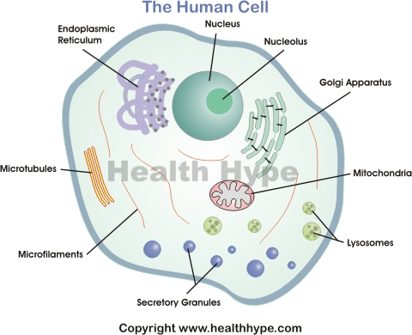
Diagram of the cell

Slide 30
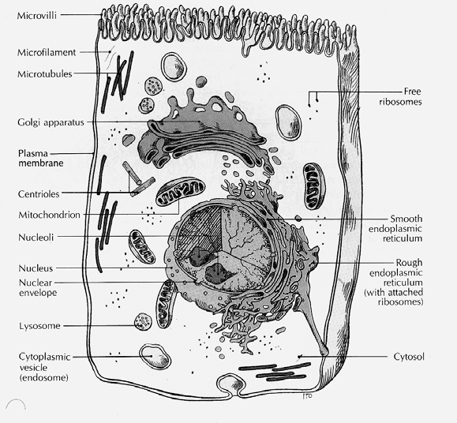

Slide 31
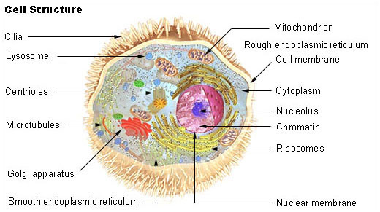
Diagram of the Human Cell

Slide 32
Cell membrane
Every cell in the body is enclosed by a cell (Plasma) membrane.
The cell membrane separates the material outside the cell (extracellular) from the material inside the cell (intracellular).
It maintains the integrity of a cell and controls passage of materials into and out of the cell.
All materials within a cell must have access to the cell membrane for the needed exchange.

Slide 33
Cell membrane cont.
The cell membrane is a double layer of phospholipid molecules.
Proteins in the cell membrane provide structural support, form channels for passage of materials, act as receptor sites, function as carrier molecules, and provide identification markers.
Microvilli (on membrane)

Slide 34
Cytoplasm
The cytoplasm is the gel-like fluid inside the cell. It is the medium for chemical reactions.
It provides a platform upon which other organelles can operate within the cell.
Cell expansion, growth and replication are carried out in the cytoplasm .
Within the cytoplasm, materials move by diffusion, a physical process that can work only for short distances.

Slide 35
Cytoplasm cont.
Water constitutes 75-90% of the cytoplasm.
It also contains solid components, proteins, carbohydrates, lipids and inorganic substances.
The inorganic components exist as solutions

Slide 36
Cytoplasmic organelles
Cytoplasmic organelles are "little organs" that are suspended in the cytoplasm of the cell.
Each type of organelle has a definite structure and a specific role in the function of the cell.
Examples of cytoplasmic organelles are:
Mitochondrion
Ribosomes
Endoplasmic reticulum (rough and smooth)
Golgi apparatus

Slide 37
Organelles cont.
lysosomes.
Microtubles
Microfilaments

Slide 38
Organelles cont.
Mitochondrion
A rod-like or thread-like structure found outside the nucleus
It produces energy for the cell through cellular respiration, and is rich in fats, proteins, and enzymes
Ribosome
Any of the RNA-rich cytoplasmic granules that are sites for protein synthesis.
Endoplasmic Reticulum
A system of interconnected vesicular and lamellar cytoplasmic membranes that functions especially in the transport of materials within the cell and that is studded with ribosomes in some places.

Slide 39
Organelles cont.
Golgi apparatus
A cytoplasmic organelle that consists of a stack of smooth membranous saccules and associated vesicles and that is active in the modification and transport of proteins
lysosome
A saclike cellular organelle that contains various hydrolytic enzymes.
They are involved in metabolic activities and also break down unwanted foreign material

Slide 40
Other structures found in the cell.
Microtubules
Microtubules are filamentous intracellular structure that are responsible for various kinds of movements in all cells. They are involved in nucleic and cell division, organization of intracellular structure, and intracellular transport, as well as ciliary and flagellar motility

Slide 41
Structures cont.
Microfilaments
Works like the microtubules
Are narrower than the tubules
Forms part of the cytoskeleton
Contain actin and myosine which causes movement in skeletal muscles

Slide 42
Microvilli

Slide 43
Nucleus and Nucleolus
The nucleus, encloded by a nuclear membrane around a fluid nucleoplasm, is the control center of the cell.
Threads of chromatin in the nucleus contain deoxyribonucleic acid (DNA), the genetic material of the cell.
The nucleolus is a dense region of ribonucleic acid (RNA) in the nucleus and is the site of ribosome formation.
The nucleus determines how the cell will function, as well as the basic structure of that cell

Slide 44
Movement across-cell membrane
Movements a cross membrane takes place in two ways.
These are passive and active movements.
Passive movement uses energy whereas active movement consumes energy in the form of ATP.

Slide 45
Passive movement of substances across the cell membrane
Simple diffusion: the random movements of molecules from area of high concentration to the area of low concentration. Example air in alveoli of lung
b. Facilitated diffusion: larger molecules, which are not soluble in lipid need protein channel to pass through the plasma membrane. No direct energy needed. Example: - Amino acid passes through the cell membrane.

Slide 46
Passive movement cont.
c. Osmosis: a special type of diffusion referring to the passage of water through a selectively permeable membrane from an area of high water concentration to lower water concentration.
d. Filtration: small molecules pass through selectively permeable membrane in response to force of pressure. Example: - filtration in the kidney in the process of urine formation.

Slide 47
Active movement of substances across the cell membrane
Substances move through a selectively permeable membrane from areas of low concentration on side of a membrane to an area of higher concentration on the other side.
This is against concentration gradient. Therefore, it requires energy.

Slide 48
Active transport
Molecules across the membrane could move passively but if equilibrium is reached and still more molecules are needed, they must be pumped through the membrane against concentration gradient.

Slide 49
Active transport cont.
This process requires the use of ATP. One example of such processes is Sodium – potassium pump and calcium pump.
These are molecules bind to carrier protein

Slide 50
Edocytosis
Endocytosis, pocketing in by plasma membrane. It includes:
Pinocytoss – cell drinking
Receptor – mediated Endocytosis- Endocytosis with the help of receptor.
Phagocytosis- cell eating.
Exocytosis, opposite to Endocytosis, to remove out undigested particles.

Slide 51
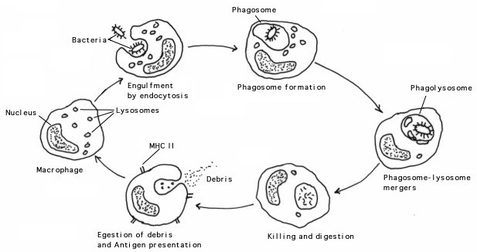
Phagocytosis

Slide 52
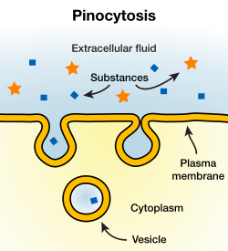
Pinocytosis

Slide 53
Cell Nucleus and DNA
The genetic code is contained in the structure of DNA which is found within the cell nucleus.
The DNA and a related molecule called the RNA are known as nucleic acids
The structure of a DNA serves as a basis for genetic coding.
There are two chains of DNA are twisted around each other to form a double helix so that molecule resembles a spiral staircase.

Slide 54
DNA and RNA
The RNA is a single-stranded polynucleotide chain with a base sequence that is complementary to a region of the DNA.
The genetic code of DNA is expressed through its direction of RNA synthesis

Slide 55
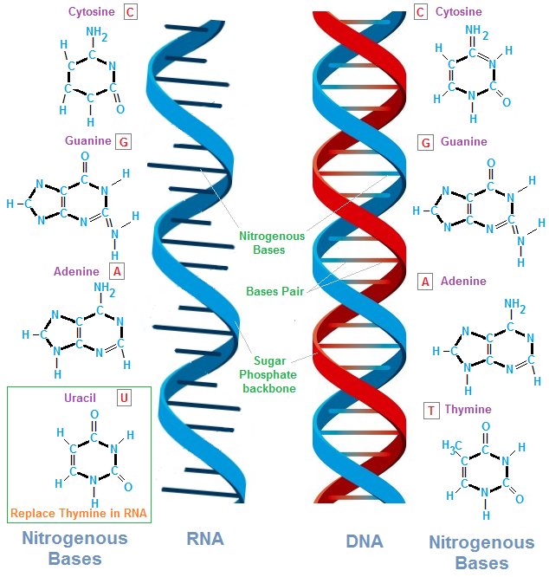
DNA and RNA cont.

Slide 56
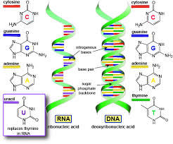
DNA and RNA

Slide 57
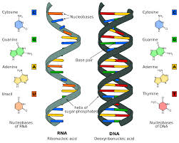
DNA & RNA

Slide 58
Basic differences between RNA and DNA
A ribonucleotide that contains the sugar ribose instead of de-oxyribose as in DNA
RNA is composed of a single polynucleotide strand unlike the DNA which has double strands
RNA is shorter than DNA

Slide 59
Types of RNA
Within the nucleus:
Precursor messenger RNA (pre-m RNA)
It is altered within the nucleus to form mRNA
Messenger RNA (mRNA)
This contains the code for the synthesis of specific proteins
Transfer RNA (tRNA)
It transfers amino acids needed for decoding genetic message contained in Mrna
Ribosomal RNA (r RNA)
Forms part of the structure of ribosomes

Slide 60
Genetic transcription
The chromosomes seen during cell division are inactive packages of DNA
The genes do not become active until the chromosomes unravel.
Active DNA directs the metabolism of the cell indirectly through its regulation of RNA and protein synthesis
Each gene is a stretch of DNA (a thousand nucleotide pairs long)

Slide 61
Genetic transcription cont.
In other for the genetic code to be translated for the synthesis of specific proteins, the DNA code must first be transcribed into an RNA code
This is accomplished by DNA-directed RNA synthesis or genetic transcription

Slide 62
Cell cycle
Eukaryotic chromosomes contain DNA and protein
The chromosomes carry the genetic information

Slide 63
Cell cycle

Slide 64
Cycle cont.
When a cell divides, chromatin fibers are very highly folded, and become visible under a light microscope as chromosomes.
During interphase (between divisions), chromatin is more extended, a form used for expression of genetic information

Slide 65
Cycle cont.
DNA is organized into informational units called genes
Chromosomes contain hundreds to thousands of genes

Slide 66
Cycle cont.
The cell cycle is therefore the period from the beginning of one division to the beginning of the next
Eukaryotic cell cycle
Beginning of one division to beginning of next
Stages in eukaryotic cell cycle
Interphase
First gap phase
Synthesis phase
Second gap phase
M phase
Mitosis
Cytokinesis

Slide 68
Cycle cont.
Chromosomes become duplicated during interphase
Cells are very active during interphase, synthesizing biological molecules and growing the G₁ (gap) phase
The S (synthesis) phase is marked by DNA replication
The G₂ (gap) phase occurs between the S phase and mitosis

Slide 69
Cell division
Genetic materials are transmitted to new cells through cell division, growth, and reproduction
Interphase
Mitosis
Cytokinesis
Meiosis

Slide 70
Mitosis
Mitosis is nuclear division plus cytokinesis, and produces two identical daughter cells during the following steps:
Prophase
Metaphase
Anaphase
Telophase.
Interphase is often included in discussions of mitosis, but interphase is technically not part of mitosis, but rather encompasses stages G1, S, and G2 of the cell cycle.

Slide 71
Interphase
The cell is engaged in metabolic activity and preparing for mitosis (the next four phases that lead up to this and include nuclear division).
Chromosomes are not clearly discerned in the nucleus, although a dark spot called the nucleolus may be visible.
The cell may contain a pair of centrioles which are the organizational sites for microtubules

Slide 72
Interphase

Slide 73
Prophase
Chromatin in the nucleus begins to condense and becomes visible under a light microscope as chromosomes.
The nucleolus disappears.
Centrioles begin moving to opposite ends of the cell and fibers extend from the centromeres.
Some fibers cross the cell to form the mitotic spindle.

Slide 74
Prophase

Slide 75
Metaphase

Slide 76
Metaphase
Spindle fibers line the chromosomes along the middle of the cell nucleus.
This line is referred to as the metaphase plate.
Polar microtubules extend from the pole to the equator, and typically overlap

Slide 77
Metaphase cont.
Kinetochore microtubules extend from the pole to the kinetochores
This organization helps to ensure that in the next phase, when the chromosomes are separated, each new nucleus will receive one copy of each chromosome.

Slide 78
Anaphase
The paired chromosomes separate at the kinetochores and move to opposite sides of the cell.
The chromosomes are pulled by the kinetochore microtubules to the poles and form a "V" shape
Motion results from a combination of kinetochore movement along the spindle microtubules and through the physical interaction of polar microtubules

Slide 79
Anaphase

Slide 80
Telophase
Chromatids arrive at opposite poles of cell, and new membranes form around the daughter nuclei.
The chromosomes disperse and are no longer visible under the light microscope.
The spindle fibers disperse, and cytokinesis starts.

Slide 81
Telophase

Slide 82
Cytokinesis
Cytokinesis results when a fiber ring composed of a protein called actin around the center of the cell contracts deviding the cell into two daughter cells, each with one nucleus

Slide 84
Reproduction
Asexual reproduction
Sexual reproduction

Slide 85
Asexual reproduction
A form of replication using only mitosis.
Produces only genetically identical offspring since all divisions are by mitosis.

Slide 86
Sexual reproduction
Formation of new individual by a combination of two haploid sex cells (gametes).
Fertilization- combination of genetic information from two separate cells that have one half the original genetic information
Gametes for fertilization usually come from separate parents

Slide 87
Sexual reproduction cont.
Female- produces an ovum (egg)
Male produces sperm
Both gametes are haploid, with a single set of chromosomes
The new individual is called a zygote, with two sets of chromosomes (diploid).
Meiosis is a process to convert a diploid cell to a haploid gamete, and cause a change in the genetic information to increase diversity in the offspring.

Slide 88
Chromosomes in a Diploid Cell
Diploid set for humans; 2n = 46
Autosomes; homologous chromosomes, one from each parent (humans = 22 sets of 2)
Sex chromosomes (humans have 1 set)
Female-sex chromosomes are homologous (XX)
Male-sex chromosomes are non-homologous (XY)

Slide 89
Most cells in the human body are produced by mitosis. These are the somatic (or vegetative) line cells.
Cells that become gametes are referred to as germ line cells.
The vast majority of cell divisions in the human body are mitotic, with meiosis being restricted to the gonads.

Slide 90
Diploid cells
Characteristic number of chromosome pairs per cell
Homologous chromosomes
Similar in length, shape, other features, and carry similar attributes
Haploid cells
Contain only one member of each homologous chromosome pair

Slide 91
Read on
Phenotype
Genotype

