Slide 1
Use of Novel Oral Anticoagulants and Anti-Platelets in Special Populations
Presented by: Kholoud Shamas
Presented to: Dr. Jihan Safwan

Slide 2
Abbreviations
A fib: Atrial fibrillation
CKD: Chronic kidney disease
TIA: transient ischemia attack
K-M: Kaplan Meier
TIMI: Thrombolytic In Myocardial Infarction
D/C: Discontinue
HR: Hazard ratio
GPI: Glycoprotein inhibitors
MD: Maintenance dose
LD: Loading dose
Bid: twice per day
Qd: once per day

Slide 3
Outline
Novel anti-platelets
Comparison between anti-platelets
Plato trial
Ticagrelor in specific populations
Ticagrelor-drug interactions
TRITON TIMI 38 trial
Prasugrel in specific populations
Prasugrel-drug interactions

Slide 4
Outline
Novel anti-coagulants
Comparison between anti-coagulants
Rationale behind novel anticoagulants use
ROCKET-AF trial
Rivaroxaban in specific populations
Rivaroxaban - drug interactions
ARISTOLE trial
Apixaban in specific populations
Apixaban - drug interactions
Take home message
Pharmacist role

Slide 5
Novel Anti-Platelets

Slide 6
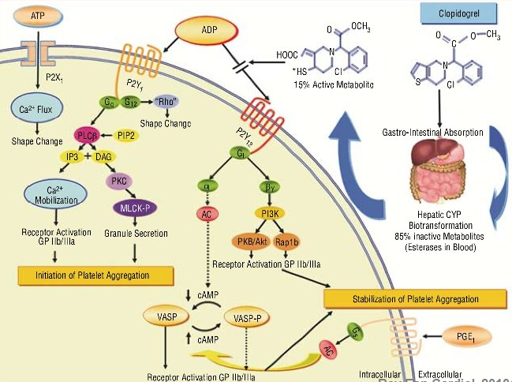
Anti-Platelets
Mechanism of action:

Slide 7
Comparison between Anti-Platelets
 | Clopidogrel | Prasugrel | Ticagrelor
Pro-drug | Yes |  | No
Protein bind | High (98%)
Onset of action | 2 hr | 30 min | 30 min
DOA | 24 hr | > 3 days | 24 hr
Dosage forms | PO
Doses | 75mg daily | 10mg daily | 90mg bid
Indications | MI PAD | MI | MI
Metabolism | CYP2C19 | CYP3A4/5/2B6 | CYP3A4/5
Half life | 6 hr | 2-15 hr | 7 hr
Elimination | 50% in urine | 68% in urine | 26% in urine
Notes:
Clopido & prasu are irreversible inh

Slide 8
Novel Anti-platelets
These drugs were compared to Clopidogrel: (phase 3 trials)
PLATO trial:
Platelet Inhibition and Patient Outcomes (Ticagrelor Compared
with Clopidogrel in Patients with ACS)
TRITON-TIMI 38 trial:
Trial to Assess Improvement in Therapeutic Outcomes by
Optimizing Platelet Inhibition with Prasugrel–Thrombolysis
In Myocardial Infarction

Slide 9
Ticagrelor

Slide 10
PLATO Trial
Study design:
STEMI
Clopidogrel-treated or -naive;
Randomised within 24 hours of index event
Clopidogrel
-If pre-treated, no additional loading dose;
-If naive: 300-600 mg loading dose, then
75 mg qd maintenance
Ticagrelor
180 mg loading dose, then
90 mg bid maintenance
6–12 month exposure
Efficacy endpoint: CV death, MI, Stroke
Stent Thrombosis Safety endpoints: Major bleeds, Life-threatening bleeds

Slide 11
PLATO Trial Results
CV death, stroke outcome:
13
12
P<0.001
Clopidogrel
11.7%
11
10
9.8%
9
8
Ticagrelor
7
K-M estimated rate (% per year)
6
5
4
3
2
1
0
0
2
4
6
8
10
12
Months

Slide 12
PLATO Trial Results
Results regarding the primary end point did not show significant heterogeneity in analyses of the 33 subgroups, except in patient:
With low weight:
p=0.04
2. Not taking lipid lowering drug:
p=0.04
3. Living in North America:
p= 0.045
Ticagrelor is less beneficial

Slide 13
PLATO Trial Results
Stent thrombosis outcome:
3
P=0.009
Clopidogrel
1.9%
2
K-M estimated rate (% per year)
1.3%
Ticagrelor
1
0
2
4
6
8
10
12
Months

Slide 14
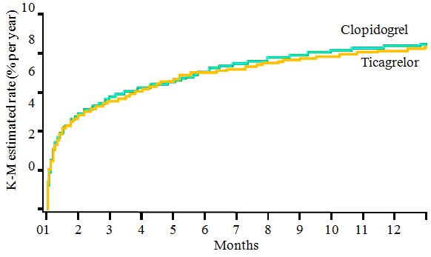
PLATO Trial Results
Bleeding Outcome:
Major bleeding risk
CABG related
15
P =0.434
Ticagrelor
11.58
11.20
p=0.32
7.9%
10
Clopidogrel
7.4%
K-M estimated rate (% per year)
5
0
0
2
4
6
8
10
12
Months
Notes:
major life-threatening bleeding :
fatal bleeding, intracranial bleeding, intrapericardial bleeding with cardiac tamponade, hypovolemic shock or severe hypotension due to bleeding
and requiring pressors or surgery, a decline in the hemoglobin level of 5.0 g per deciliter or more, or the need for transfusion of at least

Slide 15
PLATO Trial Results
Bleeding Outcome:
Non-CABG related
p=0.03
10
5
Ticagrelor
4.5
K-M estimated rate (%)
3.8
Clopidogrel
0
2
4
6
8
10
12
Months
Notes:
4 units of red cells. We defined other major bleeding as bleeding that led to clinically significant disability (e.g., intraocular bleeding with
permanent vision loss) or bleeding either associated with a drop in the hemoglobin level of at least 3.0 g per deciliter but less than 5.0 g per
deciliter or requiring transfusion of 2 to 3 units of red cells.

Slide 16
PLATO Trial Results
Side effects outcome:
 | Ticagrelor | Clopidogrel | P-value
Dyspnea | 13.8% | 7.8% | <0.001
Ventricular pauses | 5.8 | 3.6 | 0.01
Syncope | 1.1 | 0.8 | 0.8
Pacemaker implantation | 0.9 | 0.9 | 0.87
Increase in uric acid by 0.2mg/dl | 52 | 31 | <0.001
Increase in Cr by 50% | 11±22 | 9±22 | <0.001
Notes:
Inc in Cr doesn’t progress during tx & return to baseline with continued tx

Slide 17
PLATO Trial Results
Patients with ACS (STEMI), treatment with ticagrelor v.s
clopidogrel:
Significantly reduces rate of death from vascular causes, MI,
or stroke & risk of stent thrombosis
No significant increase in rate of overall major & CABG
related bleeding → D/C 5 days before CABG
Significantly increases in the rate of non–CABG-related
bleeding

Slide 18
Ticagrelor in Specific Populations
Elderly (≥ 75 yr)
Diabetic patient
Patient with CKD
Patient with history of TIA/stroke
Patient with low body weight

Slide 19
Ticagrelor in Elderly
Study population
< 75 yr
≥ 75 yr
Ticagrelor
Clopidogrel
Ticagrelor
Clopidogrel
Notes:
Elderly patients with acute coronary syndrome have a high prevalence of cardiovascular risk factors and are at high risk of recurrent ischemic events and death.
Elderly patients have a high risk of complications during antithrombotic therapy and revascularization.
The increased risk of bleeding in elderly as compared with younger patients using some antiplatelet and anticoagulant therapies reduces the net clinical benefit of these therapies.

Slide 20
Ticagrelor in Elderly
Efficacy :
CV death
> 75 yr
P-value= 0.56
< 75 yr
Stent thrombosis
> 75 yr
P-value= 0.81
< 75 yr
0.5
1
2
Ticagrelor Better
Clopidogrel Better
HR
Ticagrelor decreases CV death & stent thrombosis risk in both age groups with no significant difference

Slide 21
Ticagrelor in Elderly
Bleeding risk:
Major bleed
> 75 yr
P-value= 0.89
< 75 yr
Non CABG major bleed
> 75 yr
P-value= 0.96
< 75 yr
0.5
1
Clopidogrel Better
2
Ticagrelor Better
HR
Ticagrelor increases bleeding risk in both age groups with no significant difference

Slide 22
Ticagrelor in Elderly
Side effects:
 |  | Ticagrelor | Clopidogrel
 | Age(yr) | KM% | KM% | HR | P-value
Dyspnea | ≥ 75 | 18.8 | 12.2 | 1.63 | 0.21
 | < 75 | 14.2 | 7.8 | 1.89
Ventricular pauses | ≥ 75 | 7.2 | 6.9 | 1.06 | 0.14
 | < 75 | 5.5 | 2.9 | 1.92
More S.E with ticagrelor in both age groups with no significant difference

Slide 23
Ticagrelor in Elderly
No evidence of an age-by-treatment interaction in term of:
Risk of CV death, MI, stroke
Risk of major bleeding
Side-effects (more common with ticagrelor)

Slide 24
Ticagrelor in Diabetes
Outcomes in relation to diabetes status:
 |  | Ticagrelor | Clopidogrel | P-value (int)
1ry endpoint | Non-DM | 8.4 | 10.2 | 0.49
 | DM | 14.1 | 16.2
Definite stent thrombosis | Non-DM | 1.3 | 1.8 | 0.89
 | DM | 1.6 | 2.4
Major bleeding | Non-DM | 7.6 | 7 | 0.1
 | DM | 9 | 9.9
Non CABG related bleed | Non-DM | 4.1 | 3.4 | 0.69
 | DM | 5.5 | 4.9
Ticagrelor decreases CV death & stent thrombosis but increases bleeding risk in both groups with no significant difference

Slide 25
Ticagrelor in Diabetes
Outcomes in relation to HbA1C:
 |  | Ticagrelor | Clopidogrel | P-value (int)
1ry endpoint | HbA1C<6% | 8.2 | 9 | 0.24
 | HbA1C≥6% | 11.4 | 14.2
Definite stent thrombosis | HbA1C<6% | 1.4 | 1.4 | 0.51
 | HbA1C≥6% | 1.3 | 2
Major bleeding | HbA1C<6% | 10.9 | 8.8 | 0.08
 | HbA1C≥6% | 12.3 | 12.6
Non CABG related bleed | HbA1C<6% | 4.2 | 2.9 | 0.47
 | HbA1C≥6% | 4.8 | 4.2
Ticagrelor decreases CV death & stent thrombosis but increases bleeding risk in both groups with no significant difference

Slide 26
Ticagrelor in Diabetes
Outcomes in relation to type of diabetes:
No significant difference among DM1 & DM2 in terms of risk of:
CV death, MI, stroke (p=0.73)
All causes of death (p= 0.39)
Major bleeding (p=0.08)

Slide 27
Ticagrelor in Diabetes
Ticagrelor, when compared with clopidogrel:
Reduces ischemic events in ACS patients irrespective of:
Diabetic status
Glycemic control
Without increase in major bleeding events

Slide 28
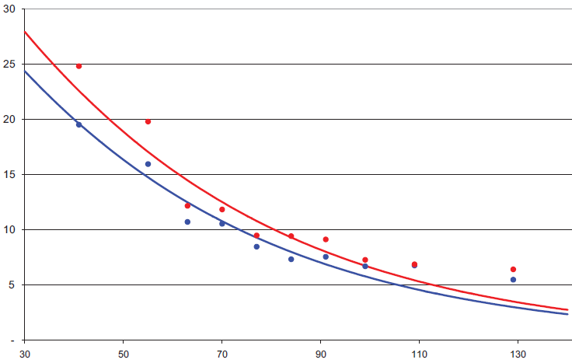
Ticagrelor in CKD
CV death risk:
Clopidogrel
P =0.13
Ticagrelor
60
Ticagrelor decreases CV death risk in both groups with no significant difference but more in renal insufficiency
Notes:
Reduced renal function is associated with a poorer prognosis and increased bleeding risk in patients with
acute coronary syndromes and may therefore alter the risk-benefit ratio with antiplatelet therapies.

Slide 29
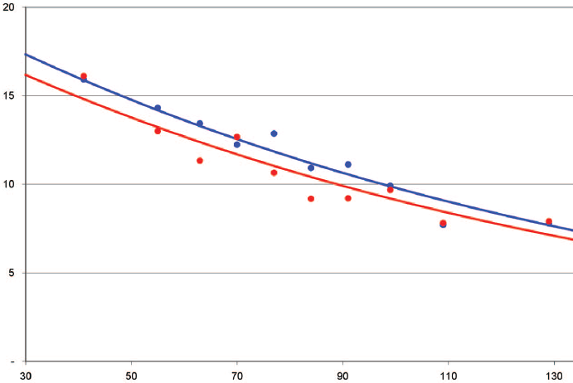
Ticagrelor in CKD
Bleeding Outcome:
Ticagrelor
P =0.92
Clopidogrel
60
Risk of:
Non-CABG bleed: p= 0.77
Intracranial bleed: p= 0.96
Numerically lower in ticagrelor group with RF versus normal renal function

Slide 30
Ticagrelor in CKD
Ticagrelor is more effective than clopidogrel in patients with ACS:
Regardless of renal function
Benefits are larger at poor renal function
No need for dose reduction to prevent major bleeding
More risk of dyspnea (p=0.04)

Slide 31
Ticagrelor in Patient with History of Stroke/TIA
Efficacy & safety results:
Patients with hx of TIA/stroke | Ticagrelor | Clopidogrel | P-value (int)
CV death risk | 19% | 20.8% | 0.84
Major bleeding risk | 14.6% | 14.9% | 0.51
Efficacy & safety of ticagrelor were same in patients with/without history of stroke/TIA

Slide 32
Ticagrelor in Patient with low body weight
Results:
Study population
Low BW
Normal BW
Clopidogrel
Ticagrelor
Ticagrelor
Clopidogrel
Less decrease in CV death risk: Pint= 0.04
Higher bleeding risk: Pint= 0.05

Slide 33
Ticagrelor Drug Interactions
Occurs with:
ASA
CYP 3A4 inhibitors/inducers
Statins

Slide 34
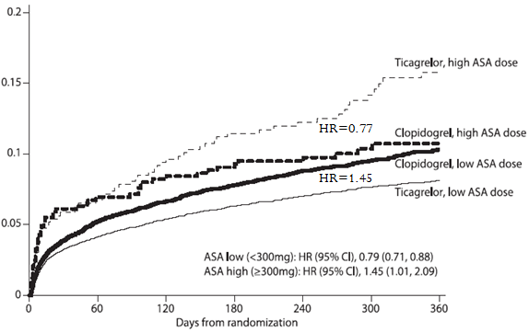
Ticagrelor Drug Interactions
Results with ASA:
P=0.00006
CV death risk (%)

Slide 35
Ticagrelor Drug Interactions
Low maintenance dose ASA had lower event rates with ticagrelor:
Clopidogrel favored for maintenance aspirin dose 300 mg
Ticagrelor favored for maintenance aspirin dose 100 mg
Black box warning

Slide 36
Ticagrelor Drug Interactions
With CYP 3A4 inhibitors/inducers:
CBZ
Phenobarbital
Rifampin
Azoles
Clarithromycin
Ticagrelor
CYP 3A4
Active metabolite
Avoid concurrent use of these drugs with ticagrelor

Slide 37
Ticagrelor Drug Interactions
Results with Statins:
Ticagrelor inhibits metabolism of simvastatin & lovastatin via CYP 3A4
Avoid doses > 40mg of these drugs with ticagrelor

Slide 38
Prasugrel

Slide 39
TRITON TIMI 38 Trial
Study design:
ACS (STEMI or UA/NSTEMI) & Planned PCI
ASA
N= 13,600
Double-blind
Clopidogrel
300 mg LD/ 75 mg MD
Prasugrel
60 mg LD/ 10 mg MD
Median duration of therapy - 12 months
Efficacy endpoint: CV death, MI, Stroke
Stent Thrombosis Safety endpoints: TIMI major bleeds, Life-threatening bleeds

Slide 40
TRITON TIMI 38 Trial Results
Efficacy results:
P =0.001
P= 0.022
Clopidogrel
12.1%
15
9.9%
10
Prasugrel
Endpoint (%)
2.4
5
1.8
0
0
30
60
90
180
Days
270
360
450

Slide 41
TRITON TIMI 38 Trial Results
Stent thrombosis outcome:
P =0.008
P =0.023
2.4%
Endpoint (%)
Clopidogrel
2
1.1 %
Prasugrel
1
0
30
60
90
180
Days
270
360
450

Slide 42
TRITON TIMI 38 Trial Results
Bleeding outcomes:
Non-CABG related
CABG related
Prasugrel
p=0·0033
20
P=0.645
5
Endpoint (%)
Prasugrel
Clopidogrel
Endpoint (%)
Clopidogrel
5
0
90
180
270
360
450
0
90
180
360
450
Days
Days
Must be D/C 7 days before CABG

Slide 43
TRITON TIMI 38 Trial Results
Patients with ACS, treatment with prasugrel v.s clopidogrel:
Significantly reduces rate of death from vascular causes, MI,
or stroke & risk of stent thrombosis
No significant increase in rate of non-CABG related
bleeding
Significantly increases the rate of CABG-related bleeding

Slide 44
Prasugrel in Specific Populations
Elderly (≥ 75 yr)
Patient with low body weight (< 60kg)
Patient with history of stroke/TIA
Patient with CKD
Diabetic patient

Slide 45
Prasugrel in Elderly
Results:
CV death risk:
Bleeding risk:
P-value (int)
P = 0.24
Age
<75 yr
P = 0.18
But more cases (16%of the population)
>75 yr
Age
<75 yr
P=0.6
>75 yr
P=0.68
0.5
1
2
Prasugrel Better
HR
Clopidogrel Better
No significant difference between all age groups in terms of:
CV death & bleeding risk

Slide 46
Prasugrel in Patient with Low Body Weight
Results:
P-value (int)
CV death risk:
Bleeding risk:
wt
≥ 60 kg
P=0.54
P=0.02
P=0.12
<60 kg
But more cases
wt
P = 0.09
<60 kg
≥ 60 kg
P = 0.36
0.5
1
2
Prasugrel Better
HR
Clopidogrel Better

Slide 47
Prasugrel in Patient with Low Body Weight
Regarding CV death risk with both drugs:
No significant difference in patients with normal BW& between different BW groups
Significantly decreased with clopidogrel in patients with
low BW
Regarding bleeding risk:
More cases with prasugrel in low patient BW group
No significant difference between both groups

Slide 48
Prasugrel in Elderly & Low BW
In elderly:
Generally prasugrel is not recommended except in high-risk
patients (DM or prior MI) in whom its effect appears to be
greater
In patient < 60 kg:
Decreasing dose of prasugrel to 5 mg, decreases exposure to
active metabolite to level were consistent outcomes are
observed as the opposite groups
Safety & efficacy of this dose is still under study

Slide 49
Prasugrel in Patient with History of Stroke/TIA
Results:
P-value (int)
CV death risk:
Bleeding risk:
P=0.15
Hx of TIA
P=0.02
No TIA
P=0.15
P = 0.04
P = 0.006
Hx of TIA
P = 0.02
No TIA
0.5
1
2
Prasugrel Better
HR
Clopidogrel Better

Slide 50
Prasugrel in Patient with History of Stroke/TIA
In patients with history of stroke/TIA:
Efficacy of prasugrel decreases significantly
Bleeding risk increases significantly with prasugrel
Contraindication

Slide 51
Prasugrel in CKD & DM
Efficacy results:
P-value (int)
UA/NSTEMI
P=0.2
STEMI
P=0.02
No DM
P=0.09
DM
P<0.001
CrCl < 60
P=0.08
CrCl > 60
0.5
1
2
Prasugrel Better
HR
Clopidogrel Better
Efficacy of prasugrel in decreasing CV death risk is consistent, regardless of:
Type of MI, renal function, diabetes status

Slide 52
Prasugrel in DM
Bleeding Risk in Diabetic Subgroup:
Non-CABG Bleeds
10
8
P=0.81
6
Endpoint (%)
Clopidogrel
4
2.6%
2
Prasugrel
2.5%
0
0
30
60
90
180
270
360
450
Days

Slide 53
Prasugrel-Drug Interaction
Efficacy outcome:
With PPI
P= 0.054
Mean inhibition of platelet aggregation
Without PPI
High dose ASA
P= 0.14
Low dose ASA
P= 0·021
GPI
P= 0·5
P= 0.44
No GPI
0.5
1
2
Prasugrel Better
HR
Clopidogrel Better
Notes:
With PPI: both clopido (7.7%) & prasug (6.2%) inc risk of CV death in comparison with no PPI (clop: 6.6%, pras: 5.4%)
Clopi : with vs without PPI p=0.02 (lower mean inh.. In PPI grp)
Pras.: with vs without PPI p=0.054

Slide 54
Prasugrel-Drug Interaction
Results:
Consistent benefits of prasugrel & clopidogrel among patients who received:
Varying doses of ASA
GPI
PPI
Statins
Use with strong CYP 3A4 inhibitors is not recommended since prasugrel is metabolized by it
Notes:
Both (pras. 5% & clopido 6.1%) dec risk of death in statin grp > non statin grp ( clop 8.9%, pras 7%)

Slide 55
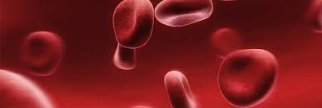
Novel Anticoagulants

Slide 56
Comparison between Anticoagulants
 | Old anticagulant | Novel anticoagulant
 | Warfarin | Rivaroxaban | Apixaban
MOA | Inhibits vitamin K epoxide reductase | Factor Xa inhibitors → inhibits fibrin formation
Onset of action | 5-7 days | 1-3 hr | 1-3 hr
Dosing interval | Once daily PO |  | Twice daily PO
Half life (hr) | 20-60 hr | 5-9 | 8-15
Metabolism | CYP2C19 | CYP3A4
Elimination | 92% | 66% → need adjustment | 25%
Monitoring | INR, drug & food interactions | None required

Slide 57
Problems with warfarin:
Narrow therapeutic range
Novel anticoagulants:
Wide therapeutic range
Rapid onset/offset of action
Slow onset of action
Long DOA & half life
Multiple drug & dietary interactions
Monitoring required (INR)
Major side
No food or DDI
Antidote needed
Well defined pharmacokinetics (in renal or hepatic disease)
No monitoring required
Easily reversible
Genetic polymorphism
Rational Behind Novel Anticoagulants Use

Slide 58
Novel Anticoagulants
These drugs were compared to warfarin: (phase 3 trials)
ROCKET-AF trial:
Rivaroxaban Once-daily oral direct factor Xa inhibition
Compared with vitamin K antagonism for prevention of stroke
and Embolism Trial in Atrial Fibrillation
ARISTOTLE trial:
Apixaban versus Warfarin in patients with Atrial Fibrillation

Slide 59
ROCKET-AF Trial
Study design:
Risk Factors:
CHF
Hypertension
Age ≥ 75
Diabetes
OR
Stroke, TIA or Systemic embolus
At least 2- 3 required
Atrial Fibrillation
Randomized
(Double Blind)
Rivaroxaban 20 mg daily
15 mg if Cr Cl 30-49 ml/min
Warfarin
INR target: 2-3
Monthly monitoring
Efficacy outcome: Stroke or non-CNS systemic embolism
Safety outcome: Major or non-major clinically relevant bleeding

Slide 60
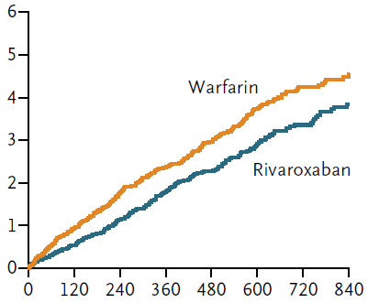
ROCKET-AF Trial Results
Efficacy outcome (non-inferiority):
P<0.001
P (superiority) = 0.02

Slide 61
ROCKET-AF Trial Results
Bleeding outcome:
Major bleed
P = 0.58
Non-major Bleed
P = 0.35
Intracranial Bleed
P = 0.02
0.5
1
2
Rivaroxaban Better
HR
Warfarin Better
Notes:
Major bleed: 3.6 vs 3.4 (warfarin less bleed risk but not sig) HR=1.04
Non major bleed: 16.7 vs 16.2 % (warfarin less bleed risk but not sig) HR=1.04
IC bleed: 0.8 vs 1.2% ( riva less IC bleed sig) HR= 0.67

Slide 62
ROCKET-AF Trial Results
Patients with ACS, treatment with rivaroxaban vs warfarin:
Significantly reduces rate of stroke or non-CNS systemic
embolism risk
Similar rates of major & non- major bleeding
Significantly decreases the rate of intracranial bleeding
Notes:
Rivaroxaban was non-inferior to warfarin for prevention of stroke and non-CNS embolism.
Rivaroxaban was superior to warfarin while patients were taking study drug.
By intention-to-treat, rivaroxaban was non-inferior to warfarin but did not achieve superiority.

Slide 63
Rivaroxaban in Specific Populations
Elderly (≥ 75 yr)
Patient with low body weight (< 60kg)
Obese patient
Patient with renal impairment
Pregnancy

Slide 64
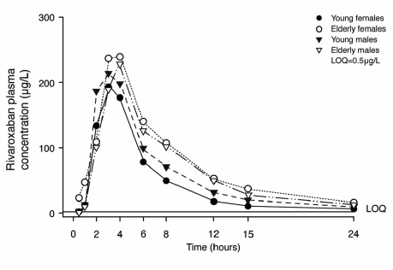
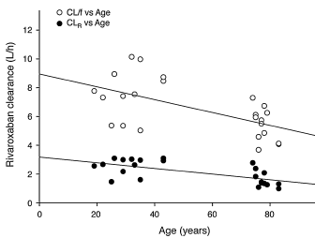
Rivaroxaban in Elderly
Pharmacokinetic results
Near each other
AUC increases significantly in elderly (41% higher) due to decrease renal function in this age group, but Cmax is similar
Notes:
Cl/f: total clearance
Cl/R: renal clearacne

Slide 65
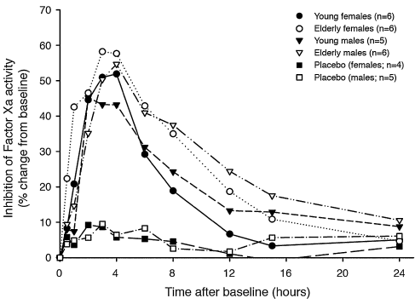
Rivaroxaban in Elderly
Efficacy:
Inhibition of Factor Xa activity and prolongation of prothrombin time were higher (p<0.05) in elderly BUT the influence was not considered clinically relevant

Slide 66
Rivaroxaban in Patient With Body Weight Extremes
Rivaroxaban was studied in 2 BW groups:
BW ≤50 kg
BW >120kg
Results:
BW ≤50 kg | BW >120kg
C_{max} of rivaroxaban was increased by 24% 15%(small) increase in prolongation of prothrombin time not clinically relevant | C_{max} of rivaroxaban was unaffected
AUC was unaffected by body weight
No need for dose adjustment

Slide 67
Rivaroxaban in CKD
Study design:
Study population
CrCl 30-49 ml/min
CrCl ≥50 ml/min
Rivaroxaban 15 mg qd
Warfarin adjusted dose
Rivaroxaban 20mg qd
Warfarin

Slide 68
Rivaroxaban in CKD
Efficacy outcome:
Stroke & systemic embolism
CrCl 30-49ml/min
P _{(int)}= 0.76
CrCl ≥50 ml/min
Ischemic stroke
CrCl 30-49ml/min
P _{(int)}= 0.41
CrCl ≥50 ml/min
0.5
1
2
Rivaroxaban Better
HR
Warfarin Better

Slide 69
Rivaroxaban in CKD
Bleeding outcome:
Major bleed
CrCl 30-49ml/min
P _{(int)}= 0.48
CrCl ≥50 ml/min
Intracranial Bleed
CrCl 30-49ml/min
P _{(int)}= 0.51
CrCl ≥50 ml/min
0.5
1
2
Rivaroxaban Better
HR
Warfarin Better

Slide 70
Rivaroxaban in CKD
Rate of stroke, systemic embolism risk & bleeding episodes were higher in those with renal insuffiecency regardless of the treatment given
But less bleeding occurred with rivaroxaban
Adjust dose in CrCl 30-49ml/min to avoid accumulation

Slide 71
Rivaroxaban in Pregnancy
Pregnancy Category C
There are no adequate or well-controlled studies for use in
pregnant women
Dosing for pregnant women has not been established

Slide 72
Rivaroxaban-Drug Interaction
Significantly with:
CYP inhibitors:(increase levels 30-100%)
Ketoconazole
Ritonavir
Macrolids (clarithromycin & erythromycin)
CYP inducers: (decrease levels 50%)
Rifampicin
No DDI with H2blockers & antacids
No information on PPIs
Recommended to be taken with food

Slide 73
ARISTOTLE Trial
Study design:
Inclusion criteria:
Age ≥ 75 yr
Prior stroke/TIA
HF or LVEF ≤ 40%
DM
HTN
Randomized
Double blind
Exclusion criteria:
Mechanical prosthetic valve
Severe renal insufficiency
Apixaban 5 mg PO bid
(2.5 mg bid in selected patients)
Warfarin
(target INR 2-3)
Efficacy outcome: Stroke or systemic embolism risk
Safety outcome: Risk of major bleeding
Notes:
stroke (ischemic or hemorrhagic)

Slide 74
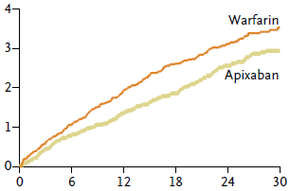
ARISTOTLE Trial Results
Efficacy outcome (non-inferiority):
P<0.001
Events (%)
Months

Slide 75
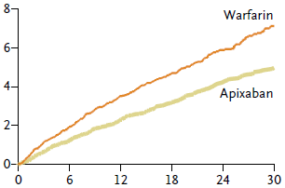
ARISTOTLE Trial Results
Bleeding outcome:
P<0.001
All types of bleeding were significantly less with apixaban except GI bleed (p=0.73)
Events (%)
Months

Slide 76
ARISTOTLE Trial Results
Patients with ACS, treatment with apixaban vs warfarin:
Significantly reduces rate of stroke or non-CNS systemic
embolism risk
Significantly decreases the rate of major & non-major
bleeding
Except GI bleeding
Notes:
Rivaroxaban was non-inferior to warfarin for prevention of stroke and non-CNS embolism.
Rivaroxaban was superior to warfarin while patients were taking study drug.
By intention-to-treat, rivaroxaban was non-inferior to warfarin but did not achieve superiority.

Slide 77
Apixaban in Specific Populations
Elderly (≥ 75 yr)
Patient with low body weight (< 60kg)
Patient with renal impairment
Obese
Pregnancy

Slide 78
Apixaban in Elderly
Results:
Efficacy outcome
< 65
P = 0.12
65-75
Age
≥75
Bleeding outcome
< 65
P = 0.18
Age
65-75
≥75
0.5
1
2
Apixaban Better
HR
Warfarin Better

Slide 79
Apixaban in Patient With Low Body Weight
Results:
Efficacy outcome
≤ 60 kg
P = 0.26
Wt
>60 kg
Bleeding outcome
≤ 60 kg
P = 0.22
Wt
>60 kg
0.5
1
2
Apixaban Better
HR
Warfarin Better

Slide 80
Apixaban in CKD
Results:(in terms of renal impairment level)
Efficacy outcome
Severe or moderate
P = 0.72
Mild
No impairment
Bleeding outcome
Severe or moderate
P = 0.03
Mild
No impairment
0.5
1
2
Apixaban Better
HR
Warfarin Better

Slide 81
Apixaban in Specific Population
Efficacy & safety of apixaban are consistent regardless to:
Age
Body weight
Renal function
No need to adjust the dose

Slide 82
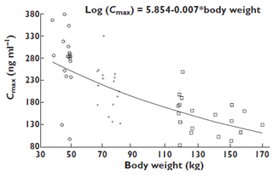
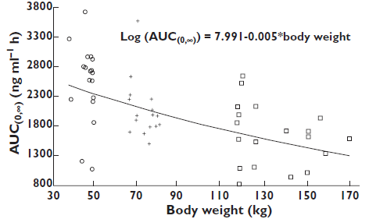
Apixaban in Obese
Pharmacokinetic parameters:
P-value<0.001
Vijay V. Upreti,1 Jessie Wang. Effect of extremes of body weight on the pharmacokinetics, pharmacodynamics, safety and tolerability of apixaban in healthy subjects.Br J Clin Pharmacol. 2011;76(6):908–916
Notes:
Normal: 50-120 kg

Slide 83
Apixaban in Obese
Pharmacokinetic parameters:
 | Under weight (≤50 kg) | Reference (65-85kg) | Obese(≥120kg)
Cmax (ng/ml) | 264 | 207 | 144
AUCo→∞ (ng/ml.hr) | 2424 | 2024 | 1561
higher by 30%
lower by 30%
higher by 20%
lower by 20%

Slide 84
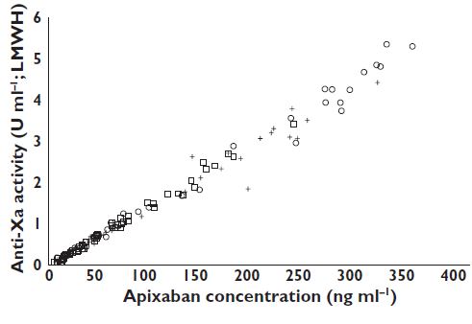
Apixaban in Obese
Efficacy:
Different weights
Plasma anti-factor Xa activity showed a direct, linear relationship with apixaban plasma concentrations, regardless of body weight groups

Slide 85
Apixaban in Obese
Recommendations:
Apixaban was well tolerated (no A.E nor bleeding-related AE)
regardless to body weight
No dose adjustment is recommended based on body weight alone
Dose reduction is recommended for those patients with ≥ 2:
Age ≥80 years
Body weight ≤60 kg
Serum creatinine ≥1.5 mg/dl

Slide 86
Apixaban in Pregnancy
Avoided because insufficient data to evaluate safety in
pregnant women

Slide 87
Take home message
Ticagrelor:
Reduces ischemic outcomes & mortality without increasing overall major bleeding rates
Not affected by: age, diabetes status, renal function, stroke history, body weight
Not used concurrently with:
ASA (dose>100mg) → Black box warning
D/C 5 days before CABG
CYP 3A4 inhibitors/inducers
High dose statins (>40mg)

Slide 88
Take home message
Prasugrel:
Reduces ischemic outcomes & mortality with increasing CABG related bleeding rates
Not affected by: diabetes status, renal function
Used in caution in elderly & low weight patient
Use 5 mg dose in specific patients
CI in patient with history of stroke/TIA
Not used concurrently with CYP 3A4 inhibitors/inducers

Slide 89
Take home message
In patients with A. fib, rivaroxaban was superior to warfarin:
Significantly decreases stroke & intracranial bleeding risk, regardless of:
Age
Dose adjustment:
Pregnancy
Body weight
CrCl 30-49 ml/min
Contraindication:
CrCl < 30ml/min
CYP 3A4 inhibitors/inducers

Slide 90
Take home message
In patients with A. fib, apixaban was superior to warfarin:
Preventing stroke or systemic embolism
Same across all subgroups (all P >0.1)
Decreasing risk of bleeding
More in moderate to severe renal impairment (Pint = 0.03)
CI in pregnancy

Slide 91
Pharmacist Role
Pharmacists can decrease rate of death in our population
Read the prescription well
Adjust the dose depending on age & PMH if needed (refer to the dr.)
Ask if patient is pregnant
Check for DDI
Counsel about non-pharmacological treatment
THEY MUST

Slide 92
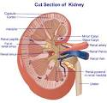
Pharmacist Role
Prasugrel 5mg daily
Rivaroxaban,apixaban & ticagrelor CI
Riva, Pras.,Tica. With
CYP inh/inducers
ASA>100mg, Statin
>40mg →ticagrelor CI
Rivaroxaban CI <30ml/min
(adjust when CrCl 30-49)

Slide 93
References
1. Fox KAA, Piccini JP, Wojdyla D, et al. Prevention of stroke and systemic embolism with rivaroxaban compared with warfarin in patients with non-valvular atrial fibrillation and moderate renal impairment. Eur Heart J. 2011;32(19): 2387–2394
2. Halperin JL, Wojdyla D, Piccini JP, et al. Efficacy and safety of rivaroxaban compared with warfarin among elderly patients with nonvalvular atrial fibrillation in the ROCKET-AF trial. Stroke. 2012;43: A148
3. Vijay V. Upreti,1 Jessie Wang. Effect of extremes of body weight on the pharmacokinetics, pharmacodynamics, safety and tolerability of apixaban in healthy subjects.Br J Clin Pharmacol. 2011; 76(6):908–916
4. Dagmar K., Michael B. Body Weight Has Limited Influence on the Safety, Tolerability, Pharmacokinetics, or Pharmacodynamics of Rivaroxaban. J Clin Pharmacol. 2007;47(2): 218–226
5. Lars W., Richard C. Ticagrelor versus Clopidogrel in Patients with Acute Coronary Syndromes. N Engl J Med 2009;361:1045-57

Slide 94
References
6. Gilles M., Stephen D. Prasugrel compared with clopidogrel in patients undergoing percutaneous coronary intervention for ST-elevation myocardial infarction (TRITON-TIMI 38): double-blind, randomised controlled trial. Lancet 2009; 373: 723–31
7. Manesh R., Kenneth W. Rivaroxaban versus Warfarin in Nonvalvular Atrial Fibrillation. N Engl J Med 2011;365:883-91
8. Christopher B.,John H. Apixaban versus Warfarin in Patients with Atrial Fibrillation. N Engl J Med 2011;365:981-92.
9. Stefan J.,Andrzej B., Ticagrelor Versus Clopidogrel in Acute Coronary Syndromes in Relation to Renal Function Results From the Platelet Inhibition and Patient Outcomes (PLATO) Trial. Circulation. 2010 Sep 14;122(11):1056-67
10. Pharmacodynamic assessment of platelet inhibition by prasugrel vs. clopidogrel in the TRITON-TIMI 38 trial. European Heart Journal. 2009;30:1753–1763

