Slide 1

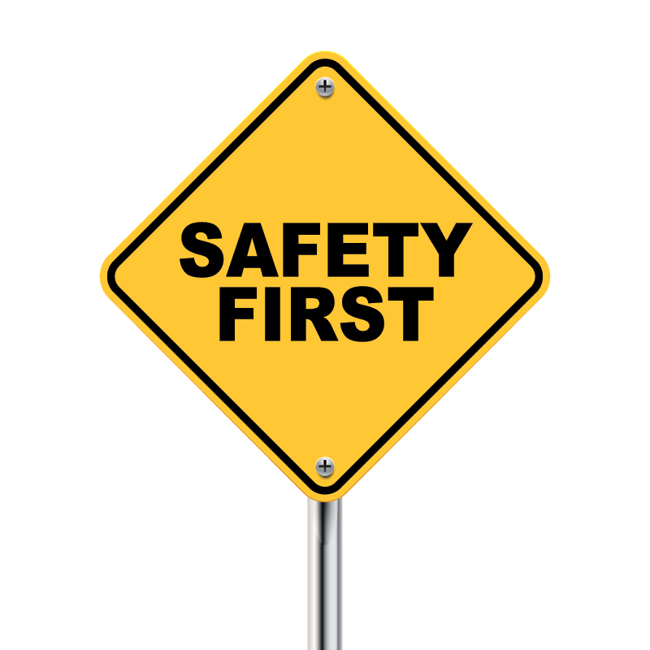

The Impact of Medical Marijuana on
Safety Sensitive Positions
Presented by: Suzie Paulson, OMAG General Counsel

Slide 2
Oklahoma Medical Marijuana &
Patient Protection Act
Allows employers to lawfully refuse to hire applicants for safety-sensitive jobs or to discipline or discharge employees who work in safety-sensitive jobs if they test positive for marijuana, even if they have a valid license to use medical marijuana.

Slide 3

Do NOT ask or require an applicant or employee to produce a Medical Marijuana license!

Slide 4
To start with . . .
Safety sensitive exceptions should be construed narrowly to limit the overall number of job positions who qualify
Analyze the job duties of each position against the safety sensitive examples provided in the State and Federal law
Ensure that duties considered are actual job duties of the particular position

Slide 5
To start with . . .
Notify employees in safety sensitive roles they are subject to testing and may be subject to disciplinary action in the event of a positive test for marijuana
Review and confirm a safety-sensitive designation prior to taking disciplinary action against an employee

Slide 6
Safety Sensitive Definitions
State Law
Oklahoma Workplace Drug & Alcohol Testing Act
Oklahoma Medical Marijuana Patient Protection Act
Federal Law
DOT Regulations
PHMSA Regulations

Slide 7
Oklahoma Standards for Workplace Drug & Alcohol Testing Act
(40 O.S. § 551 et seq.)
Written detailed policy before a drug test is administered
Employee is defined as person who supplies labor for remuneration to his employer
Testing can occur (1) pre-employment (2) for cause (3) post accident (4) random (5) post rehabilitation or return to work/fitness for duty in certain safety sensitive positions
Only 5 categories of employees who can be RANDOMLY tested
Strict rules for collection, storage, transportation, and testing facilities
EAP that provides drug/alcohol dependency care
Monetary fines for employers ($500 each violation)
Notes:
B. An employer who implements a drug or alcohol testing policy or changes its policy, shall provide at least ten (10) days' notice to its employees and shall provide a copy of its policy to each applicant upon his or her acceptance of employment by:
1. Hand-delivery of a paper copy of the policy or changes to the policy;
2. Mailing a paper copy of the policy or changes to the policy through the U.S. Postal Service or a parcel delivery service to the last address given by the employee or applicant;
3. Electronically transmitting a copy of the policy through an e-mail or by posting on the employer’s website or intranet site; or
4. Posting a copy in a prominent employee access area.
VOLUNTEER – Remuneration – “totality of the circumstances” is it money to cover expenses? Is it de minimus? Is it equivalent to min wage? This is usually limited to food, drink, travel or any equipment you need to buy. ... You might be classed as an employee or worker rather than a volunteer if you get any other payment, reward or benefit in kind.
FFD – be sure that employee is on notice that drug testing can be done before returning to work after WC injury

Slide 8


OSWDA Safety Sensitive
A public employer may require random testing only of employees who:
are police or peace officers
have drug interdiction responsibilities
are authorized to carry firearms
are engaged in activities which directly affect the safety of others
are working for a public hospital . . .
work in direct contact with inmates in the custody . . .
Notes:
Fire and Police – pretty simple

Slide 9
OSWDA: Directly Affect the Safety of Others?
Need for drug testing must be substantial - important enough to override the individual's acknowledged privacy interest, sufficiently vital to suppress the Fourth Amendment's normal requirement of individualized suspicion. Chandler v. Miller, 520 US 305 (1997)
That interest presents “special needs” beyond normal law enforcement that may justify departures from the usual warrant and probable-cause requirements. Skinner v. Ry. Labor Executives' Ass'n, 489 U.S. 602 (1989)
Significant impact upon the safety of the public, that they expose other employees to hazardous conditions or that their specific job requirements require responsibility for the safety of others.” 19 Solid Waste Dep't Mechanics v. City of Albuquerque, 156 F.3d 1068 (10th Cir. 1998)
Notes:
Our precedents establish that the proffered special need for drug testing must be substantial—important enough to override the individual's acknowledged privacy interest, sufficiently vital to suppress the Fourth Amendment's normal requirement of individualized suspicion. Chandler v. Miller, 520 U.S. 305, 318, 117 S. Ct. 1295, 1303, 137 L. Ed. 2d 513 (1997)
That interest presents “special needs” beyond normal law enforcement that may justify departures from the usual warrant and probable-cause requirements. Skinner v. Ry. Labor Executives' Ass'n, 489 U.S. 602, 603, 109 S. Ct. 1402, 1406, 103 L. Ed. 2d 639 (1989)
While the testing program's ultimate validity depends on a comparison of the government interests and privacy interests, the government must also be able to show, as a threshold matter, that its case for suspicionless testing is legitimate. Thus, even if the privacy interest is virtually non-existent, the special need requirement prevents suspicionless searches where the government has failed to show either that it has a real interest in testing or that its test will further its proffered interest. 19 Solid Waste Dep't Mechanics v. City of Albuquerque, 156 F.3d 1068, 1073 (10th Cir. 1998)
must still conduct the balancing test by weighing the government's interest in conducting suspicionless testing against the privacy interests at stake, which we evaluate by inquiring into the invasiveness of the privacy intrusion and the nature of the individual's privacy expectation. 19 Solid Waste Dep't Mechanics v. City of Albuquerque, 156 F.3d 1068, 1074 (10th Cir. 1998)
We note that the City's proffered rationale for adopting its drug-testing program was a concern for workplace and public safety and employee health, and we do not discount this rationale. Indeed, these concerns seem very real to us, unlike the concerns proffered in Chandler, despite the absence of a documented drug problem among the mechanics or any evidence that drug use by the mechanics has resulted in accidents involving the City's trash trucks. The mechanics clearly perform a job in which safety is an important concern. 19 Solid Waste Dep't Mechanics v. City of Albuquerque, 156 F.3d 1068, 1074 (10th Cir. 1998)
While we recognize that the City has important safety and health concerns in testing its mechanics for drug use, given that the scheme that the City devised would not effectively detect or deter drug use, we must conclude that the City has failed to show a special need for suspicionless drug testing. Because we find that the program is not *1075 based on a special governmental need, we do not need proceed to balance the parties' respective interests. 19 Solid Waste Dep't Mechanics v. City of Albuquerque, 156 F.3d 1068, 1074–75 (10th Cir. 1998)
Here, there is little evidence of what actually motivated the City to subject mechanics in the Solid Waste Department to suspicionless drug testing. For the most part, we have only the City's arguments as presented to the district court and to this court. At best, there is a general policy statement in the City's Administrative Instruction No. 123 that the City has an “interest in maintaining safe, healthful and efficient working conditions for its employees,” and that “[b]eing under the influence of alcohol, or the presence of certain drugs in the body system, may pose serious safety and health risks not only to the user but to all those in contact with the user.” However, this rationale could arguably be applied to any and all City employees and, in my opinion, it does not rise to the level of a real and immediate interest that could justify suspicionless drug testing. 19 Solid Waste Dep't Mechanics v. City of Albuquerque, 156 F.3d 1068, 1075 (10th Cir. 1998)
Nor has the City adequately demonstrated plaintiffs' job responsibilities are such that suspicionless drug testing is justified in the absence of a demonstrated problem of drug use. In Von Raab, the Supreme Court approved suspicionless drug testing of certain Customs Service employees even though there was no concrete evidence of a problem of drug use among such employees. 19 Solid Waste Dep't Mechanics v. City of Albuquerque, 156 F.3d 1068, 1075 (10th Cir. 1998)
Here, there is a troubling lack of evidence concerning what tasks are actually performed by plaintiffs.¹
Even overlooking this problem, I am not convinced the tasks performed and the risks faced by plaintiffs are sufficiently comparable to the employees in Von Raab to allow us to conclude the City has a special interest that justifies departure from the Fourth Amendment's usual requirement of reasonable individualized suspicion. Thus, I agree with the district court's conclusion on this point: “On the record before me, I cannot conclude that solid waste mechanics have a significant impact upon the safety of the public, that they expose other employees to hazardous conditions or that their specific job requirements require responsibility for the safety of others.” 19 Solid Waste Dep't Mechanics v. City of Albuquerque, 156 F.3d 1068, 1076 (10th Cir. 1998)

Slide 10

Federal Law: DOT (FMCSA)
Commercial Drivers License (CDL) holders who operate Commercial Motor Vehicles
(See 49 CFR Part 382)
Possession of a Commercial Driver's License (CDL) by itself, is not a safety-sensitive function.

Slide 11

Federal Law: DOT (PHMSA)
Pipeline: Operations, maintenance and emergency response of pipeline facilities.
(See 49 CFR Part 199)
Employees in a gas department that answer emergency calls and document information are safety sensitive.
Notes:
Depends--when you say dispatch--your talking employees of the gas dept, if the gas dept employees answers an emergency call and document anything--then yes. If they take the call (without noting any info) and pass it off to someone-then no. Answer service personnel taking after hour calls--yes, Police/Sheriff taking after hour emergency calls--no. We can discuss later.

Slide 12
Oklahoma Medical Marijuana &
Patient Protection Act
(OMMPPA)

Slide 13
OMMPPA - 9 Safety Sensitive Categories
Keep in Mind
New safety sensitive categories
Open to interpretation (by judges/juries)
May change in next legislative session
Don’t line up with OSWDA or DOT regulations
Notes:
REASONABLE MINDS MAY DIFFER

Slide 14

Safety Sensitive Duties:
a. the handling, packaging, processing, storage, disposal or transport of hazardous materials
b. the operation of a motor vehicle, other vehicle, equipment, machinery or power tools
c. repairing, maintaining or monitoring the performance or operation of any equipment, machinery or manufacturing process, the malfunction or disruption of which could result in injury or property damage
Notes:
Public works, utilities, police, fire, parks

Slide 15
Safety Sensitive Duties:
d. performing firefighting duties
e. the operation, maintenance or oversight of critical services and infrastructure including, but not limited to, electric, gas, and water utilities, power generation or distribution
f. the extraction, compression, processing, manufacturing, handling, packaging, storage, disposal, treatment or transport of potentially volatile, flammable, combustible materials, elements, chemicals or any other highly regulated component

Slide 16
Safety Sensitive Duties:
g. dispensing pharmaceuticals
h. carrying a firearm, or
direct patient care or direct child care
Notes:
Some cities have fitness centers with child care facilities

Slide 17

How many of you think driving a car directly affects the safety of others?
Notes:
OSWDA

Slide 18
How many think that driving a vehicle has a significant impact upon the safety of the public?
Notes:
19 Solid Waste Dep't Mechanics v. City of Albuquerque, 156 F.3d 1068 (10th Cir. 1998)

Slide 19
How many think that driving a vehicle should subject you to a suspicionless search?
Notes:
Chandler v. Miller, 520 US 305 (1997)

Slide 20
JOB DESCRIPTIONS HAVE MANY FUNCTIONS
evidence of essential job functions
Notice to employee that the position is safety sensitive
Employee notice of responsibilities & expectations
Useful in developing a vacancy announcement

Slide 21

Job Descriptions
Though an employer may use its own terminology to describe job categories, it is the actual performance of the functions which determines if an employee is safety-sensitive.

Slide 22
DO NOT JUST TYPE
“SAFETY SENSITIVE”
ON THE JOB DESCRIPTION
AND CALL IT GOOD!

Slide 23
Job Description
NOTICE: This classification is a “safety sensitive” position as defined by the United States Department of Transportation drug and alcohol testing regulations, the Oklahoma Standards for Workplace Drug and Alcohol Testing Act and/or Oklahoma Medical Marijuana laws. As a “safety sensitive” classification, you will be subject to drug and alcohol testing, including random testing. Marijuana is one of the substances included in the drug panel screening. Possession of a medical marijuana license will not excuse you from the testing process, or the consequences of testing positive for marijuana.

Slide 24

Why is this important?
The City is the government!
4th Amendment unreasonable search and seizure
Violation of employees privacy rights
No caps on damages
City, Council, and employees can be sued and liable
Notes:
Employer can randomly test employees
Any marijuana found during drug testing of a safety-sensitive employee will trigger a positive test result
Liability issues if you test employees that should not be tested
Liability issues an employee is terminated for a positive test when they have a medical marijuana license

Slide 25

Suzie Paulson, General Counsel
3650 S. Boulevard
Edmond, OK 73013
405-657-1444 spaulson@omag.org www.omag.org and www.omhrp.org

