Slide 1
Конкурс
«Мой лучший урок по ФГОС»
«Презентация к уроку по учебному предмету «Английский язык» на тему
«Мы разные, но мы вместе. Особенности инклюзии» /
On being different. School for all or Inclusive education
Бабина Елена Ивановна,
учитель английского языка
муниципальное автономное общеобразовательное учреждение
«Гимназия №6» города Губкина Белгородской области

Slide 2



Elena Babina

Slide 3


Saying
If life gives you lemons, make lemonade
Notes:
Do you like lemons?
Why not?
There is a saying in English which contains the word “lemon”. Could you make it using the words from the word splash? Any changes are possible.

Slide 4

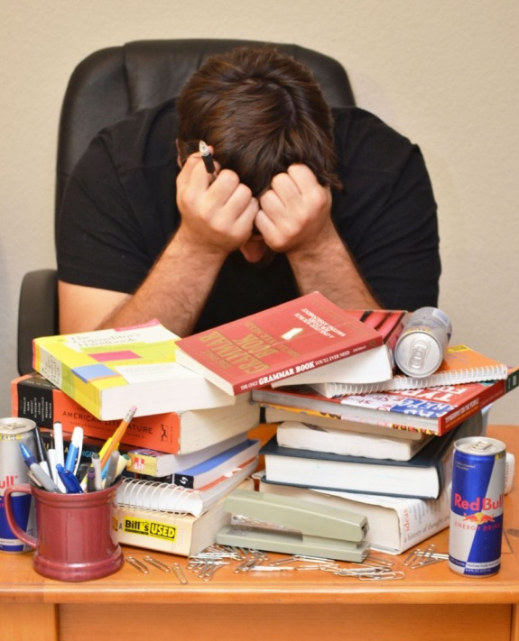

Big ?
Notes:
Could you suggest the possible topic of the lesson and its BIG Question?
I hope that today we’ll read a story about Shawn Bradley. He felt he had a problem as a child — he was so tall he towered over everyone he knew —but he turned that problem into an opportunity to become very good at the sport of basketball and a good and caring person as well.

Slide 5
Activity:
Change Problem Into Opportunity
Your TV or radio is broken
You lose your homework
You are sick and have to stay at home for two weeks
You are blind
Problem(s) | Opportunities
The best option is ____________________________________________ because _____________________________________________________
Notes:
Do you have any problems?
Is it possible to change them into opportunities – or ways to make something good hap­pen?
What opportunities come from each of these difficult situations (problems)?
Work with your partner. As you talk, use a two-column chart like the one below to note the possible opportunities.
Choose the best solution / opportunity and explain why you made that choice.

Slide 6
Activity:
Change Problem Into Opportunity
Problem(s) | Opportunities
Your TV or radio is broken | perform a play with your family
 | learn to play an instrument
 | read a book
 | play a game outside
 | …
You lose your homework | get extra practice by doing it over again
 | use the opportunity to have a conversation with your teacher...
 | …

Slide 7
Activity:
Change Problem Into Opportunity
Problem(s) | Opportunities
Your TV or radio is broken | perform a play with your family
You are sick and have to stay at home for two weeks | read those books you've always wanted to see
 | start blogging...
 | …
You are blind | learn to listen very carefully
 | learn Braille
 | use technology to read and write

Slide 8
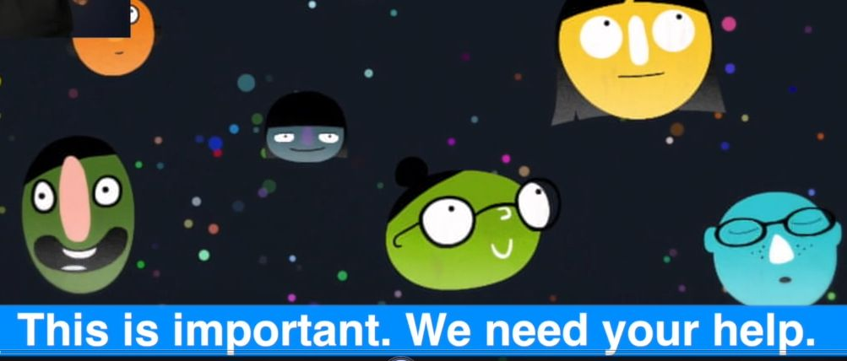
Sustainable development goals
https://vimeo.com/141065661
Notes:
I believe you know that there are a lot of more serious problems.
On September 25th, 2015 more than 100 countries (to be exact, 193) adopted a new sustainable development agenda and a set of 17 global goals to end poverty, protect the planet, and ensure prosperity for all. Each goal has specific targets to be achieved over the next 15 years.
For the goals to be reached, everyone needs to do their part:
governments,
the private sector,
civil society
and people like you.
Do you want to get involved?
You can start by watching the cartoon and then telling everyone about them.

Slide 9

Sustainable development goals

Slide 10

Sustainable development goals: Goal 4
Notes:
One of the original Millennium Development Goals was an ambition to Achieve Universal Primary Education. The new sustainable development goal relating to education is more ambitious and aims to ensure that by 2030 “all girls and boys complete free, equitable and quality primary and secondary education leading to relevant and effective learning outcomes“. Furthermore, it recognizes the importance of early childhood development and sets the challenge of ensuring that by 2030 “all girls and boys have access to quality early childhood development, care and pre-primary education so that they are ready for primary education.” There are further ambitions relating to further education, gender disparities, scholarships and supply of qualified teachers. The new goal certainly proposes a more holistic vision of how education is a lifelong process. It recognizes that education is only meaningful if it is of a certain standard. Importantly, it also implicitly acknowledges that enrolment alone is not a meaningful indicator of educational achievement or attainment nor does it alone lead to increasing social and economic mobility.

Slide 11

Qualities of educated people
Notes:
What are the qualities of educated people?
What do you need to find and develop within yourself to be successful?

Slide 12
ON BEING DIFFERENT
I was tall, very tall at a really young age. This caused all sorts of problems and opportunities. I remember going to an amusement park for my fourth birthday. We arrived at a bumper car ride and everyone got to ride the cars except me. They said I was too old. I remember feeling sick inside because the worker didn't be­lieve me. I was not lying. My folks taught me not to lie. I sat down and started to cry, watching all my friends ride the cars. Finally, my mother realized what was happening and explained the situ­ation. I wasn't too old, I was just taller than kids my age. I was able to ride with my friends after that.
We carried my birth certificate with us everywhere we went after that until I was in high school. My unusual height caused people to look, as questions, laugh, tease, and sometimes even challenge me to fight. I was teased as a kid. It wasn't fair, I knew, but that was just the way it was. Luckily, I was taught at a very young age a very important lesson. I matter and I'm important. No one could ever take that away from me. That alone helped me through the frustrations of normal life.
Notes:
by Shawn Bradley

Slide 13
ON BEING DIFFERENT
When I was in junior high school, I realized something else that helped me cope. Most teasing and harassing came from one of two places — people who were either jealous or ignorant.1 couldn't change the way they were, but I could affect the way I felt. I was not going to feel bad because of their ignorance or jealousy. It wasn't worth it! Realizing this didn't stop them, or change the fact that these comments hurt. It did, however, give me a way to understand these people and deal with their treatment in a way that was okay for me.
These things still happen today. It will probably happen the rest of my life. I will always be 7 feet 6 inches (2.29 meters) tall. I wouldn't change that for anything. People will always look because it is not every day that you see someone that tall. I learned that at a young age and I now try to teach my own children that they are important! They matter and, most importantly, God loves them. That is the message I give to you. Regard­less of your race, religion, ethnic background, or circumstances...
Notes:
by Shawn Bradley

Slide 14
On Being Different
Write the major problem Shawn Bradley faces
Brainstorm at least three solutions for this problem
Analyze, or think carefully about what is good and bad about each solution and make notes about your ideas
Write which one is your best solution and why
Compare your solution to those of others
Problem(s) | Opportunities
The best option is ____________________________________________ because _____________________________________________________
Notes:
Let’s read the story “On Being Different”.
As I have already mentioned at the beginning of the lesson the story is about someone's challenges that were also opportunities. As you read, use a two-column chart like the one below to note the chal­lenges and opportunities that Shawn Bradley has faced

Slide 15

Don't Laugh At Me
https://www.youtube.com/watch?v=f7Dej4Gfkmc
Notes:
What things have your parents taught you that help you to cope with challenges in your life?
I'm a little boy with glasses
The one they call the geek
A little girl who never smiles
'Cause I've got braces on my teeth
And I know how it feels
To cry myself to sleep.
I'm that kid on every playground
Who's always chosen last
A single teenage mother
Tryin' to overcome my past
You don't have to be my friend
Is it too much to ask?
[Chorus:]
Don't laugh at me, don't call me names
Don't get your pleasure from my pain
In God's eyes we're all the same
Someday we'll all have perfect wings
Don't laugh at me.
I'm the cripple on the corner
You pass me on the street
I wouldn't be out here beggin'
If I had enough to eat
And don't think that I don't notice
That our eyes never meet.

Slide 16
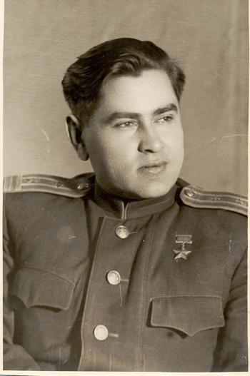
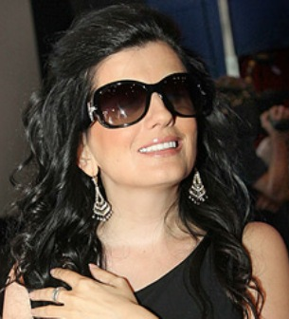
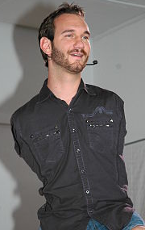
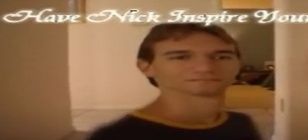
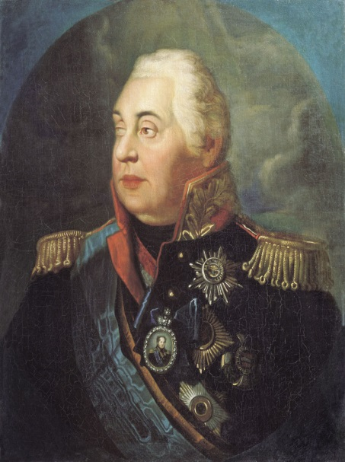
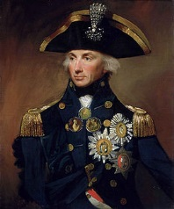
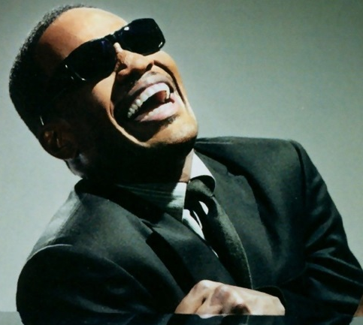
Famous People
2
1
3
6
4
5
http://www.youtube.com/watch?v=BTa1QJNkK1k
Notes:
http://www.youtube.com/watch?v=BTa1QJNkK1k
Shawn’s problem was his unusual height.
Look at the screen.
Do you know people there?
What do they have in common?
Mikhail Kutuzov
Horatio Nelson - a British naval commander and national hero, famous for his naval victories against the French during the Napoleonic Wars.
Alexey Maresyev - a Soviet fighter ace during World War II.
Stevie Wonder
Diana Gurckaia
Nick Vujicic
They all are people with disabilities. But they were and some of them are very active nowadays.
(Optional:
Just look at the screen.
Ник Вуйчич.mp4 (5:00)

Slide 17
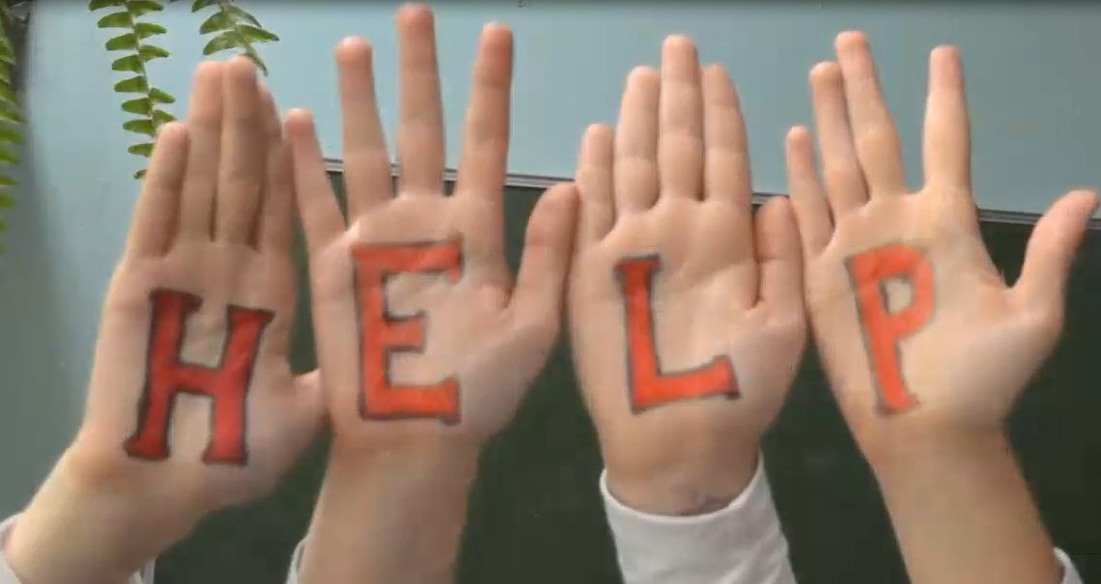
Let’s extend a helping hand
Notes:
Are there such people around you?
What can you do for them?
(Possible answers)
I think the first thing we should do is to consider them PEOPLE and respect them and treat them in a proper way.
You can HELP.

Slide 18
Hometask
Problem
Solution 1
Solution 1
Solution 1
My Solution and Opportunity
Describe a problem you face in your life
Suggest at least three solutions to the problem
Analyze each solution: what is good and bad about it
Choose the best solution and explain why you made that choice
Is there any way in which, your problem is also an opportunity?
Write your problem-solution story in paragraphs

Slide 19

Big question
Notes:
I hope you remember about global goals.
How many are them in the list? (17)
I would like to ask you to choose only one and write what you can do to achieve the goal.

Slide 20

Education Diamante

Slide 21

Diamante
Noun
Adjective, Adjective
Verb, Verb, Verb*
Noun, Noun, Noun, Noun
Verb, Verb, Verb*
Adjective, Adjective
Noun
* Gerund (action words with –ing ending)
7 lines
diamond shape
word count:
1, 2, 3, 4, 3, 2, 1

Slide 22
Example: War and Peace
Title | Line No. | Types of Words to Use
War | 1 | The topic or theme; the opposite of the noun in the last line (#7)
dark, loud | 2 | Adjectives describe the noun in the first line
hurting, screaming, crying | 3 | Gerunds describe the noun in the first line
fight, fear, home, sleep | 4 | Two nouns relate to line #1, two – to line #7
holding, caring, laughing | 5 | Gerunds describe the noun in the last line
quiet, deep | 6 | Adjectives describe the noun in the last line
Peace | 7 | An antonym (the opposite) of the noun in the first line (#1)

Slide 23

Motivational quote
Remember everyone here is important
When you're forgotten it makes you feel sad
Know that you matter and you make a difference
Let no one shame you or make you feel bad.

Slide 24
Sources
Mikhail Kutuzov (n.d.). [Graph illustration]. Retrieved October 18, 2015 from http://dic.academic.ru/pictures/wiki/files/75/Kutuzov_by_Volkov.jpg
Horatio Nelson (n.d.). [Graph illustration]. Retrieved October 18, 2015 from https://upload.wikimedia.org/wikipedia/commons/thumb/7/72/HoratioNelson1.jpg/270px-HoratioNelson1.jpg
Alexey Maresyev (n.d.). [Graph illustration]. Retrieved October 18, 2015 from https://upload.wikimedia.org/wikipedia/commons/5/55/Maresiev.jpg
Stevie Wonder (n.d.). [Graph illustration]. Retrieved October 18, 2015 from http://fooz.ru/images/stories/2015/Novosti/01-2015/04/Syivi_Yander.jpg
Diana Gurckaia (n.d.). [Graph illustration]. Retrieved October 18, 2015 from http://aifudm.net/upload/iblock/fc0/fc045d2c55f293d7197dd3001043e88c.jpg
Nick Vujicic (n.d.). [Graph illustration]. Retrieved October 18, 2015 from https://upload.wikimedia.org/wikipedia/commons/thumb/e/e4/Nick_Vujicic_speaking_in_a_church_in_Ehringshausen,_Germany_-_20110401-02.jpg/250px-Nick_Vujicic_speaking_in_a_church_in_Ehringshausen,_Germany_-_20110401-02.jpg
Goals. [Graph illustration]. Retrieved October 18, 2015 from http://i1.wp.com/www.un.org/sustainabledevelopment/wp-content/uploads/2015/09/Icons-FINAL.png
Body template [Graph illustration]. Retrieved October 19, 2015 from http://www.clipartbest.com/cliparts/4cb/Kya/4cbKyayoi.jpeg
Lemon [Graph illustration]. Retrieved October 19, 2015 from http://sweetfrog.com/images/uploads/updated-flavors/Luscious-Lemon-600x600.jpg
American Themes: An Anthology of Young Adult Literature. Office of English Language Programs. Washington, D.C. 2012
Harris, Iona-Jane. (2015). Can we ensure inclusive and quality education for all by 2030? Retrieved from https://www.educateforlife.org.uk/2015/09/24/inclusive-and-quality-education-for-all/
Thatmom. (2009). The 20 qualities of an educated person. Retrieved from http://thatmom.com/2009/09/16/the-20-qualities-of-an-educated-person/
Accessible WLL Animation (International Sign, CC, Audio description) on Vimeo (2015). [Video]. October 18, 2015 https://vimeo.com/141065661

