Slide 1
The COSO Internal Control—Integrated Framework
Lanigan & Associates, P.C
Erik Luoma, CPA
John Keillor, CPA, CIA
August 25, 2017

Slide 2
Discussion Points
Introduction to the COSO Internal Control—Integrated Framework
The 5 components and 17 underlying principles of internal control
Case studies

Slide 3
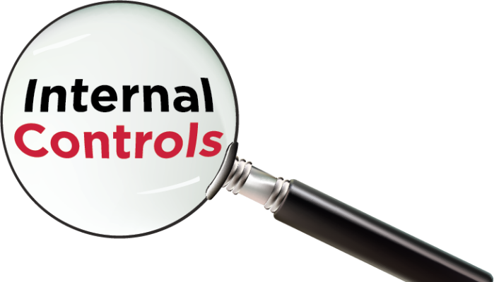
Definition of Internal Control
Internal Control is a process, effected by an entity’s board of directors, management, and other personnel, designed to provide reasonable assurance regarding the achievement of objectives relating to operations, reporting, and compliance.
Geared to the achievement of objectives (operational, reporting, compliance)
A dynamic, iterative, integrated process
Effected by people
Provides reasonable assurance
Adaptable to the entity structure

Slide 4
Define your objectives
What are you trying to achieve?
Operations Objectives
Reporting Objectives
Compliance Objectives

Slide 5
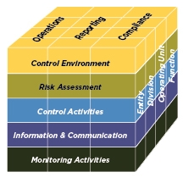
The 5 Components of Internal Control
Control Environment
Risk Assessment
Control Activities
Information and Communication
Monitoring Activities

Slide 6
PRINCIPLES OF EACH COMPONENT
Control Environment
2. Exercises oversight responsibility
3. Establishes structure, authority and responsibility
4. Demonstrates commitment to competence
5. Enforces accountability
Risk Assessment
6. Specifies suitable objectives
7. Identifies and analyzes risk
8. Assesses fraud risk
9. Identifies and analyzes significant change
Control Activities
10. Selects and develops control activities
11. Selects and develops general controls over technology
12. Deploys through policies and procedures
Information & Communication
13. Uses relevant information
14. Communicates internally
15. Communicates externally
Monitoring Activities
16. Conducts ongoing and/or separate evaluations
17. Evaluates and communicates deficiencies
1. Demonstrates commitment to integrity and ethical values

Slide 7
Control Environment
Principle 1:
The Organization demonstrates a commitment to integrity and ethical values.
Monkey see, monkey do
Notes:
Points of Focus
Sets the Tone at the Top – The board of directors and management at all levels of the entity demonstrate through their directives, actions, and behavior the importance of integrity and ethical values to support the functioning of the system of internal control.
Mission and values statements
Standards or codes of conduct
Policies and practices
Operating principles
Directives, guidelines, and other supporting communications
Actions and decisions of management at various levels and of the board of directors
Attitudes and responses to deviations from expected standards of conduct
Informal and routine actions and communication of leaders at all levels of the entity
Standards of Conduct – The expectations of the board of directors and senior management concerning integrity and ethical values are defined in the entity’s standards of conduct and understood at all levels of the organization and by outsourced providers and business partners.
Establishing what is right and wrong
Providing guidance for navigating what lies in between, considering associated risks
Reflecting governing laws, rules regulations, standards, and other expectations that the organization’s stakeholders may have, such as corporate social responsibility
Adherence to Standards of Conduct – Processes are in place to evaluate the performance of individuals and teams against the entity’s expected standards of conduct.
Addresses Deviations in a Timely Manner – Deviations from the entity’s expected standards of conduct are identified and remedied in a timely and consistent manner.
Principle 1 Approach
Establish Standards of Conduct
Lead by example on matters of integrity and ethics
Evaluate management and other personnel, outsourced service providers, and business partners for adherence to standards of conduct
Develop processes to report and promptly act on deviations from standards of conduct

Slide 8
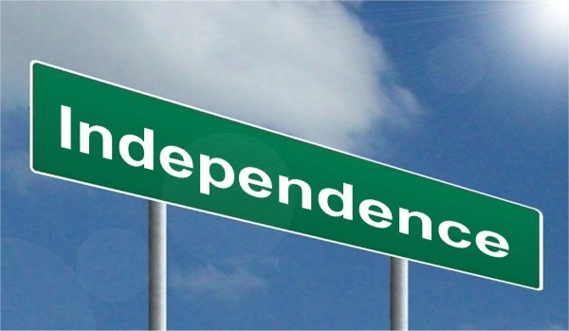
Control Environment
Principle 2:
The board of directors demonstrates independence from management and exercises oversight of the development and performance of internal control.
Notes:
Points of Focus
Establish Oversight Responsibilities – The board of directors identifies and accepts its oversight responsibilities in relation to established requirements and expectations.
Applies Relevant Expertise – The board of directors defines, maintains, and periodically evaluates the skills and expertise needed among its members to enable them to ask probing questions of senior management and take commensurate actions.
Operates Independently – The board of directors has sufficient members who are independent from management and objective in evaluations and decision making.
Provides Oversight for the System of Internal Control – The board of directors retains oversight responsibility for management’s design, implementation, and conduct of internal control.
Control Environment – Establishing integrity and ethical values, oversight structures, authority and responsibility, expectations of competence, and accountability to the board.
Risk Assessment – Overseeing management’s assessment of risks to the achievement of objectives, including the potential impact of significant changes, fraud, and management override of internal controls.
Control Activities – Providing oversight to senior management in the development and performance of control activities.
Information and Communication – Analyzing and discussing information relating to the entity’s achievement of objectives
Monitoring Activities – Assessing and overseeing the nature and scope of monitoring activities and management’s evaluation and remediation of deficiencies.
Principle 2 Approach
Establish the roles, responsibilities, and delegation of authority of the board of directors
Establish policies and practices for meetings between the board of directors and management
Identify and review board of director candidates
Review management’s assertions and judgements
Obtain an external review
Consider whistle-blower information about financial statement errors and irregularities

Slide 9
Control Environment
Principle 3:
Management establishes, with board oversight, structures, reporting lines, and appropriate authorities and responsibilities in the pursuit of objectives.
Notes:
Points of Focus
Considers All Structures of the Entity – Management and the board of directors consider the multiple structures used (including operating units, legal entities, geographic distribution, and outsourced service providers) to support the achievement of objectives.
Establishes Reporting Lines – Management designs and evaluates lines of reporting for each entity structure to enable execution of authorities of the entity.
Defines, Assigns, and Limits Authorities and Responsibilities – Management and the board of directors delegate authority, define responsibilities, and use appropriate processes and technology to assign responsibility and segregate duties as necessary at the various levels of the organization:
Board of Directors – Retains authority over significant decisions and reviews management’s assignments and limitations of authorities and responsibilities.
Senior Management – Establishes directives, guidance, and control to enable management and other personnel to understand and carry out their internal control responsibilities.
Management – Guides and facilitates the execution of senior management directives within the entity and its subunits.
Personnel – Understands the entity’s standard of conduct, assessed risks to objectives, and the related control activities at their respective levels of the entity, the expected information and communication flow, and monitoring activities relevant to their achievement of objectives.
Outsourced Service Providers – Adheres to management’s definition of the scope of authority and responsibility for all non-employees engaged.
Principle 3 Approach
Define roles and reporting lines and assess them for relevance
Define authority at different levels of management
Maintain job descriptions and service-level agreements
Define the role of internal auditors

Slide 10
Control Environment
Principle 4:
The organization demonstrates a commitment to attract, develop, and retain competent individuals in alignment with objectives.
Notes:
Points of Focus
Establishes Policies and Practices – Policies and practices reflect expectations of competence necessary to support the achievement of objectives.
Evaluates Competence and Addresses Shortcomings – The board of directors and management evaluate competence across the organization and in outsourced service providers in relation to established policies and practices, and act as necessary to address shortcomings.
Attracts, Develops, and retains Individuals – The organization provides the mentoring and training needed to attract, develop, and retain sufficient and competent personal and outsourced service providers to support the achievement of objectives.
Plans and prepares for Succession – Senior management and the board of directors develop contingency plans for assignments of responsibility important for internal control.
Principle 4 Approach
Establish required knowledge, skills, and expertise
Link competence standards to established policies and practices in hiring, training, and retention decisions
Identify and deliver on financial reporting related training as needed
Select appropriate outsourced service providers
Evaluate competence and behavior
Evaluate the capacity of finance personnel
Develop alternate candidates for key financial reporting roles

Slide 11
Control Environment
Principle 5:
The organization holds individuals accountable for their internal control responsibilities in the pursuit of objectives.
Notes:
Points of Focus
Enforces Accountability through Structures, Authorities, and Responsibilities – Management and the board of directors establish the mechanisms to communicate and hold individuals accountable for performance of internal control responsibilities across the organization and implement corrective action as necessary.
Establishes Performance Measures, incentives, and Rewards – Management and the board of directors establish performance measures, incentives, and other rewards appropriate for responsibilities at all levels of the entity, reflecting appropriate dimensions of performance and expected standards of conduct, and considering the achievement of both short-term and longer-term objectives.
Evaluates Performance Measures, Incentives, and Rewards for Ongoing Relevance – Management and the board of directors align incentives and rewards with the fulfillment of internal control responsibilities in the achievement of objectives.
Considers Excessive Pressures – Management and the board of directors evaluate and adjust pressures associated with the achievement of objectives as they assign responsibilities, develop performance measures, and evaluate performance.
Evaluates Performance and Rewards or Disciplines Individuals – Management and the board of directors evaluate performance or internal control responsibilities, including adherence to standards of conduct and expected levels of competence and provide rewards or exercise disciplinary action as appropriate.
Principle 5 Approach
Define and confirm responsibilities
Develop balanced performance measures, incentives, and rewards
Evaluate performance measures for intended influence
Link compensation and other rewards to performance

Slide 12
Risk Assessment
Principle 6:
The organization specifies objectives with sufficient clarity to enable the identification and assessment of risks relating to objectives.
Notes:
Points of Focus
Operations Objectives
Reflects Management’s Choices – Operations objectives reflect management’s choices about structure, industry considerations, and performance of the entity.
Considers Tolerances for Risk – Management considers the acceptable level of variation relative to the achievement of operations objectives.
Includes Operations and Financial Performance Goals – The organization reflects the desired level of operations and financial performance for the entity within operations objectives.
Forms a Basis for Committing of resources – management uses operations objectives as a basis for allocating resources needed to attain desired operations and financial performance.
External Financial Reporting Objectives
Complies with Applicable Accounting Standards – Financial reporting objectives are consistent with accounting principles suitable and available for that entity. The accounting principles selected are appropriate in the circumstances.
Considers Materiality – management considers materiality in financial statement presentation.
Reflects Entity Activities – External reporting reflects the underlying transactions and events to show qualitative characteristics and assertions.
External Non-Financial Reporting Objectives
Complies with Externally Established Standards and Frameworks – Management establishes objectives consistent with laws and regulations, or standards and frameworks of recognized external organizations.
Considers the Required Level of Precision – management reflects the required level of precision and accuracy suitable for user needs and as based on criteria established by third parties in non-financial reporting.
Reflects Entity Activities – External reporting reflects the underlying transactions and events within a range if acceptable limits.
Internal Reporting Objectives
Reflects Management’s Choices – Internal reporting provides management with accurate and complete information regarding management’s choices and information needed in managing the entity.
Considers the Required Level of Precision – Management reflects the required level of precision and accuracy suitable for user needs in non-financial reporting objectives, and materiality within financial reporting objectives.
Reflects Entity Activities – Internal Reporting reflects the underlying transactions and events within a range of acceptable limits.
Compliance Objectives
Reflects External Laws and Regulations – Laws and regulations establish minimum standards of conduct which the entity integrates into compliance objectives.
Considers Tolerances for Risk – Management considers to acceptable levels of variation relative to the achievement of compliance objectives.
Principle 6 Approach (financial objectives)
Identify financial statement accounts, disclosures, and assertions
Specify financial reporting objectives
Assess materiality
Review and update understanding of applicable standards
Consider the range of entity activities

Slide 13
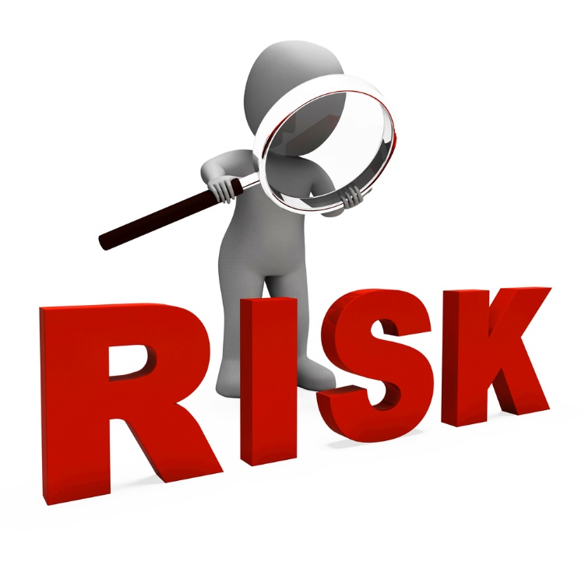
Risk Assessment
Principle 7:
The organization identifies risks to the achievement of its objectives across the entity and analyses risks as a basis for determining how the risks should be managed.
Notes:
Points of Focus
Includes Entity, Subsidiary, Division, Operating Unit, and Functional Levels – The organization identifies and assess risks at the entity, subsidiary, division, operating unit, and functional levels relevant to the achievement of objectives.
Analyzes Internal and External Factors – Risk identification considers both internal and external factors and their impact on the achievement of objectives.
Involves Appropriate Levels of Management – The organization puts into place effective risk assessment mechanisms that involve appropriate levels of management.
Estimates Significance of risks Identified – Identified risks are analyzed through a process that includes estimating the potential significance of the risk.
Determine How to respond to Risks – Risk assessment includes considering how the risk should be managed and whether to accept, avoid, reduce, or share the risk.
Principle 7 Approach
Apply a risk identification process
Assess risks to significant financial statement accounts
Meet with entity personnel
Assess the likelihood and significance of identified risks
Consider internal and external factors
Evaluate risk responses

Slide 14
Risk Assessment
Principle 8:
The organization considers the potential for fraud in assessing risks to the achievement of objectives.
Pressure
Rationalization
Opportunity
Notes:
Points of Focus
Considers Various Types of Fraud – the assessment of fraud considers fraudulent reporting, possible loss of assets, and corruption resulting from the various ways that fraud and misconduct can occur.
Assesses Incentive and Pressures – The assessment of fraud risk considers incentives and pressures.
Assess Opportunities – The assessment of fraud risk considers opportunities for unauthorized acquisition, use, or disposal of assets, altering of the entity’s reporting records, or committing other inappropriate acts.
Assesses Attitudes and Rationalizations – The assessment of fraud risk considers how management and other personnel might engage in or justify inappropriate actions.
Principle 8 Approach
Conduct fraud risk assessments
Consider approaches to circumvent or override controls
Consider fraud risk in the internal audit plan
Review incentives and pressures related to compensation programs

Slide 15
Risk Assessment
Principle 9:
The organization identifies and assesses changes that could significantly impact the system of internal control.
Notes:
Points of Focus
Assesses Changes in the External Environment – The risk identification process considers changes to the regulatory, economic, and physical environment in which the entity operates.
Assesses Changes in the Business Model – The organization considers the potential impacts of new business lines, dramatically altered compositions of existing business lines, acquired or divested business operations on the system of internal control, rapid growth, changing reliance on foreign geographies, and new technologies.
Assesses Changes in Leadership – The organization considers changes in management and respective attitudes and philosophies on the system of internal control.
Principle 9 Approach
Assess change in external environment
Conduct risk assessments relating to significant change
Consider change through succession
Consider CEO and senior executive changes

Slide 16
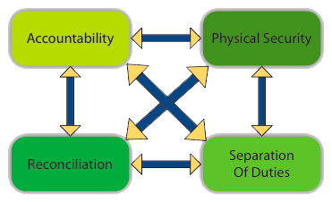
Control Activities
Principle 10:
The organization selects and develops control activities that contribute to the mitigation of risks to the achievement of objectives to acceptable levels.
Notes:
Points of Focus
Integrates with Risk Assessment – Control activities help ensure that risk responses that address and mitigate risks are carried out.
Considers Entity Specific Factors – Management considers how the environment, complexity, nature, and scope of its operations, as well as the specific characteristics of its organization, affect the selection and development of control activities.
Determines Relevant Business Processes – Management determines which relevant business processes require control activities.
Evaluates a Mix of Control Activity Types – Control activities include a range and variety of controls and may include a balance of approaches to mitigate risks, considering both manual and automated controls, and preventive and detective controls.
Considers at What Level Activities Are Applied – Management considers control activities at various levels in the entity.
Addresses Segregation of Duties – Management segregates incompatible duties, and where such segregation is not practical management selects and develops alternative control activities.
Principle 10 Approach
Use matrices, workshops, or an inventory of control activities to map identified risks to control activities
Implement or monitor control activities when outsourcing to a third party
Consider the types of control activities
Consider alternative control activities to the segregation of duties
Identify incompatible functions

Slide 17
Control Activities
Principle 11:
The organization selects and develops general control activities over technology to support the achievement of objectives.
Notes:
Points of Focus
Determines Dependency between the Use of Technology in Business Processes and Technology General Controls – Management understands and determines the dependency and linkage between business processes, automated control activities, and technology general controls.
Establishes Relevant Technology Infrastructure Control Activities – Management selects and develops control activities over the technology infrastructure, which are designed and implemented to help ensure completeness, accuracy, and availability of technology processing.
Establishes Relevant Security Management Process Control Activities – Management selects and develops control activities that are designed and implemented to restrict technology access rights to authorized users commensurate with their job responsibilities and to protect the entity’s assets from external threats.
Establishes Relevant Technology Acquisition, Development, and Maintenance Process Control Activities – Management selects and develops control activities over the acquisition, development, and maintenance of technology and its infrastructure to achieve management’s objectives.
Principle 11 Approach
Use risk and control matrices to document technology dependencies
Evaluate end-user computing
Implement or monitor control activities when outsourcing IT functions to a third party
Configure the IT infrastructure to support restricted access and segregation of duties
Configure IT to support the complete , accurate, and valid processing of transactions data
Administer security and access
Apply a system development life cycle over packaged software
Apply a system development life cycle over software developed in-house

Slide 18
Control Activities
Principle 12:
The organization deploys control activities through policies that establish what is expected and in procedures that put policies into action.
Notes:
Points of Focus
Establishes Policies and Procedures to Support Deployment of Management’s Directives – Management establishes control activities that are built into business processes and employees’ day-to-day activities through policies establishing what is expected and relevant procedures specifying actions.
Establishes Responsibility and Accountability for Executing Policies and Procedures – Management establishes responsibility and accountability for control activities with management (or other designated personnel) of the business unit or function in which the relevant risks reside.
Performs in a Timely Manner – Responsible personnel perform control activities in a timely manner as defined by the policies and procedures.
Takes Corrective Action – Responsible personnel investigate and act on matters identified as a result of executing control activities.
Performs Using Competent Personnel – Competent personnel with sufficient authority perform control activities with diligence and continuing focus.
Reassesses Policies and Procedures – Management periodically review CIOs control activities to determine their continued relevance, and refreshes them when necessary.
Principle 12 Approach
Develop and document policies and procedures
Deploy control activities through business unit or functional leaders
Conducting regular and ad hoc assessments of control activities

Slide 19
Information and Communication
Principle 13:
The organization obtains or generates and uses relevant, quality information to support the functioning of internal control.
Notes:
Points of Focus
Identifies Information Requirements – A process is in place to identify the information required and expected to support the functioning of the other components of internal control and the achievement of the entity’s objectives.
Captures Internal and External Sources of Data – Information systems capture internal and external sources of data.
Processes Relevant Data into Information – Information systems process and transform relevant data into information.
Maintains Quality throughout Processing – Information systems produce information that is timely, current, accurate, complete, accessible, protected, and verifiable and retained. Information is reviewed to assess its relevance in supporting the internal control components.
Considers Costs and Benefits – The nature, quantity, and precision of information communicated are commensurate with and support the achievement of objectives.
Principle 13 Approach
Create an inventory of information requirements
Obtain information from external sources
Obtain information from non-finance management
Create and maintain information repositories
Use an application to process data into information
Enhance information quality through a data governance program
Identify, secure, and retain financial data and information

Slide 20
Information and Communication
Principle 14:
The organization internally communicates information, including objectives and responsibilities for internal control, necessary to support the functioning of internal control.
Notes:
Points of Focus
Communicates Internal Control Information – A process is in place to communicate required information to enable all personnel to understand and carry out their internal control responsibilities.
Communicates with the Board of Directors – Communication exists between management and the board of directors so that both have information needed to fulfill their roles with respect to the entity’s objectives.
Provides Separate Communication Lines – Separate communication channels, such as whistle-blower hotlines, are in place and serve as fail-safe mechanisms to enable anonymous or confidential communication when normal channels are inoperative or ineffective.
Selects Relevant Method of Communication – The method of communication considers the timing, audience, and nature of the information.
Principle 14 Approach
Communicate information regarding external financial reporting objectives and internal control
Communicate internal control responsibilities
Develop guidelines for communication to the board of directors
Review financial and internal control information with the board of directors
Communicate a whistle-blower program to company personnel
Communicate through administrative reporting channels
Establish cross-functional and multidirectional internal control communication processes and forums

Slide 21
Information and Communication
Principle 15:
The organization communicates with external parties regarding matters affecting the functioning of internal control.
Notes:
Points of Focus
Communicates to External Parties – Processes are in place to communicate relevant and timely information to external parties including shareholders, partners, owners, regulators, customers, and financial analysts and other external parties.
Enables Inbound Communications – Open communication channels allow input from customers, consumers, suppliers, external auditors, regulators, financial analysts, and others, providing management and the board of directors with relevant information.
Communicates with the Board of Directors – Relevant information resulting from assessments conducted by external parties is communicated to the board of directors.
Provides Separate Communication Lines – Separate communication channels, such as whistle-blower hotlines, are in place and serve as fail-safe mechanisms to enable anonymous or confidential communication when normal channels are inoperative or ineffective.
Selects Relevant Method of Communication – The method of communication considers the timing, audience, and nature of the communication and legal, regulatory, and fiduciary requirements and expectations.
Principle 15 Approach
Communicate information to relevant external parties
Obtain information from outside sources
Survey external parties
Communicate the whistle-blower program to outside parties
Review external audit communications

Slide 22
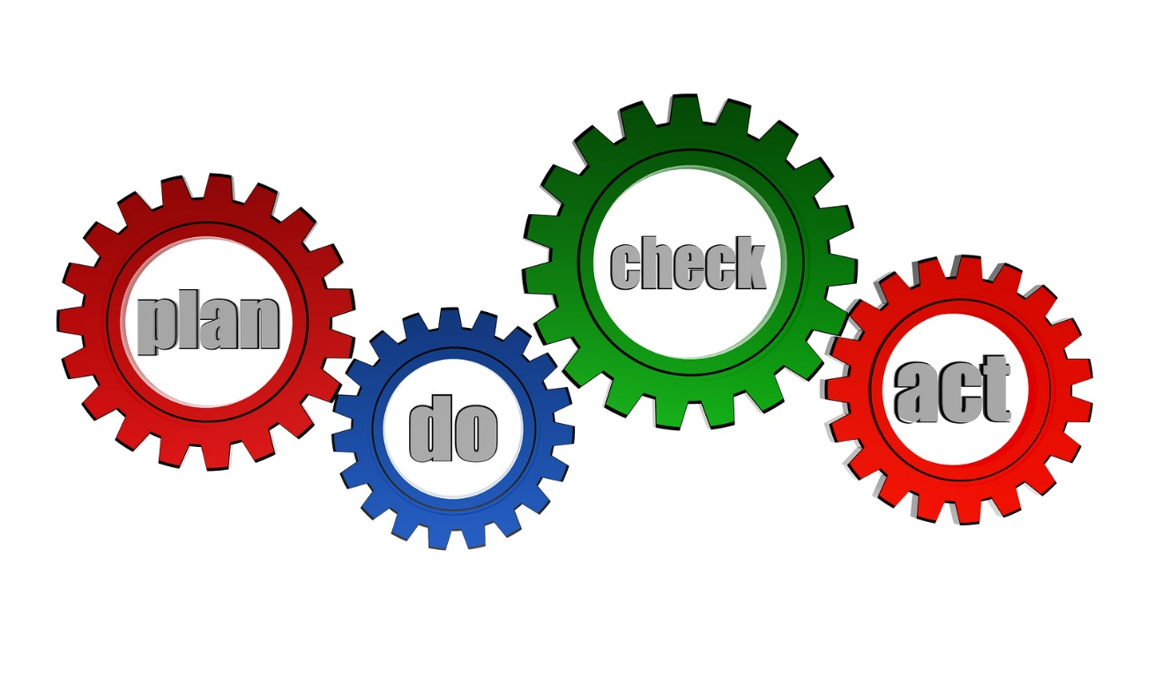
Monitoring Activities
Principle 16:
The organization selects, develops, and performs ongoing and/or separate evaluations to ascertain whether the components of internal control are present and functioning.
Notes:
Points of Focus
Considers a Mix of Ongoing and Separate Evaluations – Management includes a balance of ongoing and separate evaluations.
Considers Rate of Change – Management considers the rate of change in business and business processes when selecting and developing ongoing and separate evaluations.
Establishes Baseline Understanding – The design and current state of an internal control system are used to establish a baseline for ongoing and separate evaluations.
Uses Knowledgeable Personnel – Evaluators performing ongoing and separate evaluations have sufficient knowledge to understand what is being evaluated.
Integrates with Business Processes – Ongoing evaluations are built into the business process and adjust to changing conditions.
Adjusts Scope and Frequency – management varies the scope and frequency of separate evaluations depending of risk.
Objectively Evaluates – Separate evaluations are performed periodically to provide objective feedback.
Principle 16 Approach
Periodically review the mix of monitoring activities
Establish a baseline
Identify and use metrics
Design and implement a dashboard
Use technology to support monitoring activities
Conduct separate evaluations
Use internal audit to conduct separate evaluations
Understand controls at an outsourced service provider

Slide 23
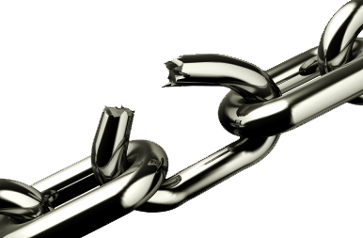
Monitoring Activities
Principle 17:
The organization evaluates and communicates internal control deficiencies in a timely manner to those parties responsible for taking corrective action, including senior management and the board of directors, as appropriate.
Notes:
Points of Focus
Assess Results – Management and the board of directors, as appropriate, assess results of ongoing and separate evaluations.
Communicates Deficiencies – Deficiencies are communicated to parties responsible for taking corrective action and to senior management and the board of directors, as appropriate.
Monitors Corrective Actions – Management tracks whether deficiencies are remediated on a timely basis.
Principle 17 Approach
Assess and report deficiencies
Monitor corrective action
Develop guidelines for reporting deficiencies

Slide 24
Limitations of Internal Control
Preconditions of Internal Control
Judgement
External Events
Breakdowns
Management Override
Collusion

Slide 25
Case Study #1 INNOVATION PARK—TALLAHASSEE, FL

Slide 26
Case Study #2 CITY OF DIXON, IL

Slide 27
Questions/comments

