Slide 1

OK Workers’ Compensation
(O.S. Title 85A)
For employees with job-related
injuries and illnesses.
WC is No-Fault.
WC Benefits are statutory.
After a claim is filed, and following an investigation, Claims Adjuster will determine whether or not the incident is covered by WC.
If it is WC, start paying the Statutory Benefits.
Notes:
First, let’s look at Workers’ Compensation. This is “No Fault” coverage with trade offs for the employee and employer.
Coverage for injuries, illnesses, or deaths arising out of and in the course of employment.
O.S. Title 85A, Administrative Workers’ Compensation Act
Case Law = Actual cases from the WC Court - up through the Oklahoma Supreme Court.
Claimant’s attorney’s lie when they say “You must call me to get your benefits.” What they should say is “Call me so I can have some of your money!”
1/23/19: JWh told me WCC had about 8,000 lawsuits last year and has 5 (five) Admin Law Judges at this time. Years ago, the Court had between 20,000 and 25,000 lawsuits a year.

Slide 2
Old WC Law compared to NEW WC Law
PRIOR to 2/1/2014 | On or After 2/1/2014
OS Title 85 - WCA | OS Title 85A - AWCA
CEC=Court of Existing Claims * | 3 WC Commissioners
10 WCC Judges | Lit Cases heard by ALJ (4)
2 Yrs Statute of Limitations | 1 Yr Statute of Limitations
WC Benefits = Regions Highest Cost | Many Benefits were lowered
Notes:
New Law was effective February 1, 2014.
Discuss open claims from an earlier date.

Slide 3
O.S. Title 85A…
Administrative Workers’ Compensation Act
For claims after 2/1/2014, cases heard by the WC Commission. Pre-2/1/14 claims stay with the Court. Old WC Court will now be called Court of Existing Claims.
The New Commission = 3 Commissioners are appointed to run the system, who are political appointees, and serve staggered terms-6, 4 & 2 years.
Current Commissioners are Business Oriented.
OMAG Cities go to www.omag.org for WC Forms
Notes:
The New Commission
The Commission has established rules, procedures and forms. (Use new CC Form 2 for all claims.)
Commissioners hire Administrative Law Judges (ALJ) to hear disputes. ALJ’s do not serve a term, and can be replaced by the Commissioners
ALJ’s are primary hearing officers of the Commission. Focus on speedy resolution of claims and disputes.
The 3 Commissioners will hear appeals from the ALJ orders.

Slide 4
The New W C Commission
The Commission has established rules, procedures and forms. (Use new CC Form 2 for all claims.)
Commissioners hire Administrative Law Judges (ALJ) to hear disputes. ALJ’s do not serve a term, and can be replaced by the Commissioners
ALJ’s are primary hearing officers of the Commission. Focus on speedy resolution of claims and disputes.
The 3 Commissioners will hear appeals from the ALJ orders.
Notes:
The New Commission
The Commission has established rules, procedures and forms. (Use new CC Form 2 for all claims.)
Commissioners hire Administrative Law Judges (ALJ) to hear disputes. ALJ’s do not serve a term, and can be replaced by the Commissioners
ALJ’s are primary hearing officers of the Commission. Focus on speedy resolution of claims and disputes.
The 3 Commissioners will hear appeals from the ALJ orders.

Slide 5
Changes in Filing Timeframes
A claim for compensation must be filed within one year of date of injury (previously 2 years)
A hearing must be requested within 6 months of the date of claim
Claim barred if employee receives no medical treatment or benefits within one year of date of injury
Notes:
Changes in Filing timeframes
A claim for compensation must be filed within one year of date of injury (previously 2 years)
A hearing must be requested within 6 months of the date of claim
Claim barred if employee receives no medical treatment or benefits within one year of date of injury
Employee must be on job for 180 days before being allowed to file for a cumulative trauma injury

Slide 6
CC-Form 2, Employers Notice of Injury
Must be filed by employer, within 10 days after notification of injury (per Statute, but Commission Rules require 10 days from 4th day of Lost Time).
File an “Incident Only” to protect your employees rights.
Employer can be fined $500 for failure to submit timely.
It is imperative for the employer to send in the CC-Form-2’s to your claim’s adjuster, as they have in the past…after notification of an on the job injury.
This is the only way for your adjuster to know about medical only claims, the majority of all workers’ compensation cases.
Email new claims to: newclaim@cbremail.com .
Notes:
CC-Form 2, Employers Notice of Injury
Must be filed by employer, within 10 days after notification of injury (per Statute, but Commission Rules require 10 days from 4th day of Lost Time).
Employer can be fined $500 for failure to submit timely.
Timely file “Incidents Only” and they will not count against the city.
It is imperative for the employer to send in the CC-Form-2’s to CBR, as they have in the past…after notification of an on the job injury. This is the only way for CBR to know about medical only claims, the majority of all workers’ compensation cases.

Slide 7
Workers’ Compensation Claims Packet for OMAG WC Plan Members
OMAG provides a Claims Packet for WC Plan Members and it is available on the Website.
https://static1.squarespace.com/static/573365789f726693272dc91a/t/5d5ea46dd7e2830001f9c603/1566483568191/2019+CBRClaim+Packet.pdf
Notes:
From OMAG Website on Workers’ Compensation Claims:
FILING A WORKERS' COMPENSATION CLAIM:
Claims for Workers' Compensation are handled by Consolidated Benefits Resources (CBR). CBR requires the submission of the completed Workers' Compensation Claim packet to initiate a claim. A claim may be submitted via email at newclaim@cbremail.com. Employers can also choose to file electronically at www.cbrcloud.com. If filing electronically, the employer will not have to follow up with an emailed copy of the claim.
Open this “Claims Packet” during class and show down through the forms.

Slide 8
Refer to the Handout: Workers’ Compensation – In a Nutshell
Notes:
Refer to the “Workers’ Compensation – In a Nutshell” Handout.

Slide 9
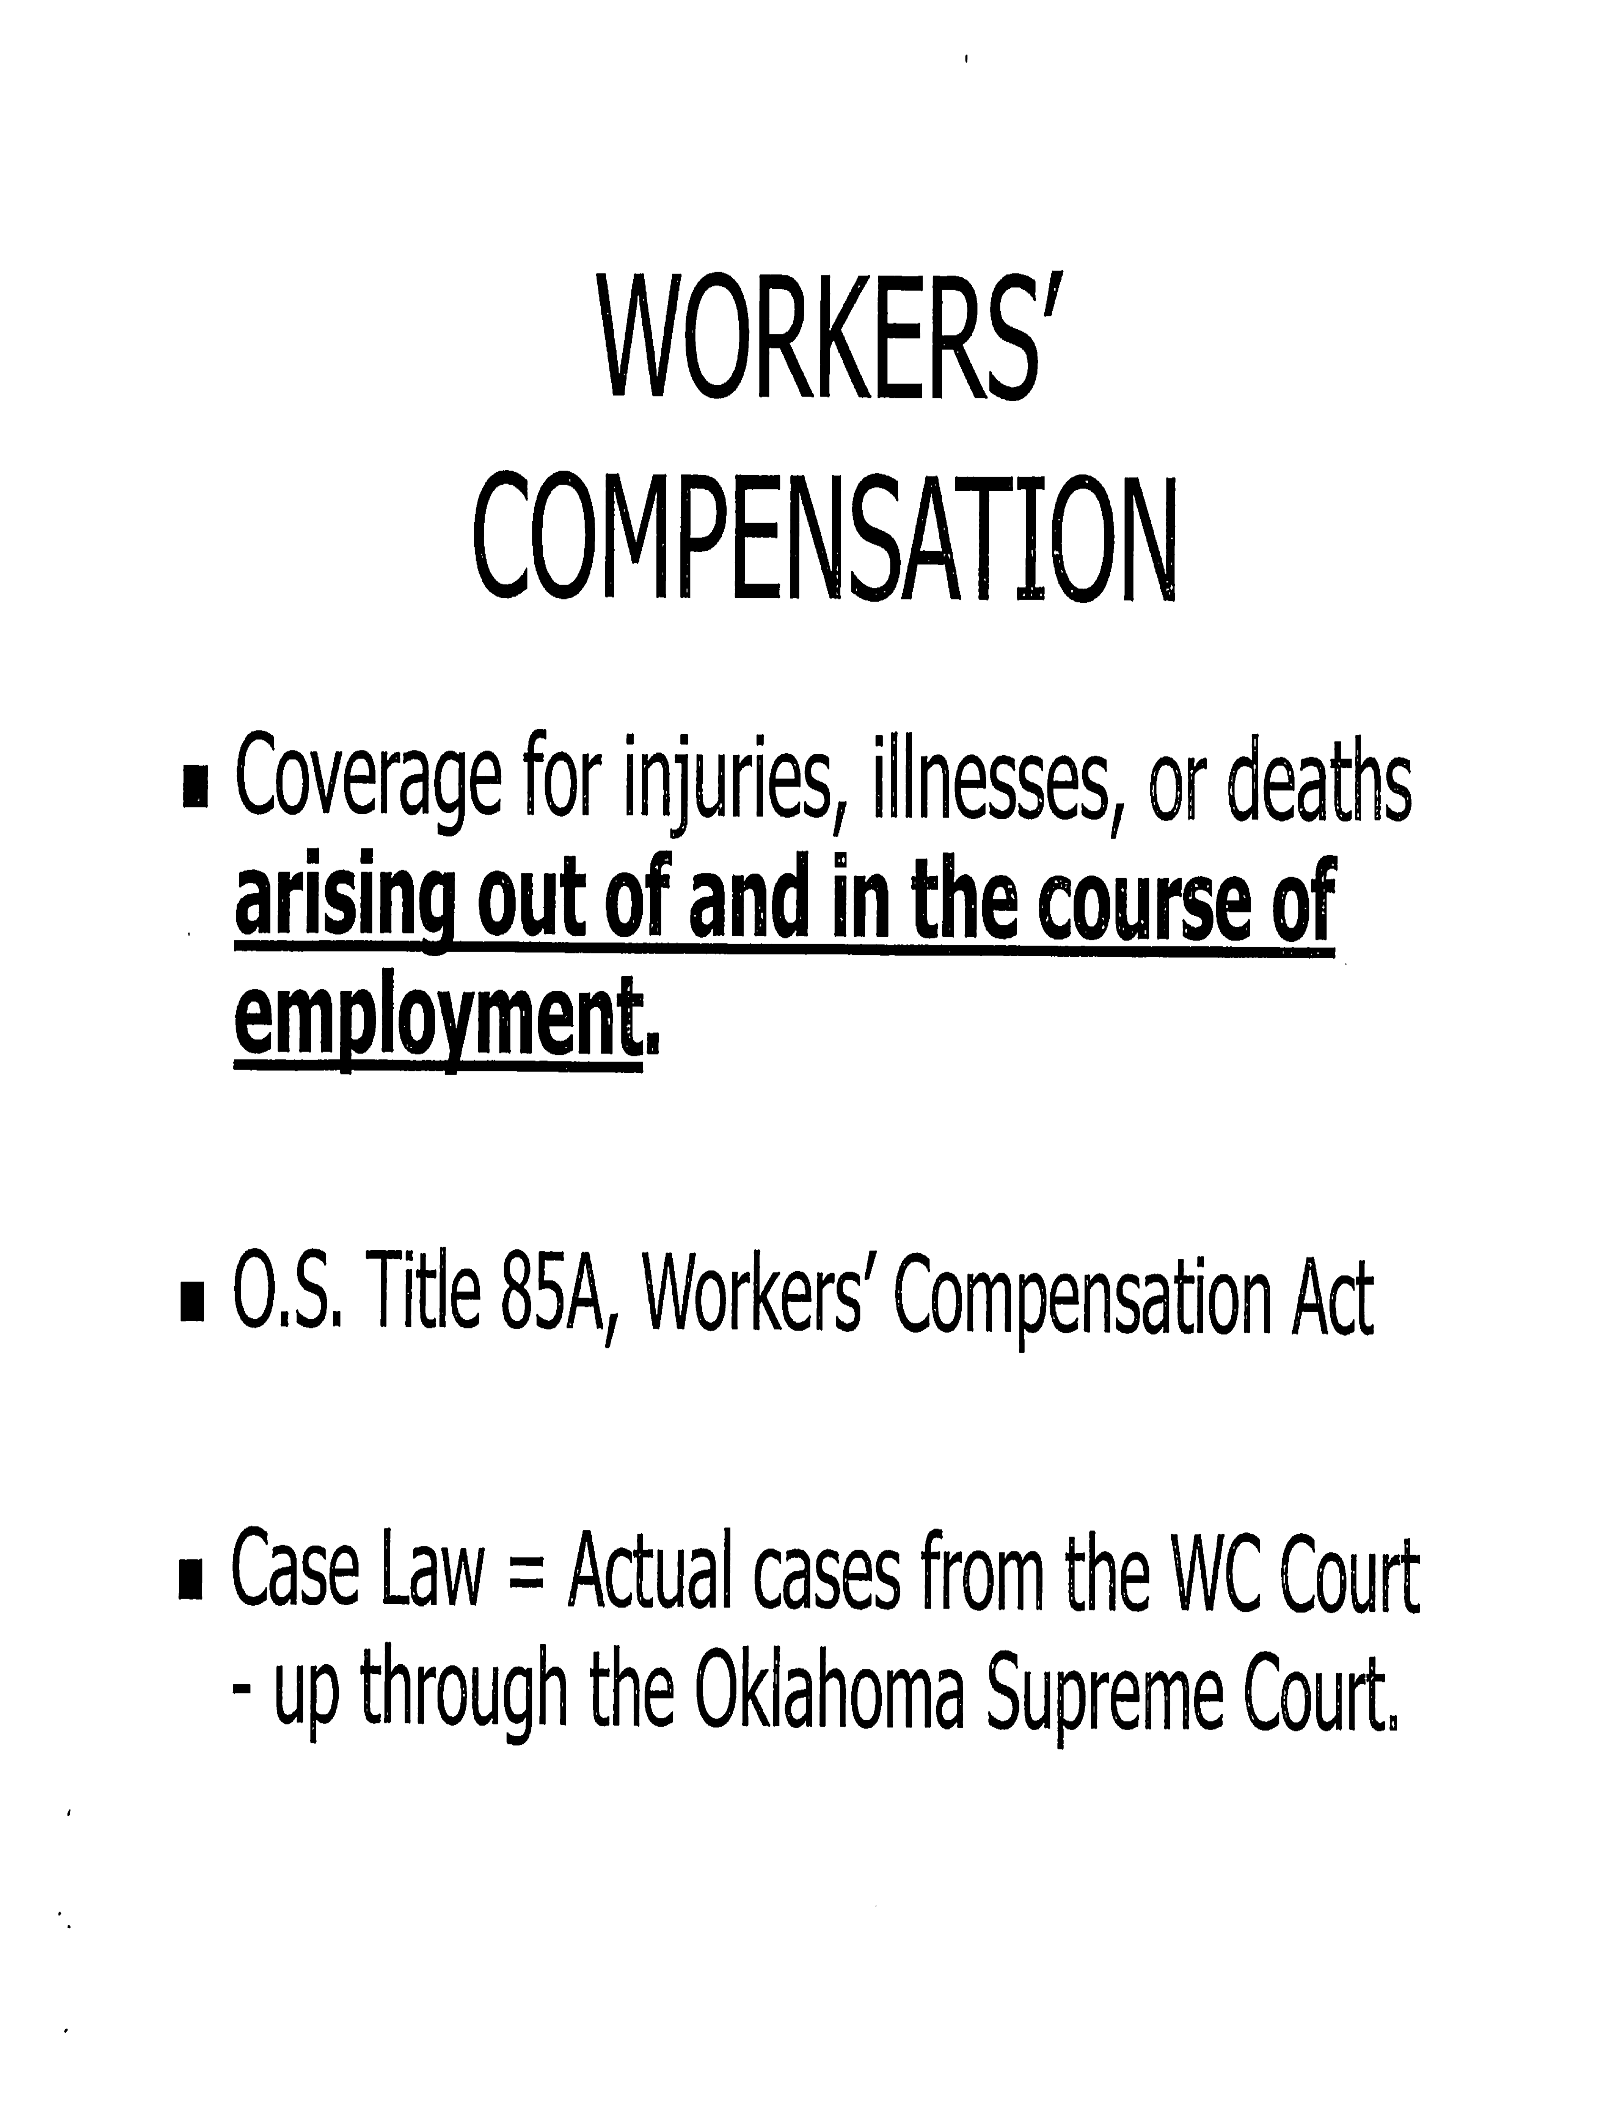
Notes:
Go the next slide for the Definitions >>>

Slide 10
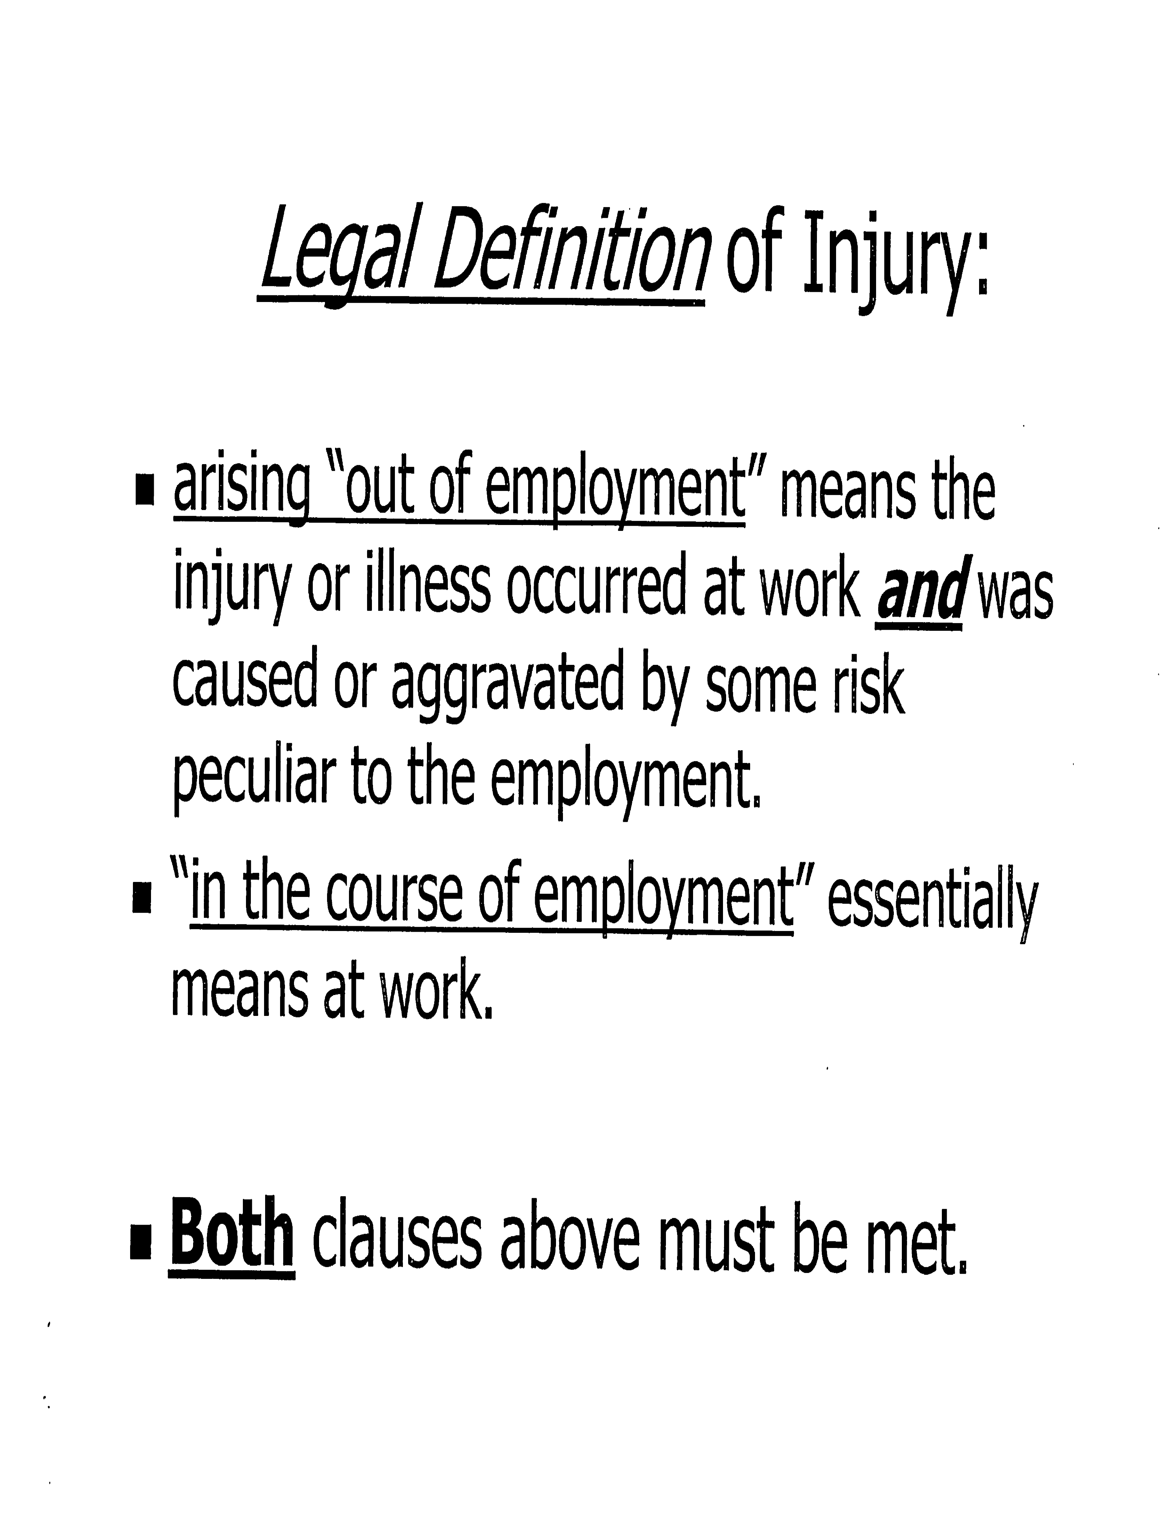

Slide 11

What are the Workers’ Compensation benefits?
① Medical benefits
② Temporary Total Disability (TTD)
③ Permanent Partial Disability and Permanent Total Disability (PPD & PTD)
④ Vocational Rehabilitation
⑤ Death benefits
Remember:
Benefits are Statutory!
Wage benefits are based on the employee’s Average Weekly Wage.
Notes:
WC claimants will receive some or all of these benefits, based on the medical evidence in their claim.
WC Lawyers tell you that only they can get you Money. But the benefits are statutory and are based on the medical reports from the doctor.

Slide 12
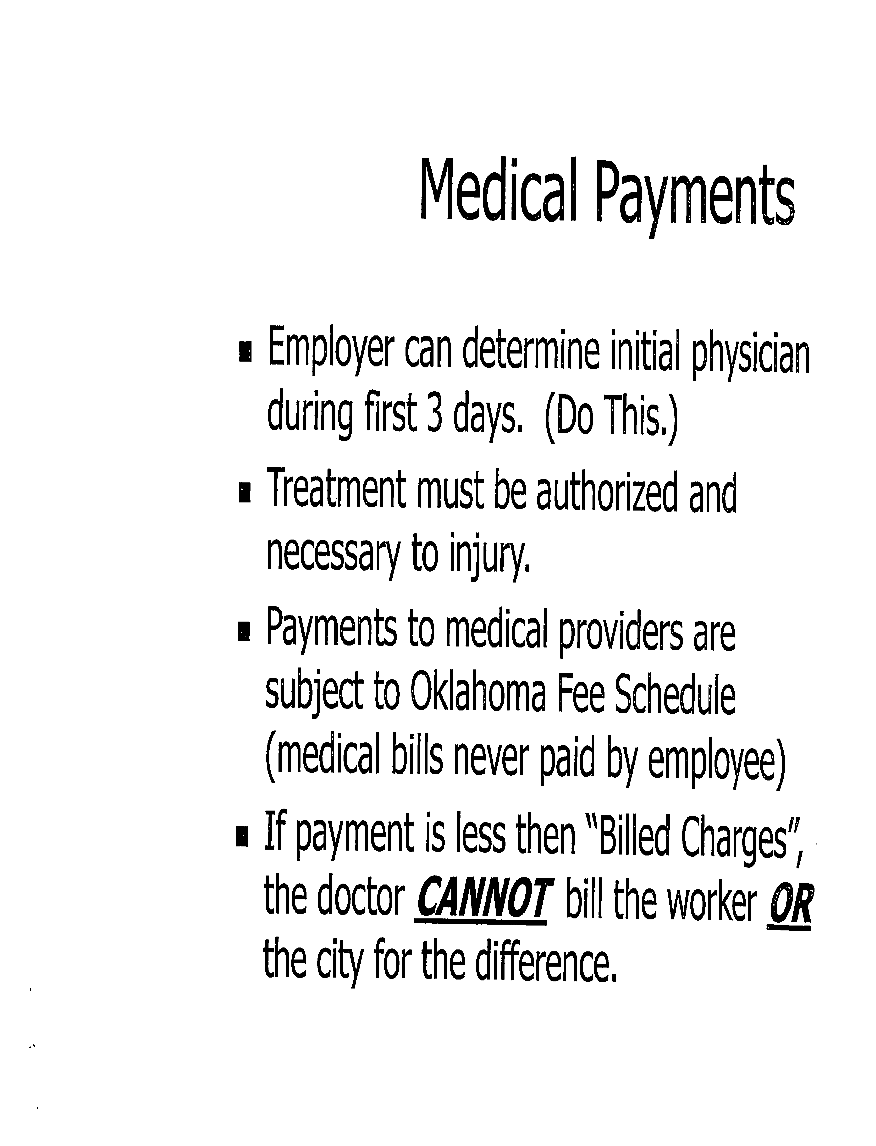

Slide 13

Notes:
WC Benefits are Tax Free.

Slide 14


Slide 15
Joe is off work on TTD (Total Temporary Disability); his WC accident was not contested.
You hear he isn’t going to be able to come back to work.
The city should fire him so you can fill the position.
Supervisor Scenario
True or False?
Notes:
TTD = Total Temporary Disability.
FALSE. You should never fire someone who is out on TTD. You should only terminate employment following a WC injury when you have competent medical information and have considered any applicable ADA accommodation.
The WC final Medical report that gives the % of PPD is NOT competent medical information for personnel actions. Not everyone who has a WC injury will be qualified under ADA (most will not).
FALSE

Slide 16
Injuries that May Not be compensable
Active participant in a fight during work hours
Horseplay
Personal intervening injury that aggravates the WC injury
Aging
Degeneration of knees elbows, backs, necks
Notes:
Injuries that are NOT compensable
Active participant in a fight during work hours
Horseplay
Recreational activities
Personal intervening injury that aggravates the WC injury
Aging
Degeneration of knees elbows, backs, necks
Injured on off-premises break

Slide 17
Injuries that May Not be compensable
Where presence of alcohol/illegal drugs an/or prescription drugs used in contravention of its directions, at the first doctor visit.
Claims that occur in the employer’s parking lot, including transportation to and from work. Exceptions are for essential job functions, or under direction from a supervisor.
Heart Attacks and Strokes...
Note: These will ultimately be decided by the OK Supreme Court.
Notes:
Injuries that are NOT compensable
Where presence of alcohol/illegal drugs an/or prescription drugs used in contravention of its directions, at the first doctor visit.
Claims that occur in the employer’s parking lot, including transportation to and from work. Exceptions are for essential job functions, or under direction from a supervisor.
These will ultimately be decided by the Supreme Court.

Slide 18
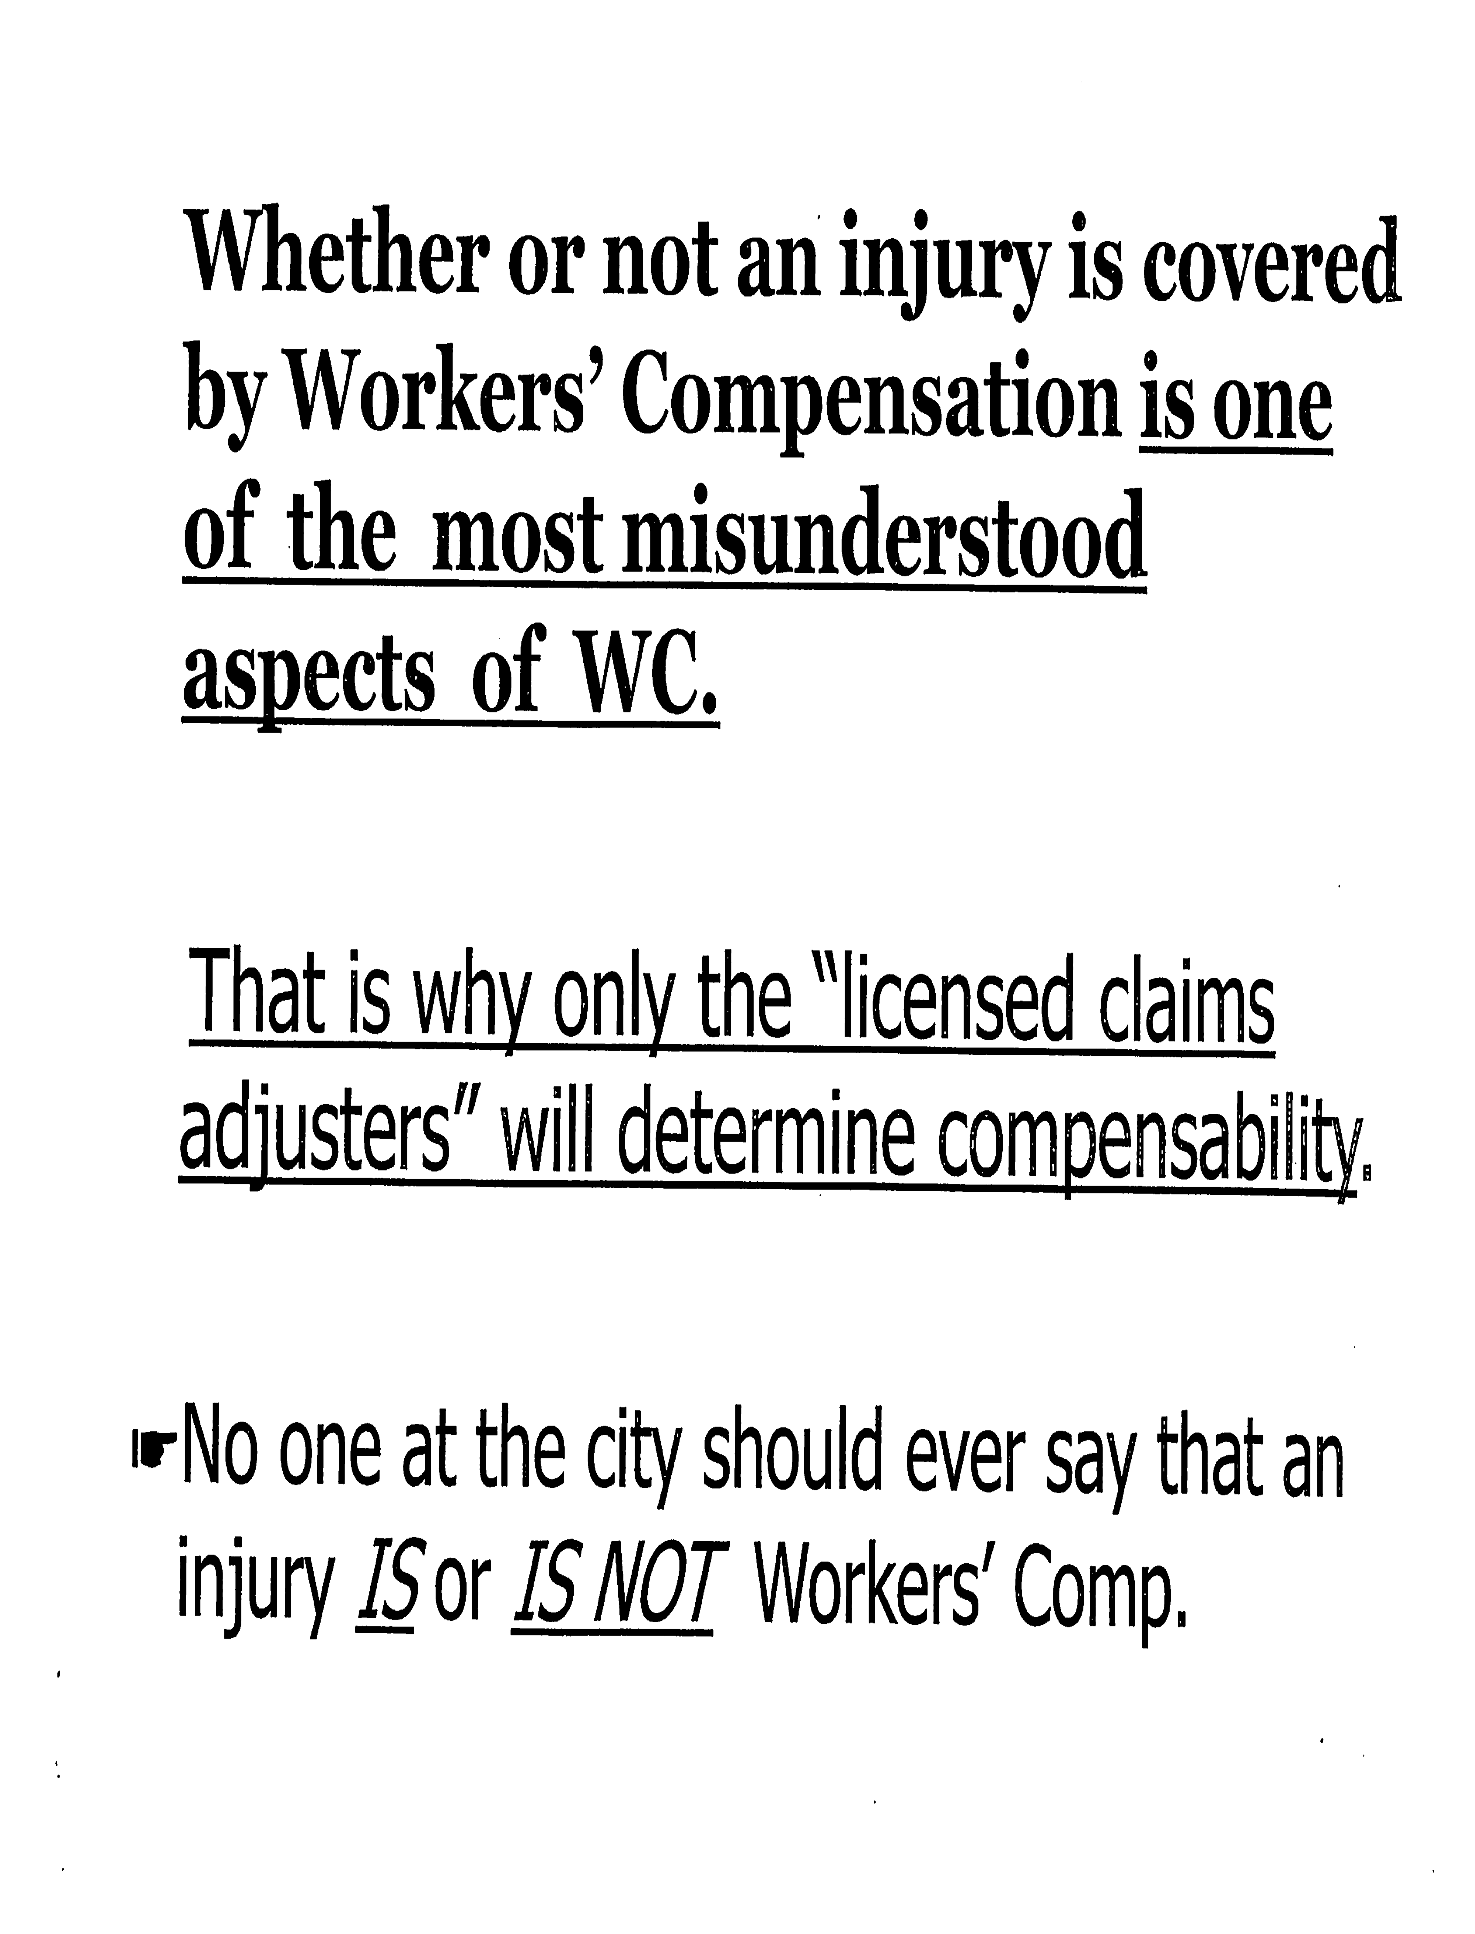

Slide 19
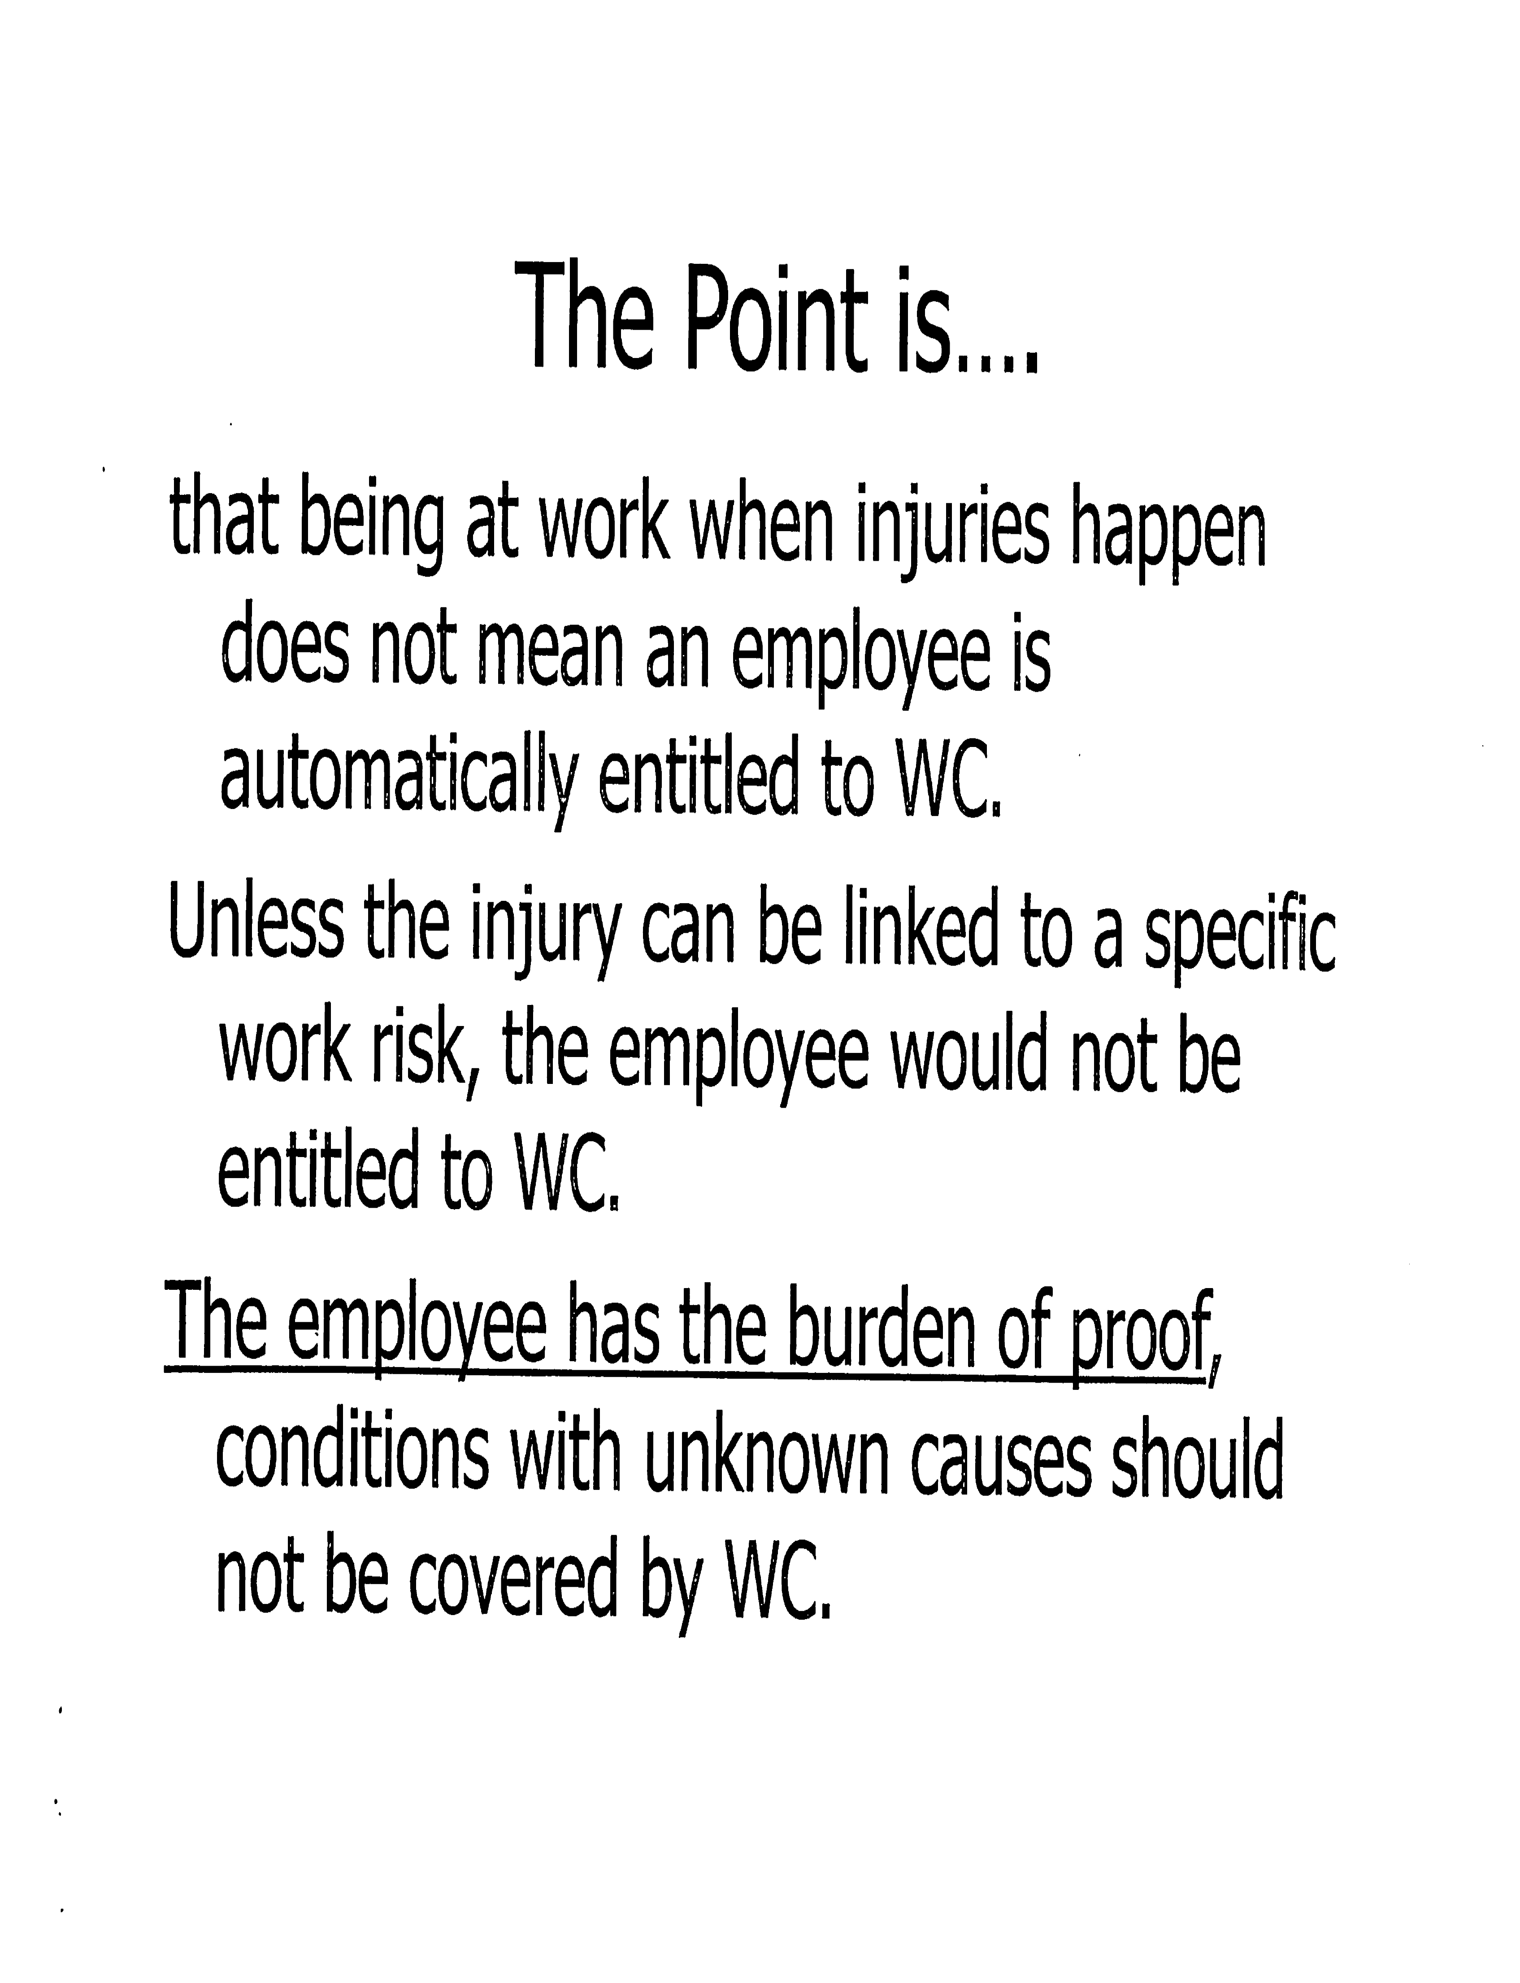

Slide 20


Slide 21
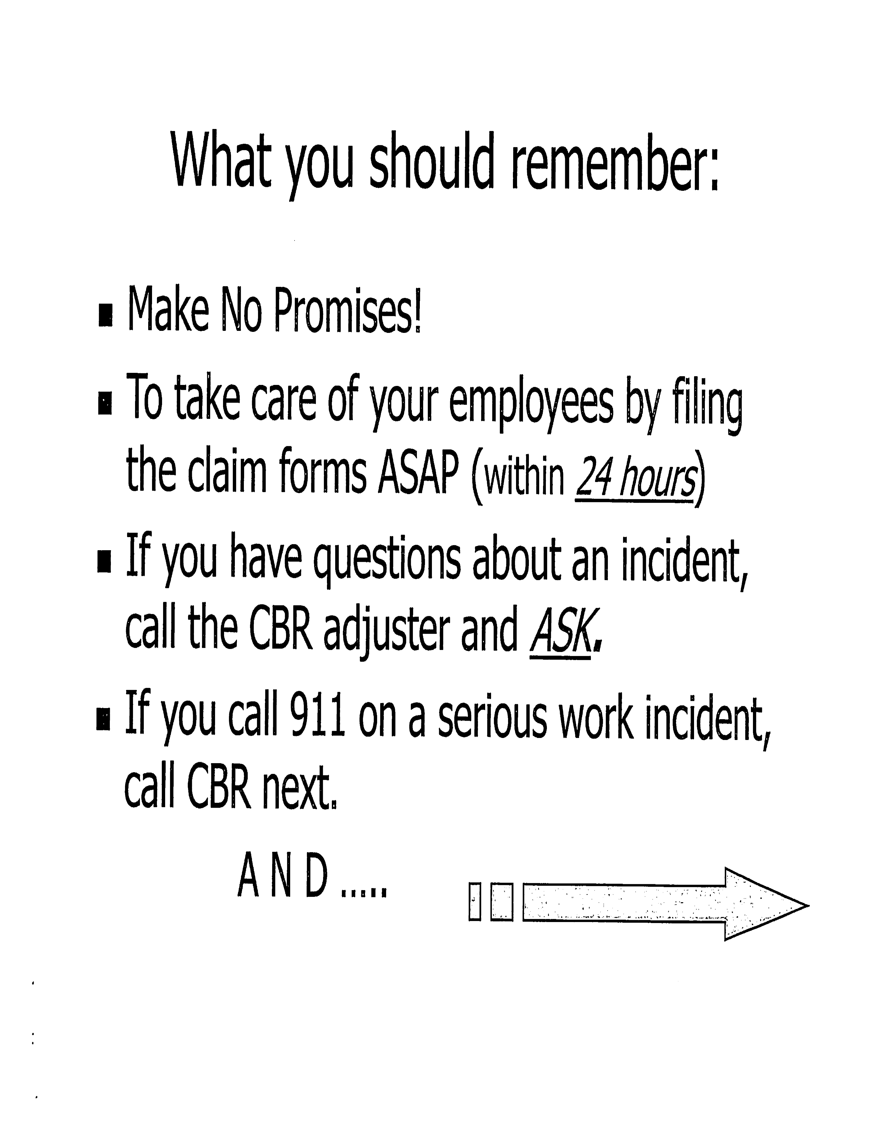

Slide 22
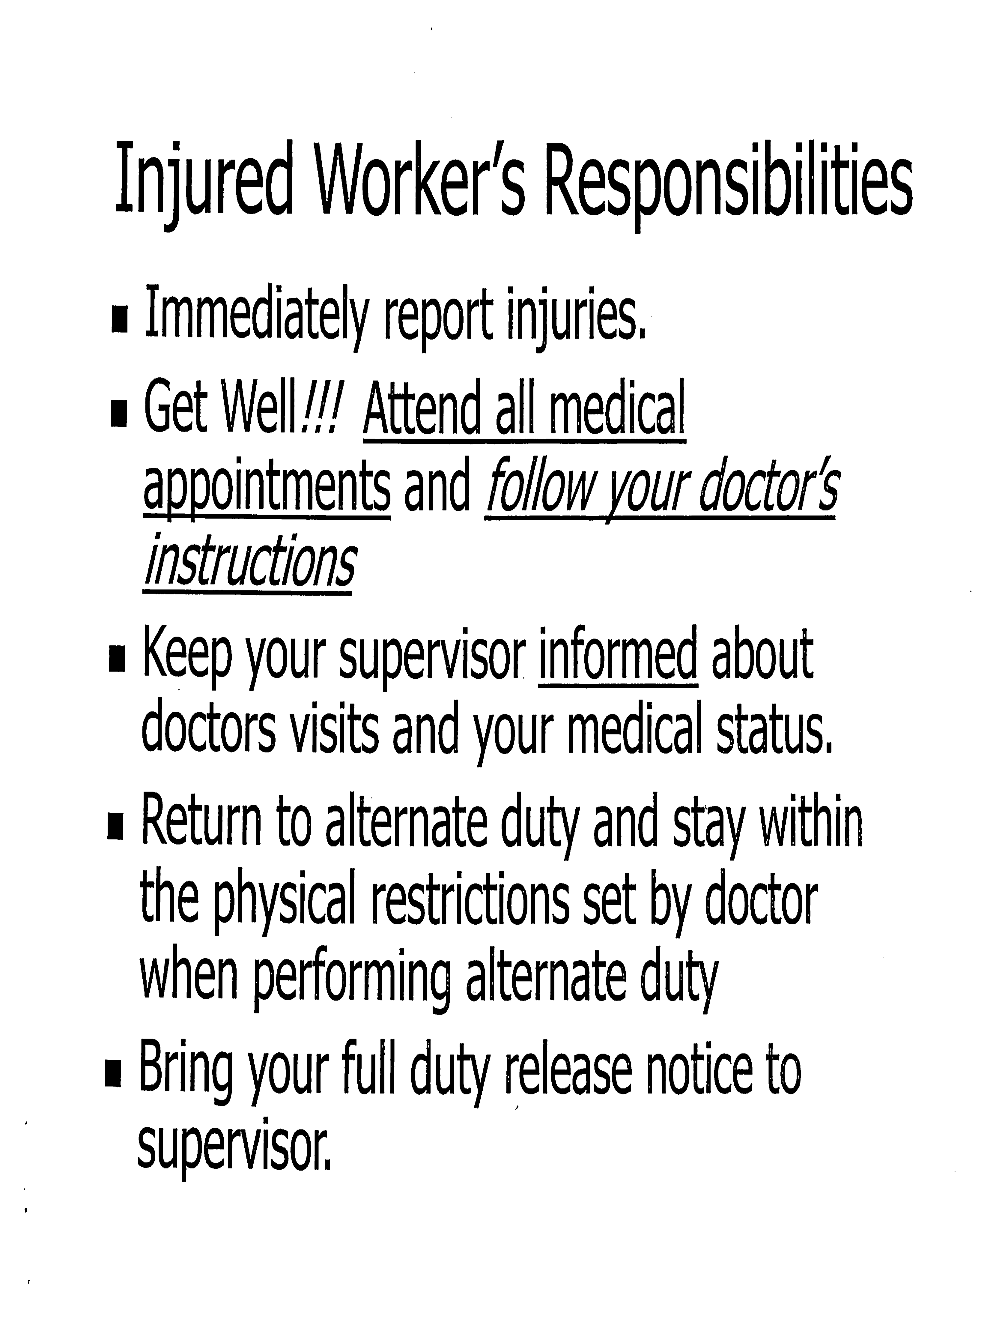

Slide 23
WC Counselors Office
Anyone can call for information:
WC COUNSELORS
For questions about workers' compensation issues:
(855) 291-3612 (In-state toll free)
(405) 522-5308
Eric Russell, Supervisor
Counselors Division Email: counselors@wcc.ok.gov.

Slide 24

Enforce Your Safety Rules!
Notes:
Enforce your safety rules! You ARE the Supervisor.
Lead by EXAMPLE…
Just like children: They will Do What They See You Do, No what you just tell them to do.

Slide 25
Supervisors ARE
Responsible for their workers.
Lead by example
Enforce & follow all safety rules & standards
Provide medical care, when necessary
Assist injured employee to complete “Employee’s Report of Injury” and give it to City Hall (ASAP)
Review accident/injury to prevent recurrence
Monitor employee’s progress while absent
Apply the “Golden Rule”
Notes:
Supervisor’s wear MANY hats. Go over this list with them at your Supervisor’s Meeting.
DOL Requirements An employer having twenty-five (25)
or more full- or part-time employees, including Title 11 and Title 19 fire department volunteers, shall:
1) Designate a Safety Coordinator
2) Provide quarterly safety training for all employees.
OAC 380: 40-1-22

Slide 26


