Slide 1
QUESTION WORDS

Slide 2
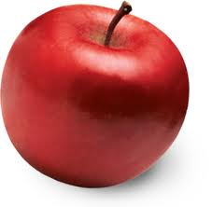
QUESTION WORDS
what
This is an apple.
what
Is this an apple?
What is this?

Slide 3
QUESTION WORDS
what
What is your name?
What is on the desk?
What is that?

Slide 4
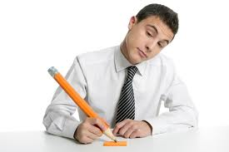
QUESTION WORDS
where
He is from Gebze.
Where
Is he from Gebze?
Where is he from?

Slide 5
QUESTION WORDS
where
Where is he from?
Where are your pencils?
Where is my pen?

Slide 6
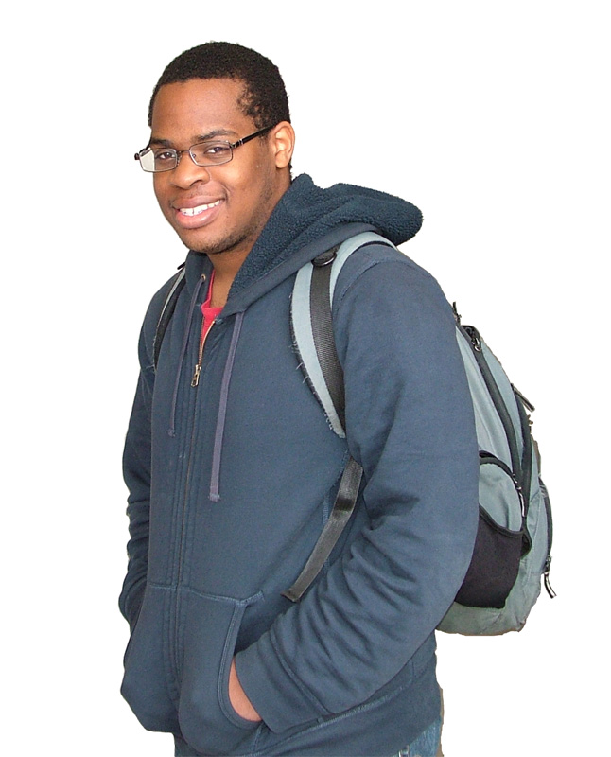
QUESTION WORDS
Who
He is a teacher.
Who
is a teacher?
Who is a teacher?

Slide 7
QUESTION WORDS
Who
Who is from Gebze?
Who are you?
Who is your father?

Slide 8
QUESTION WORDS
How old
He is 18 years old.
How old
Is he 18 years old?
How old is he?

Slide 9
QUESTION WORDS
How old
How old is he?
How old are you?
How old is your father?

Slide 10
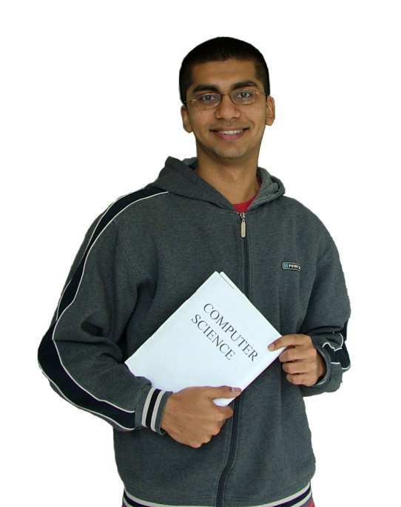
QUESTION WORDS
How many
You have got two books.
How many
have you got two books?
books
How many books have you got?

Slide 11
QUESTION WORDS
How many
How many books have you got?
How many friends has he got?
How many pencils have you got?

Slide 12
QUESTION WORDS
When
My birthday is in September.
When
Is my birthday in September?
When is my birthday?

Slide 13
QUESTION WORDS
When
When is my birthday?
When is your party?
When does the school start?

Slide 14
QUESTION WORDS
Other question words
Which:
Whose:
How much:
How:
Which pen is red?
Whose pen is this?
How much money have you got?
How are you?

Slide 15
QUESTION WORDS
Review:
What:
Where:
Who:
How old:
How many:
When:
Which:
Whose:
How much:
How:
What is your name?
Where are you from?
Who is your friend?
How old are you?
How many pen have you got?
When is your birthday?
Which pen is red?
Whose pen is this?
How much money have you got?
How are you?

Slide 16
QUESTION WORDS
Exercises:
Where
Who
When
How old
What
How many
Which
How much
How
Whose
__________ is my pen? I cannot find it.
__________ is that man over there?
__________ is your friend’s birthday?
__________ is your father?
__________ is your problem?
__________ friends have you got?
__________ pen is your pen?
__________ water do you drink?
__________ do you understand?
__________ pen is red?

Slide 17
THANKS
Please visit
www.nihatkasim.org
for more…

