Slide 1
tough Conversations
SIP #4 – January 28, 2020
At OMAG in Edmond
Notes:
Note: For Blanchard SIP #4 on 3/28/19, I added a few Mark Murphy Workshop items.
Show originally prepared by Suzie Paulson, OMAG General Counsel &
Human Resources Director, for OMAG SIP #3 on 3/1/18.
PHS revised going forward for SIP #4. 7/26/18.

Slide 2
The Goal
Is: To make people ”Inspired’ to give their best effort
Is NOT: To make subordinates “Happy”!
Notes:
Goal = From Mark Murphy Workshop.
Fire = Free up your Future.

Slide 3
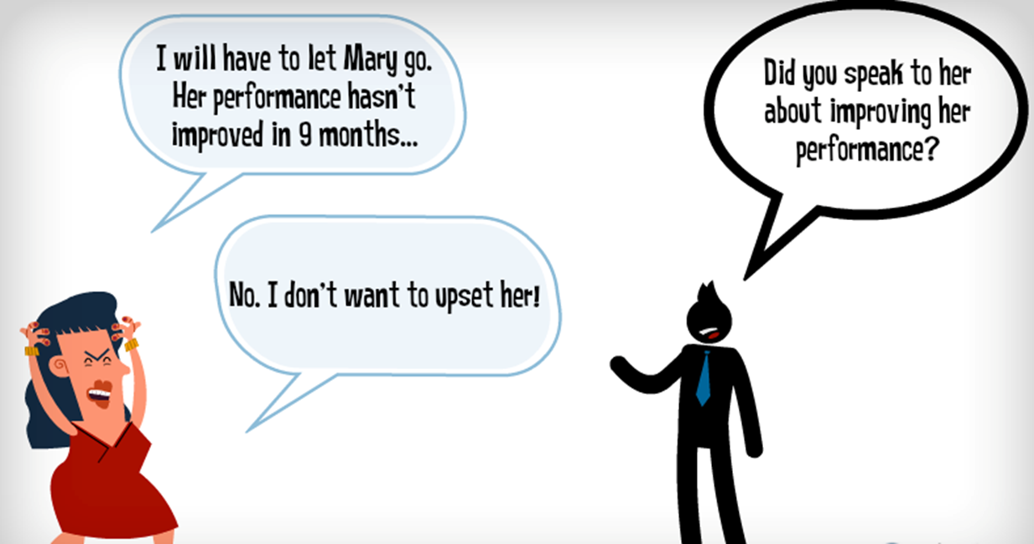
Notes:
Just Do It!

Slide 4
Performance Interventions
Good Faith attempts
To encourage employees
To change course and alter their behaviors
Notes:
Remember that performance interventions – whether verbal or written – have to be viewed as good faith attempts to encourage employees to change course and alter their behaviors. “They are never to be viewed simply as ways of “papering files” so that you have documentation on record to justify a dismissal.”
Paul Falcone, Pg. xii of 101 Tough conversations.

Slide 5
Key Rules of Communication
It’s not what you say but how you say it that counts
Notes:
Introduction – The Rules of Engagement:
To make employee turnarounds and epiphanies successful, there are a few key rules of communication to follow: First, remember that it’s not what you say by how you say it that counts. That may sound like an old saying that your grandparents taught you, but in the world of work, people tend to respond in kind: If you demonstrate respect and compassion, you’re like to receive a similar response, even when dealing with the most uncomfortable and confrontational workplace situations.
Source: 101 Tough Conversations to have with Employees. Paul Falcone. AMACOM, 2009.

Slide 6
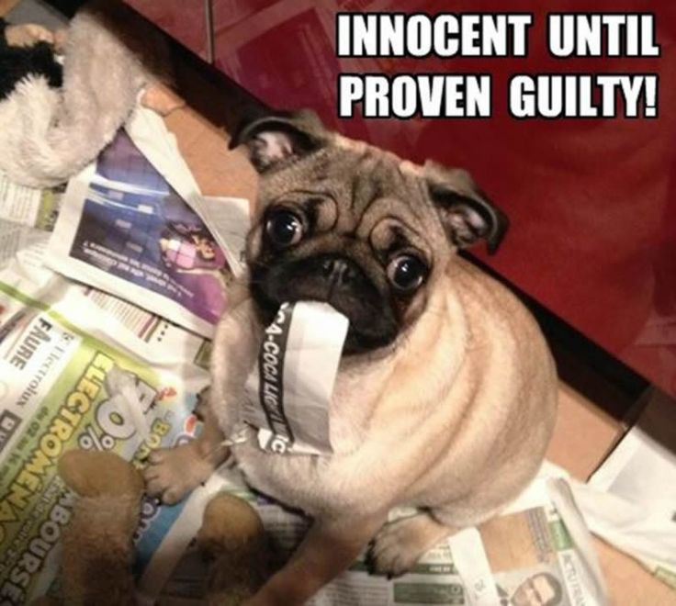
Key Rules of Communication
Your greatest asset when dealing with others is guilt, not anger.
Notes:
Your greatest asset when dealing with others is guilt, not anger. Anger is an external response: When people are mad at another person, they look outward to voice their frustration. Guilt, on the other hand, is internal: When people feel guilty, they look inward and tend to assume responsibility for the problem at hand. That’s the Golden Rule of Workplace Leadership: Allow people to assume responsibility for their actions, and you’ll “pierce their heart” and get them to want to change things for themselves. Try to force them to do something by making them mad or challenging or embarrassing them, and they’ll resist the change being forced on them. We’ll discuss strategies for invoking guilt rather than anger responses throughout the book, and psst…this works just as effectively in your personal life as well.

Slide 7
Key Rules of Communication
Remember, whatever you want for yourself, give to another.
Notes:
Remember that whatever you want for yourself, give to another. So many times, people demand respect, open communication and other forms of social acceptance without realizing that they don’t give those things to others. At a time when many demographers and sociologists are pointing major shortages in the labor market due to upcoming retirements of the baby boom generation, retention is vital. Yet people tend to join companies and leave managers: They initially see the value of the company, its reputation, and perception as a great place to work – only to flee from a manager they no longer trust or respect.

Slide 8
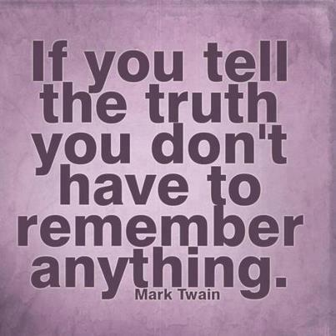
Key Rules of Communication
Honesty is the best policy.
Notes:
Which leads us to the fourth rule of thumb: Honesty is the best policy. Now I know what you are thinking: “Oh please, that’s very easily said from the HR ivory tower, but I’ve got to work side by side with these people every day, so please spare me the hackneyed adages! Being open and honest is particularly difficult when you’re dealing with particular kinds of employees, and the confrontation just isn’t worth it.”
In reality, honesty has to be the basis of everything you do as a leader. Confrontation is tough for all of us. Just remember that differences in opinion are perfectly acceptable; however, confrontation in the negative sense is optional. Speaking with others in a respectful and thoughtful tone, regardless of the content of your message, will allow them to assume responsibility for their actions or, in the case of terminations, get on with their lives.

Slide 9
Key Rules of Communication
Underused phrase:
“I’m so sorry.”
(This is a critical phrase.)
Notes:
That need to hear “I’m sorry” is a universally human trait, so don’t be shy about using those very words. It’s fair, humane, and fills a very important need in others’ lives.

Slide 10
Key Rules of Communication
In fact, a lawsuit is typically a tool of workplace revenge.
Notes:
Do you FIRE people? (Free up their Future)

Slide 11
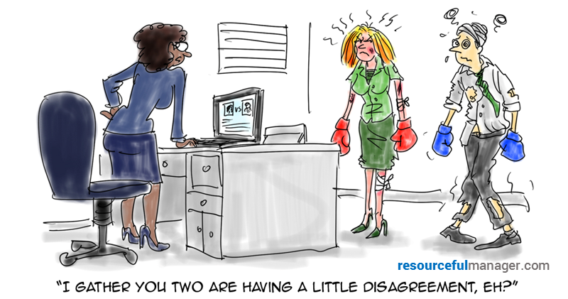
Notes:
Ever had this happen?

Slide 12
Notes:
FYI!

Slide 13
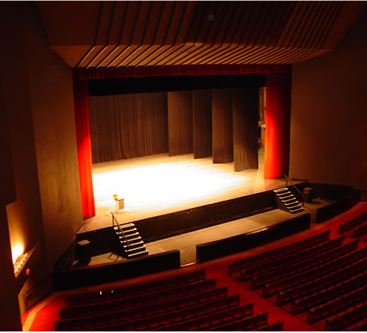
Before you discipline set the stage!
This Photo by Unknown Author is licensed under CC BY-SA

Slide 14
Communicate the “why”
Let employees in on the “Why”
This allows you to remain in control of the message
You don’t want employees finding out things from other sources
Keep middle management in the loop about all dealings within the City
Notes:
– if employees understand “why” they are more motivated to do the “what”
employees should never learn about important news from an external source
The new reality is that news is accessible on smartphones and other mobile channels anytime, anywhere.

Slide 15
Why have policies
Set Expectations
Treat employees fair
Clear and concise, use examples if necessary
Consistent
Compliance with State and Federal laws
Notes:
As a Supervisor, you should have read and have a copy handy of your city’s Personnel Policies.
Ask your HR representative to explain things you don’t understand.

Slide 17
Job Description
To justify an employee’s exempt status
To develop a vacancy announcement
To develop Interview Questions
To set goals for employees
Discourages “It’s not my job” attitude (“other duties as assigned”)
Provides a basis for employee reviews and salaries

Slide 18
Job description
Job title
Department and Supervisor
Full time/Part time, hours
Exempt/Non-exempt (FLSA exemption)
Essential job functions
Physical requirements
Required education, training, licenses
Preferred education, training, licenses
Required skills, knowledge and experience
Preferred skills, knowledge and experience

Slide 19
Address problems when they occur
Be proactive - no matter how small, address issues when they occur
Do not save up a list of offenses, in the hope that when added together you can terminate the employee – THIS WILL BACKFIRE ON YOU!

Slide 20
Negative impact of problem employees
Spreading a bad attitude
Creating a more stressful working environment
Straining working relationships
Damaging rapport with customers/clients
Contributing to a high turnover rate

Slide 21
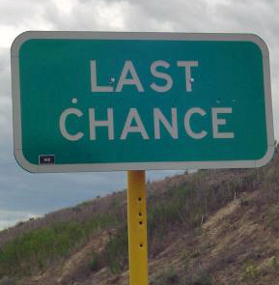
Options Before discipline
Performance Improvement Plan (PIP)
Mandatory Employee Assistance Program (EAP)
Last Chance Agreement

Slide 22
Plan of improvement
Poor performance reviews
Customer complaints
Complaints by co-workers
Employee struggling in a certain area
Improves communication

Slide 23
The plan
Step 1: Improvement Plan. These are the expectations related to performance deficiencies to be improved and addressed.
Step 2: Resources. Listed below are resources available to you to complete your Improvement activities.
Step 3: Progress Updates. Performance will be monitored by Management with regular follow-up meetings.

Slide 24
The plan
Timeline for Improvement, Consequences & Expectations: Effective immediately, you are placed on a (insert 30, 60, or 90)-day PIP. During this time you will be expected to progress on the plan outlined above. Failure to meet or exceed these expectations, or any display of gross misconduct may result in action up to and including termination
Signatures: Employee & Supervisor
Conclusion: Employee has achieved/not achieved required improvements as described above
Notes:
Show Yukon PIP letter.

Slide 25
employee assistance program (eap) formal referral
Employees experiencing performance decline (absenteeism, on the job absenteeism or tardiness, sporadic performance, poor judgment, strained relationships, or loss of temper)
No major policies violated or safety concerns
DO NOT make referrals based on suspected or perceived medical conditions, whether it be physical or mental
Example: if an employee is absent every Friday and Monday you may suspect alcoholism, but the referral will not be made on based on your perceived notion that this employee is an alcoholic – it will be made based on excessive absenteeism.

Slide 26
employee assistance program (eap) mandatory referral
Employees who violate policies or create a safety risk at the worksite
Non-compliance of a Formal Referral may result in disciplinary action, up to and including termination depending on the severity of the violation
DO NOT make referrals based on suspected or perceived medical conditions, whether it be physical or mental
Example: Employee gets in an argument with a customer and cusses and makes physical threats to do harm to himself. Do not refer the employee because you perceive he/she has a mental illness. Refer the employee based on violations of the City’s anti-harassment or violence policy.

Slide 27
employee assistance program (eap)
The EAP will keep the HR contact informed about when and if the employee is making their appointments.
The EAP will assess the employee based on the employee’s clinical presentation while taking into account additional information received from employer
The EAP will determine a course of treatment that addresses the referral issues and clearly communicate the plan to the employee
The EAP can refer employee to the appropriate resource
The EAP will communicate to HR when employee has completed treatment, or when there is non- compliance

Slide 28
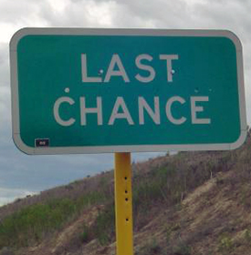
Last chance agreement
Be sure the terms are attainable and required for the position
Do not introduce too early in the progressive discipline process
Provide clear expectations so the employee knows exactly what to do in order to achieve success
Set a reasonable time frame to discard the agreement, i.e. 1-2 years
Set reasonable time frame to achieve success
Set regular evaluation dates to go over the LCA with the employee
Be sure the employee signs the agreement

Slide 29
LAST CHANCE AGREEMENT
In lieu of termination of employment, for violations of xxx policies, procedures and directives, The Town of xxx is providing [employee] a final opportunity to continue employment.
[Name of Employee] and [Name of Town] agree to the following:
[Describe the violation or reason for this agreement]. Instead of immediately terminating employment, [Name of Employee] will be [discipline, i.e. reprimanded, suspended from work without pay for five (5) work days, etc].
The employee has received prior written disciplinary notice dated [date] regarding [violation or reason for this agreement stated above], the Towns expectations, an improvement plan and a time period for improvement.
The employee understands that this agreement is [his/her] last chance to remain employed at [Name of Town]. Failure to make improvement or recurrence of inappropriate behavior or conduct within the specified time period as described in the [date] warning will result in immediate termination.
The employee understands that [Name of Town] is an employment-at-will employer. The employee agrees to comply with all Town policies, practices and procedures and understands that this agreement in no way prevents the employer from taking disciplinary action, including termination, for violations.
/s/ signatures of Supervisor and Employee Date: ____________
S A M P L E
Notes:
LAST CHANCE AGREEMENT
In lieu of termination of employment, for violations of xxx policies, procedures and directives, The Town of xxx is providing [employee] a final opportunity to continue employment.
[Name of Employee] and [Name of Town] agree to the following:
[Describe the violation or reason for this agreement]. Instead of immediately terminating employment, [Name of Employee] will be [discipline, i.e. reprimanded, suspended from work without pay for five (5) work days, etc].
The employee has received prior written disciplinary notice dated [date] regarding [violation or reason for this agreement stated above], the Towns expectations, an improvement plan and a time period for improvement.
The employee understands that this agreement is [his/her] last chance to remain employed at [Name of Town]. Failure to make improvement or recurrence of inappropriate behavior or conduct within the specified time period as described in the [date] warning will result in immediate termination.
The employee understands that [Name of Town] is an employment-at-will employer. The employee agrees to comply with all Town policies, practices and procedures and understands that this agreement in no way prevents the employer from taking disciplinary action, including termination, for violations.
/s/ signatures of Supervisor and Employee Date: ____________

Slide 30
Presenting the discipline
Meet with the employee in private
Don’t be in rush
Address the behavior, not the person
Describe the incident that led to discipline
Point out the specific policies that were violated
Point out all prior counseling, training, discipline steps taken
Allow employee to speak their mind
Ask employee what can be done differently
Develop a plan with the employee
Depending on the person, offer an “out”
Notes:
“out” = I think you are burned out, Your strengths are xxx and going to waste in this position

Slide 31
Protected classes
Race
National Origin
Gender or Sex
Religion
ADEA (age)
ADAAA (disability)
GINA (genetics)
Retaliation
+Medical
Marijuana
Certificate
Notes:
This slide below is not in PPT:

Slide 32
Plan for termination meeting
Timing and location
Employer representatives
Concise and clear message
Manage employee’s expectations
Anticipate security risks
Transition of job duties
Notes:
The specific persons who will attend and their roles, i.e. convey the message, take notes, and act as witnesses

Slide 33
Is Due Process required?
State Fire and Police Pension Pension
Union employees (CBA)
Written appeal or review process in handbook
Crime alleged
Past practice
Charter or ordinance
Notes:
discussed the issue with the employee and offered the employee an opportunity to be heard (for a sample form to use in discussions with employees
City council's termination of employee for budgetary reasons did not violate due process, where employee had actual notice that council might eliminate her position, that she could argue against her layoff by attending meeting, and that she was free to and did submit written materials to council.
Montgomery v. Ardmore: brief face to face meeting with supervisor provides sufficient notice and opportunity to respond to satisfy pretermination due process requirements.
Post-termination remedies, no matter how elaborate, do not relieve the employer of providing the minimal pre-termination procedural protections noted in Loudermill. ---Montgomery v. City of Ardmore, 365 F.3d 926, 937 (10th Cir. 2004)

Slide 34
Post termination issues
Public relations strategy
Responding to reference checks
Disable access to technology
Return of property
Anticipate security risks
Transition of job duties
Notify co-workers of transition

Slide 35
BE NICE.
Until You Can’t Be Nice
Notes:
Be Nice until you Can’t be Nice anymore!

Slide 36
CHOOSE YOUR WORDS WISELY

Slide 37
PERCEPTION
IS
REALITY

Slide 38
EMPLOYEES ARE NOT MIND READERS
Notes:
This will keep everyone on the same page – IF THE SUPERVISOR DOES NOT TELL EMPLOYEES THERE IS A PROBLEM IT CANNOT BE FIXED.
Objective standards meaning standards that can be measured that all employees have to follow.
Document whether an employee can physically keep up or lift 50 lbs or climb down a hole, etc. If they can’t perform the essential functions of the job, then document that.
REMEMBER TO USE: constructive action plans and task lists

Slide 39
DOCUMENT, DOCUMENT, DOCUMENT
IF IT’S NOT WRITTEN DOWN,
IT DIDN’T HAPPEN
WHEN IT IS WRITTEN DOWN
YOU OWN IT!
Notes:
This will keep everyone on the same page – IF THE SUPERVISOR DOES NOT TELL EMPLOYEES THERE IS A PROBLEM IT CANNOT BE FIXED.
Objective standards meaning standards that can be measured that all employees have to follow.
Document whether an employee can physically keep up or lift 50 lbs or climb down a hole, etc. If they can’t perform the essential functions of the job, then document that.
REMEMBER TO USE: constructive action plans and task lists

Slide 40
Closing Thought: Turn ‘They’ into ‘WE’
https://www.youtube.com/watch?v=4R3dgtORjjQ&list=PLg_BQpoFW2k3Iu54XmkEFnQX3ITdeZuxv&index=4
Notes:
Set up Comments by L. David Marquet about turning They into WE!
https://www.youtube.com/watch?v=4R3dgtORjjQ&list=PLg_BQpoFW2k3Iu54XmkEFnQX3ITdeZuxv&index=4
Act Your Way to New Thinking - Leadership Nudge #286 3:41 min.
•Dec 4, 2019
Search: intentbasedleadership.com

Slide 41
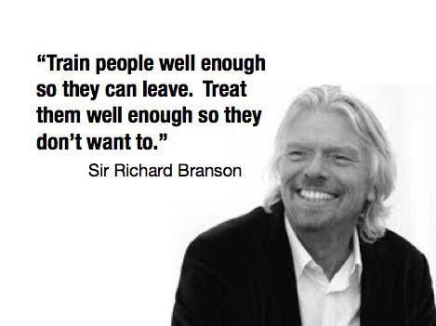

Slide 43
www.omag.org
www.twitter.com/omag1977
www.facebook.com/oklahomamunicipalassurancegroup
www.linkedin.com/oklahoma-municipal-assurance-group

Slide 44
3650 S. Boulevard
Edmond, Oklahoma 73013-5581
800-234-9461 ∙ 405-657-1400 ∙ Fax: 405-657-1401

Slide 46
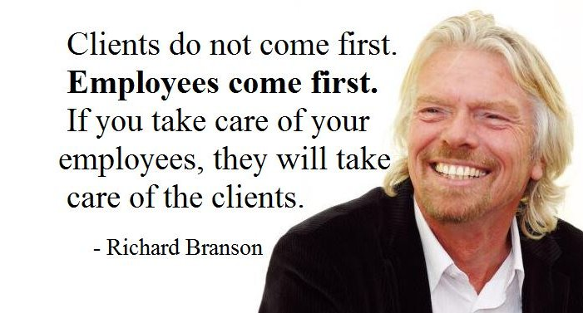

Slide 47
Would you prefer:
To have a tough conversation with a subordinate about their performance problem?
OR
To be hit in the eye with a stick?
Notes:
Paul Falcone says in his book: Having tough discussions with your employees will always be one of the most daunting tasks that you’ll face as a manager.
This book is designed and structured as a handy guide to be there by your side and walk you through these issues carefully and thoughtfully, all the while protecting you as well as your city from liability and unforeseen consequences.

Slide 48
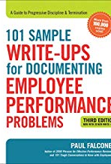
101 Sample Write-ups
These write-ups are designed to treat people with dignity and respect at all times.
Focus on two key areas:
Documenting your affirmative efforts at proactively rehabilitating employees and “meeting them halfway” in terms of fixing the problem at hand, and
Holding employees fully accountable for their actions and shifting the responsibility for improvement to the employee and away from the city.
Notes:
The 101 Tough conversations compliments the book 101 Sample Write-ups.
The conversations are verbal.
The write-ups are for written documentation.
These write-ups are designed to treat people with dignity and respect at all times, even through discipline and termination processes. .

Slide 50
THE END

Slide 51
https://www.youtube.com/watch?v=2WOZSCptSHk&t=150s
Notes:
Get Matt B’s help to shorten this video on Falcone’s book.
YouTube:
https://www.youtube.com/watch?v=2WOZSCptSHk&t=150s
Start at 1.23 to get past sales pitch and end at 4:00.

Slide 52
Establish a case?
Employee (Plaintiff) must establish a prima facie* case.
* Sufficient evidence
Employer (Defendant) must establish a legitimate business reason for the action taken.
Employee (Plaintiff) must prove the legitimate business reason was a pretext (not true).
Notes:
THE TEST - McDonnel Douglas v. Green supreme court case from 1973
sufficient to establish a fact or raise a presumption unless disproved or rebutted

Slide 53
Past practice
Has existed for a reasonably long time.
Occurs repeatedly
Is clear and consistent, repeated the same way each time.
Must be known and accepted to both management and employees
Notes:
An exception might occur around a holiday. If every year for seven years management allows workers to go home early Christmas Eve, this could be a valid past practice.
An example: Management has always let workers accept personal phone calls. The union can document 100 times in the last five years. Management points out three occasions where workers were refused the right. The overwhelming pattern favors the union.
Sometimes it’s not good enough for a low-level foreman to know; it must be higher management. For instance: Workers have been leaving work a little early on Fridays for years. According to the absentee program, they should receive one point, but the foreman never gives points for Friday. Upper management finds out and decides to give everybody warnings. Management did not inform the union that it wanted to change the practice. However, since upper management did not know about this practice, it would be hard to argue that workers could continue to leave work early every Friday.

Slide 54
Eeoc investigation
Position statements
1
Request for Interrogatories and Production of Documents
2
On-site Interviews
3
Mediation
4
Notes:
3 to 10 months

Slide 55
Life Cycle of an eeoc Charge
EEOC Charge filed by Claimant
EEOC emails charge to Employer
EEOC investigates
EEOC urges mediation
EEOC issues right to sue
Claimant has 90 days to file suit
Employer contacts attorney (or OMAG)
Employer submits a position statement

Slide 56
Life Cycle of an EEOC Charge ( “cause” finding)
EEOC Charge filed by Claimant
EEOC emails charge to Employer
Employer contacts attorney (or OMAG)
Employer submits position statement
EEOC investigates
EEOC urges mediation
EEOC issues a FOR CAUSE finding
EEOC forces Employer into Conciliation process
EEOC issues Right to Sue or Dept. of Justice gets involved

Slide 57
Eeoc CONCILIATION PROCESS
Reasonable cause to believe discrimination
Letter of Determination
Conciliation
(voluntary)
Conciliation fails
EEOC sends to DOJ
DOJ sues or EEOC issues right to sue letter
Notes:
If the EEOC determines there is reasonable cause to believe discrimination has occurred, both parties will be issued a "Letter of Determination" telling them that there is reason to believe that discrimination occurred. The Letter of Determination invites the parties to join the agency in seeking to settle the charge through an informal and confidential process known as conciliation. Conciliation is a voluntary process, and the parties must agree to the resolution - neither the EEOC nor the employer can be forced to accept particular terms. The EEOC is required by Title VII to attempt to resolve findings of discrimination on charges through conciliation. The EEOC strongly encourages the parties to take advantage of this opportunity to resolve the charge informally and before the EEOC considers the matter for litigation. Conciliation is an efficient, effective, and inexpensive method of resolving employment discrimination charges.
When deciding whether to file a lawsuit, the EEOC considers several factors, including the seriousness of the violation, the type of legal issues in the case, the wider impact the lawsuit could have on the agency's efforts to combat workplace discrimination, and the resources available to litigate the case effectively.
Filing lawsuits is a last resort - the EEOC files suit in less than 8 percent of the cases where it believes discrimination occurred and conciliation was unsuccessful.
In fiscal year 2014, the agency filed 133 lawsuits against employers accusing them of unlawful employment discrimination, including 105 on behalf of particular individuals and 28 on behalf of groups or classes of employees. In that same time period, EEOC's legal staff resolved 136 of the lawsuits filed that year and previous years, for a total monetary recovery of $22.5 million. At the end of fiscal year 2014, the EEOC had 228 cases on its active docket, of which 57 (25 percent) involved challenges to class-wide or systemic discrimination. By any measure, the EEOC has compiled a remarkable record in court. It achieved a favorable resolution in approximately 90 percent of all district court resolutions.

Slide 58
Eeoc charges 2010 to 2016

Slide 59
Dewitt v. southwestern bell (2017)
Prima Facie Case
Diabetic employee terminated after requesting retroactive leniency due to a medical condition as reasonable accommodation.
Legitimate Business Reason
Last chance agreement already in place; intentionally hung up on customers; never asked for medical help; investigation and witnesses
Pretext
Witnesses not credible; motived to invent disability related cause b/c of last chance agreement in place.
Notes:
COURT ANALYZED THE HR PERSONS THOUGHT PROCESS WHEN DECIDING ON VIOLATION AND PUNISHMENT: In reaching her conclusion that Ms. DeWitt intentionally dropped the calls, Ms. Baskett–McEnany considered multiple factors. First, she considered how “difficult [it is] to accidentally hang up on a customer.” Terminating a phone call is a two-step process, she testified, requiring two separate clicks of the mouse; that is, hanging up on customers required “discrete decisions to do that.” Second, Ms. Baskett–McEnany considered that Ms. DeWitt operated successfully the rest of the day and never reported that she was not feeling well. She also interacted with a co-worker on an instant messaging system immediately prior to the first dropped call. Third, Ms. DeWitt did not go into auxiliary mode or take a break from accepting calls, which she was permitted to do if she became ill. Fourth, Ms. DeWitt was in close proximity to other customer service representatives when the dropped calls occurred yet Ms. DeWitt identified no witnesses that would have observed her disorientation. Fifth and finally, Ms. Baskett–McEnany considered that although she believed Ms. DeWitt to be an honest person, Ms. DeWitt's Last Chance status put her job in jeopardy and could have motivated her to invent a disability-related cause for her misconduct. Ms. Baskett–McEnany weighed these facts against Ms. DeWitt's claim that her disability caused her to drop the calls, and developed the belief that Ms. DeWitt intentionally dropped the calls.

Slide 60
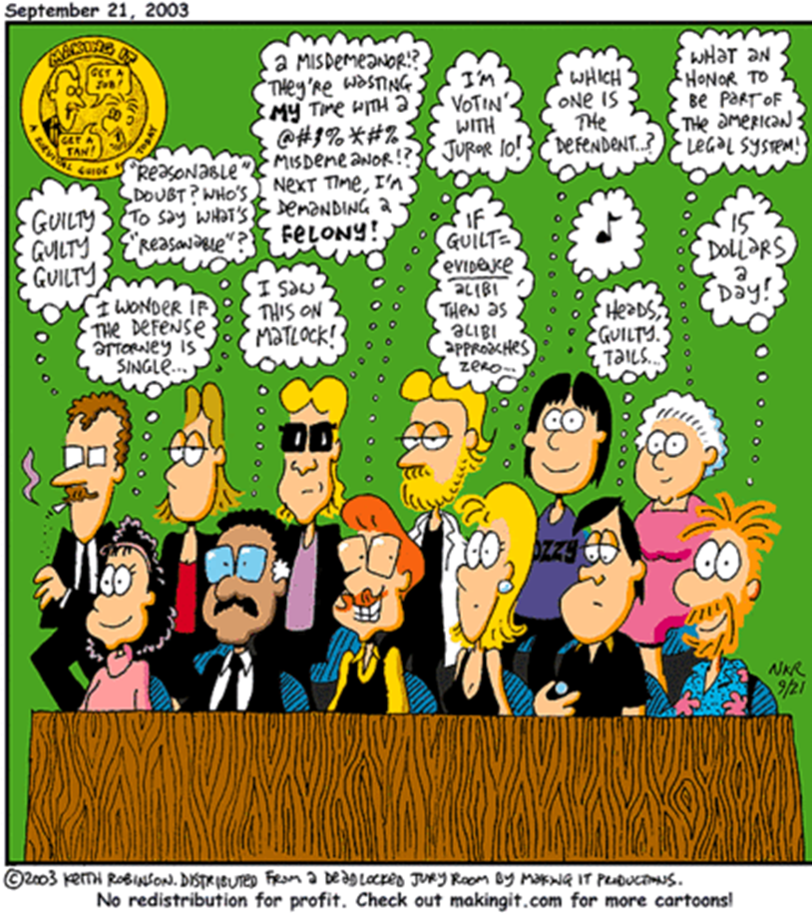
it’s important TO BE FAIR because that’s what judges & juries like!

Slide 61
The numbers are likely to remain high because:
Don’t need to hire an attorney to file an EEOC charge.
1
Those who do retain counsel often do so on a contingency basis.
2
It is very rare for an individual filing a claim to be assessed attorney’s fees, even if they are unsuccessful.
3

Slide 62
Actions* | Low | High
Investigate complaint | 2 | 40
Handling claim/lawsuit | 1 | 10
Initial interview defense attorney | 2 | 10
Answering Interrogatories | 2 | 24
Answering Request for Production | 4 | 40
Deposition preparation | 2 | 10
Depositions | 5 | 40
Mediation/Settlement Conference | 2 | 8
Trial witness preparation | 5 | 10
Trial | 16 | 40
TOTAL EMPLOYEE/SUPERVISOR HOUR: *These actions may be involve 1 or multiple employees. | 41 hrs. | 232 hrs.
Notes:
These actions take place over a 1-2 year period for a case that stays on track and is moving along.
On top of the duties that you have to complete on a daily basis – taking calls, doing payroll, waiting on customers, etc. you will have to find time to do these things. Typically you will have time to plan for most of these items but it does create major work that someone has to perform. The Court can sanction the City if this information is not provided in a timely manner.
*These numbers may include more than one employee handling the claim and/or appear for deposition.

Slide 63
Defense costs $60,000 to $100,000
Notes:
This is just in defense costs.
This does not count cost of a verdict.

Slide 64
Case Activity | Est. Cost
Initial Investigation | $2,500
Responsive Pleadings | $2,500
Discovery | $7,000
Depose Plaintiff | $3,500
Depose Additional Witnesses | $7,000
Depose City Officials | $3,000
Dispositive Motions | $10,000
Pretrial and Trial | $30,000
Misc. | $5,000
Total Initial Estimate of Defense: | $70,500

Slide 65
Separation agreement Consideration by the parties
City:
Administrative Leave
Separation Pay
Health and Welfare Benefits
References for future employment
Employee:
Resignation
Release of all employment claims

Slide 66
Separation agreement legal requirements
If the employee is older than 40, then the Older Worker Benefit Protection Act applies
The Act requires employers to provide a notice to employees who agree to severance agreements
The notice provides information to the employee about their rights with regard to age discrimination
Notes:
To amend the Age Discrimination in Employment Act of 1967 to clarify the protections given to older individuals in regard to employee benefit plans, and for other purposes.
Be it enacted by the Senate and House of Representatives of the United States of America in Congress assembled,
SECTION 1. SHORT TITLE.
This Act may be cited as the `Older Workers Benefit Protection Act'.
TITLE I--OLDER WORKERS BENEFIT PROTECTION SEC. 101. FINDING.
The Congress finds that, as a result of the decision of the Supreme Court in Public Employees Retirement System of Ohio v. Betts, 109 S.Ct. 256 (1989), legislative action is necessary to restore the original congressional intent in passing and amending the Age Discrimination in Employment Act of 1967 (29 U.S.C. 621 et seq.), which was to prohibit discrimination against older workers in all employee benefits except when age-based reductions in employee benefit plans are justified by significant cost considerations.
SEC. 102. DEFINITION.
Section 11 of the Age Discrimination in Employment Act of 1967 (29 U.S.C. 630) is amended by adding at the end the following new subsection:
`(l) The term `compensation, terms, conditions, or privileges of employment' encompasses all employee benefits, including such benefits provided pursuant to a bona fide employee benefit plan.'.

Slide 67
Oklahoma office of civil rights enforcement (ocre)
Oklahoma Attorney General's Office
Enforces the Oklahoma Anti-Discrimination Act (OADA)
OCRE can bring an action on behalf of the employee and request an injunction, liquidated damages, and attorney fees; or
OCRE can issue a right to sue and employee has 90 days to file suit
Notes:
If less than 15 Employees…

Slide 68
Eeoc jurisdiction
Must have 15 or more employees in last 20 weeks
Discriminatory act occurred in past 300 days
90 days to file suit once receive Right to Sue letter

Slide 69
EEOC Electronic filing
Send to Adrian McDaniel at the EEOC:
Name, Title, City, mailing address, email addresses, and phone number of City’s Designated Representative
215 Dean A. McGee, Suite 524, OKC, OK 73102; or
Adrian.mcdaniel@EEOC.gov

Slide 70
How to respond
Send EEOC charge to your City Attorney
Send to OMAG – A.S.A.P.
Gather necessary information for response, i.e. policies, personnel file, photos, statements, etc.
Keep it confidential!

