Slide 1
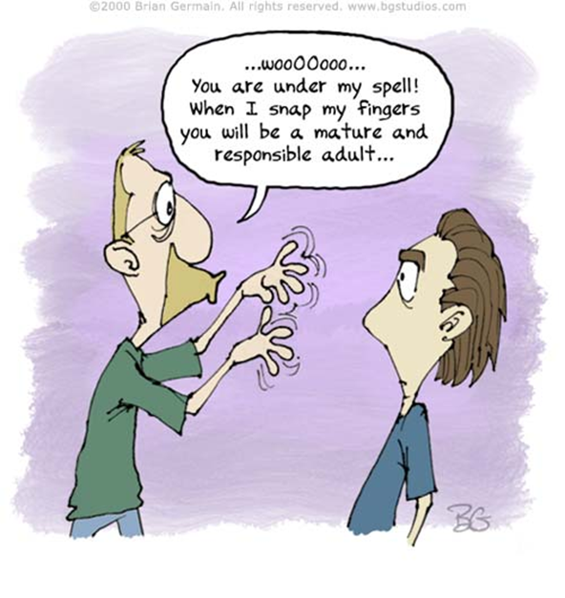
Dare to Dream…

Slide 2
Coaching is...
S.I.P. #3
Helping someone expand and apply skills, knowledge and abilities, by:
Teaching
Motivating
Listening
Encouraging
Setting Goals
Notes:
Coaching is helping someone else expand and apply skills, knowledge, and abilities.
It involves teaching, motivating, empowering, and listening to others so they can take action on specific tasks.
Coaching approaches should be adapted to each situation. Each coaching opportunity is person- and task- specific.

Slide 4
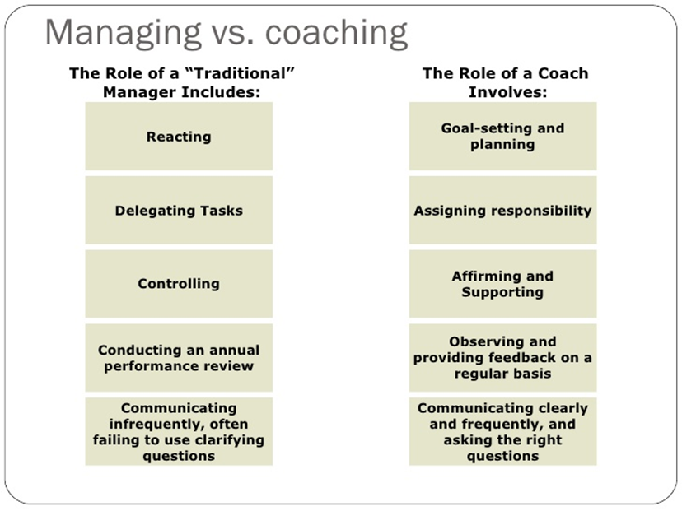

Slide 5
Coaching to Improve Employee Performance
Part of Day-to-Day discussions
Provide positive feedback – Employees want to know when they do well.
You reinforce those positive behaviors with recognition of a job well done
Notes:
The First Step in Coaching an Employee
The first step in any effort to improve employee performance is counseling or coaching. Counseling or coaching is part of the day-to-day interaction between a supervisor and an employee who reports to her, or an HR professional and line managers.
Coaching often provides positive feedback about employee contributions. Employees need to know when they are effective contributors.
By providing this positive feedback, you are also letting the employee know the actions and contributions that you'd like to reinforce so that you see more of them.
Source: https://www.thebalancecareers.com/use-coaching-to-improve-employee-performance-1918083

Slide 6
Coaching When Performance Issues Exist
Regular coaching brings performance issues to the employee’s attention
Goal of performance coaching is not to make the employee feel back
Goal is to work with the employee to solve performance problems
Employees who respond positively to coaching are likely to become valued contributors
Notes:
Coaching When Performance Issues Exist
At the same time, regular coaching brings performance issues to an employee's attention when they are minor. Your coaching feedback assists the employee to correct these issues before they become significant detractions from her performance.
The goal of performance coaching is not to make the employee feel bad, nor is it provided to show how much the HR professional or manager know. The goal of coaching is to work with the employee to solve performance problems and to improve the work of the employee, the team, and the department.
Employees who respond positively to coaching and improve their performance can become valued contributors to the success of the business. Employees who fail to improve will find themselves placed on a formal performance improvement plan, known as a PIP. This sets up a formal process wherein the manager meets regularly with the underperforming employee to provide coaching and feedback.
At the meetings, they also evaluate how well the employee is performing in achieving the performance goals that were enumerated in the PIP. Generally, by the time an employee has received a PIP, Human Resources staff are significantly involved in both the meetings and in the review of the employee's progress and performance.
Employees who fail to improve when on the PIP are likely to find their employment terminated.

Slide 7
6 Steps to Coaching
Show confidence in the employee's ability and willingness to solve the problem. Ask for their help in solving the issue.
Describe the performance problem to the employee. (Discuss the behavior is a way that they understand.)
Determine whether issues exist that limit the employee's ability to perform the task or accomplish the objectives. (Barriers: Time, Training, Tools or temperament.)
Notes:
Use these six steps to provide effective supportive coaching to your reporting employees.
Show confidence in the employee's ability and willingness to solve the problem. Ask him or her for help in solving the problem or improving their performance. Ask the employee to join in with you with the goal of increasing the employees' effectiveness as a contributor to your organization.
Describe the performance problem to the employee. Focus on the problem or behavior that needs improvement, not on the person. Use descriptions of the behavior with examples so that you and the employee share meaning.
Ask for the employee's view of the situation. Do they see the same problem or opportunity that you do?
Determine whether issues exist that limit the employee's ability to perform the task or accomplish the objectives. Four common barriers are time, training, tools, and temperament. Determine how to remove these barriers. Determine whether the employee needs your help to remove the barriers—a key role of a manager—or if he is able to tackle them by himself.

Slide 8
6 Steps to Coaching (Cont.)
Discuss potential solutions to the problem or improvement actions to take.
Agree on a written action plan. Identify specific goals that the employee must accomplish.
Set a date and time for follow-up.
Express confidence in the employee's ability to improve. Recognize, however, that the only person who is in charge of their performance improvement is the employee.
Notes:
Discuss potential solutions to the problem or improvement actions to take. Ask the employee for ideas on how to correct the problem or prevent it from happening again. With a high performing employee, talk about continuous improvement.
Agree on a written action plan that lists what the employee, the manager, and possibly, the HR professional, will do to correct the problem or improve the situation. Identify the core goals that the employee must meet to achieve the appropriate level of performance that the organization needs.
Set a date and time for follow-up. Determine if a critical feedback path is needed, so the manager knows how the employee is progressing. Offer positive encouragement. Express confidence in the employee's ability to improve. Recognize, however, that the only person who is in charge of their performance improvement is the employee. As much as you try to help, he is the one in charge.

Slide 9
Use a Core Script

Slide 10
Sample Script

Slide 11
Your turn to Practice…
Situation with Public Works employees:
PW Director is getting calls for workers going into backyards without attempting to contact home owners before accessing the backyard. Workers are not properly identifying themselves as a City Public Works employee needing to access a sewer manhole located in the homeowner’s backyard. They are not acting professional and sometimes show up smoking or chugging a Route 44 drink. They are not making sure they secure gates when entering and leaving. As a result, pets are getting out and running loose in the neighborhood.

Slide 12
Performance Improvement Plan (PIP)
Can resolve workplace productivity issues and help even the most unlikely employee succeed in your organization.
A PIP is designed to facilitate constructive discussion between a staff member and their supervisor and to clarify the exact work performance requiring improvement.
It is implemented at the discretion of the manager.
Notes:
A formal PIP is best used for those employees who appear to have the greatest potential for improvement. To help ensure an employee's success, the PIP should be realistic, fair, and clearly specify the required goals and means for accomplishing them. It should also be vetted and approved by upper management and HR. If used properly, a PIP can transform a struggling employee into a top performer.
Disclaimer: Please note that the information provided, while authoritative, is not guaranteed for accuracy and legality. This site is read by a worldwide audience and employment laws and regulations vary from state to state and country to country. Please seek legal assistance or assistance from state, federal, or international governmental resources, to make certain your legal interpretation and decisions are correct for your location. This information is for guidance, ideas, and assistance.

Slide 13
Sample PIP Form
Employee Name:
Title:
Department:
Date:
Performance in need of improvement: (List the goals and activities the employee will initiate to improve performance. Include skill development and changes needed to meet work performance expectations.)
Target date for improvement:

Slide 14
Sample PIP Form (Cont.)
Expected results: (List measurements where possible.)
Dates to review progress by the employee and supervisor:
Progress at review dates:
Employee Signature:____________________________
Date:________________________________
Supervisor Signature:____________________________
Date:________________________________

Slide 15
By Mark Murphy
McGraw-Hill, 2012
www.leadershipiq.com

Slide 16
Beginning the Coachability question https://www.youtube.com/watch?v=6k8yhZYIDa4
Notes:
Hiring for Attitude: Beginning the Coachability Question 1:25
https://www.youtube.com/watch?v=6k8yhZYIDa4
5/19/15

Slide 17
Add: The Coachability Question
What was your boss’s name? Please spell the full name.
Tell me about __(Name)__ as a boss.
What’s something that you could have done (or done differently) to enhance your working relationship with ___(Name)___?
When I talk to ___(Name)___, what will he or she tell me your strengths are?
Now all people have areas where they can improve, so when I talk to ___(Name)___, what will he or she tell me about your weaknesses are?
Notes:
Coachability Question. 1) Make them believe you are going to talk with their Previous Boss. You must ask for the name and the correct spelling of the name or the Coachability Question will not work.
2) Ask them to describe their boss. Here are two probing follow-up questions: What’s something you wish Pat had done more of? And, What’s something you wish Pat had done less of?
3) Ask what they personally could have done differently. This will assess to what extent the Candidate feels personally accountable for his/her own success. High performers have high levels of critical self-awareness – the definition of coachability. Natural Law of the Universe that everyone has the potential for more improvement; the real question is who is personally aware this room for improvement exists.
4) Ask them what their boss considered their Strengths. You get a canned answer when you ask “Tell me your strengths”. This way they will answer more honestly because they believe you will be calling the boss to confirm. This gives you a different answer.
5) Ask them what their boss considered their Weakness. “Now everyone has some weaknesses, so when I talk to Kate, what will she tell me yours are? (Most critical step in this 5 step process and it only works if you do all 5 Steps. This question will determine whether someone is Coachable of Not. “I can’t think of any weaknesses.” or “I don’t know what Kate thought about me.” = Warning, they are not coachable. Non-coachable people are a nightmare to try and manage!

Slide 18
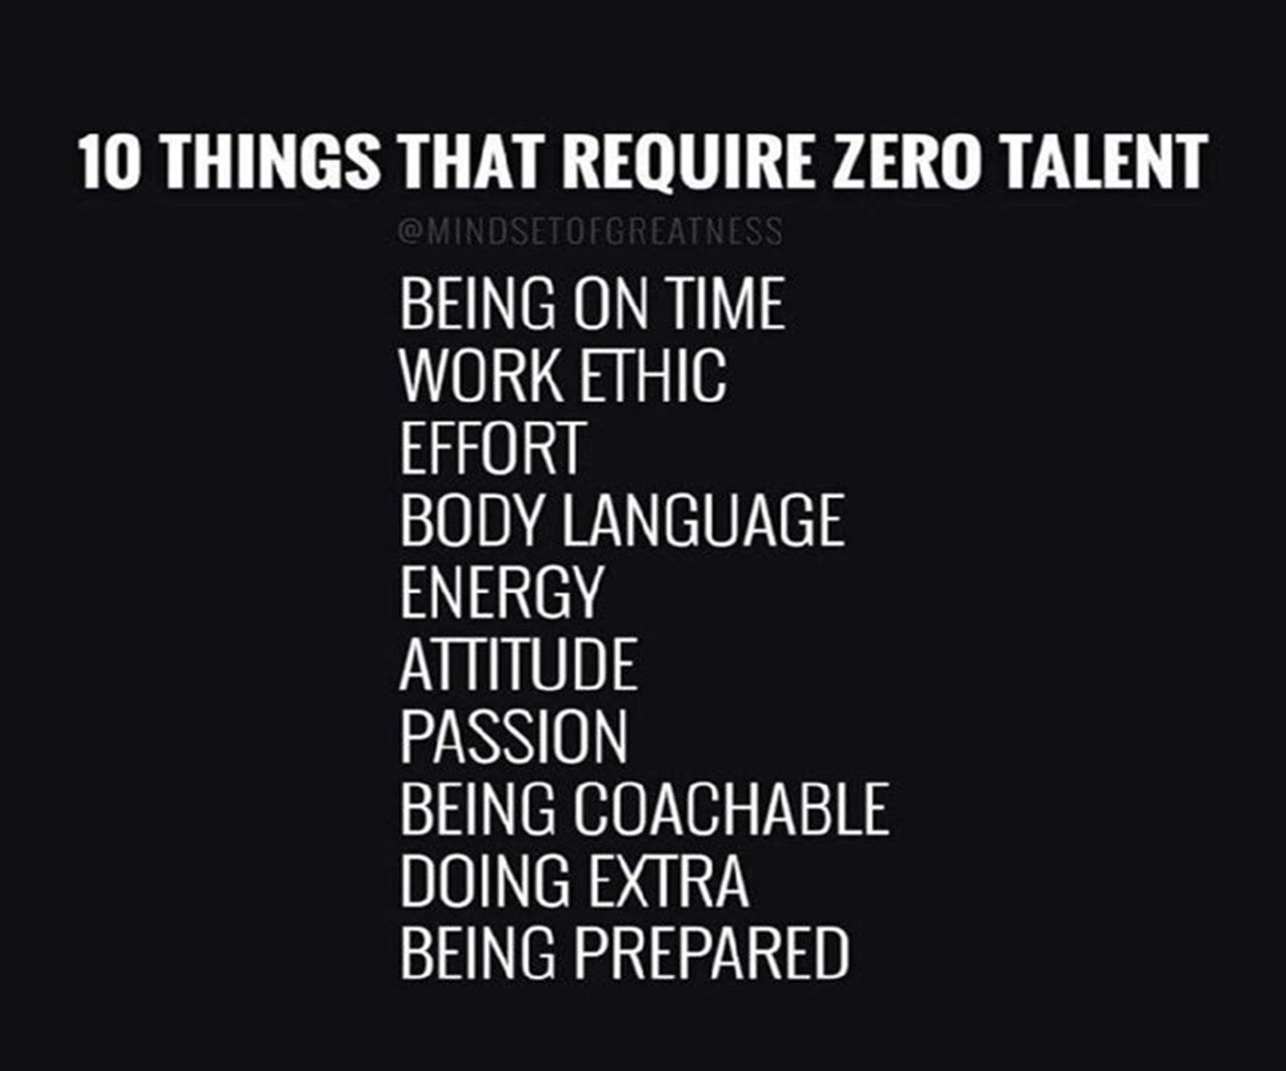

Slide 19
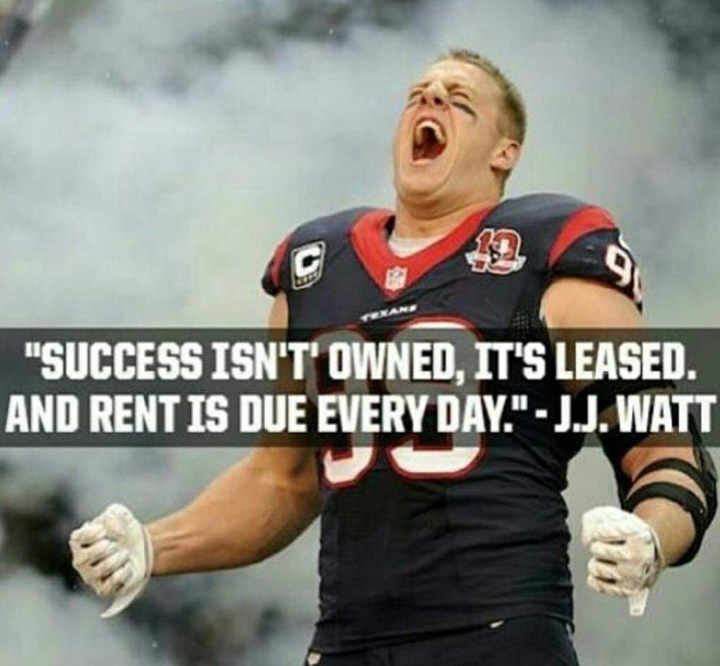
Notes:
tJ. J. Watt. Justin James Watt (born March 22, 1989) is an American football defensive end for the Houston Texans of the National Football League (NFL). He was drafted by the Texans with the 11th pick in the first round of the 2011 NFL Draft, and played college football at Wisconsin.
2019 season[edit]
In week 1 against the New Orleans Saints, Watt recorded zero tackles and zero quarterback hits in the 30-28 loss. This was the first time in 105 career games that Watt was held to these numbers.^{[99][100]} In week 3 against the Los Angeles Chargers, Watt sacked Philip Rivers twice in the 27-20 win. ^{[101]} In the week 8 game against the Oakland Raiders, Watt suffered a season-ending torn pectoral.^{[102]} He was placed on injured reserve on October 30.^{[103]}

Slide 20
Be The Broken Record
Be Consistent
Be Concise
Be Calm
Let your subordinates know this is Serious!

Slide 21
The Gift of FEEDBACK
Give Feedback for the right reasons.
Give feedback at an appropriate time.
Feedback must be voluntarily accepted.
Feedback begets feedback.
Feedback is not the same as truth.
Notes:
New research from Leadership IQ finds that interview answers rated Poorly by hiring managers contain very different words than interview answers rated Highly.
See Handout: The Gift of Feedback.

Slide 22
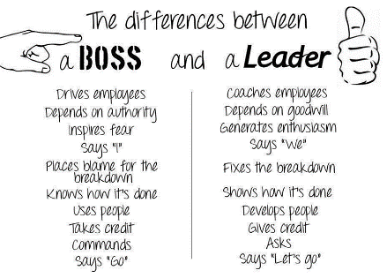

Slide 23
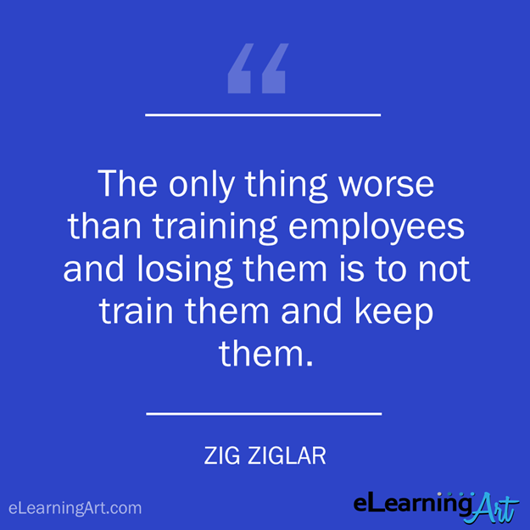

Slide 24
