Slide 1

Basic Federal Employment Laws for Supervisors
Documentation protects you in Court.
If it’s not written down, it didn’t happen!
When you write it down, you Own It!
Notes:
Remember… Ignorance of the law is no defense.
Remember: If it’s not written down, it didn’t happen!
>>>Let’s consider some situations you might have… (Scenarios)
When in doubt, call for Help. This review is the 30,000 Ft. Fly-Over.

Slide 2
Disclaimer
The comments and advice provided by me today are not intended to replace the advice of your City Attorney.
Pam Spinks
For additional assistance, please call Suzie Paulson, Matt Love, Monica Coleman or Jeff Bryant @ OMAG for guidance, 405-657-1400 or 1-800-234-9461.
Notes:
However, I have worked closely with and learned much from our attorneys over my 35 years…

Slide 3
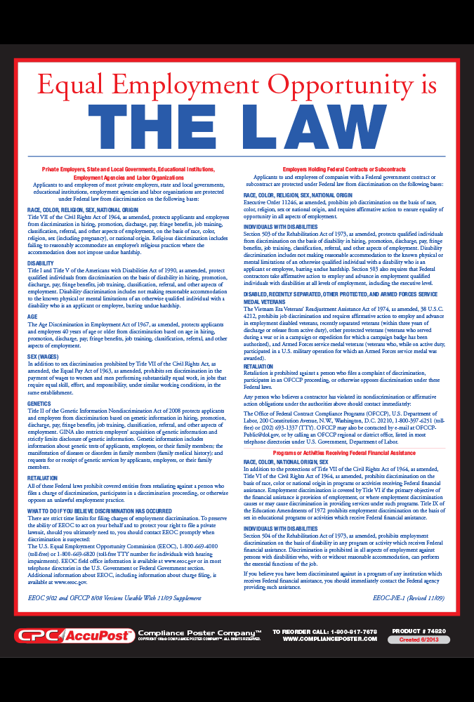

Equal Employment Opportunity Commission (EEOC)
Federal law applies to employers with 15 or more employees.
Notes:
Never BUY Posters. They are free on government websites.
Federal Law (& OK WC) Posters must be posed in every location of your city or town.

Slide 4
Oklahoma Anti-Discrimination Act (OADA)
Applies to Employers with less than 15 employees.

Slide 5
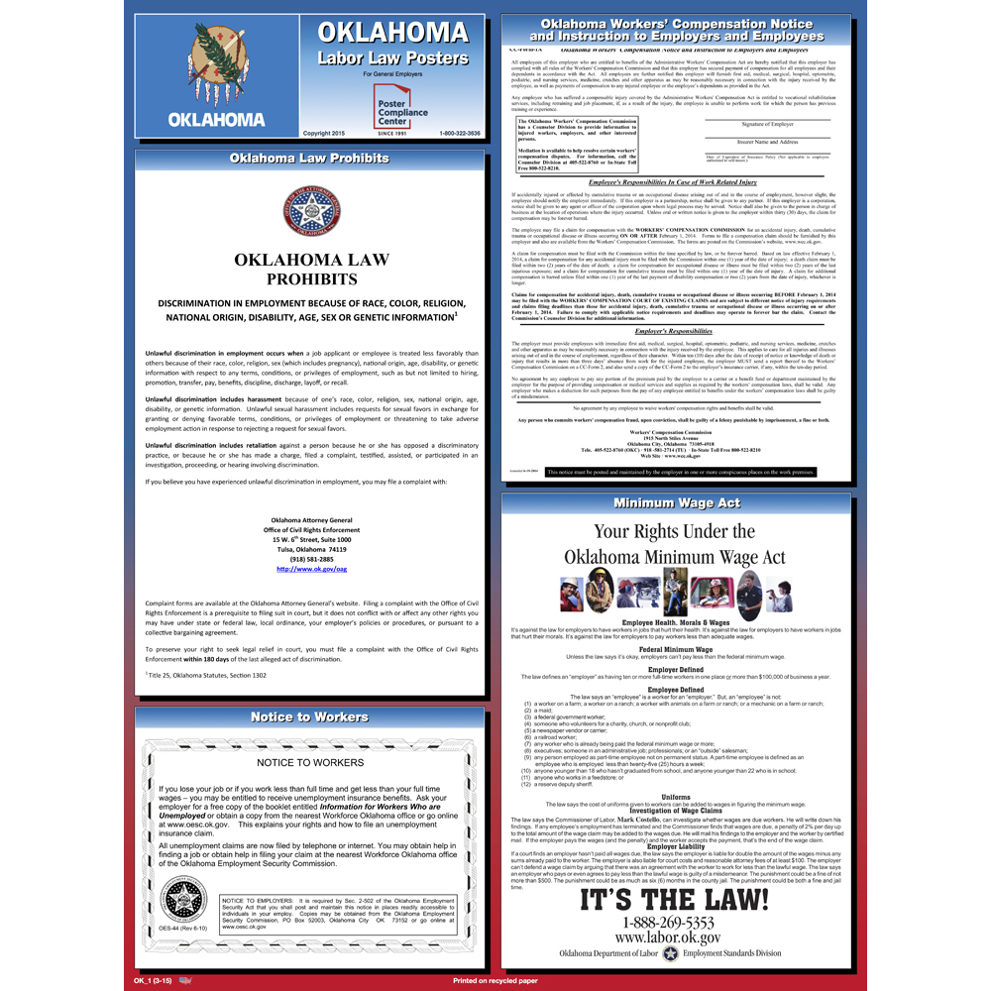
Labor Posters Are FREE on Gov websites.
You do not have to buy them…

Slide 6


= WIIFM
Learn enough to:
Stay Out of Court!
Notes:
You may be asking, WIIFM?
Starting with Your name, your boss, your boss’s boss will all be listed in the Lawsuit.

Slide 7

Document, Document, Document!
When you write it down, you own it!

Slide 8

Notes:
Supervisors should always take the time to Plan and Consider what they will say to an employee when it comes to Discipline and Terminations.
YOU control these meetings. You can stop and reschedule if a discussion is not working…

Slide 9
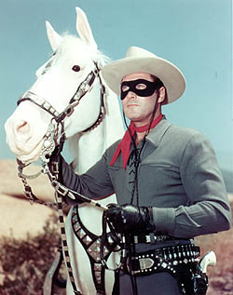

Never be a Lone Ranger
__________
Ask HR for help if you are unsure...
Notes:
Remember, the Goal is to:
Stay Out of Court!
The Lone Ranger, New Movie in August, 2013.
New Lone Ranger is Armie Hammer.
New Tonto is Johnny Depp.

Slide 10
LABOR LAWS FOR SUPERVISORS
Civil Rights Act of 1964 and 1991
ADEA - Age Discrimination in Employment Act
ADAAA - Americans With Disabilities Act
FLSA - Fair Labor Standards Act
FMLA - Family and Medical Leave Act
PLUS:
Case Law (=Court Cases)
Notes:
Basics of Employment Law – When in doubt, seek out help. Call Human Resources.
This is a “30,000 Ft Fly-Over”.
Federal Statutes and State Statutes (like Governmental Tort Claims Act, WC Act and Drug Testing) are the laws. However, Court Cases (federal, state and appeals courts) are constantly happening that tell us how to “interpret” the law.

Slide 11
Civil Rights Act of 1964
Protected Groups:
All These Topics are
Off-Limits!
  Forbids discrimination in
  employment based on:
  Race
  Color
  Religion
  Sex
  National origin
  Other Federal & State Laws:
  Gender
  Marital status
  Sexual orientation
  Age
  Disability
Notes:
Under Title VII, it is illegal to discriminate in any aspect of employment. Making employment decisions based on the Protected Groups is forbidden by Federal Law.
42 U.S.C. § 2000e - It shall be an unlawful employment practice for an employer to discriminate against any individual with respect to compensation, terms, conditions, or privileges of employment because of such individual’s race, color, religion, sex, or national origin. + age, gender, sexual orientation, disability & veteran status.
NEXT: Don Logan and AIA >>>

Slide 12
Gender Discrimination
Gender discrimination is discrimination against a person or group based on the person’s sex, sexual orientation or gender identity.
Notes:
If there is a trait, characteristic, medical condition, etc. that is particular to one gender or the other – you may not base an employment decision upon that trait, characteristic, medical condition, etc.
Example: Pregnancy
Gender Bias: (Added 8-13, Slides from Suzie Paulson.)
Assigning more or less work based on sexual stereotypes
Only giving more physical work to male workers
Only giving paperwork to female employees
The presumption that men do only manly things and women do only girly things.
Assigning arts and crafts to females and sport related activities to males.
Women plant flowers and men mow.

Slide 13

Everything discussed in this video also applies to Oklahoma.
Notes:
Video by Don Logan for Arizona Interscholastic Association (AIA).
Arizona is an At Will state, so is Oklahoma, unless you are part of a CBA.
Referees are “independent contractors” but their standards of behavior must match an employee.
Report to AIA should translate to Report to a Supervisor…

Slide 14

Notes:
We should be as Tolerant as this bear!
This bear is Open-Minded and Inclusive.
He Embraces the full Diversity of his Food Chain!

Slide 15

Professional Conduct

Slide 16


People who are different in regards to religion, clothing, cultural identity, hairstyles, etc. should accept the fact that they may be teased by their fellow coworkers and not consider such teasing as harassment.
Supervisor Scenario #2
Notes:
TRUE. OK is an “At Will” Employment state. All you say is: “he/she was terminated for the “Good of the Service.””
However, if your City Charter, or Personnel Policies, or Collective Bargaining Agreement specify a “Process for Termination”, then you and your city must follow the process – every time with everyone.
TRUE

Slide 17
Do you know harassment when you see it?
Sometimes, sure, but often not, because harassment isn't about intent, it's about effect.
Employees may appear to be enjoying a situation but be thinking, "I'm being harassed."
The message that counts … is the one received.
Anytime inappropriate behavior or comments are intended to humiliate someone or continue despite requests to stop, it’s Harassment.
Notes:
Do you know harassment when you see it?
Sometimes, sure, but often not, because harassment isn't about intent, it's about effect.
Employees may appear to be enjoying a situation but be thinking, "I'm being harassed."
The message that counts … is the one received.
Anytime inappropriate behavior or comments are intended to humiliate someone or continue despite requests to stop, it’s Harassment.

Slide 18
Reporting discrimination is itself a protected act under the law.
Supervisor Scenario #3 & #4
Discrimination and Harassment
are the same.
Notes:
TRUE: If you feel discriminated against by your employer, you have a legal right to report that belief to company management, the appropriate state and federal agencies, and the courts - without retaliation occurring.
_________________________________________
False. Although they are often lumped together and can be associated with each other, the legal understanding of discrimination and harassment differ.
Discrimination deals with employment decisions like recruitment, interviewing, hiring, promotion and terminations. If an employment decision is made based on age, race or ethnicity, gender, religion or disability, then that decision is most likely discriminatory.
When negative actions outside of employment decisions are directed at an individual personally, the misconduct is called harassment. Examples of harassment in the workplace are racist jokes, slurs and insults, and unwanted physical contact.

Slide 19
Bias, Stereotypes and Prejudice
Bias is a Feeling We’ve Learned.
Stereotype - when we apply a bias against a Whole Group of people.
Prejudice* - is when we act on the stereotypes we hold.
* It is NEVER APPROPRIATE to take action or speak at work from your personal prejudice!
Notes:
Bias are Feelings We’ve Learned:
Creates Stereotypes
Filter we see the world through (filters out truth)
Overlook credentials and qualifications
Are natural
Stereotype occurs when we apply a bias we have against a Whole Group of people
Prejudice takes it a step further when we act on the stereotypes we hold. Taking action or speaking at work from your personal prejudice is always INAPPROPRIATE! (or NEVER Appropriate)

Slide 20

Don't be a “Jerk”!
Jerk = a person who is unwelcome due to unlikable qualities and behavior
Frequently called: Obnoxious,
Horrible, Intolerable
Shows No Respect to Anyone
If you are a “Jerk”, then YOU have to Change.
NOTE: Anyone can be a Jerk!
Be aware of your behavior
Notes:
Jerks “judge” people and talk about them based on their biases.
Jerks often point and laugh at other people.
***Guess what, Jerk, three fingers are pointing back at you.
Personal insults
Invading one's personal territory
Uninvited personal contact
Threats and intimidation, both verbal and non-verbal
Sarcastic jokes and teasing used as insult-delivery systems
Withering e-mail flames
Status slaps intended to humiliate their victims
Public shaming or status-degradation rituals
Rude interruptions
Two-faced attacks
Dirty looks
Treating people as if they are invisible.

Slide 21
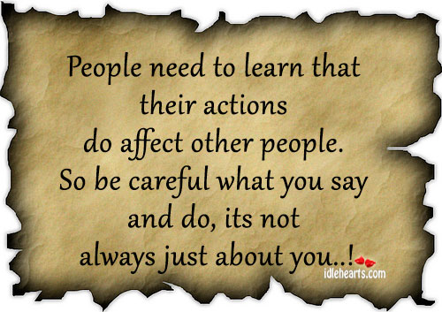
JERKS

Slide 22
A municipality can be found guilty of allowing sexual harassment, even if its supervisors never knew of the offending behavior.
Supervisor Scenario #5
True or False
Notes:
TRUE based on court cases, the courts expect you to know what is happening in your workplace. You “knew or should have known”.
Supervisors should train their subordinates that they are also responsible for keeping discrimination and harassment out of the workplace. Employees should speak up when they see it, or in the very least, report it to a supervisor ASAP.
TRUE if a Quid-pro-Quo claim.
This is probably FALSE if it is a claim of hostile work environment, because the hostile environment must be very pervasive in the workplace.
TRUE

Slide 23
Harassment occurs because:
Different opinion on what is appropriate workplace behavior
Incorrectly assuming what others consider appropriate behavior
No correction when inappropriate behavior occurs
Notes:
Added 8-13, Slides from Suzie Paulson:
Is all Harassment Wrong? YES!! All Harassment is wrong and should not be tolerated.
Harassment can be unlawful when someone is tormented because of a protected characteristic such as age, race or gender.
Note: If court thinks activity is bad, then it will find a way to say there is harassment.
See Handout How to Revamp your Harassment Prevention Program.

Slide 24


It does not count as sexual harassment if, at one time, you had a consensual relationship with the harasser.
Supervisor Scenario #6
Notes:
FALSE. Many falsely assume that a past consensual relationship grants either party a free pass to make more intimate sexual advances in the workplace after the relationship ends. However, by law, a previously consensual relationship does not tarnish the unwelcomeness of current behavior. In Green v. Administrators of the Tulane Educ. Fund, a supervisor and an employee had previously had a consensual relationship, which was broken off by the employee. The employee later rejected the supervisor’s attempt to renew the relationship, and the supervisor began harassing the employee. In this case, the Fifth Circuit Court of Appeals held that the employee could maintain a hostile work environment claim, notwithstanding her prior relationship with her supervisor. In reaching its conclusion, the Green court cited the Supreme Court case of Oncale v. Sundowner Offshore Serv., Inc. and found that since “it was only after the relationship ended that [the supervisor] began to harass [the employee] . . . this fact alone supports a jury’s inference that he harassed her because she refused to continue to have a casual sexual relationship with him.”
A sexual relationship between co-worker’s is a break-up away from a sexual harassment complaint.

Slide 25
Hostile Work Environment Factors
  Interferes with a person’s ability to work
  Frequency of discrimination conduct (pervasiveness)
  Severity of conduct
Physically threatening, humiliating or mere offensive utterance
  Based on victim’s perception
  Perception takes precedence over the harasser’s intention
Notes:
In order to determine whether or not a hostile work environment has been created, these factors are considered and weighed –
The frequency of the discriminatory conduct – how pervasive is the conduct? Pervasive = widespread, extensive, inescapable.
Severity of the conduct: Federal Courts have held that there is no “federal guarantee of refinement and sophistication in the workplace.”
Physically threatening, humiliating OR mere offensive utterance -
Conduct affects work performance or alters condition of employment.

Slide 26
An employee who is offended by a co-worker’s conduct must first tell the offender that the behavior is unwelcome before reporting it to Human Resources.
Supervisor Scenario #7
Notes:
FALSE: The Supreme Court made it clear in two cases in 1998 that employers must have internal complaint procedures that provide a harassed employee “multiple avenues” to complain internally. The law requires that employer policies provide several ways for employees to request that unwelcome harassing behavior be stopped, including complaints to managers, supervisors and/or the human-resources department. These policies, coupled with appropriate corrective action when harassment occurs, can support a successful defense to claims of supervisory harassment that the employee did not first voice through the internal complaint process.
*** Offended Employee MUST follow the city’s procedures in reporting an incident.

Slide 27
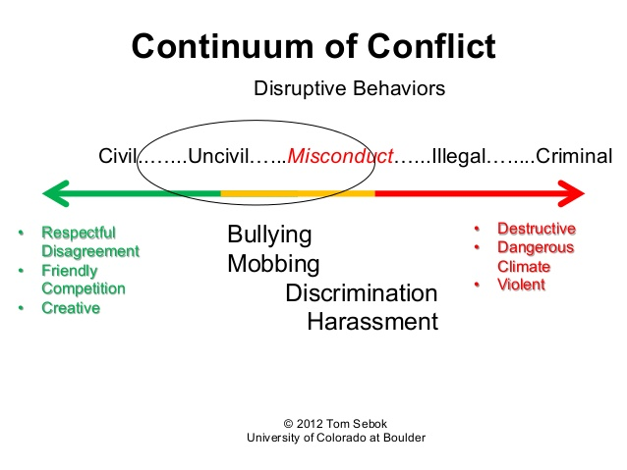

Slide 28
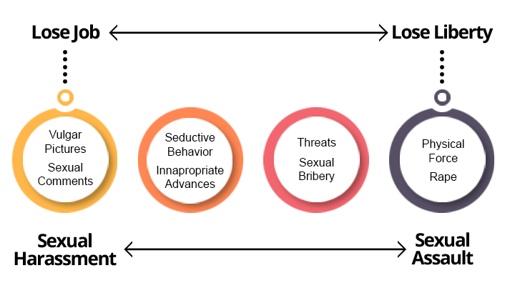
Continuum of Harm
0 ---------------------------------------- 100
Notes:
Behaviors that may qualify as sexual harassment can range from lewd remarks or gestures to persistent, unwanted sexual attention, to jokes of a sexual nature, to stalking and sexual assault.
It’s all bad! But the Consequences Become Different once you place “hands on”!
However, in the extreme, it becomes a criminal offense – not just harassment.

Slide 29
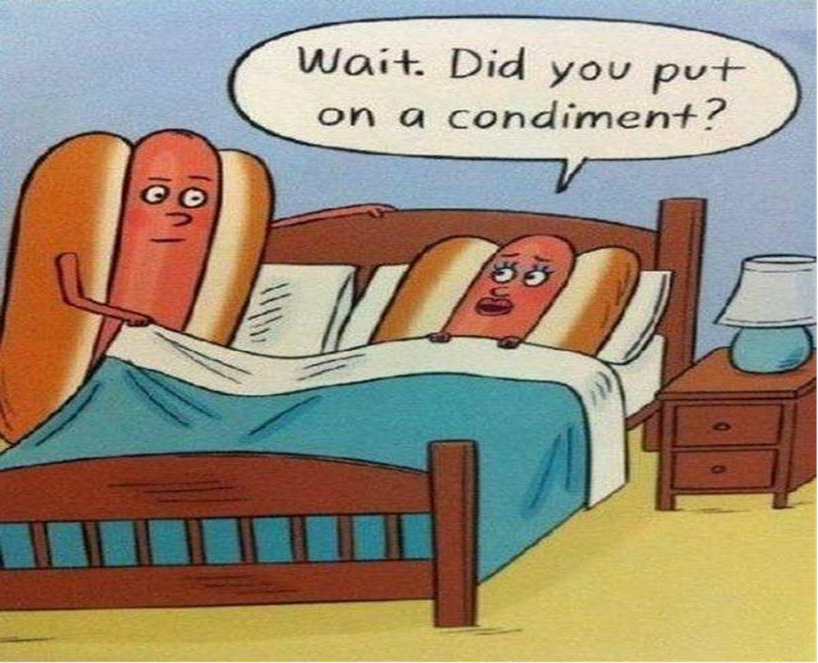
For Discussion Purposes Only.
Notes:
It is the sexual content that could be offensive to someone. Doesn’t matter if it doesn’t offend you or if you think it is hilarious!
FB keeps a log of every thing you do. Claimant’s attorney’s start with that Activity Log in their investigations.
Let’s be Clear about what is sexual harassment . . . Don’t do these things:
•Don’t tell your co-workers your wife does not have sex with you so you need to get it somewhere else.
•Don’t ask your co-workers for a blow job.
•Don’t ask to “get it on” in the office real quick.
•Don’t ask your co-workers if you can warm your hands on her breasts.
•Don’t blow in your co-workers ears.
•Don’t ask to lick your co-workers ear to get them all hot and bothered.
•Don’t kiss your co-workers.
•Don’t send your co-workers naked pictures.
•Don’t send your co-workers semi-naked pictures.
•Don’t sleep with your subordinates.
•Don’t tell your co-workers that you are horny.
•Don’t ask your co-workers to sit on your lap.
Always: Assume you are being recorded.

Slide 30
Is there a Federal law that protects employees 40 years old and older.?
Supervisor Scenario #8
If true, from what does it protect them?
Notes:
FALSE: The Supreme Court made it clear in two cases in 1998 that employers must have internal complaint procedures that provide a harassed employee “multiple avenues” to complain internally. The law requires that employer policies provide several ways for employees to request that unwelcome harassing behavior be stopped, including complaints to managers, supervisors and/or the human-resources department. These policies, coupled with appropriate corrective action when harassment occurs, can support a successful defense to claims of supervisory harassment that the employee did not first voice through the internal complaint process.
*** Offended Employee MUST follow the city’s procedures in reporting an incident.

Slide 31

Notes:
Just for Fun! I am tickled and offended by this video. This is NOT True about Human Resources.
Funny Video from New Human Resources Department
https://www.youtube.com/watch?v=1xC3iqKm0rE
This video ends by saying: “Thank you for calling Human Resources where it is our job to make your job miserable!”
Published on Jun 24, 2009
SUBSCRIBE 4.6KSUBSCRIBE SUBSCRIBED UNSUBSCRIBE
A Message From Ya New Human Resources Department Follow me on instagram: http://instagram.com/EddieGoing

Slide 32

ADEA – AGE DISCRIMINATION IN EMPLOYMENT ACT
Covers individuals over the age of 40
May not discriminate on any term or condition of employment because of Age
Enforcement is with EEOC
O L D
Notes:
The question is always, can the person do the job. This is why you must have an up to date job description with details of the job. 1967 Law.
NOTE: Ultimate factor was whether the employer was motivated by age or a factor other than age.
NOTE: Discrimination can occur when the preferred individual for the position is over 40 and the individual being replaced is substantially older then the preferred individual.
NOTE: For example, if the preferred individual is 45 but the individual being replaced is 70. This may be age discrimination although both individuals are over 40.
NOTE: Mere speculation on the part of the employee is not enough. Just because an employee believes that he/she was discriminated against based on their age is not good enough. Must have real evidence.

Slide 33
Actions or words that may constitute age-based harassment:
Old fart (calling someone Grandpa, Grandma)
Too old to learn new tricks
Long term employees have a diminishing return
Weed out older employees
You’re getting too old and need to retire
Old dogs won’t hunt
Need more college aged workers
He/She can’t keep up with the times
Notes:
Actions or words that may constitute age-based harassment: (Added 8-13, Slide from Suzie Paulson)
Old fart
Too old to learn new tricks
Long term employees have a diminishing return
Need young blood in this office
Weed out older employees
You’re getting too old and need to retire
Old dogs won’t hunt
Need more college aged workers
He/She can’t keep up with the times
>>> What about “overqualified”?

Slide 34
Poor Attitude
It is not good practice to discipline an employee for having a poor attitude.
"Attitude" is a very subjective judgment that courts will dismiss because it is often associated with a mere difference of opinion or personality conflict.
It is therefore critical that you avoid that term in the actual disciplinary notice.
Instead, be sure to describe the objective behaviors that create a negative perception of the employee in the others' eyes. Only behaviors and actions that can be observed and documented may be presented as evidence in court. (Think – CYA)
Source: 101 Sample Write-Ups by Paul Falcone
Notes:
^{Note:} It is not good practice to discipline an employee for having a poor attitude. "Attitude" is a very subjective judgment that courts will dismiss because it is often associated with a mere difference of opinion or personality conflict. It is therefore critical that you avoid that term in the actual disciplinary notice. Instead, be sure to describe the objective behaviors that create a negative perception of the employee in the others' eyes. Only behaviors and actions that can be observed and documented may be presented as evidence in court.
Source: 101 Sample Write-Ups by Paul Falcone

Slide 35
At a bar after work, an employee tells you (his supervisor) in confidence he has a medical problem that may affect his ability to do the job safely.
Are you (as the supervisor) obligated to act on this information?
Supervisor Scenario #9
Notes:
TRUE. If the information is reliable, the supervisor must take appropriate action. If you ever doubt what the “appropriate action” should be, contact your Department Head and/or the Personnel Office.
A Supervisor is No Longer - Just - a Friend.
Supervisor and Subordinate are NOT Equal.

Slide 36

ADAAA - AMERICANS WITH DISABILITIES ACT
May not discriminate because of real or perceived disability that limits one or more major life functions
Employee must be capable of performing the essential (core) functions of the position, with or without accommodation
Notes:
ADA: 1990 - The ADA was the first piece of comprehensive legislation designed to protect individuals with disabilities.
ADAAA: January 1, 2009 - clarifies and broadens the meaning of disability and reverses a series of supreme court cases defining disability.
The ADA was enacted in 1990 to remove barriers that prevent qualified individuals with disabilities from enjoying the same opportunities as individuals without disabilities.
Requires employers to consider requests for job accommodations and provide them unless doing so would create and undue hardship
Requires state and local governments to ensure that no qualified person with a disability is excluded from participating in, or denied the benefits of, its programs, services and activities because of a disability
New structures must be constructed to be accessible
Employer required to make reasonable accommodation unless doing so would create an undue hardship. May decline accommodation if individual’s condition creates a real danger to self or others. Correctable medical condition not considered a disability
Disabilities and/or impairments includes cosmetic disfigurement, physiological, anatomical loss, and mental or psychological disorders. Homosexuality, bisexuality, voyeurism, compulsive gambling, pyromania and current use of illegal drugs or alcohol are excluded.

Slide 37
ADAAA (continued)
“ADA defines disability as a mental or physical impairment that substantially limits one or more major life activities”.
Impairment cannot be a “disability” unless it limits something, and that something is one or more major life activities. (i.e. Walking, Seeing, Speaking, Learning, etc. - performing manual tasks that are central to daily life.)
Notes:
“ADA defines disability as a mental or physical impairment that substantially limits one or more major life activities”.
An impairment cannot be a disability unless it limits something, and that something is one or more major life activities. A major life activity is an activity that is central to daily life. According to the Department’s regulations, major life activities include: walking, seeing, hearing, breathing, caring for oneself, sitting, standing, lifting, learning, thinking, working, and performing manual tasks that are central to daily life.

Slide 38
ADAAA –
Examples of Major Life Activities
Caring for oneself
Performing manual tasks
Walking
Seeing
Speaking
Breathing
Learning
Working
Eating
Sleeping
Standing
Lifting
Bending
Concentrating
Thinking
Communicating
Notes:
The ADAAA does not place a lot of emphasis on the term “major” in “major life activities.”
An impairment that substantially limits a single major life activity is sufficient.
The disability need not be linked to the job or ability to do the job.

Slide 39
MEDICAL CONDITIONS
COVERED
ADAAA
FMLA
Cancer
Diabetes
Kidney disease
Recovering addict
HIV positive
Blindness
Cancer
Diabetes
Kidney disease
Broken leg
Pregnancy
Depression
Migraine headaches
Notes:
ADA: Temporary Illnesses not usually ADA qualifying, but they are for FMLA

Slide 40
MEDICAL CONDITIONS
NOT COVERED
ADAAA
FMLA
Pregnancy
In-patient treatment for mental disorders
Skin conditions
Chicken pox
Appendicitis
Broken leg
Current drug/alcohol use
Cosmetic surgery
Colds
Headaches
Routine medical and dental care
Hearing impairment
Non-incapacitating blindness
Notes:
ADAAA: mental disorders expressly excluded, i.e. pedophilia, pyromania, transvestitism, etc.
Temporary disorders are excluded, i.e. pregnancy. Note from SP: Mental disorders like bipolar (if medical diagnosis and treatment) are likely considered a disability if the individual can show that it substantially limits a major life activity. But, those specific examples listed, pedophilia, pyromania, transvestitism are not disabilities under the ADAAA.
FMLA: temporary disorders are covered; if the routine medical care falls into the category of in-patient or chronic conditions then it would be covered by FMLA

Slide 41
ADAAA-Reasonable Accommodation
CASE: Employee complained of high risk pregnancy, migraines and diabetes and the City provided reasonable accommodation for all alleged disabilities. Employee further requested another position but was a member of a CBA.
Does City have to give employee vacant positions just because she is disabled?
Notes:
NO; must be the best candidate. City provided employee reasonable accommodation for her alleged disabilities, including high-risk pregnancy, diabetes, and migraine headaches, as required by the Americans with Disabilities Act (ADA). City complied with the collective bargaining agreement and considered employee for other vacant positions, but, based on the placement policies contained in the agreement, employee had no right to bump another employee from the other available positions within her collective bargaining unit and she failed in her effort to obtain a position outside her unit because she was not the most qualified candidate.

Slide 42
FLSA - FAIR LABOR STANDARDS ACT
Covers classification and pay of employees:
Sets minimum wage, maximum hours and overtime pay (time and one-half for all hours in excess of 40)
Non-exempt (Hourly) – employees not exempt from overtime
Exempt (Salary) – employees exempt from overtime, i.e. executive, administrative, and professional staff
www.dol.gov/esa/whd/flsa
Notes:
FLSA always controls unless you have a Collective Bargaining Agreement (CBA). The CBA can give More. FLSA sections address police and fire.
Sets minimum wage, maximum hours and overtime pay (OT=time and one-half for all hours in excess of 40)
Non-exempt (Hourly) – employees not exempt from overtime
Exempt (Salary) – employees exempt from overtime, i.e. executive, administrative, and professional staff
Includes: Minimum Wage, Overtime, Break time, Meal time, Record keeping, Child labor www.dol.gov/esa/whd/flsa.

Slide 43
FLSA - FAIR LABOR STANDARDS ACT
City should have a policy concerning Permission to work Overtime. Who gives permission?
City must have a Comp Time Off agreement with an individual employee if they will accept Comp Time in lieu of Overtime.
City has the burden of recordkeeping.
www.dol.gov/esa/whd/flsa
Notes:
Give them sample OMAG Policy…
City should have a policy concerning Permission to work Overtime. Who gives permission? (Train your employees.)
City must have a Comp Time agreement with an individual employee if they will accept Comp Time in lieu of Overtime.
City has the burden of recordkeeping.
www.dol.gov/esa/whd/flsa.

Slide 44
AGREEMENT TO ACCEPT COMPENSATORY TIME OFF
IN LIEU OF OVERTIME PAY
In accordance with the provisions of the Fair Labor Standards Act and the policies of the City/Town of xxx, non-exempt employees are allowed, with the approval of their department heads, to accrue compensatory time off of work instead of receiving payment for overtime hours worked. I voluntarily agree to accept compensatory time off in lieu of overtime pay for overtime hours worked. I understand that I will accrue compensatory time at the rate of one and one-half hours for each overtime hour worked during a workweek. I understand that this compensatory time will not be counted as time worked for purposes of computing overtime or additional compensatory time.
I further understand that compensatory time may be accrued up to a maximum of 240 hours (divisions and/or departments may establish a lower cap) and must be used or paid in accordance with City/Town policy and the law. I also understand that compensatory time may be limited, preserved, used or cashed out consistent with the provisions of City/Town policy and the law. Occasional cash payment of overtime hours does not negate the compensatory time agreement.
I understand that it is the sole responsibility of a department to monitor and maintain records of my accrued and used compensatory time. I understand that if I would resign or be terminated from my position, transfer from a department or be promoted into an exempt position, the department in which the overtime was incurred is responsible for arranging for me to use or be paid the balance of my accrued compensatory time at my final hourly rate of pay prior to termination or a change in position.
I understand that this agreement is in effect during my employment at the City.
EMPLOYEE:
PRINTED NAME_______________________________SIGNATURE_________________________________
DEPARTMENT__________________________________________DATE_______________________________
DEPARTMENT APPROVAL:
PRINTED NAME_______________________________SIGNATURE_________________________________
DEPARTMENT__________________________________________DATE_______________________________
Notes:
Give them sample OMAG Policy…
City should have a policy concerning Permission to work Overtime. Who gives permission? (Train your employees.)
City must have a Comp Time agreement with an individual employee if they will accept Comp Time in lieu of Overtime.
City has the burden of recordkeeping.
www.dol.gov/esa/whd/flsa.
OMAG Sample Comp Time Policy:
https://www.omag.org/human-resources/

Slide 45
David plans to take 12 weeks of FMLA leave beginning in August for the birth of his second child. Earlier in the leave year, however, David took two weeks of annual leave to care for his mother following her hospitalization for a serious health condition.
The City failed to notify him at the time of his mother’s hospitalization that the time he spent caring for her would be counted as FMLA leave. Can he still take 12 weeks for the birth of his child in August?
Supervisor Scenario #10
Notes:
TRUE. The city didn’t designate his earlier two weeks as FMLA. Therefore, he still has 12 weeks available this leave year.
It’s Critical that Supervisors let HR know when an employee is missing work.

Slide 46
David plans to take 12 weeks of FMLA leave beginning in August for the birth of his second child. Earlier in the leave year, however, David took two weeks of annual leave to care for his mother following her hospitalization for a serious health condition.
The City failed to notify him at the time of his mother’s hospitalization that the time he spent caring for her would be counted as FMLA leave. Can he still take 12 weeks for the birth of his child in August?
Supervisor Scenario #10
TIP: It is Critical that Supervisors let HR know when an employee is missing work.
Notes:
TRUE. The city didn’t designate his earlier two weeks as FMLA. Therefore, he still has 12 weeks available this leave year.
It’s Critical that Supervisors let HR know when an employee is missing work.

Slide 47
FMLA - FAMILY and MEDICAL LEAVE ACT
Applies to all government entities.
  (May not have eligible employees if City does not employ 50 or more employees within 75 miles. )
Provides for up to 12 weeks Unpaid Leave (per year) to an eligible employee in the event of: serious health condition to self, spouse, child or parent, or the birth or adoption of a child.
 Refer to your City’s FMLA Policy
Notes:
FMLA Poster is on FLMA Website.
City must have 50 employees to be covered by FMLA.
Employee Eligibility: Must have been employed for 12 months or 52 weeks although these are not required to be consecutive; Must have worked a minimum of 1,250 hours during the 12 months immediately preceding the requested leave;
Reason for leave must be covered by law.
A SERIOUS HEALTH CONDITION IS:
A condition which requires inpatient care at a hospital, hospice, or residential medical care facility including any period of incapacity or any subsequent treatment in connection with such inpatient care, or a condition which requires continuing care by a licensed health care provider.

Slide 48
FMLA-Serious Health Condition
(of employee or family member)
Regimen of continuing treatment – course of prescription medicine, physical therapy
Inpatient care – overnight stay in a hospital
Pregnancy (prenatal care) or adoption
Permanent or long-term conditions
Chronic conditions – diabetes, epilepsy
https://www.omag.org/human-resources
Notes:
FMLA-Serious Health Condition
(employee or family member)
Regimen of continuing treatment – course of prescription medicine, physical therapy
Inpatient care – overnight stay in a hospital
Pregnancy (prenatal care) or adoption
Permanent or long-term conditions
Chronic conditions – diabetes, epilepsy
Forms are available at OMAG:
https://www.omag.org/human-resources

Slide 49
MEDICAL CONDITIONS
COVERED
ADAAA
FMLA
Cancer
Diabetes
Kidney disease
Recovering addict
HIV positive
Blindness
Cancer
Diabetes
Kidney disease
Broken leg
Pregnancy
Depression
Migraine headaches
Notes:
ADAAA: temporary illnesses not usually ADAAA qualifying, but are for FMLA.
Use Forms at “FMLA forms” on government website:
http://www.dol.gov/whd/forms/WH-381.pdf
FMLA Poster is on website, too.

Slide 50
MEDICAL CONDITIONS
NOT COVERED
ADAAA
FMLA
Pregnancy
In-patient treatment for mental disorders
Skin conditions
Chicken pox
Appendicitis
Broken leg
Current drug/alcohol use
Cosmetic surgery
Colds
Headaches
Routine medical and dental care
Hearing impairment
Non-incapacitating blindness
Notes:
ADA: mental disorders expressly excluded, i.e. pedophilia, pyromania, transvestitism, etc.
Temporary disorders are excluded, i.e. pregnancy. Note from SP: Mental disorders like bipolar (if medical diagnosis and treatment) are likely considered a disability if the individual can show that it substantially limits a major life activity. But, those specific examples listed, pedophilia, pyromania, transvestitism are not disabilities under the ADAAA.
FMLA: temporary disorders are covered; if the routine medical care falls into the category of in-patient or chronic conditions then it would be covered by FMLA

Slide 51

The FACTS about Employment Lawsuits . . .
“Crisis” (^ 400% over 20 years)
Time consuming
Expensive
Stressful
Jury trials
Continued “pot-stirring”
Notes:
EEOC refers to it as a Crisis. Jury Trials???
Jurors are not lawyers but are required to take the facts and apply the law to it. Lawyers do this but after 3 years of full time school. That does not mean lawyers are smarter than jurors it just means it a lot to ask someone who has never done it before. Like anything it takes practice.
“Appreciate the possibility” that you MAY Win or you MAY Lose.

Slide 52
Juries want Fairness
Did the employer give the employee the proper tools to do their job
Did the employer warn and explain issues as they occurred
Did the employer treat others better
Did you give the employee a reason
Notes:
Additional items:
Did you give the employee the opportunity to defend their actions
Was the punishment consistent with the offense
Was the punishment consistent with what others have received in the past

Slide 53
Juries want Sympathy
How did the employer support this employee, i.e. progressive discipline, open door policy, EAP, training
Did the employer care that there may be personal issues
Did the employer communicate problems to the employee
Notes:
Additional Items:
Did the employer give the employee ample time to fix those problems
Was the employer clear about the consequences

Slide 54

Thinking about suing?
Even if you think you were mistreated at work, it is unlikely that you were treated illegally
Litigation is long, drawn out, stressful, and painful process
You may find out that your co-workers are not on your side
You may be opening up your own life to scrutiny
This Photo by Unknown Author is licensed under CC BY-SA
Notes:
DISCLAIMER: I am a defense lawyer. That means that, in any kind of workplace legal dispute, I am on the employer's side, not the employee's side. The following is not legal advice. But I make this post in good faith, based on my experience and observations in many years of employment litigation.
1. Even if you got the shaft at work, it is unlikely that you were treated illegally. The law does not require employers to treat their employees like "family," or to be nice, or even to be particularly fair. In fact, employers can usually be downright jerks as long as they are equally jerky to everybody. They can be arbitrary and play favorites as long as they're not making distinctions based on "protected" categories, like race or sex.
The American legal system would collapse in a heap if people could sue every time their feelings were hurt. Our system is designed to prevent only the worst kinds of behavior -- you know, like murder, armed robbery, and driving 70 in a 55.
If you sue your employer, it won't be enough for you to prove that your employer made the wrong decision, or even that your employer was a jerk. If you don't have a valid legal claim against your employer, then you will ultimately lose your case.
2. Litigation is long, drawn-out, stressful, and painful. The only people who really enjoy litigation are lawyers. And, here's a secret: not even lawyers are that crazy about litigation. If even lawyers don't necessarily like litigation, just think about how much you will hate it. "Well," you retort, "if lawsuits are that bad, then my employer will pay any amount to get rid of it, right? So it's still worth it to sue." Well, no. Or, at least, not necessarily. You see, your employer gets sued a lot. This is what they call a "cost of doing business" in the United States. It is true that your lawsuit will be stressful and disruptive for your company. But it will be a lot more stressful and disruptive for you, who are not used to the court system. The distraction and stress of a lawsuit may also make it more difficult for you to do well in your new job. And having to continually dwell on an unpleasant experience (as you'll have to do while your lawsuit lasts) is difficult and stressful.
3. You may find out that your co-workers are not on your side. You feel very strongly that your employer did you wrong. You find a lawyer willing to take your case. You sue, and start taking depositions of all of your co-workers, who were your BFFs when you worked there. Well. It turns out that your BFFs weren't such BFFs after all. They say, "I liked Maudie, but I felt that she was out of line, and in my opinion she was treated fairly." And then you have the co-worker who saw you when you were not at your best, and she testifies about all the things you said to her in confidence when you were having a rotten day.
Your co-workers probably were on your side when you all worked together and complained about what went on in the office. But that was just gossip, harmless venting. Nobody thought you were really going to sue! And now, thanks to you, they're being dragged in front of lawyers and court reporters and judges and juries, and they're ticked off. And maybe what they said to you in confidence about the boss is coming out -- while the boss is sitting across the table with a stern-looking lawyer in a pinstripe suit. AWKWARD! No wonder they've turned on you.
4. You may be opening up your own life to scrutiny. In order to get more money, and because you really were very upset when you were fired, your lawyer includes a claim for emotional distress in your lawsuit. Next thing you know, the company has asked for your medical and psychiatric records dating back 10 years. And maybe you saw a shrink a few times and have been diagnosed as bipolar. Along with a few physical conditions that you don’t want the public to know and other personal information like your marriage, your kids, criminal background, financial background, etc.

Slide 55
What does all this mean to you as a supervisor?
You must take every complaint seriously.
You must PROMPTLY report any complaints of discrimination, harassment and/or retaliation to the appropriate people within the City.
You must PROMPTLY report acts of discrimination, harassment, and/or retaliation you know of or should know of. You cannot turn a blind eye to misconduct.
Notes:
If You Know, as the supervisor, then the City Knows!
And, the Courts assume that you know!
Even if the employee has a long history of making complaints that are unsubstantiated or unfounded – every complaint must be taken seriously.

Slide 56

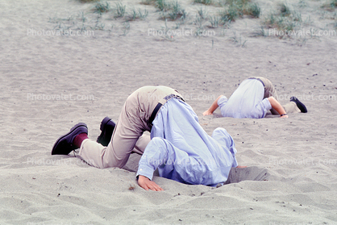



All Supervisors
Notice to you means that the “City Has Notice”. (You = City)
Do not fail to report to your supervisor or to HR or the City Manager.
Notes:
The Courts expect you to KNOW what is going on in your work group.
The Courts do NOT expect you to always FIX it!

Slide 57
Supervisor Remember:
You must not retaliate in any way against an employee who has made a complaint or who has provided information as a witness to an incident of alleged discrimination or harassment.
You must maintain Confidentiality, to the extent possible, in communicating or investigating any claims of alleged discrimination or harassment.
Notes:
You must not retaliate in any way against an employee who has made a complaint or who has provided information as a witness to an incident of alleged discrimination or harassment.
You must maintain confidentiality, to the extent possible, in communicating or investigating any claims of alleged discrimination or harassment.
Per Suzie Paulson, PPT, 6-2013.

Slide 58

WHY?
If you fail to take PROMPT, APPROPRIATE ACTION to report a complaint of discrimination, harassment and/or retaliation, or fail to report discrimination, harassment and/or retaliation that you know of or should have known of, YOU and the CITY may be Sued.
(You could be liable for your inaction)!!
Jury of Your Peers
Notes:
Why? As a supervisor, if you fail to take PROMPT, APPROPRIATE ACTION to report a complaint of discrimination, harassment and/or retaliation, or fail to report discrimination, harassment and/or retaliation that you know of or should have known of, YOU and the CITY may be liable for your inaction!!

Slide 59




Words to Live by…
Happy Customers
Do not Sue you…
NEVER throw a Co-worker or Department under the Bus…
Just so you know:
If you throw me under the bus, I am grabbing your ankles and taking you with me.

Slide 60
SIP #3 – Dec 5th ___ SIP #4 – Dec 12th
SIP #3:
Conflict Resolution
Generational Communication
Delegating
SIP #4:
Coaching
Ethics
Difficult Conversations – Discipline and Terminations
Please email me your specific Questions? We can discuss in December.

Slide 61
The End of SIP #2

Slide 62

Be careful what you write and say in your Social Media.
EMAIL
TEXTING
TWEETS
BLOGS
Notes:
Facebook, Twitter, Instagram, YouTube,
Caution employees, YOU should have NO expectation of privacy while using the Internet.
2/26/19: Pix from 60+ Social Networking Sites You Need to Know About (Updated 23rd December 2018). Source: https://makeawebsitehub.com/social-media-sites/

Slide 63

Electronic
Media =
EVIDENCE can
Blow Up your Career
Notes:
Electronic Media = EVIDENCE.
EVIDENCE CAN BLOW UP YOUR CAREER.

Slide 64
Main Evidence:
9,000 Text Messages!
Notes:
Article of the former teacher convicted by 9,000 text messages.

Slide 65
Case Activity | Est. Cost
Initial Investigation | $2,500
Responsive Pleadings | $2,500
Discovery | $7,000
Depose Plaintiff | $3,500
Depose Additional Witnesses | $7,000
Depose City Officials | $3,000
Dispositive Motions | $10,000
Pretrial and Trial | $30,000
Misc. | $5,000
Total Initial Estimate of Defense: | $70,500

Slide 66
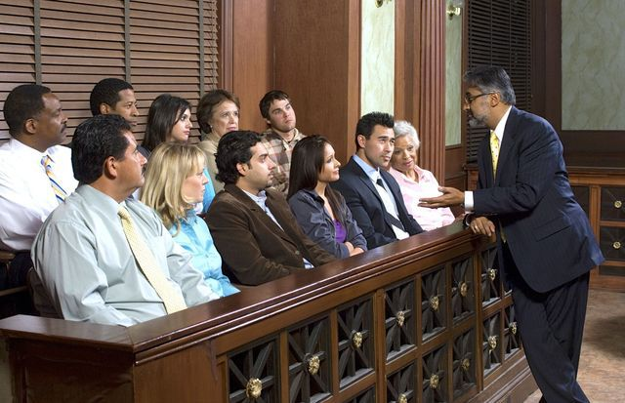
Jury Trials
Jurors are not lawyers
Jurors have their own sense of morals and values that they judge others by
Credibility
Performance by witnesses
“Appreciate the possibility” that you MAY Win or you MAY Lose
Notes:
Jurors are not lawyers but are required to take the facts and apply the law to it. Lawyers do this but after 3 years of full time school. That does not mean lawyers are smarter than jurors it just means it a lot to ask someone who has never done it before. Like anything it takes practice.
“Appreciate the possibility” that you MAY Win or you MAY Lose

