Slide 1
aeroplane

Slide 2
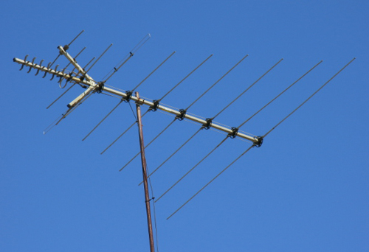
antenna

Slide 3
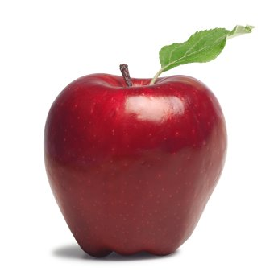
.
apple

Slide 4
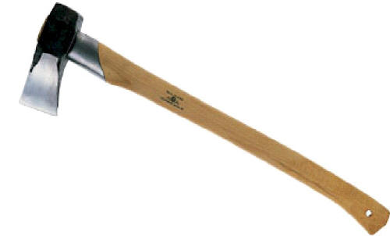
.
axe

Slide 5
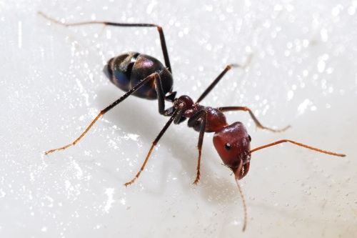
ant

Slide 6
butterfly

Slide 7
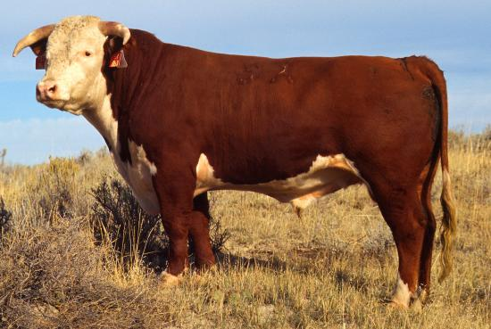
bull

Slide 8
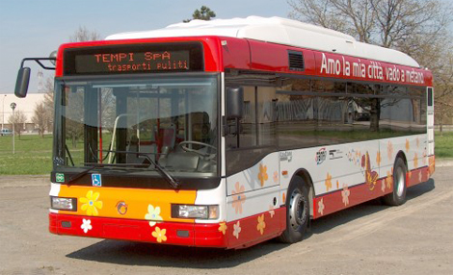
bus

Slide 9
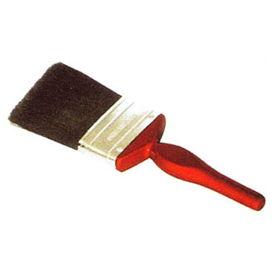
brush

Slide 10
button

Slide 11
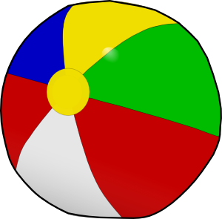
ball

Slide 12
box

Slide 13
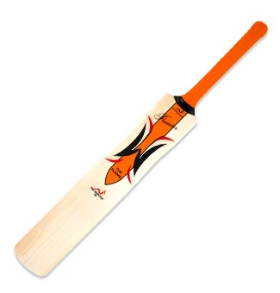
bat

Slide 14
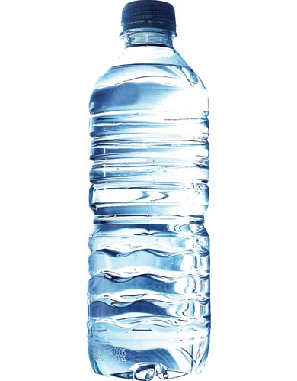
.
bottle

Slide 15
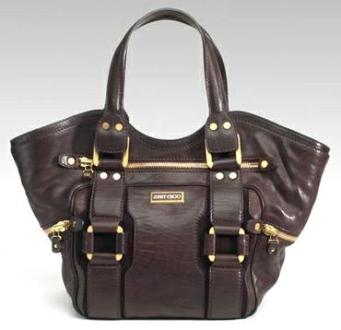
.
bag

Slide 16
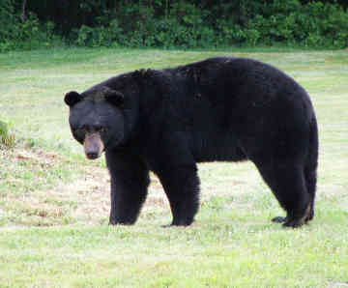
bear

Slide 17
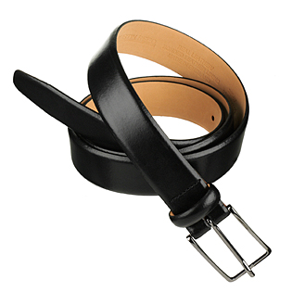
belt

Slide 18
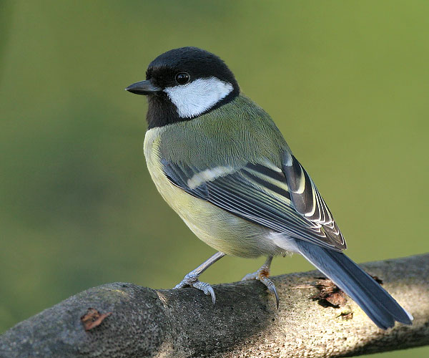
bird

Slide 19
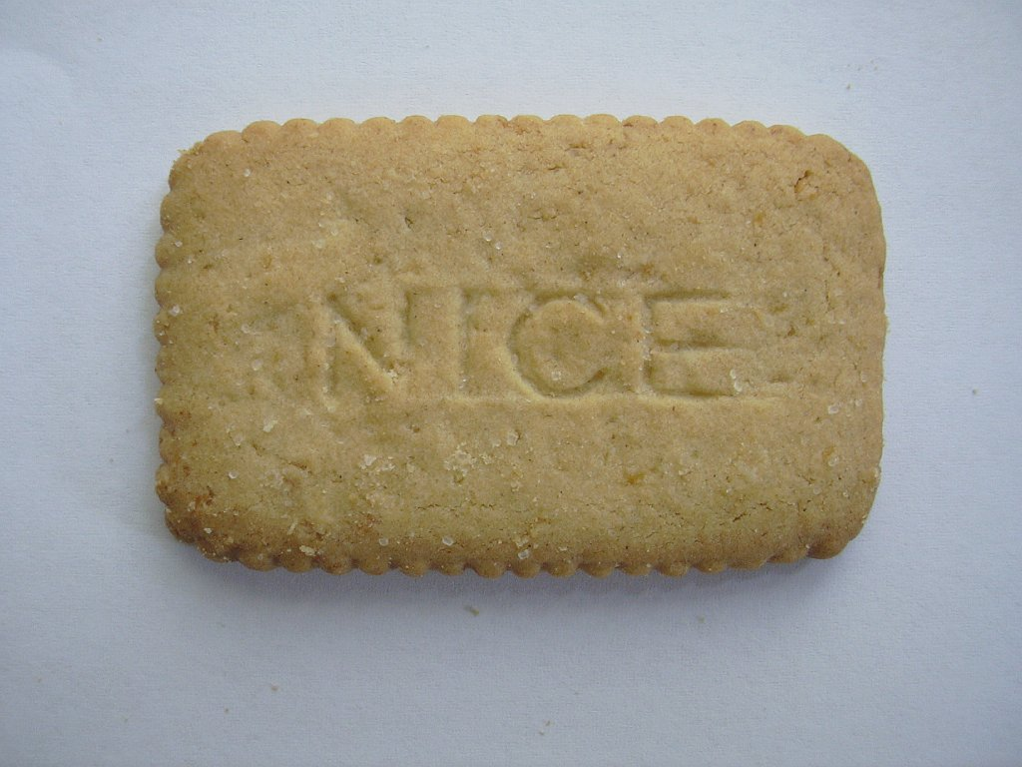
biscuit

Slide 20
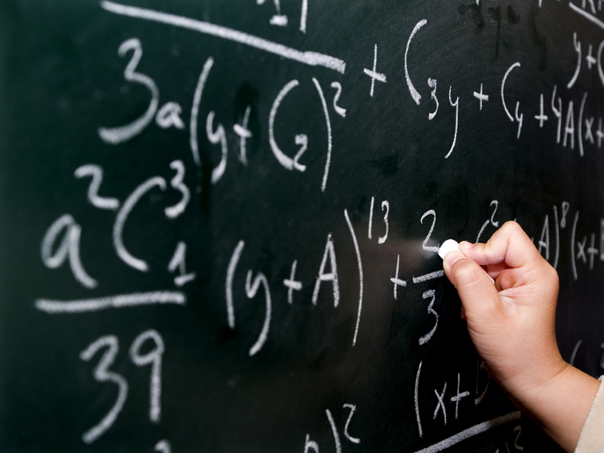
blackboard

Slide 21
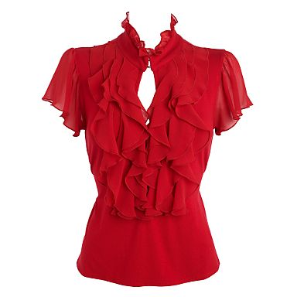
blouse

Slide 22
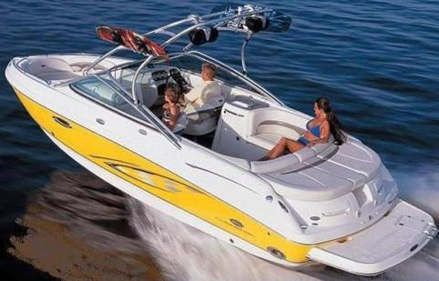
boat

Slide 23
book

Slide 24
banana

Slide 25
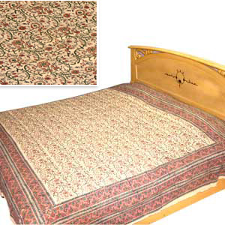
bed

Slide 26
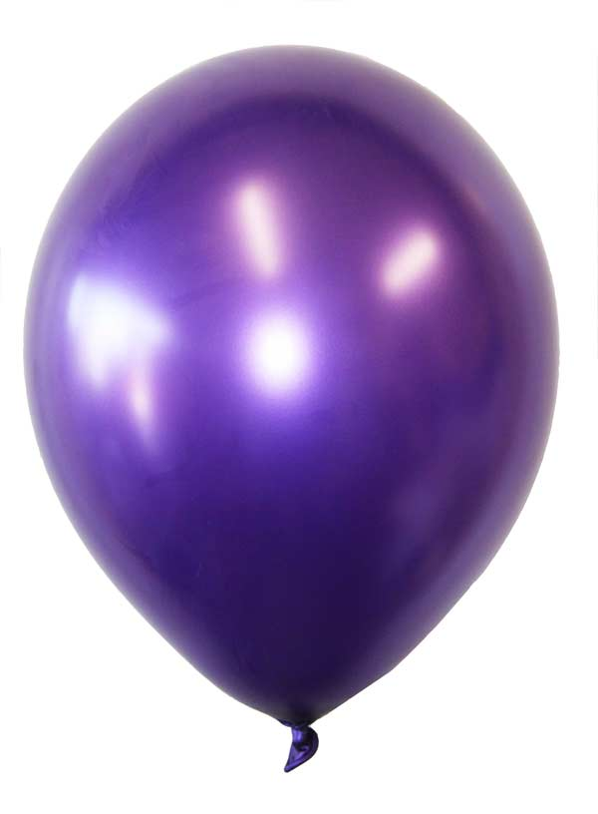
balloon

Slide 27
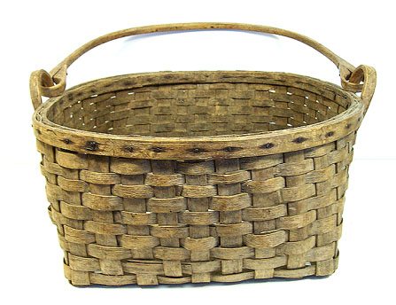
basket

Slide 28
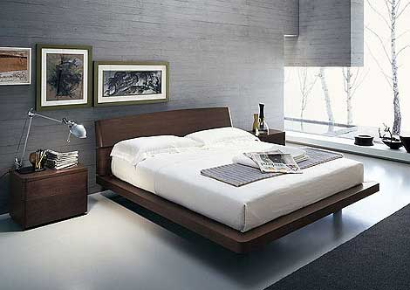
bedroom

Slide 29
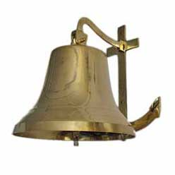
bell

Slide 30
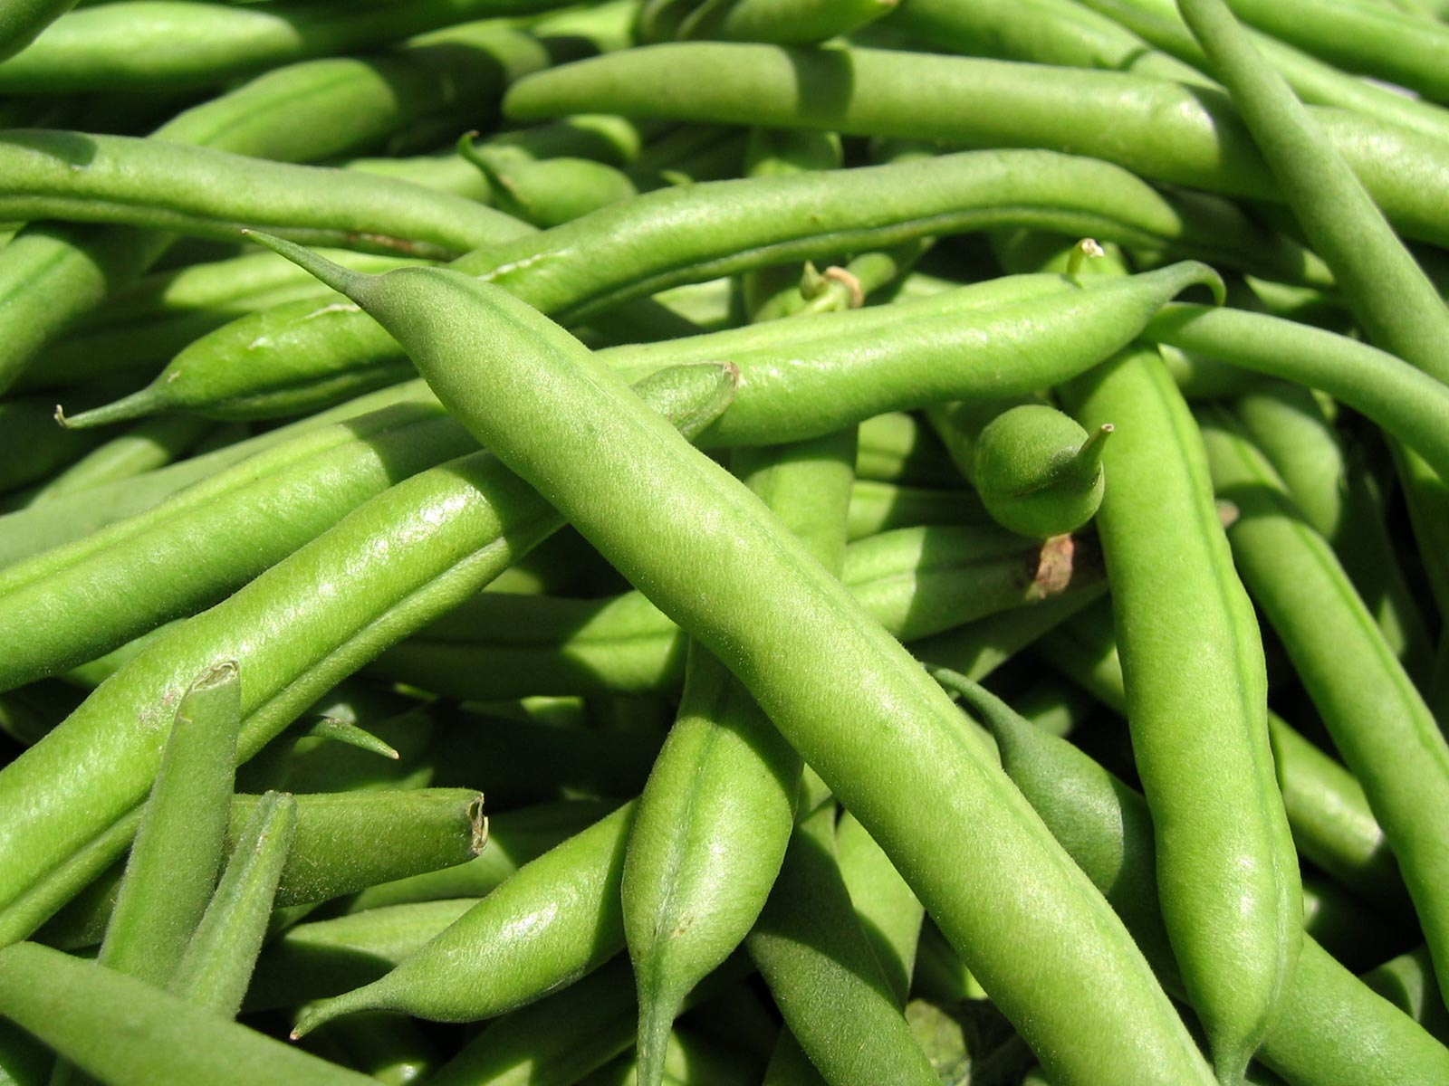
beans

Slide 31
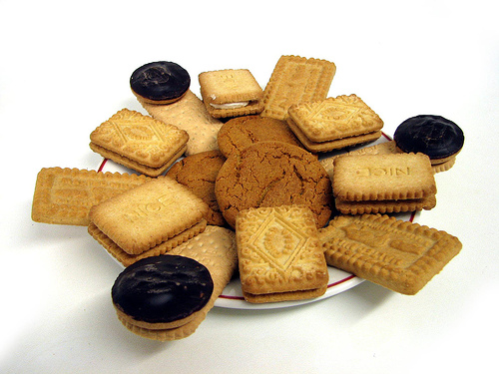
biscuits

Slide 32
black

Slide 33
blue

Slide 34
brown

Slide 35
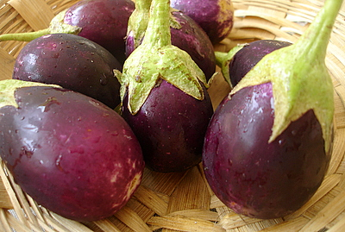
brinjal

Slide 36
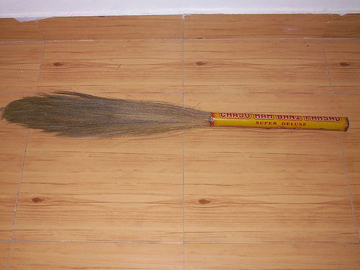
broom

Slide 37
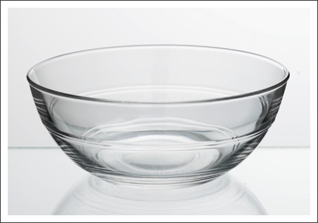
bowl

Slide 38
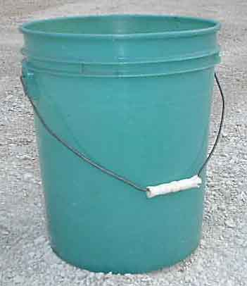
bucket

Slide 39
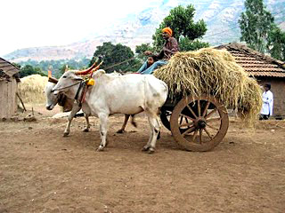
Bullock-cart

Slide 40
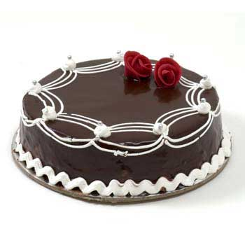
cake

Slide 41
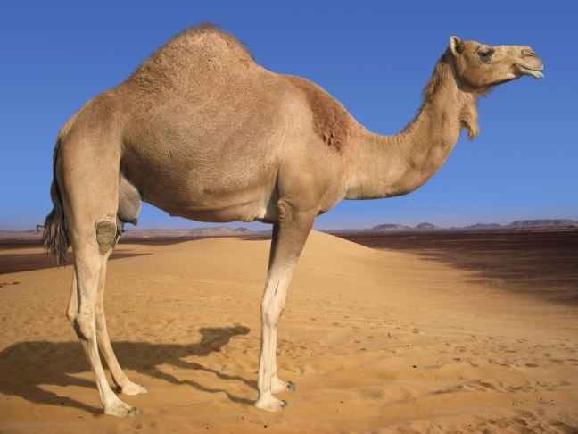
camel

Slide 42
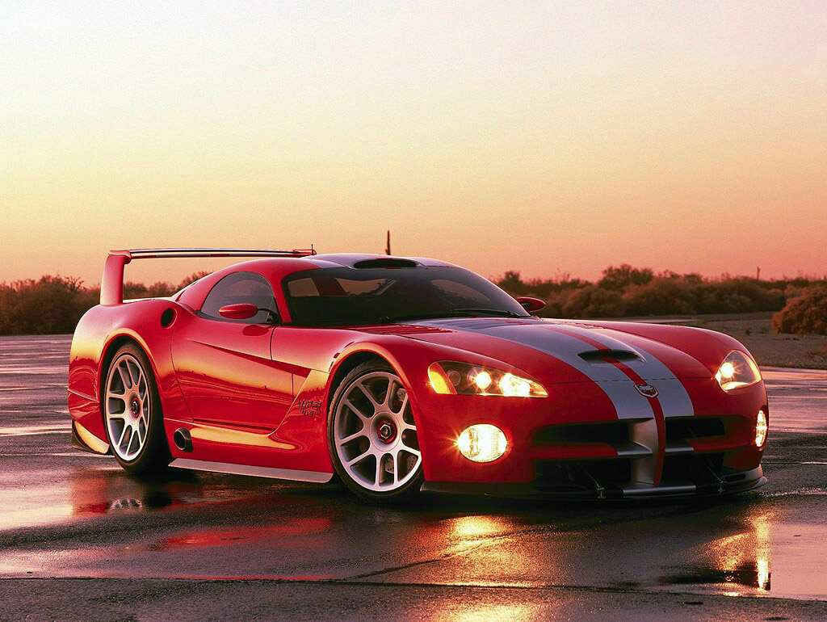
car

Slide 43
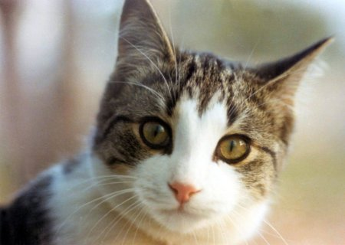
cat

Slide 44
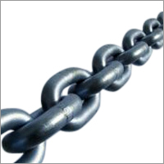
chain

Slide 45
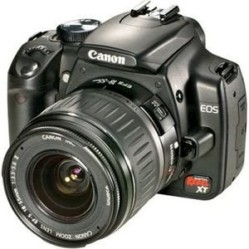
camera

Slide 46
cap

Slide 47
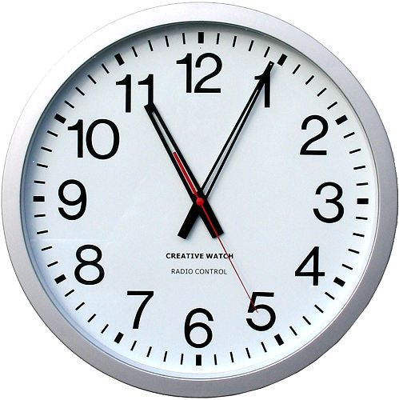
clock

Slide 48
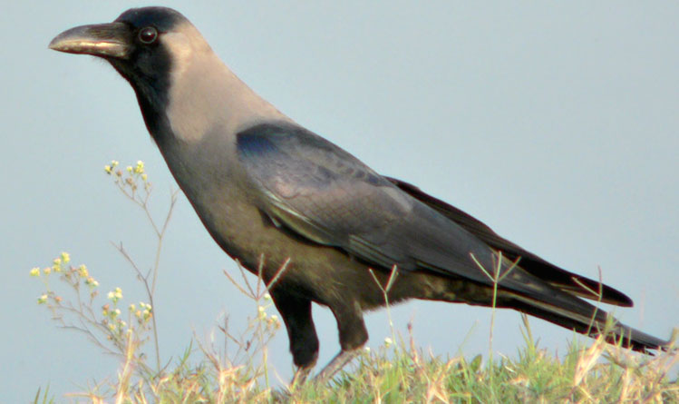
crow

Slide 49
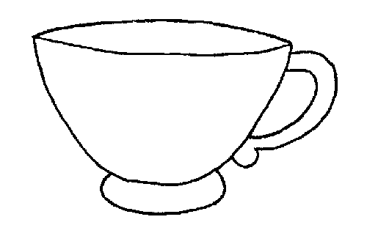
cup

Slide 50
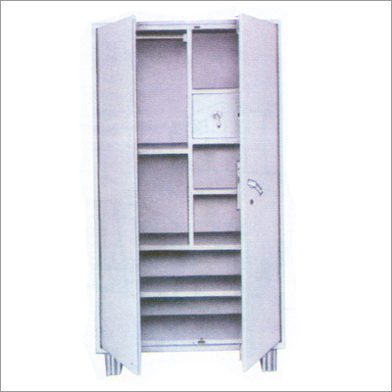
cupboard

Slide 51
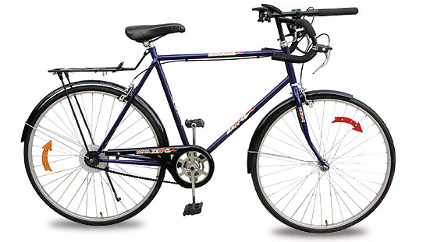
cycle

Slide 52
chalk

Slide 53
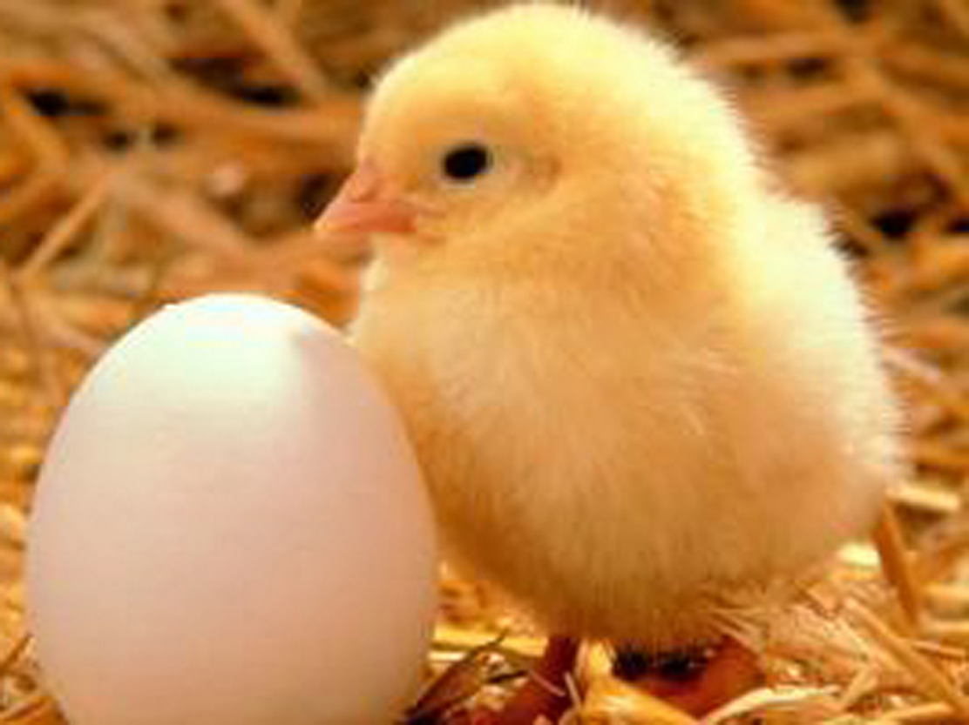
chick

Slide 54
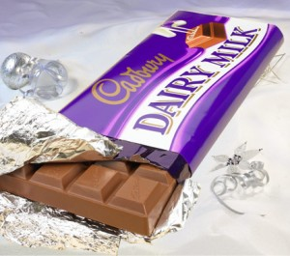
chocolate

Slide 55
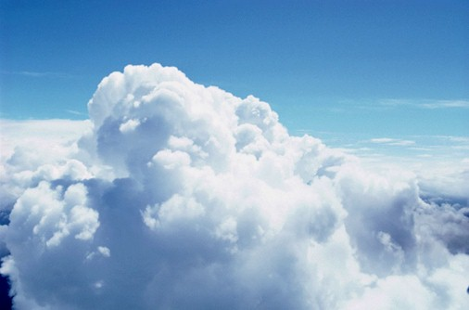
cloud

Slide 56
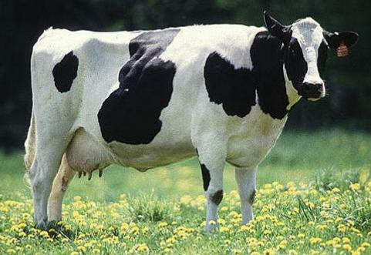
cow

Slide 57
crane

Slide 58
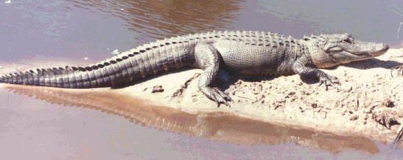
crocodile

Slide 59
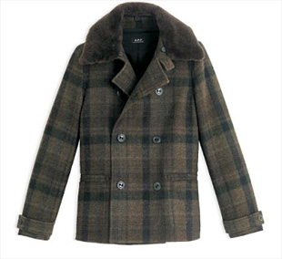
coat

Slide 60
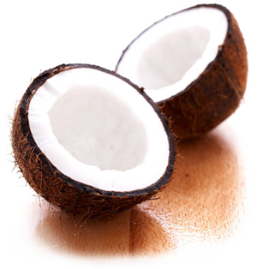
coconut

Slide 61
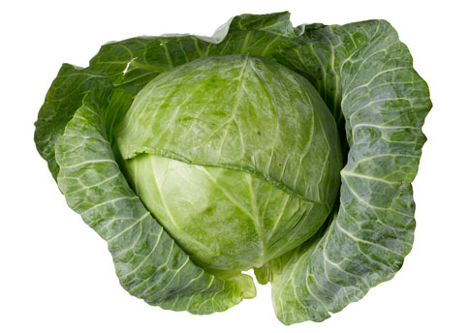
cabbage

Slide 62
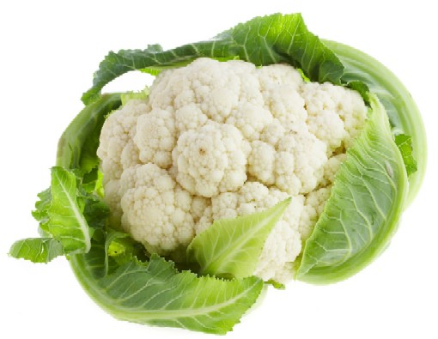
cauliflower

Slide 63
coffee

Slide 64
comb

Slide 65
cooker

Slide 66
corner

Slide 67
cot

Slide 68
cock

Slide 69
cricket

Slide 70
curtain

Slide 71
carrot

Slide 72
dog

Slide 73
deer

Slide 74
dish

Slide 75
doctor

Slide 76
donkey

Slide 77
door

Slide 78
duck

Slide 79
dot

Slide 80
drum

Slide 81
duster

Slide 82
doll

Slide 83
eraser

Slide 84
egg

Slide 85
elephant

Slide 86
engine

Slide 87
ear

Slide 88
eye

Slide 89
Tiger

