Slide 1
Презентация к уроку по учебному предмету «Английский язык» в 9-11 классах по теме «Королевская семья Великобритании»
Автор: Лукъянчик
Юлия Викторовна
учитель английского
языка
МБОУ «СОШ №1»
г. Королёв

Slide 2
Royal Family Quiz
How well do you know the British royal family?

Slide 3
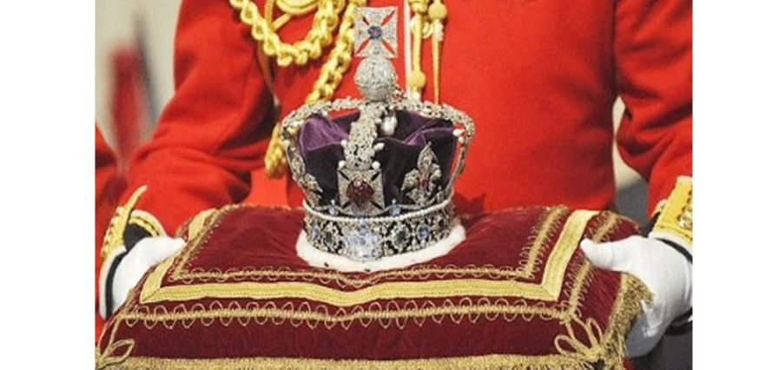
1. What is the family name of the present royal family?
Smith
Tudor
Stuart
Windsor

Slide 4
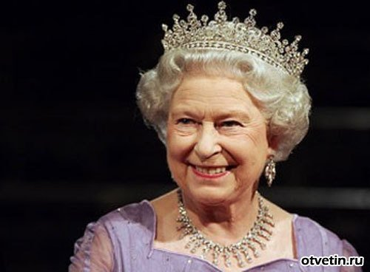
2. When did Queen Elizabeth II become Queen?
1952
1962
1972
1982

Slide 5
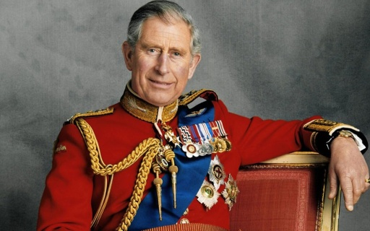
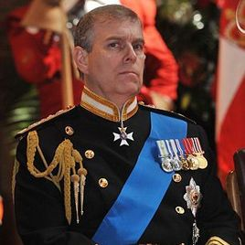
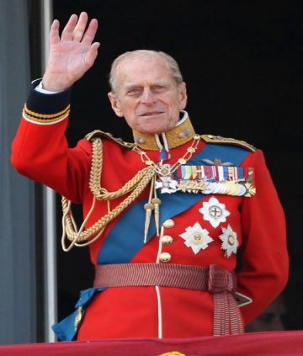
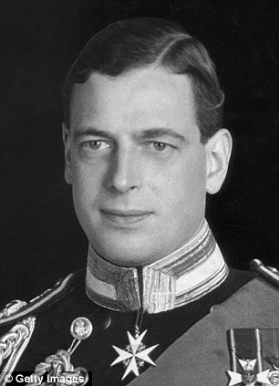
3. Who is her husband?
a) Prince Charles
b) Prince Andrew
c) Prince Philip
d) Prince George

Slide 6
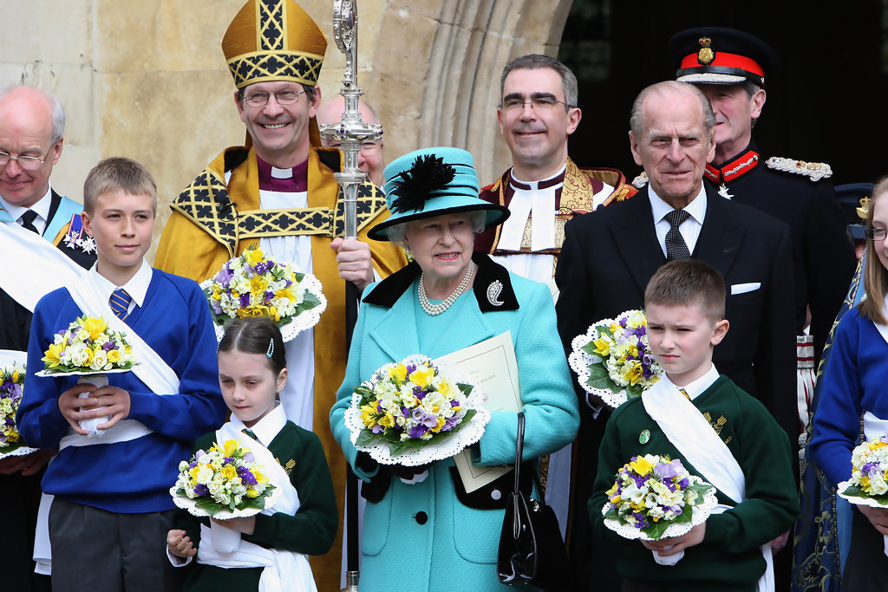
4. How many children does Queen Elizabeth II have?
1
2
3
4

Slide 7
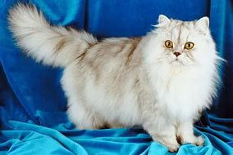
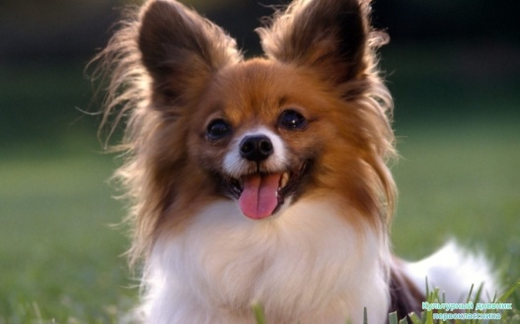
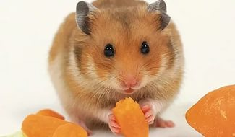
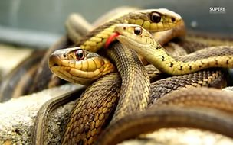
5. What are the Queen’s favourite animals?
cats
dogs
hamsters
snakes

Slide 8
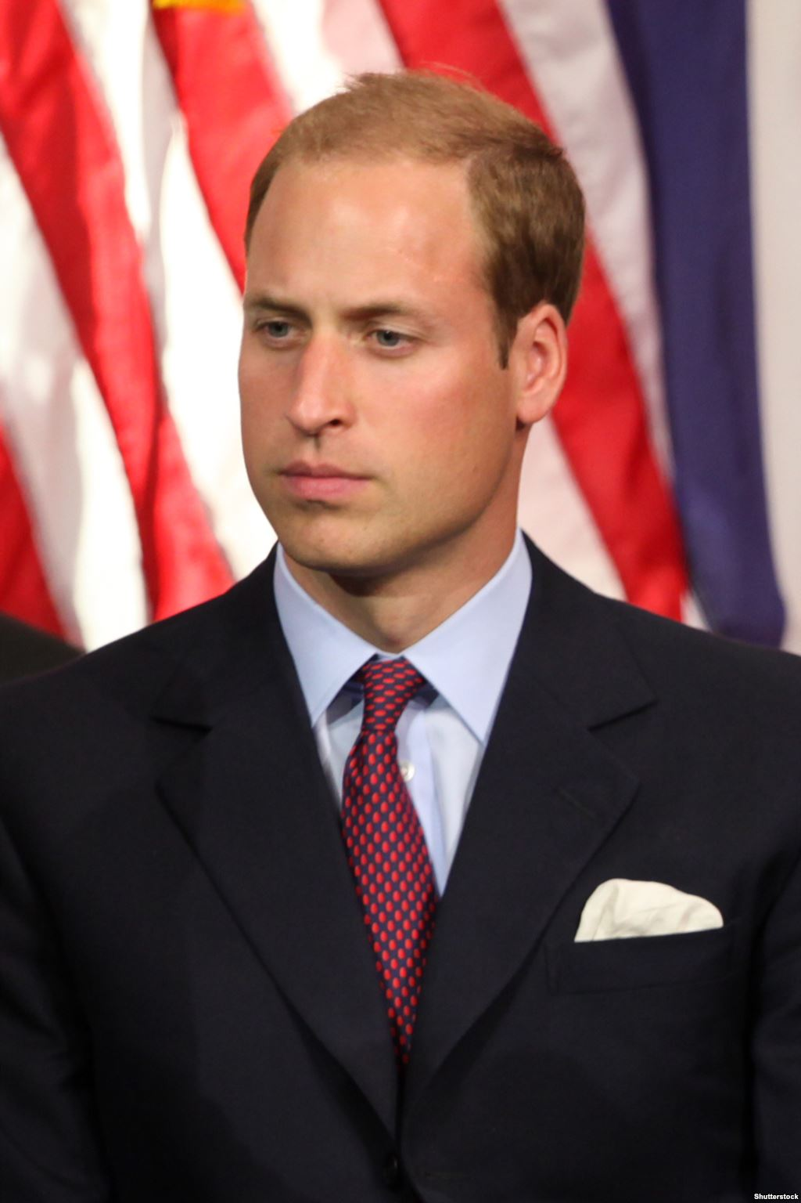
6. When was Prince William born?
1982
1984
1985
1987

Slide 9
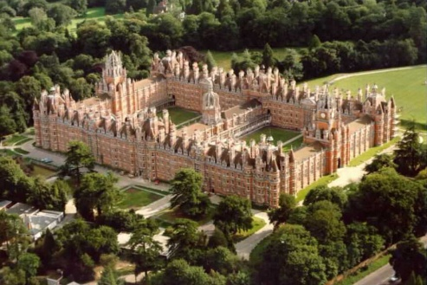
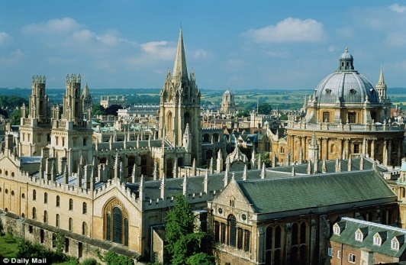
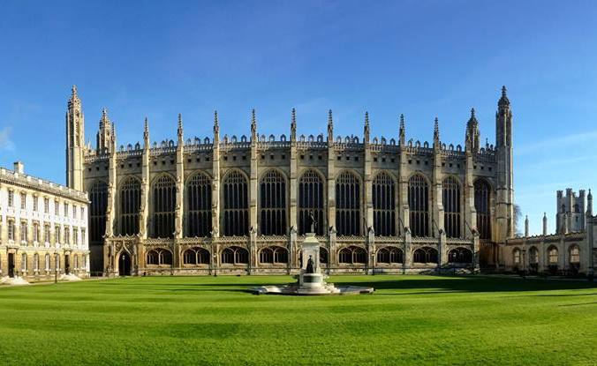
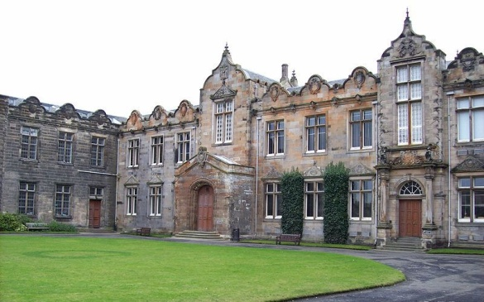
7. Which university did Prince William attend?
Oxford University
Cambridge University
St Andrews University
London University

Slide 10
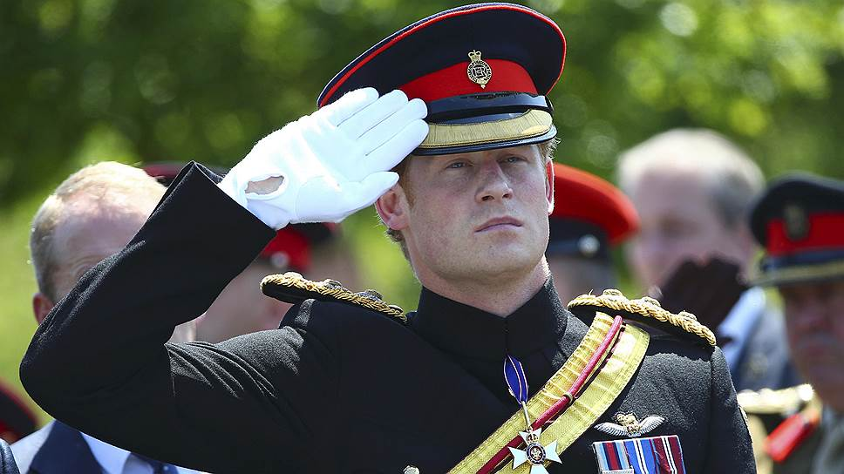
8. What is Prince Harry’s real name?
Henry Charles Albert David
Henry Charles Albert
Henry Charles
Henry Albert

Slide 11
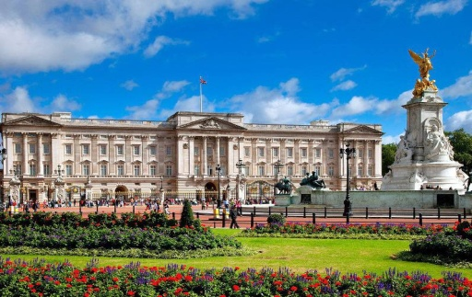
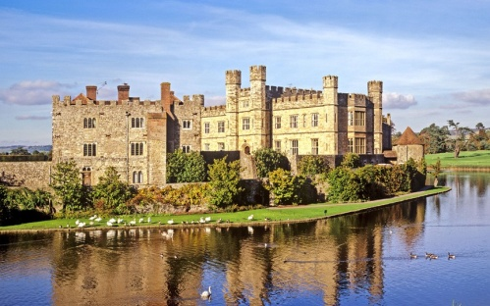
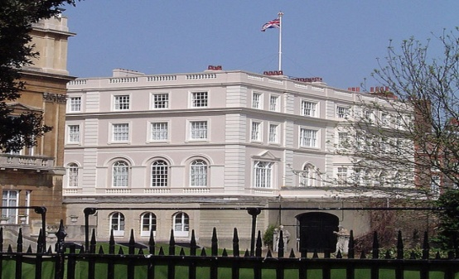
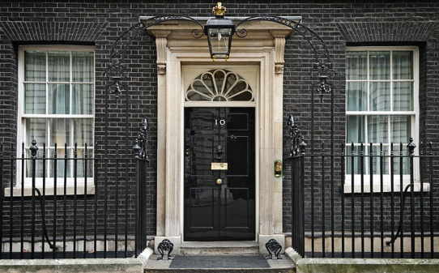
9. Where do Prince William and Prince Harry live?
Buckingham Palace
St James Palace
Clarence House
10 Downing Street

Slide 12
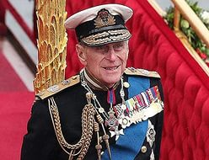
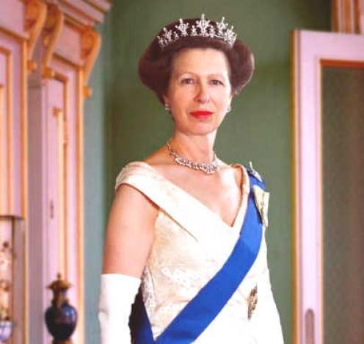
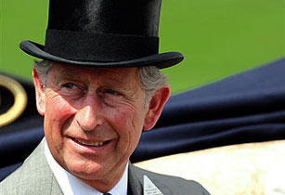
10. Who was once part of the British horse-riding team in the Olympic Games?
Prince Philip
Prince Charles
Prince Andrew
Prince Anne

Slide 13


11. Which member of the present royal family once wrote a successful children’s book?
Prince Philip
Prince Charles
Prince Andrew
Prince Anne

Slide 14
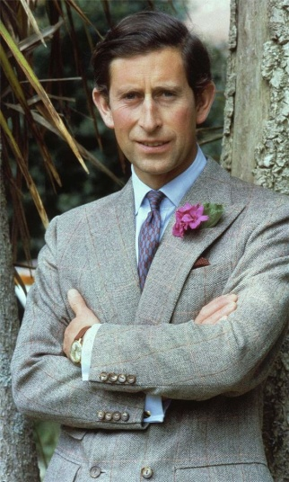
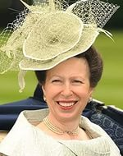
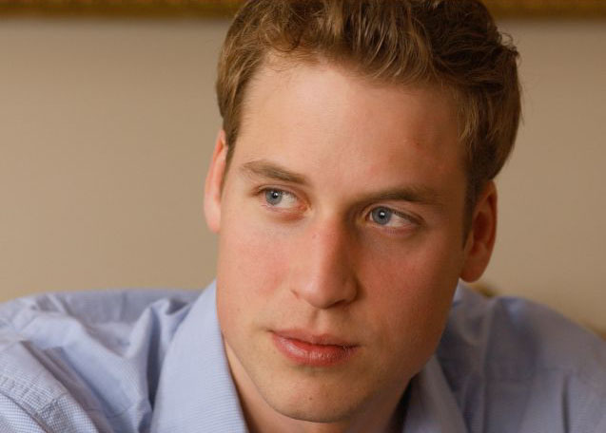
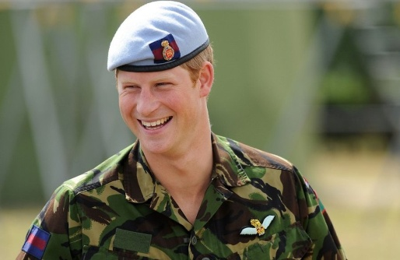
12. Which member of the present royal family is president of England’s Football Association?
Prince Charles
Prince Anne
Prince William
Prince Harry

Slide 15
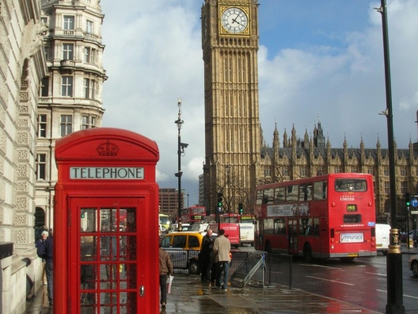
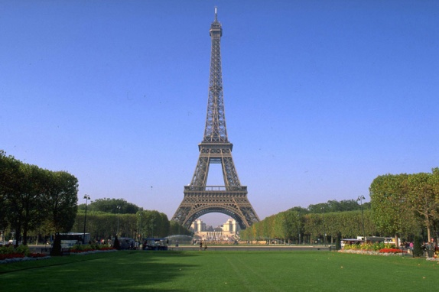
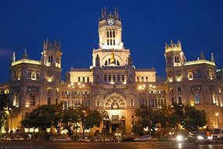
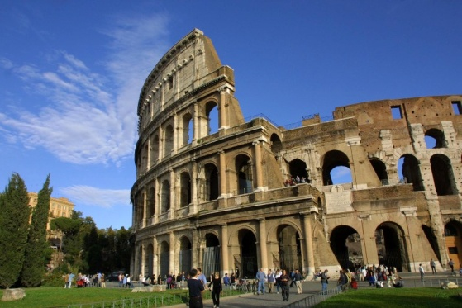
13. Which city did Princess Diana died in?
London
Paris
Madrid
Rome

Slide 16
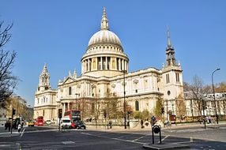
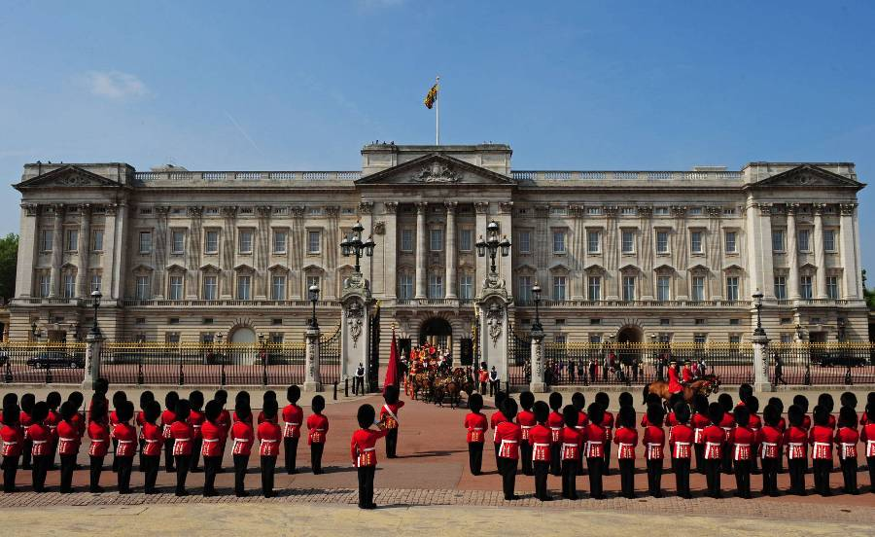
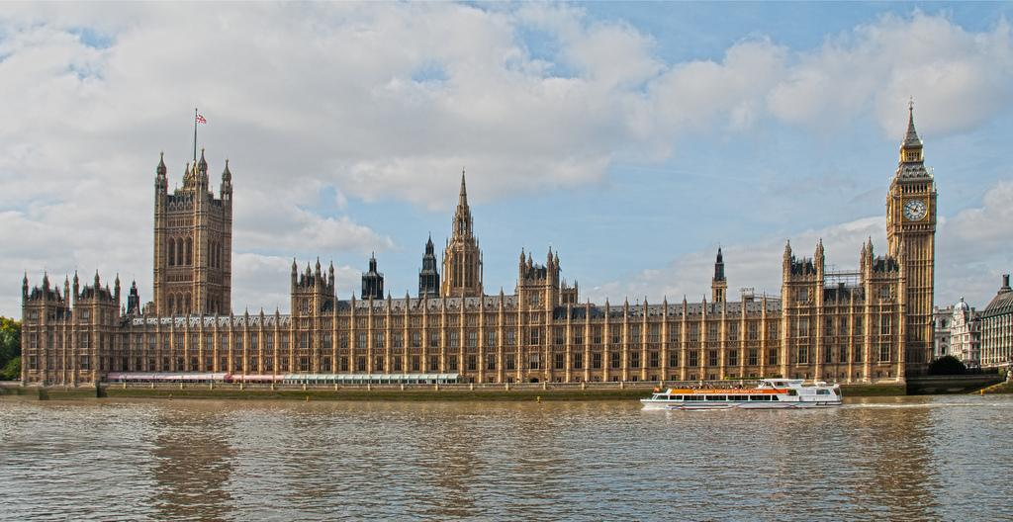
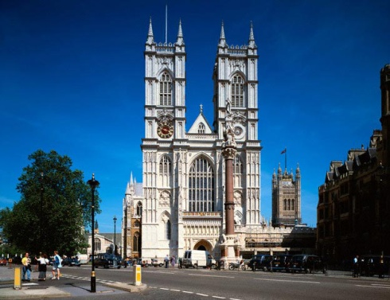
14. Where are the British monarchs crowned?
St Paul’s Cathedral
Buckingham Palace
Westminster Abbey
Houses of Parliament

Slide 17
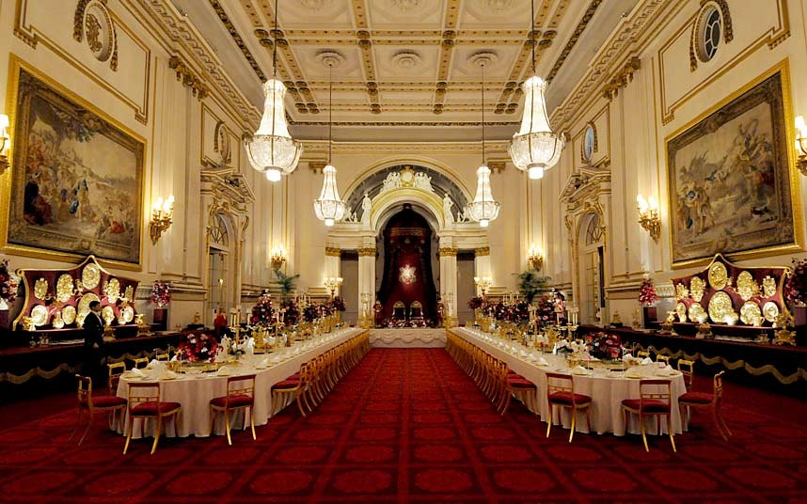
15. How many rooms are there in Buckingham Palace?
100
200
300
600

Slide 18
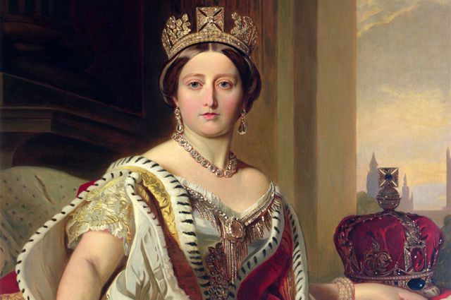
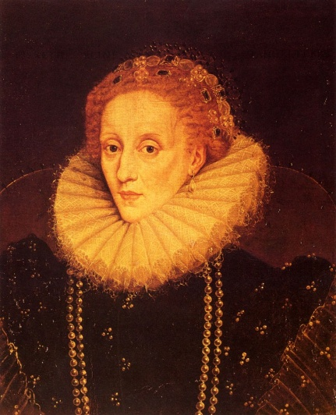
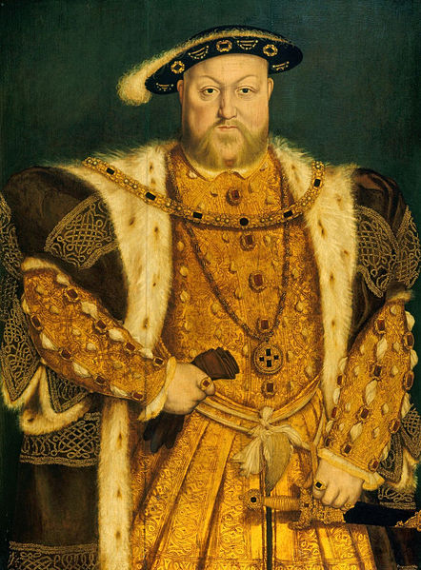
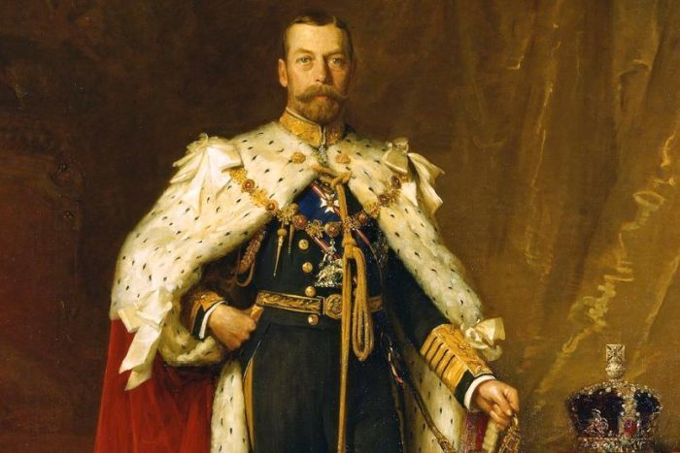
16. Which British monarch reigned for the longest period?
Queen Victoria
Elizabeth I
Henry VIII
George V

Slide 19
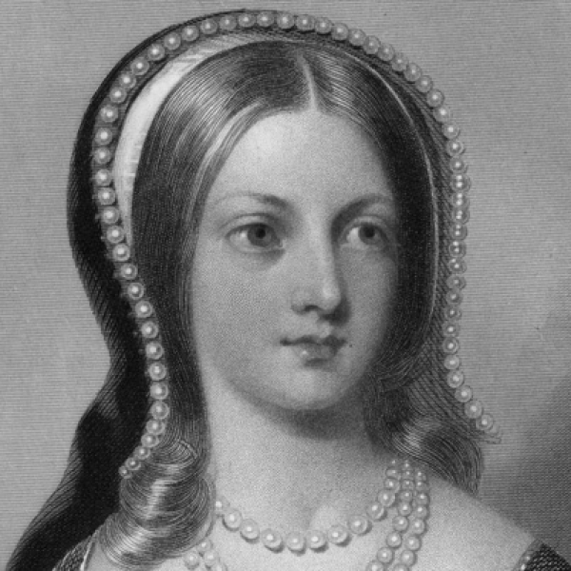
17. Lady Jane Grey had the shortest reign of any British monarch. How long did she reign?
9 months
9 weeks
9 days
9 hours

Slide 20
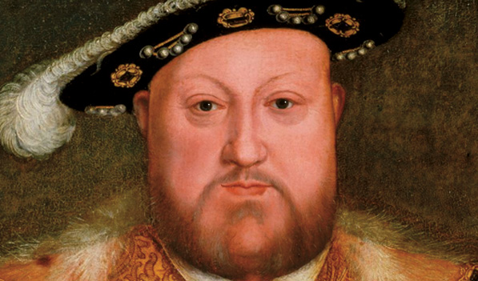
18. How many wives did Henry VIII have?
10
8
6
4

Slide 21
Answers
D
A
B
D
B
A
C
A
C
D
B
C
B
C
D
A
C
C

