Slide 1
LEBANESE INTERNATIONAL UNIVERSITY
SCHOOL OF PHARMACY
ADVANCED PPE
Respiratory Syncytial Virus and Recurrent
Wheeze in Healthy Preterm Infants
Journal Club
Fall 2013-2014
Done by: Zeina Shrayteh
Presented to: Dr. Jihan Safwan

Slide 2
Outline: Background
RSV Taxonomy
RSV Pathophysiology
Infection process
Clinical presentation
Risk factors for severe disease
Treatment
Prophylaxis
Palivizumab
Bronchiolitis
Pathogenesis controversy

Slide 3
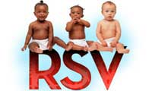
Introduction
Respiratory syncytial virus (RSV) was discovered in 1956
Taxonomy
Order Mononegavirales
Family Paramyxoviridae
Subfamily Pneumovirinae
Genus Pneumovirus
RNA genome is enveloped, negative-sense single-stranded, and non-segmented
Composed of 10 genes encoding for 11 proteins
Envelope is formed by 4 proteins in a lipid bilayer: the 2 glycosylated surface G and F (fusion) proteins, the M(matrix) protein, and the SH (small hydrophobic) protein

Slide 4
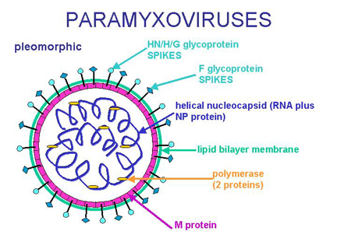
Introduction (cont’d)
The G and F proteins play a key role in the pathogenesis of the infection since
The G protein determines the adhesion to the cells of the respiratory epithelium
The F protein is responsible for the entry of the virus in the cells and determines the insertion of viral RNA in the cell which is responsible for the formation of syncytia

Slide 5
RSV Subtypes
Two subtypes of RSV, A and B, are different for the G protein structure
RSV A and B coexist during every RSV epidemic season
subtype A associated with more severe infections
Neutralizing antibodies against G protein are subtype specific, while antibodies against F protein neutralize both subtypes and could be more useful for active and passive immunization
1ry & 2ry infection with group-A can induce cross-reactive to group-B

Slide 6
RSV Pathophysiology
Transmission
Direct contact of respiratory secretions to nasopharyngeal or conjunctival mucous membrane
Viable on hard surface (6 hrs); rubber gloves (90 min); skin (20 min)
Incubation: 2-8 days
Shedding
3 weeks in immunocompetent
Several months in immunocompromised

Slide 7
RSV Pathophysiology (cont’d)
Replication
Occurs in nasopharyngeal but most efficient in the bronchiolar epithelium
Direct spread
Hematogenously via monocytes
RSV distributes from cell to cell through cytoplasmatic bridges (syncytium) from upper to lower parts of respiratory tract
Causes: necrosis of the bronchiolar epithelium → lymphocytic peribronchiolar infiltration & subsequent submucosal edema; mucus secretions increase in both quantity and viscosity

Slide 8
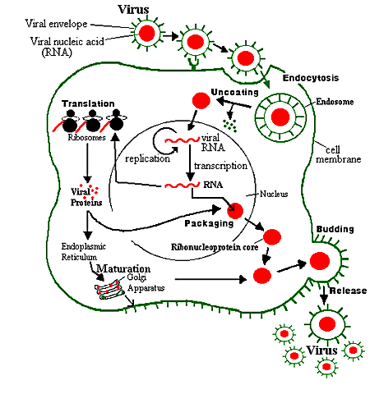
Infection Process
Fusion to cell membrane & injection of viral genome into the cell’s cytoplasm
Translation and replication
Genome is transcribed from 3’ end into monocistronic mRNA molecules
Each species only encodes a single protein
New viruses released via budding
Clumping may occur
Spread from cell to cell
A characteristic fusion of human cells in tissue culture
the syncytial effect
www.bact.wisc.edu/.../ViralDisease.html

Slide 9
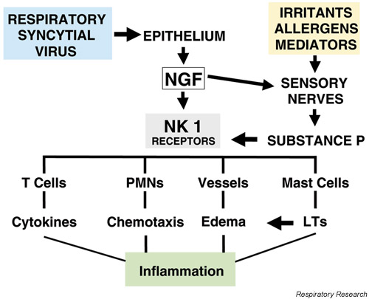
Immune Response

Slide 10
RSV Infection
Most common diseases of early childhood
Causes acute respiratory tract infections in people of all ages
Infection occurs during the first year of life, with at least once by the second birthday
In infants, RSV causes bronchiolitis, pneumonia and episodic viral wheezing
Re-infection with RSV throughout life is common
RSV: Co-infection Organisms: H. influenza, S. aureus, M. catarrhalis, S. penumoniae, S. pyogens
Rare: Pseudomonas, B. pertussis, K. pneumoniae, E. coli

Slide 11
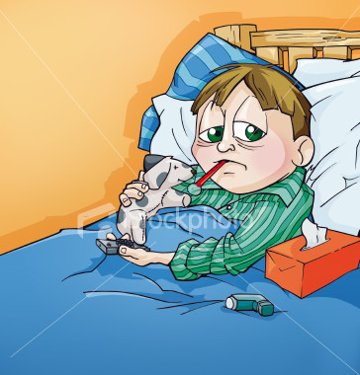
Clinical Presentation
Seasonal occurrence: typically Nov through Apr
Depends on geographic location
Appears in Nov. or Dec. persists till Apr. or May
Peak in January/February
Incubation 4-5 days, LRI between days 5-7
Peak incidence 2-5 months
Signs and Symptoms
Neonates and infants:
LRT symptoms (e.g. bronchiolitis, and pneumonia), wheezing, lethargy, irritability, poor feeding and apnea
Older children:
URT symptoms

Slide 12
Clinical Presentation
Most previously healthy infants who develop RSV bronchiolitis do not require hospitalization
Most who are hospitalized improve with supportive care and are discharged in fewer than 5 days
Approximately 1% to 3% of all children in the first 12 months of life will be hospitalized because of RSV lower tract disease

Slide 13
Risk factors for Severe Disease
Premature birth
Bronchopulmonary dysplasia
Cyanotic or complicated congenital heart disease
Immunodeficiency
Airway abnormalities
Other
Low socioeconomic status
Passive smoking
Day care attendance
Siblings

Slide 14
Treatment
1- Supportive
Fluid, nutrition, and hydration
Supplemental oxygen
Mechanical ventilation as needed
Deep nasal suction
CPT: administered to mobilize secretions and recruit atelectatic lungs: not beneficial

Slide 15
Treatment
2- Ribavirin
Active against RSV replication
Not shown to reduce mortality in immunocompetent patients
Not shown to reduce ventilator days, stay in the intensive care unit/hospital, or hospital cost
The AAP states that ribavirin “may be considered” in a select group of high-risk patients (e.g. complicated CHD, BPD, immunocompromised)

Slide 16
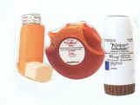
Treatment
3- Bronchiodilators
β2-Agonists
Not shown to improve outcome measures
Not considered the standard of care
Racemic epinephrine:
No benefit in in-patient settings but may produce a modest short-term improvement in out patient
Anticholinergic:
not effective in RSV

Slide 17
Treatment
4- CorticosteroidsSystemicInhaled
Not shown to improve outcome measures
Not recommended
Combination: oral dexamethasone + inhaled racemic epi → significantly less likely to require hospitalization
5- Antibiotics
Not indicated unless secondary bacterial infection develops

Slide 18
Treatment
6- Recombinant Human Deoxyribonuclease (DNAse)
No demonstrable benefits
7- Hypertonic saline
Nebulized HTS could reduced LOS without any adverse effects
8- Surfactant
Decrease surface tension
Exogenous surfactant decrease ventilation & PICU LOS, improvement of pulmonary mechanics & gas exchange

Slide 19
Treatment
9- Heliox
No improvement in ventilation or oxygenation
10- Anti-Leukotrienes
Controversies in using montelukast

Slide 20
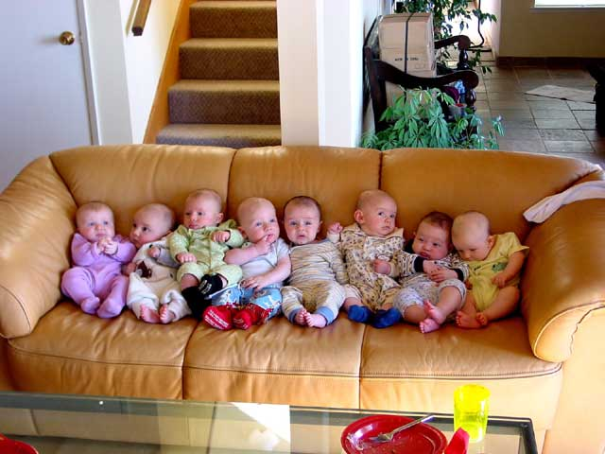
Prophylaxis
1- Nonpharmacologic
Avoid crowds during RSV season
Conscientiously use good hand-washing practices

Slide 21
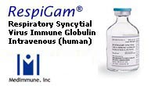
Prophylaxis
2- RSV IVIG (Respigam ®)
Dosing: 15 mL/kg (750 mg/kg) intravenously once monthly during RSV season
Effects on outcomes
A 41% reduction in hospitalizations for RSV
Significant increase in cyanotic episodes and death in patients with cyanotic congenital heart disease
No reduction in overall mortality
Interferes with the response to measles, mumps, and rubella vaccine (MMR) and varicella vaccine
Disadvantages:
Large volume 15ml/kg, infused over 4-6 hrs → fluid overload
Transfer of blood born pathogens

Slide 22
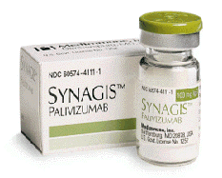
Prophylaxis
3- Palivizumab (Synagis®)
Humanized murine monoclonal immunoglobulin
Produced by recombinant DNA technology with neutralizing and fusion-inhibitory activity against RSV
FDA-approved for the prevention of serious LRTI caused by RSV in pediatric patients at high risk of RSV disease
Safety & efficacy of Synagis has not been established for treatment of RSV disease
Safety and efficacy were established in infants with CLD of prematurity BPD, infants with a history of premature birth (< 35 weeks gestational age), and children with hemodynamically significant CHD

Slide 23
Prophylaxis
3- Palivizumab (Synagis®)
Effects on outcomes
A 55% reduction in hospitalizations for RSV
Safe in patients with cyanotic congenital heart disease
No reduction in overall mortality
Does not interfere with the response to vaccines
Not recommended for the prevention of nosocomial transmission of RSV

Slide 24
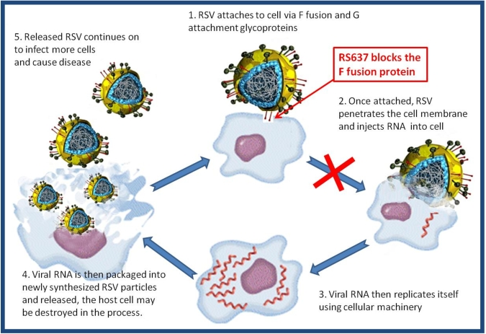
Mechanism of Action

Slide 25
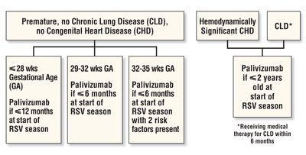
AAP Guidelines for RSV Prophylaxis Using Palivizumab
AAP recommendations for RSV prophylaxis depend upon gestational age and/or the presence of additional risk factors.
Source: AAP Subcommittee on Diagnosis and Management of Bronchiolitis. Pediatrics. 2006; 118: 1774-1793.

Slide 26
AAP recommendations for use

Slide 27
Palivizumab (Synagis®)
Dose & Administration
Dose: 15mg/kg IM injection once monthly throughout the RSV season
The 1st dose administered before the beginning of the RSV season when possible
5 injections/doses per season
benefit in terms of protection beyond 5 doses has not been established
No interference with the immune response to vaccines
The monoclonal antibody is specific for RSV
Notes:
administered intramuscularly preferably in the anterolateral aspect of the thigh. The gluteal muscle should not be used routinely as an injection site because of the risk of damage to the sciatic nerve

Slide 28
Palivizumab (Synagis®)
Contraindications
Known hypersensitivity to the active substance or to any of the excipients or other humanised monoclonal antibodies
Excipients: histidine, glycine, mannitol, water for injection

Slide 29
Palivizumab (Synagis®)
Special Warnings & Precautions for Use
Allergic reactions (very rare cases of anaphylaxis)
Moderate to severe acute infection or febrile illness may warrant delaying the use of palivizumab, unless withholding palivizumab entails a greater risk
Do not defer in case of a mild febrile illness
Given with caution to patients with thrombocytopenia or any coagulation disorder

Slide 30
Palivizumab (Synagis®)
Interactions with Medicinal Products/Vaccines
No interactions
Separate administration with other vaccines to identify the causative agent should an adverse drug reaction occur
Either give the palivizumab first, or give the influenza vaccination at least a week before palivizumab

Slide 31
Side Effects
Most common side effects noted are:
diarrhea,
fever and
injection site reactions
Uncommon side effects include:
pain,
vomiting,
wheeze,
rhinitis,
cough,
rash,
altered LFTs,
leucopenia

Slide 32
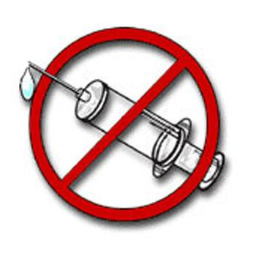
RSV Vaccine
Palivizumab is not a vaccine
Maternal immunization may be protective, but not for LBW infants
Development of an effective vaccine remains a challenge
Types of candidate vaccines include inactivated, live attenuated & subunit vaccines
Many challenges for effective vaccine
Immature immunity
Possible suppression of immune response by maternal antibody
Several antigenically divergent strains
Live attenuated vaccines are being tested but must be very attenuated in this young group
However, lessens chance of detectable Ab response

Slide 33
Prophylaxis
4- Motavizumab (Rezied®)
2nd generation IgG1 monoclonal antibody
70x higher affinity for the RSV F protein.
Inhibits RSV replication in upper respiratory tract and fully humanized
Phase III with 26% reduction in hospitalization compared to palivizumab, 50% reduces in outpatient medical management
Not yet approved by FDA

Slide 34
Bronchiolitis
Bronchiolitis: a specific clinical symptom complex
<12 months old
Brief prodrome of URI followed by nasal flaring, expiratory grunt, expiratory wheezing, prolonged expiration, rales, and rhonchi dyspnea, hypoxemia and cyanosis, respiratory distress, tachypnea, chest wall retractions, hyperinflation on CXR
Premature
Apneic spells, atelectasis/infiltrates and hyperinflation
May require oxygen supplementation and mechanical ventilation

Slide 35
RSV & Bronchiolitis
The association between RSV bronchiolitis early in life and subsequent asthma remains poorly understood
RSV bronchiolitis may be associated with short-term or long-term complications (recurrent wheezing & abnormalities in pulmonary function
This association may reflect an underlying predisposition to asthma rather than a direct consequence of RSV infection

Slide 36
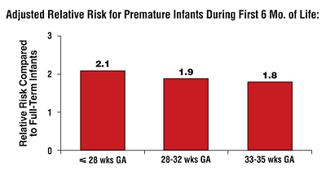
RSV-Related Hospitalization & GA
Although RSV-related hospitalization rates are independent of gestational age, its prevalence relative to full-term infants shows the unique vulnerability of premature infants.
Source: Michael L. Forbes, MD, FAAP. Adapted from Boyce TG, et al. J Pediatr. 2000; 137:865-870.

Slide 37
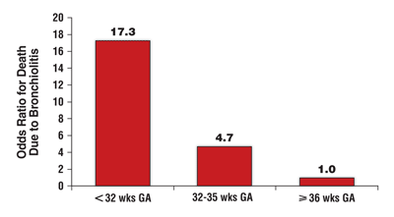
Degree of Prematurity and Risk of Bronchiolitis-Associated Death
As gestational age (GA) decreases, the risk of bronchiolitis-related death increases, illustrating the vulnerability of premature infants to respiratory infections.
Source: Michael L. Forbes, MD. Adapted from Holman RC, et al. Pediatr Infect Dis J. 2003; 22:483-489.

Slide 38
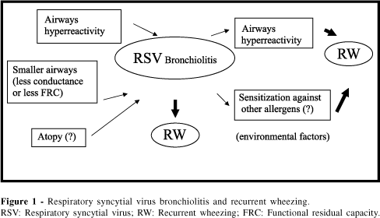
RSV Bronchiolitis

Slide 39
Phases of RSV-Induced Bronchiolitis
Phase I
Phase II
Phase III
Long term
Viral infection
Acute phase
Persistent wheezing
Wheezing and asthma
Days
Weeks
Months
(
39
Notes:
Slide 6
RSV-induced bronchiolitis may consist of several phases:
Phase 1: Infection with RSV in children usually begins in the nasopharynx with coryza and congestion, often associated with low-grade fever.⁷
Phase 2: Acute phase. During a period of 2-5 days, the infection may progress to the lower respiratory tract, with subsequent development of cough, dyspnoea, and wheeze.⁷ This phase lasts for several days and symptoms are usually mild to moderate in severity; however, 1-2% of infants will require hospitalisation.⁸
Phase 3: Persistent or recurrent episodes of wheezing.
A study held in a private paediatric clinic in North Carolina, in which 6,165 cases of lower respiratory illnesses were seen, 52.9% of patients aged ≤2 years had an occurrence of wheezing with RSV infection.⁵
Longer term: Children who develop RSV-induced bronchiolitis can be at risk of recurrent episodes of wheezing as well as the development of asthma.
A summary of available retrospective and prospective studies of children with mild to moderate or severe RSV lower-respiratory tract infection shows that infection in infancy may be associated with an increased risk of bronchial obstructive symptoms years after the infection, and lung function may be affected for several years. The mechanisms that underlie this connection are not clear.⁹
A prospective study followed 127 children aged <2 years, who were hospitalised due to wheezing (n=83) or pneumonia (n=44) during 12 months in 1981-1982. A total of 108 children were followed up until 3 years of age. Recurrent wheezing was more common in the children originally admitted for wheeze compared with pneumonia. From the patients admitted due to wheeze, subsequent wheezing was seen in 76% (61/80) of children aged 1-2 years and in 58% (44/76) aged 2-3 years. The respective values in the pneumonia group were 9% (3/33) and 15% (5/32). Subsequent wheezing was seen in 52% (15/29) of children with wheezing-associated RSV infection, compared with 14% (2/14) of patients with pneumonia as the initial infection. The findings suggested that bronchial hyper reactivity was the host factor most conducive to recurrent wheezing.¹⁰
In a prospective follow-up study of 54 children aged <2 years hospitalized for RSV bronchiolitis, 51% (24/47) had late-onset or persistent wheezing at age 5 years. “Persistent wheezing” included children who wheezed during the first year of life and had asthma or asthma attacks at age 5 years; “late-onset wheezing” was defined as no wheeze during the first year of life and the presence of asthma or asthma attacks at age 5 years.¹¹
In another prospective follow-up study, 47 children initially hospitalized with RSV bronchiolitis were assessed at a mean age of 7.5 years. A matched control group of 89 children were also followed over the same period. The cumulative incidence of asthma was 30% (14/47) in the RSV group vs. 3% (3/93) in the control group.¹²

Slide 40
Pathogenesis Controversy
Controversies exists about pathogenesis of recurrent wheezing:
what is the cause? RSV or familial predisposition?
Number of children in the family, sex, breastfeeding?
Severity of bronchiolitis & subsequent development of recurrent wheezing influenced by smoking in the environment, atopic inheritance and feeding (breastfeeding or formula)
RSV infection of LRT does not influence asthma development afterwards

Slide 41
JOURNAL CLUB

Slide 42
Outline
1- Journal evaluation
2- Authors evaluation
3- Sponsor
4- Title evaluation
5- Abstract
6- Introduction
7- Methods
a- Study design
b- Patients
c- Inclusion & Exclusion
d- Ethical issues
e- Randomization

Slide 43
Outline (cont’d)
f- Study outcomes and follow-up
g- Laboratory tests and follow-up
h- Study oversight
i- Statistical analysis
8- Results
a- Patients
b- RSV infection
c- Primary & secondary outcomes
d- Adverse events
9- Discussion
10- Conclusion
11- Recommendation
12- References

Slide 44
Journal Evaluation
The New England Journal of Medicine (NEJM)
An English-language peer-reviewed medical journal published by the Massachusetts Medical Society
Among the most prestigious in the world
Established in 1812
It describes itself as the oldest continuously published medical journal in the world
The journal publishes editorials, papers on original research, review articles, correspondence, and case reports, and has a special section called "Images in Clinical Medicine"

Slide 45
Journal Evaluation (cont’d)
The journal usually has the highest impact factor of the journals of clinical medicine
IF in 2012 = 51.658
According to the Journal Citation Reports, the first research journal to break 50
Issues published per year: 52
Ingelfinger rule: NEJM requires that articles it publishes not have been published or released elsewhere.
This policy protects the originality of content
Journal homepage: www.nejm.org
The article was published in May 9, 2013 -----> up to date

Slide 46
Respiratory Syncytial Virus and Recurrent Wheeze in Healthy Preterm Infants
Maarten O. Blanken, M.D., Maroeska M. Rovers, Ph.D., Jorine M. Molenaar, M.D., Pauline L. Winkler-Seinstra, M.Sc., Adam Meijer, Ph.D., Jan L.L. Kimpen, M.D., Ph.D., and Louis Bont, M.D., Ph.D., for the Dutch RSV Neonatal Network

Slide 47
Maarten O. Blanken
Title: MD, MSc, Pediatrician-in-training / PhD student Pediatric Infectious Diseases / Health Economics Demographic info Amsterdam Area, Netherlands | Hospital & Health Care
Current: Resident Pediatrics at Meander Medisch Centrum, AGIKO Pediatrics at UMC Utrecht, PhD-student at UMC Utrecht
Past: Visiting Research Fellow at The Hospital for Sick Children, AGNIO Pediatric Nephrology / Neonatology at UMC Utrecht, Internship at De Tjongerscha
Education: TULIPS PhD curriculum, Erasmus Universiteit Rotterdam, University of York, Rijksuniversiteit Groningen, Hanzehoge school Groningen, Rijksuniversit

Slide 48
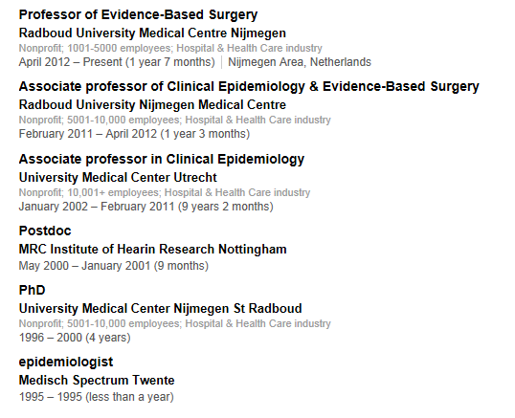
Maroeska M. Rovers

Slide 49
Adam Meijer
Adam Meijer, RIVM, The Netherlands
Adam Meijer National Institute for Public Health, Bilthoven, The Netherlands
Adam Meijer National Institute for Public Health, Bilthoven, The Netherlands
From the department of virology, National institute for Public Health and the Environment, Bilthoven
Dr Meijer’s research focuses on virological surveillance of acute respiratory infections, with a special focus on antiviral susceptibility and determination of molecular determinants for virulence and transmission networks at the animal-human interface

Slide 50
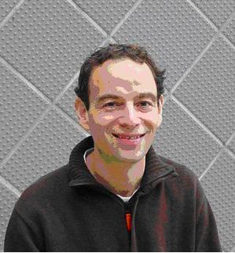
Louis Bont
Louis Bont, MD, PhD Paediatric Infectious Diseases Specialist Leader of the RSV Research Group University Medical Center Utrecht Utrecht, The Netherlands
Founder and chairman of the Bronchiolitis Academy, a educational network for experts in Europe and South America
Current chairman of the Global Expert Meeting, a conference on Respiratory Viruses in Europe and South America
Founder of the Training of Upcoming Leaders In Pediatric Science (TULIPS) program, a career training program for young talented researchers
Actively involved in the EUREKA network, an international high-quality translational medicine network
Dr. Bont has authored many articles and book chapters on RSV bronchiolitis.
He has served as reviewer for Lancet, British Medical Journal, Journal of Allergy and Clinical Immunology, Journal of Infectious Diseases, European Respiratory Journal, European, Thorax, American Journal of Respiratory and Critical Care Medicine and Pediatrics.

Slide 51
Authors Cont’d
Others
Jorine M.Molenaar, M.D.
Pauline L.Winkler-Seinstra, M.Sc.
Jan L.L.Kimpen, M.D., Ph.D. with around 172 publications,
All Are from the Division of Pediatric Immunology and Infectious Diseases, University Medical Center Utrecht, Utrecht

Slide 52
Authors Cont’d
Authors Evaluation
The authors are highly educated (PhD & M.D.) & are reputable source of trust in medical field
No biostatician
No pharmacists (the source of drug information & counseling)

Slide 53
Sponsor
The study was funded by Abbott Laboratories & the Netherlands Organization for Health Research and Development (NWO-AGIKO) grant

Slide 54
Sponsor Cont’d
Sponsor Evaluation
The Netherlands Organization for Health Research & Development is a national organization that promotes quality & innovation in the field of health research and health care, initiating and fostering new developments
Activities in the Medical Sciences (MW) are realized by the Netherlands Organization for Health Research and Development (ZonMw)
ZonMw facilitates health research and innovation in care: from fundamental research to the implementation of new treatments, preventative interventions or improvements in the structure of healthcare. It also participates in NWO-wide programmes.

Slide 55
Sponsor Cont’d
Sponsor Evaluation
Dr. Blanken, the primary author of the article, received the grant and reported conflicts of interest
Study authors reported relationships with Abbott, Medimmune, and GlaxoSmithKline
Synagis® is marketed by Abbott in many foreign countries around the world
Therefore
Authors’ interference & Bias cannot be eliminated!

Slide 56
Title
Respiratory Syncytial Virus and Recurrent Wheeze in Healthy Preterm Infants

Slide 57
Title Cont’d
The title is nonconclusive, objective unbiased
Clear and straightforward general not specific
Gives a brief idea about the article
The population of interest and age group is defined

Slide 58
Title Cont’d
The title did not:
Identify the therapeutic options being used
Indicate the type of study design neither the study regimen
Incomplete purpose

Slide 59
Abstract
Background
Poses the problem of controversy regarding causal relationship between RSV infection and recurrent wheeze and previous use of palivizumab
Methods
Palivizumab vs placebo in otherwise healthy preterm infants GA 33 to 35 weeks
Results
Primary & 1 secondary outcome results were stated with P-values
Conclusion
Brief, straightforward, and reflective to the overall study

Slide 60
Abstract Cont’d
Abstract evaluation
Conventional method used (background, methods, results, and conclusion)
Brief & reflective of the main ideas in the article
Type of study design mentioned
Primary outcome mentioned but secondary outcomes not mentioned
Target & number of population identified
Duration of treatment mentioned
Dose and number of doses received not mentioned
P value listed
Objective not clearly listed in the background
Therapeutic option to which results were compared was mentioned

Slide 61
INTRODUCTION

Slide 62
Introduction Cont’d
Rationale
Epidemiologists have been arguing for years as to whether or not RSV disease in infancy causes subsequent reactive airways disease
Observational studies cannot determine whether RSV infection is the cause of recurrent wheeze or the 1st indication of preexistent pulmonary vulnerability in preterm infants

Slide 63
Introduction Cont’d
Objective
To investigate the potential causal role of RSV infection in the pathogenesis of wheezing illness during the first year of life, using the commercially available monoclonal antibody palivizumab against RSV
Hypothesis
We hypothesize that RSV primarily causes direct pulmonary epithelial damage and local immunologic alterations in the lungs, leading to long-term airway hyperresponsiveness and wheezing

Slide 64
Introduction Cont’d
Two non-exclusive hypotheses exist, which are paraphrased as "the chicken and the egg“
First, the pre-existent genetic, pulmonary and immunological mechanisms of RSV bronchiolitis & post-bronchiolitis wheeze were reviewed
Second, RSV as the causative virus of long-term airway morbidity is reviewed. Clearly, RSV infection is capable of causing direct damage to the airways and/or inducing long-term inappropriate immune responses to respiratory viruses or aero-allergens
The study aims to distinguish between these 2 hypotheses by investigating whether prevention of RSV (by palivisumab) results in decreased incidence of recurrent wheeze

Slide 65
Introduction Cont’d
Introduction evaluation
Provide a brief overview of the current understanding of the complex pathogenesis of RSV bronchiolitis and post-bronchiolitis wheeze
Pathogenesis of RSV bronchiolitis as well as post-bronchiolitis wheeze are incompletely understood
It is not known whether recurrent wheeze in preterm children is caused by RSV infection or that RSV infection is the first indication of chronic airway morbidity that would develop anyway

Slide 66
Introduction Cont’d
Introduction evaluation
References:
16 references are identified
All of them except 1 are recent (2000-2012)
Most are 1ry literatures : review articles, articles, supplements
Trustful & highly informative sources
Provide powerful relevance with topic: microbiology, asthma, infectious diseases
Wide medical background extending to other fields on medicine
Other cited clinical trials & articles were also involved
Referred to specific studies in the reference list
Appropriate literature was cited to validate the conduction of this study

Slide 67
Introduction Cont’d
Introduction evaluation
The objective was short, clear
Underlines the need to investigate the important role of RSV infection as a contributing factor to the development of recurrent wheezing in the first year of life
Provided assertiveness on the limited evidence for the causal relationship between RSV and recurrent wheeze

Slide 68
METHODS

Slide 69
Methods
Study design
Multicenter, double-blind, randomized, placebo-controlled MAKI trial
Multicenter: 1 university and 15 regional hospitals
This provides replication and generalizability as long as all sites have the same procedure followed for standardization
It is a triple blind rather than double blind since the subjects, investigators & group involved in interpretation of data were unaware of assignment of subjects to intervention or control
Only the administering nurses were aware of the study group assignments and were not involved in the reporting of data analyses

Slide 70
Methods cont’d
Patients
Healthy preterm infants (n=429) born at a gestational age of 33 to 35 weeks aged 6 months of age or younger at the start of the RSV season
Enrolled in the Netherlands during a 2-year period from 2008 to 2010
Requirement for parent informed consent was obtained

Slide 71
Methods cont’d
Inclusion criteria
1- Healthy preterm infants < 6 months at the start of RSV season
2- GA between 32 & 35 weeks, either sex
3- Children of parents who master the Dutch language
GA was not correlated with the guideline requirements approved for the use of palivizumab

Slide 72
Methods cont’d
Exclusion criteria
1- A known cardiac anomaly (CHD), BPD, Down’s syndrome or other serious congenital disorders
2- Require intensive respiratory treatment (surfactant or at least 2 weeks of mechanical ventilation)
3- >6 months at the start of the RSV season
4- Airway morbidity before the start of the RSV season, monitored before the first injection

Slide 73
Methods cont’d
Ethical issues
Local IRB approved protocol
Study marketed as a therapeutic study

Slide 74
Methods cont’d
Randomization
1:1 ratio to receive either monthly palivizumab (dose = 15 mg/kg) injections (n=214) or matching placebo (n=215) during the RSV season
Randomization 1:1 patients have equal chances to be in either groups
Researchers and parents were blinded
Randomization performed by an independent pharmacist
Stratification according to GA rather than randomization was done
However stratification can become complex
Used the parallel design

Slide 75
Methods cont’d
Randomization evaluation
Randomized controlled trial is the best design for determining causality
Minimizes bias through randomization and stratification

Slide 76
Methods cont’d
Randomization evaluation
Cluster randomizations where interventions are assigned to groups not individuals describes best the randomization used in the study
A useful strategy for lifestyle interventions (because of possibility of “leaks” or contamination) or vaccine trials (because of “herd” effects)
However it requires a larger sample size where statistical analysis becomes more complex

Slide 77
Methods cont’d
Methods evaluation
Patients characteristics were not presented in the article
Number of patients enrolled in each group is correct
Doses & frequency of administration are within the normal range
Route of administration (IM) was compatible with the drug recommendation
Following up patients was checked at each subsequent home visit
Randomization was done accurately by a pharmacist

Slide 78
Methods cont’d
Study outcomes & follow-up
Primary outcome: Number of parent-reported wheezing days (daily log) during the first year of life
Secondary outcomes:
1- The number of days with bronchodilator use
2- The number of RSV infections confirmed by nasopharyngeal swabs positive for RSV RNA with or without medical attention
3- The number of wheezing episodes
4- Prevalence of recurrent wheeze

Slide 79
Methods cont’d
Study outcomes & follow-up
Parents were instructed to record wheezing incidents in a diary along with physician visits & respiratory medications until the child's first birthday
Instructions for completing the log & compliance were checked
A "wheezing episode" was defined as two or more consecutive days with wheezing reported. Three or more episodes, spaced at least 1 week apart, constituted recurrent wheezing
Medical attention was defined as a visit to either a PCP or a hospital
A physician diagnosis of asthma, hay fever, or eczema confirmed a family history of atopy

Slide 80
Methods cont’d
Laboratory tests & follow-up
Parents were instructed to take a nasopharyngeal swab in case of the occurrence of respiratory symptoms lasting for more than 1 day to be tested for the presence of RSV RNA
X This study relied on the subjective discretion of wheeze as reported by the guardian as having a formal daily logs is difficult to attain in this age group

Slide 81
Methods cont’d
Laboratory tests & follow-up
RespiFinder® SMART 22 is a ready to use set of primers, probes & enzymes for the simultaneous detection and differentiation of 22 respiratory pathogens 18 viral + 4 bacterial RTI causing pathogens in one assay
Multiparameter Real Time PCR based tests provide a fast and accurate means of molecular diagnostics
Diagnosis within 6 hours based on melting curve analysis
As sensitive as monoplex Real Time PCR
Internal Amplification Control included
RespiFinder-SMART-22 showed a higher analytical sensitivity for adenoviruses and coronaviruses
PathoFinder is a privately owned nucleic acid diagnostics company founded in 2004 and based in Maastricht, The Netherlands

Slide 82
Methods cont’d
Study Oversight
All authors vouch for the accuracy and completeness of data reported and for the fidelity of the data

Slide 83
Methods cont’d
Statistical Analysis
Sample size calculation
90% power means that the study (when conducted repeatedly over time) is likely to produce a statistically significant result 9 times out of 10 with 95 % CI and α = 0.05
All analysis were based on intention-to-treat principle
Poisson regression analysis for differences in the number of days with wheezing
"Exposure" and offset: Poisson regression may also be appropriate for rate data, where the rate is a count of events occurring to a particular unit of observation, divided by some measure of that unit's exposure

Slide 84
Methods cont’d
Statistical analysis
Chi-square tests: to evaluate differences in percentages
Student’s t-tests: to evaluate differences in mean values
2 sample test for 2 independent samples that compares the means of 2 normal distributions of continuous data
Mann-Whitney U tests: : to evaluate differences in median values
compares 2 independent samples of ordinal data
Overall missing data was less than 10%
Post-hoc subgroup analyses
Post-hoc subgroup analysis where if subgroups are data-derived, results in subgroups are hypothesis generating
SPSS software, version 20

Slide 85
Methods cont’d
Statistical analysis evaluation
Approaching to analysis using intention-to-treat analysis (as-randomized) compares outcomes based on initial group assignment
Determines the effect of treatment under usual conditions of use
Detects method effectiveness but not magnitude and gives a conservative estimate of differences in treatments thus may underestimate treatment benefits
Results were associated with
ARR (indicates the decrease in number of cases)
RRR (indicates decrease in risk)
BUT lacked the calculation for the number needed to treat (NNT) is the number of patients u need to treat to prevent additional bad outcome

Slide 86
RESULTS

Slide 87
Results
Patients
Four hundred and twenty-nine were enrolled in the study
The 2 study groups were well balanced on the basis of inclusion year, gestational age, and birth month. Birth weight, family history of atopy, presence of siblings, and other baseline characteristics were similar,
Except for sex where there is slightly more male in the treatment group (58% male infants in the RSV prevention group vs 44% in the placebo group).
Male gender is a risk factor in RSV infection
The authors took into consideration confounders that can be a risk factor for the acquisition of RSV infection and subsequent development of wheezing

Slide 88
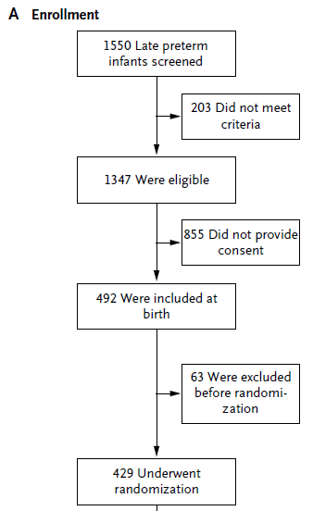
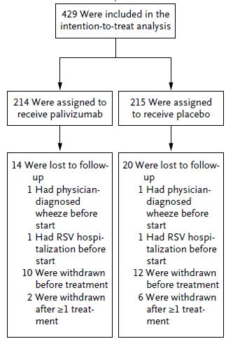
Results cont’d

Slide 89
Results cont’d
Patients
A median number of 4 injections during the RSV season were administered to infants in the RSV-prevention group (range, 1-5) and the placebo group (range, 2-5)
In the RSV-prevention group, 95% of scheduled injections and 89% of follow-up of daily logs were completed, as compared with rates of 92 and 88%, respectively, in the placebo group
The median follow-up duration was 10 months (range, 0-12) in the two study groups

Slide 90
Results cont’d
Evaluation
The study oversight of the trial was well controlled, >90% of scheduled injections completed in both the placebo and palivizumab groups
Once the intention to prophylaxis is made, completion of the immunoprophylaxis series is mandatory. Without complete treatment, compliance breakthrough infections may occur, placing the child at risk
Compliance with the log and injections was greater than 87%;
When compliance is low, there are higher rates of emergency department visits and hospitalizations
Nasopharyngeal samples were obtained in only 29%
X Withdrawal bias cannot be eliminated where characteristics of patients who withdraw from a study may differ from those who remain may affect the study results

Slide 91
Results cont’d
RSV Infection
Infants who were treated with palivizumab had
Lower incidence of RSV-related hospitalization than those treated with placebo
Lower incidence of medically attended nonhospitalized RSV infection
Significantly lower rate of RSV infection requiring medical attendance but not hospitalization
 | Placebo | Palivizumab | P-value
RSV infections | 14.0% | 4.7% | 0.001
Hospitalizations for RSV | 5.1% | 0.9% | 0.01
Physician visits for RSV without hospitalization | 4.7% | 0.9% | 0.02
RSV infection without medical attention | 4.2 % | 2.8% | 0.4
RSV infection: Occurrence & Severity

Slide 92
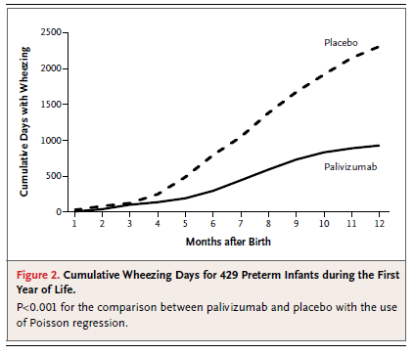
Results cont’d
Primary outcome
After a median follow-up of 10 months,
monthly palivizumab treatment resulted
in a significant reduction in wheezing
days in healthy pre-term infants
during the first year of life compared
to placebo RRR 61%
Days with wheezing | Palivizumab | Placebo | RRR | P-value
 | Incidence per day
1st year of life | 1.8 % | 4.5% | 61% | <0.001
RSV season = October 1 to March 31

Slide 93
Results cont’d
Secondary Outcomes
The effect of RSV prevention on the number of wheezing days persisted during the post-prophylaxis period (i.e., starting at 2 months after the last injection; secondary outcome), for a relative reduction of 73% (95% CI, 66 to 80)
Days with wheezing | Palivizumab | Placebo | RRR | P-value
 | Incidence per day
< 2 mo after prophylaxis | 2.3% | 4.9% | 52 | 0.006
> 2 mo after prophylaxis | 1.1% | 3.9% | 73 | <0.001
During RSV season | 2.5% | 5.2% | 52 | <0.001
Outside RSV season | 1.1% | 3.7% | 73 | <0.001

Slide 94
Results cont’d
Infants with Wheezing
 | Placebo | Palivizumab | Relative risk reduction | P-value
Any wheezing | 47 % | 30.8 % | 34% | <0.001
Wheezing episodes | 266 | 137 | 48% | 0.005
Recurrent wheezing | 20.9% | 11.2% | 47% | 0.005

Slide 95
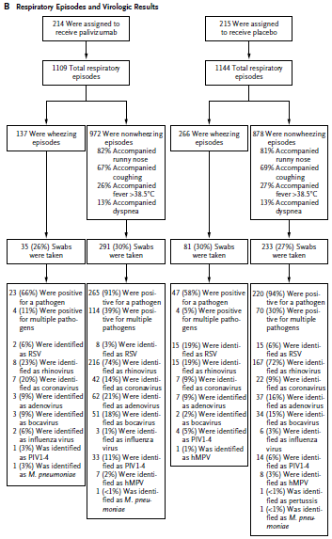

Slide 96
Results cont’d
Results evaluation
The adherence of the parents to take nasopharyngeal swab when their infants had respiratory symptoms with an URTI or LRTI lasting for more than 1 day, this was adhered to in less than 30% of the cases
In addition only a minority were identified as RSV infections and the majority as rhinovirus infections
Knowing that RespiFinder-SMART-22 shows a higher analytical sensitivity for adenoviruses and coronaviruses
Instrument bias, defects in the calibration or maintenance of measurement instruments may lead to systematic deviations in results, is suspected

Slide 97
Results cont’d
Secondary outcomes
The proportion of babies who developed recurrent wheezing was approximately half as high among those who received palivizumab as among those who received placebo (11.2% vs 20.9% respectively) (P=0.005)
The proportion who were given bronchodilator therapy was similarly lower in the palivizumab group than in the placebo group (13% vs 23% respectively) (P<0.001)

Slide 98
Results cont’d
Secondary outcomes
The researchers also collected data on family history of atopy
Notably, the efficacy of immunoprophylaxis was similar and not significantly different between children who had a family history of atopy (and those who did not (54% vs 72% reduction in wheezing days respectively) (P=0.89)
Palivizumab’s efficacy was similarly consistent whether the children’s parents had asthma (68% reduction) or did not have asthma (35% reduction) No P-value given
More co-infections during non-wheezing episodes were reported in the RSV-prevention group than in the placebo group (39% vs 30% of swab, P=0.03)

Slide 99
Results cont’d
Results evaluation
This research seems to underscore something that many parents of premature babies seems to know
RSV infection does appear to have a connection to recurrent wheeze in premature babies
BUT
Other factors can contribute to infant wheezing risk, including certain genetic variants as well as allergic sensitization
Palivizumab treatment, while decreasing morbidity in infancy, may have limited effects on at least some asthma-risk pathways

Slide 100
Results cont’d
Results evaluation
Wheezing has been used as a surrogate marker to identify clinically relevant association with infection
A major concern with using wheezing to define an illness is the subjectivity involved in assessing this symptom in terms of caregiver recognition, agreement between parenteral and physician assessment, and the recognition of the degree of severity that portends subsequent administration of medication or hospitalization
Attention and reporting bias: subjects may alter their behavior if they know they are being observed

Slide 101
Results cont’d
Adverse Effects
The proportion of patients with serious adverse events was lower in the RSV-prevention group than in the placebo group
12.6% as compared to 21.9% hospitalizations respectively (P = 0.04)
HOWEVER
Bont and colleagues did not report other types of adverse events, although the drug's label indicates a number of common side effects including injection-site reactions, elevated liver enzymes, and, rarely, thrombocytopenia

Slide 102
Results cont’d
Adverse effects evaluation
Palivizumab (Synagis®) is a monoclonal antibody directed against an epitope in the A antigenic site of the F protein in RSV where 5% of it is murine derived
Since it is given as IM injection, caution should be taken in infants with bleeding diathesis
Concern is about the long-term effect of those relatively new modalities of therapy, especially now that they are given to a really young generation with a long years of expected survival even though palivizumab seems to be safe so far

Slide 103
Results cont’d
Adverse Effects Evaluation
The question is: Are we hitting hard against the wall and missing the who rock that could collapse on our heads to get that done?
The long-term implications of what happens beyond that first year is even more important
What about the long term malignancy and demyelating effects of that intervention?

Slide 104
DISCUSSION

Slide 105
Discussion
In this proof-of-concept study,
MAKI trial found that prophylaxis of healthy, late preterm infants with the palivizumab significantly reduced parent-reported wheezing days & recurrent wheeze during the 1st year of life, even after RSV prevention effect would have waned & outside the RSV season
This is a major step in solving a conundrum that has been debated for more than 4 decades; ie, is RSV bronchiolitis linked to subsequent recurrent wheezing and asthma
The answer coming from this first randomized study is 'yes,' at least during the first year of life in preterm-born infants

Slide 106
Discussion cont’d
Discussion evaluation
The authors intended to probe what appears to be a causal relationship between RSV infection and recurrent wheeze – not to identify an effective treatment
The results are in line with previous studies that acknowledge the relationship between RSV bronchiolitis and recurrent wheeze
Specifically, research in mice has indicated that RSV infection can cause persistent airway hyperresponsiveness and chronic lung inflammation

Slide 107
Discussion cont’d
Discussion evaluation
RSV was recognized before as a contributing factor to the development of recurrent wheeze in the first year of life, playing together with genetic factors in altering the lung structure and function early in life , an event that is thought to play an important role in the airway hypersensitivity syndrome
Interestingly, there was 61% relative risk reduction in the primary end point in the intervention vs the placebo group. This prevention will translate to a lower morbidity rates and hence cost and disturbed life style in this high risk population

Slide 108
Discussion cont’d
Discussion evaluation
The randomization and utilization of a virus-specific drug in this appropriately powered trial provides convincing evidence for a special role for RSV to be a contributing factor to the development of recurrent wheezing in the first year of life
Although this study does not prove that RSV infection, through damage to the lungs, causes long-term airway hyperresponsiveness and wheezing
Interesting too, to note that the babies in this study were not extremely premature either. It would be helpful to see similar work on even earlier babies to look at outcomes

Slide 109
Discussion cont’d
Discussion evaluation
HOWEVER
This study does not provide definitive information beyond the first year of life and in full-term born children that represent the large majority of asthmatic children
The study did not include term infants; therefore the results may not be generalizable to term infants and to the general population

Slide 110
Discussion cont’d
Discussion evaluation
Additionally the study showed that preventing RSV infection reduced wheezing regardless of family history of atopy
The integration of family history in the analysis further strengthens the authors’ argument for a causal role of RSV in recurrent wheeze

Slide 111
Discussion cont’d
Discussion evaluation
However
The study lacked sufficient time and power to address the issue of asthma
Whether the reduction in wheezing would lead to a commensurate decrease in incidence of asthma was not addressed in the study
Other factors can contribute to infant wheezing risk, including certain genetic variants as well as allergic sensitization
Palivizumab treatment, while decreasing morbidity in infancy, may have limited effects on at least some asthma-risk pathways

Slide 112
Discussion cont’d
Discussion evaluation
"Is that really all that clinically useful especially in light of the uncertainty over the impact on subsequent asthma development?
It is important to recognize that other asthma-risk “pathways,” which are independent of allergic sensitization, may also contribute to increased asthma risk
One pathway may involve genetic variation at the 17q21 locus and virus-induced wheezing illnesses
So rather than prophylactic treatment, a better approach would be an RSV vaccine

Slide 113
Discussion cont’d
Discussion evaluation
Would it be a wise decision to begin treating premature infants routinely with palivizumab?
Not only is the drug costly, but adherence to the monthly injection schedule is frequently poor and missed doses greatly reduce the protective effect
When the commitment to prophylaxis is made, when should it begin? The “season” is fairly predictable, but it is important to understand seasonal variability
Data suggest that the season not only varies from year to year, but also depends on the location of the patient base

Slide 114
Discussion cont’d
The reduction in wheezing comes at a price, however. The price tag is still an important consideration for people
Cost varies from country to country. A child's weight, which determines dosage, also affects the cost of treatment
In Lebanon, Synagis® cost is
100mg vial: 1,549,595 L.L.
50 mg vial: 947,490 L.L.
Society needs to define whether its cost-effectiveness is acceptable for palivizumab to be a standard preventive treatment for premature infants during RSV season
This is a very expensive intervention. But if wheezing episodes in pre-term infants are associated with significant illnesses, then preventing RSV could translate into money too

Slide 115
Discussion cont’d
Strengths
Randomized design
Precludes bias from selection or confounding
Subsequently provides unbiased and conclusive evidence

Slide 116
Discussion cont’d
Limitations
Need for participation of more parents with atopic history
Only 30% of nasopharyngeal swabs were obtained of all respiratory episodes
Underestimation for the incidence of RSV infection
Whether results can be generalized to health term infants
No objective measure of wheezing, relying on parent-reported morbidity data

Slide 117
CONLUSION

Slide 118
Conclusion
This investigation addresses pediatricians’ age-old, chicken-or-egg question: Does early RSV infection cause later wheezing in childhood or are infants who develop severe symptoms with early RSV preprogrammed to be wheezers?
This prospective, randomized, controlled study offers evidence that RSV is the egg rather than the chicken

Slide 119
Conclusion cont’d
Given the limitations of using wheezing as a primary outcome measure, which is identified as a limitation by the study coordinators, researchers concluded that in otherwise healthy preterm infants, prophylactic treatment with palivizumab reduced the total number of wheezing days in the first year of life among preterm infants with a gestational age of 33 to 35 weeks
They further confirm the role that RSV plays in the pathogenesis of recurrent wheeze
These findings implicate RSV infection as an important mechanism of recurrent wheeze during the first year of life in this population
How this can translate into healthy term infant is still to be answered

Slide 120
Conclusion cont’d
Conclusion evaluation
The relatively low incidence of wheezing days in both treatment groups -- 1.8% with palivizumab and 4.5% with placebo
The results indicated that 37 infants would have to be treated with the drug to prevent one case of recurrent wheezing
Is that really all that clinically useful especially in light of the uncertainty over the impact on subsequent asthma development?
Rather than prophylactic treatment, a better approach would be an RSV vaccine

Slide 121
Recommendation
The significance of these conclusions must be validated in additional randomized, controlled trials in order to be considered for inclusion into the recommendations of the Committee on Infectious Diseases (COID) of the American Academy of Pediatrics (AAP) on palivizumab prophylaxis of infants and young children
This population for which palivizumab is currently recommended is not representative of the study population

Slide 122
OTHER STUDIES

Slide 123
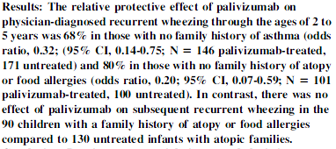
Study 1

Slide 124
Study 1 cont’d
Using a retrospective and randomized study design, premature infants were treated with palivizumab and compared with an untreated cohort matched for chronologic and gestational age
During a 24-month follow-up period, physician-diagnosed recurrent wheezing was significantly less frequent in the treated group
This reduction in wheezing frequency was seen only in children who did not have a family history of atopy

Slide 125
Study 2
Shigemi Yoshihara, MDª, Satoshi Kusuda, MD^{b}, Hiroyuki Mochizuki, MD^{c}, Kenji Okada, MD^{d}, Sankei Nishima, MDe, Eric A.F. Simões, MD^{f}, on behalf of the C-CREW Investigators

Slide 126
References Evaluation
Forty four references were used
Majority are uptodate ranging from years 2000 to 2012
6 are older than year 2000 with 2 very old articles
Bont L. was the author of 6 out of 44 articles

Slide 127
References
1- Çaliskan M, Bochkov YA, Kreiner-Møller E, et al. Rhinovirus wheezing illness and genetic risk of childhood-onset asthma. N Engl J Med 2013;368:1398-407
2- Fonseca C de B et al. Bronchiolitis, respiratory syncytial virus, and recurrent wheezing: what is the relationship? Rev. Hosp. Clín. Fac. Med. S. Paulo 58(1):39-48, 2003
3- Groothuis J. R., Hoopes J. M., and Hemming V. G., Prevention of serious respiratory syncytial virus-related illness—II: immunoprophylaxis, Advances in Therapy, vol. 28, no. 2, pp. 110–125, 2011
4- Marcello Lanari, Silvia Vandini, Santo Arcuri, Silvia Galletti, and Giacomo Faldella2.The Use of Humanized Monoclonal Antibodies for the Prevention of Respiratory Syncytial Virus Infection. Clinical and Developmental Immunology Volume 2013, 20 May 2013
5- McBride JT, McConnochie KM. Respiratory syncytial virus, recurrent wheezing and ribavirin. Ped Pulmonol 1998; 25:145-6
6- Michael E. Speer and Amy B. Good. Review: The Prevention of Respiratory Syncytial Virus Infection in Children: Focus on Palivizumab. Clinical Medicine: Therapeutics 2009:1 459–469
7- Public health functions to be exercised by the NHS Commissioning Board. Respiratory syncytial virus (RSV) immunisation programme. November 2012
8- Simoes EA, Carbonell-Estrany X, Rieger CH, et al. The effect of respiratory syncytial virus on subsequent recurrent wheezing in atopic and nonatopic children. J Allergy Clin Immunol 2010;126:256-62
9- Synagis [package insert]. Gaithersburg, MD: MedImmune, Inc.;2007
10- Yuh-Jyh Lin, Chyi-Her Lin. Recent Literature Review on Respiratory Syncytial Virus (RSV) Infection in Infants and Children. J Pediatr Resp Dis 2013;9:6-10
11- Zhu Q., McAuliffe J. M., Patel N. K. et al., “Analysis of respiratory syncytial virus preclinical and clinical variants resistant to neutralization by monoclonal antibodies palivizumab and/or motavizumab,” Journal of Infectious Diseases, vol. 203, no. 5, pp. 674–682, 2011

Slide 128
THANK YOU

