Slide 1
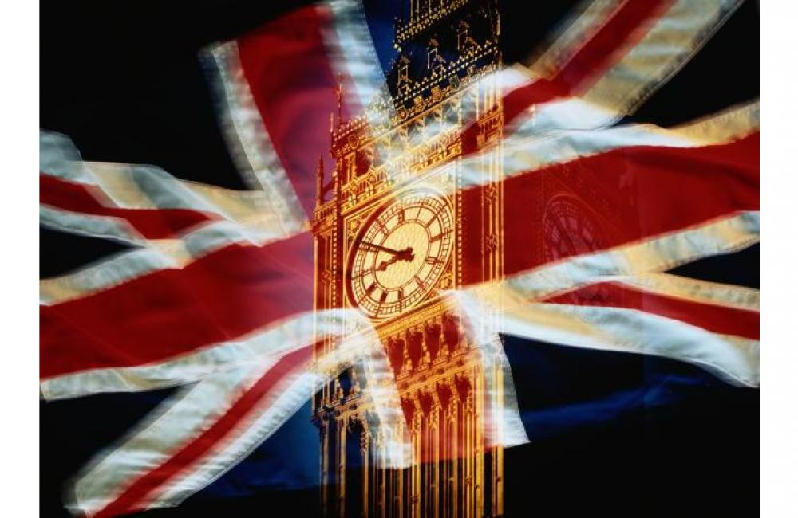
What do you know
about London’s parks?
Составила: учитель
английского языка
МОУ «СОШ №2 г.о. Стрежевой»
Саунина Елена Анатольевна

Slide 2
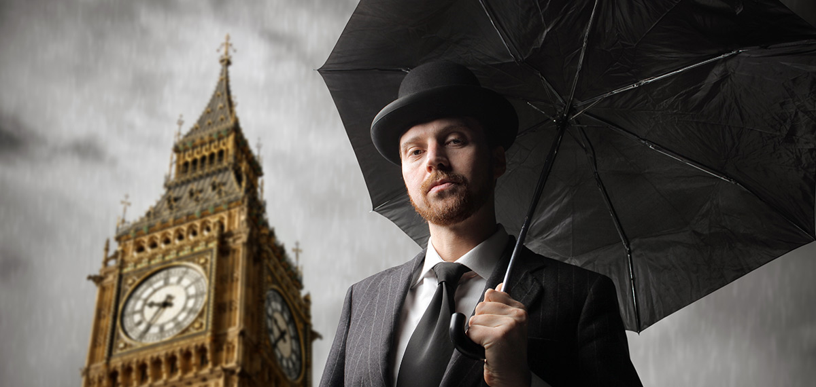
How are you?
-
I am
fine
good
sad
so so
bad
not bad
happy

Slide 3

umsemu
museum
numontme
monument
ghsits
sights
aresqu
square
lapace
palace

Slide 4
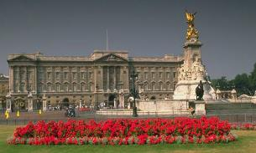
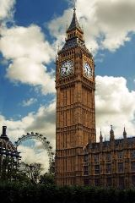
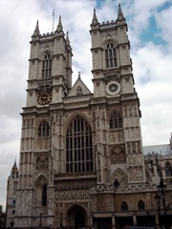
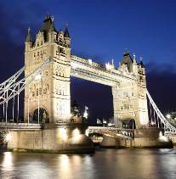

Slide 5
Sights
of
London

Slide 6

SEA BATTLE

Slide 7



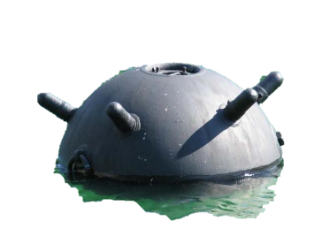



A
B
C
1
2
3
next

Slide 8

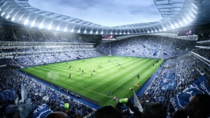

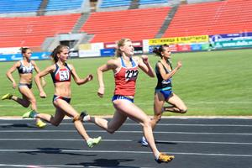
place
care of
take
pictures
part in
back

Slide 9
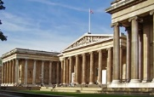
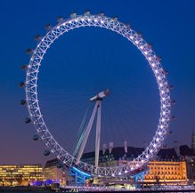
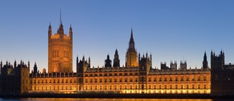
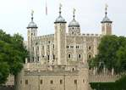
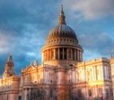
1___________________________
4____________________________________
3________________________
The London Eye
St. Paul’s Cathedral
The British Museum
Westminster Palace
2___________________________
5_______________________________
The Tower of London
back

Slide 10
h
o
w
z
l
a
q
j
x
c
k
d
u
f
n
a
g
e
v
o
a
f
t
o
w
e
r
e
n
k
y
h
s
y
t
j
v
p
i
r
a
v
e
n
s
d
b
y
p
m
m
h
u
d
b
i
g
b
e
n
o
q
u
e
g
r
i
s
h
m
c
z
u
m
x
l
w
y
t
u
i
back

Slide 11
situated on
founded in
full of
famous for
1. London was _____________43 AD.
2. It is _____________ the River Thames.
3. It is ___________________ its places of interest.
4. London is _____________history.
back

Slide 12
Write down the names of the sights
Big
Tower
Buckingham
Parliament
Abbey
Ben
London
The Tower of
Square
Eye
Palace
Westminster
Bridge
The London
The Houses of
Trafalgar
back

Slide 13

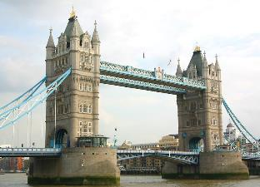
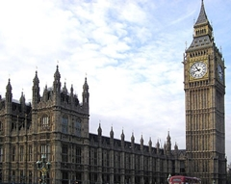
Match the questions and the answers
1. Where does the Queen of Britain stay when she is in London?
In Westminster Abbey
Near the Houses
of Parliament
2. Where do the
famous black
ravens live?
3. What is the most famous London’s bridge?
The Tower Bridge
4. Where are the
famous English
people buried?
In Buckingham Palace
5. Where is Big Ben situated?
In the Tower of London
back

Slide 14
Correct the mistakes
1. The Tower of London is one of the
famous clocks in the world.
2. Westminster Abbey are the buildings
where the British Parliament sits.
3. The Houses of Parliament is the most
famous bridge in London.
4. Big Ben is the most well-known English church.
5. Tower Bridge is the London’s ancient fortress.
back

Slide 15
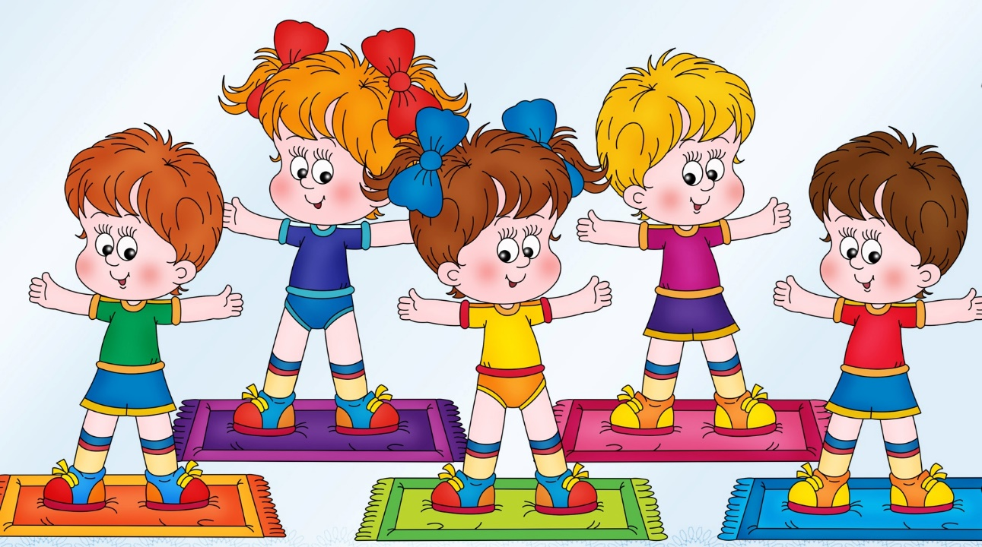

Let’s have a short break

Slide 16


Solve the puzzle
,,
“

Slide 17
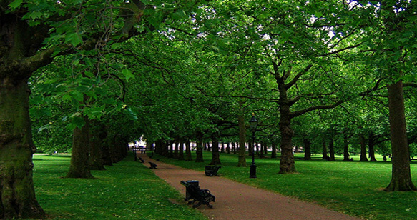
Parks of London

Slide 18
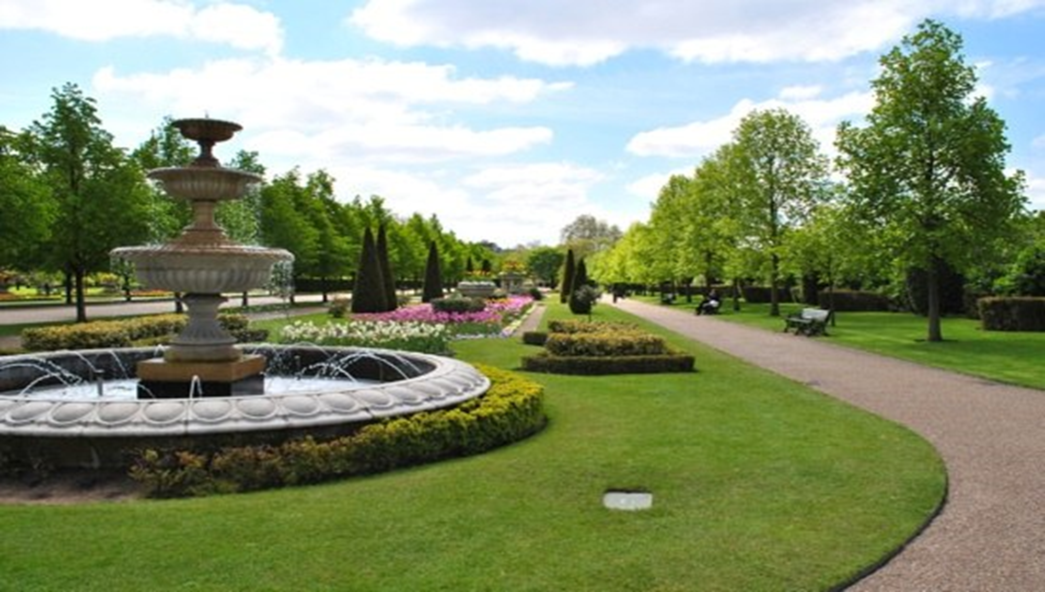

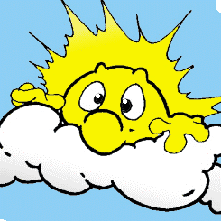
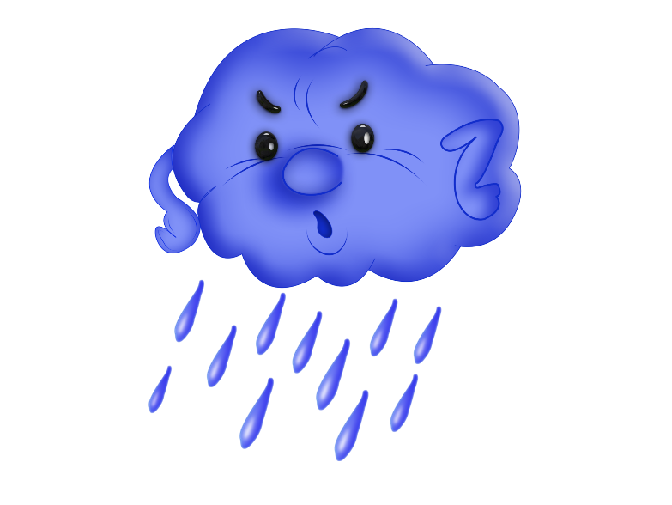

What’s the weather like in your park?
It’s sunny and hot
It’s warm but cloudy
It’s stormy
It’s rainy

