Slide 1

Taller 1
Cómo Hacer Crecer Su Iglesia
Multiplicar Discípulos
1-19-20
Notes:
Workshop 1
How to Grow Your Church
Multiply Disciples
Introduction
Greetings, introduction, and prayer by local coordinator
Thank the pastors and leaders for coming
Trainers introduce themselves
This workshop will show you how to grow your Church numerically and spiritually

Slide 2
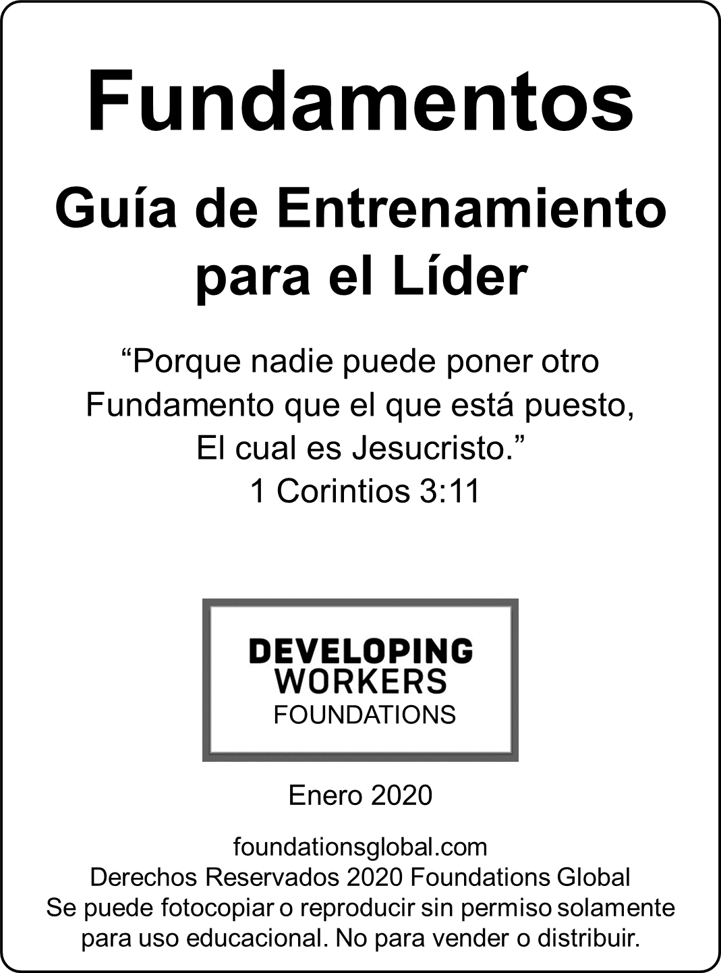
Notes:
The Foundations Leader Training Guide is used
to train people how to use the Foundations Bible study material to make disciples

Slide 3
Fundamentos Guía de Entrenamiento para el Líder
1. La Gran Comisión
2. Nuestra Respuesta a la Gran Comisión
3. Plan de Discipulado de Fundamentos
4. Multiplicar Discípulos por Aprendizaje
5. Cómo Dirigir una Reunión de Fundamentos
“Fundamentos Guía de Entrenamiento para el Líder” página
Notes:
The Foundations Leader Training Guide consists of the following
1. The Great Commission
Vision for making multiplying disciples
2. Our Response to the Great Commission
3. Foundations Discipleship Plan
4. Multiply Disciples by Apprenticeship
5. How to Lead a Foundations Meeting
Trainer will model how to lead
Participants will lead

Slide 4
Material de Fundamentos
1. Venir
4. Ir
2. Crecer
3. Servir
Todo el material está disponible gratuitamente en foundationsglobal.com
Notes:
Foundations Material
The material can be used to disciple one person or 2-10 people
There are 4 parts to the Foundations material
The Come section is evangelistic
The Grow, Serve, and Go sections are discipleship
All Foundations material is available for free at foundationsglobal.com

Slide 5
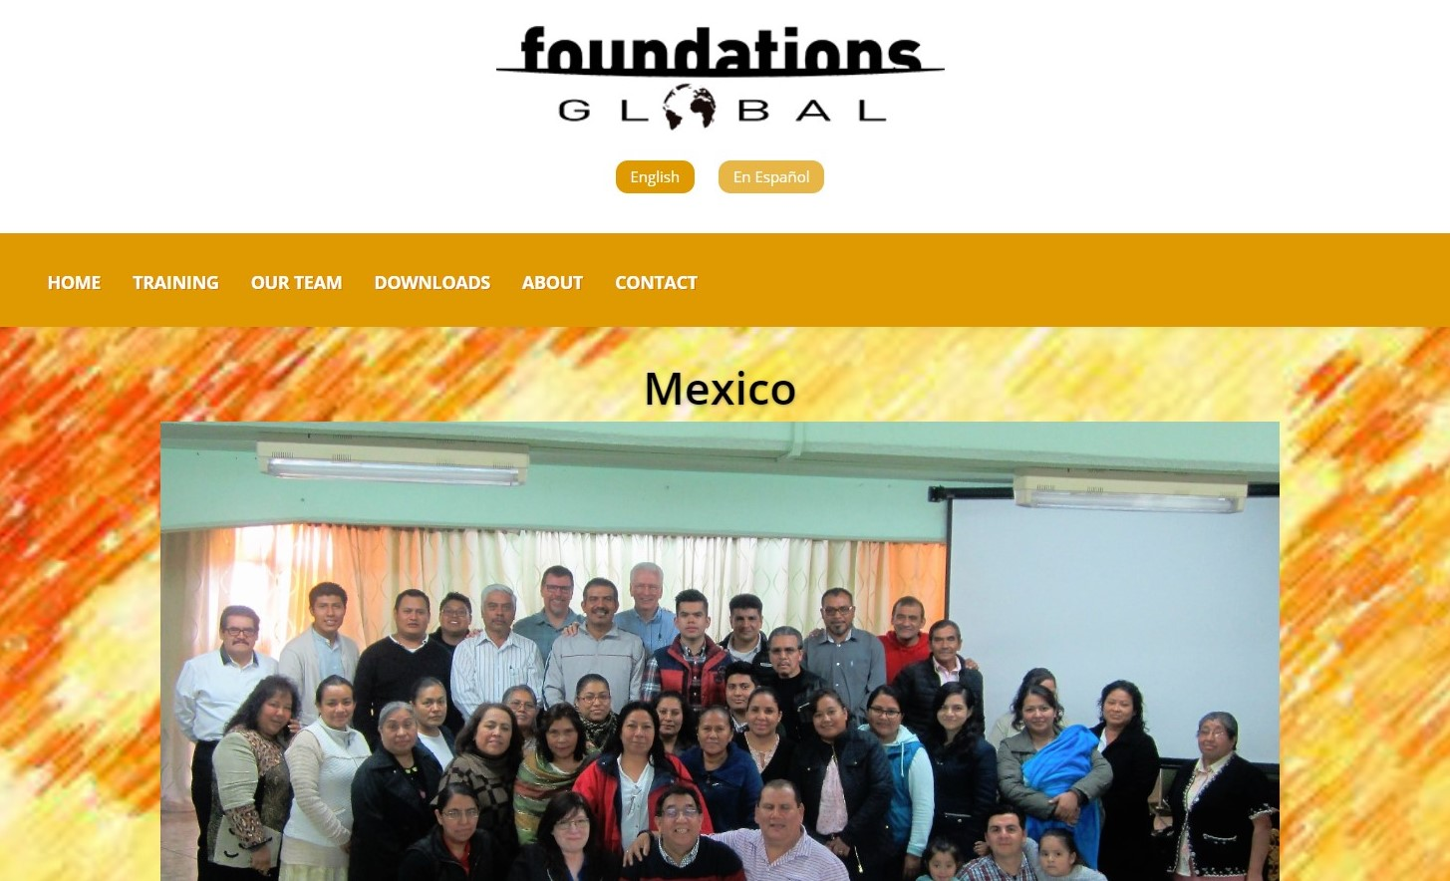
Cómo Descargar Documentos
Ir a foundationsglobal.com
Seleccionar Idioma
Seleccionar Descargas
Notes:
How to Download Documents
Go to foundationsglobal.com
Select language
Select Downloads

Slide 6
La Gran Comisión
Capítulo 1
Adán & Eva
Noé y sus Hijos
Abraham
Jacob
Jesús
Multiplicar
Notes:
Foundations Leader Training Guide
The Great Commission
Chapter 1
I. God’s Plan of Redemption
The theme of the whole Bible is about God creating us to love us
and then redeeming us back to himself after we sinned.
You can see that Multiplying is a recurring theme in God’s plan of redemption.
Genesis 1:28. Adam and Eve – Be fruitful and multiply
Genesis 9:1. Noah and Sons – Be fruitful and multiply
Genesis 22:17. Abraham – I will multiply your seed
Genesis 35:11. Jacob – Be fruitful and multiply
Matthew 28:19-20. Jesus – Make multiplying disciples

Slide 7
El Plan de Jesús:
Multiplicando Discípulos
1. Morir en la cruz por nuestro pecado
2. Anunciar a la gente las buenas nuevas
Notes:
II. Jesus’ Plan: Make Multiplying Disciples
Jesus’ plan had two parts:
Die on the cross for our sins
Let people know the good news
But if Jesus had died for our sins
and there was no plan to let people know about it,
none of us would have become God’s children.

Slide 8
Jesús:
Predicó a las multitudes y sanó a muchos
Pero
El entrenó a doce hombres ordinarios
  por tres años para que fuesen sus discípulos
Sus discípulos debían entrenar a otros discípulos
Notes:
Jesus:
Preached to the crowds and healed many,
But he trained 12 ordinary men
for three years to be His disciples
His disciples were to train other disciples
until everyone in the world had an opportunity to become a child of God.

Slide 9
Un discípulo llega a ser como Jesús
Un discípulo hace otros discípulos
Notes:
A disciple becomes like Jesus
“be conformed to the likeness of his Son” Romans 8:29
A disciple makes other disciples
“make disciples of all nations” Matthew 28:19

Slide 10
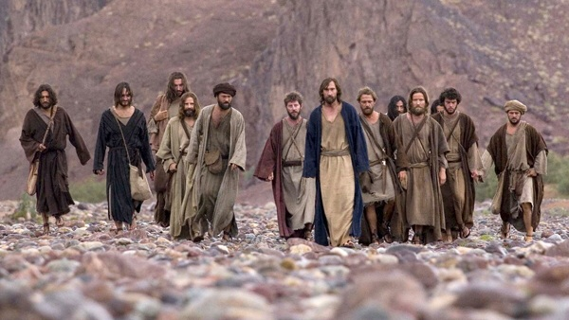
La Gran Comisión
Mateo 28:19-20
Id y haced discípulos a todas las naciones
Bautizándolos y enseñándoles
Yo estoy con vosotros todos los días
3
Notes:
The Great Commission is best known from Matthew 28:19-20
How to Make Disciples:
What we are to do is:
Make disciples: As defined by Jesus using Jesus’ process.
Where we are to do it:
All Nations: All nationalities (No discrimination), the entire world.
How we are to do it:
Go: As you go through life, wherever you are
Baptizing: Discipleship starts with Evangelism,
leading people to faith in Christ.
Teaching obedience to all of Jesus’ commands: Discipleship.
Maturing in all of the ingredients of a disciple.
I am with you always: Make disciples through the power of the Holy Spirit

Slide 11

Línea de Tiempo de la Gran Comisión
Hechos 1
Juan 20
Mateo 28
Marcos 16
Lucas 24
3 Dias
40 Dias
Ascensión
Resurección
Crucifixión
Notes:
Great Commission Timeline
The Great Commission includes both evangelism and discipleship
Both are essential to finish the Great Commission.
Jesus gave the Great Commission
during the 40 day period after His Crucifixion and Resurrection
and during His Ascension into heaven.
five times
to different groups of people
at different locations
at different times
Whatever Jesus said after His death and resurrection with such repetition
must motivate us to obedience.

Slide 12
“Plan de Jesús
“Multiplicandos Discípulos”
Modelo (Juan 20:21)
Ejemplo (2 Timoteo 2:2)
Jesus
Pablo
Multiplicar
12 Discipulos
Timoteo
Cristianos Obedientes
(Discípulos)
Hombres Fieles
(Discípulos)
Todas las Naciones
Otros
También
5
Notes:
Jesus’ Plan
“Multiplying Disciples”
After His resurrection and before his ascension Jesus told his disciples in John 20:21,
“As the Father has sent me, I am sending you.”
He told them to make disciples just as He did
Train disciples to make disciples
and reach all nations
Paul is an example of obeying the Great Commission
as he trained Timothy
to train faithful men
who would teach others also
and finish the Great Commission.

Slide 13
En grupos de 2-5 hable sobre:
Lo que aprendiste sobre la Gran Comisión
Por qué la multiplicación es tan importante
Notes:
In groups of 2-5 talk about:
What you learned about the Great Commission
Why multiplication is so important
Ask participants to share what they talked about
Questions?

Slide 14
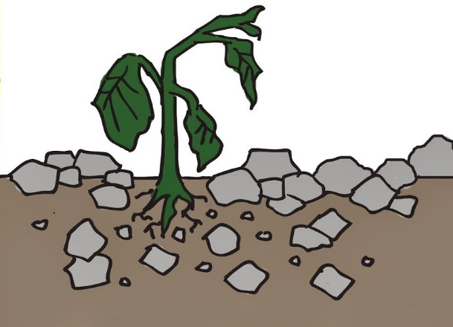
El Principio de La Gran Comisión
Parábola del Sembrador
1. Terreno Pedregoso
Oye la palabra y recibe con gozo pero al venir la aflicción o la persecución, luego tropieza
Notes:
Great Commission Principle
Parable of the Sower
Have you noticed that some people attend church for a while
and then leave or just sit in church and never get involved?
Jesus tells us why some people choose not to follow Him as His disciple
in the Parable of the Sower (Matthew 13)
In this parable:
the seed is the Word of God
the different soils are the different types of people who hear the Word of God
1. Rocky soil
Some rejoice but fall away when trouble and persecution come

Slide 15

2. Espinos
Oye la palabra, pero las preocupaciones de esta vida y el engaño de las riquezas la ahogan
Notes:
2. Thorns
Choked out by the cares of the world and the deceitfulness of riches

Slide 16

3. Buen Terreno
Multiplicandos Discípulos
Notes:
3. Good soil
Bears the fruit of multiplying disciples
The Parable of the Sower teaches us that it is the nature of the Kingdom of God
that some will be distracted from faithfully following Jesus
but some will faithfully follow Jesus and bear much fruit.
We cannot become discouraged when people don’t faithfully follow Jesus despite our best efforts.
It is their choice.
God does not force us to accept Jesus for eternal life and He doesn’t force us to obey Him.
Look for the faithful followers who will bear much fruit
and train them to be multiplying disciples.

Slide 17
En sus grupos hable sobre:
Por qué es importante buscar fieles seguidores que fructifiquen mucho
Notes:
In your groups talk about:
Why it is important to look for the faithful followers who bear much fruit
Ask participants to share what they talked about
Questions?

Slide 18
Nuestra Respuesta a la Gran Comisión
Capítulo 2
Por Qué Es Importante Para Mi la Misión de Jesús
Notes:
Our Response to the Great Commission
Chapter 2
I. Why Jesus’ Mission Matters to Me
Jesus expects me to continue His mission
Jesus gave the Great Commission four times after His Crucifixion and Resurrection and one time during His Ascension.
If I want to be like Jesus, my Life Mission must be His Life Mission.
John 17:18. Jesus prayed to the Father: In the same way that you gave me a mission in the world, I give them a mission in the world.”
Because people are hopeless without Christ
Acts 4:12. Jesus is the only one who can save people. His name is the only power in the world that has been given to save people. We must be saved through him.
Because God wants everybody saved
1 Timothy 2:4. God wants all men to be saved and to come to a knowledge of the truth.
I will be glad when I see people in heaven.
Luke 15:7. I tell you there is much joy in heaven when one sinner changes his heart.

Slide 19
En sus grupos hable sobre:
Por qué la Gran Comisión es importante para ti
Notes:
In your groups talk about:
Why the Great Commission matters to you
Ask participants to share what they talked about
Questions?

Slide 20
Costo del Discipulado
Obedecer la enseñanza de Jesús.
Llevar mucho fruto
Negarse a sí mismo, tomar su cruz cada día, seguir a Jesús
Amar a otros discípulos
Amar a Jesús más que a nadie
Amar a Jesús más que nada
Notes:
Paul tells us in Ephesians 4:13 the goal of being a disciple of Jesus:
“The fullness of the maturity of Christ”
In Luke 14:28 Jesus told us to “count the cost” of being His disciple.
What Did Jesus Say Is the Cost to Be His Disciple?
1. Obey everything Jesus commanded. John 8:31
2. Bear the fruit of disciples and the fruit of righteousness (Fruit of the Spirit). John 15:8
3. Deny your fleshly desires. Die to self daily. Think, say, and do what Jesus would. Luke 9:23
4. Love disciples the same way Jesus loved us (He gave His life for us) and thereby let non-Christians know that we are Jesus’ disciples. John 13:34-35
5. Love Jesus more than anyone. Luke 14:26
6. Love Jesus more than we love things. Luke 14:33
To be a disciple of Jesus requires
our total commitment
and the power of God in us.

Slide 21
En sus grupos hable sobre:
La diferencia entre
  alguien que solo asiste a la iglesia
  y un discípulo de Jesús
Notes:
In your groups talk about:
The difference between
someone who just attends church
and a disciple of Jesus
Ask participants to share what they talked about
Questions?

Slide 22
Los Recursos de Dios
Toda bendición espiritual en Cristo
Su ayuda en la tentación
Su provisión
Su Poder
Oración
Gracia
Su Espíritu
Vida Eterna
Compañerismo
Su Palabra
Su Paz
Su presencia
Su fidelidad
Todo lo que necesitamos para la vida y la santidad
Notes:
Here are some of the resources God has given us
Every spiritual blessing in Christ
Eternal life
Fellowship
His Word
His Peace
His presence
His faithfulness
Help in temptation
His provision
His strength
Prayer
Grace
His Spirit
Everything we need for life and godliness

Slide 23

Costo
Beneficios
Dios nos da todo lo que necesitamos
  para crecer como discípulos
  y para hacer discípulos.
8
Notes:
When we do a cost – benefit analysis of being a disciple,
we find that the benefits far outweigh the costs.
God gives us everything we need
to grow as a disciple
and to make disciples
Trainer shares personal cost and benefits of discipleship and making disciples
.

Slide 24
¿Qué es lo que Necesitamos Hacer?
Entrenar multiplicando discípulos para evangelizar el mundo (Mateo 9:37-38)
Usar los dones espirituales para entrenar a los creyentes para hacer discípulos (Efesios 4:11-13)
Notes:
What Do We Need to Do?
In Matthew 9:37-38 Jesus told His disciples,
"The harvest is plentiful but the laborers are few. Ask the Lord of the harvest, therefore, to send out laborers into his harvest field."
Jesus was training His disciples to be laborers in the harvest
The harvest is still plentiful today and the laborers are still few.
Laborers (multiplying disciples) are needed
to harvest (evangelize) the crop (the world)
Pastors and leaders are often exhausted because they are doing ministry that others should be trained to do
The role of pastors and Christian leaders (Ephesians 4:11-13):
Use your spiritual gifts
To train the believers to do the work of the ministry
Which is to make disciples

Slide 25
El Trabajo de los Pastores y Líderes
Entrenar a los creyentes
para hacer el ministerio
En sus grupos hable sobre:
Cómo esto ayudará a los pastores y líderes
Cómo esto ayudará a tu iglesia a crecer
Notes:
In your groups talk about:
How training believers to do the ministry will help pastors and leaders
How it would help your church grow
Ask participants to share what they talked about
Questions?

Slide 26

  La Gran Comisión
  El propósito dado por Dios
  de cada iglesia y cada creyente
Obedece a Dios y observa cómo Él transforma tu comunidad
Notes:
Summary
The Great Commission is
the God given purpose
of every church and every believer
God gives us all of the resources we need
Obey God and watch Him transform your community

Slide 27
Plan de Discipulado de Fundamentos
Capítulo 3
Misión: Hacer Discípulos
Definición: Ser como Jesús
        El discipulado solo ocurre:
        De cerca
        En persona
        Con el tiempo
Notes:
Foundations Discipleship Plan
Chapter 3
Our Mission
Our mission is the same mission as Jesus’ mission: To make disciples.
Definition of a Disciple
A person who is growing spiritually to become more like Jesus
Discipleship only happens
up close
personal
and over time
Discipleship is relational
Jesus trained 12 ordinary men
for three years to be His disciples and to train other disciples
por tres años para ser sus discípulos y entrenar a otros discípulos.

Slide 28
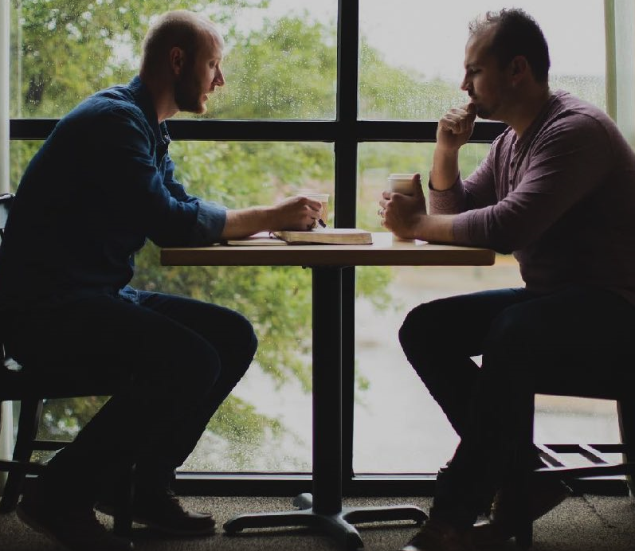
En sus grupos hable sobre:
¿Qué significa que el discipulado solo ocurre?
  De cerca
  En persona
  Con el tiempo
Notes:
In your groups talk about:
What it means that discipleship only happens
Up close
Personal
Over time
Do you have any questions or comments about the Discipleship Plan?

Slide 29
Base Bíblica de los componentes de un discípulo de Jesús:
  El Gran Mandamiento
  La Gran Comisión
Notes:
Ingredients of a Disciple of Jesus
We become like Jesus by maturing in all of the ingredients of a disciple.
The Biblical basis of the ingredients of a disciple of Jesus are:
The Great Commandment (Matt. 22:37-39)
Love the Lord
Love your neighbor
The Great Commission (Matt. 28:19-20)
Make disciples of all nations
Obey everything I have commanded you

Slide 30
Proceso de Discipulado de Fundamentos
Evangelismo | Discipulado
1. Venir | 2. Crecer | 3. Servir | 4. Ir
Adoración Compañerismo | Palabra de Dios Oracion | Servicio | Evangelismo
9-10
Notes:
Ingredients of a disciple of Jesus:
Worship, Fellowship, God’s Word, Prayer, Service, and Outreach
These ingredients provide a summary of all of Jesus’ commands
The Bible is not a menu that we use to choose what areas we want to obey.
A disciple needs to grow spiritually in all these areas
Foundations Discipleship Process
Jesus used four distinct training phases to make His disciples and we do the same thing.
We follow a process of Come-Grow-Serve-Go.
This figure shows how all of the ingredients of a disciple are included in the discipleship process.
Unless we use the same ingredients and the same process Jesus used,
we won’t make the kind of disciples Jesus wants us to make.
Foundations Group members stay with the same group
and the same leader through the Foundations study
This way they maintain the relationships they started with.
This is the same way Jesus trained His disciples.

Slide 31
Material de Fundamentos
Puede usarse para discipular a una persona
  con 2-10 otras personas
Venir - Venir y conocer a Dios y a su pueblo
Crecer - Crecer en tu relación con Dios.
Servir - Servir dando y cuidando a los demás
Ir - Ir y haced discípulos
10
Notes:
Foundations Material
The Foundations material can be used for one-on-one discipleship
or with 2-10 other people
Foundations is a series of topical Bible studies:
Come and get to know God and His people. This is where we learn who God is and the importance of fellowship with other Christians.
Grow in your relationship with God. Learn how to grow spiritually through God’s Word and prayer.
Serve by giving and caring for others. Learn about your spiritual gifts and abilities and how to give to and serve God and others.
Go and make disciples. Invest in the lives of others and invite them to know the Lord when they are ready. Then we make disciples by helping them go through this process of Come-Grow-Serve-Go.

Slide 32
Características de la Sección “Venir”
Evangelización
Relaciones y confianza, no entrenamiento
Enfatizamos ánimo
Divertirse juntos
Es mejor reunirse en una casa privada o en otro lugar neutral
Los creyentes aprenden cómo ayudar a los incrédulos a aceptar a Cristo
Notes:
Distinctives of the “Come” Section
Evangelism
Help people find out who the God of the Bible is
and to give them enough information
so that they can make an informed decision to receive Christ for eternal life.
We are developing relationships and trust rather than engaging them in training.
We emphasize encouragement and not accountability.
Having fun together is very important.
It is best to meet in someone’s home or another neutral location.
Believers should go through the Come section in a Foundations Group
for their own spiritual growth
and to see how to help an unbeliever get to know who God is
and how to help them receive Christ for eternal life.

Slide 33
Características de la
"Crecer, Servir, e Ir" Secciones
Discipulado
Compromiso, disciplina, y responsabilidad
Hábitos Cristianos
Relaciones mas profundas
Ministerio
Estos grupos pueden reunirse en hogares, lugares neutros, o en la iglesia.
Notes:
Distinctives of the “Grow, Serve, and Go” Sections
Discipleship
Growing to be a spiritually mature follower of Jesus, a disciple.
Increasing Commitment, Discipline, and Accountability
Focus on Christian Habits like prayer and Bible study
The focus changes from basic beliefs to basic habits.
Deeper Relationships
We are developing authentic Christian relationships
where people can share their hurts and experience real life change.
Continue to have fun together
Ministry
Learn about serving, giving, and outreach
You can meet in homes, neutral locations, or in the church.

Slide 34
¿A quién puede invitar
a estar en su Grupo de Fundamentos?
1. Familia cercana
2. Parientes
3. Amigos cercanos
4. Vecinos y compañeros de trabajo
5. Conocidos
6. Miembros de la iglesia
Notes:
Who can you invite to be in a Foundations Group?
Immediate family
Relatives
Friends
Neighbors and work associates
Acquaintances
Church members
Have participants write names on index cards

Slide 35
En sus grupos hable sobre:
¿Qué desafíos has tenido al entrenar líderes para hacer discípulos?
Notes:
In your groups talk about:
What challenges have you had in training leaders to make disciples
Ask participants to share what they talked about and if they have any questions

Slide 36
Multiplicar Discípulos por Aprendizaje
Capítulo 4
Proceso de Aprendiz
4. Entrenamiento Inicial
3. Observar al Líder
2. Escoger
1. Modelar
13
Notes:
Multiply Disciples by Apprenticeship
Chapter 4
Apprenticeship Process with a Foundations Group or One-on-One
Model how to lead Foundations
Choose the right people
Only a few people have the gifts, abilities, and calling to be Foundations leaders.
They understand this is about life change and not just learning information
They are: Faithful, Available, Teachable
It may be apparent early on or it may take a while to know if the person is capable of being a Foundations leader
Ask the potential apprentice to observe you lead
Initial Leader Training using the “Foundations Leader Training Guide”

Slide 37
8. Entrenamiento Continuo
7. Líder
6. Co-Líder
Proceso de Aprendiz
5. Observar y Adiestrar
4. Entrenamiento Inicial
3. Observar al Líder
2. Escoger
1. Modelar
13
Notes:
Observe and Coach them leading several sections of Foundations
Go through the Pre-Meeting Reminders with them before the meeting
Observe them as they lead
Coach them afterward using the Post-Meeting Evaluation
Use mostly encouragement.
Make needed suggestions in a positive way
Ask them to be a co-leader
Allow them to lead on a regular basis
Observe and coach them as above using the Foundations Meeting Checklist
Do this until you think they are ready to lead
Ask them to be the leader of Foundations with a group or one-on-one
Ongoing training with other Foundations leaders

Slide 38
8.6 Billones
El Poder de la Multiplicación
Discípulos
17 millón
16,000
1
16
1
5
10
15
20
25
30
34
Años
Notes:
The Power of Multiplication
The Great Commission can be finished in one generation by just one disciple
if each disciple makes one multiplying disciple every year
Growth starts slowly: 1, 2, 4, 8, 16, etc.
But growth reaches the entire population of the world in only 34 years
This is exponential growth

Slide 39
16,000
Pero ¿qué pasa con tu Comunidad?
4,000
Discipulos
512
128
1
4
16
1
5
10
15
Años
Notes:
If you start making disciples who will multiply every year,
You will have made 16,000 multiplying disciples in your community in 15 years

Slide 40
En sus grupos hable sobre:
¿Qué pasaría en nuestras iglesias si empezáramos a multiplicar discípulos en nuestras iglesias en lugar de agregarlos?
Notes:
In your groups talk about
What would happen in our churches if we started multiplying disciples in our churches instead of adding them
Ask participants to share what they talked about and if they have any questions

Slide 41
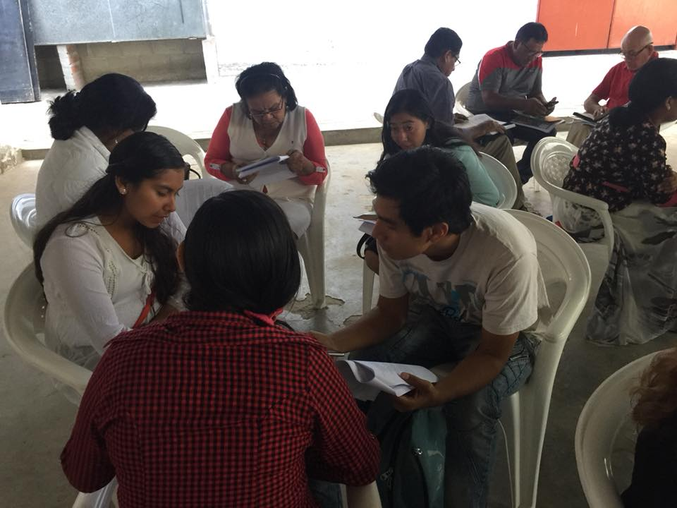
Cómo Dirigir una Reunión de Fundamentos
Capítulo 5
Prepare su propio estudio
Ore
Utilice la Lista de Verificación de las Reuniones de Fundamentos
Haz preguntas, no sermones
15
Notes:
How to Lead a Foundations Meeting
Chapter 5
Prepare your own study
Pray
Pray as you prepare each study
Pray before and after each meeting.
Pray every week for each group member by name.
Use the Foundations Meeting Checklist before and after each meeting.
Ask questions, don’t lecture

Slide 42
Cómo Dirigir una Reunión de Fundamentos
Si alguien está hablando demasiado, dirija una pregunta a otra persona.
Debe asegurarse de que todos estén participando
Ayude a todos a sentirse valorados
Mantenlo simple
15
Notes:
If someone is talking too much, direct a question to someone else
Make sure everyone participates
Help everyone feel valued
It is important that you give some positive response to every answer
Keep it simple for unbelievers and new believers.

Slide 43
Cómo Dirigir una Reunión de Fundamentos
Las Relaciones son importantes
No se sienta con la obligación de cubrir cierta cantidad de material en cada reunión
Comience y termine a tiempo
Durante la primera reunión:
  Explique la importancia de la confidencialidad
15
Notes:
Relationships are important and take time to develop.
Emphasize having fun
Don’t feel that you must cover a certain amount of material at each meeting.
Start and end on time
It’s good to stay afterward and talk with those who want to.
During the first meeting:
Explain the importance of confidentiality
Explain that this will be a short term group and that the duration varies from group to group.
Toward the end of the Come section, let the members know that they can continue into the Grow section

Slide 44

Recordatorios Pre-Reunión
No hables demasiado
Recuerda que Dios es el maestro
Haz preguntas y escucha
Mantenlo simple
Asegúrate que todos participen
Da retroalimentación positiva
Notes:
Pre-Meeting Reminders
Don’t talk too much
Remember that God is the teacher
Ask questions and listen
Help people self-discover
Keep it simple for unbelievers and new believers.
Make sure everyone participates
Give positive feedback to every answer
We will look at the post-meeting evaluation after you have led a group
Read “How to Lead a Foundations Meeting” before you lead a Foundations meeting

Slide 45


Slide 46
Fundamentos
Venir, Capitulo 1
El entrenador lidera
3
Notes:
Trainer leads 4 volunteers for 15-30 minutes
Trainer has first person read: Table of Contents
Trainer has next person read: Introduction
Trainer reads: Chapter 1, Your Heavenly Father
God’s Nature
What do the following verses teach you about God’s nature?
a. Trainer has next person read Psalm 107:1 and the answer underlined:
Trainer asks next person:
b. What does Romans 8:28 teach you about God’s nature?
The trainer asks the group:
Q. In what things does God work out for your good?
Q. What does “all” mean?
Q. Does this include the bad experiences in your life?
Trainer asks next person:
c. What does Malachi 3:6 teach you about God’s nature?
Trainer asks the group:
Q. Why is it important that God doesn’t change?
Trainer asks the group:
2. What is your response to these facts about God?
Trainer asks next person to read the summary.
Etc.

Slide 47
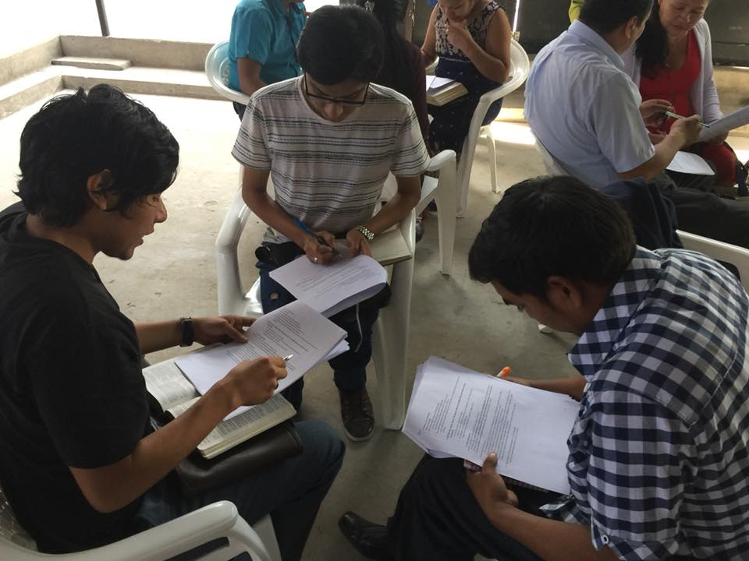
Fundamentos
Venir, Capitulo 2
Formar grupos de 2-5 personas
Cada grupo elige un líder
6
Notes:
Form groups of 2-5 people
Each group chooses a leader
Trainer coaches the groups
Stop the groups after 15-30 minutes depending on time available

Slide 48
Fundamentos
Venir, Capitulo 3
Elige un nuevo líder
10
Notes:
Each group chooses a new leader
Trainer coaches the groups
Stop the groups after 15-30 minutes depending on time available

Slide 49
Fundamentos
Venir, Capitulo 4
Elige un nuevo líder
14
Notes:
Each group chooses a new leader
Trainer coaches the groups
Stop the groups after 15-30 minutes depending on time available

Slide 50
La Evaluación Después de la Reunión
¿Cuáles fueron algunas de las experiencias positivas durante el tiempo del grupo?
¿Participaron todos?
¿Fueron mis reacciones positivas a las respuestas?
¿Hablé demasiado?
¿Alguien más habló demasiado?
¿Nos desviamos Del tema?
¿Lo mantuve simple para los no creyentes y los nuevos creyentes?
¿Otros observaciones?
Guía de Entrenamiento
para el Líder
Notes:
In your groups use these questions to evaluate the experience.
Post-Meeting Evaluation
What were some positive experiences?
Did everyone participate?
Did I give positive feedback to every answer?
Did I talk too much?
Did someone else talk too much?
Did we get off track during the meeting?
Did I keep it simple for unbelievers and new believers?
Other observations?
Ask them to share some of their observations
What questions do you have?

Slide 51
Esenciales de Fundamentos
Meta de Jesús: Terminar la Gran Comisión
Método de Jesús: Multiplicar discipulos
Modelo de Jesús: Entrenar líderes por aprendizaje
Notes:
Foundations Essentials
Jesus’ Goal: Finish the Great Commission
Jesus’ Method: Make multiplying disciples
Jesus Model: Train leaders by apprenticeship
Initial training with the Foundations Leader Training Guide
Apprenticeship
Ongoing training in the Foundations Leader Team

Slide 52
Esenciales de Fundamentos
Material
  Fundamentos Material de Discipulado
  Fundamentos Guía de Entrenamiento para el Líder
Dios es el Maestro.
  Hacer preguntas, no sermones
Notes:
Foundations Essentials
Material
Foundations Discipleship Material
Follows Jesus’ process of sequential learning
Come, Grow, Serve, Go
Includes all of the ingredients of a disciple (“obey everything I have commanded you”)
Worship, Fellowship, God’s Word, Prayer, Service, Outreach
Foundations Leader Training Guide
God is the teacher
We facilitate discussion by asking questions, we don’t lecture.
We help people self-discover and apply God’s Word to their lives

Slide 53
Implementación
1. Hacer discípulos
  Con una persona o un grupo
  Usar material de Fundamentos
2. Entrenar a un aprendiz
  Multiplicar discipulos
  Utilice la Fundamentos Guía de Entrenamiento para el Líder
Notes:
Implementation
1. Make disciples
With one person or a group
Use Foundations material
2. Train an apprentice
To multiply disciples
Use the Foundations Leader Training Guide

Slide 54

Preguntas y Comentarios
Notes:
Questions and Comments

Slide 55
Felicitaciones
Terminado
Taller 1
Notes:
Congratulations!
You have finished
Workshop 1
Thank them for their participation

Slide 56

Taller 2
Equilibrio Entre Vida Personal y Ministerio
Vida Personal
Ministerio
Notes:
Workshop 2
Balancing Personal Life and Ministry
God’s Mission
Leading a Balanced Christian Life
Personal Challenges
Setting Goals for Personal Development
Accountability Partner
Talk about when the next workshop will be
Ask the host to close in prayer
Take a group photo

