Slide 1
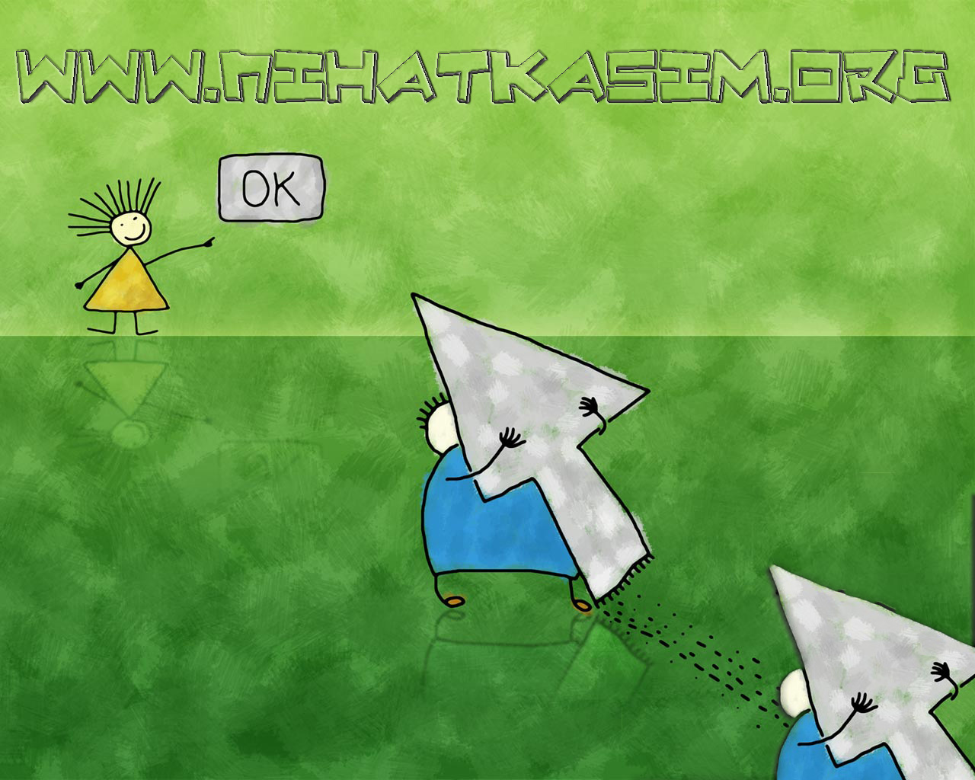
PRESENTS
TO BE
IN PRESENT TENSE
(am, is, are)

Slide 2
To be is “am, is, are” in present.
TO BE IN PRESENT
I am a student.
to be
Yes, She is a student.

Slide 3
To be is “am, is, are” in present.
TO BE IN PRESENT
POSITIVE
to be
I
am
happy.

Slide 4
To be is “am, is, are” in present.
TO BE IN PRESENT
NEGATIVE
to be
I
not
am
happy.
“not” comes here

Slide 5
To be is “am, is, are” in present.
TO BE IN PRESENT
QUESTION
I
am
happy.
“to be” comes at the beginning of the sentence.

Slide 6
To be is “am, is, are” in present.
POSITIVE
TO BE IN PRESENT
I
You
He
She
It
We
You
They
am
are
is
is
is
are
are
are
a student.
a teacher.
in our class.
happy.
black.
students.
friends.
brothers.

Slide 7
To be is “am, is, are” in present.
NEGATIVE
TO BE IN PRESENT
I
You
He
She
It
We
You
They
am
are
is
is
is
are
are
are
not
not
not
not
not
not
not
not
a student.
a teacher.
in our class.
happy.
black.
students.
friends.
brothers.

Slide 8
To be is “am, is, are” in present.
QUESTION
TO BE IN PRESENT
I
You
He
She
It
We
You
They
am
are
is
is
is
are
are
are
not
not
not
not
not
not
not
not
a student.
a teacher.
in our class.
happy.
black.
students.
friends.
brothers.

Slide 9
TO BE IN PRESENT
EXERCISES
I am an engineer.
Am I an engineer?
I am not an engineer.

Slide 10
TO BE IN PRESENT
EXERCISES
You are in the office.
Are you in the office?
You are not in the office.

Slide 11
TO BE IN PRESENT
EXERCISES
This is my computer.
Is this my computer?
This is not my computer.

Slide 12
TO BE IN PRESENT
SHORT FORMS
I am
You are
He is
She is
It is
We are
They are
I’m
You’re
He’s
She’s
It’s
We’re
They’re

Slide 13
TO BE IN PRESENT
SHORT FORMS
I am not
You are not
He is not
She is not
It is not
We are not
They are not
I’m not
You aren’t
He isn’t
She isn’t
It isn’t
We aren’t
They aren’t

Slide 14
TO BE IN PRESENT
EXERCISES
We aren’t from İstanbul. We’re from Kocaeli.
She isn’t my sister. She’s my friend.
We’re students. We aren’t teachers.
They aren’t blue. They’re black.
My car isn’t BMW. It’s Anadol.

Slide 15
TO BE IN PRESENT
SHORT ANSWERS
Are you a student? Yes, I am. or No, I am not.
Am I in this class? Yes, you are. or No, you aren’t
Is it big? Yes, it is. or No, it isn’t.
Is she your sister? Yes, she is. or No, she isn’t.
Is he from Darıca? Yes, he is. or No, He İsn’t.
Are we friends? Yes, we are. or No, we aren’t.
Are they brothers? Yes, they are. or No, They aren’t.

Slide 16
TO BE IN PRESENT
EXERCISES
-Is he a child?
-No, he isn’t. He is an adult.
-Is he a cleaner?
-No, he isn’t. He is a teacher.

Slide 17
TO BE IN PRESENT
EXERCISES
She is a nurse.
My car isn’t blue.
They are happy.
My father isn’t 45.
Our school is big.
This movie is boring.
My friends aren’t lazy.
Is she a nurse?
Is my car blue?
Are they happy?
Is my father 45?
Is our school big?
Is this movie is boring?
Are your friends lazy?
Yes, She is.
No, It isn’t.
Yes, they are.
No, he isn’t.
Yes, it is.
Yes, it is.
No, They aren’t.

Slide 18
IF IT IS NOT CLEAR ASK YOUR TEACHER AGAIN!
PLEASE VISIT
WWW.NIHATKASIM.ORG
TO DOWNLOAD THIS LESSON.
THANKS!

