Slide 1
THIS THESE THAT THOSE

Slide 2
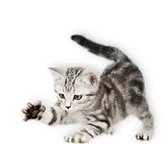
THIS – THESE, THAT - THOSE
THIS
One cat (singular)
very close
This is a cat.

Slide 3
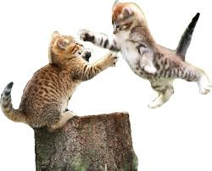
THIS – THESE, THAT - THOSE
THESE
Two or more cats (plural)
Very close
These are cats.

Slide 4
THIS – THESE, THAT - THOSE
One cat (singular)
Two or more cats (plural)
Very close
THIS
THESE

Slide 5
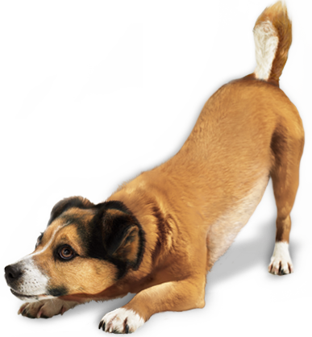
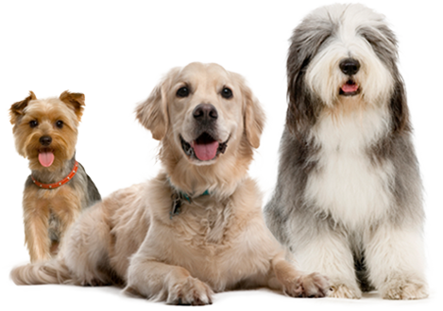
THIS – THESE, THAT - THOSE
EXERCISES
This is a dog.
These are dogs.

Slide 6
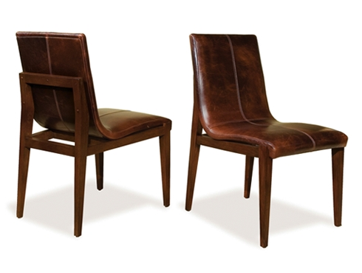
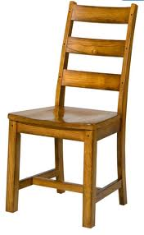
THIS – THESE, THAT - THOSE
EXERCISES
This is a chair.
These are chairs.

Slide 7
THIS – THESE, THAT - THOSE
Not very close
One chair (singular)
THAT
That is a chair.

Slide 8
THIS – THESE, THAT - THOSE
Not very close
THOSE
Two or more chairs (plural)
Those are chairs.

Slide 9
THIS – THESE, THAT - THOSE
One chair (singular)
Two or more chairs (plural)
Not very close
Those are chairs.
That is a chair.

Slide 10
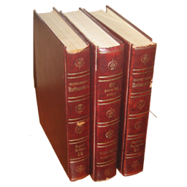
THIS – THESE, THAT - THOSE
EXERCISES
Those are books.
That is a book.

Slide 11
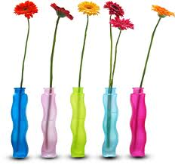
THIS – THESE, THAT - THOSE
EXERCISES
Those are flowers.
That is a flower.

Slide 12
THIS – THESE, THAT - THOSE
Those
These are books.
That
This is a flower.

Slide 13
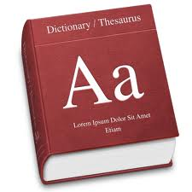
THIS – THESE, THAT - THOSE
EXERCISES
________ is a dictionary.
This
These
Those
That

Slide 14
THIS – THESE, THAT - THOSE
EXERCISES
________ flowers are red.
This
These
Those
That

Slide 15
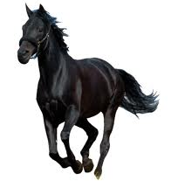
THIS – THESE, THAT - THOSE
EXERCISES
________ is a black horse.
This
These
Those
That

Slide 16
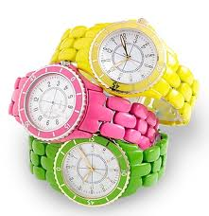
THIS – THESE, THAT - THOSE
EXERCISES
________ watches are great.
This
These
Those
That

Slide 17
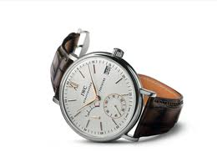
THIS – THESE, THAT - THOSE
EXERCISES
________ watch is my watch.
This
These
Those
That

Slide 18
THANKS
Please visit
www.nihatkasim.org
for more…

