Slide 1
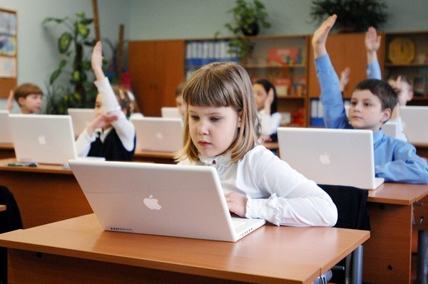
Here we read and write, and draw and count
And then we play and run about
And we make friends, and learn together.
And then we play in sunny weather.

Slide 2


School is fun

Slide 3
The tasks of our lesson are
to tell about school things
to ask your classmate to lend you a thing you need;
to read the text and choose the information we need;
to repeat some verbs in Past Simple form
to make project about class

Slide 4
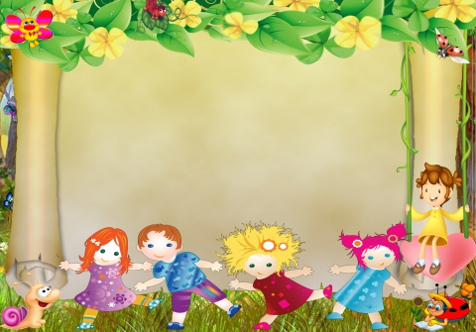

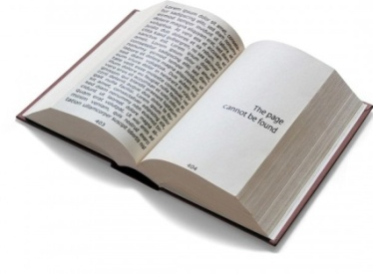
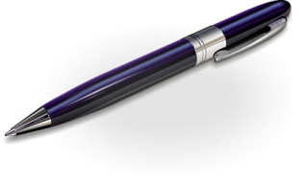
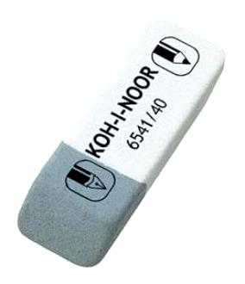
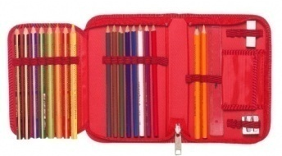



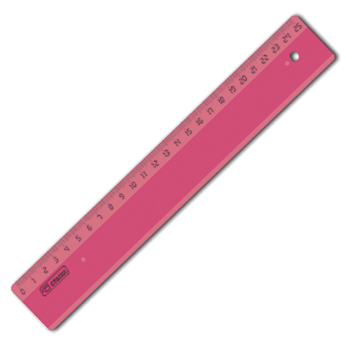
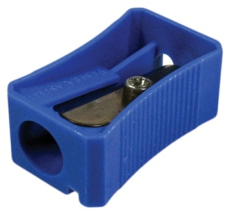
It’s a pencil
It’s a pen
It’s a book
It’s a rubber
It’s a pencil box
It’s an exercise book
It’s colored pencils
It’s a dictionary
It’s a ruler
It’s a pencil-sarpener
h

Slide 5
Now ,lets find all these words in this picture

Slide 6
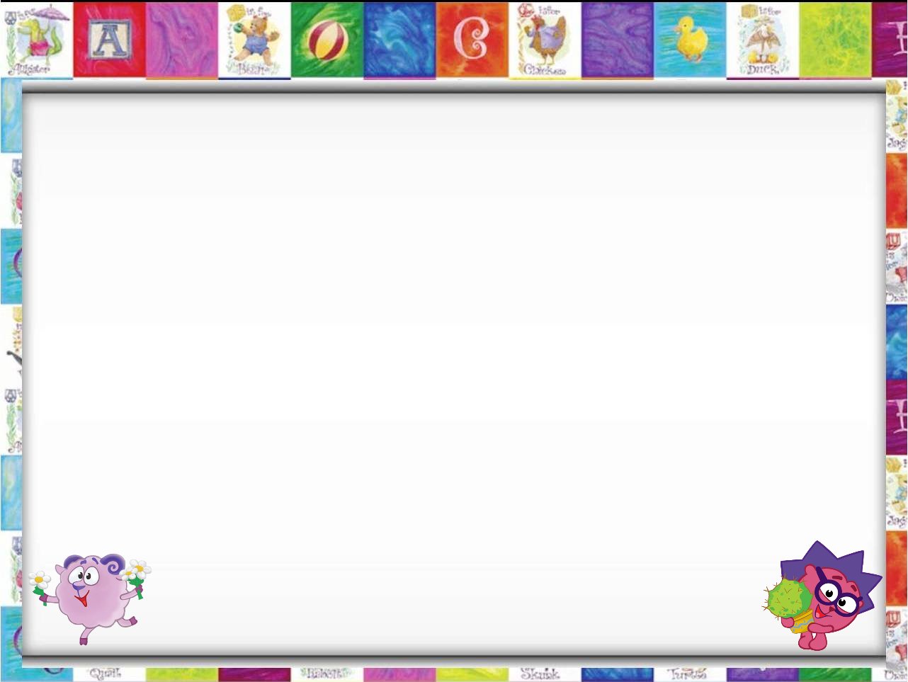
Please read the sentences and give right answer
I draw with a pencil/ a ruler.
I write with a pen /a rubber.
I write in my book / in my exercise book.
I sit on a chair / on a desk.
I go to school with my friends / with my teacher.

Slide 7
Put the sentences in the correct order and act out the dialogues
1)-Yes. Here you are.
-Could you give me a red pencil, please?
-Thank you
2)-It’s OK. I’ll ask Dasha.
-I’m afraid I left it at home.
-Could you give me a rubber, please?
3)- Could you give me a dictionary, please?
-Thank you very much.
-Yes, of course.

Slide 8
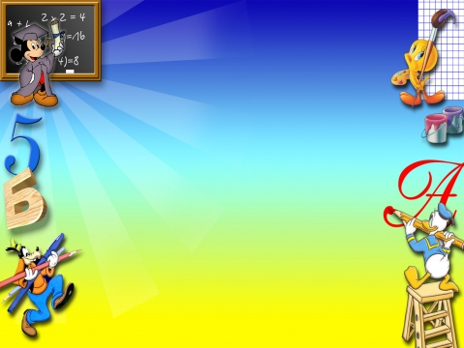
Put the letters
Bla**board, rul**, penc*l, sh**pener, c*mputer, n*tebook, felt-t*p pen, di****nary, cl**sroom, booksh*lf, pl*nt.

Slide 9
Put the letters
Blackboard, ruler, pencil, sharpener, computer, notebook, felt-tip pen, dictionary, classroom, bookshelf, plant.

Slide 10
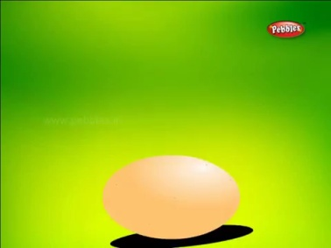
I see you are tired,
lets have a rest. Stand up please

Slide 11
Past Simple
(e)d
II
to walk walked
to go went
Verb

Slide 12
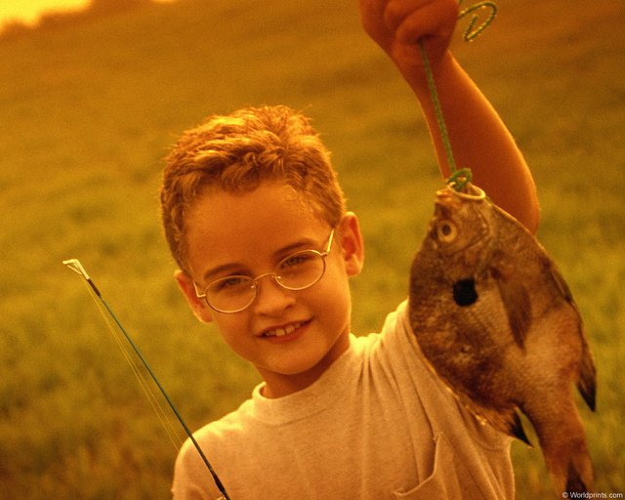
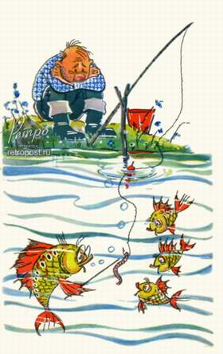
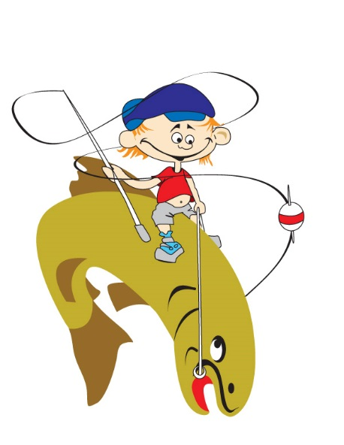
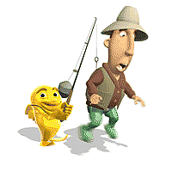
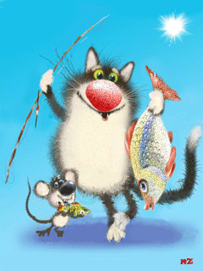

One, two, three, four, five,
Once I caught a fish alive.
Six, seven, eight ,nine,ten,
Then I let it go again.
Why did you let it go?
Because it bit my finger so!
What finger did it bite?
The little finger on the right!

Slide 13
Jason and Becky at school

Slide 14
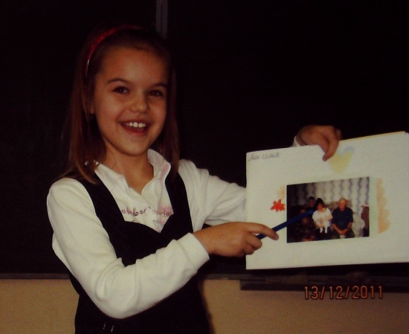
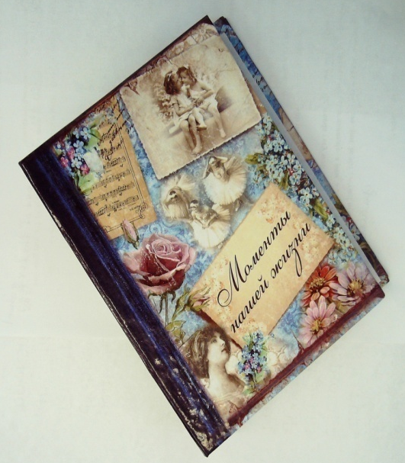
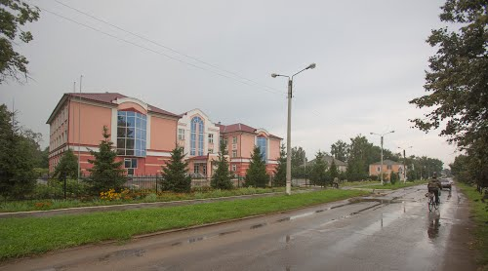
Our projects
tsarapkinaei.ucoz.ru
Проект
по английскому языку
Тема «My school»
(«Моя школа»)

Slide 15



Slide 16



