Slide 1


Building Software Systems for Image-Guided Robot-Assisted Interventions
SSMR/ISMR ‘19 Workshop
Junichi Tokuda¹, Axel Krieger², Tamas Ungi⁴, Simon Leonard³,
¹ Brigham and Women’s Hospital and Harvard Medical School, Boston MA
² University of Maryland, Collage Park, MD
³ Queen’s University, Kingston, ON
⁴ Johns Hopkins University, Baltimore, MD

Slide 2
Acknowledgements
This work is supported in part by:
  U.S. National Institutes of Health (R01EB020667, R01EB020610, P41EB015898).
  Ontario Consortium for Adaptive Interventions in Radiation Oncology (OCAIRO), SparKit project
  CANARIE’s Research Software Program
Contributors:
  Tobias Frank, M.Sc. Leibniz Universität Hannover
  Niravkumar Patel, Ph.D., Johns Hopkins University

Slide 3
Background
Growing Interest in Robot Assisted Interventions
  Robot-assisted laparoscopy
  Robotic catheter systems
  Robotic radiosurgery, etc.
R&D of Surgical Robot System
  Image processing and visualization for surgical planning
  Kinematics and motion planning for robot control
  Device management and control
➔ Requires a wide range of tools and methods developed in robotics and medical image computing fields

Slide 4
Background (2)
Common research platforms
  Medical Image Computing
    3D Slicer
    MITK
    NifTK
    OsiriX…
  Medical Robotics
    da Vinci Toolkit (dVRK)
    Raven II
    KUKA Lightweight Robot
➔ Need for a bridge between ROS and OpenIGTLink
Data sharing interface based on OpenIGTLink
Integrated with
Robot Operating System (ROS)

Slide 5
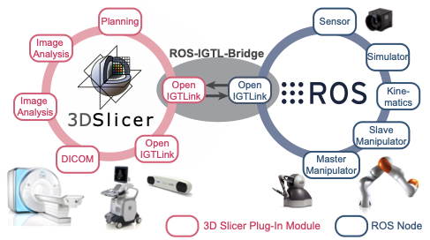
Architecture

Slide 6
Goals of This Tutorial
Prototype surgical robot system using open-source software
  3D Slicer as a planning interface
  Robot Operating System (ROS) as robot control software
  Robot arm (UR-5)
Through this tutorial, you will:
  Learn software architecture and clinical workflow for surgical robot systems
  Acquire hands-on experience of software-hardware integration for medical robotics

Slide 7
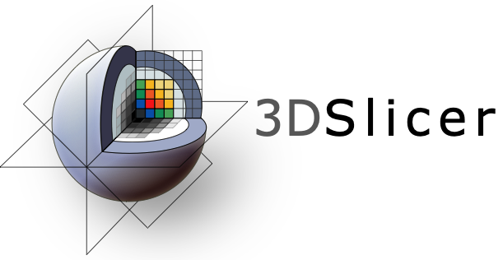
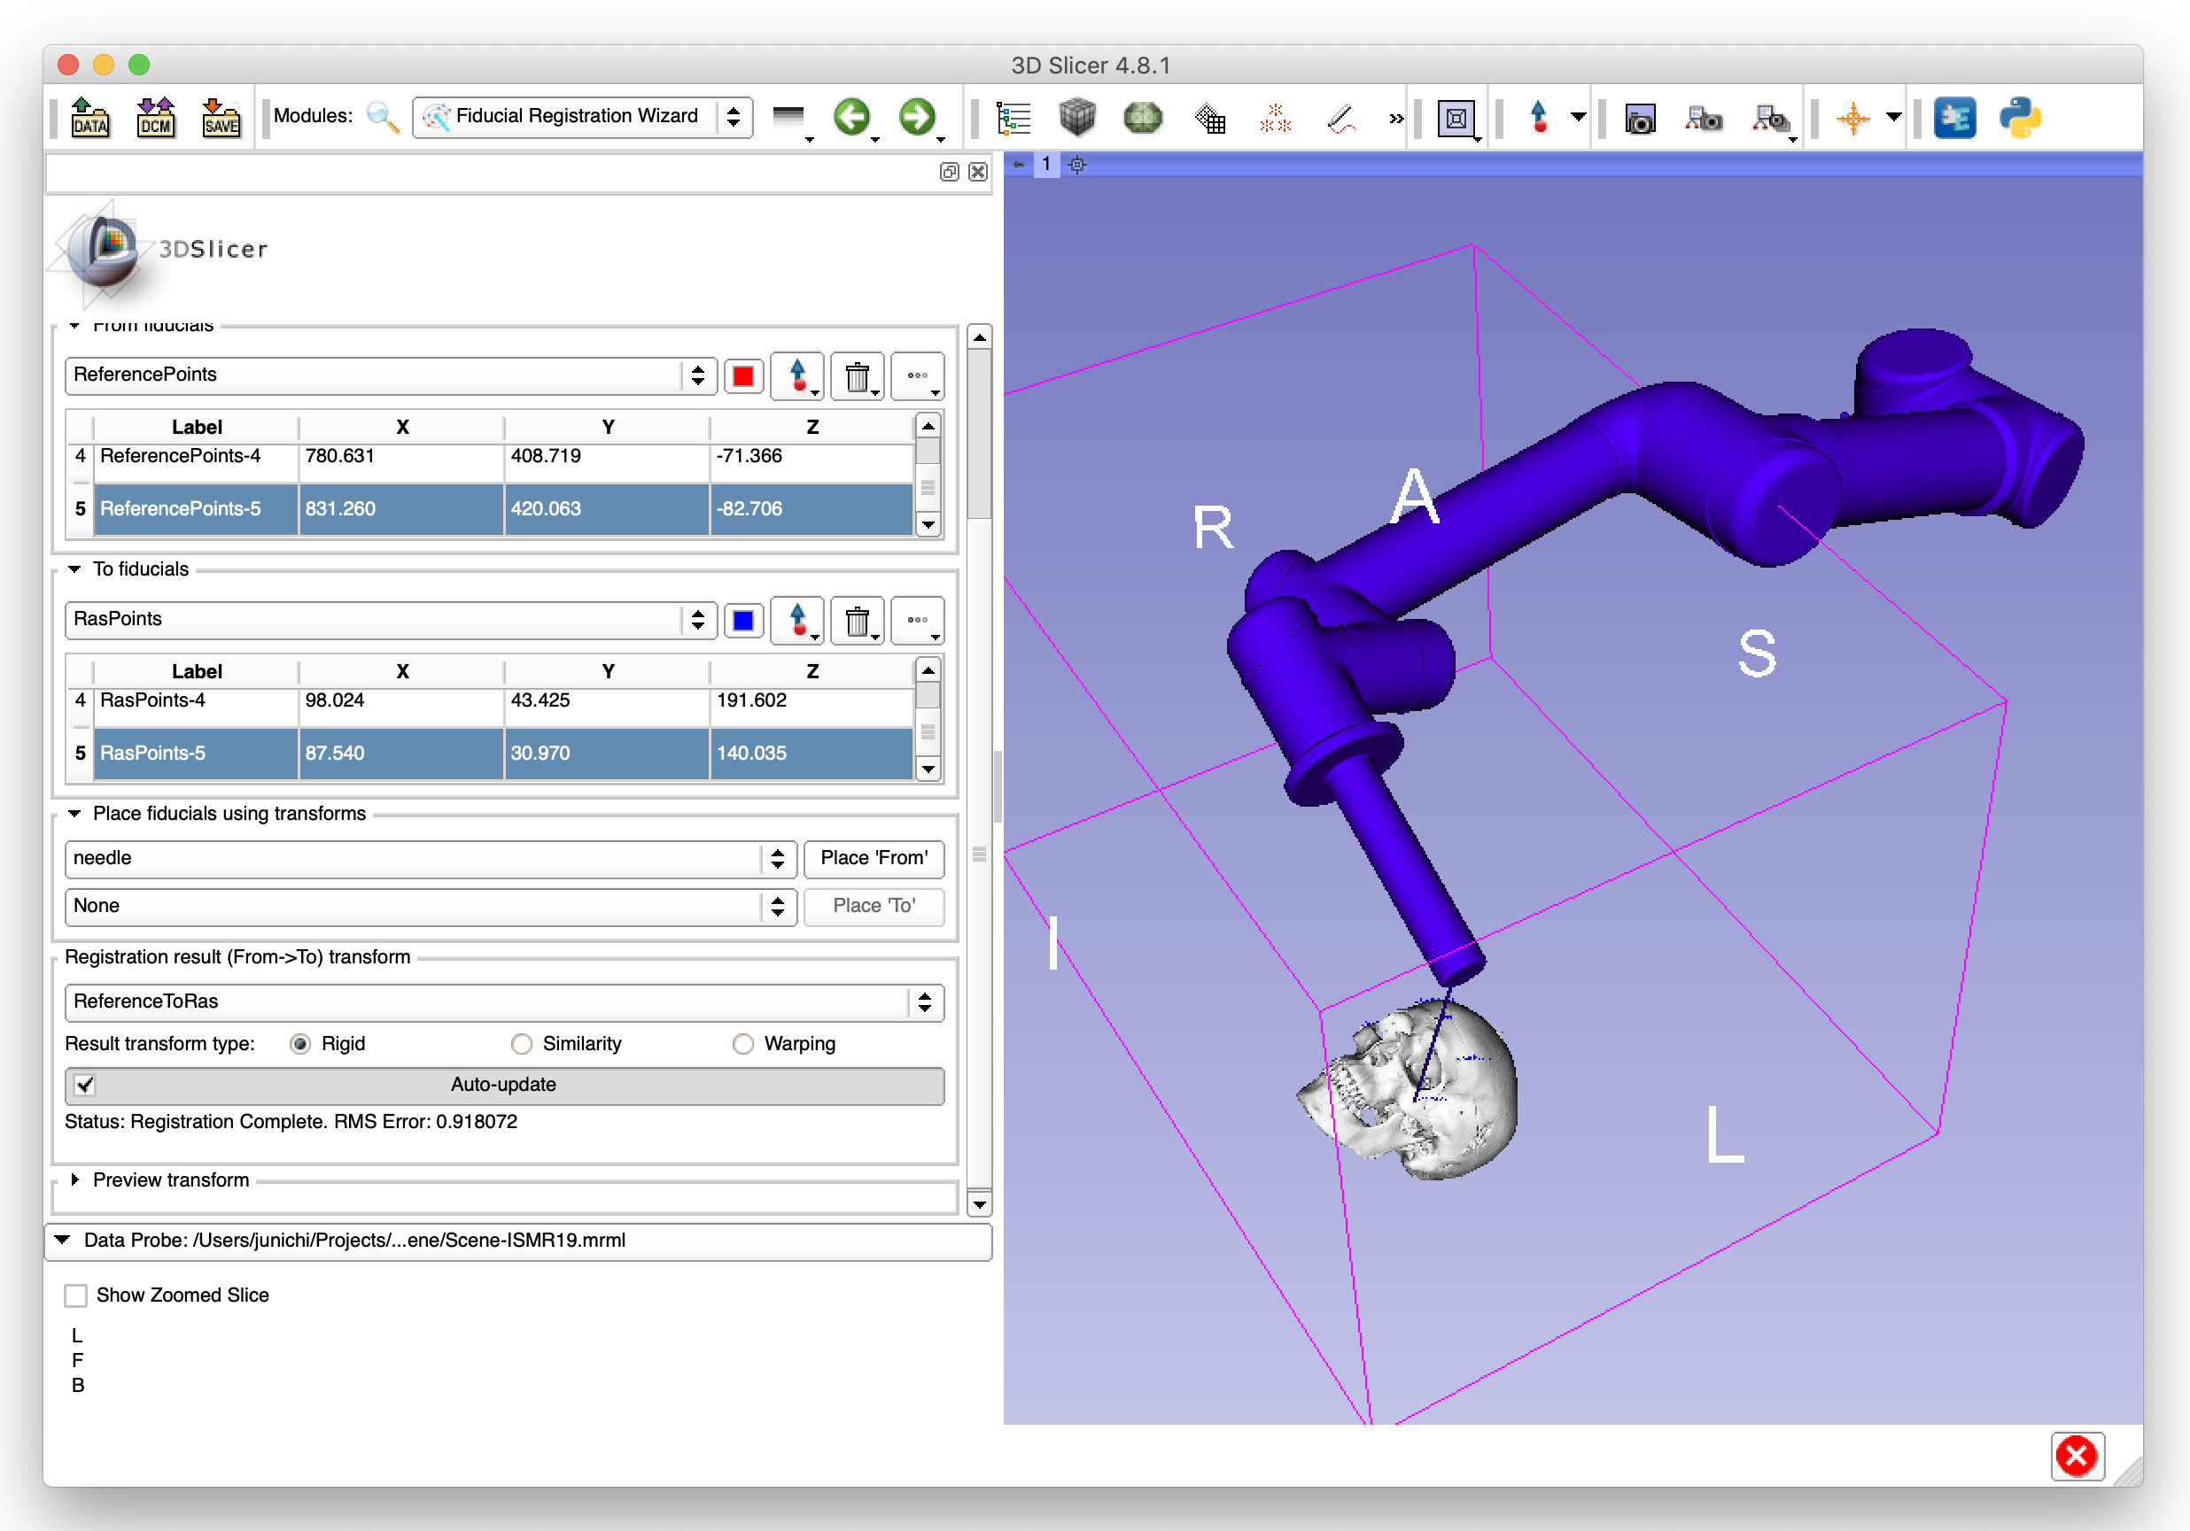
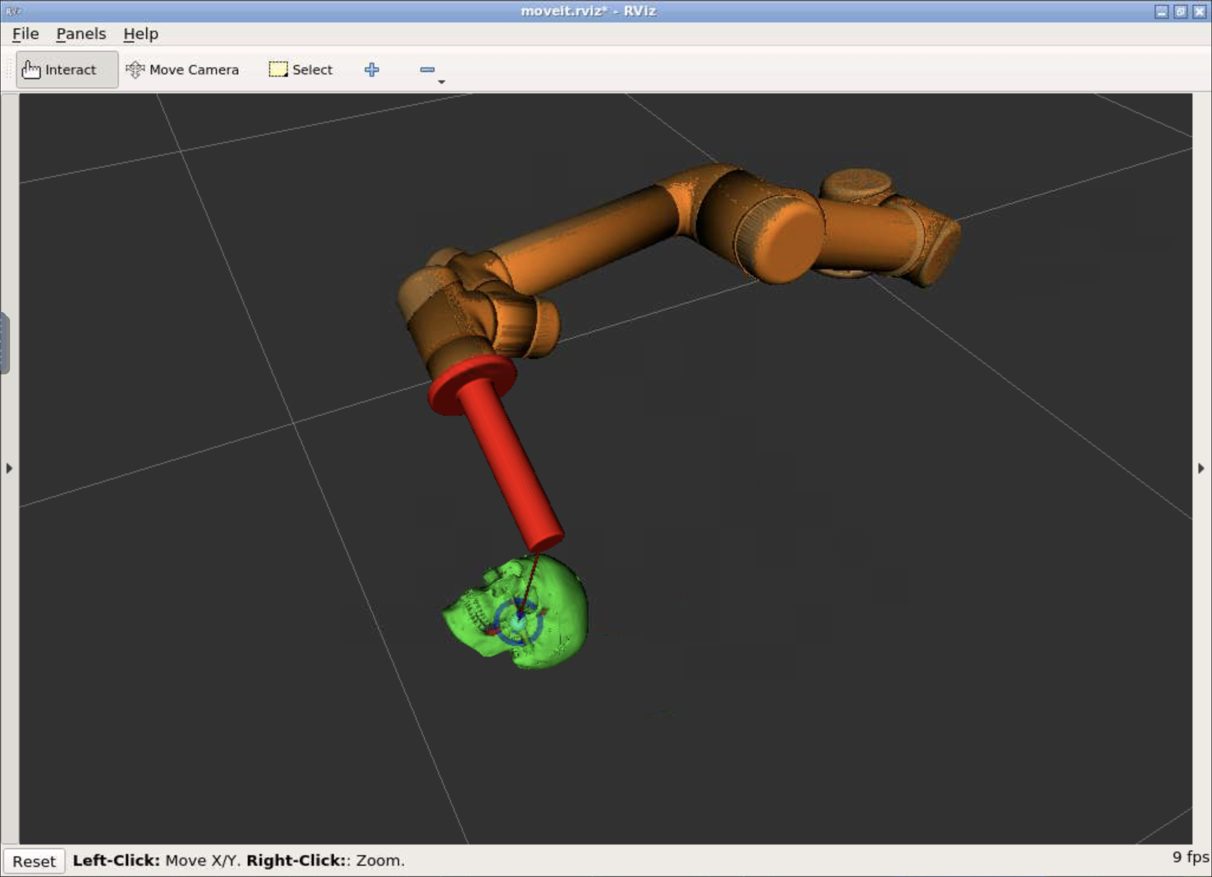
System Diagram for Tutorial
Target/entry points
Positions of links
3D medical image (MRI)
Surgical planning
Procedure monitoring
Robot Arm
Kinematics
Path planning

Slide 8
Challenges…
Exchanging data between two different systems
Two coordinate systems
  Defined by the base link on ROS
  Defined by the patient on 3D Slicer

Slide 9
Prerequisite
Computer with one of the following operating systems:
  Windows 7 or higher (Windows 10 recommended)
  Mac OS X (macOS) 10.7 or higher (macOS Sierra or higher is recommended)
  Linux
Software
  3D Slicer Version 4.8.1* ( http://www.slicer.org/ )
  Docker ( https://wwww.docker.com/ )
  Git Client ( https://git-scm.com/ )
See http://rosmed.github.io/ismr2019/prerequisite for detail.
* Some of the features used in this tutorial have not been supported in Slicer 4.10.x

Slide 10
Step 1: Setting up Environment

Slide 11
Overview of Step 1
Set up ROS – two options:
  [Option 1] Virtual environment (Docker)
  [Option 2] Native Linux machine
Set up 3D Slicer
  SlicerIGT extension (plug-in)
Test communication between ROS and 3D Slicer

Slide 12

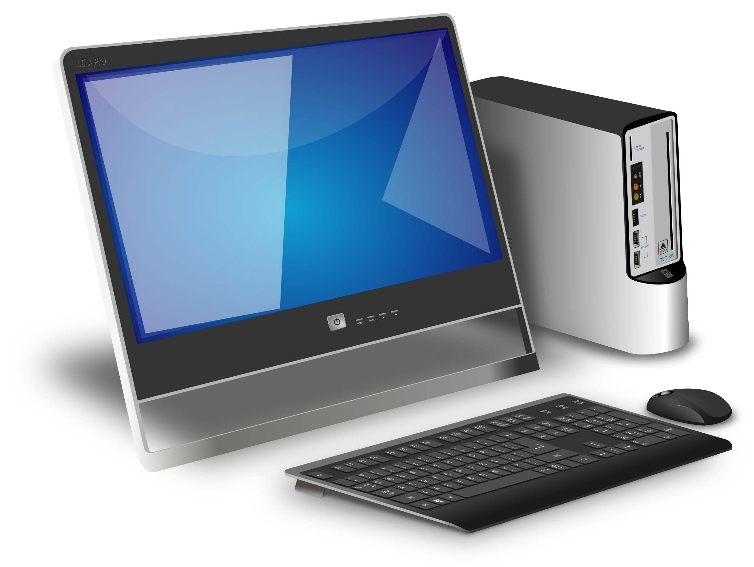
Options for ROS Environment
[Option 1] Virtual environment (recommended for tutorial)
  Runs on the same host where 3D Slicer is installed
  Pre-configured OS image
  Minimum installation effort / no extra cost
  Suitable for learning and prototyping software
[Option 2] Dedicated hardware
  Runs on a dedicated Linux computer
  Performance advantage
  Require Linux installation
  Cost for the computer hardware
  Can be extended for actual system
https://www.goodfreephotos.com

Slide 13


[Option 1] Downloading Docker Image
Pre-configured Docker image contains:
  Ubuntu 16.04
  ROS Kinetic
  OpenIGTLink
  ROS-IGTL-Bridge
  HTML5 VNC (for desktop environment)
To download Docker image, open a terminal on the host and run:
$ docker pull rosmed/docker-ros-igtl

Slide 14
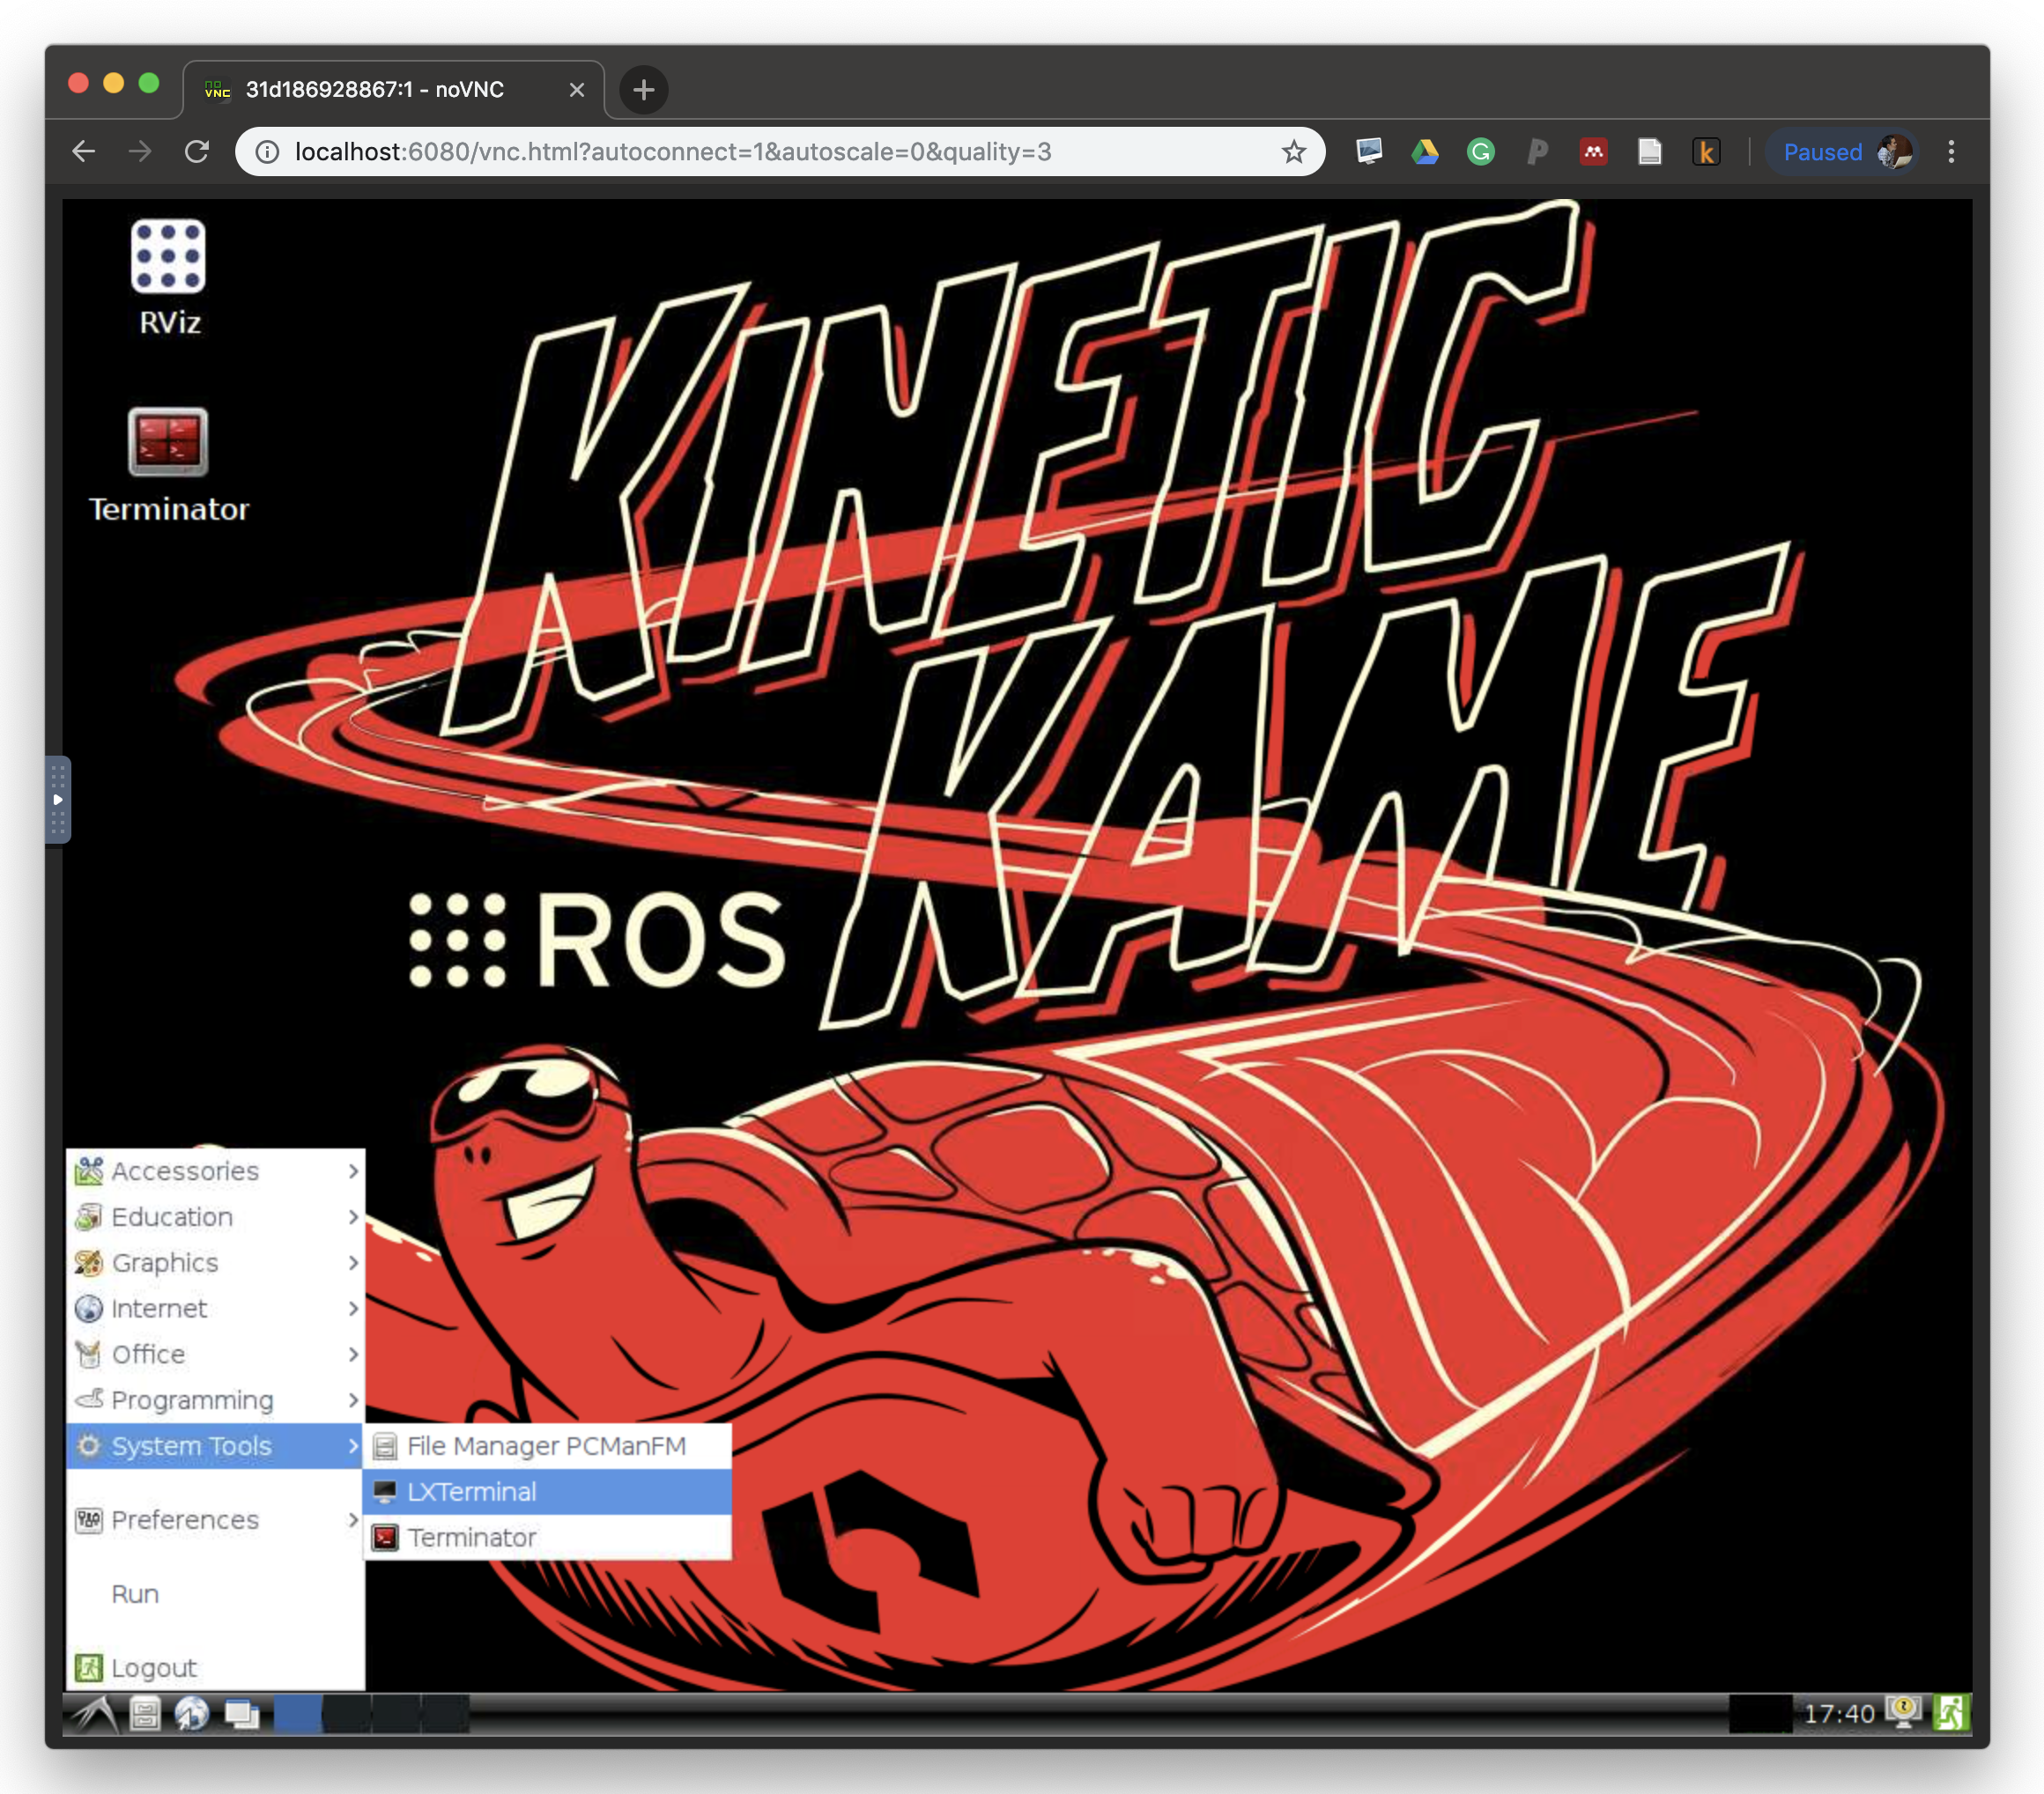
[Option 1] Launching ROS on Docker
From the command prompt on the host :
From an HTML5 web browser
(e.g. Chrome), open:
$ docker run -it --rm -p 6080:80 -p 28944:18944 rosmed/docker-ros-igtl
http://localhost:6080

Slide 15
[Option 2] Setting up ROS Environment
Please follow: http://rosmed.github.io/ismr2019/ros_environment

Slide 16
Installing 3D Slicer (1)
Download 3D Slicer 4.8.1
  Windows: http://slicer.kitware.com/midas3/download/item/329467/Slicer-4.8.1-win-amd64.exe
  Mac: http://slicer.kitware.com/midas3/download/item/330418/Slicer-4.8.1-macosx-amd64.dmg
  Linux: http://slicer.kitware.com/midas3/download/item/330417/Slicer-4.8.1-linux-amd64.tar.gz
Follow instructions at: https://www.slicer.org/wiki/Documentation/4.8/SlicerApplication/Installation

Slide 17
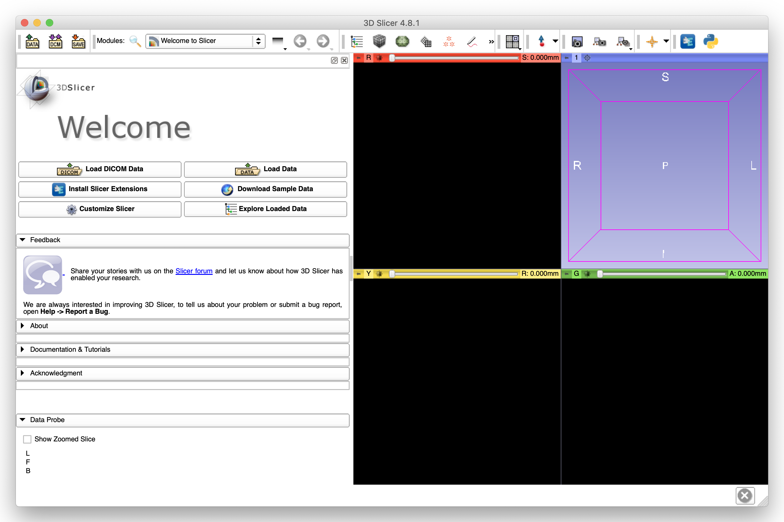
Installing 3D Slicer (2)
After installing 3D Slicer, open Extensions Manager.
1. Click “Extensions Manager”

Slide 18
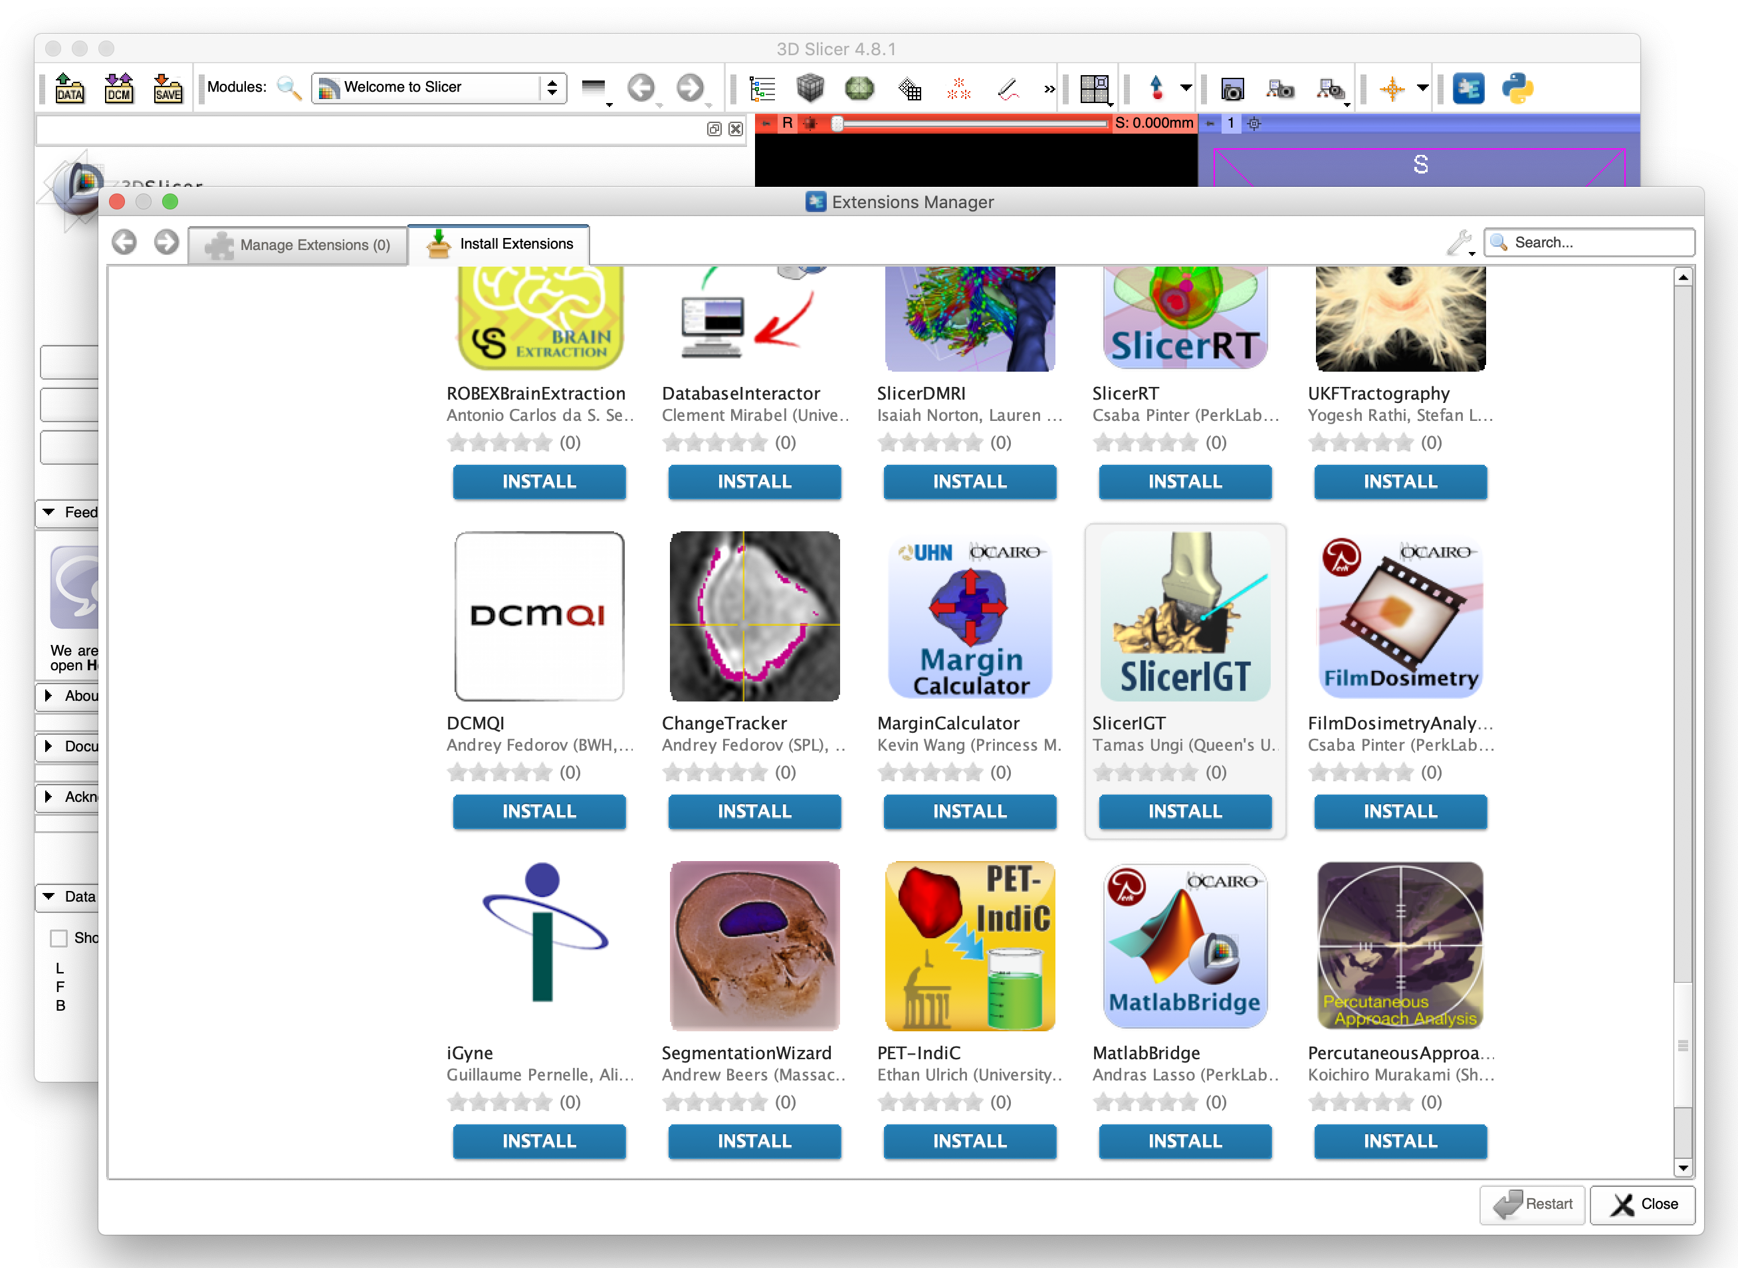
Installing 3D Slicer (3)
Install “SlicerIGT” extension and restart 3D Slicer.
1. Click “INSTALL” for “SlicerIGT”

Slide 19
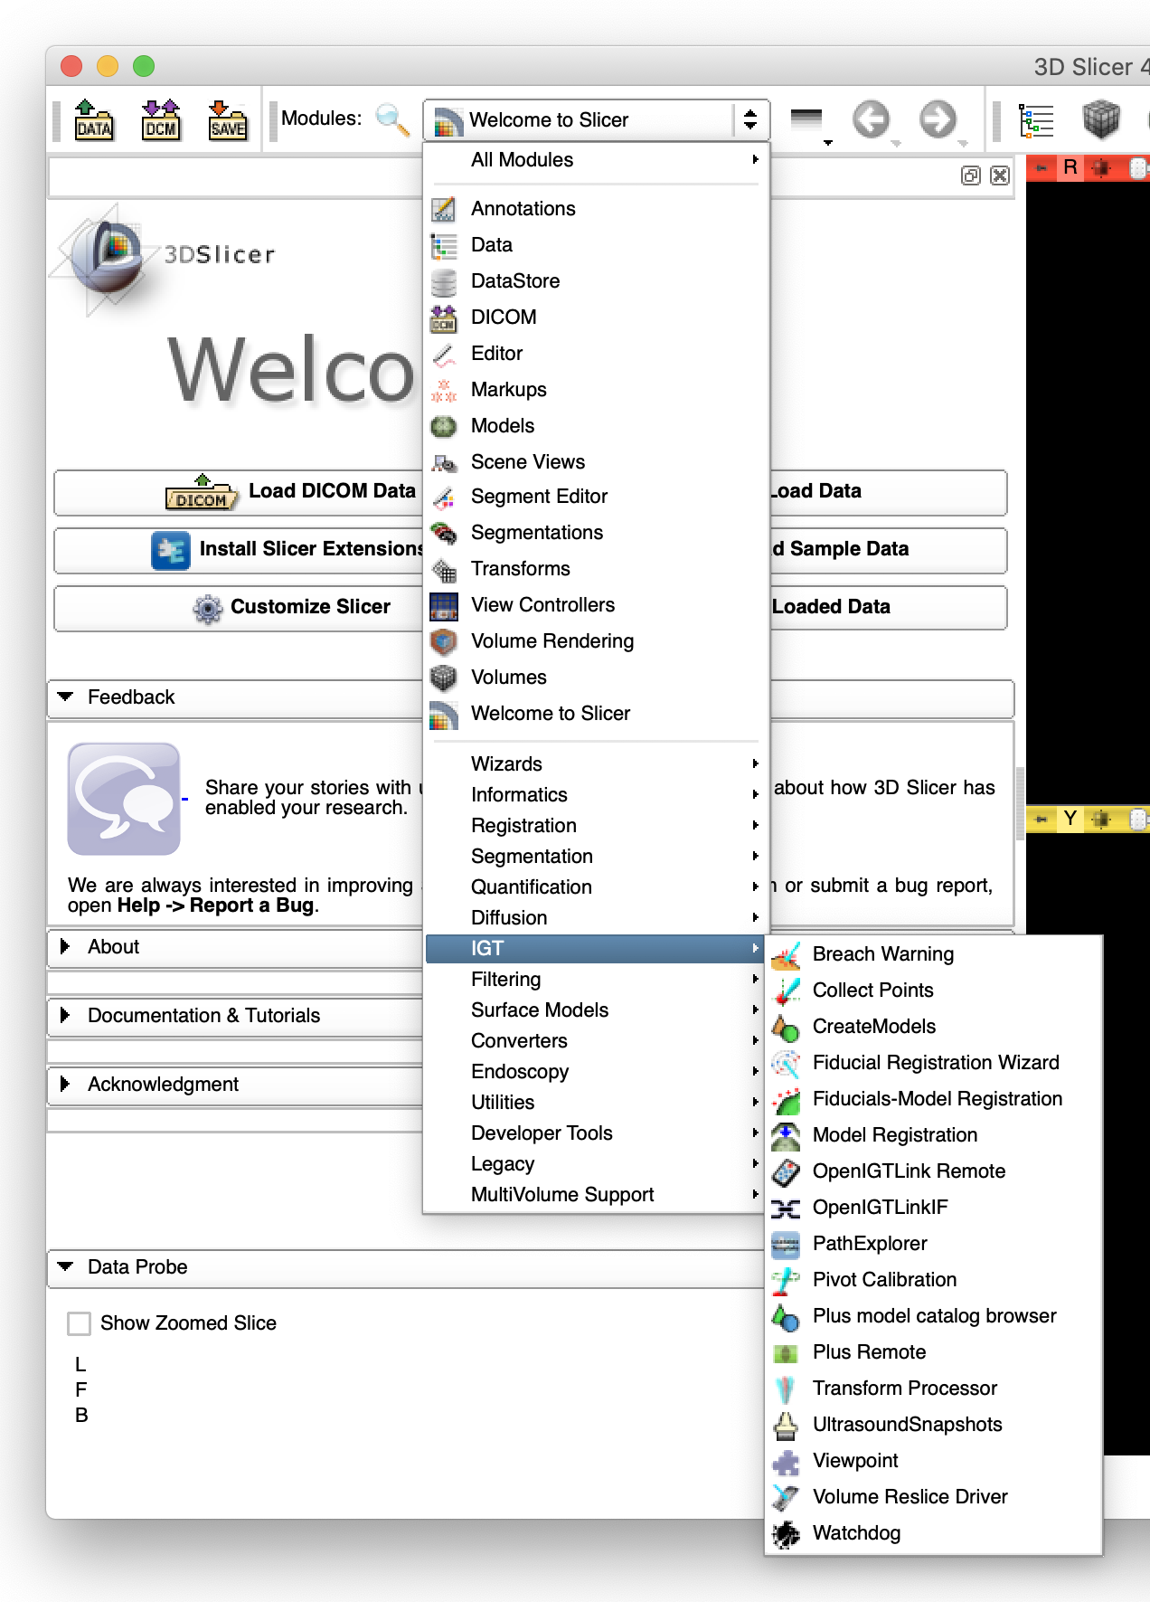
Installing 3D Slicer (4)
Modules for SlicerIGT can be found under “IGT” section of the Modules menu.
1. Click “Modules” menu
2. Select “IGT”
3. SlicerIGT modules

Slide 20
Testing Communication (1)
Open a first terminal on the ROS computer (Menu -> System Tools -> LXTerminal), and start ‘roscore’:
Open a second terminal, and launch the bridge node:
$ roscore
$ cd ~/catkin_ws
$ source devel/setup.bash
$ roslaunch ros_igtl_bridge bridge.launch

Slide 21
Testing Communication (2)
The terminal asks to enter the type. Choose ‘1’ (Server)
Then the terminal asks to enter the port number. Enter ‘18944’.
[ROS-IGTL-Bridge] Please try <1> or <2> to run node as OpenIGTLink client or server:
1: Server
2: Client
1
[ROS-IGTL-Bridge] Input socket port:
18944

Slide 22
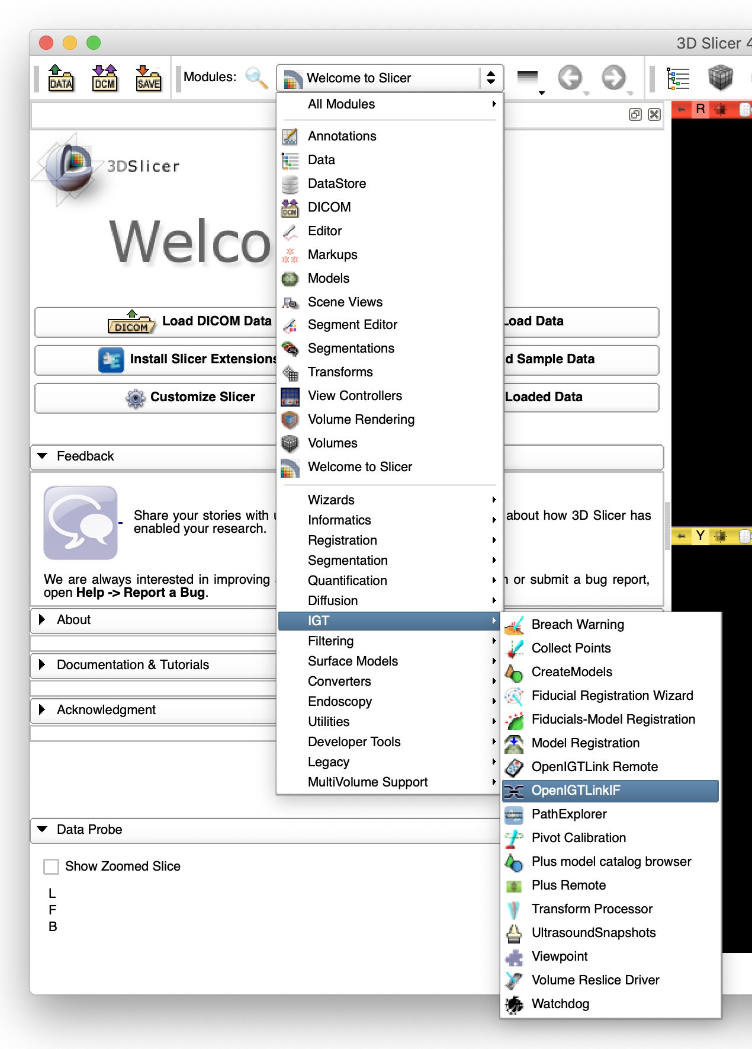
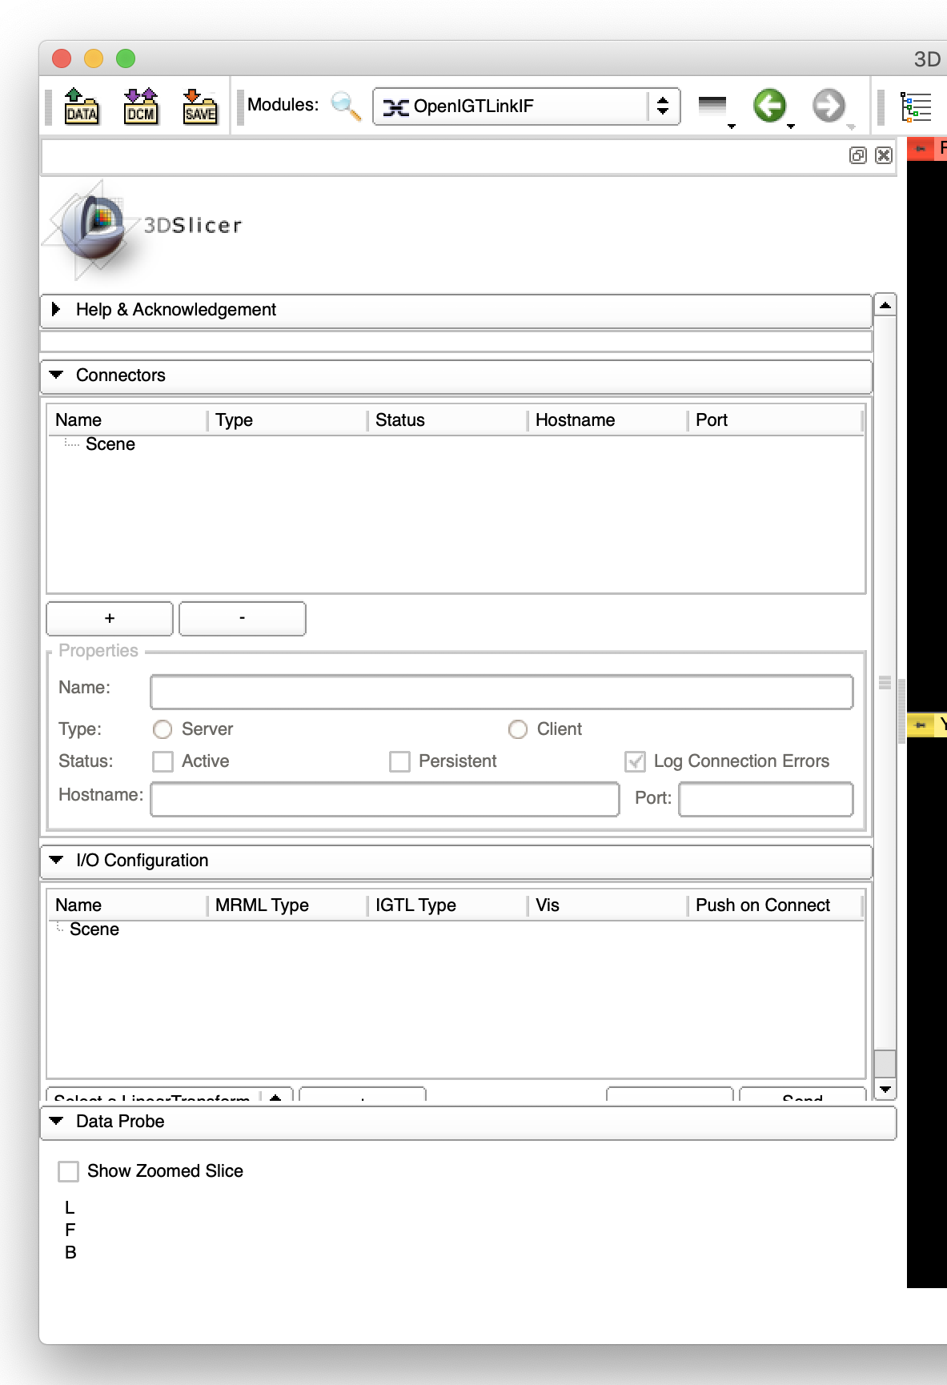
Testing Communication (3)
In 3D Slicer, Open “Modules” -> “IGT” -> “OpenIGTLink IF”

Slide 23
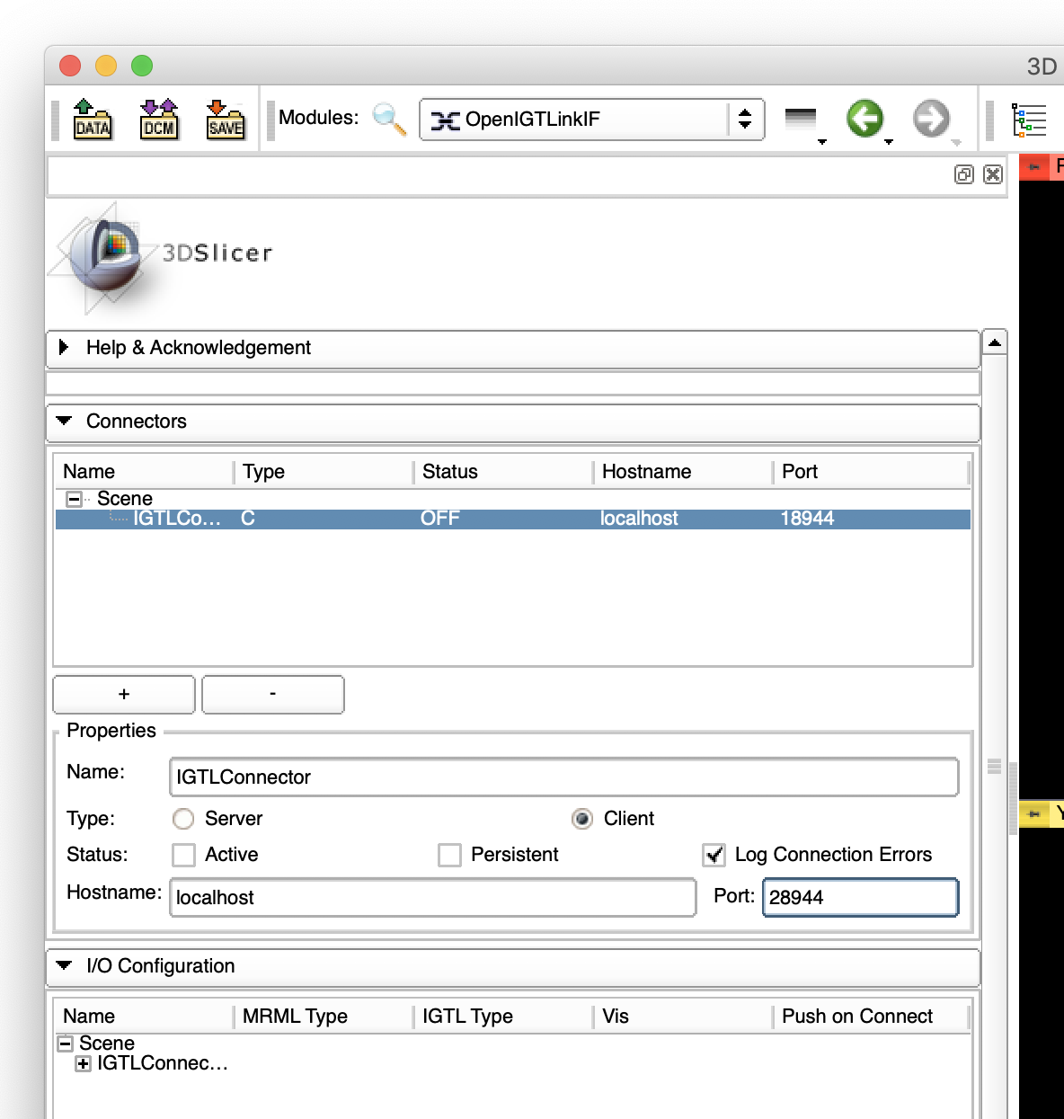
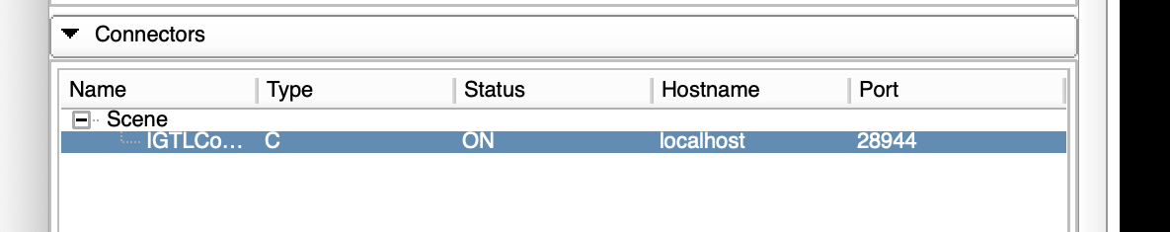
Testing Communication (4)
Create a connector node and configure:
After configuring the node, click “Active”. If successful, the status becomes “ON”.
Name | “IGTLConnector” (default)
Type | “Client” (default)
Status | Unchecked (default)
Hostname | “localhost” (if Docker is used)
Port | “28944”
1. Click “+”
2. Change port to
28944
3. Click “Active”
Status indicates “ON”

Slide 24
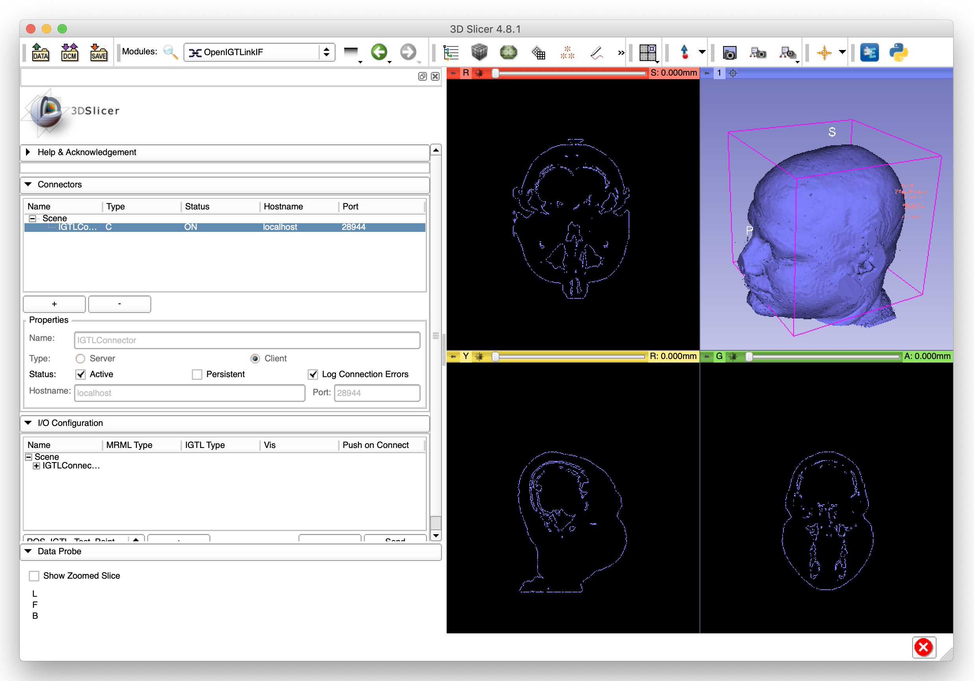
Testing Communication (4)
Open a third terminal on the ROS computer and run the test node:
If successful, image and points will show up on 3D Slicer.
$ cd ~/catkin_ws
$ source devel/setup.bash
$ roslaunch ros_igtl_bridge test.launch

Slide 25
Testing Communication (5)
After confirming the communication between 3D Slicer and ROS:
  On 3D Slicer, turn the “Active” checkbox off in the status panel of the ”OpenIGTLink IF” module.
  On the third terminal, press ”Ctrl + c” to stop the test node.
  On the second terminal, press “Ctrl + c” to stop the bridge node.
  On the first terminal, press “Ctrl + c” to stop the roscore.
  Close all the terminals.

Slide 26
Step 2: Setting up Universal Robot Arm on ROS

Slide 27
Overview of Step 2
Messaging from ROS to 3D Slicer
Robot model
ROS-IGTL-Bridge
Igtl_
exporter
tf

Slide 28
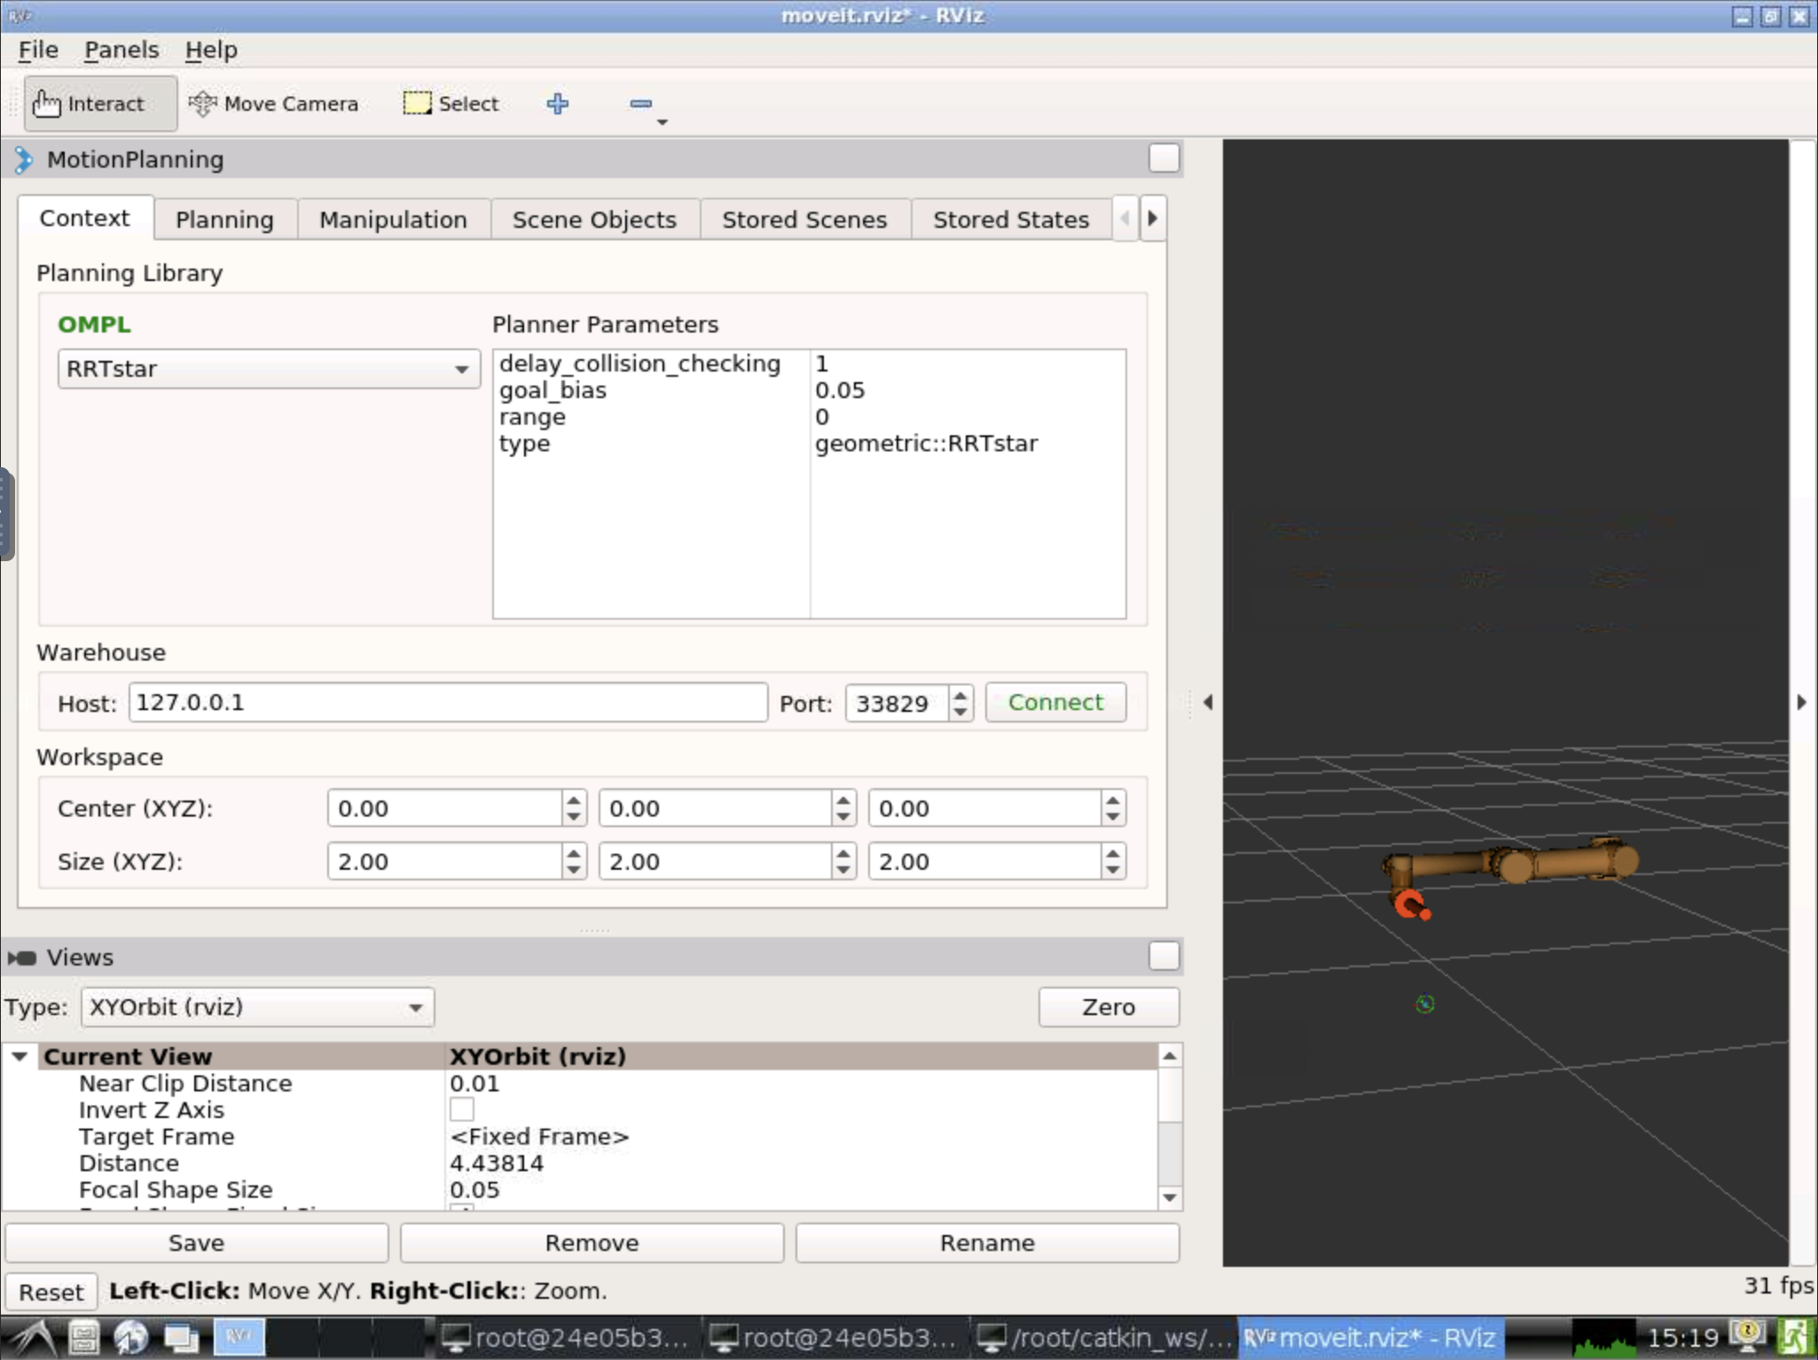
Launching Universal Robot (1)
On a terminal on the ROS computer:
rviz software with a 3D model of the Universal Robot appears.
Next, launch IGTL Exporter/Importer from a new terminal:
$ cd ~/catkin_ws
$ source devel/setup.bash
$ roslaunch ismr19_moveit demo.launch
$ cd catkin_ws
$ source devel/setup.bash
$ rosrun ismr19_control igtl_exporter.py

Slide 29
Launching Universal Robot (2)
Start ROS-IGTL-Bridge from a terminal on ROS computer.
Choose ‘1’ (Server) and enter port # 18944
$ cd ~/catkin_ws
$ source devel/setup.bash
$ roslaunch ros_igtl_bridge bridge.launch
[ROS-IGTL-Bridge] Please try <1> or <2> to run node as OpenIGTLink client or server:
1: Server
2: Client
1
[ROS-IGTL-Bridge] Input socket port:
18944

Slide 30
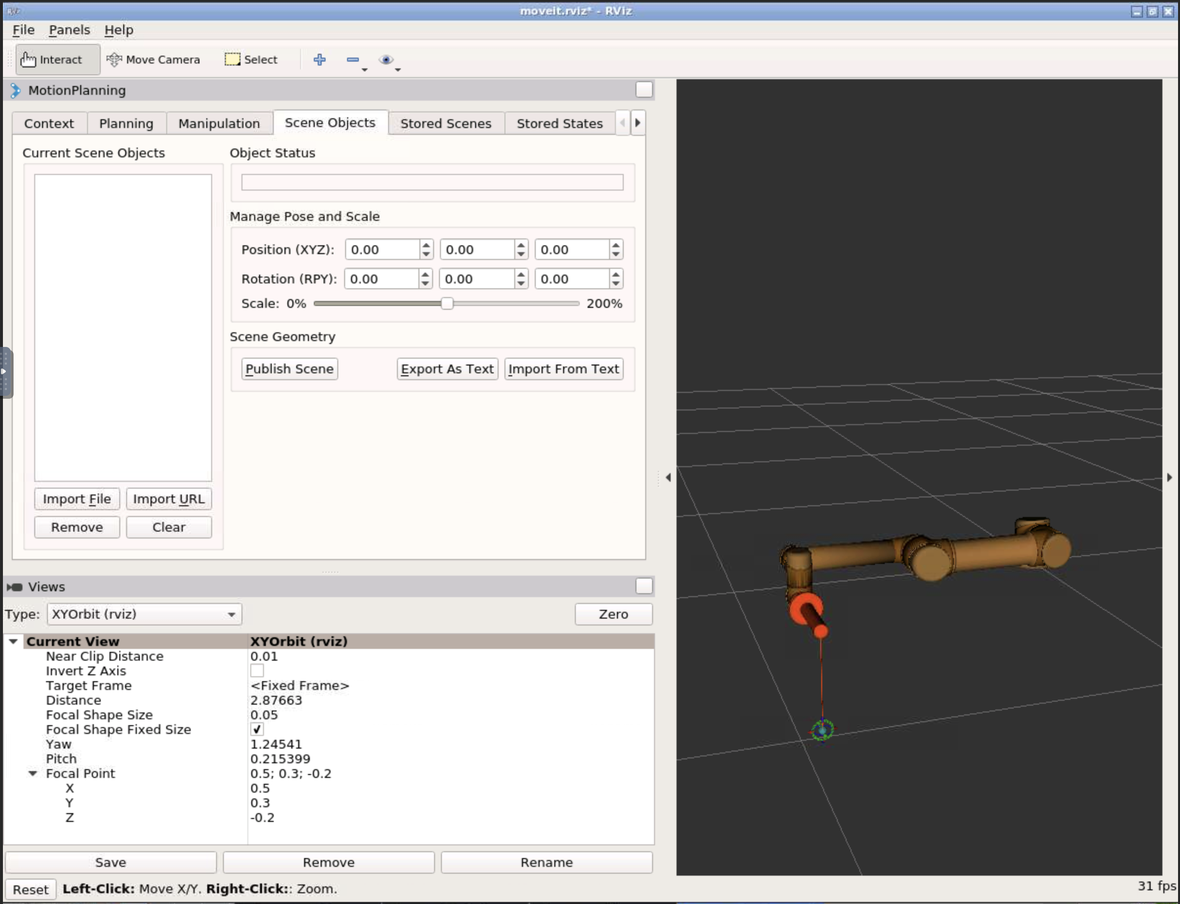
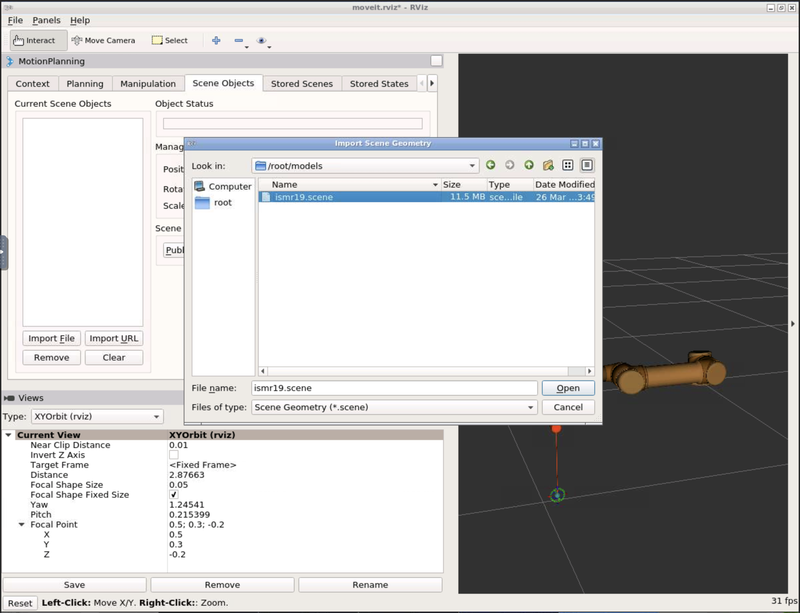
Loading 3D Patient Model on rviz (1)
Import a scene file with a patient model (skull).
1. Open “Scene Objects”
3. Select ”ismr19.scene” under
/root/models/
2. Click “Import from Text”
4. Click “Open”

Slide 31
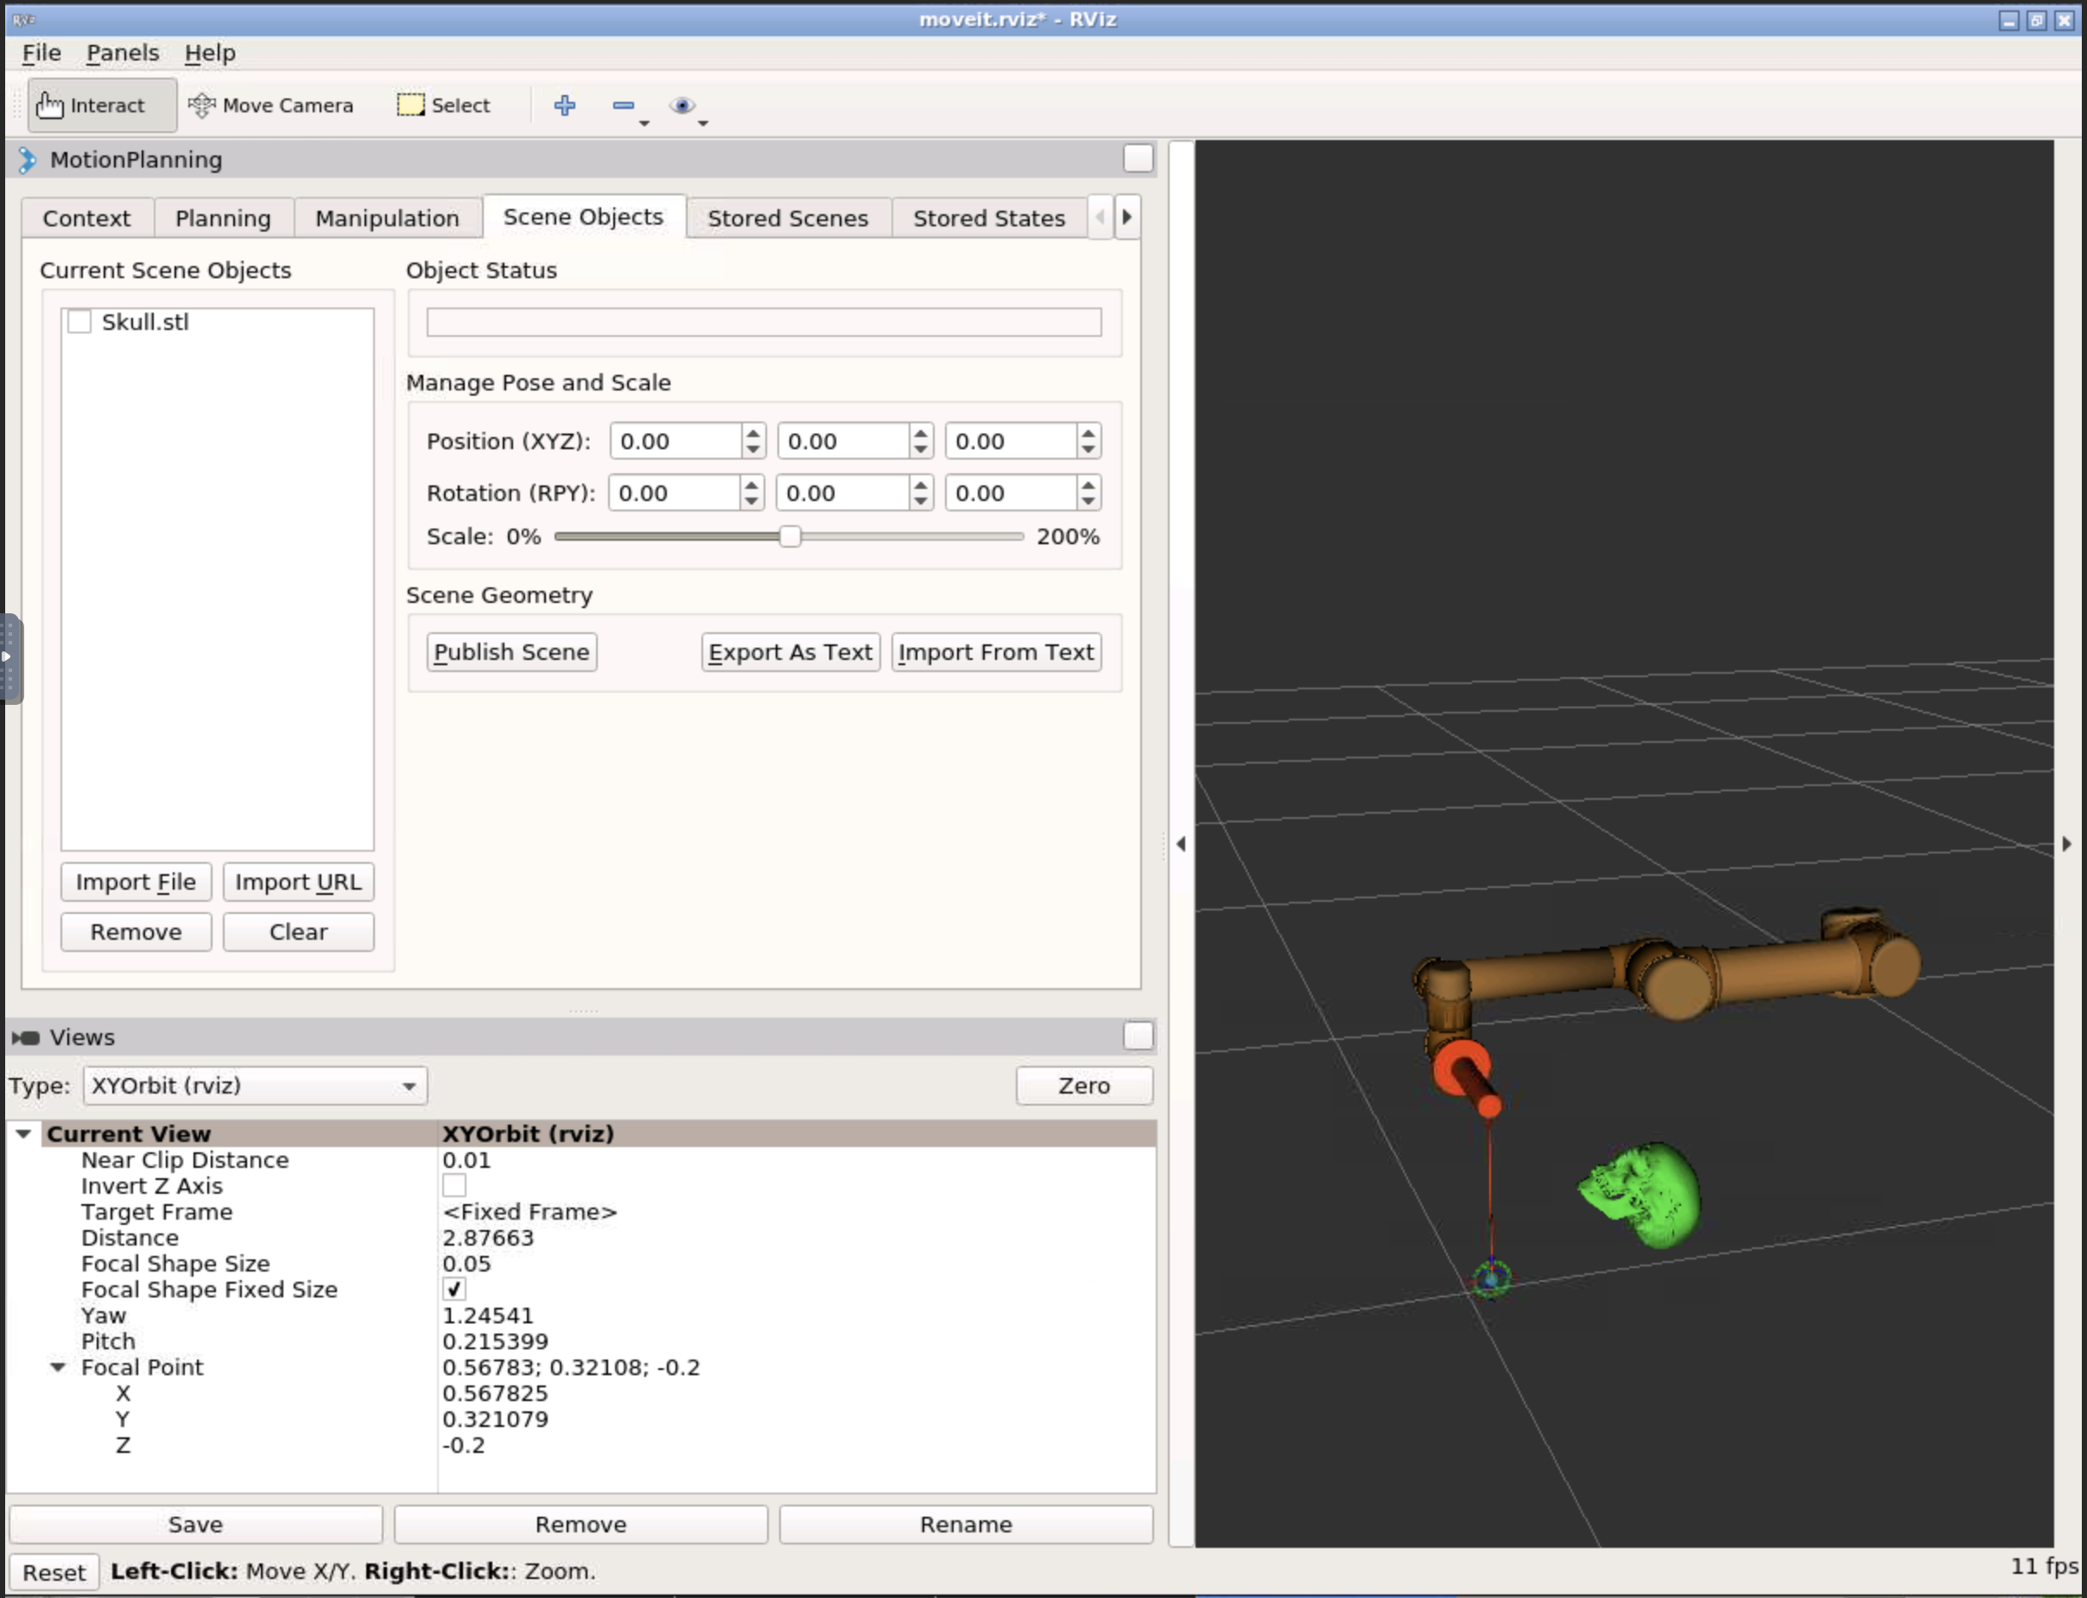
Loading 3D Patient Model on rviz (2)
Check if the patient model has appeared.
1. The model appears as a green skull.

Slide 32
Step 3: Planning Procedure on 3D Slicer

Slide 33
Overview of Step 3
Surgical planning using 3D images (e.g. MRI, CT)
  Considerations:
    Target location
    Entry point on the skin
    Critical structures around the needle path
  Output: needle trajectory
    Coordinates of the target (patient coordinate system)
    Coordinates of the entry point (patient coordinate system)

Slide 34
Loading Image and Model of the Patient (1)
Download zipped scene data from http://bit.ly/2HTFHTl and rename to “SlicerScene-ISMR19.zip”. Alternatively, you can download using wget command:
Decompress the .zip file. On a Linux/Mac terminal:
$ cd <working folder>
$ wget –O SlicerScene-ISMR19.zip http://bit.ly/2HTFHTl
$ unzip SlicerScene-ISMR19.zip

Slide 35
Loading Image and Model of the Patient (2)
The scene contains:
  Scene description (.mrml format)
  MR image (.nrrd format)
  3D surface model of the skull (.stl format)
  3D surface models of the robot arm (.stl format)
  Transforms of the links of the robot arm (.tfm format)

Slide 36
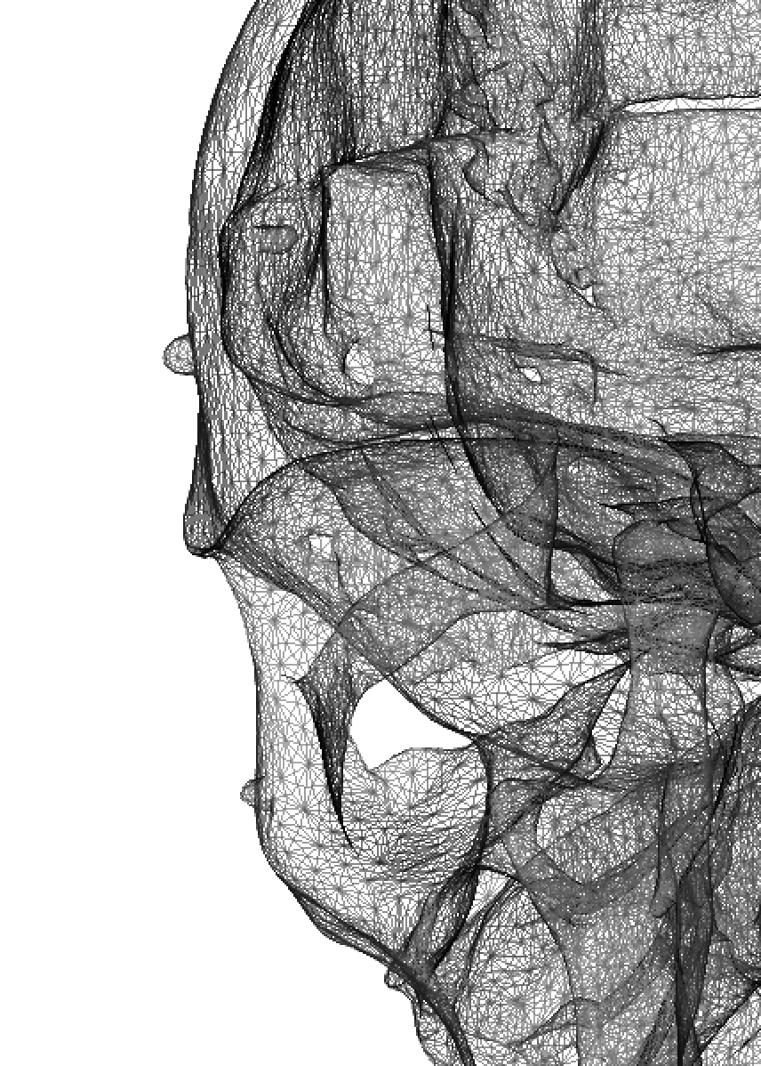
Notes on STL file format
A STL (stereolithography) file contains the coordinates of vertices and connection of them to define polygons.
The STL format is widely used to exchange 3D surface model data.
The file format does not contain the unit.
  ‘Meter’ is used in rviz.
  ‘Millimeter’ is used in 3D Slicer
STL files must be scaled for each software (i.e. rviz and 3D Slicer)

Slide 37
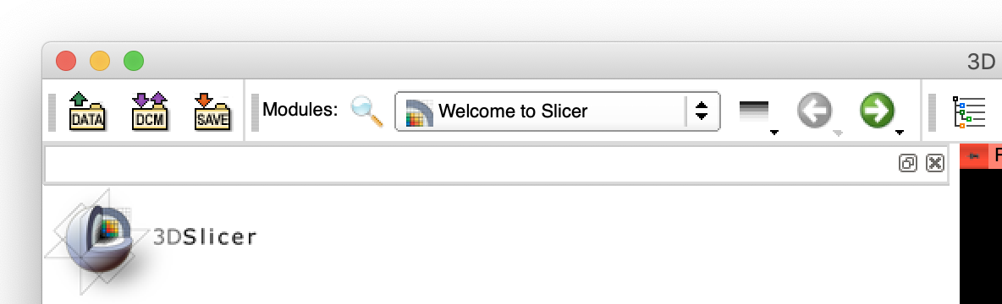
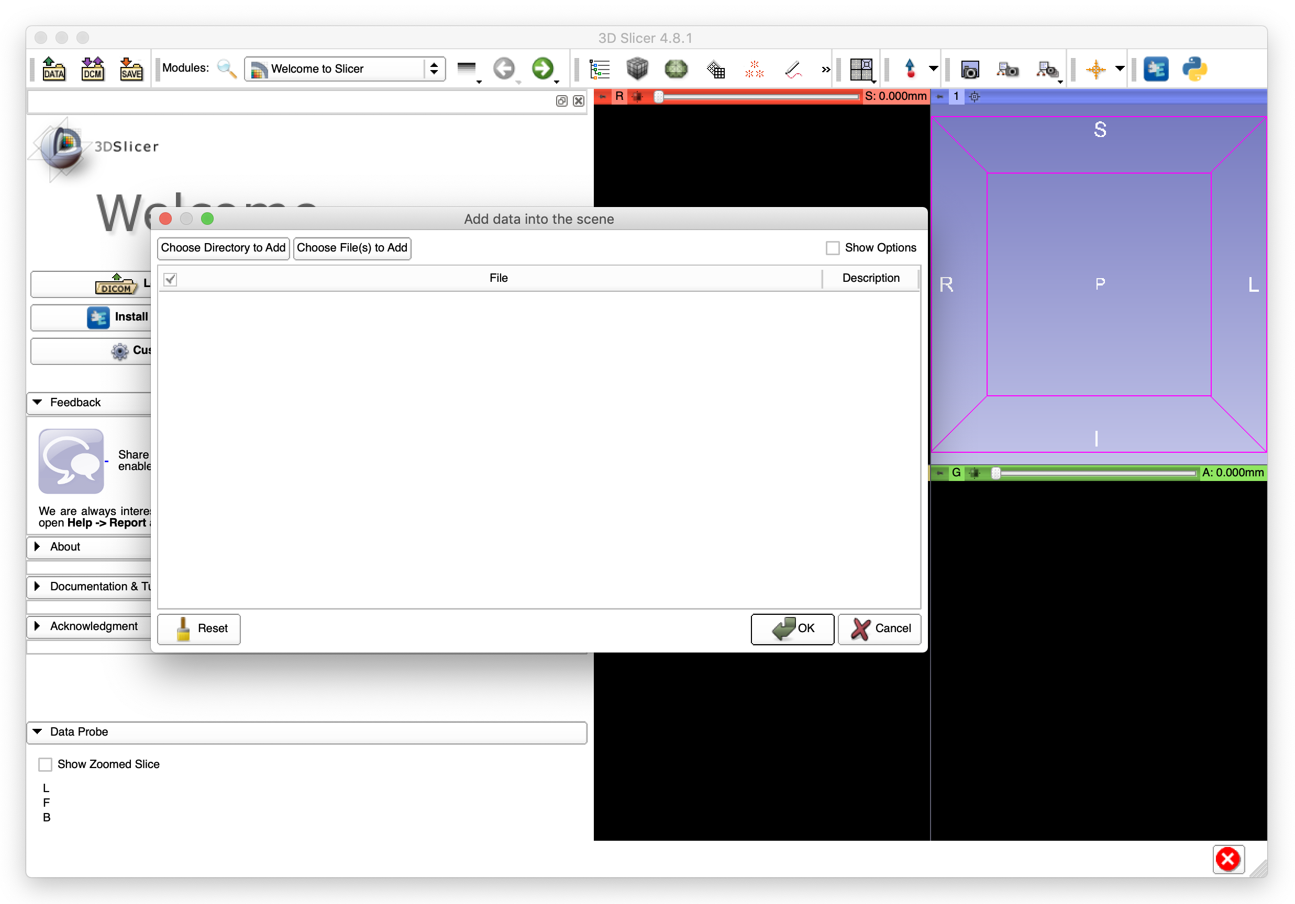
Loading Image and Model of the Patient (3)
Launch 3D Slicer.
Click “Data” icon on the menu bar.
Click “Choose File(s) to Add”
1. Click the “Data” icon.
2. Click the “Choose File(s) to Add” button

Slide 38
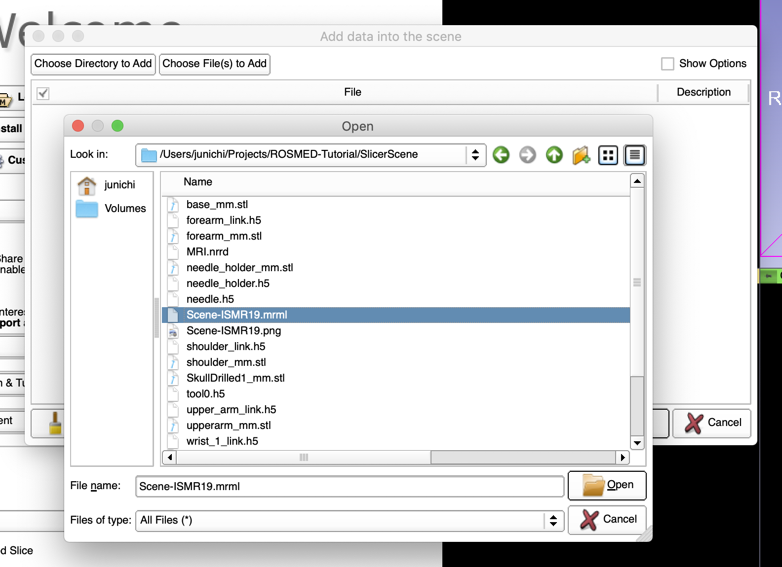
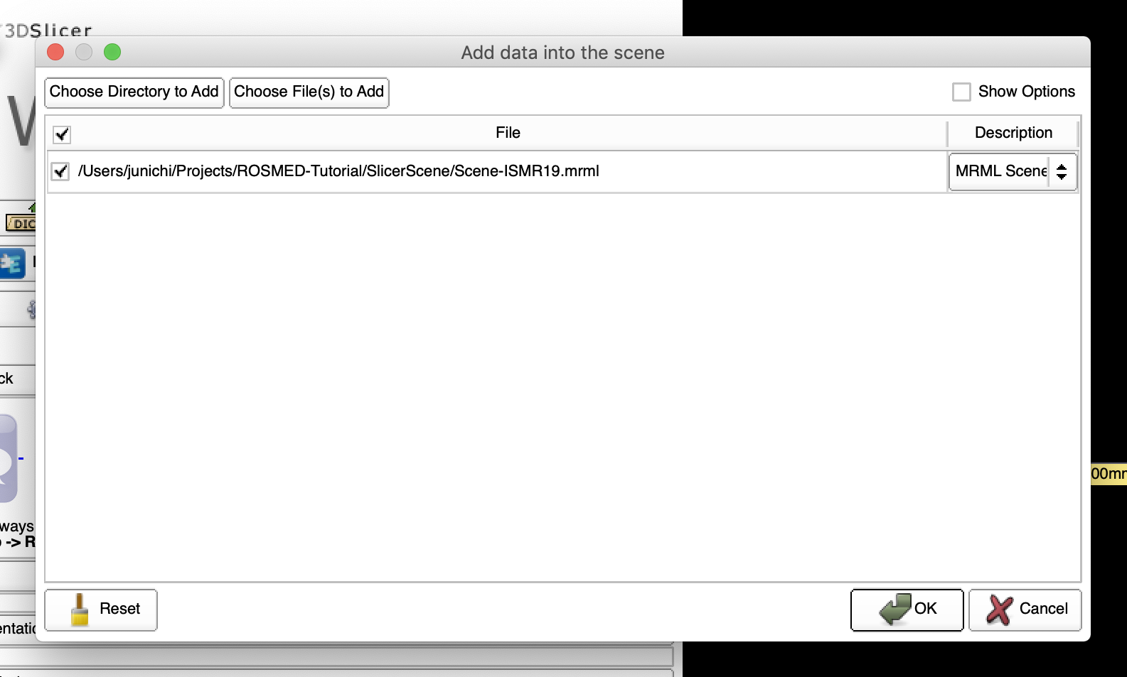
Loading Image and Model of the Patient (4)
In the “Open” dialog box, select ”Scene-ISMR19.mrml” in the folder extracted from the .zip archive.
Click “Open”.
Click “OK” on the “Add data into the scene” dialog box.
1. Select “Scene-ISMR19.mrml”
2. Click “Open”
3. Click “OK”

Slide 39
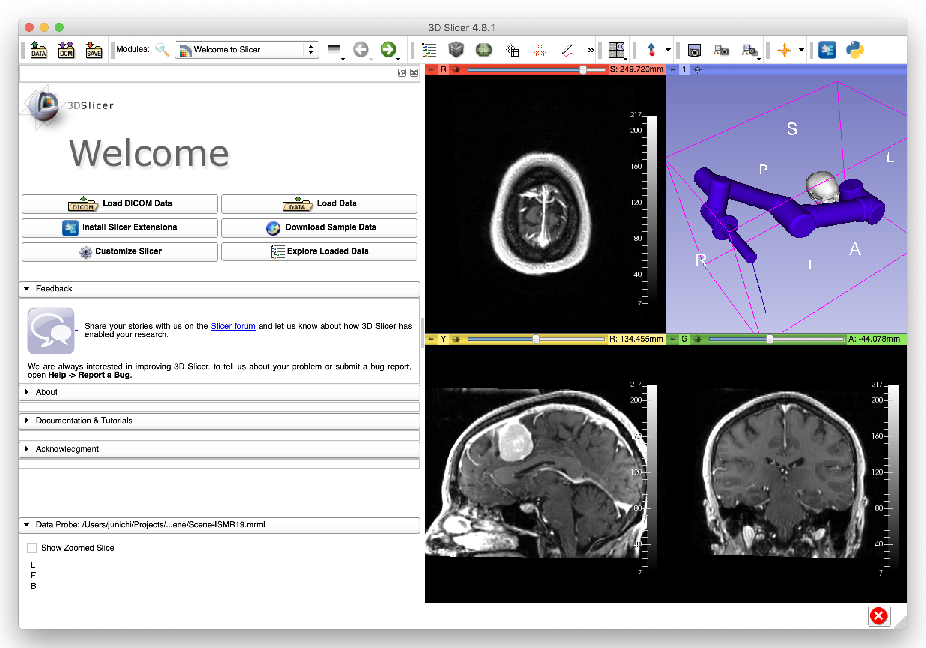
Loading Image and Model of the Patient (5)
MR image and 3D models appear on 3D Slicer.

Slide 40
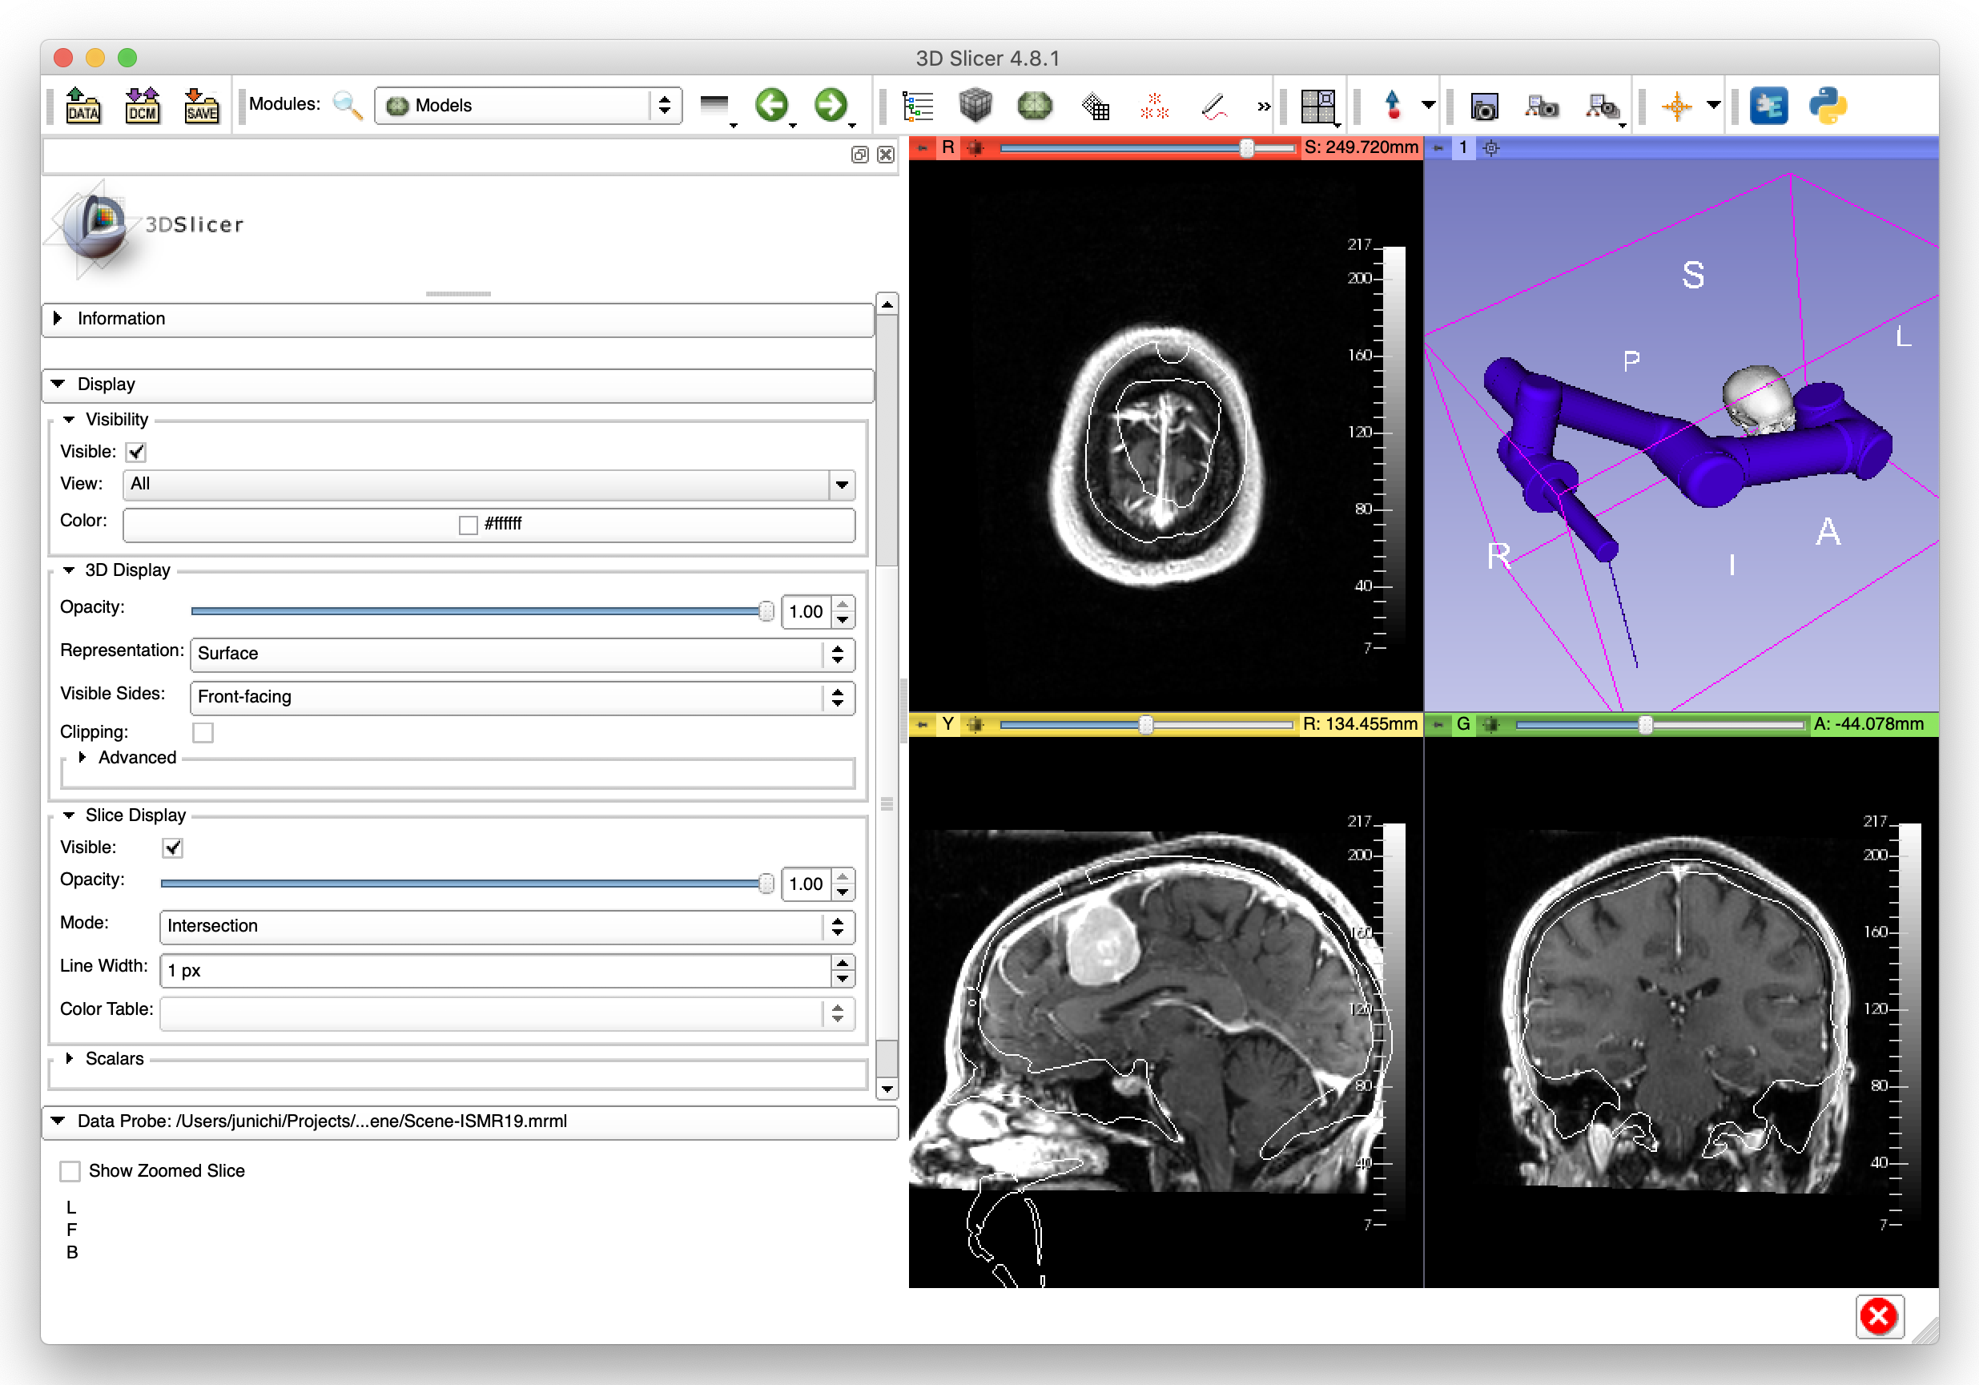
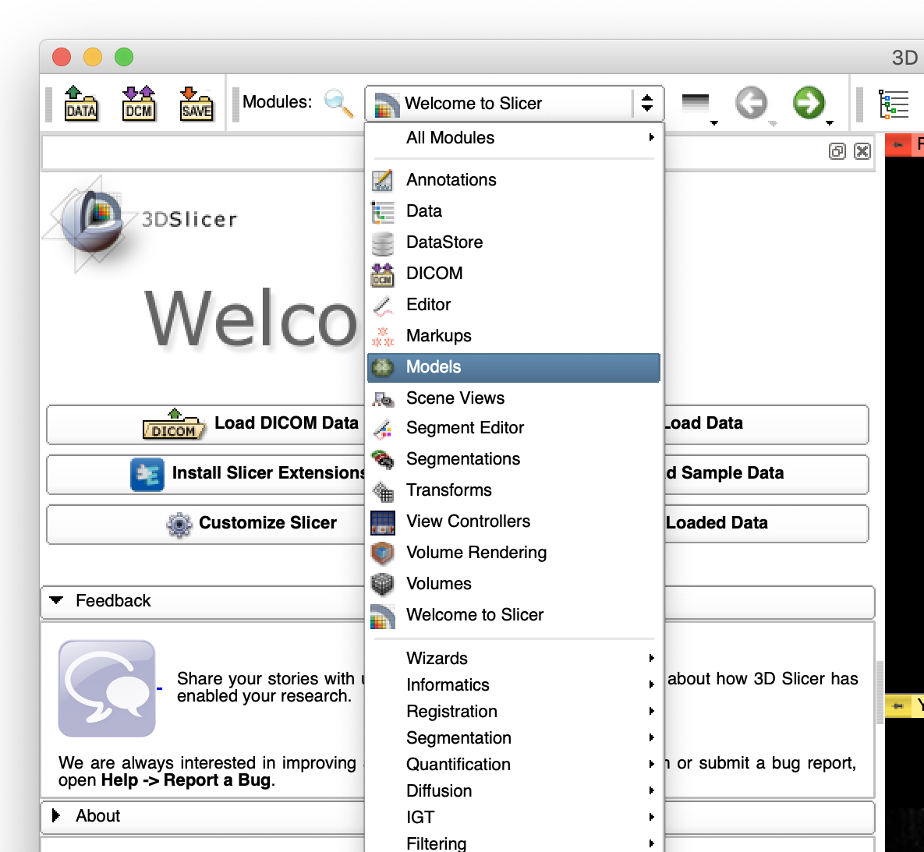
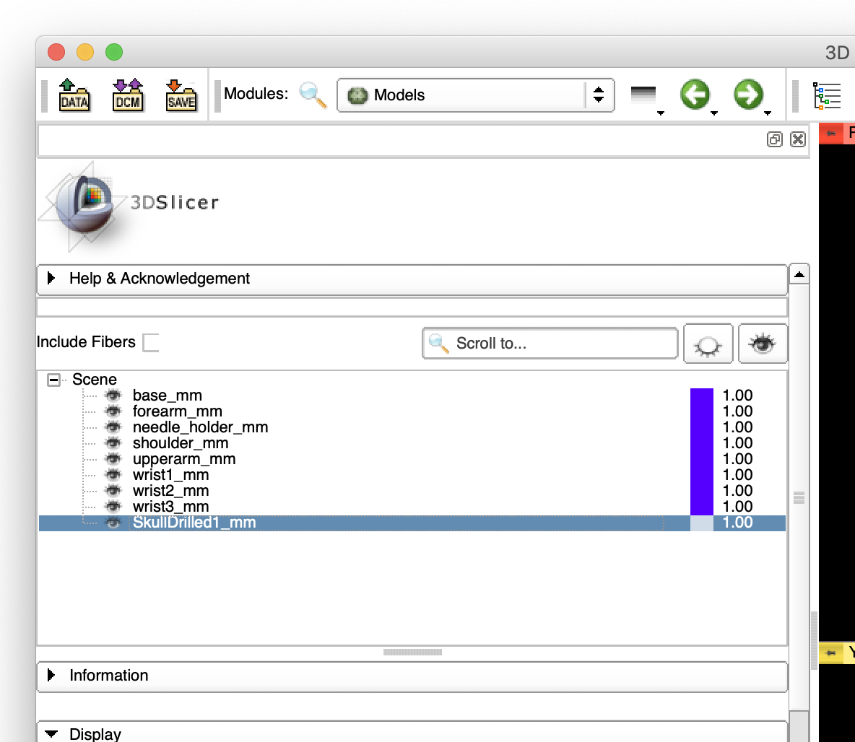
Showing Cross Section of the Skull Model (1)
To show the cross section of the model on the 2D views:
  Open the “Models” module.
  Choose “SkullDrilled1_mm”
  Check “Visible” in the “Slice Display”
1. Select “Models”
2. Select “SkullDrilled1_mm”
3. Check “Visible” in “Slice Display”

Slide 41
Showing Cross Section of the Skull Model (2)
The cross sections of the skull model show up on the 2D views.

Slide 42
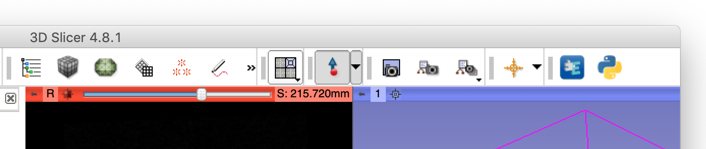
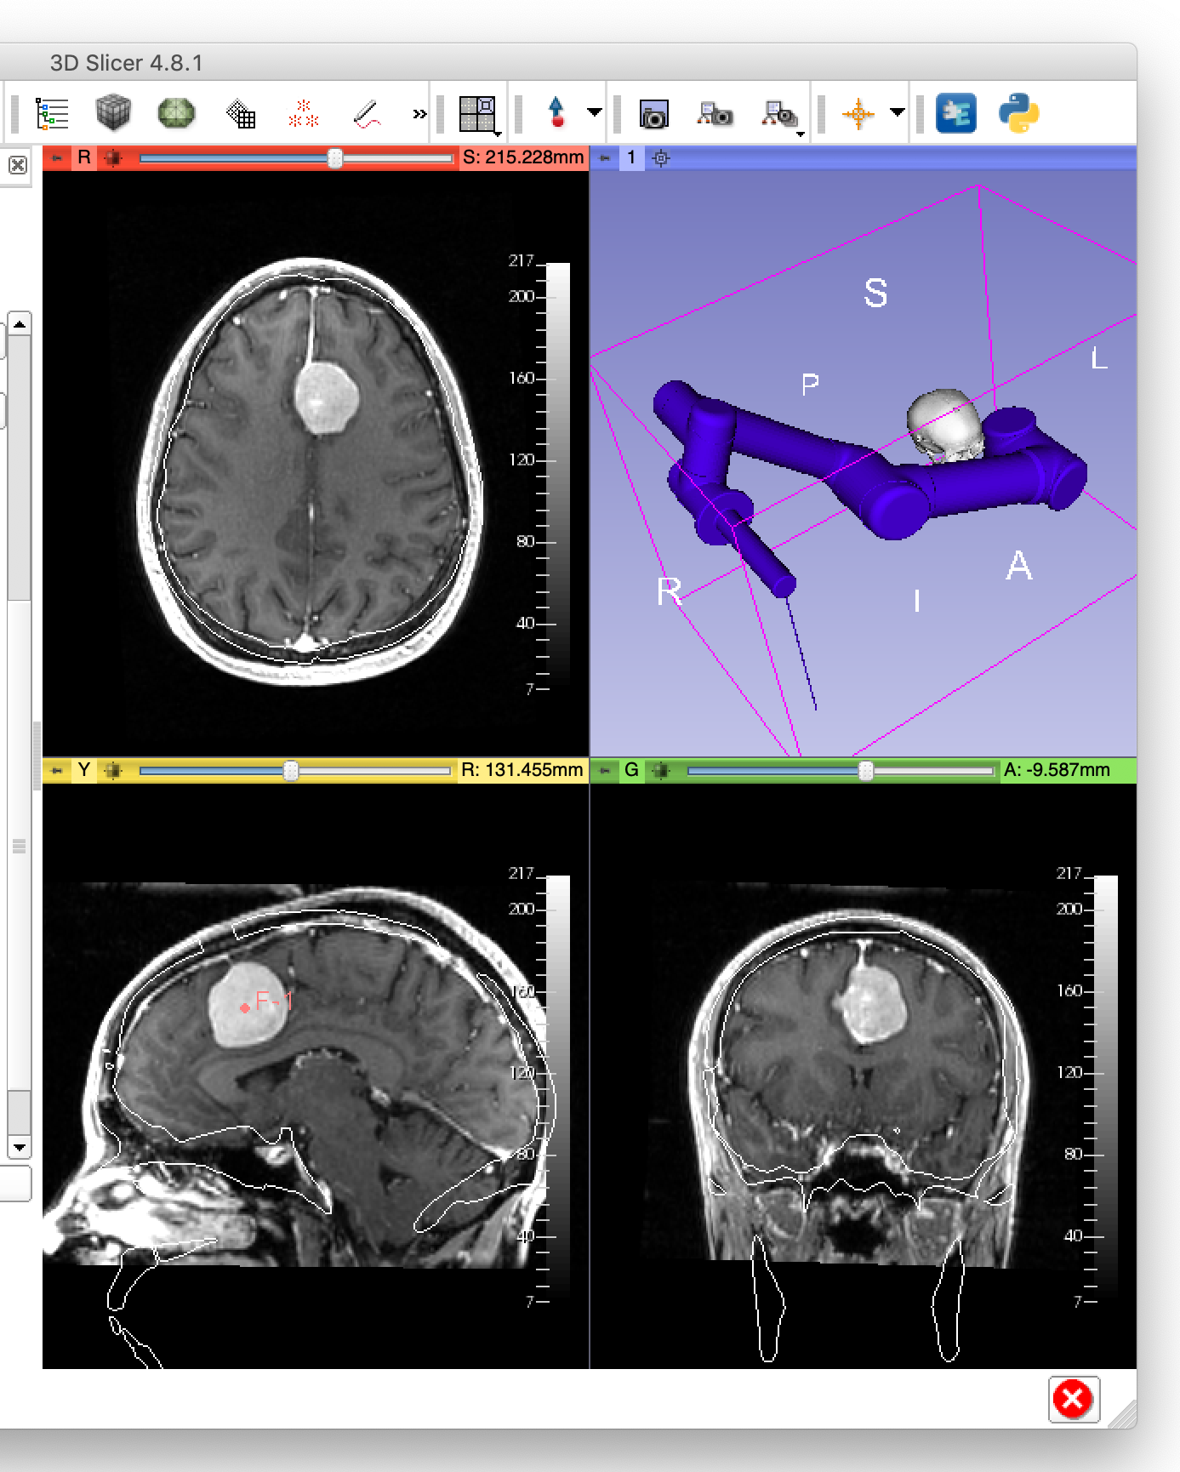
Selecting Target Point
Click “Create-and-Place Fiducial” button.
Scroll 2D view to find the target point (center of the tumor)
Place a fiducial by clicking the target point on the 2D view (either red, yellow, or green view)
1. Click “Create-and-Place Fiducial”
2. Scroll until the target point become visible
3. Click the center of the tumor as a target

Slide 43

Selecting Entry Point
Click “Create-and-Place Fiducial” button.
Scroll 2D view to find the entry point (on the skin above the tumor)
Place a fiducial by clicking the entry point on the 2D view (either red, yellow, or green view)
1. Click “Create-and-Place Fiducial”
2. Scroll until the target point become visible
3. Click the skin entry point

Slide 44
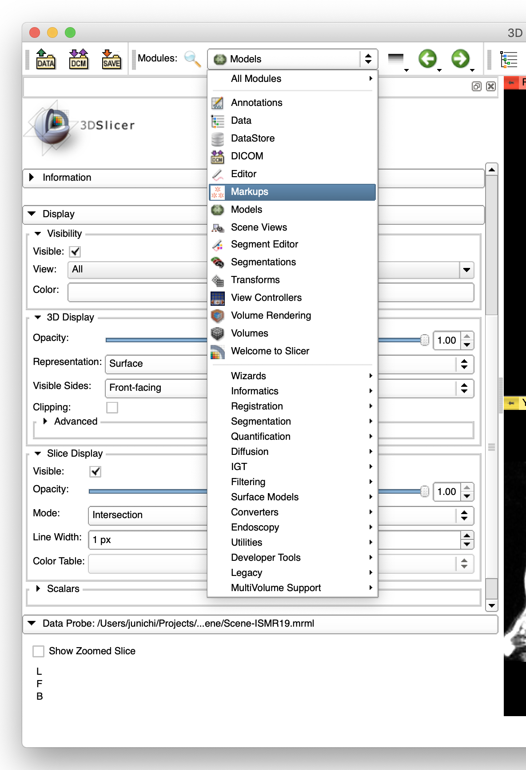
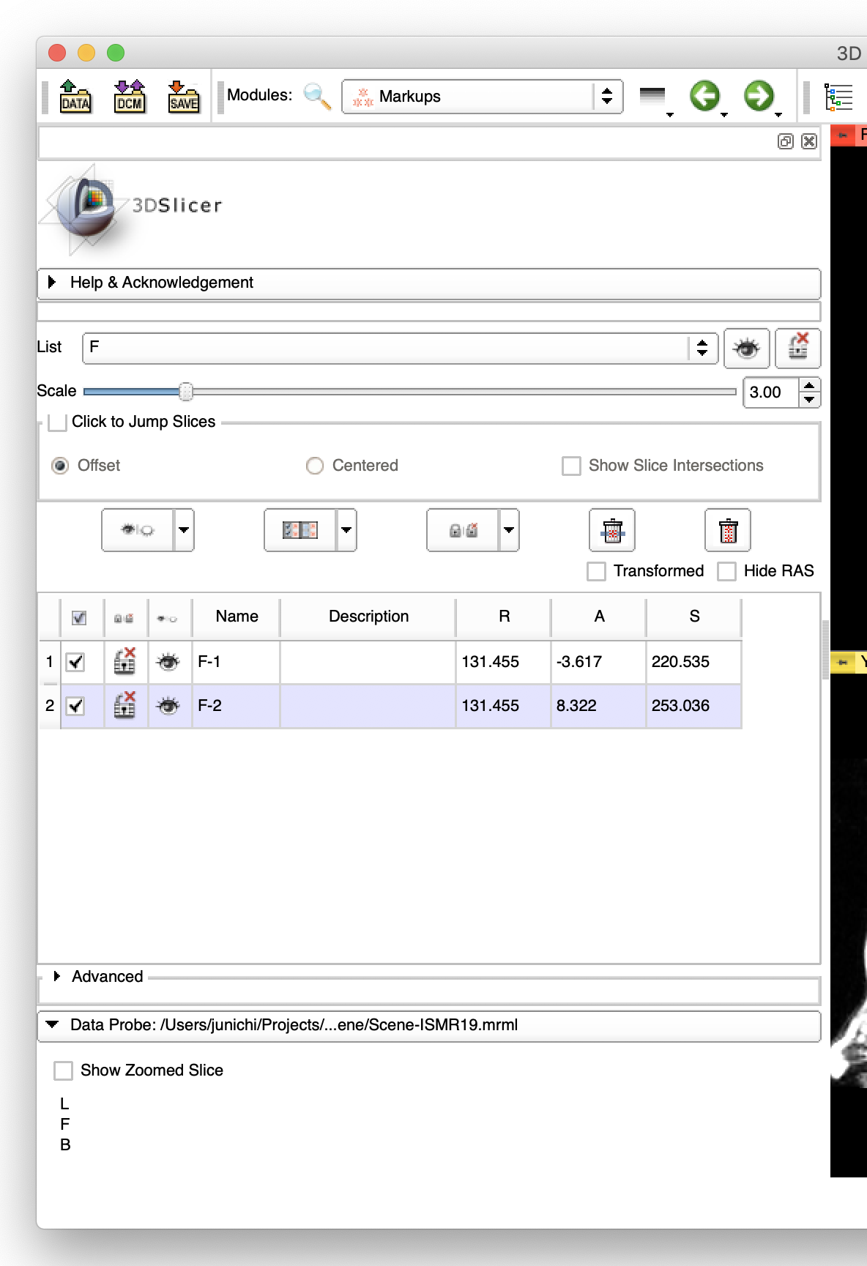
Naming Target and Entry Points (1)
Open “Markups”.
Please note:
  The coordinates and the names of the points will be exported to ROS over OpenIGTLink.
  The names edited in this step will be used for identification on ROS, and are case-sensitive.
1. Select “Markups” from the module list

Slide 45
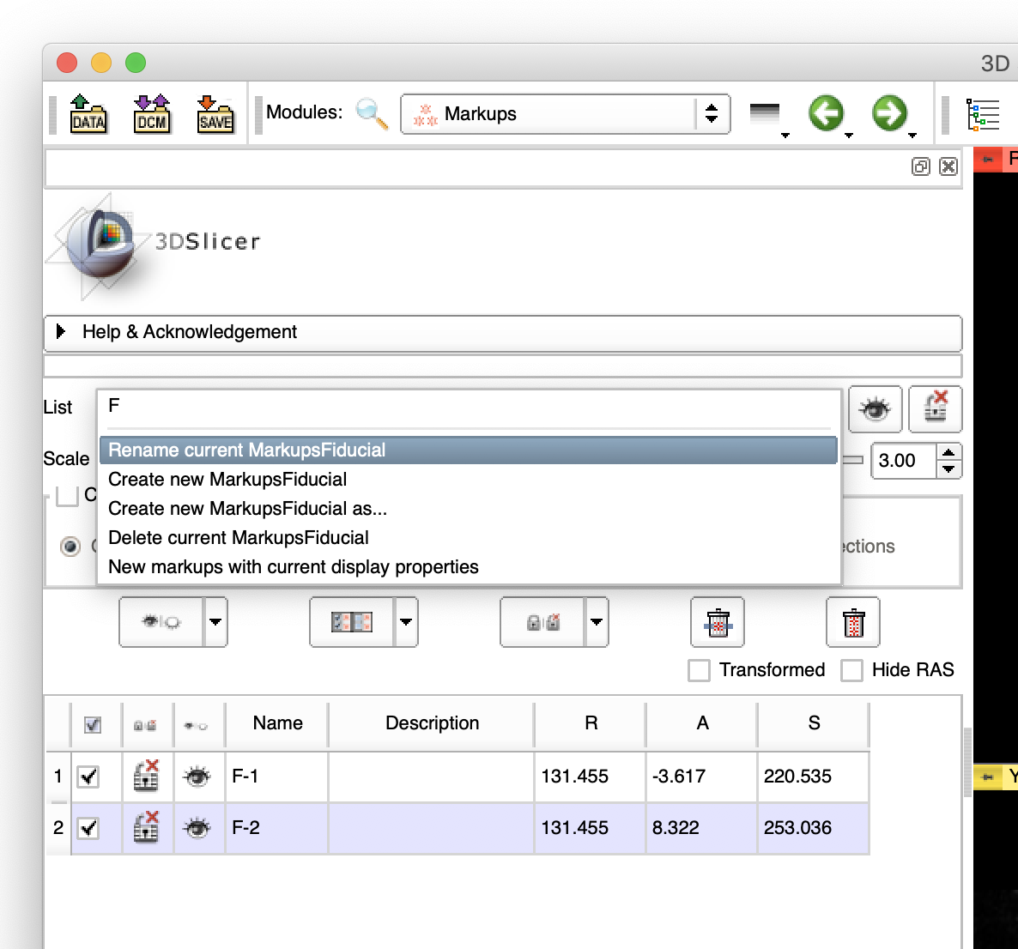
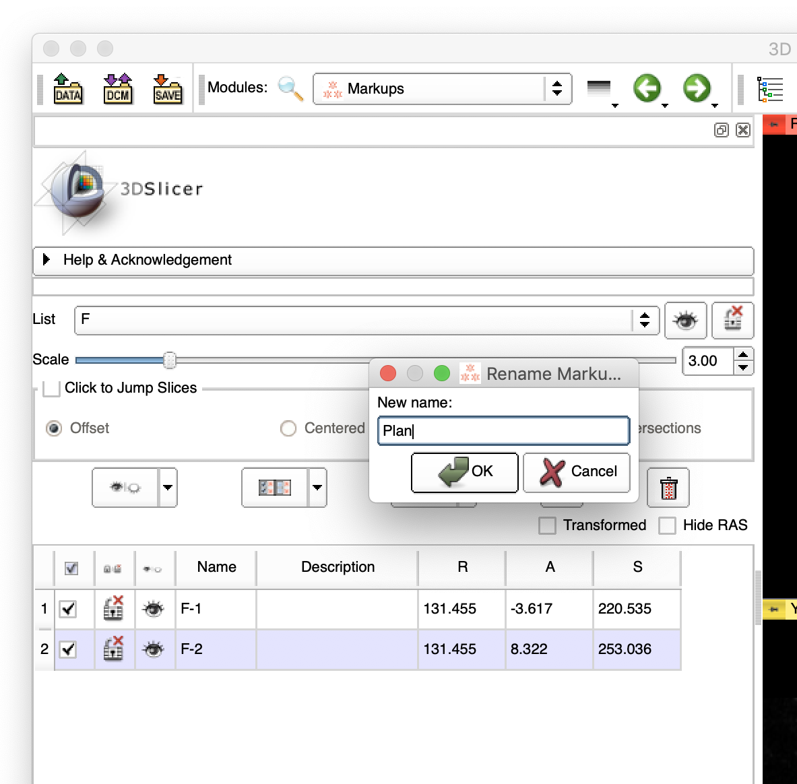
Naming Target and Entry Points (2)
Rename the list (MarkupFiducials) to “Plan”
2. Enter ”Plan”
1. Select “Rename current MarkupFiducial” from the “List”
3. Click “OK”

Slide 46
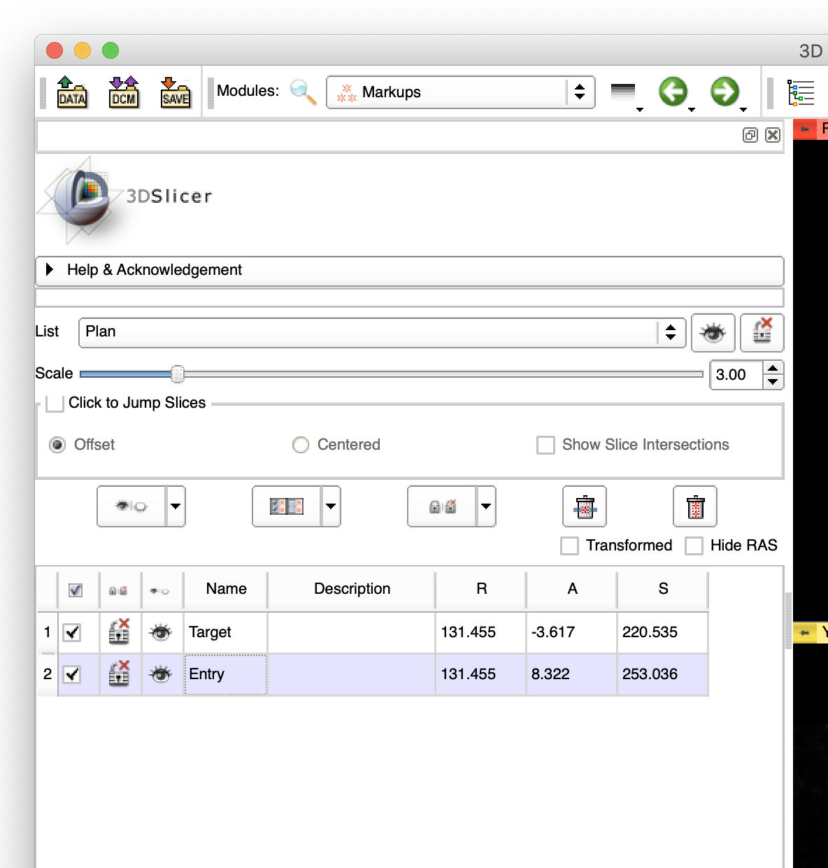
Naming Target and Entry Points (3)
Rename the first point to “Target”.
Rename the second point to “Entry”.
1. Double-click and enter “Target”
2. Double-click and enter “Entry”

Slide 47
Step 3: Robot-to-Image Registration

Slide 48
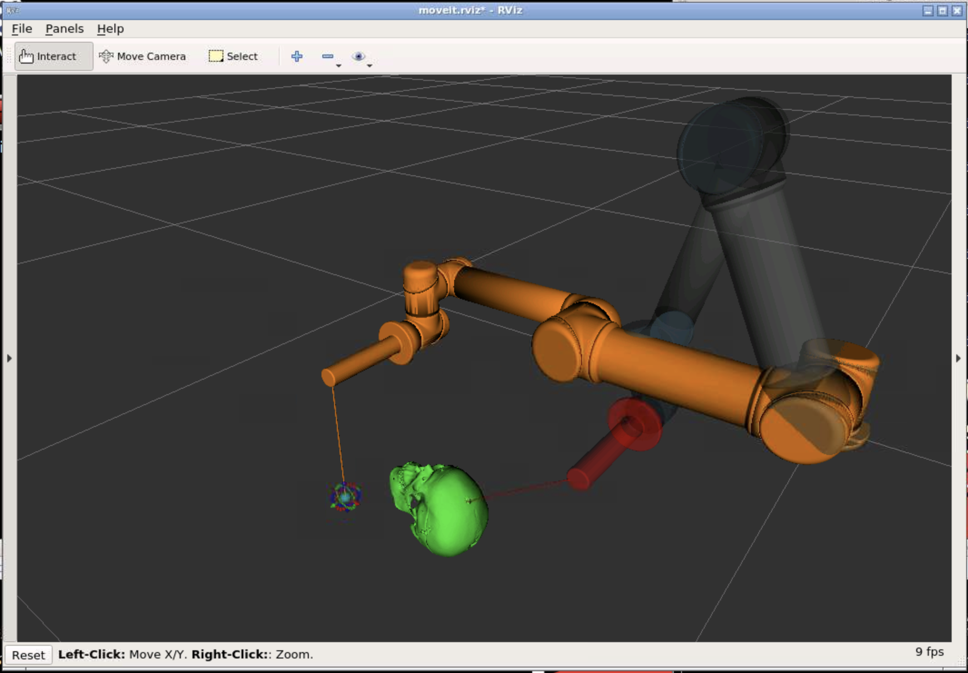
Overview of Step 4
Two coordinate systems
  Points on the images are defined in the patient coordinate system (RAS coordinate system)
  Points for execution are given in the robot coordinate system (Reference coordinate system)
(R₁, A₁, S₁)
(R₁, A₁, S₁)
(R₂, A₂, S₂)
(R₂, A₂, S₂)
Surgical Plan (RAS)
(X₁, Y₁, Z₁)
(X₂, Y₂, Z₂)
Execution (Reference)

Slide 49
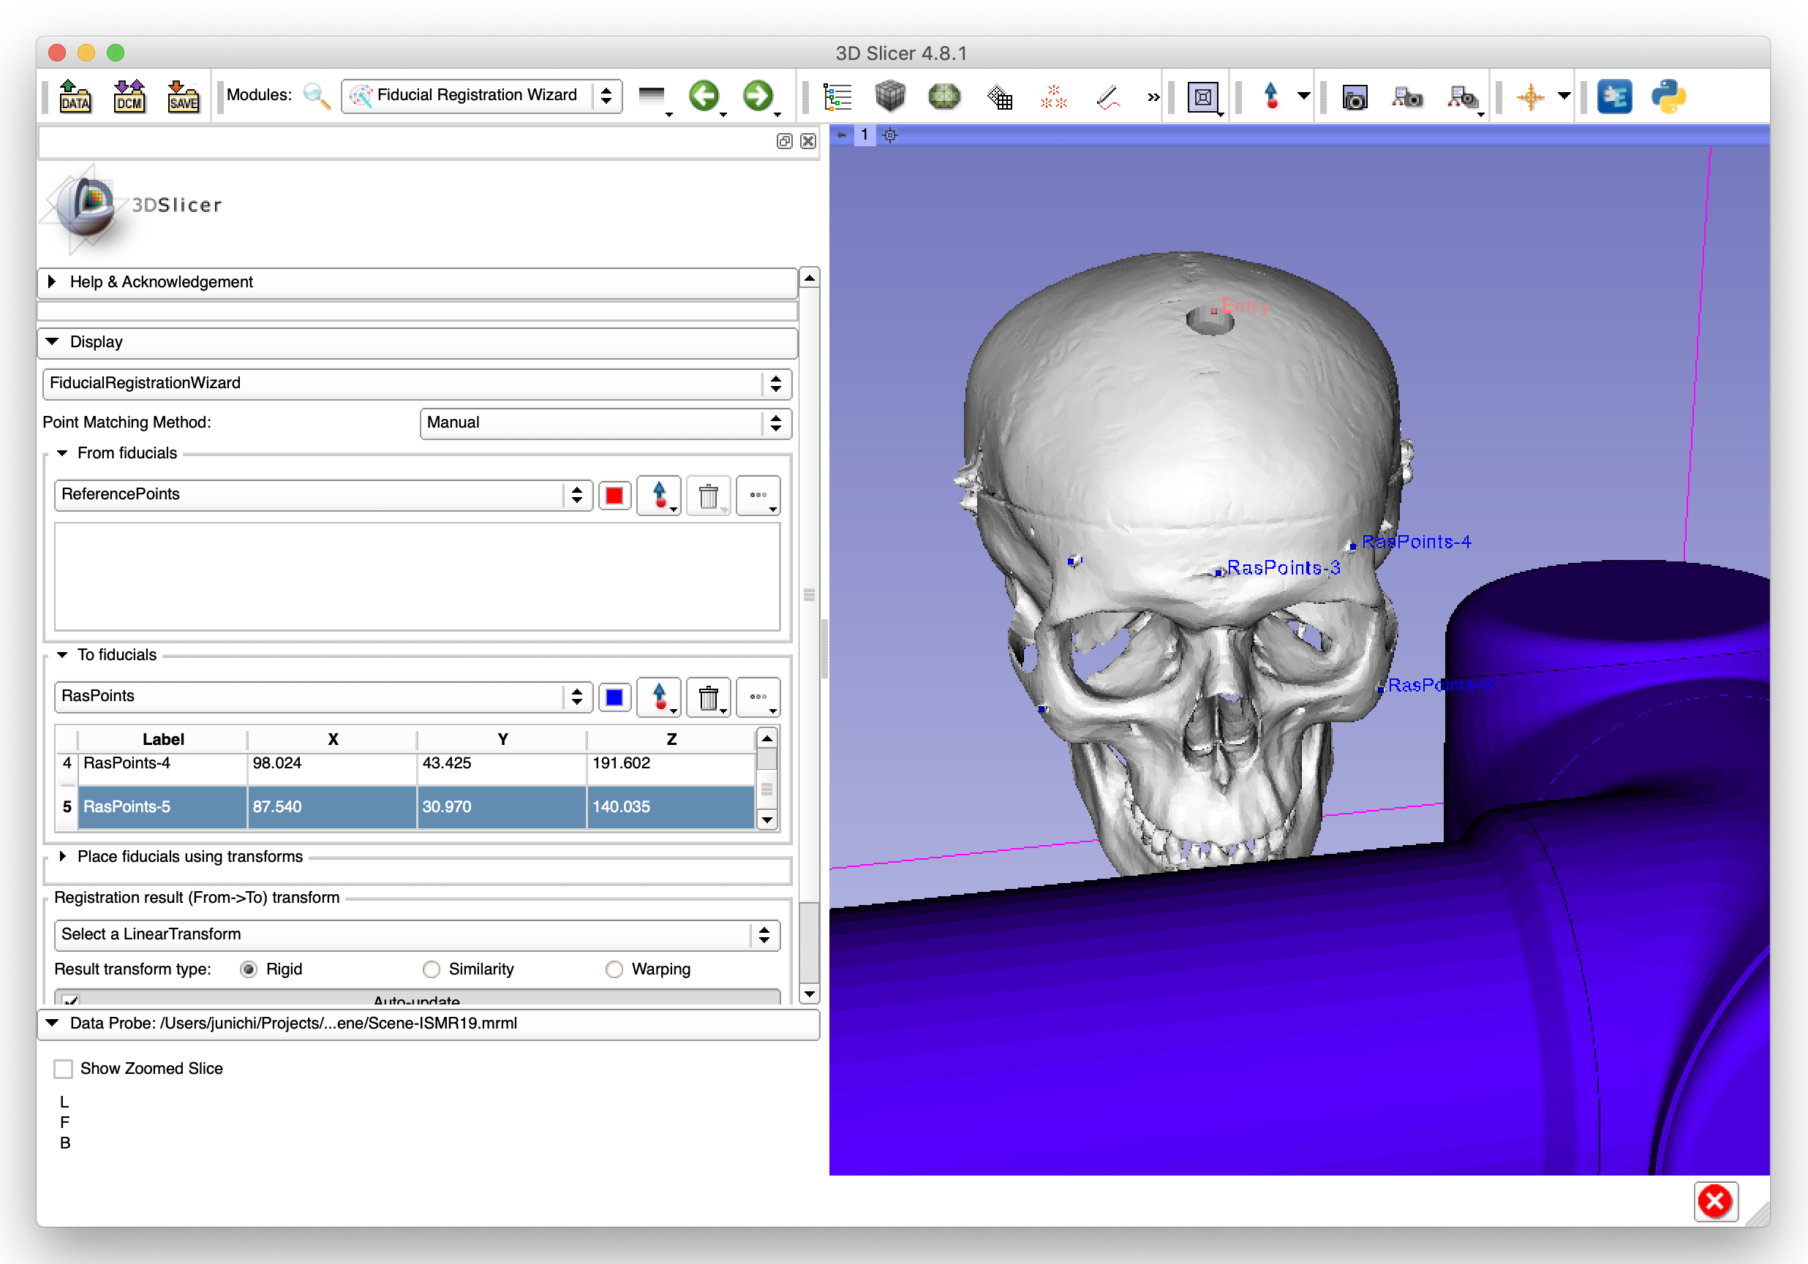
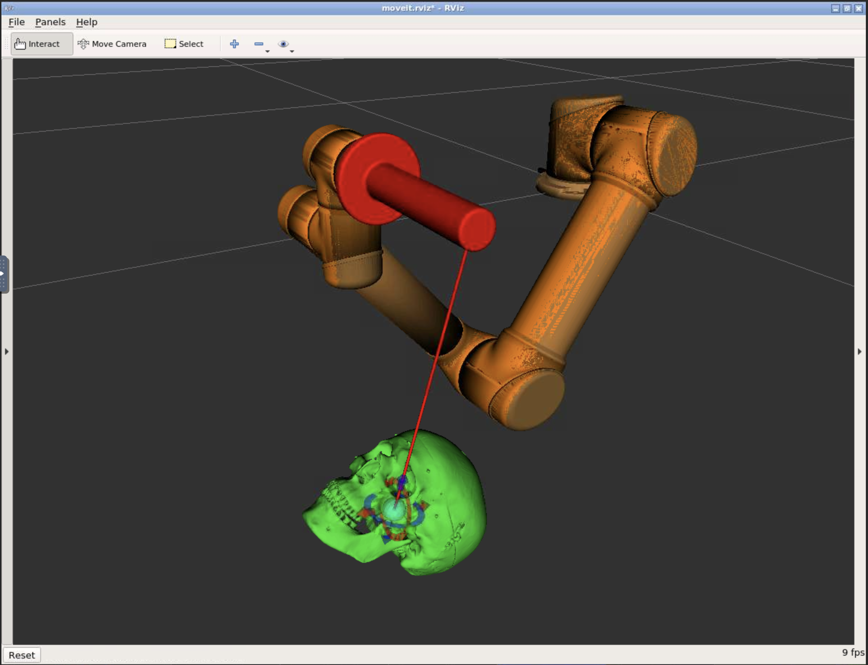
Overview of Step 4
Fiducial registration
  Estimate a transformation matrix between the RAS and Reference coordinate systems by matching the corresponding landmarks
  Outcome of registration is a matrix that transforms coordinates from the Reference coordinate system to the RAS coordinate system (T_{Ref,RAS})
T_{Ref,RAS}
Image (RAS)
Robot (Reference)

Slide 50
Connecting from 3D Slicer (1)
In 3D Slicer, Open “Modules” -> “IGT” -> “OpenIGTLink IF”

Slide 51
Connecting from 3D Slicer (2)
Configure a connector node and configure:
After configuring the node, click “Active”. If successful, the status becomes “ON”.
Name | “IGTLConnector” (default)
Type | “Client” (default)
Status | Unchecked (default)
Hostname | “localhost” (if Docker is used)
Port | “28944”
1. If there is no connector, Click “+”
3. Click “Active”
2. Change port to
28944
Status indicates “ON”

Slide 52
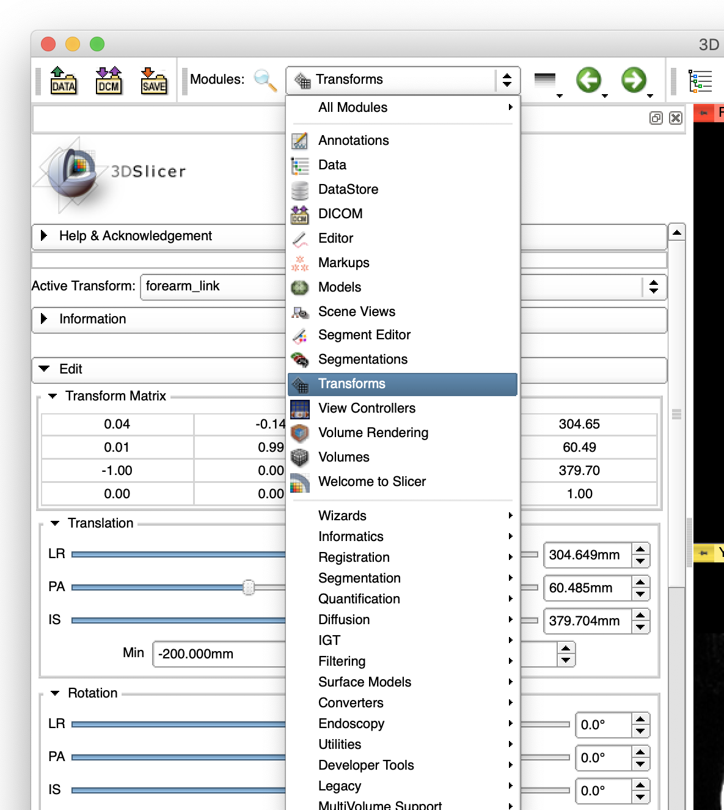
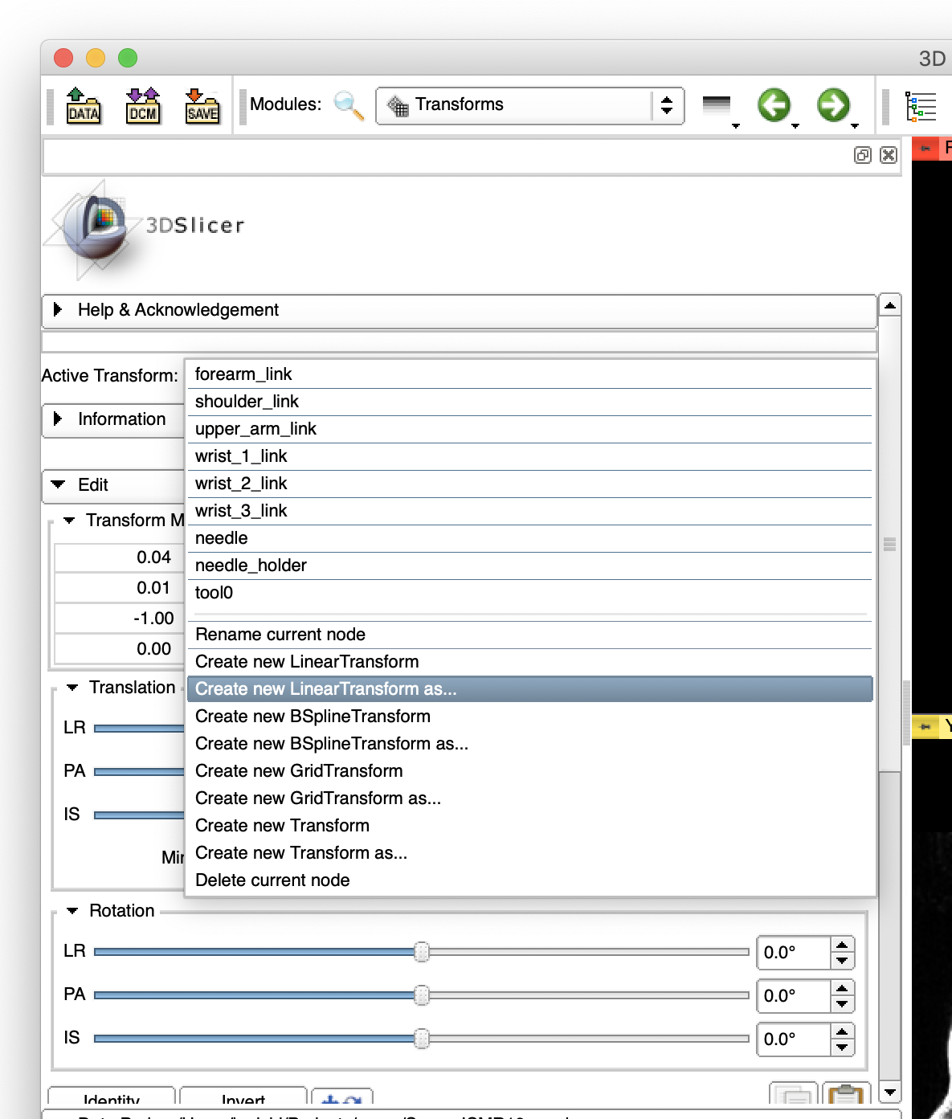
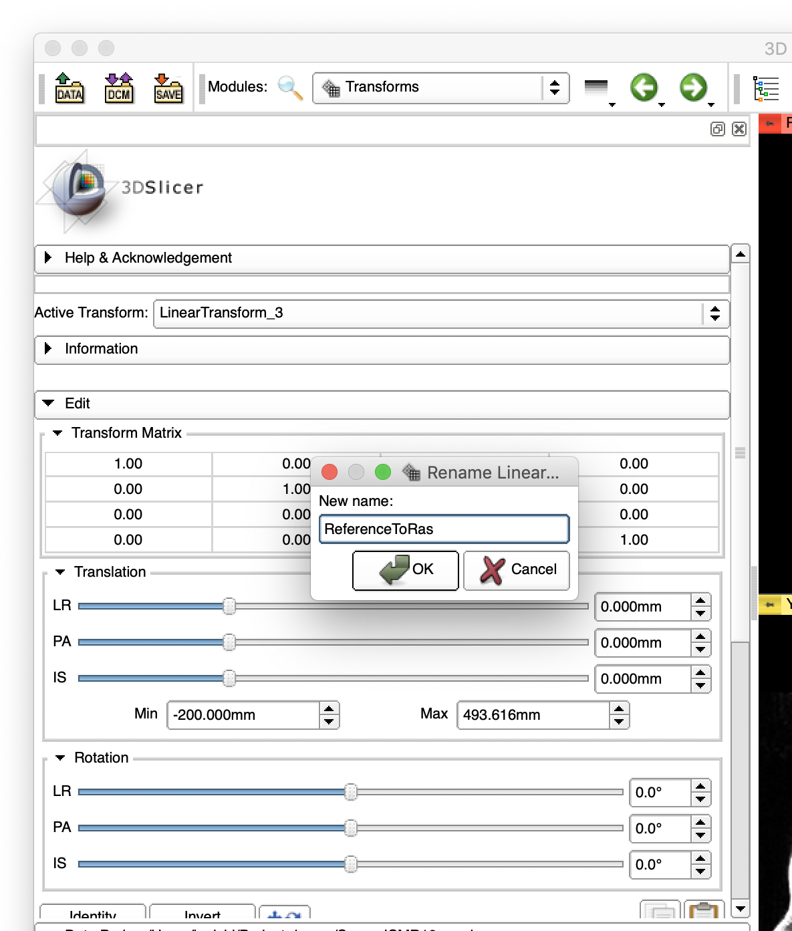
Creating Registration Transform (1)
Open “Transforms” module.
Create a new transform as “ReferenceToRas”.
3. Enter “ReferenceToRas”
1. Select “Transforms” from Modules
4. Click “OK”
2. Select “Create new LinearTransform as..” from “Active Transform”

Slide 53
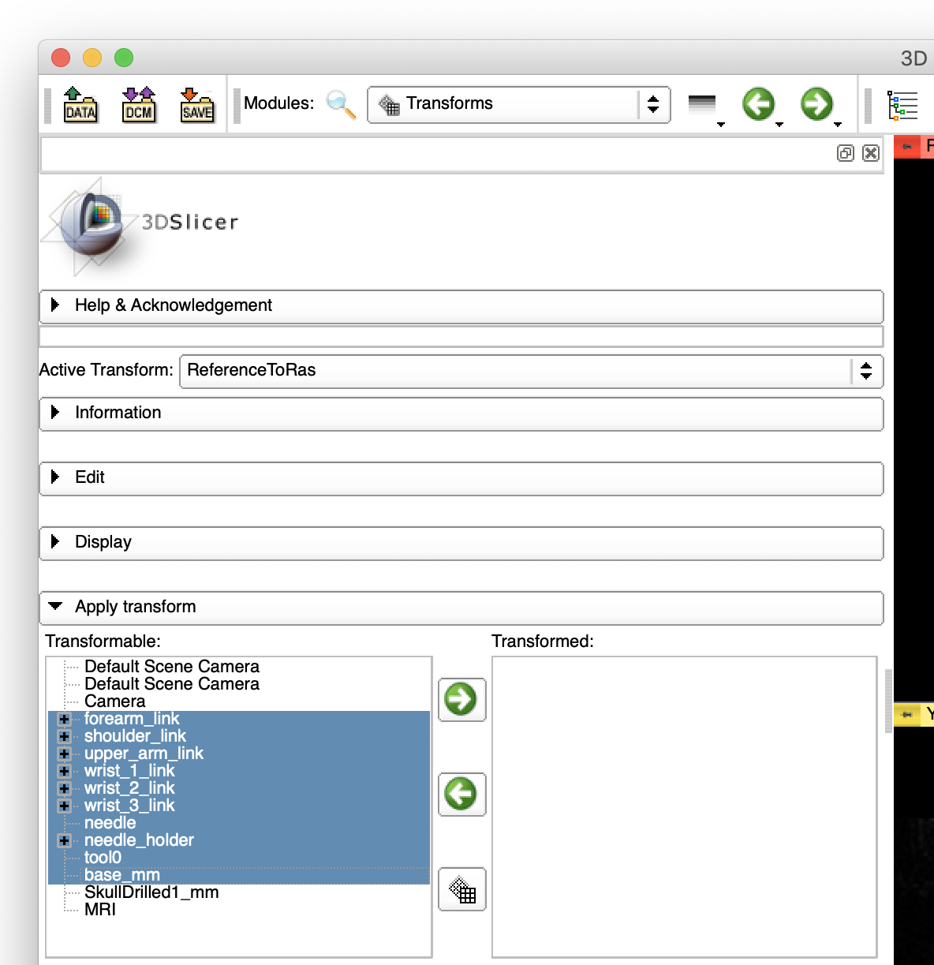
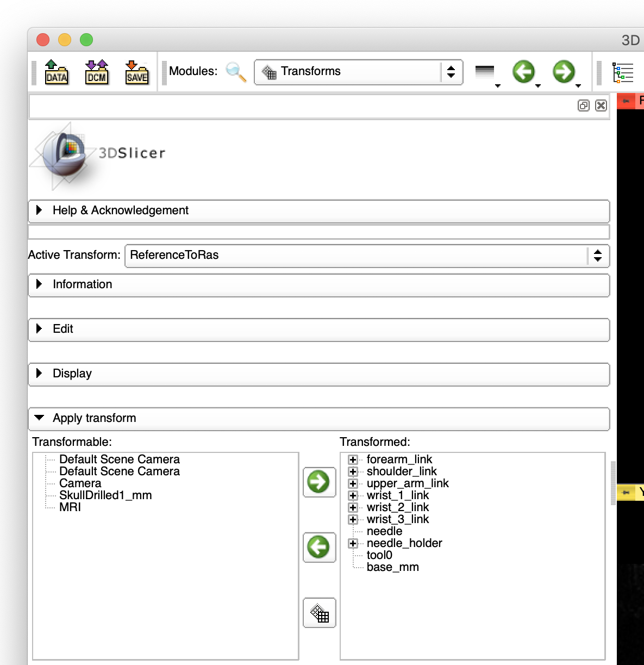
Creating Registration Transform (2)
In “Apply transform” frame, move the all links of the robot and their transforms to ”Transformed”.
1. Open “Apply transform”
2. Select:
forearm_link
shoulder_link
upper_arm_link
wrist_1_link
wrist_2_link
wrist_3_link
needle
needle_holder
tool0
base_mm
3. Click “->” button to move the links and transforms to “Transformed”

Slide 54
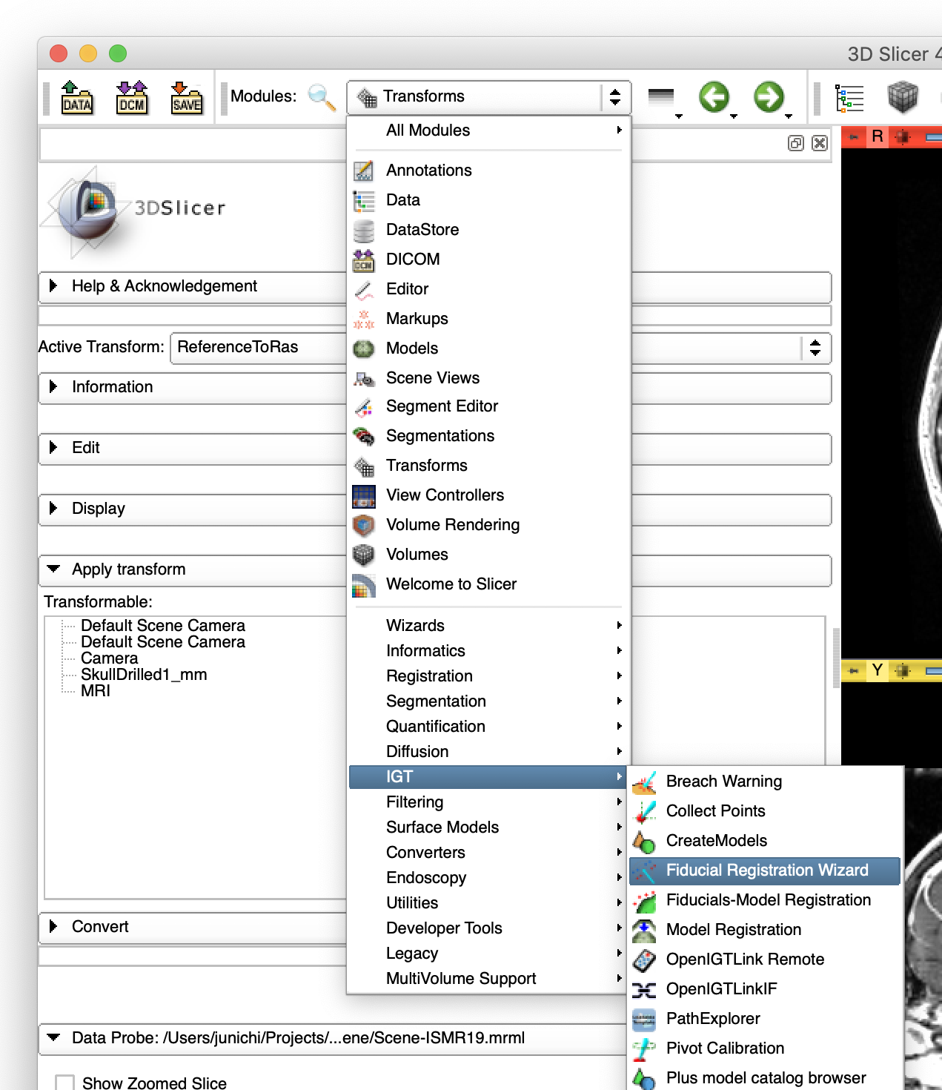
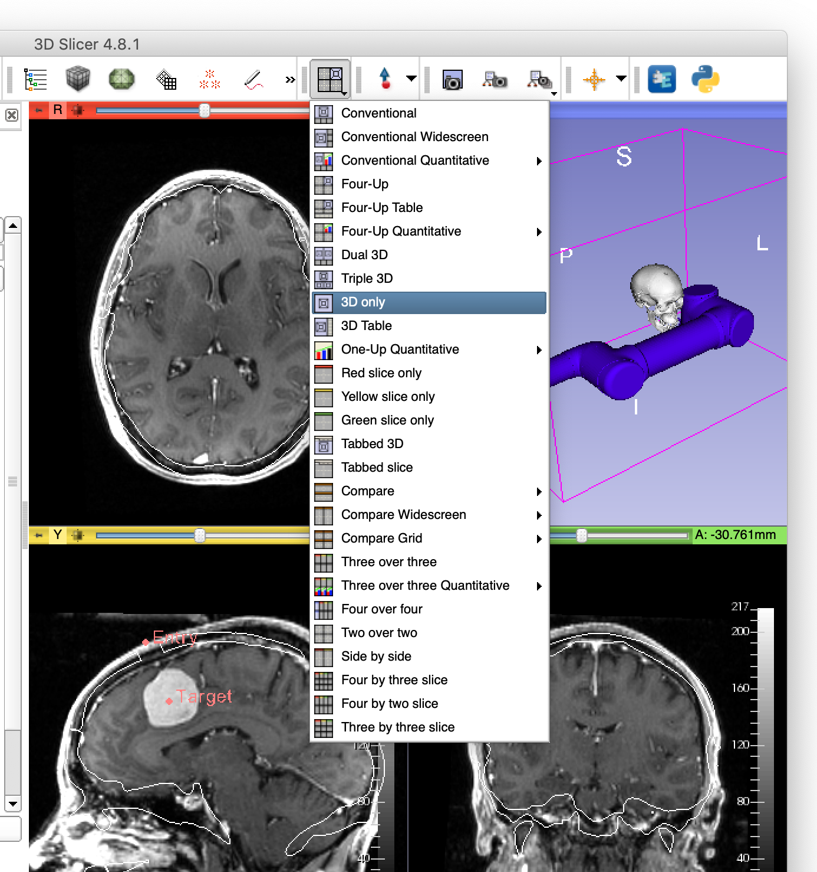
Fiducial Registration Wizard
Open ”IGT” -> “Fiducial Registration Wizard”.
Change to “3D only” view.
2. Select “3D only” view
1. Open “IGT”->”Fiducial Registration Wizard”

Slide 55
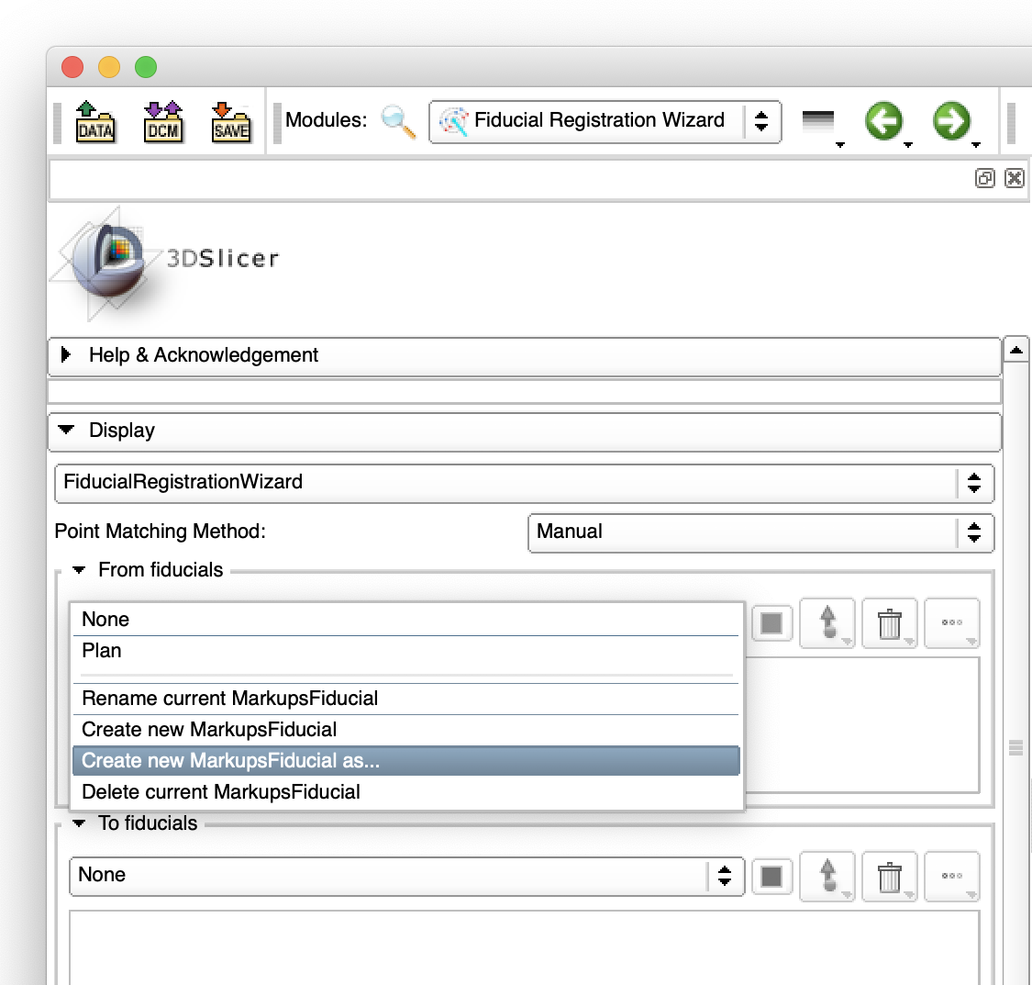
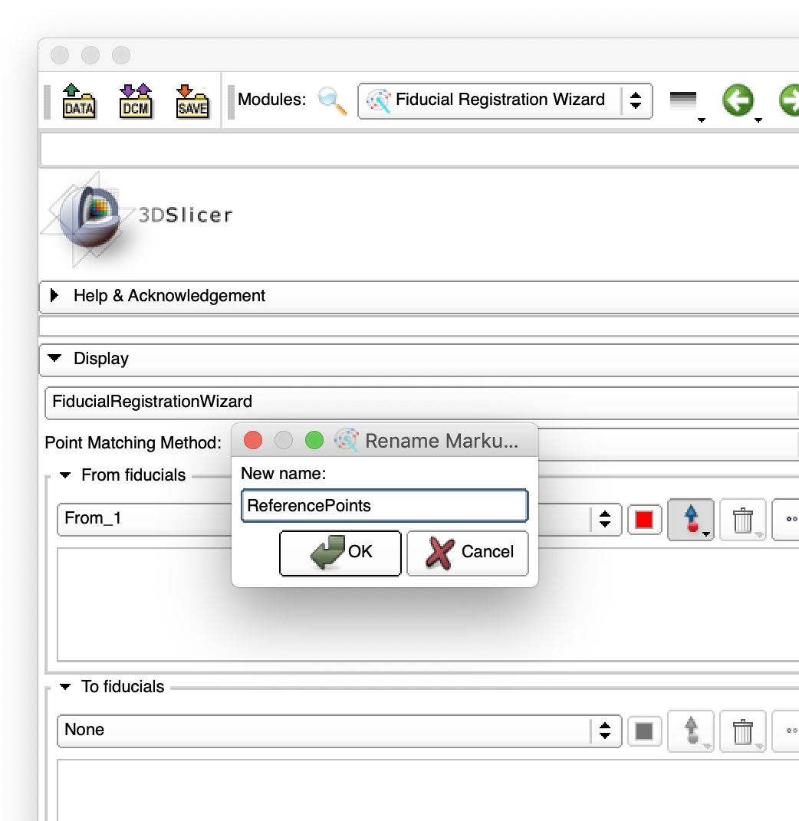
Creating Fiducial Lists (1)
Create a fiducial list for robot as “ReferencePoints”
3. Enter “ReferencePoints”
1. Open “From fiducials”
4. Click “OK”
2. Select “Create new MarkupsFiducials as …”

Slide 56
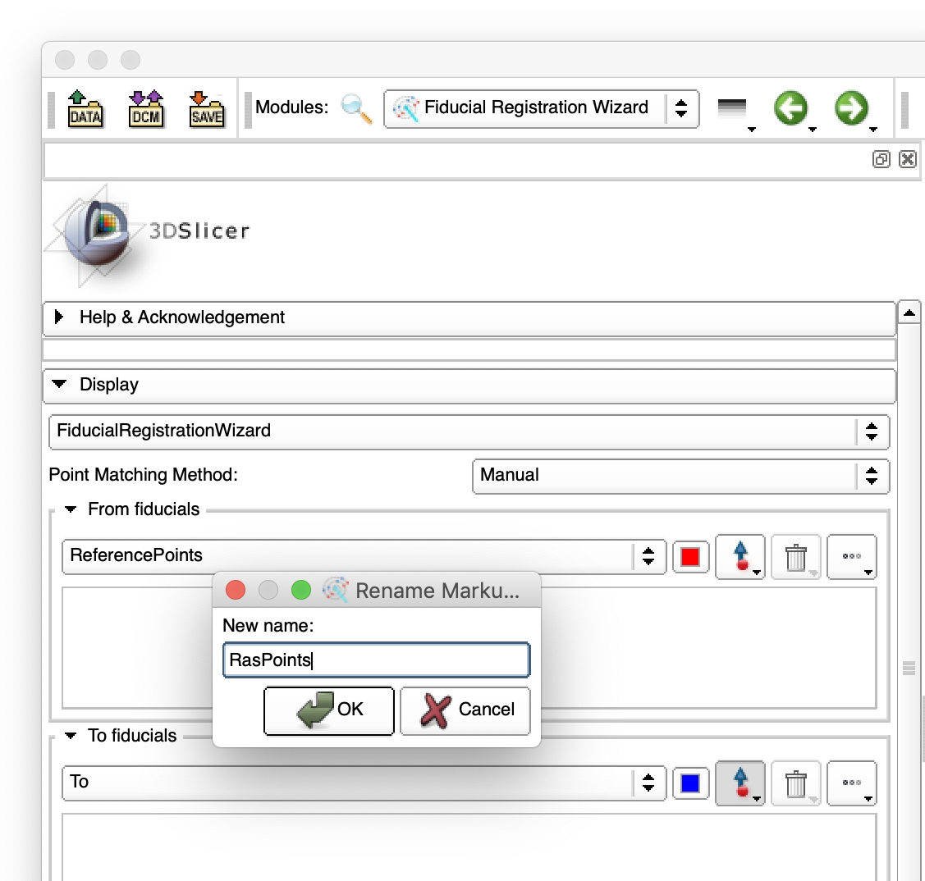
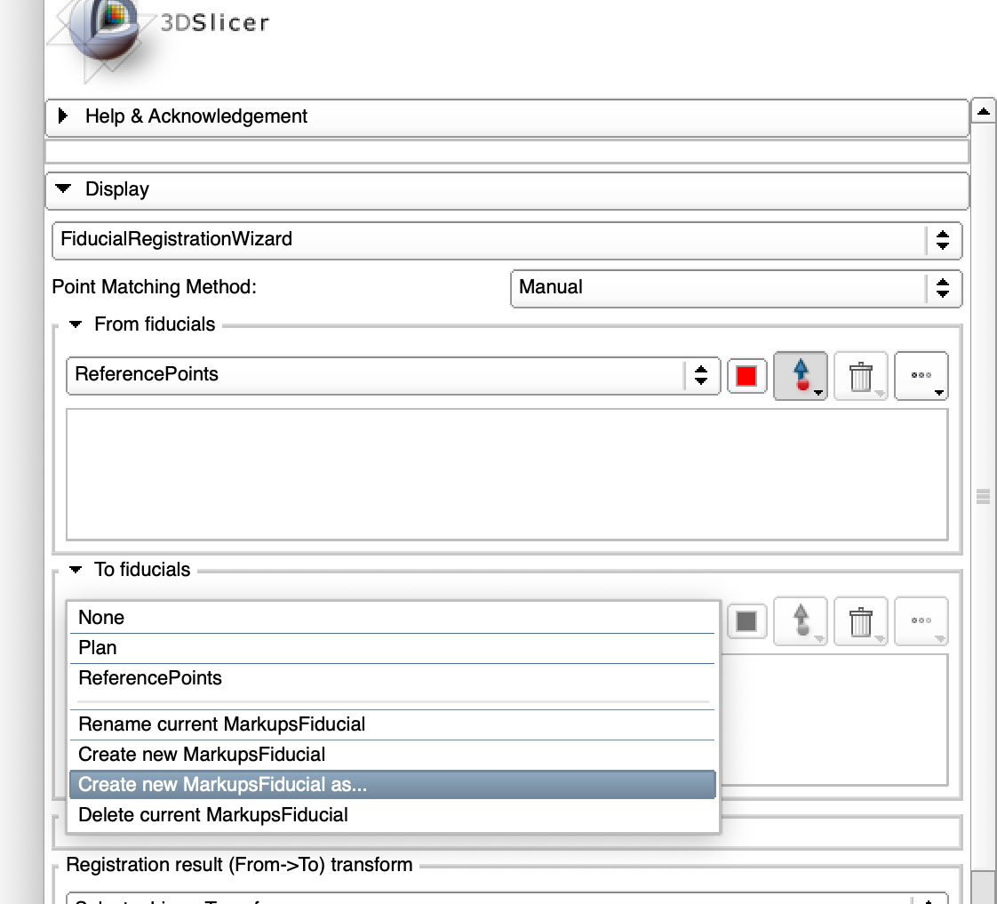
Creating Fiducial Lists (2)
Create a fiducial list for image as “RasPoints”
1. Open “To fiducials”
3. Enter “RasPoints”
4. Click “OK”
2. Select “Create new MarkupsFiducials as …”

Slide 57
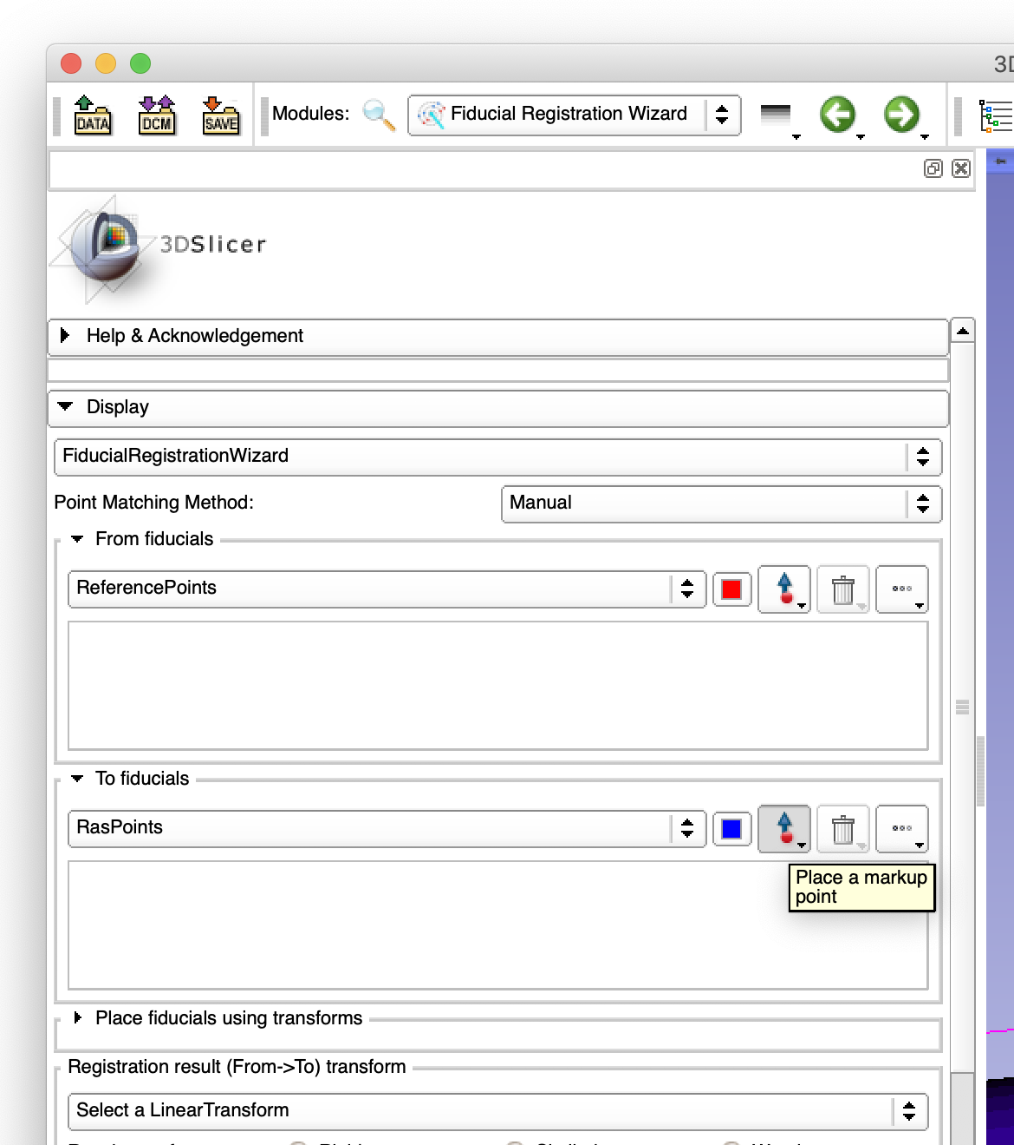
Selecting Landmarks on Image
Click five fiducial markers on the skull in the 3D view.
4. Click 3nd landmark
3. Click 2nd landmark
5. Click 4th landmark
1. Click “Place a markup point”.
2. Click 1st landmark
6. Click 5th landmark

Slide 58
Reviewing Landmarks
The list of the landmarks are shown in “To Fiducials”.
Make sure to deactivate the “Place a markup point” button
2. Deactivate “Place a markup point” button
1. Review the list of landmarks

Slide 59
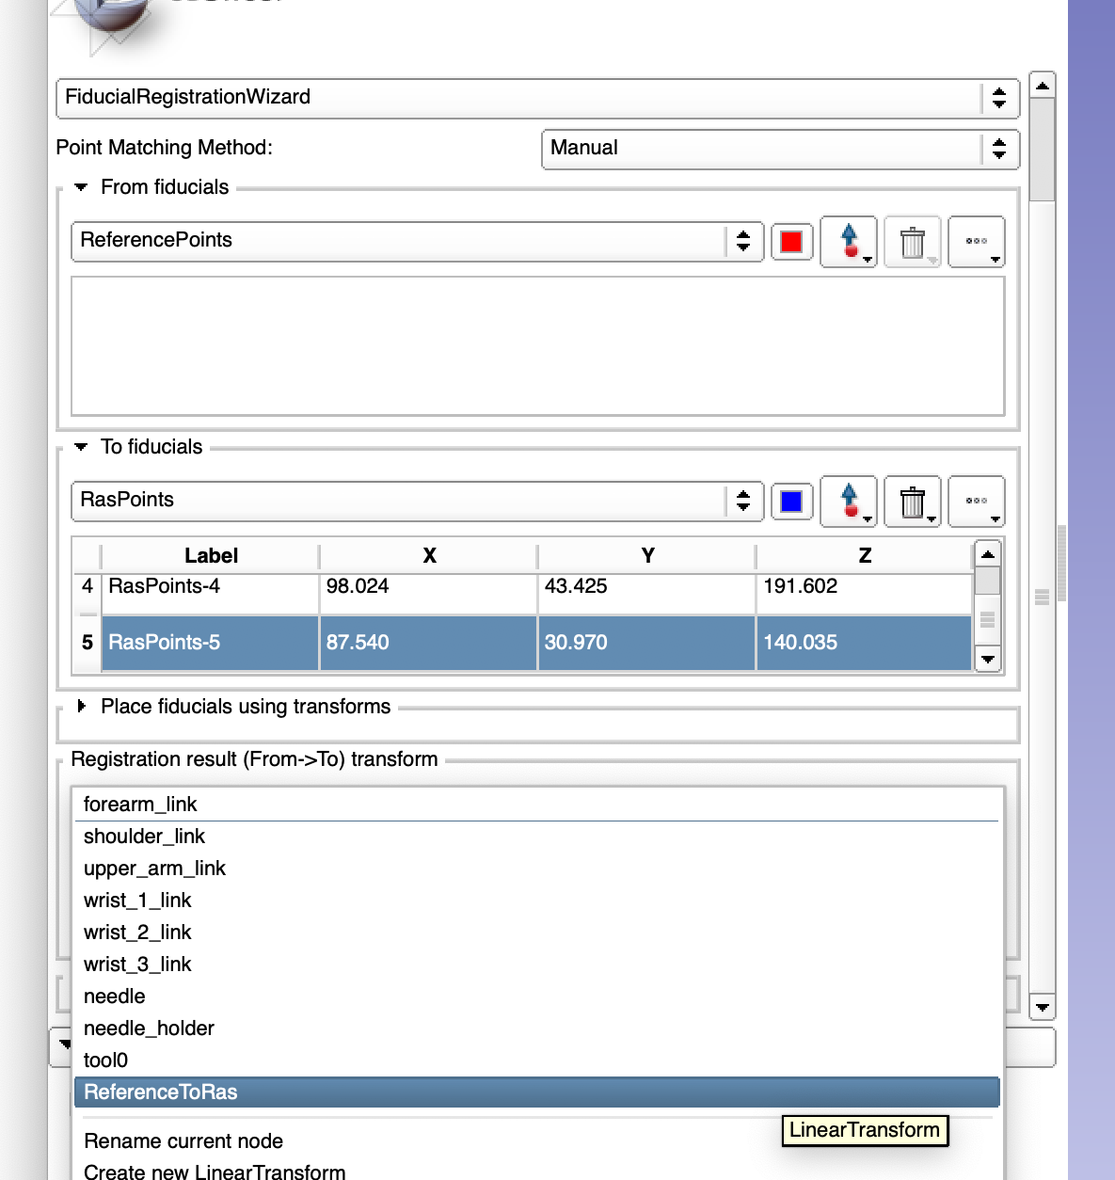
Setting Registration Transform
Select “ReferenceToRas” in “Registration result transform”
1. Open “Registration result (From->To) transform”
2. Select “ReferenceToRas

Slide 60

Selecting Landmarks on Patient (1)
Select the needle transform on 3D Slicer
1. Open “Place fiducials using transforms”
2. Select “needle” for “Place ‘From’”

Slide 61


Selecting Landmarks on Patient (2)
On rviz, move the planned needle tip to the first landmark using the arrows and the disks.
2. The needle turns red, when it contacts the skull model.
1. Move the needle tip to the landmark

Slide 62



Selecting Landmarks on Patient (3)
Generate a plan for execution.
1. Open “Planning”
2. Click “Plan”
3. Wait until the planning is completed.
4. Completed

Slide 63

Selecting Landmarks on Patient (4)
Execute the plan to bring the needle to the landmark.
2. The needle moves to the landmark on rviz
1. Click “Execute”
3. The robot model on 3D Slicer follows

Slide 64


Selecting Landmarks on Patients (5)
Record the coordinates on 3D Slicer.
2. The point appears on the “From fiducials” list
1. Click “Place ‘From’”

Slide 65




Selecting Landmarks on Patients (6)
Repeat the previous steps for the rest of the landmarks.

Slide 66


Selecting Landmarks on Patients (7)
The registration matrix is updated as the landmarks are recorded on 3D Slicer.
1. The needle is now pointing the skull on 3D Slicer
Make sure to activate “Auto-update”

Slide 67
Confirming Registration
Review the relationship between the robot and the patient on rviz and 3D Slicer

Slide 68
Step 4: Targeting

Slide 69
Overview of Step 4 (1)
Coordinate systems for targeting:
  The planned points (i.e. ‘Target’ and ‘Entry’) are defined in the image coordinate system.
  The plan is executed by the robot arm in the robot coordinate system.
Execution of the plan:
  Transform points from the RAS coordinates to the Reference coordinates by applying T_{RAS,Ref}
  T_{RAS,Ref} is the inverse matrix of T_{Ref,RAS}

Slide 70
Overview of Step 4 (2)
A custom control node for this tutorial:
  Receives the coordinates of entry and target points
  Calculate needle orientation and motion plan
  Execute
Robot model
Igtl_
exporter
tf
ROS-IGTL-Bridge
Custom Control Node

Slide 71
Starting Custom Control Node
On a terminal on the ROS computer:
$ cd ~/catkin_ws
$ source devel/setup.bash
$ rosrun ismr19_control ismr19_control_node

Slide 72


Transforming Planned Points (1)
Copy “Plan” to “Plan-Reference”
1. Open ”Data” module
2. Select “Plan”
4. Select “Plan Copy”
3. Right click -> “Clone”
5. Right click -> “Rename”
6. Rename to “Plan-Reference”

Slide 73


Transforming Planned Points (2)
Copy “ReferenceToRas” to “RasToReference”
1. Select “ReferenceToRas”
3. Select “ReferenceToRas Copy”
2. Right click -> “Clone”
4. Right click -> “Rename”
5. Rename to “RasToReference

Slide 74

Transform Planned Points (3)
Invert Transform
1. Select “RasToReference”
2. Right click -> “Invert transform”

Slide 75


Transform Planned Point (4)
Open “RasToReference” transform in “Transforms”
1. Open “Transforms”
2. Click “Active Transform”
3. Select “RasToReference”

Slide 76



Transform Planned Points (5)
Apply “RasToReference” transform to “Plan-Reference”
3. Select ”Plan-Reference”
4. Click “Harden transform” button
2. Click “->” button
1. Select “Plan-Reference”

Slide 77
Sending Plan from 3D Slicer to ROS (1)
Open “OpenIGTLink IF” module
77

Slide 78



Sending Plan from 3D Slicer to ROS (2)
Add “Plan-Reference” in “I/O Configuration”
1. Open “I/O Configuration”
5. “Plan-Reference” appears
2. Select “Scene” -> “IGTLConnector” -> “OUT”
4. Click ”+”
3. Select “Plan-Reference” from the pull-down menu next to “+”

Slide 79

Sending Plan from 3D Slicer to ROS (3)
Send “Plan-Reference” in “I/O Configuration”
1. Click “Send”

Slide 80

Move Needle to Target
Once the Plan is sent to ROS, the robot moves to the entry, and then the target.
1. Needle is moved to the entry
1. Needle is moved to the entry

Slide 81



[Optional] Visualizing Trajectory on MRI
Make the needle visible on MRI
1. Select ”Models” from the Module list
2. Select ”needle_holder_mm”
3. Check ”Visible” in “Slice Display”

Slide 82


[Optional] Visualizing Trajectory on MRI
Switch to ”Four-up” view.
1. Select “Four-up”

Slide 83


[Optional] Visualizing Trajectory on MRI
Align slices with the needle using “Volume Reslice Driver”.
1. Select ”IGT”
2. Select ”Volume Reslice Driver”

Slide 84


[Optional] Visualizing Trajectory on MRI
Select:
  R: Driver: ”needle”, Mode: “Inplane”
  Y: Driver: “needle”, Mode: “Inplane 90”
  G: Driver: “needle”, Mode” “Transverse”
2. Select ”Inplane” from Mode list (for red slice)
1. Select ”needle” from Driver list

Slide 85


[Optional] Visualizing Trajectory on MRI
Turn on slice visibility in 3D View
1. Click the ‘pin’ icon
2. Click “Link/Unlink” button
3. Click “Link/Unlink” button

Slide 86

[Optional] Visualizing Trajectory on MRI
Reformatted 2D slices along the needle is now visible.

Slide 87



[Optional] Visualizing Trajectory while Moving
Terminate the custom control node by pressing Ctrl+c on the terminal.
Move the robot to the home position.
3. Click “Plan”
1. Select ”home” from “Select Goal State”
4. Click “Execute” after the button becomes active.
2. Click “Update”

Slide 88
[Optional] Visualizing Trajectory while Moving
Start the custom control node
Send the target (see page 68)
$ rosrun ismr19_control ismr19_control_node

Slide 89

[Optional] Visualizing Trajectory while Moving
The reformatted plane follows the needle.

Slide 90
References (Web)
Tutorial Page: https://rosmed.github.io/
3D Slicer: http://www.slicer.org/
ROS: http://www.ros.org/
OpenIGTLink: http://openigtlink.org/
ROS-IGTL-Bridge: https://github.com/openigtlink/ROS-IGTL-Bridge

Slide 91
References (Papers)
Fedorov A, Beichel R, Kalpathy-Cramer J, Finet J, Fillion-Robin JC, Pujol S, Bauer C, Jennings D, Fennessy F, Sonka M, Buatti J, Aylward S, Miller JV, Pieper S, Kikinis R. 3D Slicer as an image computing platform for the Quantitative Imaging Network. Magn Reson Imaging. 2012 Nov;30(9):1323-41. doi: 10.1016/j.mri.2012.05.001. Epub 2012 Jul 6. PubMed PMID: 22770690; PubMed Central PMCID: PMC3466397.
Frank T, Krieger A, Leonard S, Patel NA, Tokuda J. ROS-IGTL-Bridge: an open network interface for image-guided therapy using the ROS environment. Int J Comput Assist Radiol Surg. 2017 Aug;12(8):1451-1460. doi: 10.1007/s11548-017-1618-1. Epub 2017 May 31. PubMed PMID: 28567563; PubMed Central PMCID: PMC5543207.
Tauscher S, Tokuda J, Schreiber G, Neff T, Hata N, Ortmaier T. OpenIGTLink interface for state control and visualisation of a robot for image-guided therapy systems. Int J Comput Assist Radiol Surg. 2015 Mar;10(3):285-92. doi: 10.1007/s11548-014-1081-1. Epub 2014 Jun 13. PubMed PMID: 24923473; PubMed Central PMCID: PMC4265315.
Tokuda J, Fischer GS, Papademetris X, Yaniv Z, Ibanez L, Cheng P, Liu H, Blevins J, Arata J, Golby AJ, Kapur T, Pieper S, Burdette EC, Fichtinger G, Tempany CM, Hata N. OpenIGTLink: an open network protocol for image-guided therapy environment. Int J Med Robot. 2009 Dec;5(4):423-34. doi: 10.1002/rcs.274. PubMed PMID: 19621334; PubMed Central PMCID: PMC2811069.
Ungi T, Lasso A, Fichtinger G. Open-source platforms for navigated image-guided interventions. Med Image Anal. 2016 Oct;33:181-186. doi: 10.1016/j.media.2016.06.011. Epub 2016 Jun 15. Review. PubMed PMID: 27344106.

Slide 92
Contact
If you have any questions or feedback regarding this tutorial, please contact:
Junichi Tokuda, Ph.D.
  Department of Radiology
  Brigham and Women’s Hospital / Harvard Medical School
  tokuda @ bwh.harvard.edu

