Slide 1
Работу выполнила учитель английского языка МБОУ СОШ № 28 города Пятигорска
Барекян Алла Георгиевна
Презентация к уроку английского языка в 4 классе на тему: «Счастливы в городе и в деревне» «Being happy in the country and in the city»

Slide 2
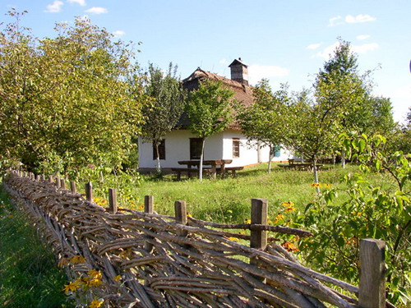
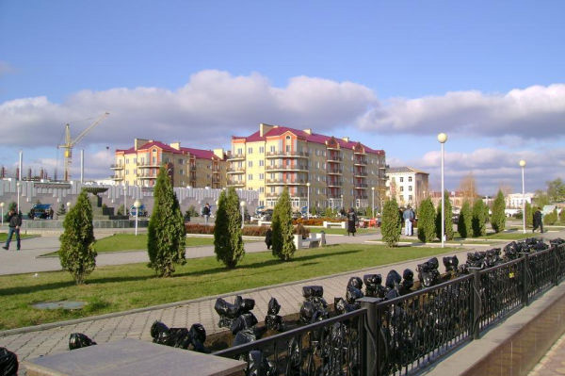
Being happy in the country and in the city

Slide 3



Listen, read and learn:
Warm – warmer – the warmest
Cold – colder – the coldest
Clean – cleaner – the cleanest
Kind – kinder – the kindest
Tall – taller – the tallest
hot- hotter- the hottest
fat – fatter- the fattest

Slide 4
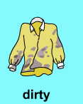
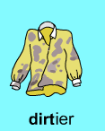
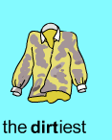
sunny – sunnier – the sunniest
happy – happier – the happiest
hungry – hungrier – the hungriest
merry – merrier – the merriest

Slide 5
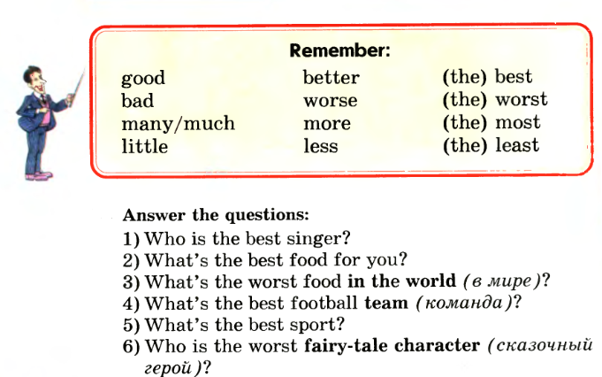

Slide 6
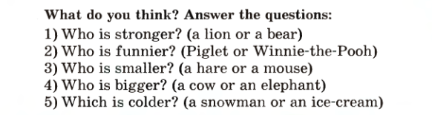
Упражнение 1
Напишите прилагательные в трёх степенях сравнения.
Noisy, nice, wide, green, deep, old, hot, fat, windy, merry.
Упражнение 2

Slide 7
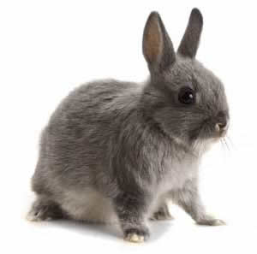
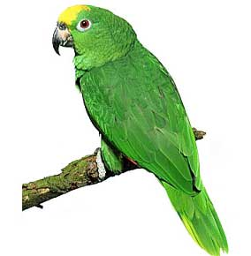
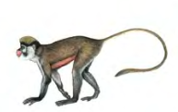
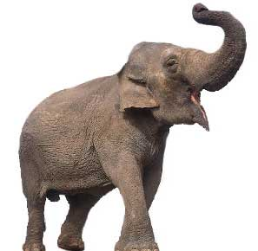
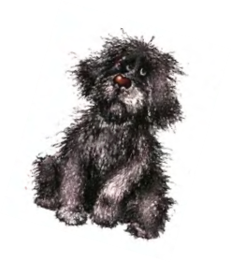
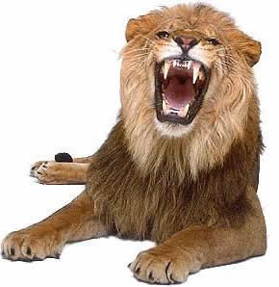
Упражнение 3
Compare the animals. Use the words: useful, clever, big, strong, beautiful, funny.
Ex: An elephant is bigger than a lion.

Slide 8

Let’s sing.
If you are happy and you know it
1.Clap your hands…
If you are happy and you know it.
Then your face will surely show it
If you are happy and you know it
Clap your hands…
2. …stamp your feet.
3. … shout”Hurray!”
… Do all four (clap, clap, stamp, stamp,
shout “Hurray!”)

Slide 9
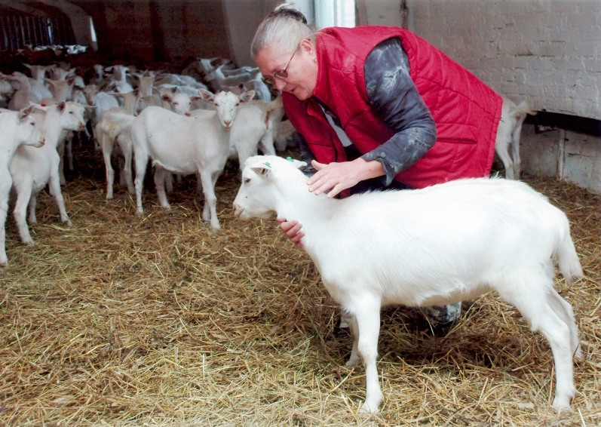
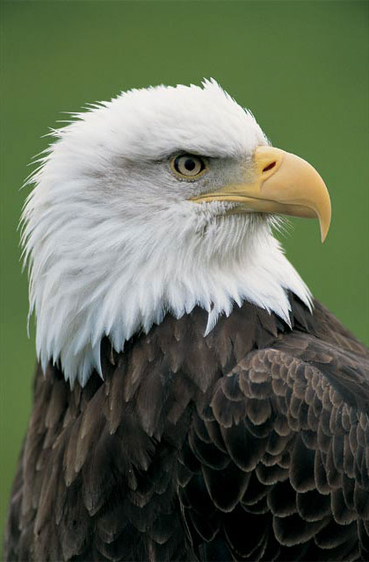
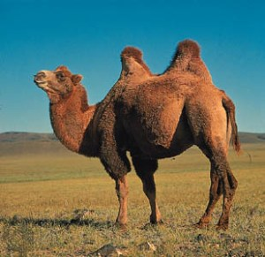
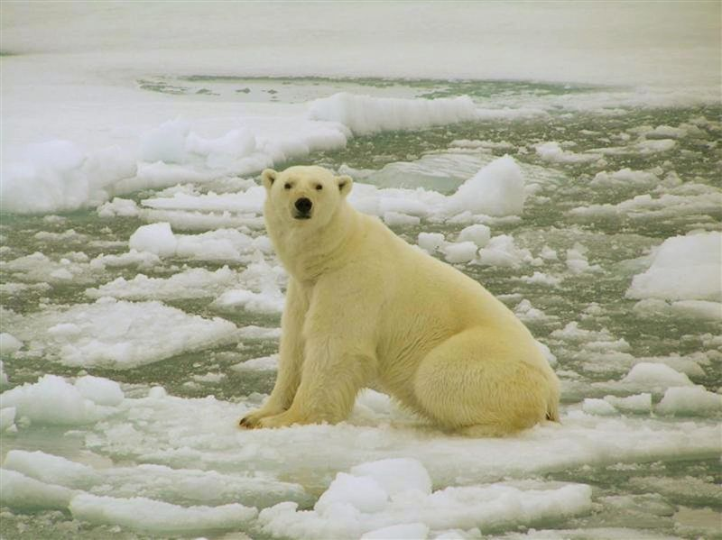
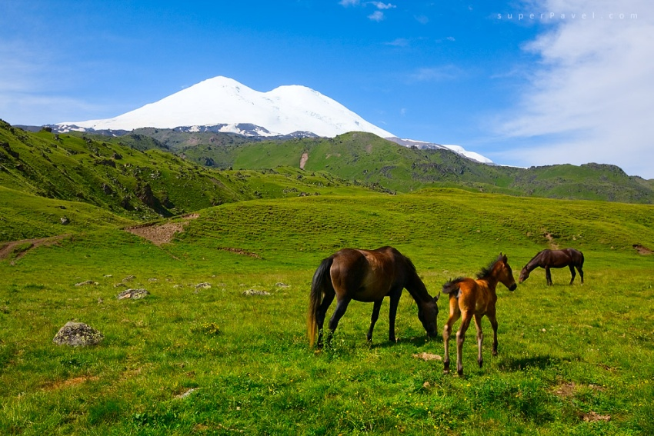
Упражнение 3
Say which animals live:
a). On the farm b). In the zoo c). In the forest d). In the mountains
e). In the river f). In the ocean g). In the desert e). In the sea

Slide 10
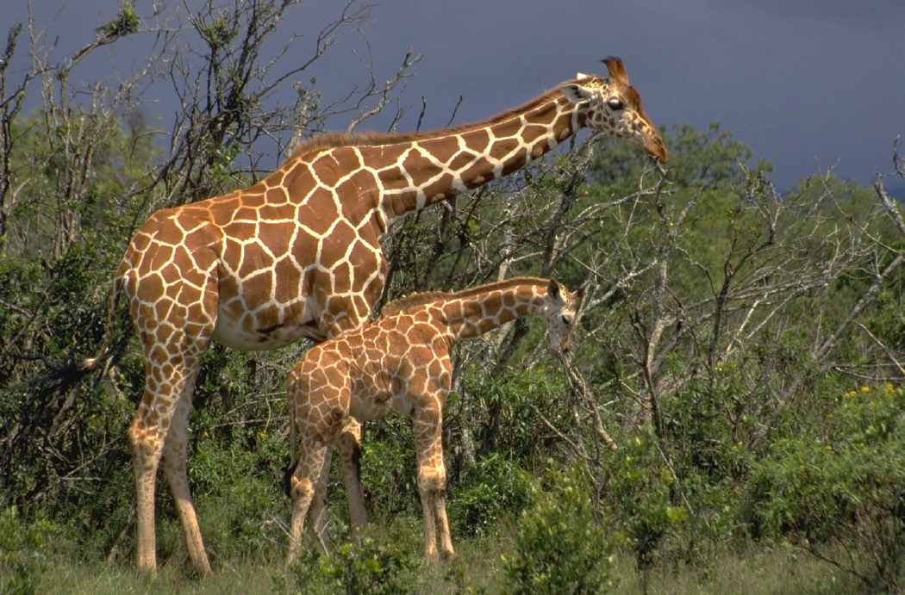
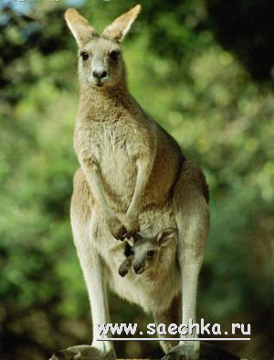
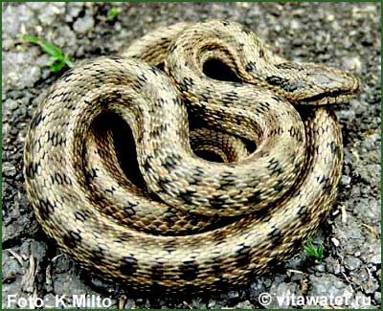

Slide 11
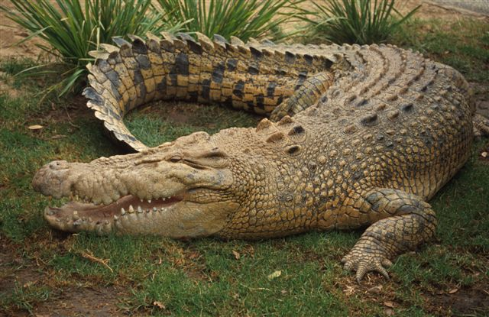

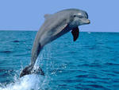
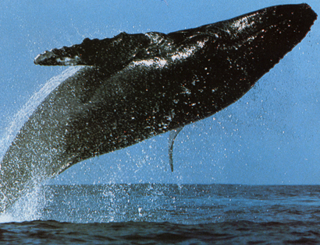

Slide 12
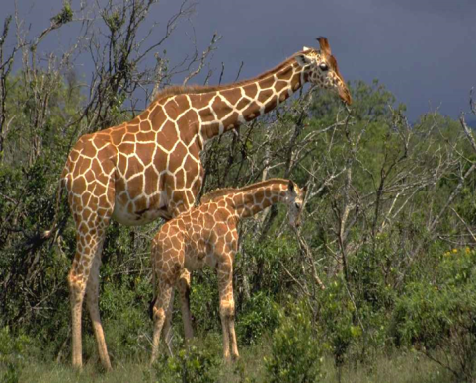
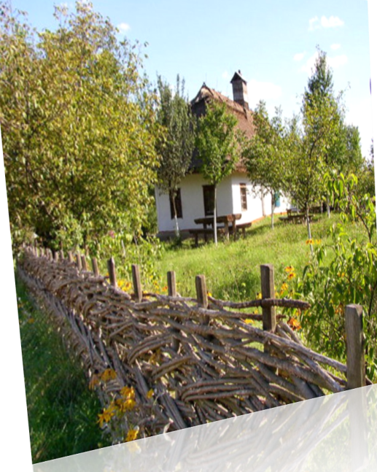
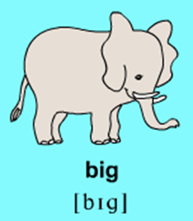
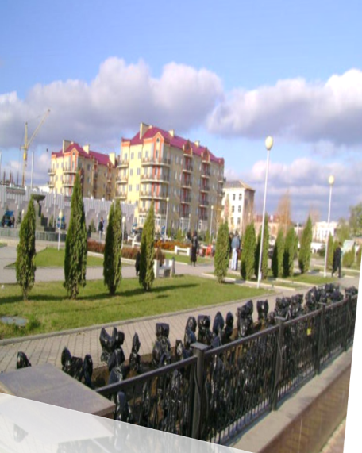


I liked I didn’t like
- to work together
to play games
to say new words
to write adjectives
to speak about my classmates
to sing a song
to make sentences

Slide 13

describe
animals
Speak about
my classmates
write adjectives
Now I can…
say where
animals live
sing a merry song
know irregular
adjectives
Now I can sing a merry song.

