Slide 1

TALLER 4
Cómo Alcanzar a Su Ciudad
y País para Cristo
Multiplicar Iglesias
que Multiplican Discípulos
10-7-20
Notes:
WORKSHOP 4
How to Reach Your City and Country for Christ
Multiply Churches that Multiply Disciples
Greetings and Introductions
If there is a local coordinator, he will welcome the participants, introduce the trainers, and open the workshop in prayer.
Thank the pastors and leaders for coming
Trainers introduce themselves

Slide 2
Talleres
1. Cómo Hacer Crecer Su Iglesia
Multiplicar Discípulos
2. Equilibrar la Vida personal y el Ministerio
3. Cómo Entender y Aplicar la Biblia
  Cómo Predicar Efectivamente
4. Cómo Alcanzar a Su Ciudad y País para Cristo
  Multiplicar Iglesias que Multiplican Discípulos
Notes:
Workshops
How to Grow Your Church
Multiply Disciples
Balancing Personal Life and Ministry
How to Understand and Apply the Bible
How to Preach Effectively
How to Reach Your City And Country for Christ
Multiply Churches that Multiply Disciples

Slide 3
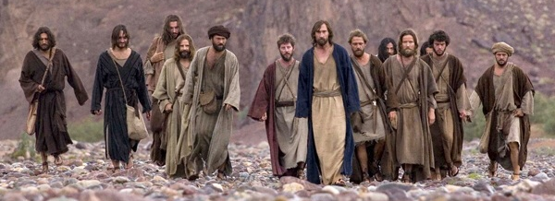
La Gran Comisión
La misión de cada iglesia y cada creyente
Mateo 28: 19-20
Una Iglesia que Hace Discípulos Multiplicadores
Lección 1
Taller 4 página
Notes:
A Church that Makes Multiplying Disciples
Lesson 1
In Workshop 1 you learned how individuals can make multiplying disciples with Foundations material.
The Great Commission
The Mission of Every Church and Every Believer
Matthew 28:19-20

Slide 4
“Plan de Jesús
“Multiplicandos Discípulos”
Modelo (Juan 20:21)
Ejemplo (2 Timoteo 2:2)
Jesus
MultiplIcar
Pablo
12 Discipulos
Timoteo
Cristianos Obedientes
(Discípulos)
Hombres Fieles
(Discípulos)
Todas las Naciones
Otros
También
Notes:
Jesus’ Plan
“Multiplying Disciples”
Jesus trained 12 disciples for 3 years to make multiplying disciples just as He did
and reach all nations
Paul is an example of obeying the Great Commission
as he trained Timothy
to train faithful men
who would teach others also
and finish the Great Commission.

Slide 5

Línea de Tiempo de la Gran Comisión
Hechos 1
Juan 20
Mateo 28
Marcos 16
Lucas 24
3 Dias
40 Dias
Ascensión
Resurección
Dado 5 veces
Después de su resurrección
Crucifixión
Notes:
Great Commission Timeline
Jesus gave the Great Commission 5 times after His resurrection
Whatever Jesus said after His death and resurrection with such repetition
must motivate us to obedience.

Slide 6
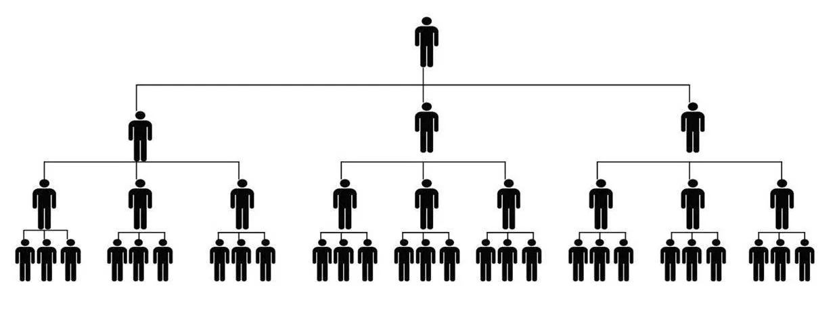

La Gran Comisión
Mateo 28: 19-20
Qué
Haced discípulos multiplicadores
Dónde
Todas las naciones
Notes:
Matthew 28:19-20
What we are to do:
Make disciples who multiply: As defined by Jesus using Jesus’ process.
Where we are to do it:
All Nations: All nationalities (No discrimination), the entire world.

Slide 7
The Great Commission
Matthew 28:19-20
Cómo
En el transcurso de su vida
Evangelizmo
Discipulado
A través del poder del Espíritu Santo
Notes:
How we are to do it:
Go: As you go through life, wherever you are
Baptizing: Discipleship starts with Evangelism
Leading people to faith in Christ.
Teaching obedience to all of Jesus’ commands: Discipleship.
Maturing in all of the ingredients of a disciple.
I am with you always: Make disciples through the power of the Holy Spirit

Slide 8
Proceso de Discipulado de Fundamentos
Evangelismo | Discipulado
1. Venir | 2. Crecer | 3. Servir | 4. Ir
Adoración Compañerismo | Palabra de Dios Oracion | Servicio | Evangelismo
Notes:
Foundations Discipleship Process
Jesus used four distinct training phases to make His disciples and we do the same thing.
We follow a process of
Come (Evangelism)
Grow-Serve-Go (Discipleship)
Ingredients of a disciple of Jesus
From the Great Commandment and the Great Commission
Worship, Fellowship, God’s Word, Prayer, Service, and Outreach
This figure shows how all of the ingredients of a disciple are included in the discipleship process.

Slide 9
16,000
El Poder
de la Multiplicación
4,000
Discípulos
512
128
16
1
4
1
5
10
15
Años
Notes:
Power of Multiplication
Utilize apprenticeship to multiply
Every Foundations leader should identify at least one person
who they are spending extra time with
to train them to become a Foundations leader
One disciple multiplying every year will make 16,000 disciples in 15 years

Slide 10
Multiplicar Discípulos por Aprendizaje
8. Entrenamiento Continuo
7. Líder
Proceso de Aprendizaje
6. Co-Líder
5. Observar y Adiestrar
4. Entrenamiento Inicial
3. Observar al Líder
2. Escoger
1. Modelar
Notes:
Multiply Disciples by Apprenticeship
Model how to lead Foundations
Choose the right people
Only a few people have the gifts, abilities, and calling to be Foundations leaders.
They understand this is about life change
They are: Faithful, Available, Teachable, and Responsive
Ask the potential apprentice to observe you lead
Initial Leader Training using the “Foundations Leader Training Guide”
Observe and Coach them leading several sections of Foundations
Go through the Pre-Meeting Reminders with them before the meeting
Observe them as they lead
Coach them afterward using the Post-Meeting Evaluation
Ask them to be a co-leader
Allow them to lead on a regular basis
Observe and coach them using the Foundations Meeting Checklist
Do this until you think they are ready to lead
Ask them to be the leader of Foundations
Ongoing training with other Foundations leaders

Slide 11
Cómo Alcanzar a su Comunidad, Ciudad y País para Cristo
Alcanzar a su comunidad convirtiéndose en una iglesia que hace discípulos multiplicadores
Alcanzar a su ciudad para Cristo plantando iglesias que hagan discípulos multiplicadores
Alcanzar a su país para Cristo capacitando a otros pastores cómo a enseñar estos talleres
Notes:
B. This workshop is to train pastors and leaders how their churches can make multiplying disciples to reach your community, city, and country for Christ.
1. Reach your community by becoming a church that makes multiplying disciples
• Start multiplying Foundations discipleship groups
• Make sure all ministries are helping to make multiplying disciples
2. Reach your city for Christ by planting churches that make multiplying disciples
• Grow churches by multiplying Foundations groups until there is enough support to start a new church
3. Reach your country for Christ by training other pastors how to teach these workshops
• Pastors train other pastors until every city and community has been reached for Christ

Slide 12
Implementación de Talleres Anteriores
Usted está:
1. Haciendo discípulos multiplicadores por media del aprendizaje
2. Implementando metas para la vida personal y ministerial
3. Entrenando las personas sobre a hacer un estudio bíblico personal
Notes:
C. Assumptions for what you are implementing from what you learned in previous workshops
Workshop 1: You have passion for and are discipling your leaders in a Foundations group and training them with the apprenticeship process how to make multiplying disciples in Foundations groups.
Workshop 2: You are committed to having goals and are creating and implementing goals for your personal and ministry life.
Workshop 3: You are growing in your love for God’s Word and are training people how to do personal Bible study

Slide 13
Elementos de una Iglesia
que Hace Discípulos Multiplicadores
Estrategia normal de la iglesia
Principalmente eventos y programas a corto plazo
No hace discípulos multiplicadores
vs
La estrategia de Jesús
De cerca, personal y con el tiempo
Incluye un proceso y los ingredientes necesarios para que la gente crezca y llegue a ser como Jesús
Hace discípulos multiplicadores
Notes:
II. Elements of a Disciplemaking Church
If we want to understand the elements that your church must have
in order to become a disciplemaking church,
we need to understand Jesus’ strategy
as opposed to the strategy most churches use.
Normal church strategy
Mainly events and short-term programs
Does not make multiplying disciples
vs
Jesus’ strategy
Up close, personal, and over time
Includes a process and ingredients to help people grow to become like Jesus
Makes multiplying disciples
To achieve the results Jesus wants for us,
we must be patient and take the time needed to make multiplying disciples.

Slide 14
1. Entrenar a Líderes de Discipulado
de Fundamentos
Esta es el área con la que la mayoría de las iglesias luchan
Los líderes que no han sido entrenados para hacer discípulos multiplicadores no pueden hacer discípulos multiplicadores
Este es el elemento más crítico para hacer discípulos multiplicadores
Notes:
Train Foundations Discipleship Leaders
Having leaders trained to make multiplying disciples is the area most churches struggle with.
Leaders who have not been trained to make multiplying disciples cannot make multiplying disciples.
This is the most critical element in making multiplying disciples.

Slide 15
1. Entrenar Líderes de Discipulado
de Fundamentos
12-18 Meses
Repase la "Guía de Entrenamiento para Líder de Fundamentos”
Comience un grupo de Fundamentos con líderes potenciales
Entrene líderes de Fundamentos por aprendizaje
Notes:
Train Foundations Discipleship Leaders
Pastors should do the following to start creating disciplemaking leadership in their church:
Review:
“Multiply Disciples by Apprenticeship”
and “How to Lead a Foundations Meeting”
in the “Foundations Leader Training Guide”
Start the first Foundations Group with people you think have the potential to become Foundations leaders
Train Foundations leaders by apprenticeship

Slide 16
Antes de que alguien pueda dirigir Fundamentos, necesitará:
• Tener los dones espirituales, habilidades, y llamado para dirigir Fundamentos
• Haber sido entrenados en la "Guía de Entrenamiento para Líder de Fundamentos”
• Haber terminado el proceso de aprendizaje (12-18 meses)
Notes:
Before someone can lead Foundations, they will:
Have the spiritual gifts, abilities, and calling to lead Foundations
Have been trained in the Foundations Leader Training Guide
Have completed the apprenticeship process (12-18 months)

Slide 17
2. Iniciar Grupos de Fundamentos
en Toda la Iglesia
Después de una serie de sermones de 4 semanas, iniciar grupos de Fundamentos en toda la iglesia
Iniciar grupos de Fundamentos en toda la iglesia
4 Semanas
Notes:
2. Start Foundations Groups in the Whole Church
After 12-18 months you will have trained enough Foundations leaders
and can begin the process of involving all of your church members
in being a church that makes multiplying disciples.
Don’t start your Foundations groups in the whole church until you have enough trained Foundations leaders
After a 4-week sermon series, you will start Foundations groups in the whole church.

Slide 18
3. Multiplicar por Aprendizaje
Continuar creciendo tu iglesia haciendo discípulos multiplicadores a través del aprendizaje
Notes:
3. Multiply by Apprenticeship
After starting Foundations groups in the whole church, you will have everything in place
To continue growing your church by making multiplying disciples through apprenticeship.
An essential aspect of a church that makes multiplying disciples is that
Foundations leaders train apprentices.
An apprentice is someone who is learning
to become a Foundations leader.

Slide 19
4. Administrar la Iglesia que Hace Discípulos Multiplicadores
El trabajo principal del pastor
Entrenar y administrar líderes para hacer el trabajo del ministerio
Notes:
4. Manage the Church that Makes Multiplying Disciples
After starting Foundations groups in the whole church, you will have to manage the church structure that makes multiplying disciples
The primary job of the pastor is to train and manage leaders to do the work of the ministry.
As your church grows, you will need to develop more leaders.

Slide 20
Elementos de una Iglesia
que Hace Discípulos Multiplicadores
1. Entrenar a Líderes de Discipulado de Fundamentos
12-18 Meses
2. Iniciar grupos de Fundamentos
en toda la iglesia
4 Semanas
3. Multiplicar por Aprendizaje
4. Administrar la Iglesia
que Hace Discípulos Multiplicadores
Notes:
Summary
First start a Foundations group with potential leaders
And train Foundations leaders by apprenticeship
Then you go through a process of involving all of the church members in becoming a church that makes multiplying disciples
And start Foundations groups in the whole church
Then you continue to grow your church by multiplying disciples through apprenticeship
And train and manage leaders to do the work of the ministry

Slide 21
Proceso de Convertirse en una Iglesia
que Hace Discípulos Multiplicadores
Los líderes de Fundamentos invitan a las personas a estar en sus nuevos Grupos de Fundamentos
2. El pastor prepara 4 sermones sobre discipulado
3. Iniciar la serie de sermones de 4 semanas
  Anuncio y testimonio
  Líderes de las Fundamentos con hojas de inscripción
  Iniciar Grupos de Fundamentos en Toda la Iglesia
Notes:
III. Process of Becoming a Church that Makes Multiplying Disciples
After the pastor has trained Foundations leaders by apprenticeship,
you can begin process of making multiplying disciples in Foundations Groups in the whole church.
Trained Foundations leaders start inviting people to be in their new Foundations Groups
Pastor prepares 4 sermons on discipleship by adapting the examples in the Appendix to fit your church situation.
Begin the 4-week sermon series
Have an announcement and a testimony from a member of your Foundations group every service
Foundations leaders will be ready with sign-up sheets after each service
Start Foundations Groups at the end of the sermon series

Slide 22
Tener servicios dominicales periódicamente para iniciar nuevos grupos de Fundamentos
El servicio incluirá:
  Un anuncio
  Un testimonio de una vida cambiada
  Un sermón sobre el discipulado
Una iglesia saludable
hace discípulos multiplicadores
Notes:
As your church grows and you have more trained Foundations group leaders,
you will periodically have Sunday services devoted to starting new Foundations groups.
The service will include:
An announcement that Foundations small groups are starting
and group leaders with sign-up sheets are available after the service.
A testimony by someone whose life has been changed by being in a Foundations group
A sermon on discipleship and a challenge to join a Foundations group
The leaders for the new Foundations groups should also be inviting people to be in their group.
The health of your church will be determined by the ability of your church to continue to make multiplying disciples.
Study and apply:
“How to Manage Change to Become a Disciplemaking Church”
at foundationsglobal.com,
“Other Discipleship Resources”

Slide 23
Formar grupos de 2 a 5 personas
Discute los 4 elementos
¿Qué se requiere para que una persona lidere un grupo de Fundamentos?
¿Cómo implementará esto en su iglesia?
Elementos de una Iglesia
que Hace Discípulos Multiplicadores
Entrenar Líderes de Discipulado de Fundamentos
Iniciar Grupos de Fundamentos en Toda la Iglesia
Multiplicar por Aprendizaje
Administrar la Iglesia que Hace Discípulos Multiplicadores
Notes:
Form groups of 2 to 5 people
Discuss the 4 elements of a church that makes multiplying disciples
What is required for a person to lead a Foundations group?
How will you implement this in your church?
What comments or questions do you have?
Elements of a Church
that Makes Multiplying Disciples
Train Leaders to Make Multiplying Disciples
Start Foundations Groups in the Whole Church
Multiply by Apprenticeship
Manage the Church that Makes Multiplying Disciples

Slide 24
Cómo Crear y Dirigir un Equipo de Líder de Fundamentos
Lesson 2
El núcleo de un ministerio de discipulado es el Equipo de Líder de Fundamentos
Dios usará este equipo para hacer que su iglesia crezca de la manera en que Jesús quiere que crezca
8
Notes:
How to Create and Lead a Foundations Leader Team
Lesson 2
I. Introduction
Just like leadership is the core of your church,
the core of a ministry that makes multiplying disciples is the Foundations Leader Team
The Foundations Leader Team is made up of people
who care about discipleship
and want to see the church grow Jesus’ way.
God will use this team to build your church.

Slide 25
Los líderes de Fundamentos se asocian
con usted para hacer el trabajo más importante en su iglesia
Están entrenando discípulos
  para encontrar su lugar de ministerio en su iglesia
Se multiplican por medio del aprendizaje
  y alcanzan a su comunidad para Cristo
Notes:
Foundations leaders partner with you to do the most important work in your church.
They are training your people to be disciples
and find their place of ministry in your church.
They are multiplying by apprenticeship
and reaching your community for Christ.

Slide 26
Creación de su Equipo de Líder de Fundamentos
Miembros del equipo de líderes d Fundamentos
Líderes de Fundamentos
Aprendices de Fundamentos que se convertirán en líderes de Fundamentos
8
Notes:
II. Creating Your Foundations Leader Team
The team is made up of existing Foundations group leaders
and apprentices who are future Foundations group leaders.
When you are first starting your Foundations ministry,
this leadership team will be small,
and will grow as you continue to train new leaders through apprenticeship.

Slide 27
Busque líderes que sean fieles, disponibles, educables y receptivos
Las personas se agregarán al equipo cuando se conviertan en co-líderes en los grupos de Fundamentos
8
Notes:
Look for leaders who are faithful, available, teachable, and responsive
The apprentices in your first Foundations group
will be the first members of the Foundations Leader Team.
Future people will be added to the team
when they become co-leaders in Foundations groups
in the apprenticeship process to become leaders

Slide 28
Líderes de Fundamentos continuarán madurandose en todos los ingredientes de un discípulo en el Equipo de Líder de Fundamentos
Adoración: Alabanza y acción de gracias
Compañerismo: Intimidad, autenticidad, responsabilidad
Palabra de Dios: Aplicación para ser más como Jesús
Oración: Relación íntima con Dios
Servicio: Dar tiempo, talento, tesoro, nosotros mismos
Evangelismo: Hacer discípulos multiplicadores
Notes:
Foundations leaders continue to mature
in all of the ingredients of a disciple
In the Foundations Leader Team
1. Worship - Growth in knowledge of our infinite God and praise for who He is and thanksgiving for what He has done
2. Fellowship - Intimacy and authenticity as we share our failures and victories, troubles and triumphs. Allow others we trust to speak into our lives and they allow us to speak into their lives. Have an accountability partner to help us become the person we want to be.
3. God’s Word - Understanding of God’s Word through a balanced intake by hearing, reading, studying, memorizing, and meditating. Application of God’s Word so we are becoming more like Jesus.
4. Prayer - An intimate relationship with our loving Heavenly Father as we continue to grow in our ability to communicate with Him.
5. Service - Joy as we learn to serve our Heavenly Father for the right reasons and not out of obligation. Joy as we give God our time, talent, treasure, and ourselves.
6. Outreach - Finishing the Great Commission as we develop relationships with people, lead them to Christ, disciple them, and train them to make disciples.

Slide 29
Reuniones del Equipo de Líder
de Fundamentos
Recibir estímulo mutuo
Ver el progreso del ministerio de Fundamentos
Recibir entrenamiento continuo
Tratar cualquier problema
Notes:
III. Foundations Leader Team Meetings
The Foundations Leader Team meetings are important.
In the meetings Foundations Leaders:
Receive mutual encouragement
See the progress of the Foundations ministry in your church
Receive ongoing training
Deal with any problems in the Foundations groups.
It’s critically important that you as the leader of this team are prepared to lead these meetings.
We are not just training them in leadership but spiritual leadership.
The Foundations Leader Team should meet once a month.

Slide 30
Elementos de una Reunión del Equipo de Líder de Fundamentos
Visión
Crecimiento Continuo como Discípulo
Entrenamiento de Liderazgo Continuo
9
Notes:
IV. Elements of a Foundations Leader Team Meeting
There are two examples of Foundations Leader Team meetings in the Appendix
The elements of the Foundations Leader Team meeting are
Vision,
Continuing Growth as a Disciple,
and Ongoing Leadership Training.

Slide 31
Visión
  Abrir con oración
  Historias de vidas cambiadas
  Revisar los Esenciales de Fundamentos
    Enseñar uno de los esenciales en profundidad
  Compartir periódicamente el progreso numérico
9-10
Notes:
A. Vision
Open in prayer.
Share stories of life change in the Foundations Groups since the last meeting.
Review the Foundations Essentials at every meeting
Teach one of the Foundations Essentials in depth
Periodically share the numerical progress of multiplication
Number of Foundations Groups and people in groups
Number of Foundations Group leaders and apprentices
Number of people discipled so far

Slide 32
Esenciales de Fundamentos
Meta de Jesús: Terminar la Gran Comisión
Método de Jesús: Haz Discípulos Multiplicadores
Modelo de Jesús: Entrenar líderes por medio del aprendizaje.
Material
  Fundamentos Material de Discipulado
  Fundamentos Guía de Entrenamiento para el Líder
Dios es el Maestro
  Haga preguntas, no dé sermones
Notes:
Foundations Essentials
Jesus’ Goal: Finish the Great Commission
Jesus’ Method: Make multiplying disciples
Jesus Model: Train leaders by apprenticeship
Initial training with the Foundations Leader Training Guide
Apprenticeship
Ongoing training in the Foundations Leader Team
Material
Foundations Discipleship Material
Follows Jesus’ process of sequential learning
Come, Grow, Serve, Go
Includes all of the ingredients of a disciple
(“obey everything I have commanded you”)
Worship, Fellowship, God’s Word, Prayer, Service, Outreach
Foundations Leader Training Guide
God is the teacher
We facilitate discussion by asking questions, we don’t lecture.
We help people self-discover and apply God’s Word to their lives

Slide 33
Celebre Periódicamente el Progreso Numérico
de la Multiplicación
31 Líderes
Ejemplo
Equipo Líder de Fundamentos
20 Apprentices
No
creyentes
Grupos de Fundamentos
260+ Discípulos
Otros Ministerios
17 Grupos Existentes
173 Personas en Grupos de Fundamentos
Notes:
This is a real example of the Foundations Ministry in a church after 6 years
There were currently 17 Foundations Groups
with 173 people in Foundations Groups
Over 260 people had been discipled in Foundations Groups
with most of the disciples becoming involved in the church ministries
There were 31 Foundations leaders and 20 apprentices in the Foundations Leader Team
Multiplication by apprenticeship is occurring and the church is growing

Slide 34
Crecimiento Continuo como Discípulo
Crecimiento continuo en todos los ingredientes de un discípulo
Estudiar un libro de la Biblia juntos
Mantener a cada uno responsable de aplicarlo a sus vidas y ser más como Jesús
Enseñar algo del material en este taller y otros talleres
10
Notes:
B. Continuing Growth as a Disciple
Choose a subject that you think is most needed to help your Foundations leaders grow.
Continued growth in all of the ingredients of discipleship (Worship, fellowship, God’s Word, prayer, service, outreach)
Study a book of the Bible together
Hold each other accountable to apply God’s Word to your lives to become more like Jesus
Teach some of the material in this workshop and other workshops such as:
Prayer
Leading a balanced Christian life
Setting goals for personal development
Having an accountability partner

Slide 35
Entrenamiento de Lideres Continuo
Líderes comparten cualquier problema en sus grupos
Enseñar algo del material en este taller y otros talleres
Enseñar a algunos de los "Otros Recursos Discipulado" de foundationsglobal.com
Revisar los temas de la la “Guía de Entrenamiento de Líderes de Fundamentos”
10
Notes:
C. Ongoing Leader Training
Choose a topic that you think is most needed to help your Foundations leaders be better leaders.
Have the leaders share any problems they are having in their Foundations Group
Have the group brainstorm solutions to the problems
Teach some of the material in this workshop and other workshops
Teach some of the “Other Discipleship Resources” from foundationsglobal.com
Review topics from the “Foundations Leader Training Guide”

Slide 36
Temas de la "Guía de Entrenamiento
de Líder de Fundamentos"
Como dirigir Grupos de Fundamentos Asegurarse de que todos usen la Lista de Revisión de Reuniones de Fundamentos Proporcionar entrenamiento profundo en los Essenciales de Fundamentos Revisar la enseñanza de la Gran Comisión Estudiar el costo y los beneficios del discipulado Revisar el Plan de Crecimiento Espiritual Revisar el proceso de aprendizaje Enseñar el poder de la multiplicación
Notes:
Foundations Leader Training Guide Topics
How to lead Foundations Groups
Make sure everyone is using the Foundations Meeting Checklist
Provide deeper training in elements of the Foundations Essentials
Review the teaching on the Great Commission
Study the cost of discipleship and the benefits of discipleship
Review the Spiritual Growth Plan
Review the apprenticeship process
Teach the power of multiplication

Slide 37
En sus grupos
Discutan el Equipo de Líder de Fundamentos
  Visión
  Crecimiento Continuo como Discípulo
  Entrenamiento de Lideres Continuo
¿Cómo ayudarán los líderes de entrenamiento al pastor?
Notes:
In your groups
Discuss the Foundations Leader Team
Vision
Continuing Growth as a Disciple
Ongoing Training
How will training leaders help the pastor?
What comments or questions do you have?

Slide 38
Cómo Evaluar Sus Ministerios
Lección 3
Asegúrese de que sus ministerios sean esenciales para la misión de su iglesia
  de hacer discípulos multiplicadores
Probablemente descubrirá ministerios que necesitan ser
  Eliminados
  Cambiados
  Agregados
Notes:
How to Evaluate Your Church Ministries
Lesson 3
I. Introduction
It is the responsibility of the pastor to make sure that discipleship affects every area of the church.
You will now evaluate your ministries to make sure they are essential to the mission of your church
To make multiplying disciples
You will probably discover ministries that need to be
Eliminated
Changed
And Added

Slide 39
¿Por qué es Necesario
Evaluar los Ministerios?
Es muy difícil involucrar a las personas
en la obra de hacer discípulos multiplicadores porque ellas están tan ocupadas
en otros ministerios
Notes:
II. Why Evaluating Ministries is Necessary
In training pastors around the world to have a disciplemaking church,
the pastors have shared that it is very difficult to get people involved in making multiplying disciples
because of all of the other ministries they are involved in.

Slide 40
Muchos ministerios tenían una buena razón para comenzar pero se han vuelto ineficaces
Debes elegir entre
  dirigiendo tu iglesia como siempre lo has hecho
  o tener una iglesia que hace discípulos multiplicadores
Notes:
Several things are very clear.
Many ministries had a good reason to be started but have become ineffective
You must choose between
running your church the way you have been
or having a church that makes multiplying disciples

Slide 41
Excusas para no eliminar programas
La mayoría de las iglesias están impulsadas por programas
Las personas se quejarán o se irán si eliminan algunos programas
Estos pastores creen estas cosas
  a pesar de su falta de progreso
  y a pesar de la clara enseñanza de la Palabra de Dios.
Notes:
Here are some excuses pastors have for not reducing the number of programs in their church:
Some pastors think that since most churches are program driven that
it must be a good thing and that we must find a way to have many church programs and make multiplying disciples.
Still other pastors are not willing to pay the price of some of their people complaining or leaving
if they remove some programs in order to make multiplying disciples.
These pastors believe these things
despite their lack of progress
and despite the clear teaching of the Word of God.

Slide 42
Muchos ministerios continúan por tradición
Los hacemos aunque hayan perdido su propósito
Jesús habla muy en contra de valorar las tradiciones por encima de la obediencia.
“Ustedes han desechado
los mandamientos divinos
y se aferran a las tradiciones humanas.”
Mark 7:8
Notes:
Many ministries continue because of tradition.
We do them because we have always done them
and they seem right even though they have lost their intended purpose.
Jesus and others in the Bible speak very strongly against valuing traditions above obedience. Look at what Jesus said:
“ You have let go of the commands of God and are holding on to human traditions.” Mark 7:8
Jesus was very angry that the spiritual leaders were forcing the people to practice traditions and not obey God.

Slide 43
Algunos argumentarán que está bien mantener el programa en el que están involucrados
  a pesar de que se ha vuelto ineficaz
Pero no está bien
Dios nos dice que la obediencia parcial es lo mismo que la desobediencia
  La obediencia parcial costó a Saúl el reino
(1 Samuel 15)
Notes:
Some church members will argue that it’s ok to keep the program that they are involved in even though it has become ineffective.
But it is not ok.
God tells us in His Word that partial obedience is the same as disobedience
Partial obedience cost Paul the kingship
In 1 Samuel 15:
King Saul was given specific instructions by God and he had a great victory.
But when the Prophet Samuel approached Saul and rebuked him for being disobedient, Saul gave excuses.
God gave King Saul the following response through the Prophet Samuel:
“Does the Lord delight in burnt offerings and sacrifices as much as in obeying the voice of the Lord? To obey is better than sacrifice, and to heed is better than the fat of rams. For rebellion is like the sin of divination, and arrogance like the evil of idolatry. Because you have rejected the word of the Lord, He has rejected you as king.” 1 Samuel 15:22-23
Yes, partial obedience is disobedience and it cost Saul the kingship

Slide 44
El apóstol Pablo se enfrentó a los líderes cristianos en Jerusalén (Hechos 15)
  e incluso al apóstol Pedro (Galatians 2)
  quienes estaban imponiendo tradiciones en la iglesia
Notes:
The Apostle Paul faced the Christian leaders in Jerusalem in Acts 15
and even the Apostle Peter
who were imposing traditions on the church
but Paul would not compromise the truth for even a moment.
In Galatians 2:5, 11 The Apostle Paul wrote:
“We did not give in to them for a moment,
so that the truth of the gospel might remain with you.
When Peter came to Antioch, I opposed him to his face,
because he was clearly in the wrong.”

Slide 45
Bases para Evaluar los Ministerios de la Iglesia
El Apóstol Pablo nos dijo
La misión de la iglesia es hacer discípulos multiplicadores
Cómo la iglesia debe hacer discípulos multiplicadores y crecer numérica y espiritualmente (Efesios 4:15-16)
Toda la iglesia debe participar en la solo misión de hacer discípulos multiplicadores
Cada parte debe funcionar propiamente en la solo misión de hacer discípulos multiplicadores
Notes:
III. Basis for Evaluating Church Ministries
The Apostle Paul not only told us the mission of the church,
he told us how the church should function to accomplish the mission in Ephesians 4:15-16.
“we are to grow up in every way into him who is the head, into Christ, from whom the whole body, joined and held together by every joint with which it is equipped, when each part is working properly, makes the body grow so that it builds itself up in love.” Ephesians 4:15-16
The mission of the church is to make disciples (Help people grow to become like Jesus)
These verses also tell us how the church should make disciples and grow numerically and spiritually (Evangelism and Discipleship).
The whole church must be involved in the single mission of making multiplying disciples
Each part must be working properly in the single mission of making multiplying disciples

Slide 46
Cada ministerio debe ser evaluado en dos áreas
¿Cómo nos ayuda este ministerio a hacer discípulos multiplicadores?
¿Este ministerio está funcionando propiamente para ayudarnos a hacer discípulos multiplicadores?
Notes:
Your church structure is very important
if you want to accomplish the mission that God gave the church.
Every ministry in your church must be evaluated for two things.
How does this ministry help us make multiplying disciples?
Is this ministry working properly to help us make multiplying disciples?

Slide 47
Hay muchas cosas buenas que una iglesia puede hacer,
  pero estas cosas buenas nos impiden cumplir nuestra misión
  si no nos ayudan a cumplirla
Estos ministerios
deben ser arreglados
o terminados
Notes:
Ministries that don’t have a role in making multiplying disciples should never be started or should be stopped.
There are many good things a church can do,
but these good things impede us from accomplishing our mission
if they aren’t helping us accomplish it.
Some ministries start out well in helping the church accomplish its mission,
but then they quit working properly to accomplish their intended purpose.
These ministries must be fixed or terminated.

Slide 48
Other Ministries
Todos los Líderes del Ministerio y Obreros Deberían ser Discipulados en Fundamentos
Notes:
Other Ministries
All of the Ministry Leaders and Ministry Workers should be discipled in Foundations.

Slide 49
Otros Ministerios
Ministerios de Alcance
Ministerios de Etapas de Vida
Clases con Temas para Adultos
Ministerios de Caridad
Ministerios de Recuperación
Grupos de Servicio
Equipo de Adoración
Notes:
Here is a summary of other ministries:
Outreach Ministries.
These are groups to attract unbelievers, to develop relationships, and for them to come to faith in Christ.
These are groups like sports teams,
special interest groups
like marriage training, child raising training, financial management, etc.
Stage of Life Ministries.
Children, youth, women, men, and singles
Adult Topical Classes.
Short term classes such as how to study the Bible.
Care Ministries.
To the poor and needy.
Recovery Ministries.
To alcoholics, drug addicts, etc.
Service Groups.
These are groups like ushers and greeters, long term committees,
and your board of elders or whatever you call your lay leadership team.
Worship Team.
Singers and musicians.

Slide 50
El Problema con los Ministerios de la Iglesia
Las iglesias mueren a diario porque sus ministerios se enfocan hacia adentro
Otras iglesias añaden tantos ministerios
que el evangelismo y el discipulado
se conviertan en parte de una lista de ministerios
en lugar del propósito de la iglesia
Notes:
The problem with church ministries is that they can become inwardly focused
and can get you off target of making multiplying disciples.
Churches die every day
because their ministries became inwardly focused,
the church stopped growing and got smaller,
and then ceased to exist.
Other churches add so many ministries
that evangelism and discipleship
become part of a list of ministries
rather than the purpose of the church.

Slide 51
Resumen
Los ministerios que no hacen discípulos quitan recursos que podrían usarse para hacer discípulos.
Muchas iglesias tienen ministerios que se han convertido en tradiciones
A Jesús, Samuel, Pablo y otros en la Biblia les molestó cuando la tradición reemplazó la obediencia a Dios
Los ministerios que no tienen un papel en el hacer discípulos multiplicadores deben ser modificados o terminados
Debe evaluar sus ministerios cada año
Notes:
In summary:
Ministries and activities that do not have a role in making disciples
take away the resources of time, manpower, facilities, and money that could be used to make multiplying disciples
Many churches have ministries that have turned into traditions that seem right
but have lost their intended purpose
or their purpose can better be met through the disciplemaking process
Jesus, Samuel, Paul, and others in the Bible hated partial obedience
and hated replacing obedience to God with obedience to tradition
(The way we’ve always done things)
Ministries that don’t have a role in making multiplying disciples
must be fixed or terminated.
You must evaluate your ministries every year
to make sure they are essential to your mission
to make multiplying disciples
to finish the Great Commission

Slide 52
En sus grupos
Analice por qué es importante evaluar la eficacia de sus ministerios
Notes:
In your groups
Discuss why it is important to evaluate the effectiveness of your ministries.
What comments or questions do you have?

Slide 53
Evaluar los Ministerios Existentes
Hemos incluido los ministerios para el ministerio de discipulado de Fundamentos como ejemplos
Estos ministerios incluyen cada Objetivo Ministerial
Example
Evaluar los Ministerios Existentes
Ministerios | Revisión | Objectivo Ministerial
 |  | No Creyente | Creyente | Obrero | Lider
Fundamentos Venir |  | X
Fundamentos Crecer-Servir-Ir |  |  | X
Entrenamiento de Aprendices de Fundamentos |  |  |  | X
Equipo de Lider de Fundamentos |  |  |  |  | X
Notes:
IV. Evaluate Existing Ministries
We have included the ministries for the Foundations discipleship ministry as examples
You can see how these ministries are designed to include every Ministry Objective

Slide 54
Evaluar los Ministerios Existentes
Ministerios | Revisión | Objectivo Ministerial
 |  | No Creyente | Creyente | Obrero | Lider
Fundamentos Venir |  | X
Fundamentos Crecer-Servir-Ir |  |  | X
Entrenamiento de Aprendices de Fundamentos |  |  |  | X
Equipo de Lider de Fundamentos |  |  |  |  | X
Adultos de la Escuela Dominical |  |  | X
Reunión de Oración Semanal |  |  | X
Estudio Bíblico para Mujeres |  |  | X
Estudio Bíblico para Hombres |  |  | X
Equipo de fútbol | X |  | X
TOTAL |  | 1 | 6 | 1 | 1
Ejemplo
Example
Desequilibrio: Demasiados ministerios para los creyentes
Notes:
Here is an example of what the existing ministries in a church might look like.
You can see in this example
that a majority of ministries of this church
are for Believers.
This church probably will not grow
and will eventually die
because it is not focused on equipping workers
and multiplying leaders to win unbelievers.
Most churches in the U.S. doing an evaluation
discover that 80-90% of their ministries are for believers
and they are neglecting all areas of a disciplemaking ministry.
Many churches have an imbalance
because they have too many ministries for believers

Slide 55
INSTRUCCIONES DE EVALUACIÓN
DE MINISTERIO
Haga una lista de los ministerios existentes.
Determine el "Objetivo Ministerial" para cada ministerio y coloque una “X” en la casilla correspondiente
Coloque una "X" en la columna "Revisión" para los ministerios que deben considerarse para una revisión y evaluación adicionales
Notes:
MINISTRY EVALUATION INSTRUCTIONS
Make a list of existing ministries.
Weekly, monthly, or yearly activities or programs
This is for existing ministries not for previous or planned ministries
2. Determine the Ministry Objective for each ministry and place an “X” in the box.
The Ministry Objective is for the people the ministry is helping
Mark just one for each ministry.
Select it as it is right now, not as it was in the past or will be in the future.
Ministry Objective Definitions:
Unbeliever – Unsaved people.
Believer – People who have accepted Christ as savior and need to be growing in their faith.
Worker – People who are serving in church ministries
Leader – People who lead others who are serving in church ministries
3. Place an “X” in the Review column by ministries that need to be considered for further review and evaluation.
These are ministries you feel are not as effective as they should be in accomplishing God’s purpose
It could be ministries you feel are not cost effective, which are redundant, etc.

Slide 56
Evaluar los Ministerios Existentes
Ministerios | Revisión | Objectivo Ministerial
 |  | No Creyente | Creyente | Obrero | Lider
Fundamentos Venir |  | X
Fundamentos Crecer-Servir-Ir |  |  | X
Entrenamiento de Aprendices de Fundamentos |  |  |  | X
Equipo de Lider de Fundamentos |  |  |  |  | X
TOTAL
Example
Example
Notes:
Evaluate your existing ministries.

Slide 57
Revisión y Evaluación Adicionales
1. Sumar el número de “X” en cada columna
Coloque el número en la fila del “Total”
2. Ver si tiene el equilibrio adecuado de ministerios para los Objetivos del Ministerio
3. Seleccione los ministerios que deben revisarse y evaluarse más
Coloque una "X" en la columna Revisar
4. Incluya los ministerios que considere que pueden ser ineficaces o que su propósito se cumpla mejor a través del ministerio de discipulado de Fundamentos
Notes:
IV. Further Review and Evaluation
Add the number of “X”s in the Ministry Objective columns
and place the number in the “Total” row.
Now you can see if you have the proper balance of ministries for the Ministry Objectives
If there is an imbalance, select the ministries that need to be reviewed and evaluated further
and place an “X” in the Review Column
Also, include ministries which you believe may be ineffective or have their purpose better met through the Foundations discipleship ministry.

Slide 58
Forma de Auditoría del Ministerio
Ministerio | Acción
Equipo de Fútbol | Eliminar Progresivamente. Ningún equipo la próxima temporada. Creado como un ministerio de alcance pero no hay alcance. Utiliza recursos financieros y de personal que podrían usarse en otros ministerios de divulgación y discipulado.
Ejemplo
Notes:
Ministry Audit Form Example
The ministry example that needs action is the church soccer team
The action needed is to remove this ministry by phasing it out by having no team next season
The reason for phasing out this ministry is that it was created as an outreach ministry but there is no outreach.
This ministry uses financial and personnel resources that could be used in other outreach and discipleship ministries.
Do you have any comments or questions about evaluating ministries?

Slide 59
Enumere los ministerios que cree que deben cambiarse
Escriba en la acción que se necesita:
  Mantener, Modificar
  Mantener, Libertad Condicional
  Cambiar de Líder
  Eliminar Progresivamente
  Eliminar de Inmediato
Describa la acción que se necesita y la razón de la acción
Forma de Auditoría del Ministerio
Ministerio | Acción
Notes:
Fill out the Ministry Audit Form
List the ministries you think may need to be changed
Write in the action that is needed:
Keep, Modify
Keep, Probation
Change Leader
Remove, Phase-out
Remove, Immediate
Describe the action that is needed and the reason for the action
Ask any questions you have while you fill out the form
If you didn’t have time to finish, you can complete the Ministry Audit Form
for other ministries later.

Slide 60
En sus grupos
¿Qué aprendió cuando evaluó sus ministerios?
¿Qué cambios necesitas hacer para tener una iglesia que haga discípulos multiplicadores?
¿El servicio de su iglesia es amigable con las personas que no asisten a la iglesia?
¿Por qué es importante evaluar sus ministerios una vez al año?
Notes:
In your groups
What did you learn when you evaluated your ministries?
What changes do you need to make in order to have a church that makes multiplying disciples?
Is your church service friendly to unchurched people?
Why is it important to evaluate your ministries once a year?
Do you have any questions?
Please share some of the things you talked about

Slide 61
Estructura Organizacional de una Iglesia que Hace Discípulos Multiplicadores
Lección 4
Después de 2100 años, la Gran Comisión no ha sido completada
El plan de Jesús empezó bien.
  Se dice de los primeros discípulos
  ellos habían volteado el mundo boca arriba
Hechos 17:6
18
Notes:
Organizational Structure of a Church
that Makes Multiplying Disciples
Lesson 4
I. Introduction
After 2100 years, the Great Commission has still not been finished.
Jesus’ plan started out well.
It was said of the early disciplemakers in Acts 17:6,
they “have turned the world upside down”.

Slide 62
¿Qué pasó?
Hoy las iglesias tienen muchos ministerios buenos:
Servicios de Adoración
Sermones de Predicación
Clases de escuela dominical
Avivamientos
Muchas otras actividades buenas
18
Notes:
What happened?
Today our churches have many ministries:
Worship services
Preaching sermons
Sunday school classes
Revivals
Many other activities

Slide 63
Pero la misión de Dios se ha quedado incompleta o parcialmente terminada
1. La misión de cada iglesia y cada creyente: Terminar la Gran Comisión
2. El método de Jesús para terminar la Gran Comisión: Hacer Discípulos Multiplicadores
18
Notes:
We have many good ministries
but God’s mission is left undone or partially done.
The mission of every church and every believer:
Finish the Great Commission
Jesus’ method of finishing the Great Commission:
Make Multiplying Disciples

Slide 64
Church Structure Comparison
Comparación de la Estructura de la Iglesia
Iglesia Típica
Pocos
No Creyentes
Pocos
Discípulos
Ministerios de la Iglesia
Iglesia que Hace Discípulos Multiplicadores
Muchos
No Creyentes
Muchos
Discípulos
Enfoque Discipulado
Notes:
Now you will learn how to integrate the Foundations discipleship ministry into your church structure.
Church structure is defined as the effective organization of church ministries to produce multiplying disciples.
This figure shows that a church with a typical structure
attracts few unbelievers
and makes few disciples,
but a church that makes multiplying disciples
attracts many unbelievers,
and makes many disciples

Slide 65
Estructura de la Iglesia
que Hace Discípulos Multiplicadores
Líderes de Fundamentos
No
Creyentes
Discípulos
Obreros de Ministerio
Fundamentos
Líderes de Ministerio
Notes:
II. Church Structure that Makes Multiplying Disciples
It is the responsibility of the pastor to make sure that all ministries are working together to make multiplying disciples.
Unbelievers accept Christ and become disciples of Christ with Foundations
Trained Foundations Leaders invest in relationships with unbelievers
And disciple them one-on-one or in a group with Foundations
Most of the disciples become Ministry Workers
Some of the disciples become Ministry Leaders
Some of the disciples become Foundations Leaders
Depending on their gifts, abilities, and calling

Slide 66
Ministerio de Discipulado de Fundamentos
Equipo de Líder de Fundamentos
Líderes de Fundamentos Aprendiz
Líderes de Fundamentos
No Creyentes
Discípulos
Fundamentos
Notes:
Foundations Discipleship Ministry
Some of the disciples become Apprentice Foundations Leaders
Receive initial training and are apprenticed by their Foundations Leader
Join the Foundations Leader Team with other Foundations Leaders
for ongoing training, vision, and continued growth.
The pastor leads the Foundations Leader Team
Then they become Foundations Leaders and make multiplying disciples
Look at Lesson 2 for ideas on how to provide training for the Foundations Leaders

Slide 67
Otros Ministerios
Obreros del Ministerio
Ministerios de la Iglesia
Discípulos
Líderes del Ministerio
Lideres del Ministerio Aprendiz
Equipo de Líder del Ministerio
Notes:
Other Ministries
Most of the disciples will become Ministry Workers in the ministries of the church
Some of the disciples will become Apprentice Ministry Leaders
Receive initial training and are apprenticed by their Ministry Leader
Join the Ministry Leader Team with other Ministry Leaders
for ongoing training,
vision for making disciples,
and continued growth as a disciple
The pastor leads the Ministry Leader Team
Then they become Ministry Leaders and make multiplying Ministry Leaders
Look at Lesson 2 for ideas on how to provide training for the leaders and workers

Slide 68
Estructura de la Iglesia que Hace Discípulos Multiplicadores
Equipo de Líder de Fundamentos
Líderes de Fundamentos
Líderes de Fundamentos Aprendiz
No Creyentes
Obreros del Ministerio
Discípulos
Ministerios de la Iglesia
Foundations
Lideres del Ministerio Aprendiz
Líderes del Ministerio
Equipo de Líder del Ministerio
Notes:
This figure shows how Foundations discipleship ministry is integrated into the church structure.
The yellow color is the Foundations discipleship ministry structure.

Slide 69
Terminar Fundamentos debe ser un requisito para
  Obreros del Ministerio,
  Lideres del Ministerio Aprendiz,
  Líderes de Ministerio,
  Líderes de Fundamentos Aprendiz,
  y los Lideres de Fundamentos.
El papel de los pastores es preparar a los Cristianos para participar en el ministerio.
Todos los ministerios están trabajando juntos para hacer discípulos multiplicadores
Notes:
Finishing a Foundations Group should be a requirement for
Ministry Workers,
Apprentice Ministry Leaders,
Ministry Leaders
Apprentice Foundations Leaders,
and Foundations Leaders
Remember from Ephesians 4:11-12 that the role of pastors
is to prepare Christians to be involved in ministry.
All ministries are working together to make multiplying disciples.

Slide 70
En sus grupos
¿Por qué es importante la estructura adecuada de la iglesia?
¿Por qué es importante el ministerio de discipulado de Fundamentos?
¿Cuáles son algunos de los problemas potenciales de los ministerios de la iglesia?
¿Cuál es el problema de tener demasiados ministerios en la iglesia?
¿Por qué es importante la formación de líderes y trabajadores?
Notes:
In your groups
Why is proper church structure important?
Why is the Foundations discipleship ministry important?
What are some of the potential problems of church ministries?
What is the problem with having too many church ministries?
Why is training leaders and workers important?
What comments or questions do you have?

Slide 71
Crear una Estructura de Iglesia que Hace Discípulos Multiplicadores
Lección 5
Incluir a los ministerios necesarios para lograr la misión de hacer discípulos multiplicadores
Cambiar o eliminar a los ministerios basado en la evaluación de su ministerio
Notes:
Create a Church Structure that Makes Multiplying Disciples
Lesson 5
You will now create the organizational structure you need
in order to accomplish the mission of your church
to make multiplying disciples.
Make sure each ministry you include is needed to accomplish the mission.
You will probably have to change and delete some ministries
based on your ministry evaluation

Slide 72
Servicios de Adoración
Cuando la asistencia aumenta al 80% de sus asientos disponibles
  Los visitantes tal vez no regresan
Soluciones posibles
  Agregar servicios de adoración adicionales
  Plantar otras Iglesias
  Alquilar un espacio más grande
Notes:
1. Worship Services
Every time your attendance grows to 80% of your available seating
you need to take action.
Visitors may not come back
if your church is too crowded.
Some possible solutions are:
You can add additional worship services
You can plant other churches
You can rent a larger space

Slide 73
Servicios de Adoración
Asistencia semanal promedio: 80
Capacidad para un servicio de adoración: 100
Número actual de servicios de adoración: 1
Número de servicios de adoración necesarios: 2
Ejamplo
Notes:
Worship Services Example
In this example the average weekly church attendance is 80 people.
The seating capacity is 100.
They currently have 1 worship service.
Since this attendance is 80% of their capacity,
they should have 2 worship services.

Slide 74
Servicios de Adoración
Asistencia semanal promedio: ______
Capacidad para un servicio de adoración: _____
Número actual de servicios de adoración: _____
Número de servicios de adoración necesarios: ____
Notes:
Fill in the table for your church.
Worship Services
Average weekly attendance at worship services: _______.
Seating capacity for one worship service: ________.
Current number of worship services: _________.
Number of worship services needed: _________.

Slide 75
Grupos de Fundamentos
Asumir que la mitad de sus adultos están en grupos de Fundamentos
Suponga una iglesia con 80 adultos
  Los adultos en grupos de Fundamentos: 40
Suponga 10 adultos en cada grupo
  Número de grupos de Fundamentos: 4
Un lider y una aprendiz para cada grupo
  Líderes de Fundamentos: 4
  Aprendices de Fundamentos: 4
Ejemplo
Notes:
2. Foundations Groups Example
Assume half of the adults are in a Foundations Group
In this example:
A church with 80 adults
should have 40 adults in Foundations groups
Assuming 10 adults in each group,
4 Foundations groups are needed
4 Foundations leaders and 4 apprentices are needed
Foundations leaders have been trained through apprenticeship
to lead Foundations discipleship groups

Slide 76
2. Grupos de Fundamentos
Suponga que la mitad de sus adultos están en grupos de Fundamentos
  Los adultos en grupos de Fundamentos: ___
Suponga 10 adultos en cada grupo
  Número de grupos de Fundamentos: ____
Un lider y un aprendiz para cada grupo
  Líderes de Fundamentos: ____
  Aprendices de Fundamentos: ____
Notes:
Now fill in the table for your church
Foundations Groups
Assume half of your adults are in Foundations Groups
Adults in Foundations groups: ____
Assume 10 adults in each group
Number of Foundations groups: ____
One leader and one apprentice for each group
Foundations Leaders: ____
Foundations Apprentices: ____

Slide 77
Equipo de Líder de Fundamentos
La mayoría de las iglesias necesitarán un solo Equipo de Líder de Fundamentos
Notes:
3. Foundations Leader Team
Most churches will need only one Foundations Leader Team.
Only very large churches will need more than one Foundations Leader Team.
You will need to add a new Foundations Leader Team
when any team reaches 15 leaders.

Slide 78
Estructura de Iglesia que Hace Discípulos Multiplicadores
Grupos de Fundamentos | Líderes de Fundamentos | Aprendices de Fundamentos
 | 4 | 4
Otros Ministerios | Líderes Ministerio | Obreros Ministerio
Niños | 1 | 4
Juventud | 1 | 2
Equipo de Adoración | 1 | 6
Ujieres y Saludadores | 1 | 2
Mesa Directiva | 1 | 2
Total | 9 | 24
Ejemplo
Notes:
Here is an example of the structure of a church with 80 adults that makes multiplying disciples.

Slide 79
Estructura de Iglesia que Hace Discípulos Multiplicadores
Grupos de Fundamentos | Líderes de Fundamentos | Aprendices de Fundamentos
Otros Ministerios | Líderes Ministerio | Obreros Ministerio
Total
Notes:
Based on your ministry evaluation, create the structure you need to have a church that makes multiplying disciples.
Fill in the number of Foundations Leaders and Apprentices in the table
Fill in the needed Church Ministries based on your ministry evaluation
Examples of Church Ministries are:
Pre-school/Elementary,
Jr. and Sr. High School,
Ushers and Greeters,
Outreach Groups,
Worship Team,
Board of Directors,
Newcomer Class,
Care Ministry,
Adult Topical Class.
Fill in the number of Ministry Leaders and Ministry Workers needed.
Please ask any questions you have while you fill out the table
This table shows what the organizational structure of your church should look like in order to be a church that makes multiplying disciples.

Slide 80
Como Alcanzar a su Ciudad para Cristo
Lección 6
Plantar iglesias que tengan grupos de Fundamentos multiplicadores
Notes:
How to Reach Your City for Christ
Lesson 6
I. Introduction
So far in this workshop we have been looking at how to effectively expand the Kingdom of God in your community by making multiplying disciples.
Now we will look at how to expand the Kingdom of God in your city by planting churches that have multiplying Foundations groups.

Slide 81
Principio de Iglecrecimiento (Mark 4)
El reino de Dios se parece a quien esparce semilla en la tierra
  La semilla brota, crece, y se multiplica
  Sin que éste sepa cómo
Notes:
II. Principle of Church Growth
Jesus told a parable about growth of the Kingdom of God in Mark 4 using a farming analogy.
The kingdom of God is as if a man should scatter seed on the ground.
the seed sprouts, grows, and multiplies
he knows not how.

Slide 82
Parábola del Sembrador
Nuestro Rol
Preparar el suelo | Inviertir en relaciones
Esparcir las semillas Las semillas brotan | Compartir el evangelio Nace nueva vida
Cuidar el cultivo El cultivo crece | Ayudar a las personas a crecer espiritualmente Se hacen discípulos
Las semillas se multiplican La Cosecha | Los discípulos se multiplican La Gran Comisión es terminada
El Rol de Dios: Causa el Crecimiento
Notes:
This parable describes man’s role and God’s role in the growth of the kingdom of God.
God has chosen to use the church to grow His Kingdom,
so this parable is giving us a principle of church growth.
Parable of the Sower
Our Role
Prepare the soil Invest in relationships
Sow the seed Share the gospel
The seed sprouts New life is born
Tend the crop Help people grow spiritually
The crop grows Disciples are made
The seeds multiply Disciples multiply
The Harvest The Great Commission is finished
God’s Role: Cause the Growth

Slide 83
Si entendemos e implementamos nuestro rol para la iglesia con éxito,
  Dios hará que nuestras iglesias crezcan
Lo opuesto también es verdad
Si no entendemos e implementamos nuestro rol para la iglesia con éxito,
  nuestras iglesias no crecerán
Notes:
The spiritual truth here is that
If we understand our role for the church
and implement it effectively,
God will cause our churches to grow.
The opposite is also true.
If we don’t understand our role for the church
and we don’t implement it effectively,
our churches won’t grow.

Slide 84
La función de nuestras iglesias
es multiplicar discípulos
como se multiplica la semilla,
no solo agregarlos
Notes:
The role of our churches is to
multiply disciples just as a seed multiplies,
not just add them

Slide 85
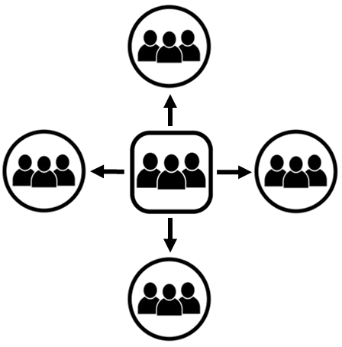
Plantando Iglesias que Tengan
Grupos de Fundamentos Multiplicadores
1. Haga Crecer Su Iglesia Presente
Multiplique los Grupos de Fundamentos para alcanzar su comunidad actual para Cristo
Notes:
III. Planting Churches that Have Multiplying Foundations Groups
Now you will use what you have learned to reach your city by planting churches tha have multiplying Foundations groups.
1.Grow Your Present Church
Multiply Foundations Groups to reach your current community for Christ.

Slide 86

2. Plante una Nueva Iglesia
Iniciar un Grupo de Fundamentos en una comunidad diferente
El Grupo de Fundamentos es el comienzo de una Iglesia Nueva
El líder de Fundamentos es el pastor de la Iglesia Nueva
Notes:
Plant a New Church
Pastor selects a Foundations leader and a few group members to start a Foundations Group in a different community.
The Foundations Group is the start of a New Church.
The Foundations leader is the pastor of the New Church.

Slide 87

3. Haga Crecer Su Nueva Iglesia
Multiplica los Grupos de Fundamentos
para alcanzar la nueva comunidad para Cristo.
1.
2.
3.
Notes:
3. Grow your New Church
Multiply Foundations Groups to reach the new community for Christ.

Slide 88
Todas las iglesias continúan multiplicándose
plantando nuevas iglesias
siguiendo este patrón
DT
FG
NC1
FG
FG
Notes:
All churches continue to multiply
by planting new churches
following this pattern

Slide 89
Nuevas iglesias comienzan como Grupos de Fundamentos reuniéndose en los hogares
Crecer por multiplicación de Grupos de Fundamentos
  hasta que pueda alquilar un espacio
  o comprar un terreno y construir un edificio para la iglesia
En algunos países donde hay persecución o pobreza,
  puede ser mejor tener la iglesia en las casas
DT
FG
NC1
FG
FG
Notes:
Your new churches start as Foundations Groups
meeting in homes.
You then grow your church
by multiplying Foundations Groups
by apprenticeship
until you can rent space for your worship services
or buy land and build a church building.
In some countries where there is persecution or poverty,
it may be best to keep the church in houses.

Slide 90
No se puede apresurar el crecimiento
Usted alcanzará a su ciudad para Cristo en un período de tiempo razonable multiplicando los Grupos de Fundamentos por medio del aprendizaje
Crecimiento por adición aún no ha funcionado para alcanzar a su ciudad
  y nunca lo hará
Notes:
You can’t rush growth.
You must have trained Foundations leaders to grow your church and reach your city for Christ,
and it takes time to train Foundations leaders.
You will reach your city for Christ in a reasonable length of time
by multiplying Foundations Groups by apprenticeship
Growth by addition hasn’t worked yet to reach your city
and it never will.

Slide 91
  En sus grupos
  Discutan el principio del crecimiento de la iglesia
  Dios quiere que hagan discípulos que se multipliquen como la semilla se multiplica,
    y no solo agregar los uno por uno
  Discutan sobre cómo puede plantar iglesias multiplicando los grupos de Fundamentos.
Notes:
In your groups
Talk about the principle of church growth from Mark 4.
God wants you to make multiplying disciples just as a seed multiplies,
not just add them
Then God will cause your church to grow
Also talk about how you can plant churches by multiplying Foundations groups
What questions or comments do you have?

Slide 92
Cómo Alcanzar a su País para Cristo
Lección 7
Problemas Resueltos por Nuestro Entrenamiento
Problema - Los pastores están sobrecargados
  Los pastores están demasiado ocupados haciendo las tareas del ministerio
Solución – Entrenar a los miembros de la iglesia para hacer la obra del ministerio
Hemos visto que ésta es la voluntad de Dios en Efesios 4:11-13.
Notes:
How to Reach Your Country for Christ
Lesson 7
I. Problems Our Training Will Solve
1. Problem – Pastors are over-worked
Pastors are too busy doing ministry tasks.
Pastors prepare sermons, preach, teach, go on visitation, and are involved in many other activities.
Solution – Train church members to do the work of the ministry
We train pastors how to train their church members to do the work of the ministry.
We have seen that this is God’s will from Ephesians 4:11-13.
As pastors train church members to minister, they will have time to focus on more strategic goals.

Slide 93
2. Problema - No podemos alcanzar nuestras comunidades
Nuestras iglesias están creciendo por adición
A veces, perdemos más de lo que añadimos
Solución – Entrenar a discípulos multiplicadores
Te entrenamos como a hacer discípulos multiplicadores
Notes:
2. Problem – Not able to reach our communities
Churches have been reaching out to their communities for years without success.
Churches have evangelistic events and church members invite people to church
but the communities still aren’t reached for Christ.
Our churches are growing by addition.
Sometimes we lose more than we add.
Solution – Train multiplying disciples
We train you how to train your church members to lead people in the community to faith in Christ
and help them grow in their faith until they too become multiplying disciples.

Slide 94
3. Problema – No hay suficientes pastores que estén haciendo discípulos multiplicadores
Solución – Entrenar pastores para entrenar a otros pastores para hacer discípulos multiplicadores
Notes:
3.Problem – Not enough pastors making multiplying disciples
The current method of training doesn’t produce enough multiplying disciples
Solution – Train pastors to train other pastors to make multiplying disciples
We provide a set of workshops and train pastors how to train other pastors
until there are enough multiplying disciples
to finish the Great Commission.
This method is inexpensive and effective.
It is also what Jesus did, what Paul and the Apostles did,
what Jesus commanded us to do, and what God wants us to do.

Slide 95
Resumen
1. No hay suficientes pastores y trabajadores
2. La solución es dejar de agregar pastores y obreros y empezar a multiplicarlos.
3. Simplemente hagamos lo que hizo Jesús y lo que nos dijo que hiciéramos
Notes:
In summary:
There are not enough pastors and workers
The solution is to quit adding pastors and workers
and start multiplying them.
Let us simply do what Jesus did
and what He told us to do.

Slide 96
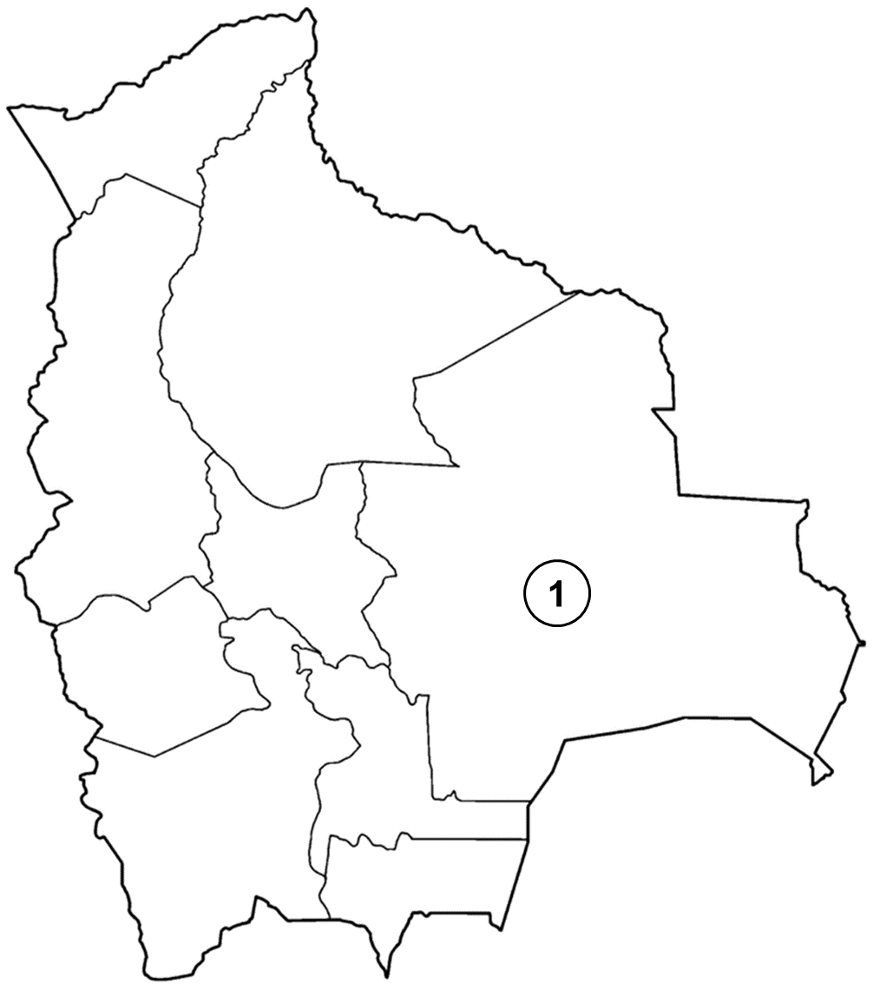
Etapas de entrenamiento para alcanzar a su país para Cristo
Etapa 1 (Primera Ciudad)
Los Pastores aprenden a reclutar
y entrenar a otros pastores
Notes:
II. Training Stages to Reach Your Country for Christ
You will reach your country for Christ through the following training stages.
Stage 1 (First City)
Pastors learn how to recruit and train other pastors

Slide 97
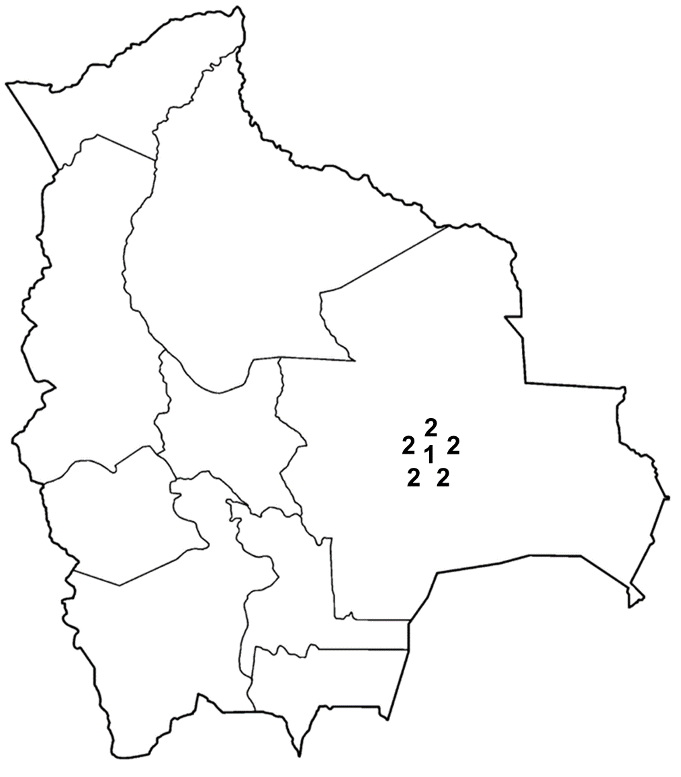
Etapa 2 (Área Local)
Los pastores entrenados en la Etapa 1 enseñan estos talleres en su área local
Notes:
Stage 2 (Local Area)
Pastors trained in Stage 1 teach these workshops in their local area

Slide 98
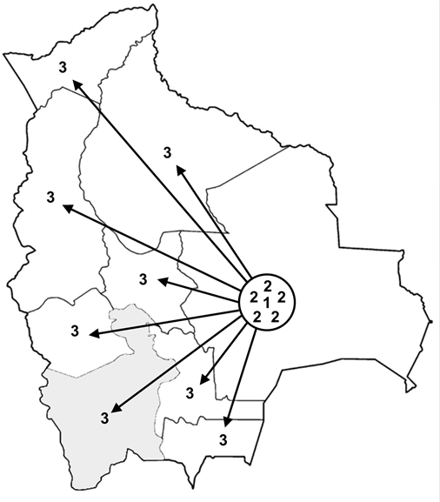
Etapa 3 (Estados)
Pastores entrenados en las Etapas 1 y 2
enseñanestos talleres en una ciudad clave
de cada estado
Notes:
Stage 3 (States)
Pastors trained in Stages 1 and 2
teach these workshops in a key city in each state.
Pastors ask their congregations to take on the mission
for reaching their country for Christ.
Each church will take offerings several times a year
to pay for the pastors’ expenses.
Some trainers may pay for their expenses by receiving an offering
from the pastors being trained.

Slide 99
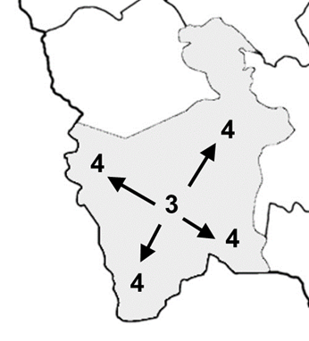
Etapa 4 (Ciudades)
Los pastores entrenados en las Etapas 1-3 en cada estado enseñar estos talleres en todas las ciudades
Notes:
Stage 4 (Cities)
Pastors trained in Stages 1-3 in every state teach Stage 4 workshops in every city in the country.

Slide 100
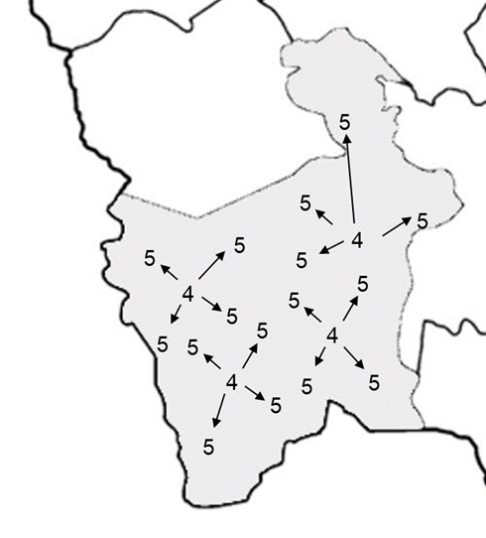
Etapa 5 (Pueblos)
Pastores que han sido entrenados en las Etapas 1-4 enseñan estos talleres en cada pueblo del país
Notes:
Stage 5 (Towns)
Pastors trained in Stages 1 to 4 will start Stage 5 workshops in every town in the country

Slide 101
Etapa 6 (Cada comunidad y área rural)
Los pastores entrenados en las Etapas 1-5
en cada ciudad y pueblo
harán discípulos multiplicadores y plantar iglesias hasta que hayan alcanzado
a cada comunidad y área rural para Cristo
¡La Gran Comisión
es Terminado en su Páis!
Notes:
Stage 6 (Every Neighborhood and Rural Area)
Pastors trained in Stages 1-5 in every city and town
will make multiplying disciples and plant churches
until they have reached every neighborhood and rural area for Christ.
The Great Commission is finished in your country!

Slide 102
Como Alcanzar su País para Cristo
Etapa | Localidad | Centros de Entrenamiento | Pastores Entrenados
1 | Primera Ciudad en su País | 1 | 20
2 | Área Local | 6 | 120
3 | Una ciudad en cada estado | 36 | 720
4 | Cada ciudad en cada estado | 216 | 4,320
5 | Cada pueblo del país | 1,296 | 25,920
6 | Cada comunidad/area rural | 7,776 | 155,520
¡La Gran Comisión se Terminado en su Páis!
Notes:
It will take about six stages of multiplying pastors
to reach your country for Christ.
We assume that 20 pastors will be trained in each training center
We assume that 5 new training centers will be started from each training center.
A training center is a location where all 4 Workshops are taught to pastors
This table demonstrates how you can finish the Great Commission in your country.
155,520 pastors will be trained:
How to reach their community and rural area for Christ by making multiplying disciples
How to reach their city for Christ by planting multiplying churches in every community
How to reach your country for Christ by training pastors in these workshops
to train other pastors in these workshops in every city, town, community, and rural area

Slide 103
En sus grupos
Hablen sobre los métodos que han probado en el pasado para alcanzar a su país para Cristo
Hablen sobre por qué el uso de estos talleres será eficaz para alcanzar a su país para Cristo
Notes:
In your groups
Talk about methods you have tried in the past to reach your country for Christ
Talk about why using these workshops will be effective in reaching your country for Christ
What comments or questions do you have?

Slide 104
Comenzando su Propio
Centro de Entrenamiento
Lección 8
Un elemento indispensable para terminar la Gran Comisión es el entrenamiento de pastores multiplicadores
Reclutar a pastores y los entrenarlos en estos talleres
Usted puede asociarse con uno o más pastores para iniciar este centro de entrenamiento
Notes:
Starting Your Own Training Center
Lesson 8
I. Introduction
An indispensable element in finishing the Great Commission
is to train multiplying pastors.
After this workshop you will recruit pastors
and train them in these workshops.
You may team up with one or more pastors to start this training center.

Slide 105
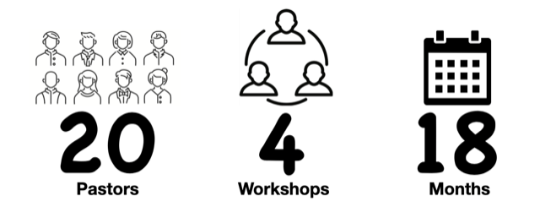
Metas para los Centros de Entrenamientos
20 pastores entrenados en 4 talleres durante 18 meses
Pastores
Talleres
Meses
Notes:
Goals for Training Centers
20 pastors trained in 4 workshops over 18 months

Slide 106
Ideas para que los Pastores Recluten
  Póngase en contacto con pastores que conozca y que no conozca
  Póngase en contacto con pastores de su denominación
  Pregúnteles sugerencias a los pastores
  Póngase en contacto con asociaciones de pastores' y peda permiso para hacer una presentación
  En sus grupos
  Hablen sobre pastores que pueden reclutar a entrenar
  Hagan una lista de pastores para invitar
Notes:
II. Ideas for Pastors to Recruit
Contact pastors you know in the area.
Make appointments and meet pastors in the area that you don’t know.
Contact pastors you know in your denomination.
Make appointments and meet pastors in your denomination that you don’t know.
Ask other pastors for suggestions of pastors to recruit.
Contact local pastor’s associations and ask to make a presentation to them.
In your groups
Talk about pastors you can recruit to train
Make a list of pastors to invite
Questions or comments

Slide 107
Prepárese para Su Presentación
Tenga copias de la página de los Talleres de Discipulado de Fundamentos para distribuir
Prepare su testimonio de cómo Fundamentos ha impactado a su iglesia
  Cómo la implementación de estos talleres lo ha ayudado a ministrar a más personas haciendo discípulos multiplicadores
La presentación de reclutamiento y el folleto
y una presentación de PowerPoint
están disponibles en foundationsglobal.com.
Notes:
I. Prepare for Your Presentation
Make sure that you have copies of the Foundations Discipleship Workshops page to hand out to the pastors and leaders
It is in this document after the Recruiting Presentation section
Take time to prepare your testimony of how Foundations has impacted your church.
Share specifically how implementing the workshops has helped you as a pastor minister to more people by making multiplying disciples.
The recruiting presentation and handout and a PowerPoint presentation are available at foundationsglobal.com.

Slide 108
Implementación
    Llevar una vida cristiana equilibrada
    Entrenar a los miembros de la iglesia sobre cómo estudiar la Biblia
    Preparar lecciones bíblicas efectivas
    Implementar el plan para iniciar Grupos de Fundamentos en toda la iglesia
    Crear un Equipo de Líder de Fundamentos
Notes:
Implementation
Lead a balanced Christian life
Train church members how to study the Bible
Prepare effective Biblical sermons
Implement the plan to start Foundations Groups in the whole church
Create a Foundations Leader Team

Slide 109
Implementación
    Evalúe sus ministerios
    Crear una estructura de iglesia que haga discípulos multiplicadores
    Plantar iglesias que hagan discípulos multiplicadores para alcanzar su ciudad
    Entrenar a otros pastores para llegar a su país
Notes:
Implementation
6. Evaluate your ministries
7. Create a church structure that makes multiplying disciples
8. Plant churches that make multiplying disciples to reach your city
9. Train other pastors to reach your country

Slide 110
¡Felicidades!!
Has Terminado el Taller 4
¡Terminar la Gran Comisión!
Notes:
Congratulations!
You have finished Workshop 4
Now go and Finish the Great Commission!
Ask the host to close in prayer
Pass out certificates
Take a group photo

