Slide 1
Unit 9
TIME IS THE COIN OF YOUR LIFE!

Slide 2
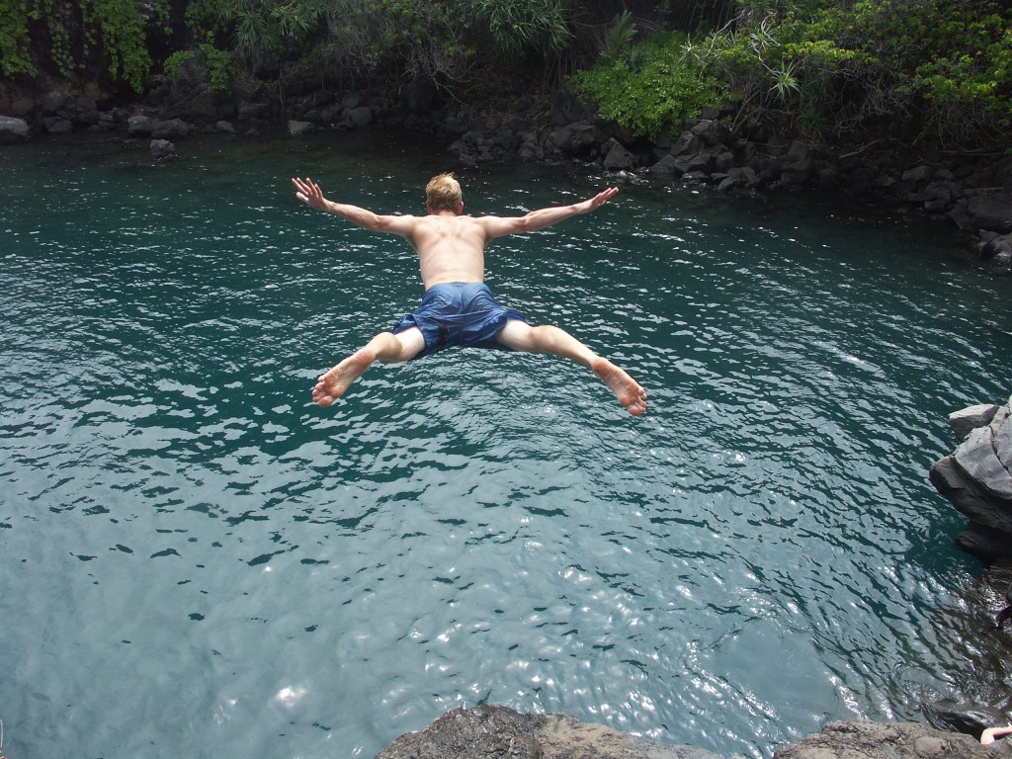
After this chapter, students are expected to be able to:
Write a self-authored biography,
Recall their happy, amazing, and adventurous memories,
Share their experiences to other people.

Slide 3
- Is it important?
- So much.
The ability to chase your own dream and passion is the most important thing an individual can pursue in their entire life. Nobody could ever able to limit, contain, and bind you. You are as free as anybody else ever be!

Slide 4
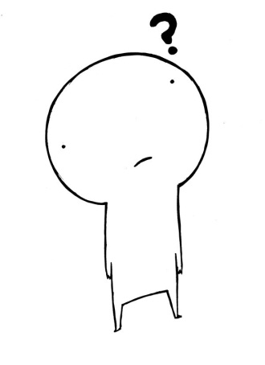
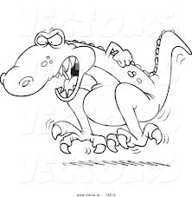
Understanding RECOUNTS
What is recount?
The definition:
- to relate in detail
Source: merriam-webster.com
Therefore, it could be conclude that recount means every record in someone’s life for every events in daily life.

Slide 5
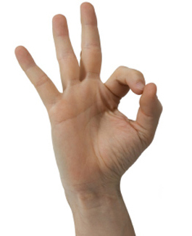
Types of recount
Personal recount: it records every detail of a single person,
Factual recount: it records an event where many people experience too,
Imaginative recount: a record of imaginative tale or story from a character.

Slide 6
There is also one type of record, a special one. In this record, every detail of one’s life is told, every secret of it spilled. Can you guess what this kind of record is?
Hints:
This type of text is usually bundled into a book,
There are two types of it, one where the author writes it themselves, and one where somebody else write it for them,
It usually composed as a tribute, especially when the character depicted in the text is deceased.
Can you guess??? Anybody???
It is………

Slide 7
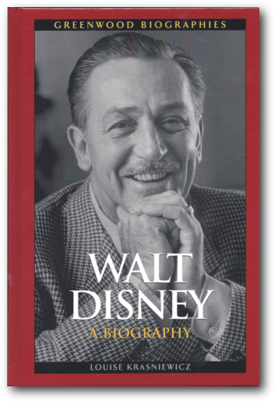
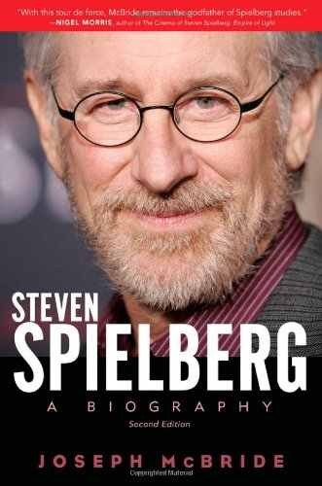
BIOGRAPHY

Slide 8
Definition:
- a usually written history of a person's life
Source: merriam-webster.com
So, a biography is a type of text which describes the life of an important person as a whole; from their moment of birth to their death.

Slide 9
There are two types of biography:
Auto-biography
Biography
And it is
job to find out the difference!
Auto-biography
…………
Biography
…………

Slide 10
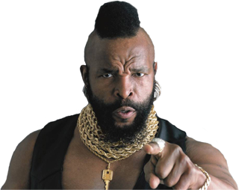
Practice!
Write an auto-biography of yourself for 2 pages long/approximately 2000-3000 words. Don’t forget to mind the grammatical pattern and correct punctuation!
GOOD LUCK!

