Slide 1
The Role of Pharmacists in Obesity
Presented by: Mary Younes Pharm-D candidate
Presented for: Dr. Jihan Safwan

Slide 2
Abbreviations
CBT: conventional behavioral therapy
Phx: pharmacologic
LMWH: low molecular weight heparin
LDUH: low dose unfractionated heparin
IPC: intermittent pneumatic compression
Pts: patients
RD: registered dietician
IBW: ideal body weight
ER: extended-release

Slide 3
Abbreviations
EN: enteral nutrition
PN: parenteral nutrition
D/C: discontinue
T2D: type 2 diabetes
CPAP: continuous positive airway pressure
Hx: history
PE: pulmonary embolism
RML: rhabdomyolysis
CK: creatinine kinase

Slide 4
Obesity Definition
Overweight and obesity are defined as abnormal or excessive fat accumulation that presents a risk to health
A crude population measure of obesity is the body mass index (BMI)

Slide 5
Obesity Definition
BMI= weight (kg) / height squared (m)
BMI ≥ 30 is generally considered obese
BMI ≥ 25 is considered overweight

Slide 6
Obesity Health Risks
Obesity increases the risk of many diseases and health conditions including:
  Coronary heart disease
  Type 2 diabetes
  Cancers (endometrial, breast, and colon)
  Hypertension
  Dyslipidemia
  Stroke
  Liver and Gallbladder disease
  Sleep apnea and respiratory problems
  Osteoarthritis
  Gynecological problems

Slide 7
Obesity Management
Behavior modifications: Identify behaviors that may contribute to weight gain
  Stress, boredom, emotional eating →Use CBT
Healthy balanced diet:
  ≥ 5 servings of fruits/vegetables
  35g of fiber
  <30% of calories from fat
  Eliminate take out, fast food, soda, & desserts

Slide 8
Obesity Management
Calorie reduction: 500-1000kcal/kg/day
  → To achieve 1-2lb weight reduction/week
Physical Activity
  30-60min of moderate activity 5 days/week
Liposuction
  It can result in a significant reduction in fat mass and weight
  It does not appear to improve insulin sensitivity or risk factors for coronary heart disease

Slide 9
Obesity Management
Pharmacologic therapy:
  BMI > 30kg/m²
  BMI 27 -29.9 kg/m² + comorbidities
Bariatric surgery:
  BMI ≥40 kg/m²
  BMI ≥ 35 kg/m2 + ≥ 1 severe obesity related comorbidities

Slide 10
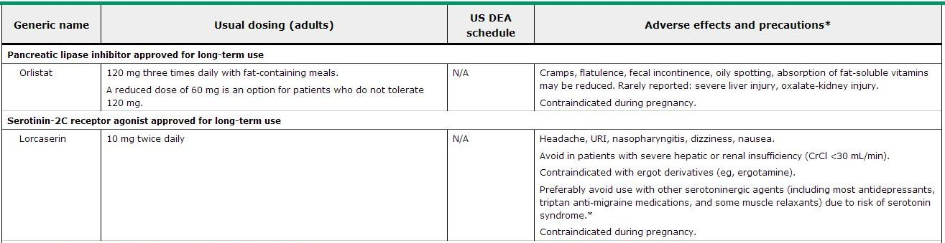
Pharmacological Therapy

Slide 11
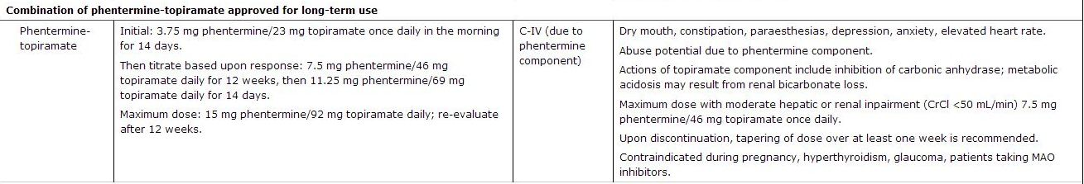
Pharmacological Therapy

Slide 12
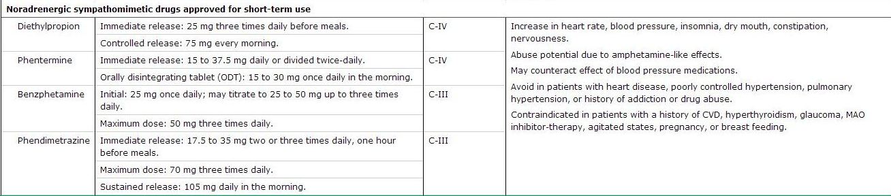
Pharmacological Therapy

Slide 13
Bariatric Surgery
Restrictive: restrict and decrease food intake
Malabsorptive: interfere with the normal digestive process
Categories
Restrictive
Adjustable gastric band
Sleeve gastrectomy
Combination
Biliopancreatic diversion with duodenal switch
Roux-en-Y gastric bypass
Malabsorptive

Slide 14
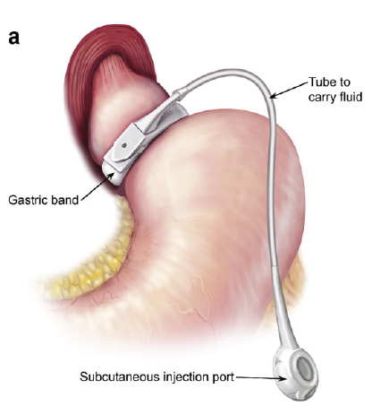
Adjustable Gastric Banding (AGB)
The surgeon places a band around the top portion of the stomach, leaving a very small pouch available for food
The small pouch makes the patient feel full after eating only small amounts of food
The procedure can be adjusted and even reversed

Slide 15
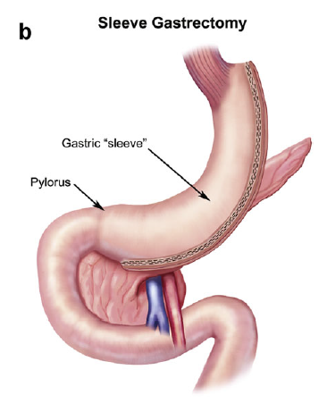
Sleeve Gastrectomy (SG)
The surgeon removes approximately 80% of the stomach
So, the stomach takes the shape of a tube or "sleeve“
The remaining stomach can hold 100-150 ml volume

Slide 16
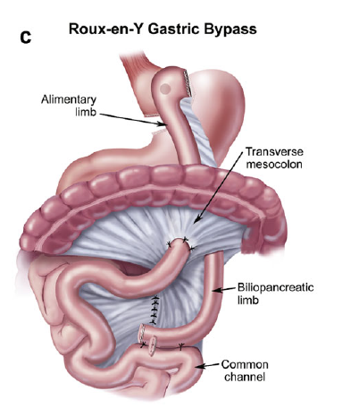
Roux-en-Y Gastric Bypass (RYGB)
The surgeon reduces the size of stomach to a small pouch – about the size of an egg
This is done by stapling off a section of it, and then attaching this pouch directly to the small intestine
Thus, bypassing most of the rest of the stomach and the upper part of the small intestine

Slide 17
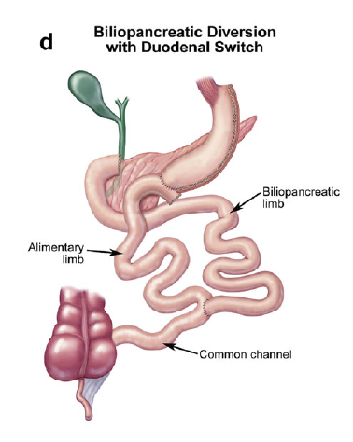
Biliopancreatic Diversion with Duodenal Switch (BPD/DS)
Part of the stomach is removed
The remaining part of the stomach is connected to the lower portion of the small intestine
This is a high-risk surgery that can cause long-term health problems, because the body has a harder time absorbing food and nutrients

Slide 18
Surgery Preference
There is still insufficient evidence to generalize in favor of one bariatric surgical procedure
In general, laparoscopic bariatric procedures are preferred over open bariatric procedures
Caution when recommending malabsorptive procedures because of the greater associated nutritional risks
Investigational procedures (such as gastric plication, electrical neuromodulation, and endoscopic sleeves) may be considered for selected patients

Slide 19
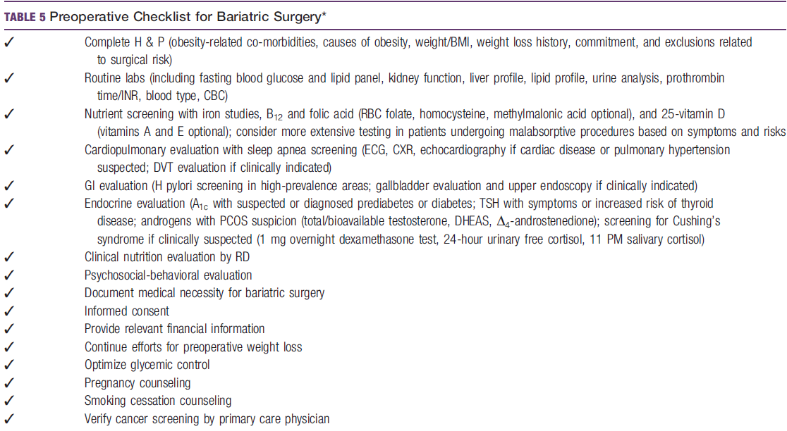
Preoperative management

Slide 20
Elements of Medical Clearance
Endocrinology:
  Optimize glycemic control
  Screen for TSH is patients with risk for hyperthyroidism
  There is insufficient data to warrant preop assessment of BMD with DXA

Slide 21
Elements of Medical Clearance
Women Health:
  Avoid pregnancy preop & 12-18 mo postop
  Pregnancy postop → monitor for weight gain, nutritional supplementation & fetal health
  Stop 1 cycle of OC
  Stop 3 weeks of HRT
  Women with PCOS may have improved fertility postop
To avoid VTE risk

Slide 22
Elements of Medical Clearance
Cardiology:
  Nonivasive cardiac testing in pts based on their RFs, PMH, & PE
  Patients with cardiac disease→ cardiac consultation
  Evaluate periop BB in pts with risk for cardiac disease
  Obtain lipid profile and tx

Slide 23
Elements of Medical Clearance
GI:
  Evaluate clinically significant GI Sxs
  Sx biliary disease & increased LFTs → abdominal US
  LFTs 2-3 x UNL → abdominal ultrasonography & viral hepatitis screening
  Screen for H.pylori in high prevalence areas

Slide 24
Elements of Medical Clearance
Respiratoy:
  Pulmonary evaluation including ABGs in pts with intrinsic lung disease or disordered sleeping pattern
Psychiatry:
  Psychosocial-behavioral evaluation for all pts
  Any patient with a known or suspected:
    Psychiatric illness, or
    Substance abuse, or dependence
Mental health evaluation before
surgery

Slide 25
Elements of Medical Clearance
Tobacco:
  Avoid in all times by all pts
  Stop cigarette smoking at least 6 weeks before surgery
EtOH:
  Eliminate consumption due to
    Impaired metabolism
    Risk of EtOH use disorder postoperatively
    →following RYGB, in highrisk groups

Slide 26
Elements of Medical Clearance
Nutrition:
  Evaluate pts’ ability to implement nutritional & behavioral changes pre & postop
  Pts should undergo appropriate nutritional evaluation specially pre malabsorptive surgeries

Slide 27
Elements of Medical Clearance
Oncology:
  Pts should undergo age and risk appropriate Ca screening before surgery
Gout:
  Hx of gout → prophylaxis
DVT:
  Appropriate DVT evaluation

Slide 28
DVT Prophylaxis
VTE Risk
Very low risk (Roger’s score<7/Caprini = 0)
No Phx tx / Mechanical if no early ambulation
High risk for major bleeding complications or consequences of bleeding are thought to be severe
High risk(Caprini ≥5)
No high risk for major bleeding complications
Low risk (7-10/1-2)
IPC
Moderate risk(>10/3-4)
No high risk for major bleeding complications
High risk for major bleeding complications or consequences of bleeding are thought to be severe
LMWH, LDUH, or IPC
IPC
LMWH or LDUH + IPC or elastic stockings
IPC

Slide 29
SIP
Preoperative-dose timing:
  Within 60min before incision
  FQ & vancomycin, require administration over 1-2hr
  →the administration should begin within 120min before incision

Slide 30
SIP
Redosing if:
  Duration of the procedure exceeds 2 t1/2 of the drug
  Excessive blood loss during the procedure
Duration:
  Single dose
  Continuation for <24 hr

Slide 31
SIP
Cefazolin 2 g, 3 g for pts weighing ≥120 kg
Pts with b-Lactam allergy:
  Clindamycin 900 mg
  or vancomycin 15 mg/kg
  + aminoglycoside (gentamicin 5 mg/kg)
  or aztreonam 2 g
  or fluoroquinolone (levofloxacin 500mg, moxifloxacin 400mg)

Slide 32
Postoperative Care
Diet:
  Initiate low sugar clear liquid within 24 hr
  Postop meal progression should be arranged & followed by a dietician
  3 meals
  Chew small bites thoroughly before swallowing

Slide 33
Postoperative Care
Diet:
  Should include at least 5 daily servings of fresh fruits and vegetables
  Minimal protein intake of 60 g/d and up to 1.5 g/ kg IBW/d should be adequate
  Higher amounts up to 2.1 g/kg IBW/d should be individualized
  Concentrated sweets should be eliminated from the diet

Slide 34
Postoperative Care
Medications:
  To maximize absorption: crushed or liquid rapid-release medications should be used instead of ER medications
Fluids:
  Consumed slowly
  30 min before meal
  > 1.5 L/d

Slide 35
Postoperative Care
Tx pts with, or at risk for micronutrient insufficiencies or
deficiencies
Adult multivitamin plus mineral (containing iron, folic acid, and thiamine)
1: LAGB / 2: RYGB ,LSG
RYGB ,LSG, &LAGB :
1200 to 1500 mg of elemental Ca
RYGB ,LSG, &LAGB :
At least 3000 IU of vitamin D
RYGB and LSG:
Vitamin B12: SL, SQ, or IM preparations, or Po (if adequately absorbed) to maintain levels in the normal range
RYGB and LSG:
Total iron provided should be: 45- 60 mg

Slide 36
Postoperative Care
EN/PN:
  Consider EN/PN in pts with NRS 2002 ≥ 3
  PN in pts unable to meet their needs using their GIT for at least:
    5-7 days with noncritical illness
    3-7 days with critical illness
    With severe protein malnutrition and/ or hypoalbuminemia, not responsive to oral or EN protein supplementation

Slide 37
Postoperative Care
For T2D pts:
  D/C insulin secretagogues (sulfonylureas and meglitinides)
  Adjust insulin therapy, using a rapid-acting and a basal long-acting to attain glycemic targets (140-180 mg/dL)
  Withhold medication if T2D is in remission after surgery
  Metformin maybe continued postop
  In outpatient not reaching glycemic targets, metformin or incretin-based therapy should be considered

Slide 38
Postoperative Care
Risk for MI:
  Monitor pts for at least the first 24 hrs postop
Pulmonary management include:
  Aggressive pulmonary toilet
  Incentive spirometry
  O2 supplementation (to avoid hypoxemia)
  Early institution of CPAP when clinically indicated

Slide 39
Postoperative Care
DVT prophylaxis:
  Extended chemoprophylaxis after discharge should be considered for high risk pts (hx of DVT)
  Early ambulation is encouraged
Respiratory distress or failure to wean from ventilatory support → prompt evaluation for an acute postoperative complication, such as PE or anastomotic leak

Slide 40
Postoperative Care
Patients should have adequate padding at pressure points during bariatric surgery
When RML is suspected:
  Determine CK levels
  Monitor urine output
  Ensure adequate hydration
  Risk increases with BMI >55-60 kg/m2 →screen in those group

Slide 41
Conclusion
Bariatric surgery is used to tx obesity pts
Clearance for cardiology, endocrinology, respiratory, GI, and nutritional evaluation should be performed preop
Initiate DVT prophylaxis & SIP in all bariatric surgery pts
Slow progression in meals & nutritional supplementation for pts at risk for deficiencies or insufficiencies

Slide 42
References
Jeffrey I. Mechanick, M.D. et al. Clinical Practice Guidelines for the Perioperative Nutritional, Metabolic, and Nonsurgical Support of the Bariatric Surgery Patient—2013 Update: Cosponsored by American Association of Clinical Endocrinologists, The Obesity Society, and American Society for Metabolic & Bariatric Surgery. Obesity. 2013 21:S1-S27
Dale W. Bratzler, E. Patchen Dellinger, Keith M. Olsen, et al. Clinical practice guidelines for antimicrobial prophylaxis in surgery. Am J Health-Syst Pharm. 2013; 70:195-283

Slide 43
References
Gordon H. Guyatt , MD. et al. Antithrombotic Therapy and Prevention of Thrombosis, 9th ed: American College of Chest Physicians Evidence-Based Clinical Practice Guidelines. CHEST. 2012 7S-47s
http://www.medscape.com/viewarticle/781619
http://bariatricsurgerymd.com/new-bariatric-surgery-guidelines-for-2013
http://www.medscape.com/viewarticle/814128

