Slide 1
Презентация к уроку английского языка в 8 классе тема урока: Праздник Севера к учебнику Spotlight-8 Module 8
Выполнила: учитель английского языка Полупанова Елена Васильевна
МБОУ лицей «Технический» г. Самара

Slide 2
Цели урока
1. Учебная:
- в говорении: развитие умений использовать изученные лексические единицы в монологических высказываниях
- в чтении: развитие умений чтения с выбором необходимой информации
- в письме: развитие умений написания статьи на заданную тему.
2. Воспитательная:
- способствовать развитию чувства уважения к спортивным традициям в нашей стране;
- совершенствование умения работать в парах, в группах, слушать друг друга, с уважением относиться к мнению партнера по команде.
3. Развивающая:
- развитие умения работать с текстом;
- развитие языковой догадки, внимания, памяти;
- развитие способности и готовности общаться.
4. Социокультурная:
- приобретение знаний о праздниках спорта в нашей стране и зимних видах спорта

Slide 3
Планируемые результаты
В ходе урока учащиеся научатся:
- использовать изученные лексические единицы в устной и письменной речи при составлении высказываний на заданную тему;
- развить умение чтения с выбором необходимой информации;
В ходе урока учащиеся получат возможность:
- развить навыки работы с текстом;
- составлять письменное высказывание по теме в виде газетной статьи;
- развить свои коммуникативные навыки при работе в парах и в группе;
- в ходе урока развить внимание, память, языковую догадку.
- получить дополнительные знания о традициях спорта в нашей стране.

Slide 4
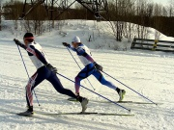
New Words
Annual [ˈænjuəl] - ежегодный
Arctic circle [ˈɑːktɪk ˊsə:kl ] - Полярный круг
Feasting- празднование
Skiing marathon -лыжный марафон
Compete[kəmˈpiːt]- соревноваться
Ice hockey tournament['tuənəmənt] турнир по хоккею
Reindeer racing['reɪndɪə]-гонки на оленях
Cross country skiing[]- лыжные гонки

Slide 5
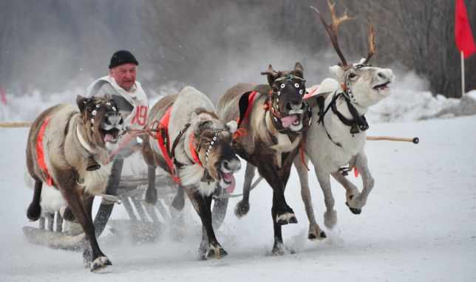
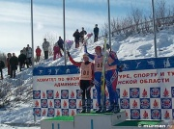
Downhill skiing-горнолыжный спорт
Underwater swimming-подводное плавание
Participant[pɑː'tɪsɪp(ə)nt]-участник
Fee[fiː] плата
Ski track-лыжная трасса
Biathlon[baɪ'æθlən]-биатлон
Ski relay-лыжная эстафета
Peninsula[pə'nɪnsjələ]-полуостров

Slide 6
Questions for discussion:
What is your favourite sport?
Is it a winter or summer sport?
What sport would you like to try that you have
never done before?

Slide 7
Let‘s read the text Spotlight on Russia page 10.
Then we will learn some more information about the event which takes place in Murmansk.

Slide 8
Festival of the North in Murmansk

Slide 9
From the history of the North Festival.
The first Sports Festival of the North was held in Murmansk in 1934.
Only 86 participants took part in it. Later the Festival has become very popular not only in our country but also with foreign countries and sportsmen. Nowadays hundreds of sportsmen from different countries come to Murmansk to take part in it. The Festival takes place at the end of March as a rule. It has become a tradition in our city and attracts a lot of athletes and tourist. About 2 000 people take part in it.

Slide 10
The Sport Festival is held in the Valley of Comfort. There is a 30km ski-track, which is illuminated in dark winter time, a ski-jump, a shooting ground for biathlon, a press- centre. Alongside with the traditional kinds of sport there are national saami sports such as reindeer races, towing of a skier by a reindeer and others.

Slide 11
Thousands of fans watch competitions in ski- racing, biathlon, ski-relay, in ski-marathon. But the most spectacular event is reindeer-racing. It is a national sport of the native population of the Kola Peninsula. The Lapps from our region as well as from Finland and Norway come together with their reindeer and sleighs, which are specially decorated for occasion.

Slide 13
What new information have you learnt from the texts?
Now let‘s read about the event that takes place in Samara.

Slide 14
Samara Ski Track of Russia
On Saturday, February 8 the XXXIIth open all- Russian mass ski race was held in the training centre «Chaika». More than 5000 people took part in the competition.
There were professional skiers, sport schools, veterans of sport and ski fans there. At the beginning there was a race for young participants. They got sweet prizes after 150 metres distance.
There was 5 km race for boys and girls, 10 km race for people older than 19 years. The distance of 3 km was for all people regardless of age and sports training. All the winners of the races got valuable prizes.
The concert program was presented to the participants of the race. There was even an exhibition of weapons and dog show there. Everybody was offered buckwheat porridge and tea.
There was a playground, pony rides, an ice skating-rink there. The balloons, the colour of which corresponded to the colour of the Olympic rings, were released in support of the Olympic Games in Sochi 2014.

Slide 15
False, True, Not Stated
1.All Russian ski race was held in January in Samara.
2.There were more than 5000 people there.
3. The weather was frosty and sunny.
4. There were professional skiers? Fans there.
5. There was a concert at the beginning.
6.10 km race was for people older than 19 years.
7. The distance of 3 km was for all people.
8. There was a cat show there.
9. Everybody was offered porridge and tea.
10. The balloons were released at the end of the race.

Slide 16
Hometask:
Find information about another sports festival or event in our region. Write and tell us about it.

