Slide 1

Презентация к уроку по учебному предмету
«Английский язык» в 3-ем классе
на тему «Счет чисел от 10 до 100»
Автор: Шашкова Екатерина Викторовна
учитель английского языка
МБОУ СОШ № 10 г. Красноярска

Slide 2
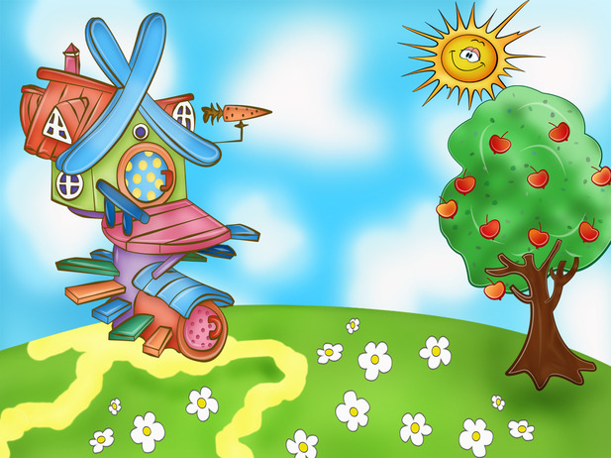

Hello!
Can you help me! Please!

Slide 3
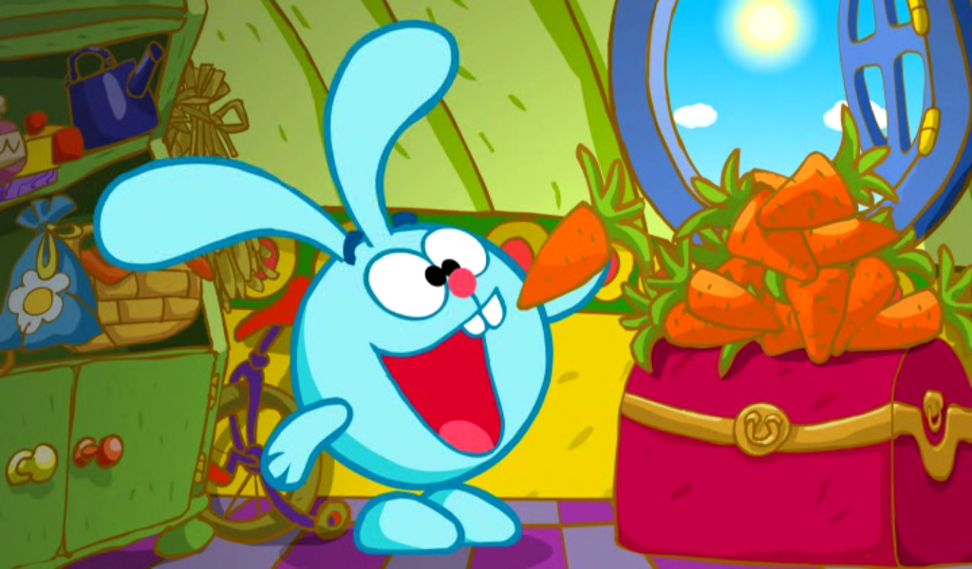




4 four
5 - five
6 - six
7 - seven
Please count my carrots!
8 - eight
3 - three
9 - nine
2 - two
1 - one
10 - ten

Slide 4


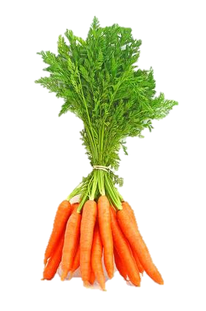
I can’t count my carrots!!!!!

Slide 5





11, 13, 14, 15, 16, 17,
18, 19, 20, 21, 22, 23
30, 40, 50, 60, 70, 80
90, 100

Slide 6


Rule № 1
13,14,..19
3, 4, 5, 6, 7, 8, 9
teen

Slide 7


four + teen =
fourteen
14
six + teen =
sixteen
16
nine + teen =
nineteen
19

Slide 8


BUT
three + teen =
thirteen
five + teen =
fifteen
eight + teen =
eighteen

Slide 9



Remember
11 -
eleven
12 -
twelve

Slide 10
Please read!!!
11 - eleven
17 - seventeen
16 - sixteen
12 - twelve
15 - fifteen
14 - fourteen
18 - eighteen
19 - nineteen
13 - thirteen

Slide 11

Rule № 2
30, 40, ……90
3, 4, 5, 6, 7, 8, 9
ty

Slide 12

six + ty =
sixty
60
seven + ty =
seventy
70
nine + ty =
ninety
90

Slide 13

BUT
three + ty =
thirty
30
four + ty =
forty
40
five + ty =
fifty
50
eight + ty =
eighty
80

Slide 14

Remember
two + ty =
twenty
20
100 – one hundred

Slide 15

40 - forty
30 - thirty
20 - twenty
70 - seventy
60 - sixty
one hundred
50 - fifty
80 - eighty
90 - ninety

Slide 16

Our results
1. 13 – 19 + teen
2. 30 – 90 + ty

Slide 17

Remember
1. eleven
2. twelve
3. twenty
4. hundred

Slide 18



Please count my carrots!
12

Slide 19



20

Slide 20

What’s the number?
45
94
12
87
41
38
15
23

Slide 21
+ 5= | - 2= | + 6= | : 2= | + 3=
- 1= | : 5= | х 3= | + 12= | + 26=
- 10= | + 11= | 20 | - 8= | : 4=
+ 16= | - 12= | х 2= | + 47= | - 14=
- 7= | + 12= | х 6= | + 20= | - 9=
Notes:
Задание выполняется в устной форме. Нужно решить примеры, Первое число в каждом примере – 20. На пример, twenty + five = twenty five.

Slide 22
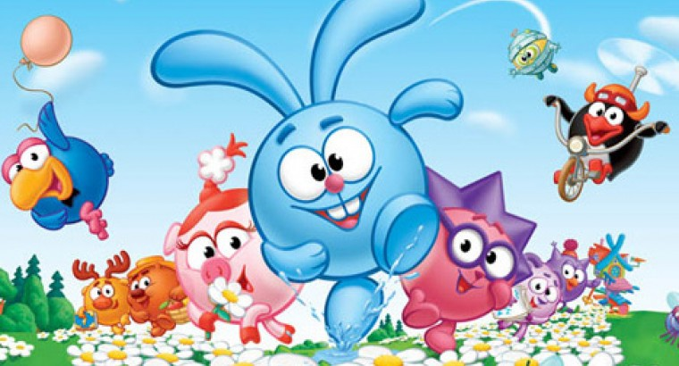
Thank you!!!

