Slide 1
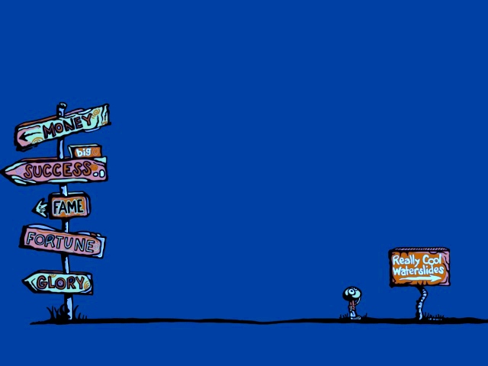
«Презентация к уроку по учебному предмету «Английский язык в 5-ом классе на тему
«What are you going to be when you grow up?»
Выполнила: Всеволожский район,
МОБУ «Агалатовская СОШ»
Бачурина Ольга Игоревна,
учитель английского языка,
УМК «Spotlight», 5.
2015

Slide 2

There are so many professions….

Slide 3
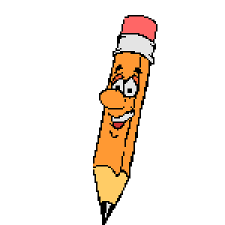
Guess! What do they do?

Slide 4
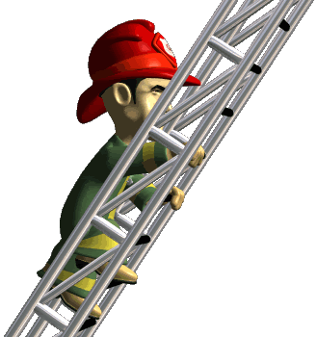
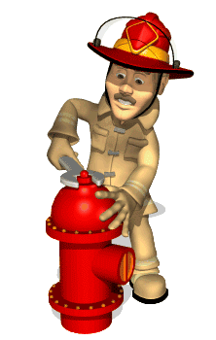
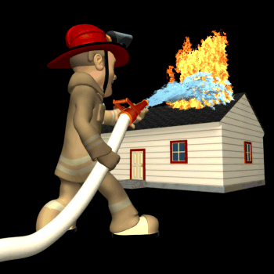
Fireman
[ˈfaɪrmən]

Slide 5
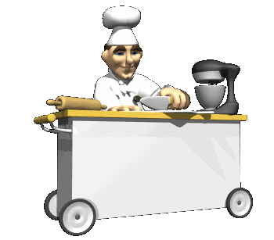
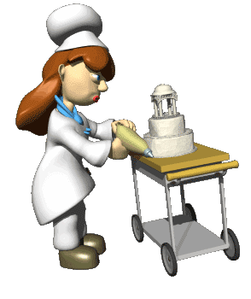
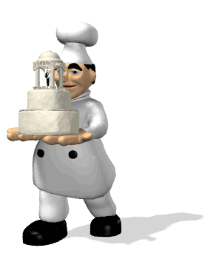
Baker
[’beɪkər]

Slide 6
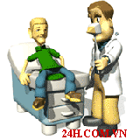
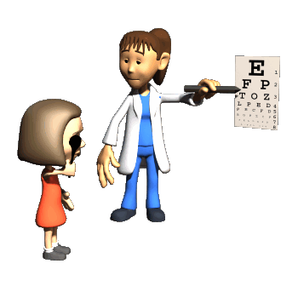
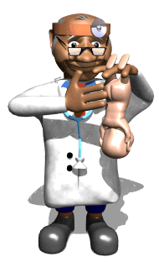
Doctor
[ˈdɒktə]

Slide 7
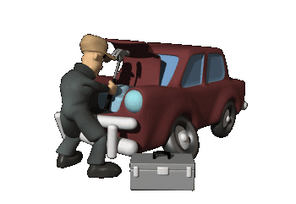
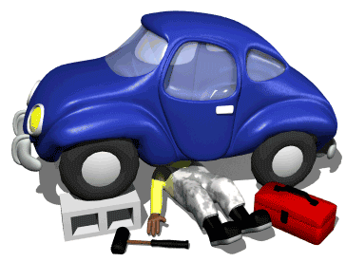
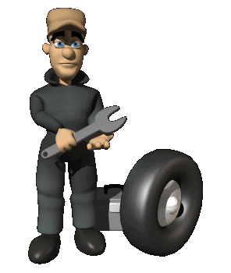
Mechanic
[məˈkænɪk]

Slide 8
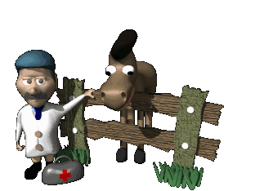
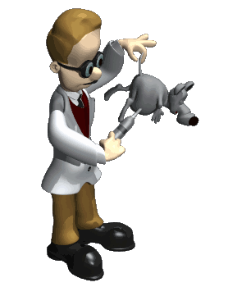
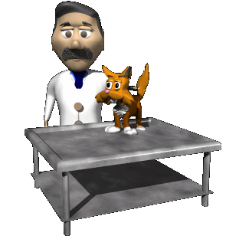
Vet
[ˈvet]

Slide 9
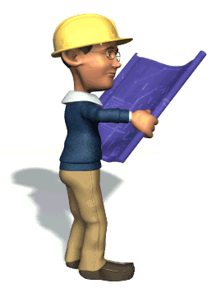
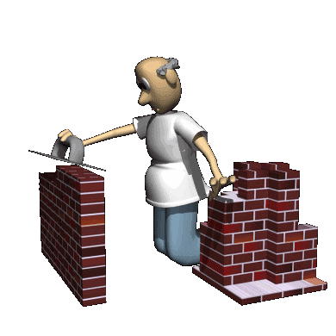
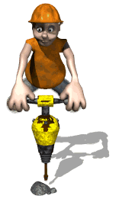
Builder
[ˈbɪldə]

Slide 10
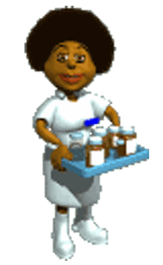
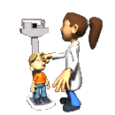
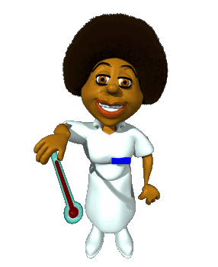
Nurse
[ˈnɝːs]

Slide 11

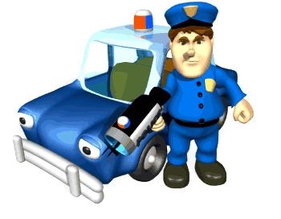
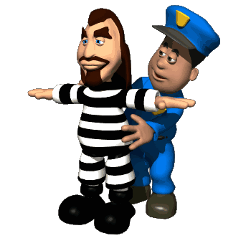
Policeman
[pəˈliːsmən]

Slide 12
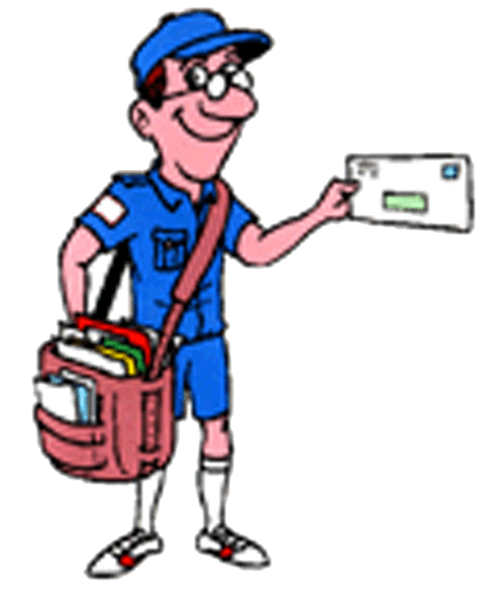

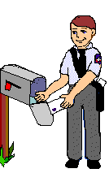
Postman
[ˈpəʊstmən]

Slide 13
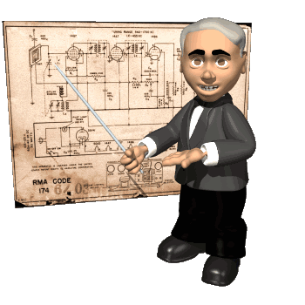
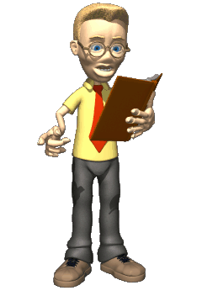

Teacher
[ˈtiːtʃə]

Slide 14
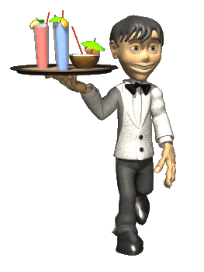
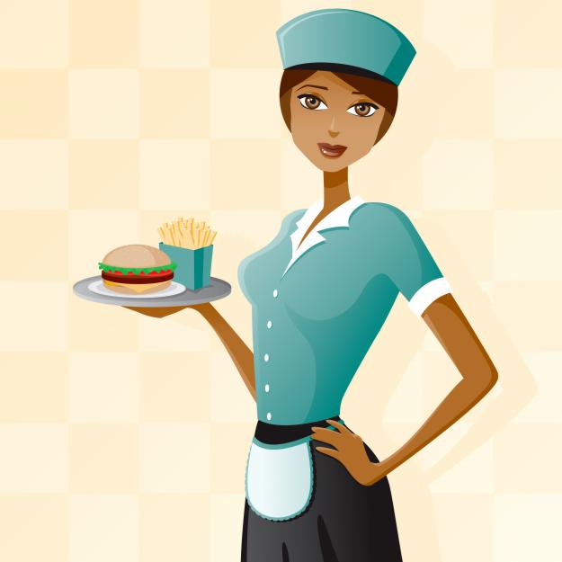

Waiter
[ˊweɪtə]

Slide 15
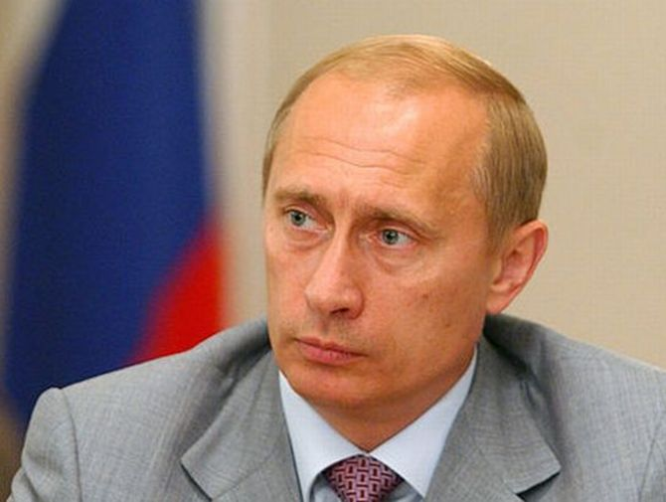
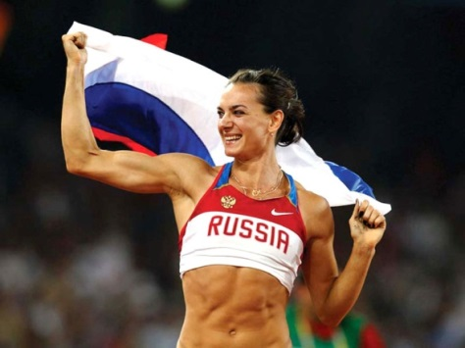
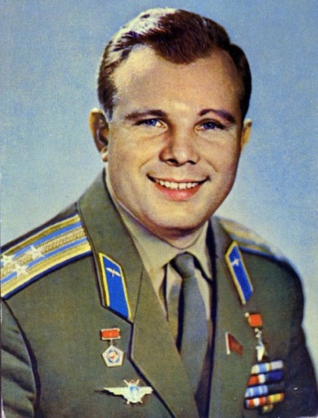
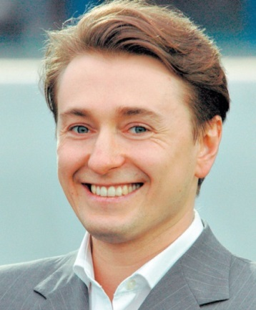

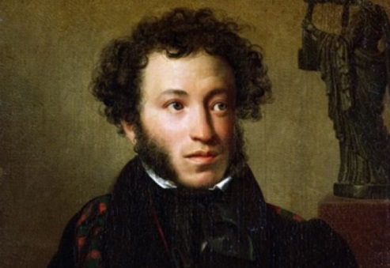
What are they? Match pictures and professions.
actor
astronaut
singer
president
writer
sportsman

Slide 16
Read and match
I fix cars.
I bake bread and make cakes.
I serve food and drinks.
I take letters to people`s house.
I help sick people.
Waiter
Postman
Mechanic
Doctor
Baker

Slide 17
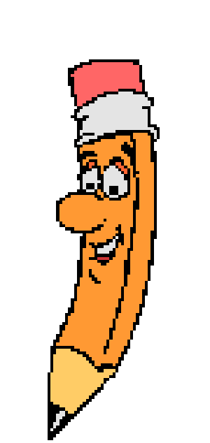
Compose professions, putting vowels among consonants.
CONSONANTS VOWELS WORDS
1 DNCR AE _____________
DRVR IE _______________
SNGR IE _______________
CK OO _______________
PLT IO _______________
DCTR OO _______________
TCHR EAE _______________
PNTR AIE _______________
PLMN OIEA _______________
PHTGRPHR OOAE _______________

Slide 18
work with people
study foreign
languages
make people nice and good-looking
wear a uniform
work on my own
I want to be ……
because ……
work in a team
travel abroad
Any ideas?
have irregular hours

Slide 19


Make the dialogue as in the example
A: - Hi, how are you?
B: - Fine, thank you!
A: - What are you doing?
B: - Oh, I `m reading an English book.
A: - What for?
B: - Because I want to be an interpreter when I grow up.
A: - Really?
B: - Why not? It`s so interesting! I`m good at English and I `d like
to travel around the world, to meet new people..
A: - Cool! Let`s read together!

Slide 20
I want to be….
I want to be an actor, Dad. I want to go on stage.
You should be a banker, Tom and earn a decent wage.
I want to be a hairdresser, Dad. I want to do people`s hair.
You should be a pilot, Tom, and work for British Air.
I want to be a clown, Dad. I think I`m very funny.
You should be a driver, Tom, and earn a lot of money.
I want to go into politics, Dad, and put the country right.
I think that`s an excellent idea. Let`s tell your mother tonight.

Slide 21
Should you already know your
future profession?

Slide 22
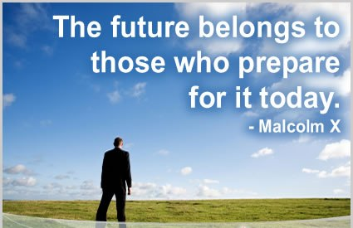

Slide 23
Thank you for your attention!

