Slide 1


SIP #2
Oklahoma Governmental Tort Claims Act
Speaker: Pam Spinks,
Director of Professional Development
1-800-234-9461 www.omag.org

Slide 2

Use OMAG Web Portal to see details on your Coverage Plans.
Notes:
OMAG is NOT a for-profit insurance company. It is an association of cities and towns and provides insurance coverage in Liability, Auto, Workers’ Compensation and Property to OK C & T.
Over 500 C & T have one or more of these coverages.
OMAG has a 7 member Board of Trustees elected by our member cities.
We started in 1977. We were Created by, we are Owned by and are Governed by our member cities.

Slide 3
Rules for SIP
Bring your Book, Name Tent & Pen
Skype Viewers – copy materials before the class.
We’ll take 10 minute breaks about every hour.
Be Respectful to Others – at all times
Please Share your experiences
Skype viewers can type in Questions
Notes:
Review the BOOK and materials for them.
Thank you for being in OMAG!
Who is Pam: See website Bio in book.
Joined OMAG 10-1984
Became Supervisor 10-5-1998.
Rules: 1. We’ll take 10 minute breaks - every hour.
2. Be Respectful to Others – at all times
3. Please Share – as Appropriate

Slide 4
Learning is Lifelong.
All Development is Self-development.
  You Own Your Own Development.
The only person You control is YOU.
  You can be a better Supervisor –
  it’s up to YOU!
You have power when You control You and work to understand others.
Notes:
All Development is Self-development.
You Own Your Own Development.
The only person You control is YOU.
You can be a better Supervisor
– it’s up to YOU!
You have power when You control You and work to understand others.

Slide 5
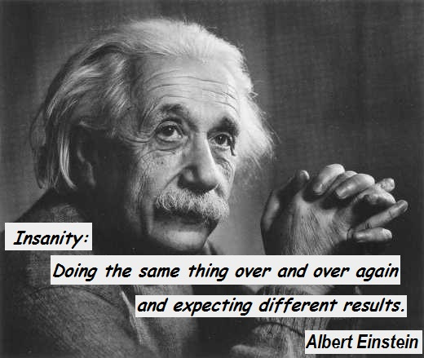
Notes:
Albert Einstein (1879-1955) said
“The definition of insanity is doing the
same thing over and over again and expecting different results”.
Effective Leadership relies on a rigorous examination of the past to affect positive change in the future. You can be the catalyst for change and make a difference!”

Slide 6
People are often promoted to a supervisory job because they have good _____?______ skills.
The Irony: Being a supervisor requires a different set of skills.
Interpersonal Skills
Communication | Conflict Resolution
Hiring | Coaching
Goal Setting | Termination
Notes:
People are often promoted to a supervisory job because they have good _____?______ skills.
The Irony: Being a supervisor requires a different set of skills.

Slide 7
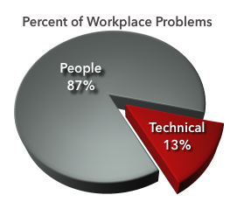

Notes:
This is WHY you need to always develop and improve your People Skills. As a supervisor, most employee issues are “people” issues. You can teach people technical skills and procedures, but “teaching” them to get along with all their co-workers requires you to use “your people skills”. You cannot change people or control how they behave toward others. You can teach and coach them how to change their behavior to “keep their job” and be better at their job.
Most people know how to manage problems;
Most people don’t’ know how to manage People!
You MUST Adapt to meet the needs of your team.

Slide 8

What changed when you first became a supervisor?
What are the characteristics of a great supervisor?
Notes:
Group Exercise – work in small groups.
What are the characteristics of a great supervisor?
Effective Communicator; Good Listener
Fair; Consistent
3) Compassionate; Caring
What changed when you first became a supervisor?
1) Work relationships changed; Longer hours
2) Preparing budgets: Monitoring the budget
More responsibilities
Name 1 or 2 skills You want to improve.
What are the characteristics of a great supervisor?

Slide 9
Who is considered a Supervisor?
A person who gets things done through others.
Supervisor = No longer a Buddy!
Person with ACTUAL or APPARENT authority
Anyone who DIRECTS how work should be done or INFLUENCES hiring, firing, promotion, pay, etc.
Notes:
You are no longer their “Buddy”.
Supervisor in Encarta Dictionary: 1) BOSS - somebody whose job is to oversee and guide the work or activities of a group of other people. Thesaurus: manager, administrator, superintendent, controller, overseer, director, boss, superior.
Tell your staff everyday:
My job is to do everything I can so my team (YOU) can be successful!
I want to hear everything that gets in the way of your success.
When you bring problems to me, bring me at least one solution.

Slide 10

The goal of SIP (Supervisor Improvement Program) is to teach you skills to help you handle the “tough moments” of being a Supervisor.
Supervisor
Skills
Can Be
Learned!
And, Must Be Practiced…
Notes:
The goal of S.I.P. is to build each of you a Supervisor Toolbox to help you handle the “tough moments” of being a Supervisor.
Supervisors must develop their “People Skills” to be successful at getting work done through others.
Supervisors must develop their “People Skills” to be successful at getting work done through others.

Slide 11
What ‘rules’ your city?
Federal Laws
State Laws
City Charter (91)
Collective Bargaining Agreements (CBA)
Forms of Government – Town (418), Aldermanic (44), Strong Mayor (8) and Council Manager (113)
Personnel Policies
  Adopted by governing body
Notes:
Get copies of all Forms of Govt and identify who does HR in each form.
What ‘rules’ your HR Activity?
Federal Laws
State Laws
City Charter
Collective Bargaining agreements (CBA)
Form of Government
Personnel Policies
Adopted by governing body

Slide 13

You are the supervisor, you can fire that problem employee at any time for any reason.
Supervisor Scenario #1
FALSE: If your
1) City Charter, or
2) Personnel Policies (Progressive Discipline), or
3) Collective Bargaining Agreement specifies a “Process for Termination”.
That’s legal, right?
Notes:
TRUE. OK is an “At Will” Employment state. All you say is: “he/she was terminated for the “Good of the Service.””
And FALSE:
However, if your City Charter, or Personnel Policies, or Collective Bargaining Agreement specify a “Process for Termination” (Progressive Discipline), then you and your city must follow the process – every time with everyone.

Slide 14

At Will Employment *
OK State Law: All employees are employed at will and, as such, are free to resign at any time without reason. The City, likewise, retains the right to terminate an employee at any time with or without reason or notice.
* Unless something over rules state law: City Charter, Personnel Policies or CBA’s.
Notes:
At Will Employment
OK State Law: All employees are employed at will and, as such, are free to resign at any time without reason. OMAG, likewise, retains the right to terminate an employee at any time with or without reason or notice.
Unless something over rules state law – City Charter, Personnel Policies w/Progressive Discipline or CBA’s.
From Anadarko #303. Employee Conduct & Work Rules: Employment with the City is at the mutual consent of the City and the employee, and either party may terminate that relationship at any time, with or without cause, and with or without advance notice.

Slide 15

Governmental Tort Claims Act
A political subdivision shall be liable for loss resulting from its torts or the torts of its employees acting within the scope of their employment.
Source: 51 O.S. § 153
Notes:
OKLAHOMA OGTCA – Governmental Tort Claims Act § 153
This statute applies only in Oklahoma. Other states may or may not have similar laws. Some have complete governmental immunity and some have very little protection.
statute actually says “political subdvision”

Slide 16
Governmental Tort Claims Act (GTCA)
Employee Includes:
    All elected
    Appointed officers, and
    Other persons designated to act for City
  Employee Does Not Include:
    Independent contractors
Notes:
Scope of Employment: performance by an employee acting in good faith within the duties of the employee’s office but shall not include corruption or fraud.
51 OS 152(7)(7a) includes volunteer FF when performing FF duties for the City
Why do we need the OGTCA?
Exclusive remedy (for torts)
Exemptions from liability
Notice before lawsuit
Investigate claim before suit
Limits of liability

Slide 17
Limits of Liability
The total liability shall not exceed:
$25,000 Property only
$125,000 Any other loss (less than 300,000)
$175,000 Any other loss (more than 300,000)
$1,000,000 (any number of claims per occurrence)
Source: 51 O.S. § 154
Notes:
Limits are “arising out of a single act or occurrence”
Population determined by the most recent census.
Attorney’s fees: 12 O.S. § 940 A. In any civil action to recover damages for the negligent or willful injury to property and any other incidental costs related to such action, the prevailing party shall be allowed reasonable attorney's fees, court costs and interest to be set by the court and to be taxed and collected as other costs of the action.
Generally, fees are not available in negligence actions in Oklahoma unless the lawsuit is over property damage. Breach of contract cases are more likely to result in the winning side recovering their fees and costs. Most lawsuits involving coverage under insurance policies can end up with the court ordering the losing party to pay attorney fees,
OK Tort Law gives some protection. Governmental Tort Claims Act,
Title 51 O.S.
OMAG has $2 Million Annual Aggregate for Personal Injury and Errors and Omissions claims.
The Math: 8 losses X $125,000 =
$1 Million-Aggregate /Occurrence.

Slide 18
Tort Liability Claims & Lawsuits
Municipality is NOT LIABLE for every situation which involves its employees, equipment or property!
Municipality must be negligent to be liable.
Municipal officials and employees can create legal difficulties when they admit liability to a citizen. (This can create the wrong expectations.)
Never Admit Liability. Never!
Notes:
“You have the right to remain silent” - actually, you have the obligation to remain silent. Don’t say things like: The city will take care of this. This must be our fault. Just go to City Hall and file a claim.
Now, I don’t know about your Mayor, but our current Mayor, Mr. Bumbles, is a problem. He’s a nice fellow and he really does care about our city. Unfortunately, he’s dumber than a stump. Any of you got one like that? I tell him to keep his mouth shut. But, he wants to tell anyone who files a claim: “Sure, we’ll pay it”.
-----I finally told him that OMAG won’t pay a claim, if we’re not legally responsible. And sometimes, it takes those nice claim people awhile to figure out if a claim should be paid. I told him to let them handle it; shoot they handle claims for cities every day.
I finally asked him if he promised to pay a claim to someone, and OMAG denied the claim, was he willing to start paying them from our budget. Well, then he started back peddling. He knows that our budget is tighter than a noose at a hanging.

Slide 19
The Elements of Negligence
1) A duty or legal responsibility; and
2) A breach of the duty by acting inappropriately or failing to act appropriately; and
3) Damages caused as a result of the breach of duty.
Now, you have a claim!
Notes:
OK law says a city must be Negligent before we are legally responsible to pay damages. This negligence is important and really has three parts. 1 – 2 – 3 If yes to all three, then we have a claim and we are legally liable.
-----Without liability insurance, you’d have to pay the damages out of your budget or put it on the property tax rolls. With liability insurance, the insurance pays your claims your behalf.
*****Liability is determined by the licensed claims adjuster. No one at the city makes that determination; use the adjusters expertise.
City has no duty to provide:
-a sewer system, but once you do, you must maintain it.
-a park or playground, but once you, you must maintain it.

Slide 20

Should this claim be paid?
Here’s what happened: a sewer backed up in a home that had never had one before. City maintenance records showed that the City did regular service on that line. However, the City found rags in the line that may have come from a commercial customer.
Notes:
No, claim denied. City had no notice of a problem. Proactive: City can document regular maintenance. We deny about 30-40% of all sewer backup claims.
Here’s a claim where Mayor Bumble’s words almost got us in trouble. It turned out we were not legally responsible for this claim. #1: we’d never had a problem at this house before and #2: we found rags that read “Ed’s Auto” in that line. So, OMAG denied that claim on our behalf.
----I have finally managed to convince our Mayor to just smile and wave and not say anything about paying claims.
Liability is not always clear, especially at the scene of the incident!

Slide 21
Exemptions from Liability
The state or political subdivision shall not be liable if a loss or claim results from an exemption.
*The statute provides 37 exemptions
Source: 51 O.S. § 155
Notes:
There are 37 exemptions that apply to State, Political Subdivisions, School Districts, Jails, etc.
If the claim falls into one of these categories then the City does not have to pay it – it is exempt from liability.
If there is a clear exemption, the claim should be denied. If the City Council chooses to pay claims that are clearly exempt, it could be subjecting the City and the Council members individually to tax payer lawsuits.
Independent contractor
Example: City hired IC to resurface streets. The IC does not barricade the streets properly and multiple cars are damaged as a result. IC is on the hook for damages, not the City.
Indemnification/subrogation
Example: Claimant is rear-ended by a City vehicle. Claimant submits the claim to their insurance and repairs are made and covered by the claimant’s insurance. Insurance company cannot recover from the City for the full amount of damages, but claimant may be able to recover the deductible.

Slide 22

Commonly Used Exemptions
Legislative functions
Performance of or the failure to exercise or perform any act or service which is in the discretion of city or its employees
Snow or ice conditions unless caused by negligence of city
Licensing powers or functions
Inspection powers or functions
Any loss to any person covered by any workers' compensation act or any employer's liability act

Slide 23
Notice before Suit
(the “Rules”)
Refer to Handout
1 year from discovery
The tort claim must be:
  In writing
  Filed with the City Clerk
  Contain name, address, phone number of claimant
  Relief requested
  Reporting requirement for Medicare
Source: 51 O.S. § 156
Notes:
TORT CLAIM CHECKLIST – when a citizen calls and requests a claim form – the Clerk should start a checklist. This may help in the future for many reasons, i.e. if there is a statute of limitations issue, whether there was notice, etc.
Add a Tort Claim form to the SIP materials.

Slide 24
Types of Notice
  Actual Notice – citizen calls the City to report a pothole
  Constructive Notice – city employees (i.e. police officers, meter readers, city manager) pass by daily and knew or should have known of the condition
Notes:
claim pictures taken by AT&T’s repair people that show a phone pedestal in them. It also clearly shows the orange locate marks and the rulers and markers that AT&T uses after damages have been done. (The phone pedestal is almost hidden in a couple of the photos but is clearly shown in one of them.)
Determination of negligence on the part of the City is not the end of the story – the claims adjusters will still work to get the amount of the claim down to a reasonable amount of settlement.
NOTE: A claim may be paid if there is a dispute about the facts to avoid legal bills in a case that may end of in front of a jury.
NOTE: $ amount of payment will depend on depreciation, actual cash value, blue book value, prior medical conditions, contributory negligence, etc.
Factors in determining whether to approve or deny claim:
Was there are a duty owed?
Was there a breach of that duty?
Were there damages?
Was it timely presented to the City?
Was the City negligent?
Did the City have actual notice?
Did the City have constructive notice?
Is there an exemption under the Act?

Slide 25
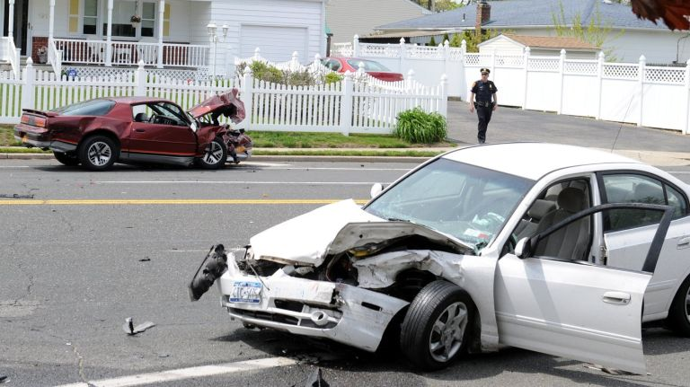
Should this claim by paid?
There is an auto accident when a driver goes through an unmarked intersection. It turns out that the stop sign was down. The driver files a claim saying the City should have replaced the sign. No one had reported it being down, but a City employee lives on that block and drives through that intersection everyday to go to work.
True or False?
Notes:
2 types of Notice:
Actual
Constructive

Slide 26
Federal Claims
No Tort Claim Required
Employment Issues:
EEOC (discrimination/harassment)
FMLA (medical leave)
FLSA (wage and hour)
Civil Rights Issues: (42 U.S.C. § 1983)
use of force claims by police
unreasonable search & seizure
Notes:
City liability:
No limits on compensatory damages
No punitive damages can be awarded
Employee liability:
No limits on compensatory damages
No limits on punitive damages
MAY RECEIVED A NOTICE OF PRESERVATION OF DOCUMENTS FROM EEOC OR OMAG – THAT MEANS DON’T DESTROY ANYTHING!
There are State laws claims similar to a lot of federal law causes of action. If the State counterpart to some of these federal causes of action are alleged then a tort claim may need to be filed. For example: if a person is terminated from employment, they could allege discrimination (Federal – Title VII) and wrongful termination (State cause of action). Then a tort claim would need to be filed to proceed on the State cause of action.
Another example would be assault and battery versus 42 USC § 1983 use of force cause of action. Remember there are caps and exemptions in the OGTCA that protect cities. In this case, there’s an exemption for providing police protection and a $125,000 cap on damages if exemption does not hold out. In 1983 action there is no cap.
State courts are usually more friendly to claimants so many times the Plaintiff’s attorney will file a tort claim alleging these similar State causes of action.

Slide 27
What can you do?
(or not do . . .)

Slide 28
DO NOT ADMIT LIABILITY
It is very important that all employees (and Elected Officials) know “do not admit liability”.
This is especially true for the City Clerk and crew workers who witness or clean up incidents and/or deal directly with citizens.
Notes:
Let the process work. Be sure to tell ALL your employees this . . . It is usually the workers in the field that are confronted with an angry citizen and they may be under one of the misconceptions as stated above.

Slide 29
INVESTIGATE
IMMEDIATELY!!!
Don’t wait for the claim to be filed.
Document, Document, Document!
Notes:
PRESERVE DOCUMENTS: Do not destroy, conceal or alter any paper documents or electronic data, including: data generated by or stored on any computer or computer storage media, (i.e. hard disks, backup tapes, video tapes) that relate to the claims or defenses in the claim
TALK TO WITNESS AND GET STATEMENTS
You have to get the FACTS! Remember there are 2 sides to every story (sometime 3-4) but at least 2.
IMMEDIATELY upon being notified of an incident that may result in a future claim YOU or your designated person should investigate what happened.
McAlester has a Safety Person who responds to any accident/possible claim situation and documents the situation with photos, information from potential claimant and statements from city employees.

Slide 30
Incident Protocol
Develop an “incident report”
Assign an employee to investigate and fill out incident report
Take pictures and gather documents
Take statements
Contact OMAG (1-800-234-9461) if questions
Notes:
Written Logs:
Citizen phone calls – i.e. citizens calling in issues with roads, service, etc.
Employee log of problems noticed by employees
Employee log of encounters with citizens
Police dispatch logs
Daily activity reports kept by supervisors
Fire run logs kept by fire stations when receive a call
Generic Information:
Employee and Supervisor Name
Name of Property Owner
Address of Accident
Property or Injury (or both)
Date and time of injury or accident
What was injured or damaged
What happened
Witnesses or other personnel involved
Was Okie contacted
Who provided medical care
Drug/Alcohol test administered
Specific Incidents:
Slip and Fall – maintenance; weather conditions
Water Meter Claims – last time meter was read; rainfall; locking devices used
Swimming Pool – lifeguards on duty; accident records
Playground – maintenance checklists; installation records; temperature readings
Sewer Backup – rainfall; cause; last backup; age and size of line

Slide 31
Taking pictures
Get before and after pictures
Date/time is programmed correctly
Take multiple angles
Use a ruler or measuring stick if appropriate
Document:
  Who took the photo
  Date and time of photo
  What direction photo was taken
Notes:
Make copies of everything. Do not just keep it on your c:/ drive on your computer.

Slide 32
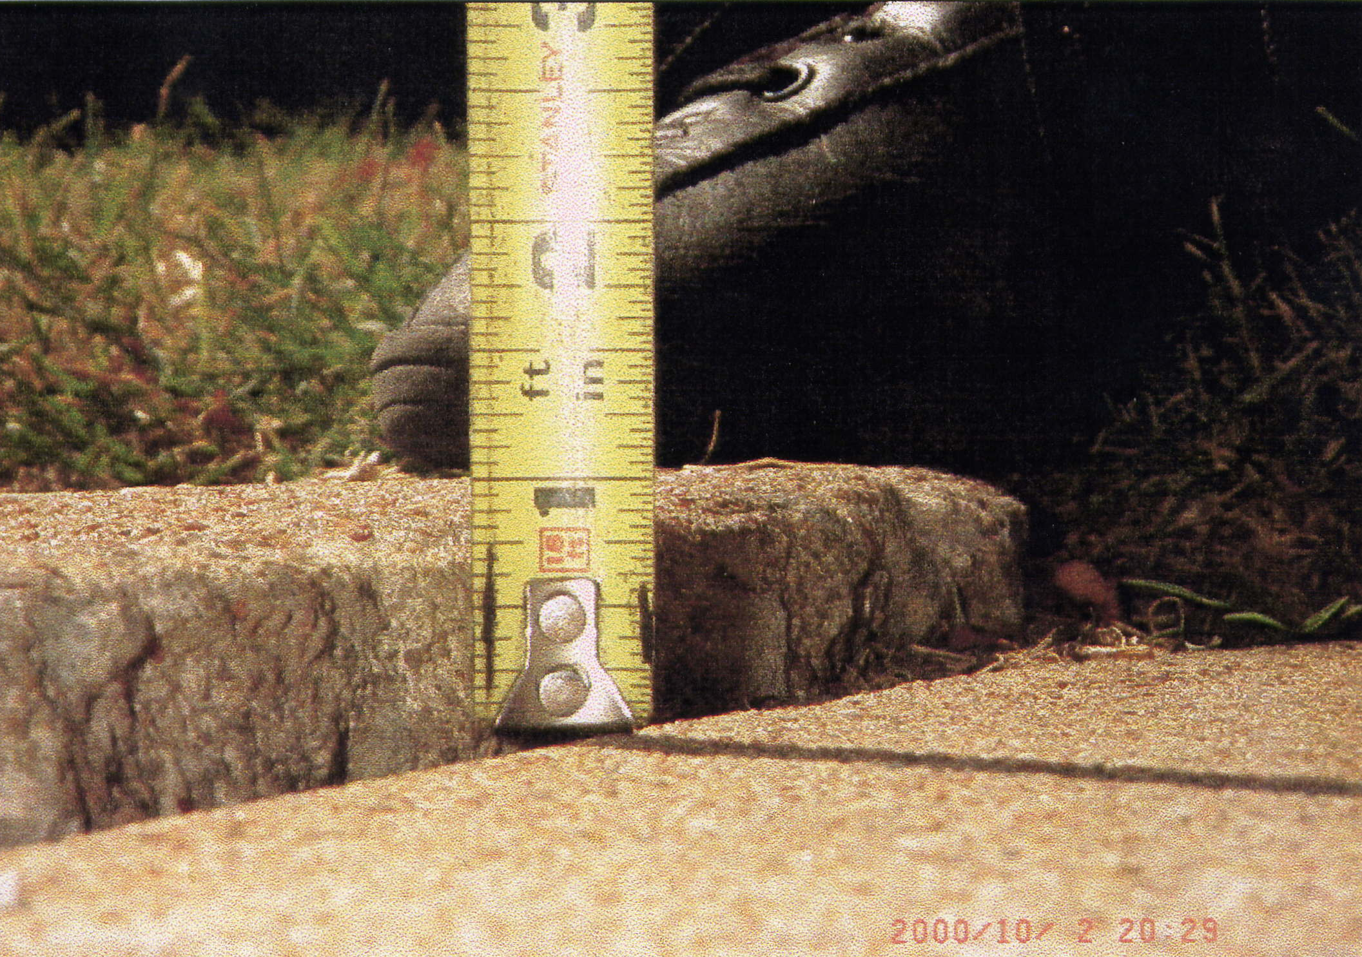
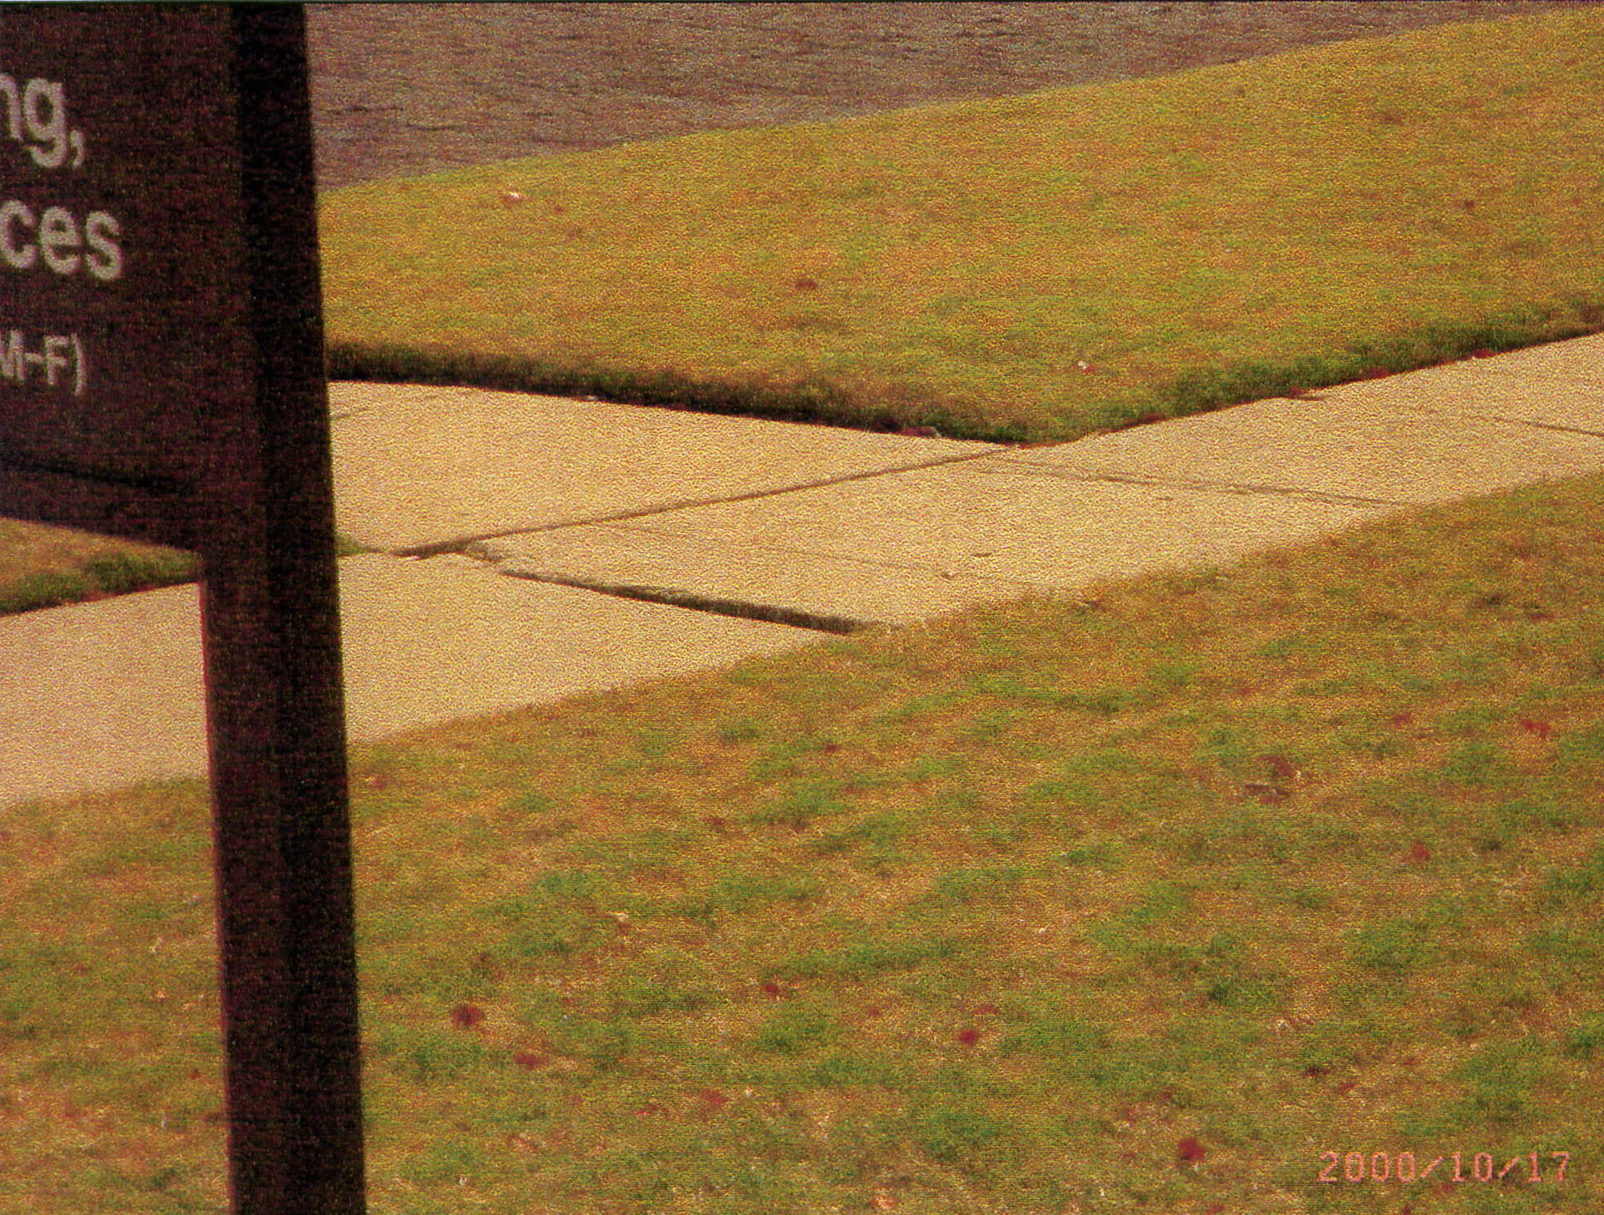
Context and Details Matter

Slide 33
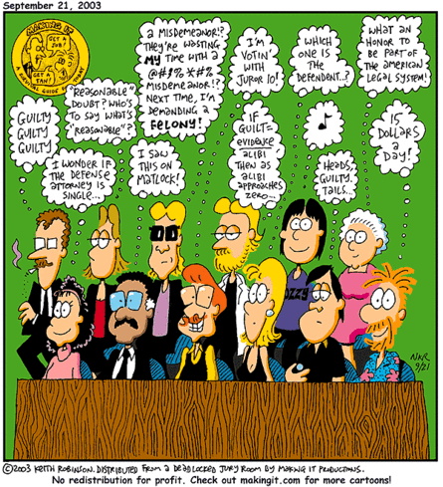
Juries
are unpredictable!

Slide 34

Topics so far have included:
  April 17, 2018: Employment Investigation Bootcamp
  June 14, 2018: Child Labor Laws
  August 16, 2018: OMAG Online Training
  October 11, 2018: Medical Marijuana Law
  December 11, 2018: Reasonable Suspicion Training
  February 13, 2019: Understanding your Personal Biases
Meeting every other month
at OMAG (lunch provided)
https://www.omhrp.org/
(Password is “OMAG”)
Notes:
Started in August 2017 – You can sign up on the website or on FaceBook.
Topics so far have included:
April 17, 2018: Employment Investigation Bootcamp
June 14, 2018: Child Labor Laws
August 16, 2018: OMAG Online Training
October 11, 2018: Medical Marijuana Law
December 11, 2018: Reasonable Suspicion Training
February 13, 2019: Understanding your Personal Biases

Slide 35

  Topics covered:
  Code and Zoning Questions
  Hiring
  Reasonable Accommodations and Disability Discrimination
  Discipline and Drug Testing
  Law Enforcement Questions
Learn about
Medical Marijuana
https://www.omag.org/search?q=marijuana
Notes:
Started in August 2017
Topics so far have included:
December 12, 2017: Employee Released Medical Maximum Improvement (MMI) With Restrictions - Now What?
February 13, 2018: Members present questions and OMAG answers
April 17, 2018: Employment Investigation Bootcamp (registration is limited)
June 14, 2018: Child Labor Laws
August 16, 2018: OMAG Online Training
(LocalGovU Speakers to Demo)
October 11, 2018: Medical Marijuana Law

Slide 36

http://omma.ok.gov/Websites/ddeer/images/SQ%20788.pdf
Text of State Question 788
Approved Emergency Rules for SQ 788 (7/31/18) with Additional Approved Revisions (8/1/18)
http://omma.ok.gov/faqs
Frequently Asked Questions
405-271-2266

Slide 37
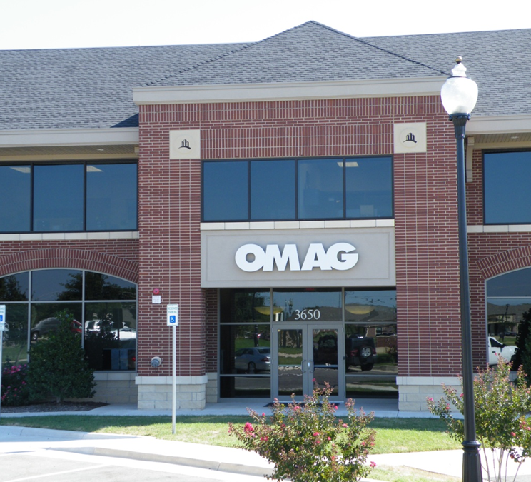
How can OMAG help?
Sample Policies
Legal Guidance
HR Guidance
Policy Review
Claim Review
Coverage Review
3650 S. Boulevard
Edmond, Oklahoma 73013-5581
800-234-9461 ∙ 405-657-1400
www.omag.org

Slide 38

www.omag.org
www.twitter.com/omag1977
www.facebook.com/oklahomamunicipalassurancegroup
https://www.linkedin.com/company/oklahoma-municipal-assurance-group/

Slide 39

"A positive attitude may not solve all your problems, but it will annoy enough people to make it worth the effort."
Notes:
You can’t supervise “attitude”, you can hold them accountable for their Behavior and Performance.
"The remarkable thing we have is a choice every day regarding the attitude we will embrace for that day. We cannot change our past... We cannot change the fact that people will act in a certain way. We cannot change the inevitable. The only thing we can do is play on the one string we have, and that is our attitude.“ -- Charles R. Swindoll
Before you say a employee has an ATTITUDE problem:
1) Check your attitude; and
2) Identify what BEHAVIOR the employee is doing that is causing you to say that about them. Behavior = Performance

