Slide 1

Ethics
SIP #4
Because you are a public servant, Ethics is a Critical topic to you.
Notes:
Definition: Ethical behavior involves the performance of our everyday activities based on some type of code of conduct. This code of conduct should permeate local government at every level. Each individual will need to hold themselves accountable for their own ethical behavior.
Because you are a public servant, Ethics is a Critical topic to you.
It makes no difference what your role is in local government You may be: City Manager, County Administrator, Director of Public Works, Administrative Assistant, Sanitation engineer, Custodian, Utility Billing clerk. Regardless of your role, your work is done in the public eye. As a result, expectations regarding your job performance are held to a high standard than your counter parts in the private sector.

Slide 2
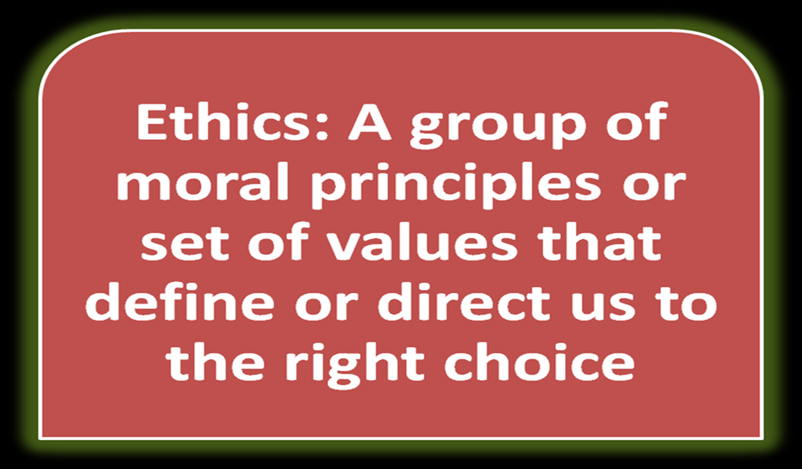
Can mean different things to different people.
Ethical behavior involves the performance of our everyday activities based on some type of code of conduct.
It should permeate local government at every level.
Notes:
What is Ethics? “A group of moral principles or set of values that define or direct us to the right choice.”
Government officials serve the people, managing the resources of others. Along with this stewardship, there is an expectation from the public that in conducting daily activities, the officials will practice fairness and equality.
They are also expected to maintain openness in their workings to ensure that they are operating within the public's perception of what is "right." Wikipedia

Slide 3
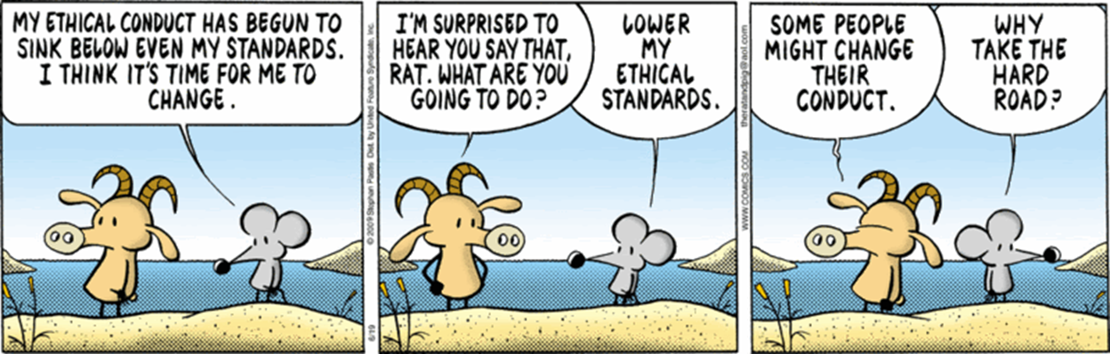
Notes:
RAT: My Ethical conduct has begun to sink below even my standards. I think it’s time for me to change.
GOAT: I’m surprised to hear you day that, Rat. What are you going to do?
RAT: Lower my ethical standards.
GOAT: Some people might change their Conduct.
RAT: Why take the hard road?
Do you Agree? The public seems to be more forgiving of film and television stars or professional athletes than they are of public employees and officials.
Again, this is because of the higher standard to which all public servants are held.

Slide 4
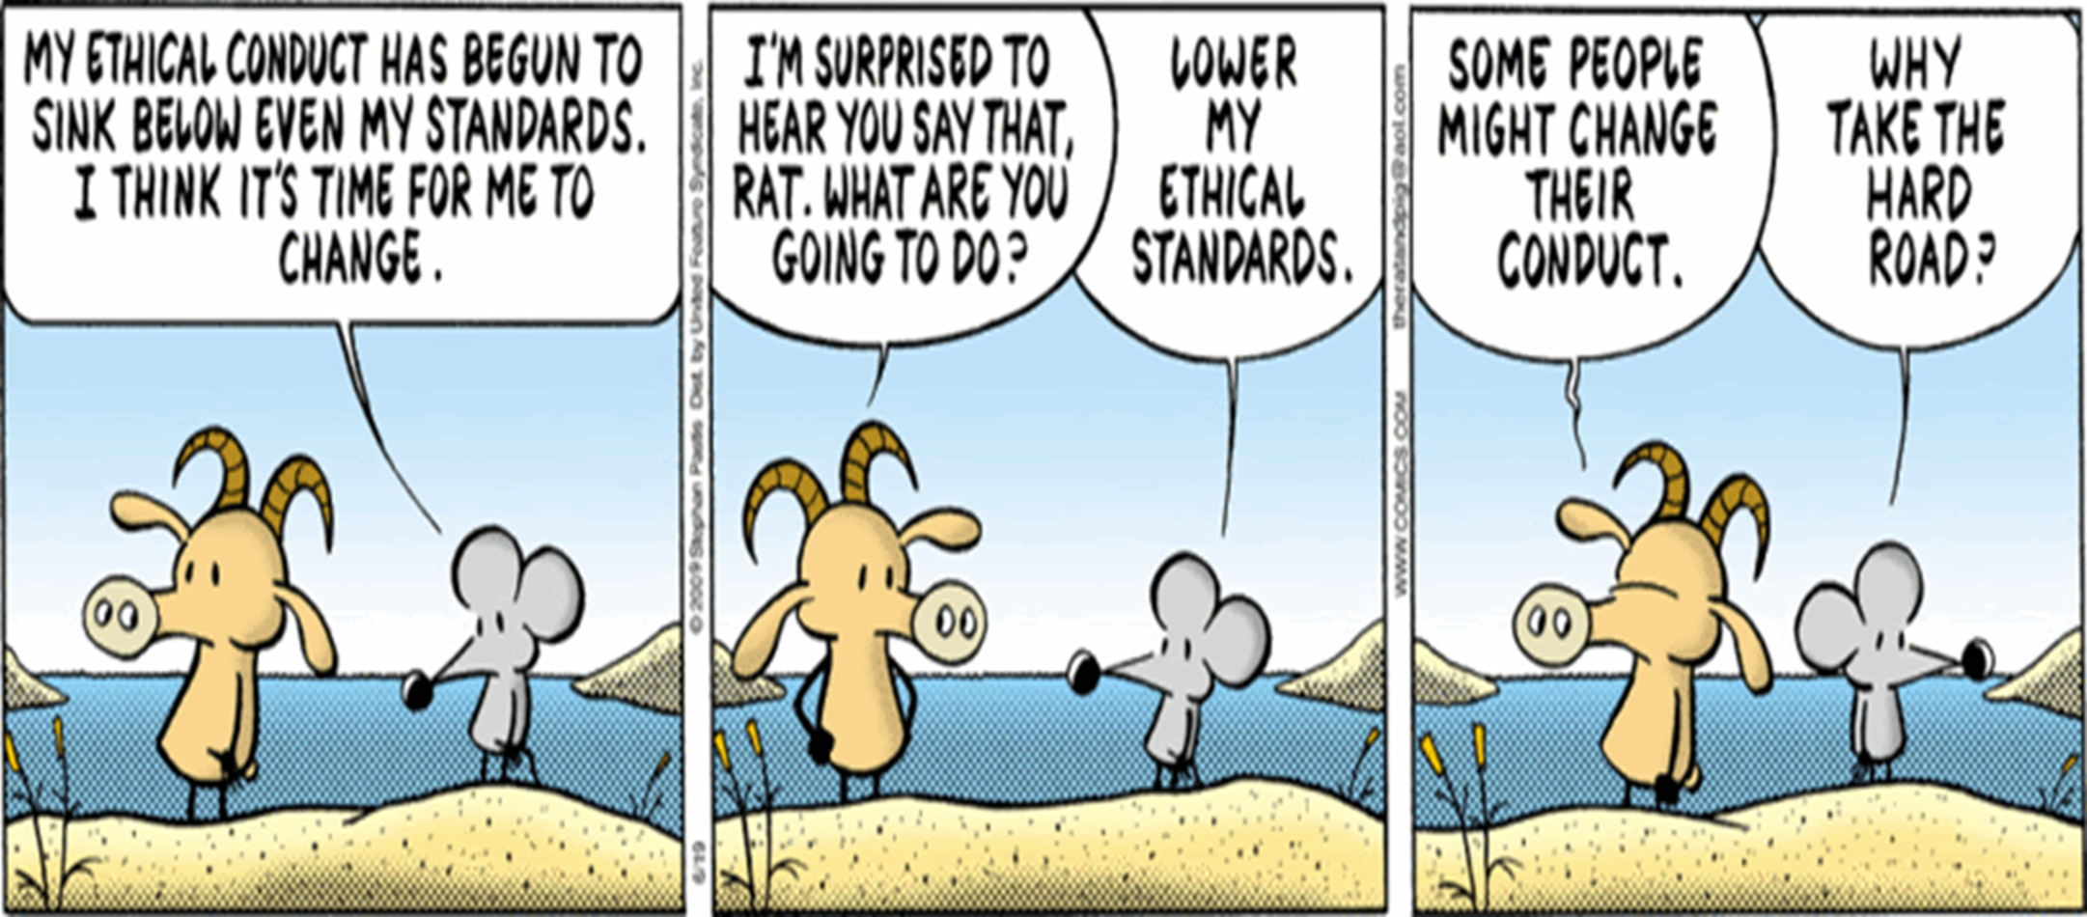
Notes:
RAT: My Ethical conduct has begun to sink below even my standards. I think it’s time for me to change.
GOAT: I’m surprised to hear you day that, Rat. What are you going to do?
RAT: Lower my ethical standards.
GOAT: Some people might change their Conduct.
RAT: Why take the hard road?
Do you Agree? The public seems to be more forgiving of film and television stars or professional athletes than they are of public employees and officials.
Again, this is because of the higher standard to which all public servants are held.

Slide 5
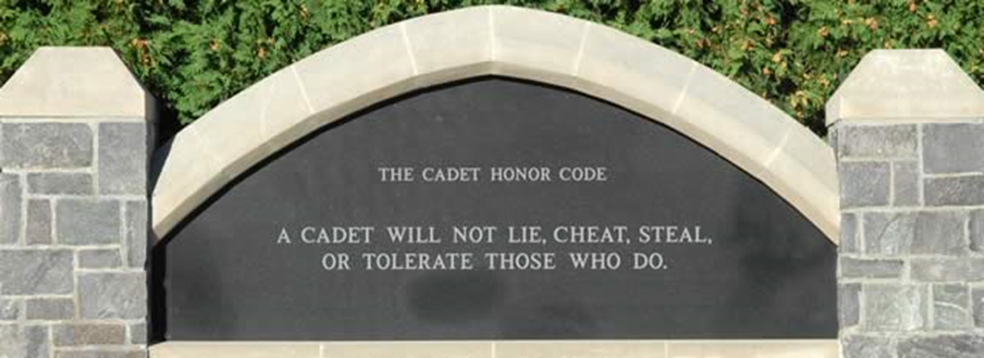
Historical Codes of Conduct
The Ten Commandments
US Constitution
Local, state and federal laws
The Hippocratic Oath (Physicians’ oath)
Honor Codes (such as with military or academic institutions)
Notes:
Does your city have a Code of Conduct?
Do you have an Ethics Code?
If yes, How often is it reviewed with your employees?
Boy Scout Oath and Law

Slide 6

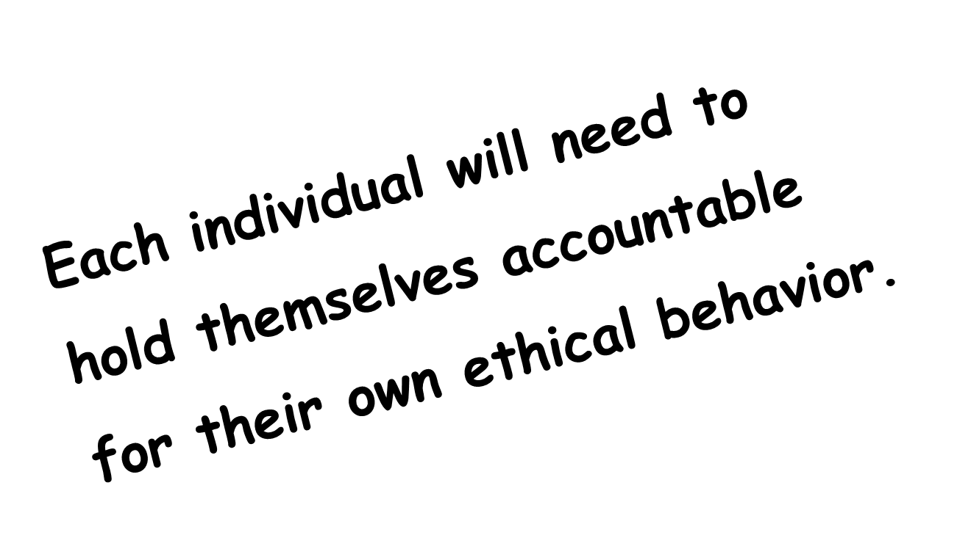
ni
Each individual will need to
hold themselves accountable
for their own ethical behavior.
Notes:
WARNING! Each individual will need to hold themselves accountable for their own ethical behavior.
You are responsible for your own actions!

Slide 7
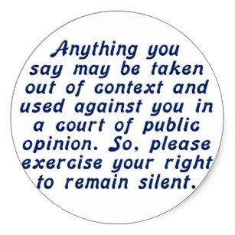

Slide 8

Your role makes no difference
City Manager
Director of Public Works
Utility Billing Clerk
Sanitation Engineer
Custodian
Your work is done in the public eye. Expectations regarding your job performance are held to a higher standard than if you worked in the private sector.
Notes:
It makes no difference what you role is in local government You may be: City Manager, County Administrator, Director of Public Works, Administrative Assistant, Sanitation engineer, Custodian, Utility Billing clerk.
Regardless of your role, your work is done in the public eye. As a result, expectations regarding your job performance are held to a higher standard than your counter parts in the private sector.

Slide 9
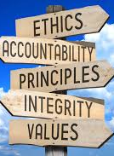
Why are Expectations Different?
Citizens are indirectly paying your salary.
Your city’s sole reason for existence is to serve the needs of the community.
Therefore, you are held to a higher standard.
Notes:
Why are Expectations Different?
The Citizens of your community are indirectly paying your salary. The income that allows you to have a regular paycheck and all the fringe benefits you take advantage of is derived from the fees and taxes that are paid by the citizens of your city. This gives them more of a sense of ownership in what goes on.
Your city’s sole reason for existence is to serve the needs of the community.
Simply stated, most businesses exist to make money. Local Government exists to serve; therefore, you are held to a higher standard.

Slide 10
Cities Provide Infrastructure
Water
Sanitation
Streets
Police
Fire
Sanitary Sewers
Enforces standards:
Building Codes
Traffic safety laws
Zoning
Animal Control
Licenses
Notes:
Cities provide basic infrastructure needs for their communities. This would include water, sanitation, street construction and maintenance, in addition to police and fire.
The city also enforces standards for the community such as building codes, traffic safety laws, zoning, animal control and licensing and noise ordinances.

Slide 11

Citizens are a “Captive Audience”
Customers like to have options.
Citizens have no other options to get the services provided by your city.
This raises their expectations.
If expectations are not met, how will they make their unhappiness known?
Notes:
Typically, citizens have no other options to get these services.
When people have choices, they can always express their dissatisfaction by going to another vendor. If a person feels there is no competition for a service, it will raise their level of expectations. If expectations are not met, they will make their unhappiness known. Ask attendees: How do citizens act if their expectations are not met?
Cities need to have ethical standards in place that will at the very least meet the level of community expectations, and ideally exceed them.

Slide 12


Conflicting Financial Interests
Employees receive their pay and benefits, nothing else.
A company owned by a municipal employee or an elected official will not be eligible to participate in the bidding process for goods and services contracted by the city.
Public funds may not be used to benefit an individual.
Notes:
Typical Issues addressed in a Code of Ethics:
Conflicting financial interests – In most cases, a company owned by a municipal employee or an elected official will not be eligible to participate in the bidding process for goods and services contracted by the city.

Slide 13

Accepting gifts
City employees and officials are prohibited from accepting gifts, usually over a specific dollar amount, from a person either doing business or attempting to do business with the city.
Notes:
Typical Issues addressed in a Code of Ethics:
Accepting gifts – Municipal employees and officials are prohibited from accepting gifts, usually over a specific dollar amount, from a person either doing business or attempting to do business with the city.
Does you city have a $ Limit? $ __?__

Slide 14

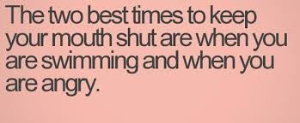
Divulging Confidential Information
City employees and officials are prohibited from disclosing confidential or privileged information about any aspect of government business.
Notes:
Typical Issues addressed in a Code of Ethics:
Divulging Confidential Information – With the exception of information that could be considered part of the public record, city employees and officials are prohibited from disclosing confidential or privileged information about any aspect of government business.
Fish: Sometimes It Pays to Keep Your Mouth Shut!

Slide 15

Employing Family Members
City employees and officials will usually be prohibited from hiring or appointing relatives to work in any department of the city.
Notes:
Typical Issues addressed in a Code of Ethics:
Employing family members – City employees and officials will usually be prohibited from hiring or appointing relatives to work in any department of the city.
What are the nepotism basics?
A. What is the general rule? No elected or appointed official shall appoint any person related by blood or marriage within the third degree to any governing body member or to himself. If the employee is already in the service of the municipality he or she may continue to serve and be promoted. 11 O.S. Section 8-106.
B. Does this apply to who the voters elect? No. The nepotism statute does not stop the people from electing as many members of the same family as they desire.
C. What is the easiest way to understand the third degree? The Nepotism chart in the OML Handbook has been reproduced by the Oklahoma Attorney General and is the best way to understand which relatives are within the third degree. The most notable relative that can be hired are first cousins. Source: http://okml.webs.com/FAQ/Inquiry%20FAQ.pdf

Slide 16

Making Campaign Contributions
Individuals who are doing any kind of business with the city may be prohibited from making campaign contributions to city officials.
Local government officials are prohibited from compelling, coercing or intimidating any city employee to make a contribution to their political campaign.
Notes:
Making Campaign contributions – There are two types of limitations imposed in this case:
Individuals who are doing any kind of business with the city may be prohibited from making campaign contributions to city officials.
Local government officials are prohibited from compelling, coercing or intimidating any city employee to make a contribution to their political campaign.

Slide 17
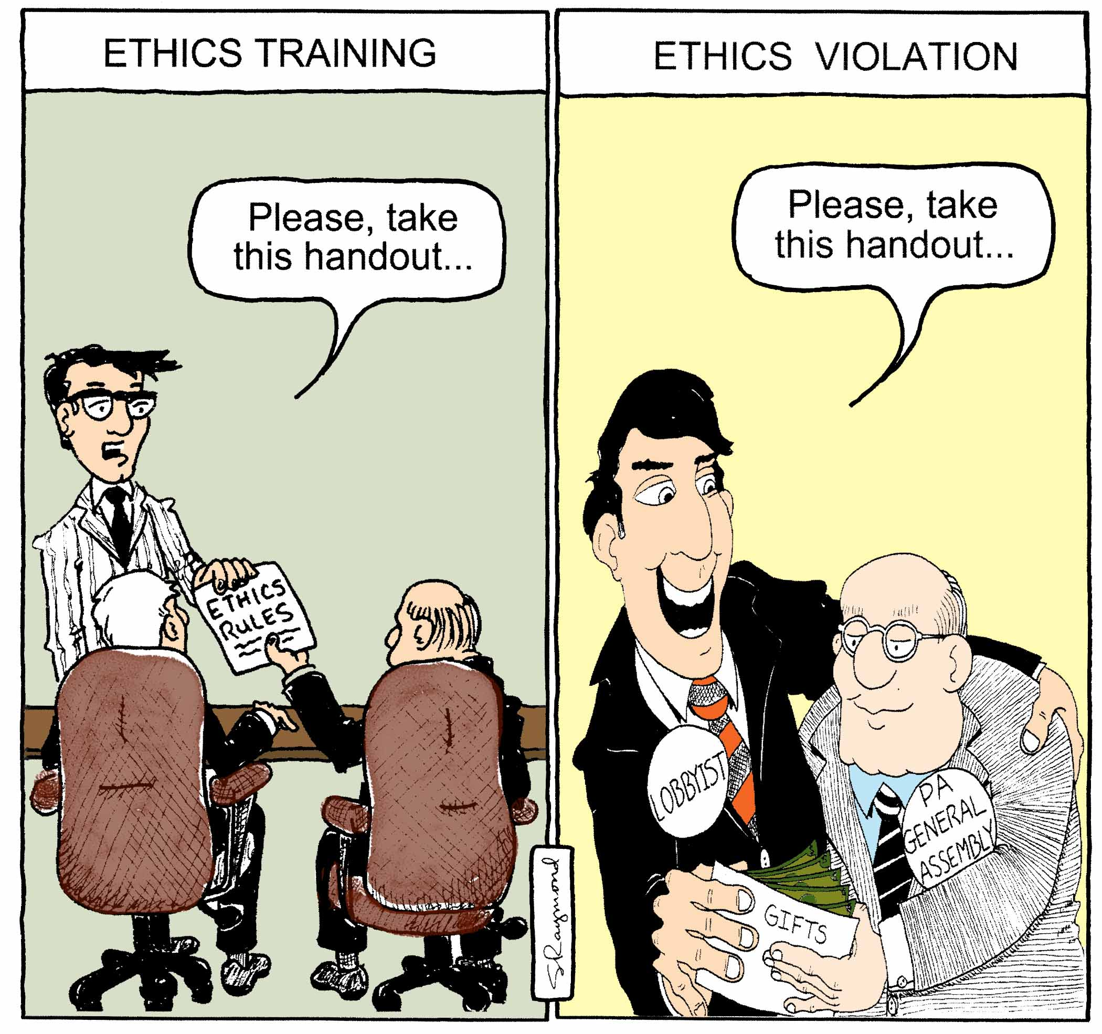
Notes:
“Please take this Handout.”

Slide 18

Drug Testing
Mandatory drug testing is one way to give the city confidence in the fact that their public servants are not engaged in an activity that is not only a violation of ethical standards, but in many instances a misdemeanor or felony!
Drug use by anyone is indefensible, but particularly so for public employees.
https://www.omag.org/788
Notes:
Drug Testing – Many communities require employees and officials to submit to one or more random drug tests throughout the course of a year.
The public seems to be more forgiving of film and television stars or professional athletes than they are of public employees and officials. Again, this is because of the higher standard to which all public servants are held. Mandatory drug testing is one way to give the city confidence in the fact that their public servants are not engaged in an activity that is not only a violation of ethical standards, but in many instances a misdemeanor or felony! Drug use by anyone is indefensible, but particularly so for public employees.
Recently, a mayor of a major metropolitan area was filmed as part of a major drug sting operation attempting to purchase drugs. The resulting negative publicity was devastating both to his reputation and the reputation of the city he was supposed to be serving.

Slide 19


Knowledge of Ethics is one thing; practicing ethical behavior is all together different.
Notes:
Ethics are Personal.
What is the perception that YOU are creating of yourself within your work environment?
Are you doing things or engaging in behavior that compromises your Integrity?
Beyond the issues that impact the image of your city as a whole, there are the issues that affect you personally. What is the perception that you are creating of yourself within your work environment? Are you doing things or engaging in behavior that compromise your Integrity?
Does the Trust Hurt? Some people might react to the previous page with righteous indignation. “I would never do anything that would call my character into question. I don’t steal. I don’t accept gifts from vendors? I’m an honest person.”

Slide 20
“I don’t steal. I don’t accept gifts from vendors? I’m an honest person.”
However, this same person may be:
Coming to work 15 minutes late every morning.
Taking extended lunches and breaks.
Using the office copier for their personal projects.
Taking more supplies from the supply closet than necessary because some are for work, but a few are for home.
Notes:
While that may be the first reaction, some soul searching might be in order before final conclusions are drawn. This same person may be:
Coming to work 15 minutes late every morning.
Taking extended lunches and breaks
Using the office copier for their personal projects
Taking more supplies from the supply closet than necessary because some are for work, but a few are for home

Slide 21
I don’t steal. I don’t accept gifts from vendors? I’m an honest person.”
However, this same person may be:
Making long and repeated personal telephone calls.
Spending office time updating their Facebook and other social media postings.
Using public vehicles for uses that are personal.
Notes:
While that may be the first reaction, some soul searching might be in order before final conclusions are drawn. This same person may be:
Making long and repeated personal telephone calls
Spending office time looking up Facebook postings
Using public vehicles for uses that are personal

Slide 22

Notes:
And assume someone is watching and/or listening.
What about all the cameras at your city?

Slide 23

Notes:
In 2019, you put your job on the line when you talk about work and people at work on your social media.
Electronic media printouts can be brought into court.
Employees are still subject to the City’s existing policies including, but not limited to: Employee Conduct, Media and Press Releases, Computer Resources, Information & Communications Systems
Caution employees, they should have NO expectation of privacy while using the Internet.
2/26/19: Pix from 60+ Social Networking Sites You Need to Know About (Updated 23rd December 2018). Source: https://makeawebsitehub.com/social-media-sites/

Slide 24
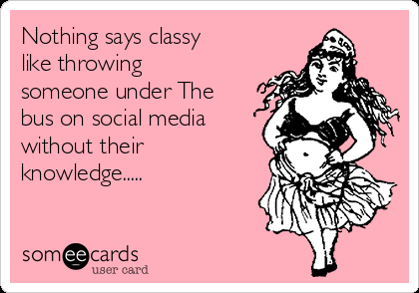
Shame on You!
Notes:
On your personal Social Media, Do Not talk about your city, councilmembers, managers, bosses or coworkers UNLESS it is Positive.
Negative comments reflect on YOU and YOUR CITY! And, social media that refers to your work could be read in court! When you talk about work, you make it a Permanent Public Record.
Do you like the Angry Bloggers? Don’t act like them…

Slide 25



Slide 26


Slide 27

Are you using your Social Media to Bully?
Notes:
Facebook, Twitter, Instagram, YouTube,
Employees are still subject to the City’s existing policies including, but not limited to: Employee Conduct, Media and Press Releases, Computer Resources, Information & Communications Systems
Caution employees, they should have NO expectation of privacy while using the Internet.
2/26/19: Pix from 60+ Social Networking Sites You Need to Know About (Updated 23rd December 2018). Source: https://makeawebsitehub.com/social-media-sites/

Slide 28

Electronic
Media
EVIDENCE can
Blow Up your Career
Notes:
Electronic Media = EVIDENCE.
EVIDENCE CAN BLOW UP YOUR CAREER.

Slide 29
Teacher CONVICTED…
Main Evidence:
9,000 Text Messages!
Notes:
Article of the former teacher convicted by 9,000 text messages.

Slide 30

Ethics Checklist
Is it legal?
Does it violate rules or regulations?
Can you live with the consequences?
What if it meant losing your job?
Notes:
Ethics Checklist - If your decision doesn’t have to be made immediately, there are several questions you can ask yourself to help you with the process:
Is it legal? If the answer is “no”, then you really don’t have to proceed any further down the list. You’re Done. If it is illegal, it is probably unethical, too.
Does it violate rules or regulations? Rules may not be as binding as laws, nor likely to result in a harsh punishment as would occur if you were caught breaking the law. Despite this fact, there may still be unpleasant consequences.
Can you live with those consequences?
What if one of those consequences was losing your job?

Slide 31
Ethics Checklist
Is it in line with our values?
Will I feel guilt?
How would I feel if someone did it to me?
Notes:
Is it in line with our values? Along with mission statements, organizational values have become popular benchmarks for directing the actions in both the private and the public sector. Ethics are driven by values. If a decision you make is contrary to your organization’s values, then it can’t be ethical.
Will I feel guilt? No one can answer that question for you. How you answer will basically make your decision for you.
Good Question: How would I feel if someone did it to me (or my loved one)? Once again, the answer to the question makes your decision for you.

Slide 32
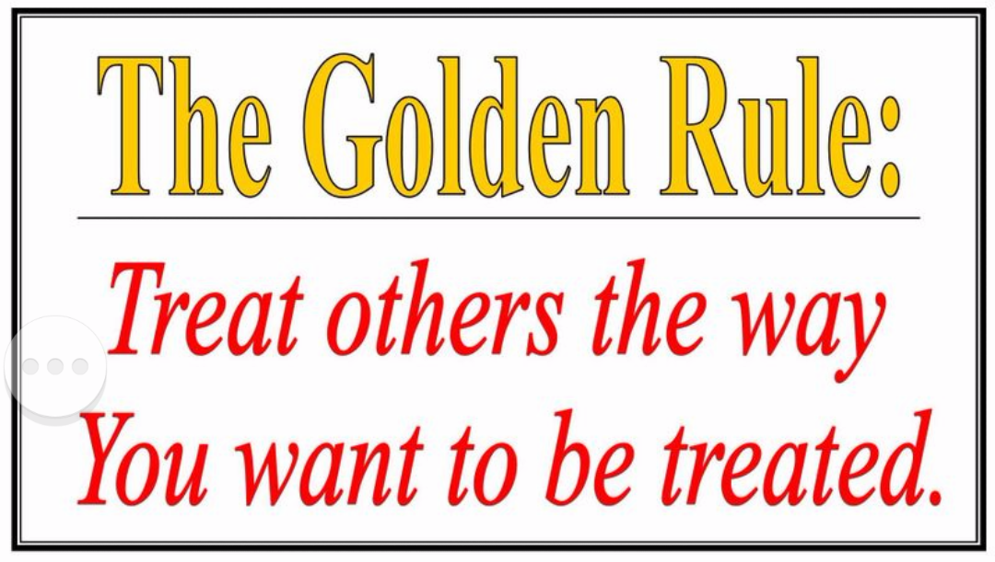
Ethics Checklist
Would the most ethical person I know do it?
The Golden Rule
Notes:
-Would the most ethical person I know do it? Is there someone you know whose ethical standards are beyond reproach? If you know what they would do, then that’s probably what you should do.
-The Golden Rule
If you are in a situation where you have to make a decision quickly, the Golden Rule is probably still the best guideline to use. Treat others the way you would want to be treated.
Would you be happy if someone was to make the decision you’re considering? If your decision meets that criterion, you’re probably doing the right thing. If it doesn’t, you’re probably not. It’s simple, but it’s accurate!

Slide 33
How can you make sure your decisions are grounded in ethical behavior?
Do Your Best - Make the best decision you can, based on the options you have before you and the facts that you have to consider.
Notes:
The bottom line is you should make the best decision you can, based on the options you have before you and the facts that you have to consider.
How would it look on the Front Page of the paper?
Kid on your Shoulder: Would I be proud and could I explain it to a 1st Grader?
If you value ethical behavior, and that is the basis for your decision making process, more often than not, you will make the right decision.

Slide 34


Slide 35
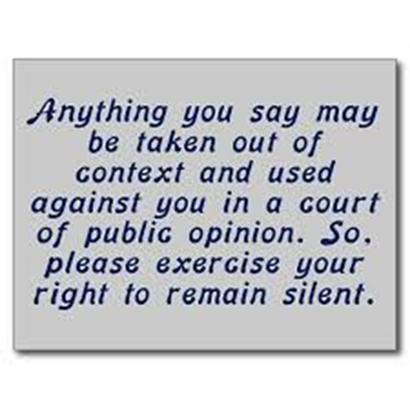
Summary
SUMMARY – CAUTION!
Notes:
Behaving ethically is not necessarily a skill that you master. Every day we are all faced with decisions. As stated earlier, sometimes the choices we’re faced with are black and white. That is, however, often the exception rather than the rule. In many situations, we’re confronted with a decision where there appears to be more than one “right” choice.
As an employee or official working in local government, your behavior and the decisions you make are subject to much closer scrutiny than people employed in the private sector. Realizing this, it is important that you know, understand and make decisions that are guided by your community’s code of ethics.

