Slide 1
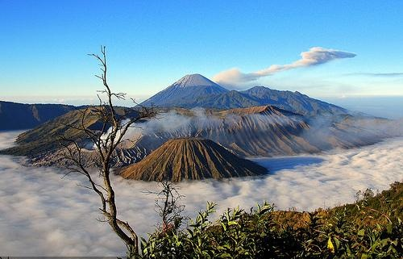
Unit 11
GIVE PEACE A CHANCE

Slide 2
Final task
This is your final task, at your final unit using this book. This final chapter is about peace. You are now expected to compose a story about peace. It should be around 4000 words long, typed in an A4-sized paper, Standard Times New Roman 12, with double line spacing, and margin of 4,3,3,3 (left, top, right, bottom). You shall write your own notion, idea, and using your own inspiration. There must a silver lining and general theme in your work, and that must be related to our main topic, peace.
Please do remember that plagiarism will not be tolerated. When detected, both students with the exact idea or paragraph will automatically fail.

