Slide 1
DEVELOPING
WORKERS
FOUNDATIONS
WORKSHOP 4
How to Reach Your City
And Country for Christ
Multiply Churches that Multiply Disciples
12-18-20
Notes:
WORKSHOP 4
How to Reach Your City and Country for Christ
Multiply Churches that Multiply Disciples
Greetings and Introductions
If there is a local coordinator, he will welcome the participants, introduce the trainers, and open the workshop in prayer.
Thank the pastors and leaders for coming
Trainers introduce themselves

Slide 2
Workshops
How to Grow Your Church
  Multiply Disciples
Balancing Personal Life and Ministry
How to Understand and Apply the Bible
  How to Preach Effectively
How to Reach Your City And Country for Christ
  Multiply Churches that Multiply Disciples
Notes:
Workshops
How to Grow Your Church
Multiply Disciples
Balancing Personal Life and Ministry
How to Understand and Apply the Bible
How to Preach Effectively
How to Reach Your City And Country for Christ
Multiply Churches that Multiply Disciples

Slide 3
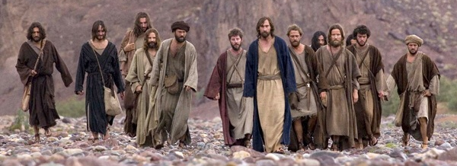
The Great Commission
The Mission of Every Church and Every Believer
Matthew 28:19-20
A Church that Makes Multiplying Disciples
Lesson 1
Workshop 4 page
Notes:
A Church that Makes Multiplying Disciples
Lesson 1
In Workshop 1 you learned how individuals can make multiplying disciples with Foundations material.
The Great Commission
The Mission of Every Church and Every Believer
Matthew 28:19-20

Slide 4
Jesus’ Plan
“Multiplying Disciples”
Model (John 20:21)
Example (2 Timothy 2:2)
Jesus
Paul
12 Disciples
Multiply
Timothy
Obedient Christians
(Disciples)
Faithful Men
(Disciples)
All
Nations
Others
Also
Notes:
Jesus’ Plan
“Multiplying Disciples”
Jesus trained 12 disciples for 3 years to make multiplying disciples just as He did
and reach all nations
Paul is an example of obeying the Great Commission
as he trained Timothy
to train faithful men
who would teach others also
and finish the Great Commission.

Slide 5

Great Commission Timeline
Acts 1
Jn 20
Matt 28
Mark 16
Luke 24
3
Days
40 Days
Ascension
Resurrection
Given 5 times
After His resurrection
Crucifixion
Notes:
Great Commission Timeline
Jesus trained 12 disciples for 3 years to accomplish the mission
Jesus gave the Great Commission 5 times after His resurrection
Whatever Jesus said after His death and resurrection with such repetition
must motivate us to obedience.

Slide 6
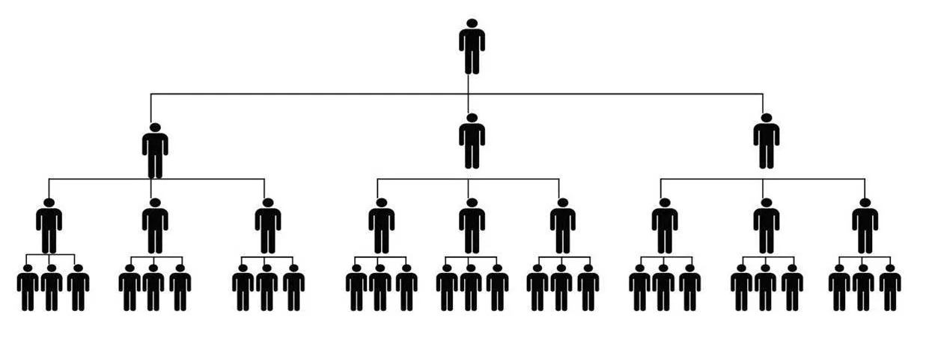

The Great Commission
Matthew 28:19-20
What
Make disciples who multiply
Where
All Nations
Notes:
Matthew 28:19-20
What we are to do:
Make disciples who multiply: As defined by Jesus using Jesus’ process.
Where we are to do it:
All Nations: All nationalities (No discrimination), the entire world.

Slide 7
The Great Commission
Matthew 28:19-20
How
As you go through life
Evangelism
Discipleship
Through the power of the Holy Spirit
Notes:
How we are to do it:
Go: As you go through life, wherever you are
Baptizing: Discipleship starts with Evangelism
Leading people to faith in Christ.
Teaching obedience to all of Jesus’ commands: Discipleship.
Maturing in all of the ingredients of a disciple.
I am with you always: Make disciples through the power of the Holy Spirit

Slide 8
Foundations Discipleship Process
Evangelism | Discipleship
1. Come | 2. Grow | 3. Serve | 4. Go
Worship Fellowship | God’s Word Prayer | Service | Outreach
Notes:
Foundations Discipleship Process
Jesus used four distinct training phases to make His disciples and we do the same thing.
We follow a process of
Come (Evangelism)
Grow-Serve-Go (Discipleship)
Ingredients of a disciple of Jesus
From the Great Commandment and the Great Commission
Worship, Fellowship, God’s Word, Prayer, Service, and Outreach
This figure shows how all of the ingredients of a disciple are included in the discipleship process.

Slide 9
16,000
Power of Multiplication
4,000
Disciples
512
128
16
1
4
1
5
10
15
Years
Notes:
Power of Multiplication
Utilize apprenticeship to multiply
Every Foundations leader should identify at least one person
who they are spending extra time with
to train them to become a Foundations leader
One disciple multiplying every year will make 16,000 disciples in 15 years

Slide 10
Multiply Disciples by Apprenticeship
8. Ongoing Training
7. Leader
6. Co-Leader
Apprentice Process
5. Observe & Coach
4. Initial Training
3. Observe You
2. Choose
1. Model
Notes:
Multiply Disciples by Apprenticeship
Model how to lead Foundations
Choose the right people
Only a few people have the gifts, abilities, and calling to be Foundations leaders.
They understand this is about life change
They are: Faithful, Available, Teachable, and Responsive
Ask the potential apprentice to observe you lead
Initial Leader Training using the “Foundations Leader Training Guide”
Observe and Coach them leading several sections of Foundations
Go through the Pre-Meeting Reminders with them before the meeting
Observe them as they lead
Coach them afterward using the Post-Meeting Evaluation
Ask them to be a co-leader
Allow them to lead on a regular basis
Observe and coach them using the Foundations Meeting Checklist
Do this until you think they are ready to lead
Ask them to be the leader of Foundations
Ongoing training with other Foundations leaders

Slide 11
How to Reach
Your Community, City, and Country for Christ
Reach your community by becoming a church that makes multiplying disciples
Reach your city for Christ by planting churches that make multiplying disciples
Reach your country for Christ by training other pastors how to teach these workshops
Notes:
B. This workshop is to train pastors and leaders how their churches can make multiplying disciples to reach your community, city, and country for Christ.
1. Reach your community by becoming a church that makes multiplying disciples
• Start multiplying Foundations discipleship groups
• Make sure all ministries are helping to make multiplying disciples
2. Reach your city for Christ by planting churches that make multiplying disciples
• Grow churches by multiplying Foundations groups until there is enough support to start a new church
3. Reach your country for Christ by training other pastors how to teach these workshops
• Pastors train other pastors until every city and community has been reached for Christ

Slide 12
Implementation from Previous Workshops
You are:
Making multiplying disciples by apprenticeship
Creating and implementing goals for personal and ministry life
Training people how to do Bible study
Notes:
C. Assumptions for what you are implementing from what you learned in previous workshops
Workshop 1: You have passion for and are discipling your leaders in a Foundations group and training them with the apprenticeship process how to make multiplying disciples in Foundations groups.
Workshop 2: You are committed to having goals and are creating and implementing goals for your personal and ministry life.
Workshop 3: You are growing in your love for God’s Word and are training people how to do personal Bible study

Slide 13
Elements of a Church
that Makes Multiplying Disciples
Normal church strategy
  Mainly events and short-term programs
  Does not make multiplying disciples
vs
Jesus’ strategy
  Up close, personal, and over time
  Includes a process and ingredients
  Makes multiplying disciples
Notes:
II. Elements of a Disciplemaking Church
If we want to understand the elements that your church must have
in order to become a disciplemaking church,
we need to understand Jesus’ strategy
as opposed to the strategy most churches use.
Normal church strategy
Mainly events and short-term programs
Does not make multiplying disciples
vs
Jesus’ strategy
Up close, personal, and over time
Includes a process and ingredients to help people grow to become like Jesus
Makes multiplying disciples
To achieve the results Jesus wants for us,
we must be patient and take the time needed to make multiplying disciples.

Slide 14
1. Train Foundations Discipleship Leaders
This is the area most churches struggle with
Leaders who have not been trained to make multiplying disciples cannot make multiplying disciples
This is the most critical element in making multiplying disciples
Notes:
1. Train Foundations Discipleship Leaders
Having leaders trained to make multiplying disciples is the area most churches struggle with.
Leaders who have not been trained to make multiplying disciples cannot make multiplying disciples.
This is the most critical element in making multiplying disciples.

Slide 15
1. Train Foundations Discipleship Leaders
12-18 Months
Review “Foundations Leader Training Guide”
Start a Foundations group with potential leaders
Train Foundations leaders by apprenticeship
Notes:
Train Foundations Discipleship Leaders
Pastors should do the following to start creating disciplemaking leadership in their church:
Review:
“Multiply Disciples by Apprenticeship”
and “How to Lead a Foundations Meeting”
in the “Foundations Leader Training Guide”
Start the first Foundations Group with people you think have the potential to become Foundations leaders
Train Foundations leaders by apprenticeship

Slide 16
Before someone can lead Foundations, they will:
Have the spiritual gifts, abilities, and calling to lead Foundations
Have been trained in the “Foundations Leader Training Guide”
Have completed the apprenticeship process (12-18 months)
Notes:
Before someone can lead Foundations, they will:
Have the spiritual gifts, abilities, and calling to lead Foundations
Have been trained in the Foundations Leader Training Guide
Have completed the apprenticeship process (12-18 months)

Slide 17
2. Start Foundations Groups
in the Whole Church
After a 4-week sermon series,
start Foundations groups in the whole church
Start Foundations groups in the whole church
4 Weeks
Notes:
2. Start Foundations Groups in the Whole Church
After 12-18 months you will have trained enough Foundations leaders
and can begin the process of involving all of your church members
in being a church that makes multiplying disciples.
Don’t start your Foundations groups in the whole church until you have enough trained Foundations leaders
After a 4-week sermon series, you will start Foundations groups in the whole church.

Slide 18
3. Multiply by Apprenticeship
Continue growing your church by making multiplying disciples through apprenticeship
Notes:
3. Multiply by Apprenticeship
After starting Foundations groups in the whole church, you will have everything in place
To continue growing your church by making multiplying disciples through apprenticeship.
An essential aspect of a church that makes multiplying disciples is that
Foundations leaders train apprentices.
An apprentice is someone who is learning
to become a Foundations leader.

Slide 19
4. Manage the Church that Makes Multiplying Disciples
The primary job of the pastor
Train and manage leaders
to do the work of the ministry
Notes:
4. Manage the Church that Makes Multiplying Disciples
After starting Foundations groups in the whole church, you will have to manage the church structure that makes multiplying disciples
The primary job of the pastor is to train and manage leaders to do the work of the ministry.
As your church grows, you will need to develop more leaders.

Slide 20
Elements of a Church
that Makes Multiplying Disciples
1. Train Foundations Discipleship Leaders
12-18 Months
2. Start Foundations Groups
in the Whole Church
4 Weeks
3. Multiply by Apprenticeship
4. Manage the Church
that Makes Multiplying Disciples
Notes:
Summary
First start a Foundations group with potential leaders
And train Foundations leaders by apprenticeship
Then you go through a process of involving all of the church members in becoming a church that makes multiplying disciples
And start Foundations groups in the whole church
Then you continue to grow your church by multiplying disciples through apprenticeship
And train and manage leaders to do the work of the ministry

Slide 21
Process of Becoming a Church
that Makes Multiplying Disciples
Trained Foundations leaders invite people to be in their new Foundations groups
Pastor prepares 4 sermons on discipleship
Begin 4-week sermon series
  Announcement and testimony
  Foundations leaders with sign-up sheets
  Start Foundations Groups in the Whole Church
Notes:
III. Process of Becoming a Church that Makes Multiplying Disciples
After the pastor has trained Foundations leaders by apprenticeship,
you can begin process of making multiplying disciples in Foundations Groups in the whole church.
Trained Foundations leaders start inviting people to be in their new Foundations Groups
Pastor prepares 4 sermons on discipleship. You can adapt the “Four Sermons on Discipleship” examples under Workshop 4 “Additional Resources for this Workshop” on foundationsglobal.com to fit your church situation.
Begin the 4-week sermon series
Have an announcement and a testimony from a member of your Foundations group every service
Foundations leaders will be ready with sign-up sheets after each service
Start Foundations Groups at the end of the sermon series

Slide 22
Periodically have Sunday services
devoted to start new Foundations groups
The service will include
  An announcement
  A testimony of life change
  A sermon on discipleship
A healthy church
makes multiplying disciples
Notes:
As your church grows and you have more trained Foundations group leaders,
you will periodically have Sunday services devoted to starting new Foundations groups.
The service will include:
An announcement that Foundations small groups are starting
and group leaders with sign-up sheets are available after the service.
A testimony by someone whose life has been changed by being in a Foundations group
A sermon on discipleship and a challenge to join a Foundations group
The leaders for the new Foundations groups should also be inviting people to be in their group.
The health of your church will be determined by the ability of your church to continue to make multiplying disciples.
Study and apply:
“How to Manage Change to Become a Disciplemaking Church”
at foundationsglobal.com,
“Other Discipleship Resources”

Slide 23
Form groups of 2 to 5 people
Discuss the 4 elements
What is required for a person to lead a Foundations group?
How will you implement this in your church?
Elements of a Church
that Makes Multiplying Disciples
Train Leaders to Make Multiplying Disciples
Start Foundations Groups in the Whole Church
Multiply by Apprenticeship
Manage the Church that Makes Multiplying Disciples
Notes:
Form groups of 2 to 5 people
Discuss the 4 elements of a church that makes multiplying disciples
What is required for a person to lead a Foundations group?
How will you implement this in your church?
What comments or questions do you have?
Elements of a Church
that Makes Multiplying Disciples
Train Leaders to Make Multiplying Disciples
Start Foundations Groups in the Whole Church
Multiply by Apprenticeship
Manage the Church that Makes Multiplying Disciples

Slide 24
How to Create and Lead a
Foundations Leader Team
Lesson 2
The core of a ministry that makes multiplying disciples is the Foundations Leader Team
God will use this team to grow your church Jesus’ way
8
Notes:
How to Create and Lead a Foundations Leader Team
Lesson 2
I. Introduction
Just like leadership is the core of your church,
the core of a ministry that makes multiplying disciples is the Foundations Leader Team
The Foundations Leader Team is made up of people
who care about discipleship
and want to see the church grow Jesus’ way.
God will use this team to build your church.

Slide 25
Foundations leaders partner with you
to do the most important work in your church
They are training disciples
  to find their place of ministry in your church
They are multiplying by apprenticeship
  and reaching your community for Christ.
Notes:
Foundations leaders partner with you to do the most important work in your church.
They are training your people to be disciples
and find their place of ministry in your church.
They are multiplying by apprenticeship
and reaching your community for Christ.

Slide 26
Forming Your Foundations Leader Team
Members of the Foundations Leader Team
  Foundations leaders
  Foundations apprentices who will become Foundations leaders
8
Notes:
II. Creating Your Foundations Leader Team
The team is made up of existing Foundations group leaders
and apprentices who are future Foundations group leaders.
When you are first starting your Foundations ministry,
this leadership team will be small,
and will grow as you continue to train new leaders through apprenticeship.

Slide 27
Look for leaders who are faithful, available, teachable, and responsive
People will be added to the team when they become co-leaders in Foundations groups
8
Notes:
Look for leaders who are faithful, available, teachable, and responsive
The apprentices in your first Foundations group
will be the first members of the Foundations Leader Team.
Future people will be added to the team
when they become co-leaders in Foundations groups
in the apprenticeship process to become leaders

Slide 28
Foundations leaders continue to mature
in all of the ingredients of a disciple
In the Foundations Leader Team
Worship: Praise and thanksgiving
Fellowship: Intimacy, authenticity, accountability
God’s Word: Application to be more like Jesus
Prayer: Intimate relationship with God
Service: Give time, talent, treasure, selves
Outreach: Make multiplying disciples
Notes:
Foundations leaders continue to mature
in all of the ingredients of a disciple
In the Foundations Leader Team
1. Worship - Growth in knowledge of our infinite God and praise for who He is and thanksgiving for what He has done
2. Fellowship - Intimacy and authenticity as we share our failures and victories, troubles and triumphs. Allow others we trust to speak into our lives and they allow us to speak into their lives. Have an accountability partner to help us become the person we want to be.
3. God’s Word - Understanding of God’s Word through a balanced intake by hearing, reading, studying, memorizing, and meditating. Application of God’s Word so we are becoming more like Jesus.
4. Prayer - An intimate relationship with our loving Heavenly Father as we continue to grow in our ability to communicate with Him.
5. Service - Joy as we learn to serve our Heavenly Father for the right reasons and not out of obligation. Joy as we give God our time, talent, treasure, and ourselves.
6. Outreach - Finishing the Great Commission as we develop relationships with people, lead them to Christ, disciple them, and train them to make disciples.

Slide 29
Foundations Leader Team Meetings
Receive mutual encouragement
See progress of Foundations Ministry
Ongoing training
Deal with problems
Notes:
III. Foundations Leader Team Meetings
The Foundations Leader Team meetings are important.
In the meetings Foundations Leaders:
Receive mutual encouragement
See the progress of the Foundations ministry in your church
Receive ongoing training
Deal with any problems in the Foundations groups.
It’s critically important that you as the leader of this team are prepared to lead these meetings.
We are not just training them in leadership but spiritual leadership.
The Foundations Leader Team should meet once a month.

Slide 30
Elements of a Foundations
Leader Team Meeting
Vision
Continuing Growth as a Disciple
Ongoing Leadership Training
9
Notes:
IV. Elements of a Foundations Leader Team Meeting
There are two examples of Foundations Leader Team meetings in the Appendix
The elements of the Foundations Leader Team meeting are
Vision,
Continuing growth as a Disciple,
and Ongoing Leadership Training.

Slide 31
Vision
  Open in prayer
  Share stories of life change
  Review the Foundations Essentials
    Teach one of the essentials in depth
  Periodically share the numerical progress
9-10
Notes:
A. Vision
Open in prayer.
Share stories of life change in the Foundations Groups since the last meeting.
Review the Foundations Essentials at every meeting
Teach one of the Foundations Essentials in depth
Periodically share the numerical progress of multiplication
Number of Foundations Groups and people in groups
Number of Foundations Group leaders and apprentices
Number of people discipled so far

Slide 32
Foundations Essentials
Jesus’ Goal: Finish the Great Commission
Jesus’ Method: Make multiplying disciples
Jesus Model: Train leaders by apprenticeship
Material
  Foundations Discipleship Material
  Foundations Leader Training Guide
God is the teacher
  Ask questions, don’t lecture
Notes:
Foundations Essentials
Jesus’ Goal: Finish the Great Commission
Jesus’ Method: Make multiplying disciples
Jesus Model: Train leaders by apprenticeship
Initial training with the Foundations Leader Training Guide
Apprenticeship
Ongoing training in the Foundations Leader Team
Material
Foundations Discipleship Material
Follows Jesus’ process of sequential learning
Come, Grow, Serve, Go
Includes all of the ingredients of a disciple
(“obey everything I have commanded you”)
Worship, Fellowship, God’s Word, Prayer, Service, Outreach
Foundations Leader Training Guide
God is the teacher
We facilitate discussion by asking questions, we don’t lecture.
We help people self-discover and apply God’s Word to their lives

Slide 33
Periodically celebrate the progress
of multiplication in the Foundations Ministry
31 Leaders
Example
Foundations Leader Team
20 Apprentices
Unbelievers
260+ Disciples
Foundations Groups
Other Ministries
17 Current Groups
173 People in Foundations Groups
Notes:
This is a real example of the Foundations Ministry in a church after 6 years
There were currently 17 Foundations Groups
with 173 people in Foundations Groups
Over 260 people had been discipled in Foundations Groups
with most of the disciples becoming involved in the church ministries
There were 31 Foundations leaders and 20 apprentices in the Foundations Leader Team
Multiplication by apprenticeship is occurring and the church is growing

Slide 34
Continuing Growth as a Disciple
Continued growth in all of the ingredients of discipleship
Study a book of the Bible together
Hold each other accountable to become more like Jesus
Teach some of the material in this workshop and other workshops
10
Notes:
B. Continuing Growth as a Disciple
Choose a subject that you think is most needed to help your Foundations leaders grow.
Continued growth in all of the ingredients of discipleship (Worship, fellowship, God’s Word, prayer, service, outreach)
Study a book of the Bible together
Hold each other accountable to apply God’s Word to your lives to become more like Jesus
Teach some of the material in this workshop and other workshops such as:
Prayer
Leading a balanced Christian life
Setting goals for personal development
Having an accountability partner

Slide 35
Ongoing Leader Training
Leaders share problems in their groups
Teach some of the material in this workshop and other workshops
Teach some of the “Other Discipleship Resources” from foundationsglobal.com
Review topics from the “Foundations Leader Training Guide”
10
Notes:
C. Ongoing Leader Training
Choose a topic that you think is most needed to help your Foundations leaders be better leaders.
Have the leaders share any problems they are having in their Foundations Group
Have the group brainstorm solutions to the problems
Teach some of the material in this workshop and other workshops
Teach some of the “Other Discipleship Resources” from foundationsglobal.com
Review topics from the “Foundations Leader Training Guide”

Slide 36
Foundations Leader Training Guide Topics
How to lead Foundations Groups Foundations Meeting Checklist Foundations Essentials The Great Commission Cost of discipleship Benefits of discipleship Spiritual Growth Plan Apprenticeship process Power of multiplication
Notes:
Foundations Leader Training Guide Topics
How to lead Foundations Groups
Make sure everyone is using the Foundations Meeting Checklist
Provide deeper training in elements of the Foundations Essentials
Review the teaching on the Great Commission
Study the cost of discipleship and the benefits of discipleship
Review the Spiritual Growth Plan
Review the apprenticeship process
Teach the power of multiplication

Slide 37
In your groups
Discuss the Foundations Leader Team
  Vision
  Continuing Growth as a Disciple
  Ongoing Training
How will training leaders help the pastor?
Notes:
In your groups
Discuss the Foundations Leader Team
Vision
Continuing Growth as a Disciple
Ongoing Training
How will training leaders help the pastor?
What comments or questions do you have?

Slide 38
How to Evaluate Your Ministries
Lesson 3
Make sure your ministries are essential to the mission of your church
    To make multiplying disciples
You will probably discover ministries that need to be
    Eliminated
    Changed
    Added
Notes:
How to Evaluate Your Church Ministries
Lesson 3
I. Introduction
It is the responsibility of the pastor to make sure that discipleship affects every area of the church.
You will now evaluate your ministries to make sure they are essential to the mission of your church
To make multiplying disciples
You will probably discover ministries that need to be
Eliminated
Changed
And Added

Slide 39
Why Evaluating Ministries is Necessary
It is very difficult to get people
involved in making multiplying disciples
because of all the other ministries
they are involved in
Notes:
II. Why Evaluating Ministries is Necessary
In training pastors around the world to have a disciplemaking church,
the pastors have shared that it is very difficult to get people involved in making multiplying disciples
because of all of the other ministries they are involved in.

Slide 40
Many ministries had a good reason to be started but have become ineffective
You must choose between
  running your church the way you have been
  or having a church that makes multiplying disciples
Notes:
Several things are very clear.
Many ministries had a good reason to be started but have become ineffective
You must choose between
running your church the way you have been
or having a church that makes multiplying disciples

Slide 41
Excuses for not eliminating programs
Most churches are program driven
People will complain or leave if programs are removed
These pastors believe these things
despite their lack of progress
and despite the clear teaching of the Word of God
Notes:
Here are some excuses pastors have for not reducing the number of programs in their church:
Some pastors think that since most churches are program driven that
it must be a good thing and that we must find a way to have many church programs and make multiplying disciples.
Still other pastors are not willing to pay the price of some of their people complaining or leaving
if they remove some programs in order to make disciples.
These pastors believe these things
despite their lack of progress
and despite the clear teaching of the Word of God.

Slide 42
Many ministries continue because of tradition
We do them even though they have lost their intended purpose
Jesus speaks very strongly against valuing traditions above obedience
“You have let go of the commands of God and are holding on to human traditions”
Mark 7:8
Notes:
Many ministries continue because of tradition.
We do them because we have always done them
and they seem right even though they have lost their intended purpose.
Jesus and others in the Bible speak very strongly against valuing traditions above obedience. Look at what Jesus said:
“ You have let go of the commands of God and are holding on to human traditions.” Mark 7:8
Jesus was very angry that the spiritual leaders were forcing the people to practice traditions and not obey God.

Slide 43
Some argue that it’s ok to keep the program that they are involved in
  Even though it has become ineffective
But it is not ok
God tells us that partial obedience is the same as disobedience
  Partial obedience cost Saul the kingship (1 Samuel 15)
Notes:
Some church members will argue that it’s ok to keep the program that they are involved in even though it has become ineffective.
But it is not ok.
God tells us in His Word that partial obedience is the same as disobedience
Partial obedience cost Paul the kingship
In 1 Samuel 15:
King Saul was given specific instructions by God and he had a great victory.
But when the Prophet Samuel approached Saul and rebuked him for being disobedient, Saul gave excuses.
God gave King Saul the following response through the Prophet Samuel:
“Does the Lord delight in burnt offerings and sacrifices as much as in obeying the voice of the Lord? To obey is better than sacrifice, and to heed is better than the fat of rams. For rebellion is like the sin of divination, and arrogance like the evil of idolatry. Because you have rejected the word of the Lord, He has rejected you as king.” 1 Samuel 15:22-23
Yes, partial obedience is disobedience and it cost Saul the kingship

Slide 44
The Apostle Paul confronted the Christian leaders in Jerusalem (Acts 15)
  and even the Apostle Peter (Galatians 2)
  who were imposing traditions on the church
Notes:
The Apostle Paul faced the Christian leaders in Jerusalem in Acts 15
and even the Apostle Peter
who were imposing traditions on the church
but Paul would not compromise the truth for even a moment.
In Galatians 2:5, 11 The Apostle Paul wrote:
“We did not give in to them for a moment,
so that the truth of the gospel might remain with you.
When Peter came to Antioch, I opposed him to his face,
because he was clearly in the wrong.”

Slide 45
Basis for Evaluating Church Ministries
The Apostle Paul told us
  The mission of the church is to make disciples
  How the church should make disciples and grow
    numerically and spiritually (Ephesians 4:15-16)
The whole church must be involved in the single mission of making disciples
Each part must be working properly for the single mission of making disciples
Notes:
III. Basis for Evaluating Church Ministries
The Apostle Paul not only told us the mission of the church,
he told us how the church should function to accomplish the mission in Ephesians 4:15-16.
“we are to grow up in every way into him who is the head, into Christ, from whom the whole body, joined and held together by every joint with which it is equipped, when each part is working properly, makes the body grow so that it builds itself up in love.” Ephesians 4:15-16
The mission of the church is to make disciples (Help people grow to become like Jesus)
These verses also tell us how the church should make disciples and grow numerically and spiritually (Evangelism and Discipleship).
How does this ministry help us make multiplying disciples?
Is this ministry working properly to help us make multiplying disciples?

Slide 46
Every ministry must be evaluated for two things
How does this ministry help us make multiplying disciples?
Is this ministry working properly to help us make multiplying disciples?
Notes:
Your church structure is very important
if you want to accomplish the mission that God gave the church.
Every ministry in your church must be evaluated for two things.
How does this ministry help us
make multiplying disciples?
Is this ministry working properly to help us
make multiplying disciples?

Slide 47
There are many good things a church can do,
  but these good things impede us from accomplishing our mission
  if they aren’t helping us accomplish it
These ministries
must be fixed or terminated
Notes:
Ministries that don’t have a role in making multiplying disciples should never be started or should be stopped.
There are many good things a church can do,
but these good things impede us from accomplishing our mission
if they aren’t helping us accomplish it.
Some ministries start out well in helping the church accomplish its mission,
but then they quit working properly to accomplish their intended purpose.
These ministries must be fixed or terminated.

Slide 48
Church Ministries
All Ministry Leaders and Workers
should be discipled in Foundations
Notes:
Church Ministries
All of the Ministry Leaders and Ministry Workers should be discipled in Foundations.

Slide 49
Church Ministries
Outreach Ministries
Stage of Life Ministries
Adult Topical Classes
Care Ministries
Recovery Ministries
Service Groups
Worship Team
Notes:
Here is a summary of the different types of church ministries:
Outreach Ministries.
These are groups to attract unbelievers, to develop relationships, and for them to come to faith in Christ.
These are groups like sports teams,
special interest groups
like marriage training, child raising training, financial management, etc.
Stage of Life Ministries.
Children, youth, women, men, and singles
Adult Topical Classes.
Short term classes such as how to study the Bible.
Care Ministries.
To the poor and needy.
Recovery Ministries.
To alcoholics, drug addicts, etc.
Service Groups.
These are groups like ushers and greeters, long term committees,
and your board of elders or whatever you call your lay leadership team.
Worship Team.
Singers and musicians.

Slide 50
The Problem with Church Ministries
Churches die every day because their ministries became inwardly focused
Other churches add so many ministries
that evangelism and discipleship
become part of a list of ministries
rather than the purpose of the church
Notes:
The problem with church ministries is that they can become inwardly focused
and can get you off target of making multiplying disciples.
Churches die every day
because their ministries became inwardly focused,
the church stopped growing and got smaller,
and then ceased to exist.
Other churches add so many ministries
that evangelism and discipleship
become part of a list of ministries
rather than the purpose of the church.

Slide 51
Summary
Ministries that do not make disciples take away resources that could be used to make disciples
Many churches have ministries that have turned into traditions
Jesus, Samuel, Paul, and others in the Bible hated when tradition replaced obedience to God
Ministries that don’t have a role in making multiplying disciples must be fixed or terminated
You must evaluate your ministries every year
Notes:
In summary:
Ministries and activities that do not have a role in making disciples
take away the resources of time, manpower, facilities, and money that could be used to make multiplying disciples
Many churches have ministries that have turned into traditions that seem right
but have lost their intended purpose
or their purpose can better be met through the disciplemaking process
Jesus, Samuel, Paul, and others in the Bible hated partial obedience
and hated replacing obedience to God with obedience to tradition
(The way we’ve always done things)
Ministries that don’t have a role in making multiplying disciples
must be fixed or terminated.
You must evaluate your ministries every year
to make sure they are essential to your mission
to make multiplying disciples
to finish the Great Commission

Slide 52
In your groups
Discuss why it is important to evaluate the effectiveness of your ministries
Notes:
In your groups
Discuss why it is important to evaluate the effectiveness of your ministries.
What comments or questions do you have?

Slide 53
Evaluate Existing Ministries
Ministries for the disciplemaker pathway are included as examples
These ministries include every Ministry Objective
Example
Existing Ministry Evaluation
Ministries | Review | Ministry Objective
 |  | Unbeliever | Believer | Worker | Leader
Foundations Come |  | X
Foundations Grow-Serve-Go |  |  | X
Foundations Apprentice Training |  |  |  | X
Foundations Leader Team |  |  |  |  | X
Notes:
IV. Evaluate Existing Ministries
We have included the ministries for the Foundations discipleship ministry as examples
You can see how these ministries are designed to include every Ministry Objective

Slide 54
Existing Ministry Evaluation
Ministries | Review | Ministry Objective
 |  | Unbeliever | Believer | Worker | Leader
Foundations Come |  | X
Foundations Grow-Serve-Go |  |  | X
Foundations Apprentice Training |  |  |  | X
Foundations Leader Team |  |  |  |  | X
Adult Sunday School |  |  | X
Weekly Prayer Meeting |  |  | X
Women’s Bible Study |  |  | X
Men’s Bible Study |  |  | X
Soccer Team | X |  | X
TOTAL |  | 1 | 6 | 1 | 1
Example
Example
Many churches have an imbalance because they have too many ministries for believers
Notes:
Here is an example of what the existing ministries in a church might look like.
You can see in this example
that a majority of ministries of this church
are for Believers.
This church probably will not grow
and will eventually die
because it is not focused on equipping workers
and multiplying leaders to win unbelievers.
Most churches in the U.S. doing an evaluation
discover that 80-90% of their ministries are for believers
and they are neglecting all areas of a disciplemaking ministry.
Many churches have an imbalance
because they have too many ministries for believers

Slide 55
MINISTRY EVALUATION INSTRUCTIONS
Make a list of existing ministries
Determine the Ministry Objective for each ministry and place an “X” in the box
Place an “X” in the Review column by ministries that need to be considered for further review and evaluation.
Notes:
MINISTRY EVALUATION INSTRUCTIONS
Make a list of existing ministries.
Weekly, monthly, or yearly activities or programs
This is for existing ministries not for previous or planned ministries
2. Determine the Ministry Objective for each ministry and place an “X” in the box.
The Ministry Objective is for the people the ministry is helping
Mark just one for each ministry.
Select it as it is right now, not as it was in the past or will be in the future.
Ministry Objective Definitions:
Unbeliever – Unsaved people.
Believer – People who have accepted Christ as savior and need to be growing in their faith.
Worker – People who are serving in church ministries
Leader – People who lead others who are serving in church ministries
3. Place an “X” in the Review column by ministries that need to be considered for further review and evaluation.
These are ministries you feel are not as effective as they should be in accomplishing God’s purpose
It could be ministries you feel are not cost effective, which are redundant, etc.

Slide 56
Existing Ministry Evaluation
Ministries | Review | Ministry Objective
 |  | Unbeliever | Believer | Worker | Leader
Foundations Come |  | X
Foundations Grow-Serve-Go |  |  | X
Foundations Apprentice Training |  |  |  | X
Foundations Leader Team |  |  |  |  | X
TOTAL
Example
Notes:
Evaluate your existing ministries.

Slide 57
Further Review and Evaluation
Add the number of “X”s in each column
  Place the number in the “Total” row
See if you have the proper balance of ministries for the Ministry Objectives
Select the ministries that need to be reviewed and evaluated further
  Place an “X” in the “Review” column
Include ministries that may be ineffective or have their purpose better met through the Disciplemaker Pathway
Notes:
IV. Further Review and Evaluation
Add the number of “X”s in the Ministry Objective columns
and place the number in the “Total” row.
Now you can see if you have the proper balance of ministries for the Ministry Objectives
If there is an imbalance, select the ministries that need to be reviewed and evaluated further
and place an “X” in the Review Column
Also, include ministries which you believe may be ineffective or have their purpose better met through the Foundations discipleship ministry.

Slide 58
Ministry Audit Form
Ministry | Action
Soccer Team | Remove, Phase-out. No team next season. Created as an outreach ministry but there is no outreach. Uses financial and personnel resources that could be used in other outreach and discipleship ministries.
Example
Notes:
Ministry Audit Form Example
The ministry example that needs action is the church soccer team
The action needed is to remove this ministry by phasing it out by having no team next season
The reason for phasing out this ministry is that it was created as an outreach ministry but there is no outreach.
This ministry uses financial and personnel resources that could be used in other outreach and discipleship ministries.
Do you have any comments or questions about evaluating ministries?

Slide 59
List the ministries you think may need to be changed
Write in the action that is needed:
  Keep, Modify
  Keep, Probation
  Change Leader
Describe the action that is needed and the reason for the action
  Remove, Phase-out
  Remove, Immediate
Ministry Audit Form
Ministry | Action
Notes:
Fill out the Ministry Audit Form
List the ministries you think may need to be changed
Write in the action that is needed:
Keep, Modify
Keep, Probation
Change Leader
Remove, Phase-out
Remove, Immediate
Describe the action that is needed and the reason for the action
Ask any questions you have while you fill out the form
If you didn’t have time to finish, you can complete the Ministry Audit Form
for other ministries later.

Slide 60
In your groups
What did you learn when you evaluated your ministries?
What changes do you need to make to have a church that makes multiplying disciples?
Is your church service friendly to unchurched people?
Why is it important to evaluate your ministries once a year?
Notes:
In your groups
What did you learn when you evaluated your ministries?
What changes do you need to make in order to have a church that makes multiplying disciples?
Is your church service friendly to unchurched people?
Why is it important to evaluate your ministries once a year?
Do you have any questions?
Please share some of the things you talked about

Slide 61
Organizational Structure of a Church that Makes Multiplying Disciples
Lesson 4
After 2100 years, the Great Commission still has not been finished
Jesus’ plan started out well
  It was said of the early disciples
  they “have turned the world upside down”
  Acts 17:16
18
Notes:
Organizational Structure of a Church
that Makes Multiplying Disciples
Lesson 4
I. Introduction
After 2100 years, the Great Commission has still not been finished.
Jesus’ plan started out well.
It was said of the early disciplemakers in Acts 17:6,
they “have turned the world upside down”.

Slide 62
What happened?
Today our churches have many ministries:
    Worship services
    Preaching sermons
    Sunday school classes
    Revivals
    Many other activities
18
Notes:
What happened?
Today our churches have many ministries:
Worship services
Preaching sermons
Sunday school classes
Revivals
Many other activities

Slide 63
But God’s mission is left undone
or partially done
The mission of every church and every believer: Finish the Great Commission
Jesus’ method of finishing the Great Commission: Make Multiplying Disciples
18
Notes:
We have many good ministries
but God’s mission is left undone or partially done.
The mission of every church and every believer:
Finish the Great Commission
Jesus’ method of finishing the Great Commission:
Make Multiplying Disciples

Slide 64
Church Structure Comparison
Typical Church Structure
Few Unbelievers
Few Disciples
Church Ministries
Church that Makes Multiplying Disciples
Many
Unbelievers
Many
Disciples
Discipleship Focus
Notes:
Now you will learn how to integrate the Foundations discipleship ministry into your church structure.
Church structure is defined as the effective organization of church ministries to produce multiplying disciples.
This figure shows that a church with a typical structure
attracts few unbelievers
and makes few disciples,
but a church that makes multiplying disciples
attracts many unbelievers,
and makes many disciples

Slide 65
Church Structure
that Makes Multiplying Disciples
Foundations
Leaders
Unbelievers
Disciples
Ministry
Workers
Foundations
Ministry
Leaders
Notes:
II. Church Structure that Makes Multiplying Disciples
It is the responsibility of the pastor to make sure that all ministries are working together to make multiplying disciples.
Unbelievers accept Christ and become disciples of Christ with Foundations
Trained Foundations Leaders invest in relationships with unbelievers
And disciple them one-on-one or in a group with Foundations
Most of the disciples become Ministry Workers
Some of the disciples become Ministry Leaders
Some of the disciples become Foundations Leaders
Depending on their gifts, abilities, and calling

Slide 66
Foundations Discipleship Ministry
Foundations Leader Team
Apprentice Foundations Leaders
Foundations Leaders
Unbelievers
Disciples
Foundations
Notes:
Foundations Discipleship Ministry
Some of the disciples become Apprentice Foundations Leaders
Receive initial training and are apprenticed by their Foundations Leader
Join the Foundations Leader Team with other Foundations Leaders
for ongoing training, vision, and continued growth.
The pastor leads the Foundations Leader Team
Then they become Foundations Leaders and make multiplying disciples
Look at Lesson 2 for ideas on how to provide training for the Foundations Leaders

Slide 67
Other Ministries
Ministry Workers
Church Ministries
Disciples
Ministry Leaders
Apprentice Ministry Leaders
Ministry
Leader Team
Notes:
Other Ministries
Most of the disciples will become Ministry Workers in the ministries of the church
Some of the disciples will become Apprentice Ministry Leaders
Receive initial training and are apprenticed by their Ministry Leader
Join the Ministry Leader Team with other Ministry Leaders
for ongoing training,
vision for making disciples,
and continued growth as a disciple
The pastor leads the Ministry Leader Team
Then they become Ministry Leaders and make multiplying Ministry Leaders
Look at Lesson 2 for ideas on how to provide training for the leaders and workers

Slide 68
Church Structure that Makes Multiplying Disciples
Foundations Leader Team
Foundations Leaders
Apprentice Foundations Leaders
Ministry Workers
Unbelievers
Disciples
Church Ministries
Foundations
Apprentice Ministry Leaders
Ministry Leaders
Ministry
Leader Team
Notes:
This figure shows how Foundations discipleship ministry is integrated into the church structure.
The yellow color is the Foundations discipleship ministry structure.

Slide 69
Finishing Foundations should be a requirement
  Ministry Workers
  Apprentice Ministry Leaders
  Apprentice Foundations Leaders
  and for membership in your church
The role of pastors is to prepare Christians to be involved in ministry
All ministries are working together to make multiplying disciples
Notes:
Finishing a Foundations Group should be a requirement for
Ministry Workers,
Apprentice Ministry Leaders,
Ministry Leaders
Apprentice Foundations Leaders,
and Foundations Leaders
Remember from Ephesians 4:11-12 that the role of pastors
is to prepare Christians to be involved in ministry.
All ministries are working together to make multiplying disciples.

Slide 70
In your groups
Why is proper church structure important?
Why is the Foundations discipleship ministry important?
What are some of the potential problems of church ministries?
What is the problem with having too many church ministries?
Why is training leaders and workers important?
Notes:
In your groups
Why is proper church structure important?
Why is the Foundations discipleship ministry important?
What are some of the potential problems of church ministries?
What is the problem with having too many church ministries?
Why is training leaders and workers important?
What comments or questions do you have?

Slide 71
Create a Church Structure that Makes Multiplying Disciples
Lesson 5
Include ministries needed to accomplish the mission of making multiplying disciples
Change and delete ministries based on your ministry evaluation
Notes:
Create a Church Structure that Makes Multiplying Disciples
Lesson 5
You will now create the organizational structure you need
in order to accomplish the mission of your church
to make multiplying disciples.
Make sure each ministry you include is needed to accomplish the mission.
You will probably have to change and delete some ministries
based on your ministry evaluation

Slide 72
Worship Services
When attendance grows to 80% of your seating
  Visitors may not come back
Possible solutions
  Add additional worship services
  Plant other churches
  Rent a larger space
Notes:
1. Worship Services
Every time your attendance grows to 80% of your available seating
you need to take action.
Visitors may not come back
if your church is too crowded.
Some possible solutions are:
You can add additional worship services
You can plant other churches
You can rent a larger space

Slide 73
Worship Services
Average weekly attendance: 80
Seating capacity for one worship service: 100
Current number of worship services: 1
Number of worship services needed: 2
Example
Notes:
Worship Services Example
In this example the average weekly church attendance is 80 people.
The seating capacity is 100.
They currently have 1 worship service.
Since this attendance is 80% of their capacity,
they should have 2 worship services.

Slide 74
1. Worship Services
Average weekly attendance: _____
Seating capacity for one worship service: ____
Current number of worship services: _____
Number of worship services needed: _____
Notes:
Fill in the table for your church.
Worship Services
Average weekly attendance at worship services: _______.
Seating capacity for one worship service: ________.
Current number of worship services: _________.
Number of worship services needed: _________.

Slide 75
Foundations Groups
Half of the adults are in Foundations Groups
Assume a church with 80 adults
Adults in Foundations groups: 40
Assume 10 adults in each group
Number of Foundations groups: 4
One leader and one apprentice for each group
Foundations Leaders: 4
Foundations Apprentices: 4
Example
Notes:
2. Foundations Groups Example
Assume half of the adults are in a Foundations Group
In this example:
A church with 80 adults
should have 40 adults in Foundations groups
Assuming 10 adults in each group,
4 Foundations groups are needed
4 Foundations leaders and 4 apprentices are needed
Foundations leaders have been trained through apprenticeship
to lead Foundations discipleship groups
Now fill in the numbers for your church

Slide 76
2. Foundations Groups
Assume half of your adults are in Foundations Groups
Adults in Foundations groups: ____
Assume 10 adults in each group
Number of Foundations groups: ____
One leader and one apprentice for each group
Foundations Leaders: ____
Foundations Apprentices: ____
Notes:
Now fill in the table for your church
Foundations Groups
Assume half of your adults are in Foundations Groups
Adults in Foundations groups: ____
Assume 10 adults in each group
Number of Foundations groups: ____
One leader and one apprentice for each group
Foundations Leaders: ____
Foundations Apprentices: ____

Slide 77
Foundations Leader Team
Most churches will need only one Foundations Leader Team
Notes:
3. Foundations Leader Team
Most churches will need only one Foundations Leader Team.
Only very large churches will need more than one Foundations Leader Team.
You will need to add a new Foundations Leader Team
when any team reaches 15 leaders.

Slide 78
Church Structure that Makes Multiplying Disciples
Foundations Groups | Foundations Leaders | Foundations Apprentices
 | 4 | 4
Other Ministries | Ministry Leaders | Ministry Workers
Children | 1 | 4
Youth | 1 | 2
Worship Team | 1 | 6
Ushers and Greeters | 1 | 4
Board of Elders | 1 | 4
Total | 9 | 24
Example
Notes:
Here is an example of the structure of a church with 80 adults that makes multiplying disciples.

Slide 79
Church Structure that Makes Multiplying Disciples
Foundations Groups | Foundations Leaders | Foundations Apprentices
Other Ministries | Ministry Leaders | Ministry Workers
Total
Notes:
Based on your ministry evaluation, create the structure you need to have a church that makes multiplying disciples.
Fill in the number of Foundations Leaders and Apprentices in the table
Fill in the needed Church Ministries based on your ministry evaluation
Examples of Church Ministries are: Pre-school/Elementary, Jr. and Sr. High School, Ushers and Greeters, Outreach Groups, Worship Team, Board of Directors, Newcomer Class, Care Ministry, Adult Topical Class.
Fill in the number of Ministry Leaders and Ministry Workers needed.
Please ask any questions you have while you fill out the table
This table shows what the organizational structure of your church should look like in order to be a church that makes multiplying disciples.

Slide 80
How to Reach Your City for Christ
Lesson 6
Plant churches that have
multiplying Foundations groups
Notes:
How to Reach Your City for Christ
Lesson 6
I. Introduction
So far in this workshop we have been looking at how to effectively expand the Kingdom of God in your community by making multiplying disciples.
Now we will look at how to expand the Kingdom of God in your city by planting churches that have multiplying Foundations groups.

Slide 81
Principle of Church Growth (Mark 4)
The kingdom of God is as if a man should scatter seed on the ground
  The seed sprouts, grows, and multiplies
  He knows not how
Notes:
II. Principle of Church Growth
Jesus told a parable about growth of the Kingdom of God in Mark 4 using a farming analogy.
“The kingdom of God is as if a man should
scatter seed on the ground.
the seed sprouts, grows, and multiplies
he knows not how.

Slide 82
Parable of the Sower
Our Role
Prepare the soil | Invest in relationships
Sow the seed The seed sprouts | Share the gospel New life is born
Tend the crop The crop grows | Help people grow spiritually Disciples are made
The seeds multiply The Harvest | Disciples multiply The Great Commission is finished
God’s Role: Cause the Growth
Notes:
This parable describes man’s role and God’s role in the growth of the kingdom of God.
God has chosen to use the church to grow His Kingdom,
so this parable is giving us a principle of church growth.
Parable of the Sower
Our Role
Prepare the soil Invest in relationships
Sow the seed Share the gospel
The seed sprouts New life is born
Tend the crop Help people grow spiritually
The crop grows Disciples are made
The seeds multiply Disciples multiply
The Harvest The Great Commission is finished
God’s Role: Cause the Growth

Slide 83
If we implement our role for the church effectively,
  God will cause our churches to grow
The opposite is also true
If we don’t implement our role for the church effectively,
  our churches won’t grow
Notes:
The spiritual truth here is that
If we understand our role for the church
and implement it effectively,
God will cause our churches to grow.
The opposite is also true.
If we don’t understand our role for the church
and we don’t implement it effectively,
our churches won’t grow.

Slide 84
The role of our churches is to
multiply disciples just as a seed multiplies,
not just add them
Notes:
The role of our churches is to
multiply disciples just as a seed multiplies,
not just add them

Slide 85
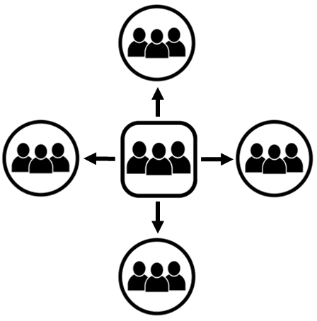
Planting Churches that Have
Multiplying Foundations Groups
1. Grow Your Present Church
Multiply Foundations Groups
to reach your current community for Christ
Notes:
III. Planting Churches that Have Multiplying Foundations Groups
Now you will use what you have learned to reach your city by planting churches tha have multiplying Foundations groups.
1. Grow Your Present Church
Multiply Foundations Groups to reach your current community for Christ.

Slide 86

2. Plant a New Church
Start a Foundations Group in a different community
The Foundations Group is the start of a New Church
The Foundations leader is the pastor of the New Church
Notes:
2. Plant a New Church
Pastor selects a Foundations leader and a few group members to start a Foundations Group in a different community.
The Foundations Group is the start of a New Church.
The Foundations leader is the pastor of the New Church.

Slide 87

3. Grow your New Church
Multiply Foundations Groups to reach
the new community for Christ.
1.
2.
3.
Notes:
3. Grow your New Church
Multiply Foundations Groups to reach the new community for Christ.

Slide 88
All churches continue to multiply
by planting new churches
following this pattern
DT
FG
NC1
FG
FG
Notes:
All churches continue to multiply
by planting new churches
following this pattern

Slide 89
New churches start as Foundations Groups meeting in homes.
Grow by multiplying Foundations Groups
  until you can rent space
  or buy land and build a church building
In some countries where there is persecution or poverty,
  it may be best to keep the church in houses
DT
FG
NC1
FG
FG
Notes:
Your new churches start as Foundations Groups
meeting in homes.
You then grow your church
by multiplying Foundations Groups
by apprenticeship
until you can rent space for your worship services
or buy land and build a church building.
In some countries where there is persecution or poverty,
it may be best to keep the church in houses.

Slide 90
You can’t rush growth
You will reach your city in a reasonable length of time by multiplying Foundations Groups
Growth by addition hasn’t worked yet to reach your city
  and it never will
Notes:
You can’t rush growth.
You must have trained Foundations leaders to grow your church and reach your city for Christ,
and it takes time to train Foundations leaders.
You will reach your city for Christ in a reasonable length of time
by multiplying Foundations Groups by apprenticeship
Growth by addition hasn’t worked yet to reach your city
and it never will.

Slide 91
  In your groups
  Talk about the principle of church growth
  God wants you to make multiplying disciples just as a seed multiplies,
    not just add them
  Talk about how you can plant churches by multiplying Foundations groups
Notes:
In your groups
Talk about the principle of church growth from Mark 4.
God wants you to make multiplying disciples just as a seed multiplies,
not just add them
Then God will cause your church to grow
Also talk about how you can plant churches by multiplying Foundations groups
What questions or comments do you have?

Slide 92
How to Reach Your Country for Christ
Lesson 7
Problems Our Training Will Solve
1. Problem – Pastors are over-worked
Pastors are too busy doing ministry tasks
Solution – Train church members to do the work of the ministry
We have seen that this is God’s will from Ephesians 4:11-13
Notes:
How to Reach Your Country for Christ
Lesson 7
I. Problems Our Training Will Solve
1. Problem – Pastors are over-worked
Pastors are too busy doing ministry tasks.
Pastors prepare sermons, preach, teach, go on visitation, and are involved in many other activities.
Solution – Train church members to do the work of the ministry
We train pastors how to train their church members to do the work of the ministry.
We have seen that this is God’s will from Ephesians 4:11-13.
As you train your church members to minister, you will have time to focus on more strategic goals.

Slide 93
2. Problem – Not able to reach our communities
Our churches are growing by addition
Sometimes we lose more than we add
Solution – Train multiplying disciples
We train you how to make multiplying disciples
Notes:
2. Problem – Not able to reach our communities
Churches have been reaching out to their communities for years without success.
Churches have evangelistic events and church members invite people to church
but the communities still aren’t reached for Christ.
Our churches are growing by addition.
Sometimes we lose more than we add.
Solution – Train multiplying disciples
We train you how to train your church members to lead people in the community to faith in Christ
and help them grow in their faith until they too become multiplying disciples.

Slide 94
3. Problem – Not enough pastors making multiplying disciples
Solution – Train pastors to train other pastors to make multiplying disciples
Notes:
3. Problems Our Training Will Solve
Problem – Not enough pastors making multiplying disciples
The current method of training doesn’t produce enough multiplying disciples
Solution – Train pastors to train other pastors to make multiplying disciples
We provide a set of workshops and train pastors how to train other pastors
until there are enough multiplying disciples
to finish the Great Commission.
This method is inexpensive and effective.
It is also what Jesus did, what Paul and the Apostles did,
what Jesus commanded us to do, and what God wants us to do.

Slide 95
Summary
There are not enough pastors and workers
Start multiplying pastors and workers
Do what Jesus did and what He told us to do
Notes:
In summary:
There are not enough pastors and workers
The solution is to quit adding pastors and workers
and start multiplying them.
Let us simply do what Jesus did
and what He told us to do.

Slide 96
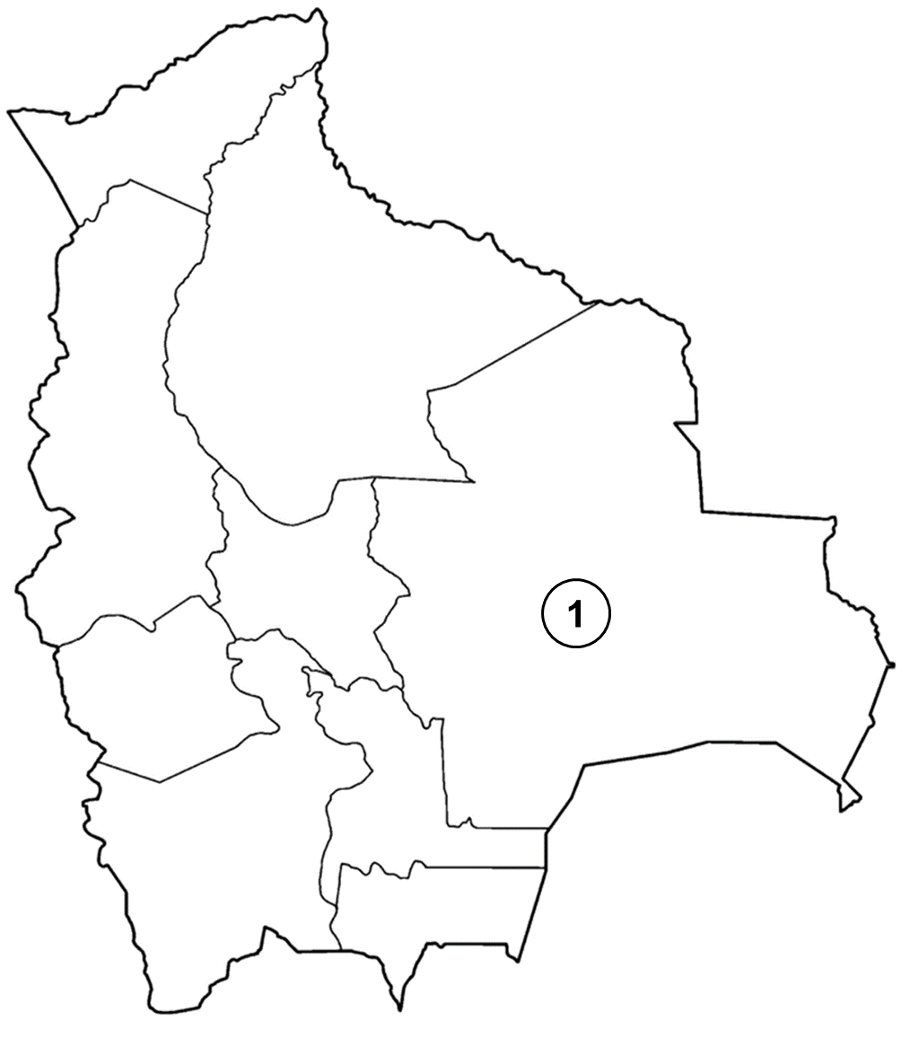
Training Stages to Reach Your Country for Christ
Stage 1 (First City)
Pastors learn how to recruit & train other pastors
Notes:
II. Training Stages to Reach Your Country for Christ
You will reach your country for Christ through the following training stages.
Stage 1 (First City)
Pastors learn how to recruit and train other pastors

Slide 97
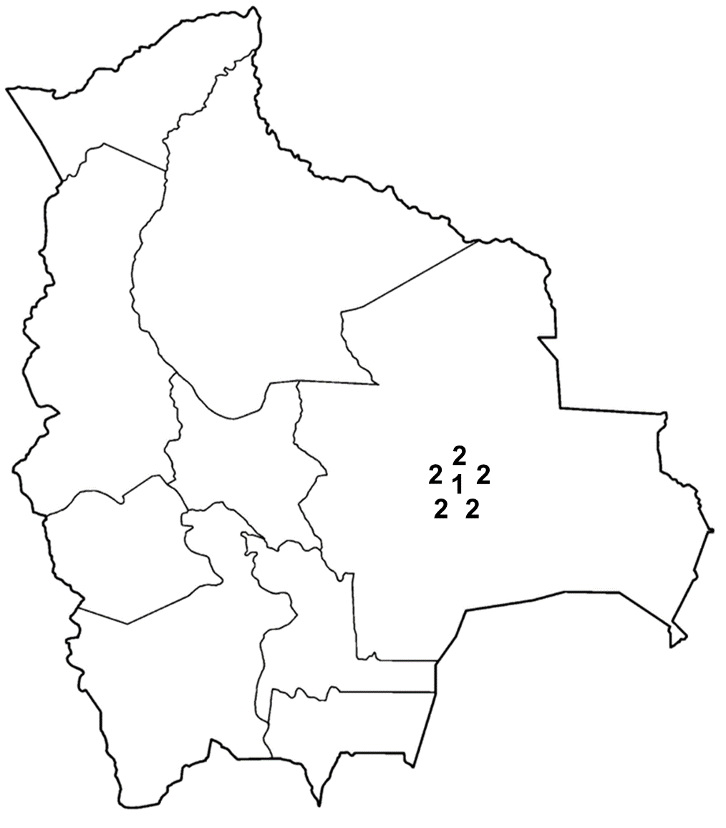
Stage 2 (Local Area)
Pastors trained in Stage 1 teach
these workshops in their local area
Notes:
Stage 2 (Local Area)
Pastors trained in Stage 1 teach these workshops in their local area

Slide 98
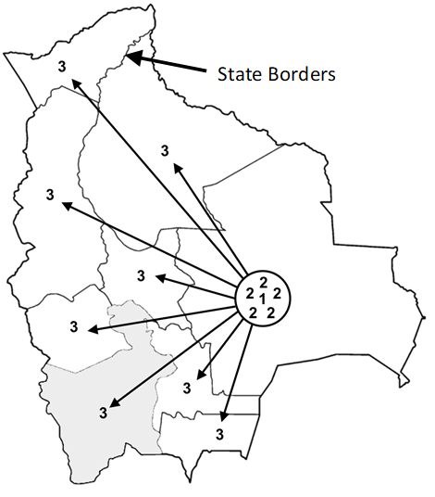
Stage 3 (States)
Pastors trained in Stages 1 and 2 teach these workshops in a key city in each state
State Borders
Notes:
Stage 3 (States)
Pastors trained in Stages 1 and 2
teach these workshops in a key city in each state.
Pastors ask their congregations to take on the mission
for reaching their country for Christ.
Each church will take offerings several times a year
to pay for the pastors’ expenses.
Some trainers may pay for their expenses by receiving an offering
from the pastors being trained.

Slide 99
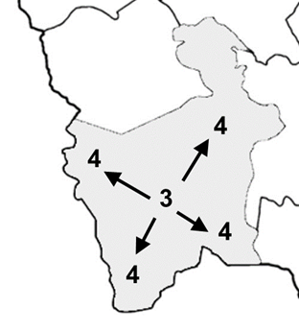
Stage 4 (Cities)
Pastors trained in Stages 1-3
teach these workshops in every city
State Borders
Notes:
Stage 4 (Cities)
Pastors trained in Stages 1-3 in every state teach Stage 4 workshops in every city in the country.

Slide 100
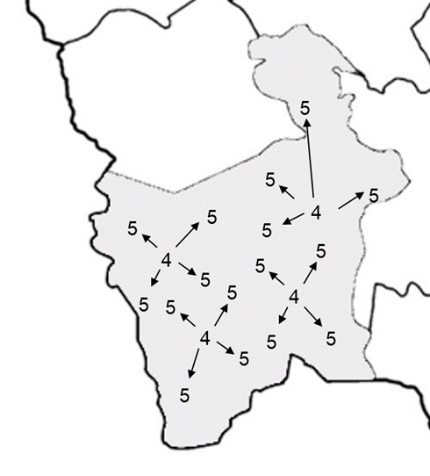
Stage 5 (Towns)
Pastors trained in Stages 1-4
teach these workshops in every town
Notes:
Stage 5 (Towns)
Pastors trained in Stages 1 to 4 will start Stage 5 workshops in every town in the country

Slide 101
Stage 6 (Every Community and Rural Area)
Pastors trained in Stages 1-5
will make multiplying disciples and plant churches
until they have reached every community
and rural area for Christ
The Great Commission
is finished in your country!
Notes:
Stage 6 (Every Neighborhood and Rural Area)
Pastors trained in Stages 1-5 in every city and town
will make multiplying disciples and plant churches
until they have reached every neighborhood and rural area for Christ.
The Great Commission is finished in your country!

Slide 102
How to Reach Your Country for Christ
Stage | Location | Training Centers | Pastors Trained
1 | First city in the country | 1 | 20
2 | Local area | 6 | 120
3 | A city in each state | 36 | 720
4 | Every city in each state | 216 | 4,320
5 | Every town in the country | 1,296 | 25,920
6 | Every community & rural area | 7,776 | 155,520
The Great Commission is finished in your country!
Notes:
It will take about six stages of multiplying pastors
to reach your country for Christ.
We assume that 20 pastors will be trained in each training center
We assume that 5 new training centers will be started from each training center.
A training center is a location where all 4 Workshops are taught to pastors
This table demonstrates how you can finish the Great Commission in your country.
155,520 pastors will be trained:
How to reach their community and rural area for Christ by making multiplying disciples
How to reach their city for Christ by planting multiplying churches in every community
How to reach your country for Christ by training pastors in these workshops
to train other pastors in these workshops in every city, town, community, and rural area

Slide 103
In your groups
Talk about methods you have tried in the past to reach your country for Christ
Talk about why using these workshops will be effective in reaching your country for Christ
Notes:
In your groups
Talk about methods you have tried in the past to reach your country for Christ
Talk about why using these workshops will be effective in reaching your country for Christ
What comments or questions do you have?

Slide 104
Starting Your Own Training Center
Lesson 8
An indispensable element in finishing the Great Commission is to train multiplying pastors
You will recruit pastors and lead them in these workshops
You may team up with one or more pastors to start this training center
Notes:
Starting Your Own Training Center
Lesson 8
I. Introduction
An indispensable element in finishing the Great Commission
is to train multiplying pastors.
After this workshop you will recruit pastors
and lead them in these workshops.
You may team up with one or more pastors to start this training center.

Slide 105

Goals for Training Centers
20 pastors trained in 4 workshops over 18 months
Pastors
Workshops
Months
Notes:
Goals for Training Centers
20 pastors trained in 4 workshops over 18 months

Slide 106
Ideas for Pastors to Recruit
  Contact pastors you know and don’t know
  Contact pastors in your denomination
  Ask pastors for suggestions
  Contact pastor’s associations and ask to make a presentation
  In your groups
  Talk about pastors you can recruit to train
  Make a list of pastors to invite
Notes:
II. Ideas for Pastors to Recruit
Contact pastors you know in the area.
Make appointments and meet pastors in the area that you don’t know.
Contact pastors you know in your denomination.
Make appointments and meet pastors in your denomination that you don’t know.
Ask other pastors for suggestions of pastors to recruit.
Contact local pastor’s associations and ask to make a presentation to them.
In your groups
Talk about pastors you can recruit to train
Make a list of pastors to invite
Questions or comments

Slide 107
Foundations Discipleship Workshops Recruiting Presentation
Prepare for Your Presentation
Have copies of the Foundations Discipleship Workshops page to hand out
Prepare your testimony of how Foundations has impacted your church
  How implementing these workshops has helped you minister to more people by making multiplying disciples
The recruiting presentation and handout and a PowerPoint presentation are available at foundationsglobal.com.
Notes:
I. Prepare for Your Presentation
Make sure that you have copies of the Foundations Discipleship Workshops page to hand out to the pastors and leaders
It is in this document after the Recruiting Presentation section
Take time to prepare your testimony of how Foundations has impacted your church.
Share specifically how implementing the workshops has helped you as a pastor minister to more people by making multiplying disciples.
The recruiting presentation and handout and a PowerPoint presentation are available at foundationsglobal.com.

Slide 108
Implementation
    Lead a balanced Christian life
    Train church members how to study the Bible
    Prepare effective Biblical sermons
    Implement the plan to start Foundations Groups in the whole church
    Create a Foundations Leader Team
Notes:
Implementation
Lead a balanced Christian life
Train church members how to study the Bible
Prepare effective Biblical sermons
Implement the plan to start Foundations Groups in the whole church
Create a Foundations Leader Team

Slide 109
Implementation
    Evaluate your ministries
    Create a church structure that makes multiplying disciples
    Plant churches that make multiplying disciples to reach your city
    Train other pastors to reach your country
Notes:
Implementation
6. Evaluate your ministries
7. Create a church structure that makes multiplying disciples
8. Plant churches that make multiplying disciples to reach your city
9. Train other pastors to reach your country

Slide 110
Congratulations!
You have finished Workshop 4
Finish the Great Commission!
DEVELOPING
WORKERS
FOUNDATIONS
Notes:
Congratulations!
You have finished Workshop 4
Now go and Finish the Great Commission!
Ask the host to close in prayer
Pass out certificates
Take a group photo

