Slide 1

Hiring for Attitude
SIP #1 – OMAG, Edmond – November 14, 2019
Start Hiring for the Right Reasons
Speaker: Pam Spinks
Director of Professional Development
1-800-234-9461 pspinks@omag.org
Notes:
Based on the book Hiring For Attitude by Mark Murphy. McGraw-Hill, 2012
www.leadershipiq.com

Slide 2


Providing liability, property and workers’ compensation coverages, plus risk management and supervisor training and legal services
www.omag.org
Notes:
Since 1977. . [Removed 40th Logo in 2018]
Created by Oklahoma cities and towns
Owned by Oklahoma cities and towns
Governed by Oklahoma cities and towns
is now into Social Media!
Follow Us on FaceBook, LinkedIn and Twitter.
Check Facebook for Winter Weather advisories.

Slide 3

Hiring for Attitude by Mark Murphy https://www.youtube.com/watch?v=rrznxVJPqmY
Notes:
Hiring for Attitude by Mark Murphy 1:46 12/16/11
https://www.youtube.com/watch?v=rrznxVJPqmY
Would you rather work short-staffed or with a person with a bad attitude?

Slide 4
Failures in Hiring
46% of newly hired employees will fail within 18 months
Only 19% will achieve clear success
Definition of Failure =
“New” employees that you fire OR Current employees that you “would never hire again.”
Notes:
According to a groundbreaking study by Leadership IQ, 46% of newly hiring employees will fail within 18 months, while only 19% will achieve unequivocal success.
Contrary to popular belief, technical skills are not the primary reason why new hires fail. Instead, poor interpersonal skills dominate the list, flaws which many of their managers admit were overlooked during the interview process.
This study (reported in Fortune and Forbes) found that:
26% fail because they can’t accept feedback;
23% fail because they're unable to understand and manage emotions;
17% fail because they lack the necessary motivation to excel;
15% fail because they have the wrong temperament for the job and
Only 11% fail because they lack the necessary technical skills.
3 Year study by Leadership IQ, a global leadership training and research company. They compiled these results after studying 5,247 Hiring Managers from 312 public, private, business and healthcare organizations. Collectively, these managers hired more than 20,000 employees in the 3 year period.

Slide 5
Typical Interview
Focuses on ensuring that new hires are “technically competent”.
Technical skills can be easily tested.
Yet only 11% fail in a job because of their technical skills.
Notes:
While the failure rate for new hires is distressing, it should not be surprising. 82% of managers reported that in hindsight, their interview process with these employees elicited subtle clues that they would be headed for trouble. But during the interviews, managers are too focused on other issues, too pressed for time, or lacked confidence in their interviewing abilities to heed the warning signs.
The Typical interview process fixates on ensuring that new hires are technically competent. If poor interpersonal skills are the reason new Hires don’t Fit, why aren’t we asking interview questions about those skills?
(But coachability, emotional intelligence, motivation and temperament are much more predictive of a new hire’s success or failure.)
QUES: Do technical skills really matter if the employee isn’t open to improving, alienates their coworkers, lacks drive and has the wrong personality for the job?

Slide 6
5 Biggest Reasons why New Hires Fail
Coachability (26%): Ability to accept and implement feedback from bosses, coworkers, customers and others.
Emotional Intelligence (23%): Ability to understand and manage one’s own emotions and accurately assess others’ emotions.
Motivation (17%): Sufficient drive to achieve one’s full potential and excel in the job.
Temperament (15%): Attitude and personality suited to the particular job and work environment.
Technical Competence (11%): Functional or technical skills required to do the job.
Notes:
5 Biggest Reasons Why New Hires Fail
Coachability (26%): Ability to accept and implement feedback from bosses, coworkers, customers and others.
Emotional Intelligence (23%): Ability to understand and manage one’s own emotions and accurately assess others’ emotions.
Motivation (17%): Sufficient drive to achieve one’s full potential and excel in the job.
Temperament (15%): Attitude and personality suited to the particular job and work environment.
Technical Competence (11%): Functional or technical skills required to do the job.

Slide 7
The Need for Attitude
“If you don’t have a good attitude, we don’t want you, no matter how skilled you are.
We can change skill levels through training. We can’t change attitude.”
Herb Kelleher
Founder of Southwest Airlines
Notes:
Do you agree with The Need for Attitude?
“If you don’t have a good attitude, we don’t want you, no matter how skilled you are.
We can change skill levels through training. We can’t change attitude.”
Herb Kelleher
Founder of Southwest Airlines
Note: Training Departments were set up to train Technical Skills.
Therapy was designed to improve attitude.
Changing attitudes is 100 times harder and very time consuming. Slide added 10/2/17

Slide 8
Hiring failures can be prevented
Hiring managers must focus their energies on the candidates’:
  Coachability
  Emotional Intelligence
  Motivation
  Temperament
  Technical Skills
Notes:
If managers focus more of their interviewing energy on candidates interpersonal skills, they will see vast improvements in their hiring success.
But while technical competence is easy to assess, it’s a lousy predictor of whether a newly hired employee will succeed or fail.
The Financial cost of hiring failures, coupled with the opportunity cost of not hiring high performers, can be millions of dollars, even for small companies or cities.
And the human cost can be even worse. If the Fire Department hires an EMT who won’t accept feedback and who alienates coworkers and customers, the result could be a medical error. Dysfunctional teams making medical decisions could cost someone their life.

Slide 9
2 Quick Tests to Discover the Attitudes you want
Test #1: Finding your High Performer Attitudes
What are the distinguishing attitudinal characteristics that make these people such a joy to work with?
Test #2: Finding your Low Performer Attitudes
What are the attitudes these folks have that makes them getting stuck in traffic on the way to work seem like a blessing?
Notes:
Hiring for attitude does not mean looking for every terrific attitude under the sun. The Goal is to determine the key attitudes that matter most to your customers and that bring the greatest benefit to your municipality.
Two (2) Tests are designed to help you identify the attitudes you need.
Test #1: Finding your High Performer Attitudes
Think of the people who are a pleasure to be around’ and
Make your job more enjoyable and easier to do.
These are the folks you would Clone, if you could
What are the distinguishing attitudinal characteristics that make these people such a joy to work with?
Test #2: Finding your Low Performer Attitudes
Only a true High performer will not possess the low performer traits that impede success
What are the attitudes these folks have that make getting stuck in traffic on the way to work seem like a blessing?
Remember, there’s no such thing as the “perfect” candidate just as there’s no universal “right attitudes”; there are only the attitudes that are right for your city of town. So, the more honest you are in your responses, the closer you’ll be to finding the talent you want. For Accurate results, you, must take both tests.

Slide 10
Characteristics of High Performers
Don’t quit until it is right
Team Player
They take Risks
Or they don’t take Risks
Sense of Humor
Class and Poise
Resilient
Emotionally sensitive to others needs
Notes:
Think of someone in the organization who really represents our culture. This is our poster child for having the exact right attitude for our city. Could you tell me about a time they did something that really exemplifies having the right attitude?
Think of our 3 Best Employees.
Can distinguish between really big problems that could permanently damage the City and minor problems that temporarily irritate employees, but don’t hurt the city or your customers.
Helps ownership make smarter strategic decisions by proactively providing important information (including bad news) in a candid and open-minded way, without tunnel vision.
Take responsibility for, and actually accomplish. Constantly growing their own skill set.
Slide added 10/2/17

Slide 11
High Performer Attitudes
Take ownership of problems
Are highly collaborative
Aren’t afraid to make mistakes
Meet their commitments
Empathetic towards customers’ and coworkers’ needs
→ Your Attitude List will be unique to your city or town.
Notes:
Here are some Sample High Performer Attitudes.
You must complete Test #1 and determine the High Performer Attitudes for your city.
Your list should not exceed 10 items either…

Slide 12
Characteristics of Low Performers
Whining
Negativity
Me-first
Blaming
Dramatic
Stir-up-trouble
Notes:
02. Without names, think of someone who works (or worked) in the city who just did not represent our culture. This is our poster child for hacing the exact wrong attitude for this city. Could you tell me about a time the did something that really exemplifies having the wrong attitude?
3 Worst Employees;
Blames others or makes excuses when things go wrong, including other departments or even customers.
Not collaborative. Preferring to fly solo and then get all the glory, even if it means ultimately generating a suboptimal solution.
Overwhelmed by multiple demands and becomes paralyzed, unable to accomplish anything, instead of effectively triaging and accomplishing all of their required work.
Slide added 10/2/17.
Slide added 10/2/17

Slide 13
Low Performer Attitudes
Always find the negative
Gossip
Respond to feedback with an argument
Only do the bare minimum expected of them
Get overwhelmed by multiple demands and priorities
Always find someone else to blame for their mistakes
Unwilling to leave their comfort zone
→ Your Attitude List will be unique to your city or town.
Notes:
You must complete Test #2 to create your list. Your responses will be unique to your city and should not exceed 10 items.
Once you have your two lists, conduct a quick assessment to make sure every point is on target.
Ask the following two questions about each attitude listed.
How does this attitude add value or competitive advantage to this city? (If the attitude brings no benefit, it doesn’t belong on the list.)
Who cares about this attitude? (If the attitude brings no benefit, it doesn’t belong on the list.)
Now, you’re ready to use Key Attitudinal Traits to start developing your Interview Questions.

Slide 14
2 categories of People
Problem Bringers (PB)
  Ask a PB about a problem and all you will hear about is the problem.
Problem Solvers (PS)
  Ask a PS about a problem, and you will hear about the problem, but you’ll also hear some potential solutions.
  (Because PS can’t even think of a problem without instantly generating possible solutions)
Notes:
2 Categories of People:
Problem Bringers (PB)
Ask a PB about a problem and all you will hear about is the problem.
(Because a PB can spend all day telling you about the problem without ever coming close to offering a solution.)
Problem Solvers (PS)
Ask a PS about a problem, and you will hear about the problem, but you’ll also hear some potential solutions.
(Because PS can’t even think of a problem without instantly generating possible solutions)
Asking Interview Questions that Elicit Honest Responses is the only way to determine if the Candidate is a PB or a PS.
Ques: Do you agree with this?

Slide 15
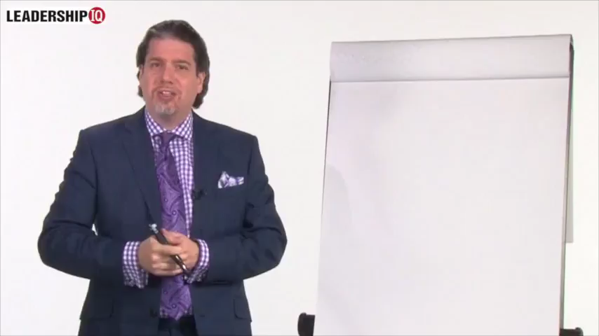
STOP Asking these Questions https://www.youtube.com/watch?v=DeyGZix4wuQ
Notes:
What interview question topics are illegal?
Race, Color, or National Origin.
Religion.
Sex, Gender Identity, or Sexual Orientation.
Pregnancy status.
Disability.
Age or Genetic Information.
Citizenship.
Marital Status or Number of Children.
Jul 30, 2019
Source: https://www.google.com/search?q=Can+you+ask+about+Bankruptcy+during+a+job+interview%3F&rlz=1C1GCEU_enUS821US821&oq=Can+you+ask+about+Bankruptcy+during+a+job+interview%3F&aqs=chrome..69i57j33.16491j0j7&sourceid=chrome&ie=UTF-8

Slide 16
Bad Interview Questions
Ask No Illegal questions!
  NEVER ask questions about Race, Color, Religion, Sex (Gender or Sexual Orientation), National Origin, Age or Disability.
Ask no questions that get a “Canned (Rehearsed)” answer!
  Tell me about yourself.
  What are your strengths?
  What are your weaknesses?
  What would you do if… (Hypothetical)
Ask no Useless questions!
  If you were a tree, what tree would you be?
Notes:
Refer to “Handout” of SHRM Acceptable and Unacceptable Interview Questions.

Slide 17
Bad Interview Questions
(Continued)
Never ask Leading Questions!
  Listen, our city culture is highly collaborative and really based around teamwork. So tell me about your teamwork skills.
  Could you tell me about a time when you had to balance competing priorities and did so successfully.
  Could you tell me about a conflict with a coworker and how you resolved it.
Notes:
Never ask leading questions!
(The Question tells them what to answer.)
Listen, our city culture is highly collaborative and really based around teamwork. So tell me about your teamwork skills.
Could you tell me about a time when you had to balance competing priorities and did so successfully.
Could you tell me about a conflict with a coworker and how you resolved it.
A candidate would have to be foolish not to realize the correct answer is, “Well, yes, I am. In fact, my last boss told me my best attribute was working in a team-based, family-oriented culture.”

Slide 18
Creating your “Attitudinal” Questions
4 Step Process:
Pick one of your High Performer Attributes
Identify a “Differential Situation” that would show that attribute
Begin the question by asking: “Could you tell me about a time you…” (Then insert the situation you identified)
Leave the Question Hanging. (Never hint at the correct answer; leave it hanging.)
Tip: 5 or 6 questions is all you need for a 1 hour interview.
Notes:
Differential Situation are moments when the differences between high and low performers are most starkly in contrast.
Build your questions around your High Performer and Low Performer Attributes.
Here are two questioning techniques:
The first if tried-and-true Behavioral Interviewing Technique: “Tell me about a time when…” This is designed to elicit a past situation and how your candidate reacted to it.
The 2nd is the Hanging Question Technique. Pin-point a real life scenario your candidate might encounter on the job. And, find a challenging situation common to your city and develop an effective hanging question from that.
M Murphy says “Could you tell me about a time…” is softer and may get better answers.

Slide 19
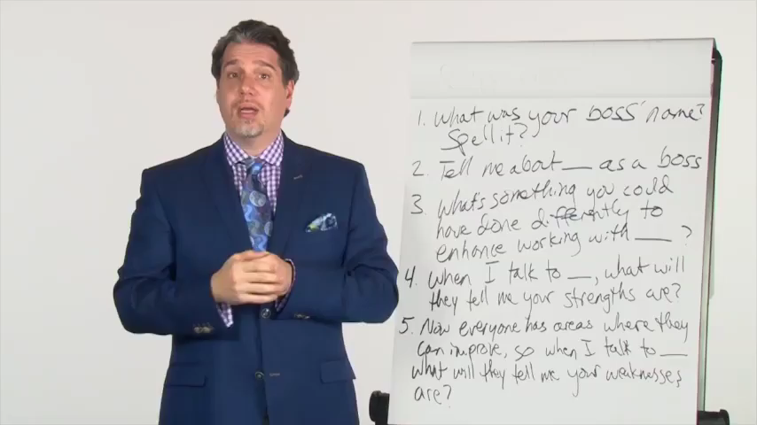
Beginning the Coachability question https://www.youtube.com/watch?v=6k8yhZYIDa4
Notes:
Hiring for Attitude: Beginning the Coachability Question 1:25
https://www.youtube.com/watch?v=6k8yhZYIDa4
5/19/15

Slide 20
Add: The Coachability Question
What was your boss’s name? Please spell the full name.
Tell me about __(Name)__ as a boss.
What’s something that you could have done (or done differently) to enhance your working relationship with ___(Name)___?
When I talk to ___(Name)___, what will he or she tell me your strengths are?
Now all people have areas where they can improve, so when I talk to ___(Name)___, what will he or she tell me about your weaknesses are?
Notes:
Coachability Question. 1) Make them believe you are going to talk with their Previous Boss. You must ask for the name and the correct spelling of the name or the Coachability Question will not work.
2) Ask them to describe their boss. Here are two probing follow-up questions: What’s something you wish Kate had done more of? And, What’s something you wish Kate had done less of?
3) Ask what they personally could have done differently. This will assess to what extent the Candidate feels personally accountable for his/her own success. High performers have high levels of critical self-awareness – the definition of coachability. Natural Law of the Universe that everyone has the potential for more improvement; the real question is who is personally aware this room for improvement exists.
4) Ask them what their boss considered their Strengths. You get a canned answer when you ask “Tell me your strengths”. This way they will answer more honestly because they believe you will be calling the boss to confirm. This gives you a different answer.
5) Ask them what their boss considered their Weakness. “Now everyone has some weaknesses, so when I talk to Kate, what will she tell me yours are? (Most critical step in this 5 step process and it only works if you do all 5 Steps. This question will determine whether someone is Coachable of Not. “I can’t think of any weaknesses.” or “I don’t know what Kate thought about me.” = Warning, they are not coachable. Non-coachable people are a nightmare to try and manage!

Slide 21
Listen to the words the Candidate Uses
Good Words
Warning Words
I, Me or We
Use past tense verbs (Acted, Called)
Positive emotions (happy, thrilled, excited)
Longer answers because they have more and better experience to share
You, Your, He, She, They
Uses present tense or future tense verbs (to call, will call)
Negative emotions (Aggravated, angry, afraid, pessimistic)
No, can’t, couldn’t, didn’t
Absolutes: always, never, absolutely, unquestionably
Notes:
New research from Leadership IQ finds that interview answers rated Poorly by hiring managers contain very different words than interview answers rated Highly.

Slide 22
Put it All Together
Yes, ask about and test for the Technical Skills. It is easy to do this.
Change your questions to assess whether they also have the right levels of Coachability, Emotional Intelligence, Temperament and Motivation to FIT your City’s Culture.
Changing your questions to assess “attitude” will double your chance of making a “Good Hire”.
Don’t hire people and a year later answer “No” when asked: Would you hire that person again?

Slide 23
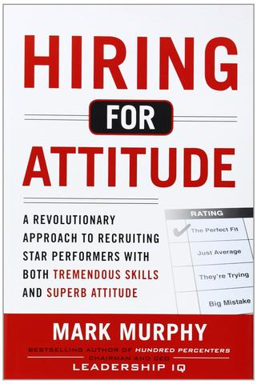
By Mark Murphy
McGraw-Hill, 2012
www.leadershipiq.com

Slide 24
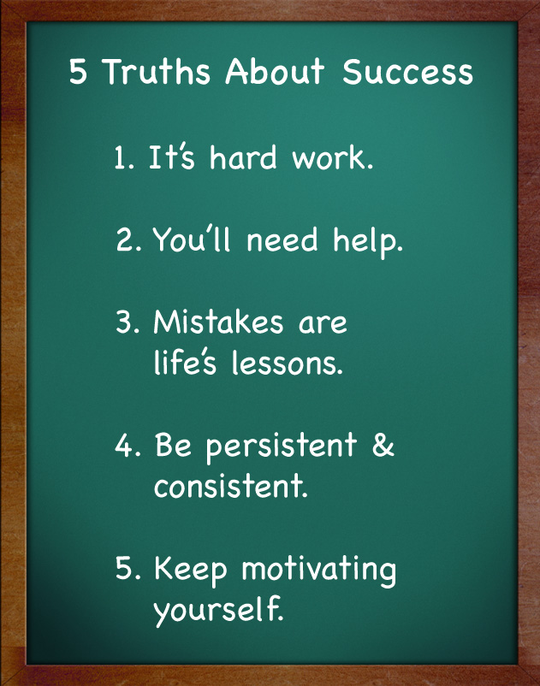
See you for SIP #2 on April 23, 2019

Slide 25
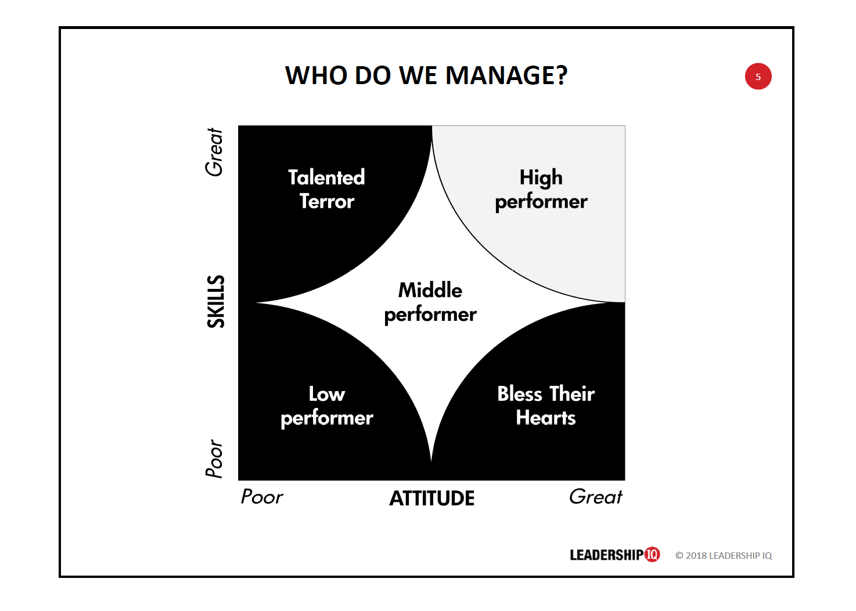

Slide 27
The End of SIP #1
See you for SIP #2 on
February 15th

Slide 28
Examples of good team goals:
“Get a shutout in 60% of the games this fall (while there certainly are things out of the teams control such as a much better team or a great goal scorer, by setting this throughout the whole season and making it attainable even against top level competition by using an average instead of a specific set of games).”
“Set up for properly for all dead ball situations in the next 6 games.”

Slide 29
Examples of good individual goals:
“Increase my ability to juggle from 10 consecutive juggles to 30 consecutive juggles in the next 60 days”
“Improve my vertical jump by 2 inches by December 15”

Slide 30
Now that you have set your individual and team goals, now what?
Think of it as you now know you want to drive from Charleston WV to Disney World in Orlando Florida. You know the final destination but now have to figure out the best route to get from Charleston to Orlando. This would mean getting maps (or using Mapquest.com or possibly a GPS system) and planning. To make the drive easier, rather then driving to Orlando you could drive to Charlotte, have lunch, then plan on next going to Jacksonville FL for dinner and then on to Orlando. By breaking this down it doesn't make the trip any shorter, but it does make it easier because when you get to Charlotte you have fulfilled one of the sub goals and then you can look forward to the next sub goal instead of simply looking at the final destination and saying "wow, I will never get there?"

Slide 31
You know where you want to be, the next step would be to figure out how to accomplish these goals.
Using the previous individual goal of improving juggling from 10 to 30 consecutive juggles in the next 60 days, the process might be as simple as allocating 15 minutes every day for the next 60 days to work on juggling. If the previous record was 10 you would want to set a sub goal of getting up to 15 after the first 10 days, then 20 after 20 days and then each day add one more. By setting these sub goals, it allows the player to see gradual improvement by achieving each of the sub goals which will encourage them to keep working at improving.

Slide 32
Once you have your goals (and your sub goals) you need to figure out how you are going to be able to accomplish these goals. You want to be as specific as possible in order to achieve your objective of achieving each of the sub goals and the ultimate goals.

Slide 33
While you want your goals to be attainable, it’s also important to have a long term BHAG. This is something that is “out there”, something that quite possibly might not be attainable but something that you would really like to accomplish long term. An example would be setting as your BHAG to be “to make the national team by the time you are 24.” While this might be something that is possible, it most likely is something that is really a push to ever accomplish but as long as you are working toward your BHAG you will most likely be successful.
Big
Hairy
Audacious
Goal

Slide 34
Does a person have to achieve their goals in order to be successful?
N O

Slide 35
Set goals, make sure they are in writing and readily visible and work toward your goals on a regular basis.

Slide 36
Three Steps to Success:
Set the Goals
Make a Commitment
Be Accountable

