Slide 1
Significance testing harms replicability
Only if misused
Yoav Benjamini
Tel Aviv University, Israel
with
Amit Meir and Yoav Zeevi
www.replicability.tau.ac.il
Supported by an ERC grant (PSARPS)

Slide 2
Replicability with significance
“We may say that a phenomenon is experimentally demonstrable when we know how to conduct an experiment which will rarely fail to give us statistically significant results.”
Fisher (1935) “The Design of Experiments”.
No further quantification until recently:
r-value ( and its generalization r_{u/n} – value)
IBC 2016 Victoria Heller, Bogomolov, Yekutieli, Sofer, YB
IB

Slide 3
Reproducibility/Replicability
Reproduce the study: from the original data, through analysis, to get same figures and conclusions
Replicability of results: replicate the entire study, from enlisting subjects through collecting data, and analyzing the results, in a similar but not necessarily identical way, yet get essentially the same results.
(Biostatistics, Editorial 2010, Nature Editorial 2013, NSF 2015)
“ reproducibilty is the ability to replicate the results…”
in a paper on “reproducibility is not replicability”
We can therefore assure reproducibility of a single study
but only enhance its replicability

Slide 4
Enhancing Replicability
Replicability is a property of the study’s result across multiple studies.
What can be done at the level of the single study to increase its replicability?
Well and transparently designed experiment
Reproducible data analysis and computation
(Nature ’13, NIH in Nature ’14, Science ’14)
All agreed that there is need for
Statistical methodology that enhances replicability
But what is it?
What problems should it address?

Slide 5
It’s the p-values’ fault!
Psychological Science “… seeks to aid researchers in shifting from reliance on NHST to estimation and other preferred techniques… we have published a tutorial by Cumming (‘14), a leader in the new-statistics movement…”
9. Do not trust any p value.
10. Whenever possible, avoid using statistical significance or p-values; simply omit any mention of null hypothesis significance testing (NHST).
11. Move beyond NHST and use the most appropriate methods, whether estimation or other approaches.
13. Interpret your single confidence interval (CI), but bear in mind the dance. Your 95% CI just might be one of the 5% that miss.
14. Prefer 95% CIs to SE bars. Routinely report 95% CIs…

Slide 6
Ban them!
Basic and Applied Social Psychology
Editorial by Trafimow & Marks Feb 24, 2015
“From now on, BASP is banning the NHSTP…prior to publication, authors will have to remove all vestiges of the NHSTP (p -values, t -values, F –values, statements about ‘‘significant’’ differences or lack thereof, and so on).
Question: Are any inferential statistical procedures required?
Answer : No, because the state of the art remains uncertain. However, BASP will require strong descriptive statistics…”

Slide 7
It’s the p-values’ fault!
Given the concern about reproducibility,
and the attack on the p-value, a year long process started by ASA.
ASA Board’s statement about p-values (Am. Stat. 2016):
The p-value “can be useful” providing “one approach to summarizing the incompatibility between a particular set of data and a proposed model for the data “ (Principle 1).

Slide 8
On the other hand:
Principle 2: “p-values do not measure the probability that the studied hypothesis is true…“;
Principle 3: “scientific decisions should not be based only on whether a p-value passes a specific threshold” as this “..leads to considerable distortion of the scientific process”;
Principle 4: “P-values and related analyses should not be reported selectively”;
Principle 5: “A p-value, or statistical significance, does not measure the size of an effect or the importance of a result”
Principle 6: “…a p-value near 0.05 taken by itself offers only weak evidence against the null hypothesis”
All problems and warnings phrased in terms of p-values

Slide 9
ASA statement’s concludes with Other Approaches
“In view of the prevalent misuses of and misconceptions concerning p-values, some statisticians prefer to supplement or even replace p-values with other approaches. “
In other wards, it is the p-values’ fault!
Some responses to the statement
We’re finally starting to get rid of the p-value tyranny

Slide 10
What other approaches were mentioned?
Likelihood ratios
Bayesian methods
Bayes factor
Credibility intervals
False discovery rates
Prediction intervals
Estimation
Confidence intervals
Notes:
Principle 2: “p-values do not measure the probability that the studied hypothesis is true…“;
Principle 3: “scientific decisions should not be based only on whether a p-value passes a specific threshold” as this “..leads to considerable distortion of the scientific process”;
Principle 4: “P-values and related analyses should not be reported selectively”;
Principle 5: “A p-value, or statistical significance, does not measure the size of an effect or the importance of a result”
Principle 6: “…a p-value near 0.05 taken by itself offers only weak evidence against the null hypothesis”

Slide 11
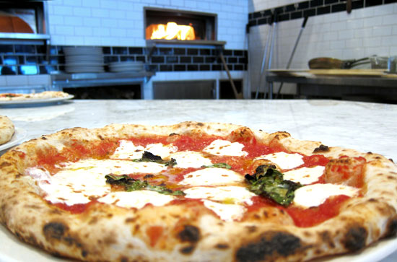
Epidemiology: a p-values free zone
Giovannucci et al. (1995) look for relationships between more than a hundred types of food intakes and the risk of prostate cancer
The abstract reports only three (marginal) 95% confidence intervals (CIs), apparently only for those relative risks whose CIs do not cover 1.
“Eat Ketchup and Pizza and avoid Prostate Cancer”

Slide 12
Using false coverage-statement rate controlling CIs (FCR-CIs),
which addresses selection by constructing
( 1-α[#selected / #considered ])100% CIs – the 3 also cover 0.
Two main statistical obstacles to replicability
which are relevant to all statistical methods
Addressing selective Inference
Addressing the relevant variability

Slide 13
Principle 4: P-values and related analyses should not be reported selectively”
True throughout: When inferring on a selected subset of the parameters, that turned out to be of interest
after viewing the data
The original properties no longer hold.
How is selection manifested?
Out-of-study selection - may not be evident in published work
File drawer problem / publication bias
Cherry-picking, Data Dredging, p-Hacking
The garden of forking path

Slide 14
Principle 4: P-values and related analyses should not be reported selectively”
In-study selection - evident in the published work:
How is in-study selection manifested?
Selection by the Abstract, a Table, a Figure
Selection by highlighting those passing a threshold
Selection by modeling: AIC, C_{p}, BIC, FDR, LASSO,…

Slide 15
In-study selection in complex research
Researcher are nowadays using lower levels as thresholds for significance in order to control
(i) the probability of making even one false discovery (FWER),
or in order to control adaptively the less restrictive
(ii) False Discovery Rate (FDR),
or to make inference
(iii) conditional on being selected by a particular rule
Using any
most of the selected findings will not be false
In QTL analysis nowadays m>800, for gene expression m>4000

Slide 16
Elsewhere? in medical research?
In100 papers from the NEJM 2002-2010. (Cohen and YB ‘16)
# of endpoints in a paper 4-167 ; mean=27
In 80% multiplicity entirely ignored: p ≤ 0.05
(in none fully addressed.)
All studies designated primary endpoints
Conclusions were based on secondary endpoints when the primary failed

Slide 17
In Psychology?
Replicability problems surfaced in experimental psychological
“Do normative scientific practices and incentive structures produce a biased body of research evidence in our field?”
Replication studies of 100 projects ended recently (Science 2015).
Our analysis of the 100:
# of inferences per study (4-700, average 72);
Only 11 (partially) addressed selection

Slide 18
“With a clean conscience” (Schnall et al ’08, Psy. Sc.)
Presented with 6 moral dilemmas and asked “how wrong each action was”
Does priming for cleanliness affect the response:
1 Assessment of wrong-doing & 9 emotions rating per each dilemma;
2 methods of priming verbal & physical (separate experiments) (m>84)
Results: No significant difference on any of the emotions in any of the experiments; only a contrast for disgust.
Each experiment barely significant on moral judgment over all dilemmas;
In 3 of the 6*2 particular dilemmas priming made a significant difference.
All tests at 0.05; No adjustment for multiplicity. Within groups variability.
Their Conclusion: The findings support the idea that moral judgment is affected by priming for cleanliness.
The replication study could not replicate these results.
Notes:
Eating dead dog
Switching Troley to kill one and avoid 5
Keeping money inside found valet
Plane Crash
False Resume
Kitten used for sexual arousal

Slide 19
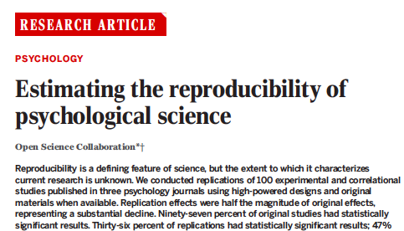
Fisher’s definition (significant in both) 36% replicated
Original effect in 95% CI of replication 47% replicated
(84% expected)
Meta-analysis of both 68% ‘replicated’
Comparison of effect sizes:
~ half in magnitude of the original effect sizes
Similar to Schooler’s conclusion
about the effect of “verbal shadowing” (NMETH ‘14)
But here the picture is more complicated

Slide 20
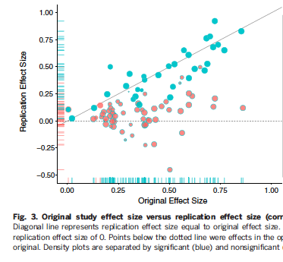
The only factor correlated with replication success is strength of evidence: effect size and p-value (not authors experience, institution, journal, area)

Slide 21
But only statistically significant results (p ≤ 0.05) were included.
Can we take this out-of-study selection into consideration?

Slide 22
Tailor the CI to the selection used
E.g. Select θ if its estimator is big enough
X=(Y | |Y| ≥ c),
where c is fixed
or (simple) data dependent c(Y).
Conditional density -> Acceptance region for each parameter (non-equivariant) with short 0-crossing -> inverting to get Conditional CIs -> offer False Coverage Rate

Slide 23
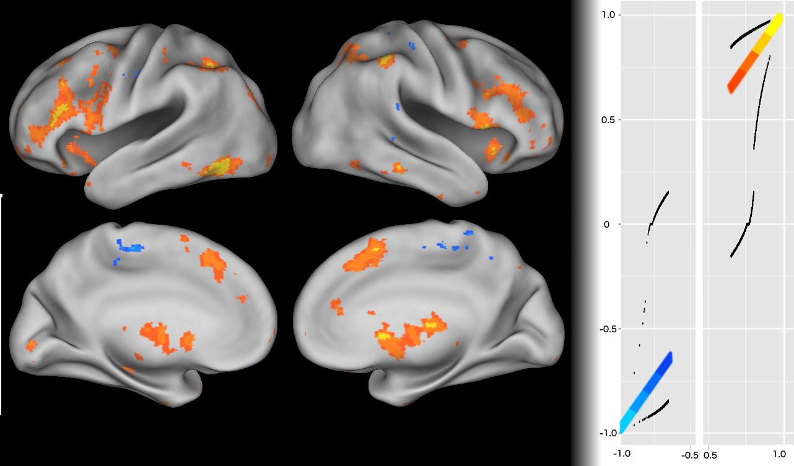
Addressing in-study ‘voodoo correlations’
Confidence Calibration Plot: Observed correlations in
significant voxels (B-H;FDR 0.1) encoding
conditional confidence intervals as well.

Slide 24
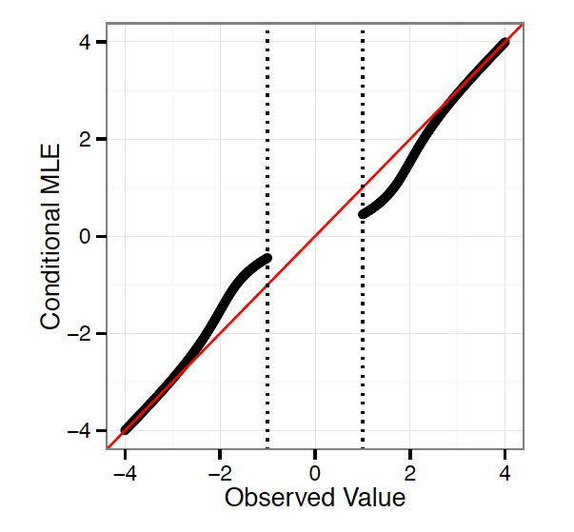
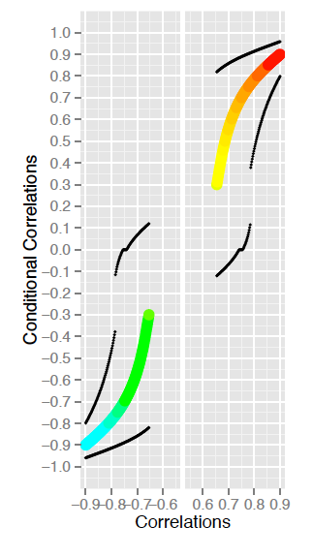
Maximum conditional likelihood estimator
Hedges ‘84, Zhong and Prentice ‘08
In Fithian, Sun Taylor terminology: 100% used for selection

Slide 25
Con
With estimators and CIs conditional on p-value ≤ 0.05
77% fall in
Cond. CI
Instead of
47%

Slide 26
Principle 6: “…a p-value near 0.05 taken by itself offers only weak evidence against the null hypothesis”
Based on Val Johnson’s ‘14 PNAS paper which offers Bayesian argument for p ≤ 0.005 threshold

Slide 27
Principle 6: “…a p-value near 0.05 taken by itself offers only weak evidence against the null hypothesis”
Based on Val Johnson’s ‘14 PNAS paper which offers Bayesian argument for p ≤ 0.005 threshold
The problem though is being close to the threshold,
not to where the threshold is set

Slide 28
With estimators and CIs conditional on p-value ≤ 0.005

Slide 29
Thresholding at
p-value ≤ 0.05
Thresholding at
p-value ≤ 0.005

Slide 30
Defending the p-value
It’s the first defense line against being fooled by randomness – separating signal from noise
Needs minimal modeling assumptions
  Compare to: LR, Bayes factor, posterior odds, CI, estimator
Assumptions can be assured to hold by design
Significant testing gives sign determination –
controls directional error (type III error)
Tukey, Shaffer, YB & Hochberg discussed it as directional FDR,
Yekutieli &YB proved it for BH . Resurfaced as sFDR.
The meaning: the null need not be precisely true,
μ=0 it is merely the least favorable configuration.

Slide 31
Defending the p-value
Principle 3: Scientific decisions should not be based only on whether a p-value passes a specific threshold”
Thresholds for decision are essential in the current industrialized modern science: High Throughput experimentation, Big Data, ease of computation
Genomics, Neuroimaging, Medicine,
Publication decision, Abstract’s content
(likelihood ratio, posterior odds, credibility intervals,…, are all practically subject to selection at some threshold)
In some emerging branches of science it’s the only way to compare across conditions: GWAS, fMRI, Brain Networks.

Slide 32
But, the p-value should not be misused
Just like any other statistical summary
Report adjusted p-values (FDR, FWER, or FWER) to address in-study selection,
Whenever feasible, accompany it by CI for effect size
( indicating by how much it can be separated from 0 )
and by an estimate.
Assessment of importance should be based on both
as well as subject matter considerations

Slide 33
Yes, it should not be misused
A hardline threshold for publication can be used, but it should be made clear that results close to threshold are less convincing than those away (on the p-value scale). Where this is the ongoing practice consider a conditional CI
Avoid other out-of-study selection. (Reproducible research)
If p-value is used to support the null – add power calculation

Slide 34
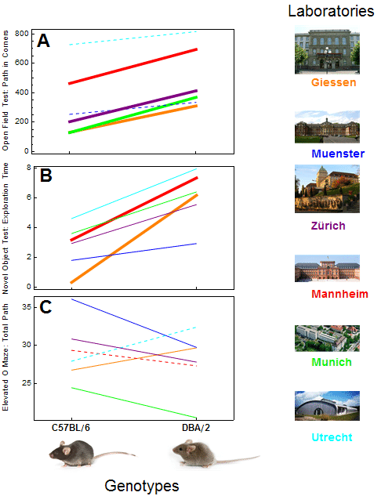
Last issue: Addressing the relevant variability
If variability is viewed too narrowly
there is danger for lack of replicability
Crabbe: Contradicting effects in different labs
Interaction between labs
and explored strains
The usually proposed remedy:
Standardization!
Does not work in mouse phenotyping:
Does not work in psychology:
College students in original ≠ never attended in replication
comments by Gilbert et al Science ‘16

Slide 35
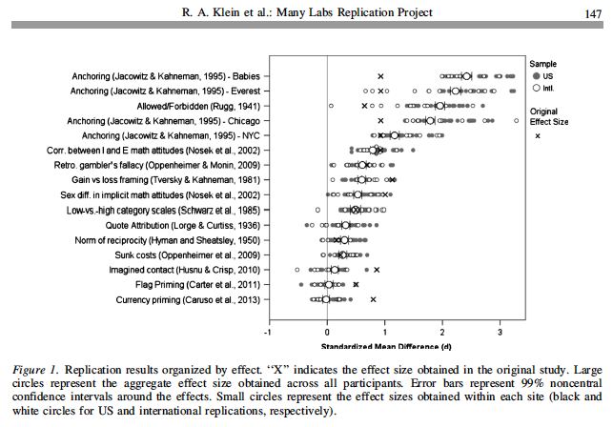
The many lab replication project: same experiments in 30 sites
|0|
combined estimate
& 99% CI
X
original
estimateI
Between subjects variability is not relevant. Between lab variability is.

Slide 36
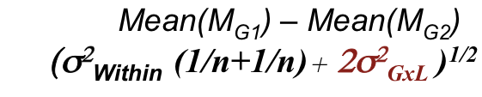
From the multi-lab study to the single lab
Schooler’s conclusion was to get together with 3 other labs and always replicate each others’ studies.
He admits this is not a solution for all research
If we can make an estimate of the interaction variability from multiple lab experiments and make it available to the researcher in the single lab then
The relevant variability can be used to calculate p-value
A prototype system for mouse phenotyping is available

Slide 37
My take home message
The p-value is an indispensible statistical tool
and
a threshold is unavoidable
Unfortunately the p-value is too widely misused
As for any other statistical tool – follow ASA principles:
It should be used for the purpose it was designed
It should not be used alone (if feasible)
It should be tailored to the selective inference challenges
and
It should be based on the relevant variability

Slide 38
Collaborative research with many
Ilan Golani, Zoology
Neri Kafkafi, Computational Biologist
Hanno Wurbel, Biologist
Ruth Heller, Dani Yekutieli TAU
Marina Bogomolov, Technion
Chiara Sabatti, Christine Peterson, Asaf Weinstein Stanford
Jonathan Rosenblatt Ben Gurion
Philip Stark, Will Fithian Berkeley
Tamar Sofer Washington
Natasha Karp Sanger
Tal Lahav, Iman Jaljule, Yotam Hechtlinger,
Practical Statistical Approaches to Replicability Problems in Life Sciences (PSARPS)

Slide 39
Thanks www.replicability.tau.ac.il

Slide 40
GxL interaction is “a fact of life”
Genotype-by-Lab effect for a genotype in a new lab is not known; but if its variability σ²_{GxL}can be estimated, use
        Mean(M_{G1}) – Mean(M_{G2})
        (σ²_{Within} (1/n+1/n)+ 2σ²_{GxL} )^{1/2}
Interaction size is the right “yardstick” against which studied effect differences should be compared,
when the concern is about replicability in other labs.
Good design, large sample size, transparency, won’t solve it.
Now GxL adjust at each lab:

Slide 41
Large lab differences
∗ Significant difference in 4/6
∗ Same direction ~same size
∗ Replicable
(true) difference
Any full line
is significant
Richter et al (‘13)

Slide 42
In spite of large lab differences
∗ Significant difference in 4/6
∗ Same direction same size
∗ Replicable
(True) difference
Any full line
is significant
∗ Significant difference in 6/6
∗ Same direction different size
∗ Replicable (True) difference

Slide 43
In spite of large lab differences
∗ Significant difference in 4/6
∗ Same direction same size
∗ Replicable
(True) difference
Any full line
is significant
∗ Significant difference in 6/6
∗ Same direction different size
∗ Replicable (True) difference
∗ Significant difference in 4/6
∗ Different directions
∗ Non- Replicable (False) difference

Slide 44
Random Lab & Interaction effects
Particular lab-effect in a new lab is not known;
but its random effect can be eliminated by design
Particular GxL interaction is not known and cannot be eliminated
Significant GxL interaction was considered as lack-of-replicability, but
the existence of GxL interaction is “a fact of life”
Interaction variability

Slide 45
In spite of large lab differences
∗ Significant difference in 4/6
∗ Same direction same size
∗ Replicable
(true) difference
V Fixed
V Interaction
V Mixed
∗ Significant difference in 6/6
∗ Same direction different size
∗ Replicable (True) difference
V Fixed
X Interaction
V Mixed
∗ Significant difference in 4/6
∗ Different directions
∗ Non- Replicable (False) difference
V Fixed
X Interaction
X Mixed

Slide 46
Replicability in multi-lab study
29 endpoints: 15 judged replicable by Mixed ANOVA
10 more judged replicable by
Fixed lab ANOVA
Of these ‘extra’ 10,
3 had significant opposing results in different labs
0 had significant opposing results after GxL adjustment
In the Random Lab & Interaction the threshold for making discoveries, is set at a higher level.
It is a way to weed out non-replicable differences
If each lab had access to σ²_{GxL}

Slide 47
From the example to generality
“Hunting out the real uncertainty” is not a new idea: Chapter’s name in Mosteller & Tukey (’79):
Choosing the relevant level of variability is critical in order to increase replicability, for any inferential procedure: tests, confidence intervals, and estimates.
Clinical research: multiple centers with Center by Treatment interaction
Educational research: random effects for schools & teachers (and interactions)
Functional MRI: Random effect for subjects

Slide 48
The replicability crisis: why now?
‘Sociology of Science’?
Publish or perish:
Publish to get promotion; Get findings to justify funding
Scientific journals avoid publishing non-significant findings
Seeking publicity outside scientific circles
University authorities pressing for marketable results, and other financial incentives
Most people inside and outside science discuss such causes

Slide 49
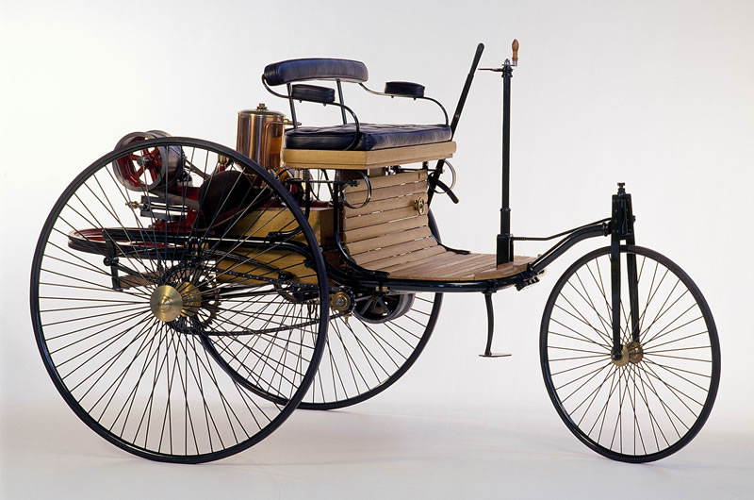
The Industrialization of the scientific process
Compare to changes in car manufacturing process
Internal Combustion production started in 1888 by Benz
5 cars per year separately and manually manufactured.

Slide 50
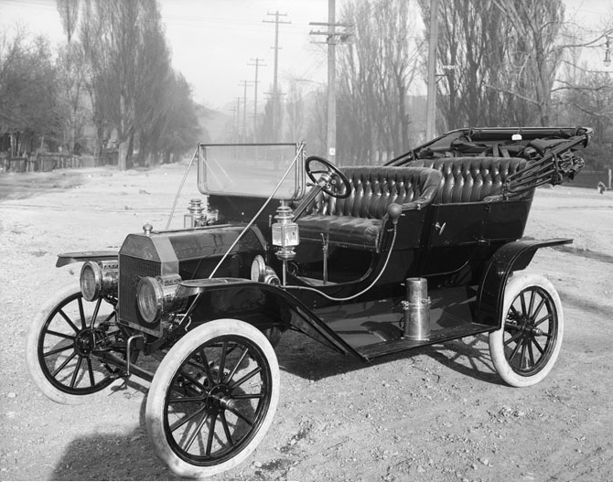
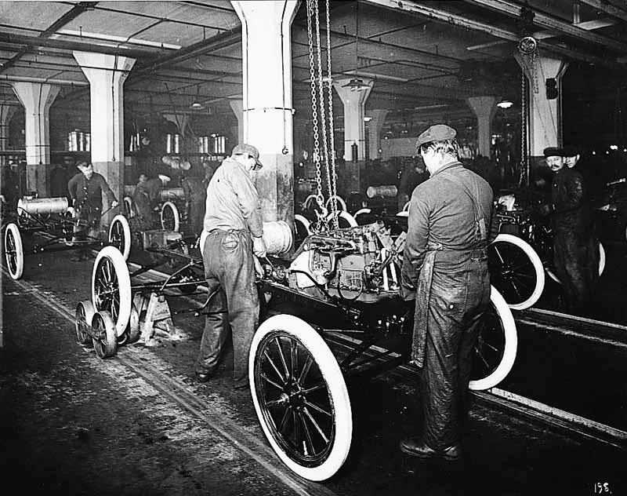
Car manufacturing
In 1902 Olds implemented the first production line.
It manufactured a car every two hours, ~1500 per year:
In 1914 Ford’s T-model, 4 cars per hour, ~12,000 per year.

Slide 51

Car manufacturing
The robotic production line started in Japan in the 1980’s
This is the way 70 millions new cars are manufactured each year. People design and supervise.

Slide 52
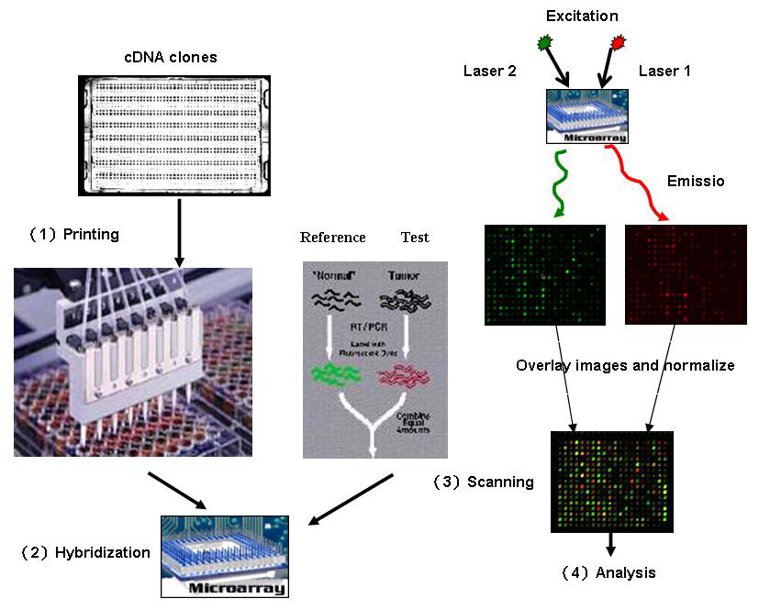
Big Data
Industrialization of the scientific process: gene expression analysis
2011
Micro-arrays
Multiplicity
addressed
Notes:
Should insert data from Rivka

Slide 53
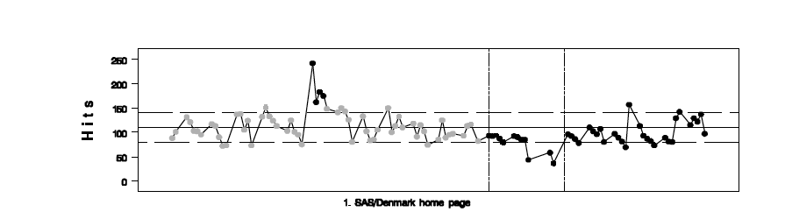
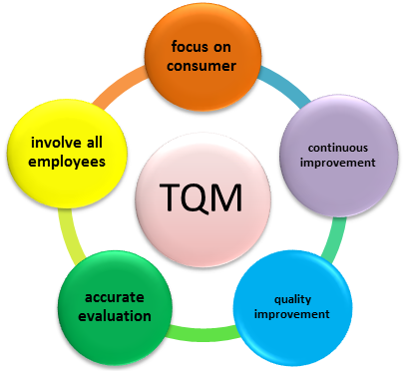

Assuring quality of cars
During the manual manufacturing period – the mechanic
In the production lines of the 50’s – statistical process control
With the beginning of automated production line in the 80’s TQM Total Quality Management
started in Japan and the methods were adopted world-wide.
The lesson: methods that were appropriate for manual manufacturing are no longer appropriate for mass production.

Slide 54
Assuring quality of scientific research
Methods developed in the 20’s for testing a single hypothesis, like Fisher’s 1/20 rule,
or during the 50’s for testing a few hypotheses,
are no longer appropriate when used after selection from the big pool of potential discoveries made available to researchers in modern industrialized research.

Slide 55
In summary
The importance of statistical issues towards improving replicability is recognized, but the problems are not well understood and solutions are ill conceived.
Addressing selective inference, in testing and estimation, is a major statistical challenge in assuring replicability.
Taking too narrow a view about variability is a second major challenge.
Practical solutions exist to the first: more for testing, less for CIs and estimation; better ones are being developed. Awareness is needed for the second, and the cooperation between scientists and statisticians is essential.
Replicability can be improved now by embracing the existing statistical approaches and methods.

Slide 56
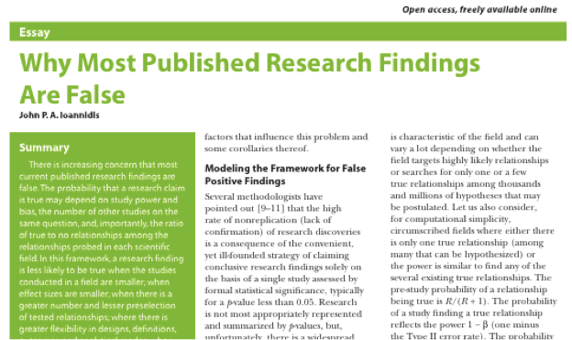
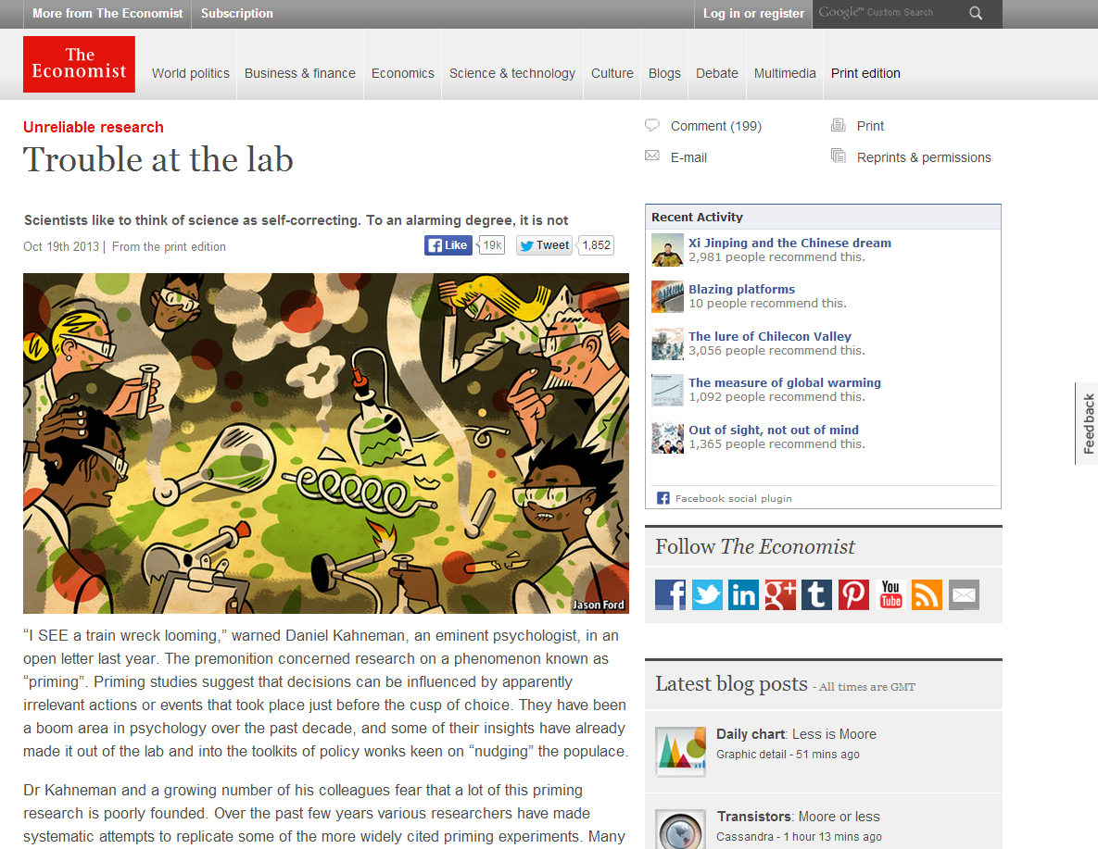
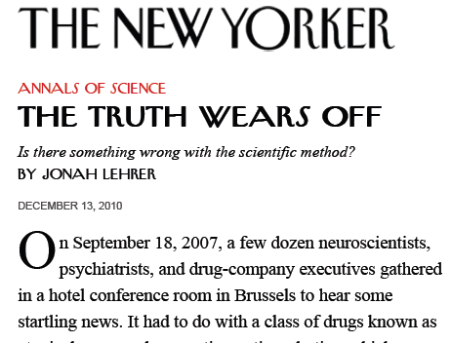
The replicability crisis

Slide 58
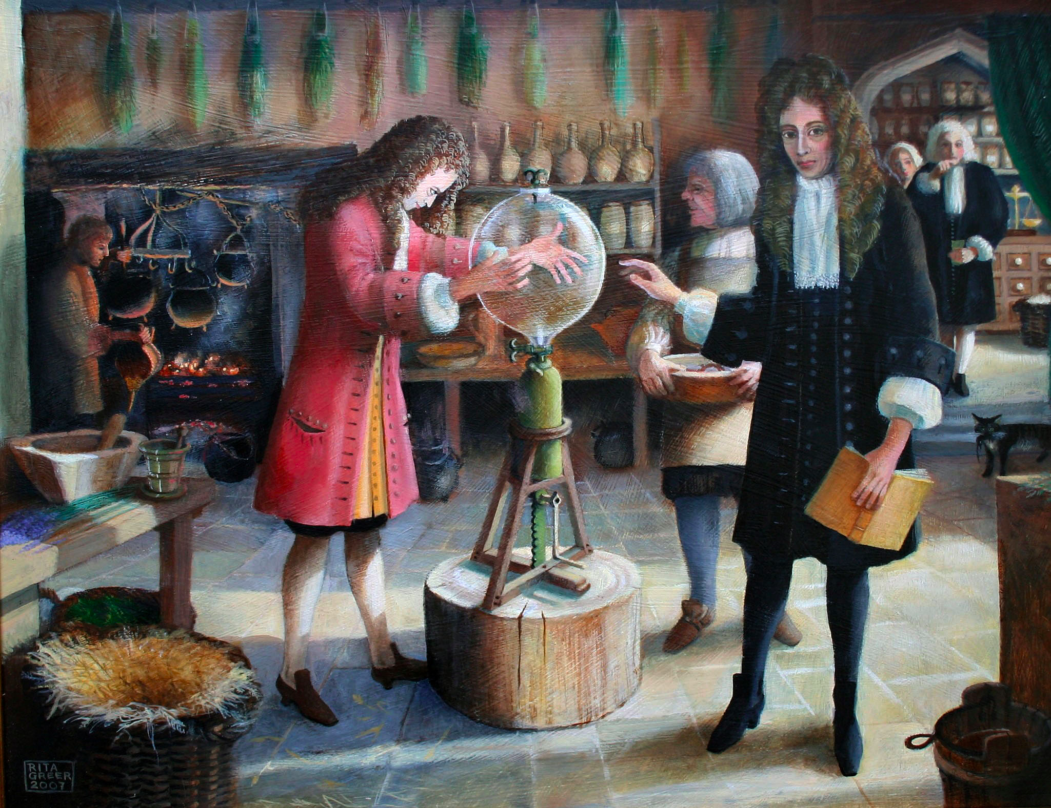
The gold standard of science: A discovery should be replicable
Goes back to the 17th century Robert Boyle, during his debate with Thomas Hobbs over his air pump and the nature of vacuum

Slide 59
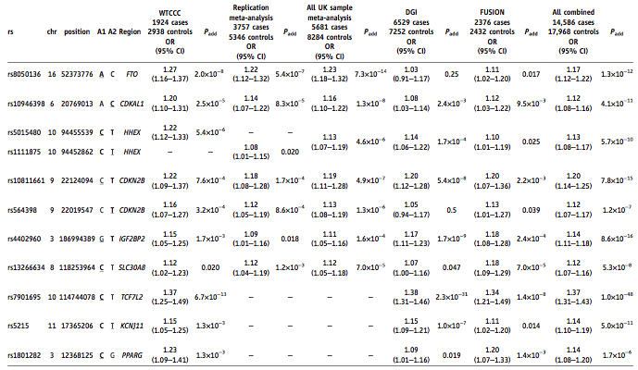
The Main Table
11 selected by the table out of ~400,000

Slide 60
[I'm off to a honeymoon to convince a couple they probably aren't soulmates!]

Slide 61
It’s the p-values’ fault!
Psychological Science “… seeks to aid researchers in shifting from reliance on NHST to estimation and other preferred techniques… we have published a tutorial by Cumming (‘14), a leader in the new-statistics movement…”
9. Do not trust any p value.
10. Whenever possible, avoid using statistical significance or p-values; simply omit any mention of null hypothesis significance testing (NHST).
11. Move beyond NHST and use the most appropriate methods, whether estimation or other approaches.
12. Use knowledgeable judgment in context to interpret observed effect sizes (ESs).
13. Interpret your single confidence interval (CI), but bear in mind the dance. Your 95% CI just might be one of the 5% that miss.
14. Prefer 95% CIs to SE bars. Routinely report 95% CIs…

Slide 62
There are general FCR controlling CIs
Selecting from m features the ‘interesting ones’
If selection is ‘simple’
For each of the selected ones,
construct a marginal 1- q∗ (#selected) / m Conf. Int.
YB & Yekutieli ‘05

Slide 63
Odds ratio point and CI estimates for confirmed T2D susceptibility variants
1-.05*10/400000
Region Odds ratio 0.95 CIs FCR-adjusted CIs
FTO 1.17 [1.12, 1.22] [1.05, 1.30]
CDKAL1 1.12 [1.08, 1.16] [1.03, 1.22]
HHEX 1.13 [1.08, 1.17] [1.02, 1.25]
CDKN2B 1.20 [1.14, 1.25] [1.07, 1.34]
CDKN2B 1.12 [1.07, 1.17] [1.00, 1.25]
IGF2BP2 1.14 [1.11, 1.18] [1.06, 1.23]
SLC30A8 1.12 [1.07, 1.16] [1.01, 1.24]
TCF7L2 1.37 [1.31, 1.43] [1.23, 1.53]
KCNJ11 1.14 [1.10, 1.19] [1.03, 1.26]
PPARG 1.14 [1.08, 1.20] [1.00, 1.30]
Using marginal CI is more common than marginal tests.
Alas, protecting from the effect of selection in testing
does not solve the problem in estimation

