Slide 1
Introduction to Internet Marketing
A Web Site is Imperative for Driving Business Results

Slide 2
Emotional Intelligence In Cyber Space
;-> Sarcasm
;-( Crying
:-@ Shouting
:-0 Uh-oh
AFAIK – As Far As I Know
IANAL – I Am Not A Lawyer
IIRC – If I Recall Correctly
IMHO – In My Humble Opinion
ROTFL – Rolling On The Floor Laughing
RTFM – Read The #@* Manual
TIA – Thanks In Advance
WRT – With Respect To

Slide 3
Presentation Overview
The Internet Imperative for Your Business
Integration
Expand Reach
Enhance Credibility
Foster Relationships
Sell Products &/or Services
Building A Web Site
How to Begin
What is the Process
Measurement Enables Optimization

Slide 4
What’s So Exciting About the Internet
It’s Global
Channel; information → e-commerce
Cost Effective
Moore’s Law is in effect – Costs plummeting
Extraordinarily Scalable
Highly Customizable
Customization
Personalization
Real Time
…..And Here to Stay!

Slide 5
Integration Across Your Enterprise
Sales
Channel; information → e-commerce
Supply Chain
Order fulfillment & processing
Inventory management
Extranet; password protected vendor and customer sites
Finance
Online Payment Processing
Investor Relations
Human Resources
Intranet; employee resources

Slide 6
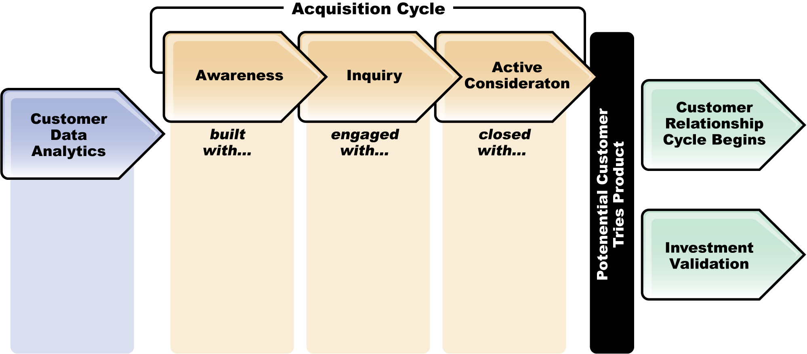
Integration Within Marketing
Match Marketing Tools To Decision Processes
Targeted Direct Mail
Modest Incentive
Memorable Execution
Broadcast Advertising
Online Advertising
Online Ad with Direct Response
Unique URL
Landing Pg
Web Site
Content is King
VoIP
Newsletter Solicitation
Wiki’s
Online Advertising
Web Site
Channel Integration
Telemarketing
Outbound Call
E-mail Mktg
Blogs
e.g.
Brand Equity
Customer Segmentation
Lifetime Value
Web Analytics

Slide 7
Expand Your Reach
Your Business is Open 24/7/365 if You Have a Good Web Site
Global Access
Search Engines –
Organic Listing
Pay Per Click; Ad Words
Search Engine Optimization (SEO) a design principle, tactics, and a host of smoke & mirrors
Rapidly Evolving

Slide 8
Google Results — Consultants in Maine
“Sponsored Links”
aka. Pay Per Click Advertising
Ranking
Organic
Listings

Slide 9
Search Engine Optimization – SEO
Start with Good Design Principles
Monitor Activities Closely
Simple Tactics Include:
Industry Key Words – maximize frequency, use as titles/headers, have these words appear as links
Meta Tagging – Significantly less important than it was i.e. categorizing and organizing content
Site Maps – Incorporate site map
Reciprocal Links – Build as many reciprocal linkages as possible

Slide 10
Enhance Credibility
There’s No Cyber Editor In Chief!
Make Your Intellectual Capital Available
Site Content
Newsletters also called E-zine (electronic magazine)
Blogs
Newsgroups
Discussion Forums
All the Leading Consulting Firms Can’t be Wrong

Slide 11
Foster Customer Relationships
Integrated Customer Database
Single Customer View
E-mail Marketing
Protocol & Privacy; Why Receiving, Unsubscribe
List Source; Double Opt In
Subject Line is Critically Important
Test vs. Control; Open, Click Through, & Action (coded response)
Contact Management
Bouncebacks – Tightly managing undeliverable mail
White Lists and Black Lists – Yes, the industry is keeping score!
Consider High-Touch Functionality
Voice Over IP (VOIP) Agent Assistance
Instant Messaging
Mobile Devices
iPhone

Slide 12
Site Content Is Still King
Visitor-Focused Content & Functionality
Competitive Comparisons, Calculators & Other Tools
Dynamic Content
Brochureware is Rarely Sufficient
Refreshed Regularly
Compelling Reasons to Return
Mechanisms for Engaging Visitors; polling, discussion forums, etc.
Deliver Value to Site Visitors Both Online & Offline
Notifications or Alerts
RSS Feeds
Webinars & Pod Casts
iPhone, Mobile Marketing, PDA

Slide 13
Newsletters & Postings
Newsletter Content Should Be:
Succinct, Well Written & Spell Checked
Written as an Abstract w/Click Thru to Full Copy
Format Compelling; Preview Pane & Above the Scroll
Sign Up, E-mail a Friend, Unsubscribe…..
Blogs, News Groups, Discussion Forums & Other Postings
Sharing Your Point of View, Publicly
Value Based on Reaching Critical Participation Level
Moderated
A Lot of Work

Slide 14
Sell Products and Services
E-Commerce
Event Registration
File Transfer - iTunes

Slide 15
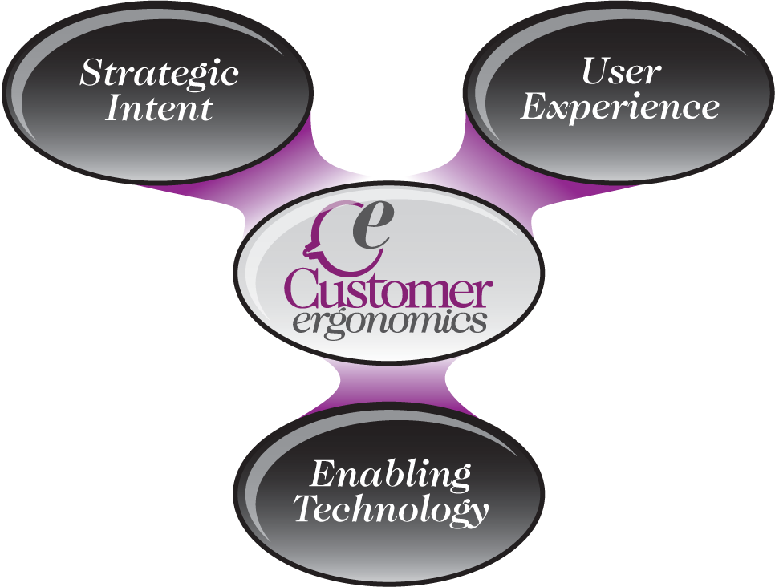
Important Considerations for Building a Site
Don’t Work with a Firm Which Isn’t Strong in ALL 3!

Slide 16
Building a Web Site – Where To Start
Strategy
How Does the Site Fit with Your Business Model?
Why Will Visitors Go the First Time & Why Will They Return?
How Do Customers Logically Think About These Goods/Svc?
User Experience – Usability Testing is a MUST
Functional; Graphically appealing, visualizing information a la E. Tufte, Intuitive Navigation
Intimacy; DB & Needs Driven, Logical, Preferences Incorporated
Internalization; Personalization
Evangelism; Word of Mouth, Send to a Friend

Slide 17
The Process for Building a Web Site*
Strategy
Site Objectives
User Needs
Branding
Segmentation
Scope – What Will It Do?
Features
Functions
Content Requirements and Content Management
* Source: The Elements of User Experience; User-Centered Design for the Web, Jesse James Garrett, New Riders, 2003

Slide 18
Process for Building a Web Site (cont’d)
Structure – How Organized
Information Architecture for Organizing Content
Interface and Nomenclature
Interaction Design; user errors
Database Driven
Skeleton – Where on Page?
Navigation/Flow
Placement
Content is King
Surface
Graphic Design
Look & Feel

Slide 19
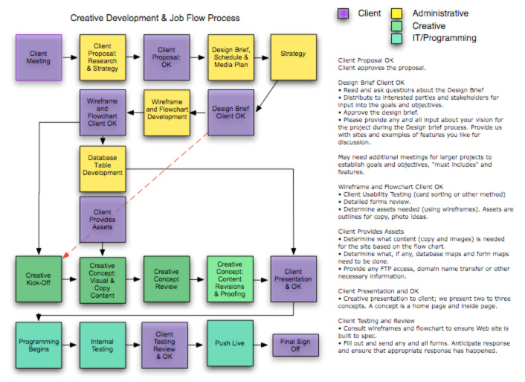
Process - Detailed Agreement with Provider

Slide 20
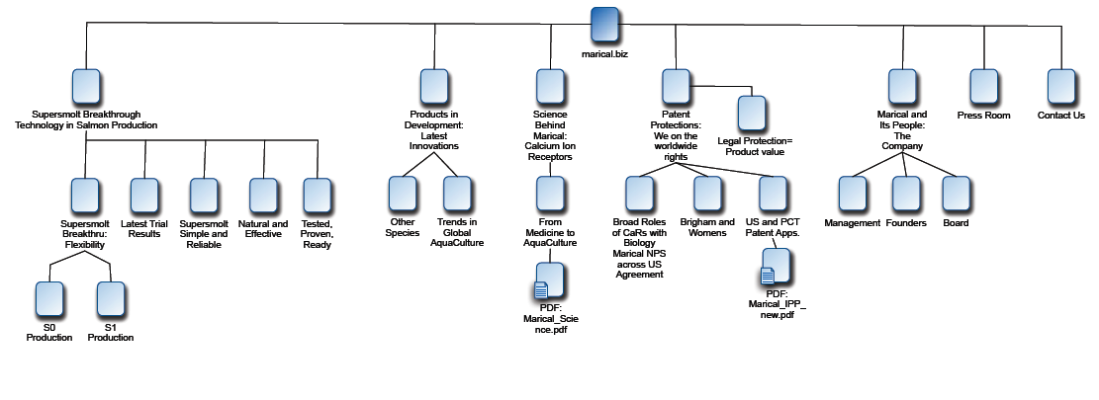
Process - Understand the Site Flow

Slide 21
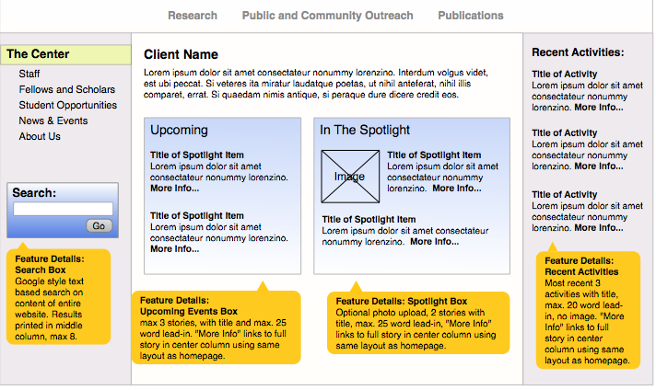
Agree to Layout & Functionality for Each Page
Client Web Page Design Header

Slide 22
Measurement Enables Continuous Improvement
All Web Sites Should Have An Analytics Tool
Analyzing Log Files
Key Metrics Include:
Page Views, Time/pg…
# of Registered Visitors/Users
$ volume
Integrated Communications:
Put URL on All Materials
Link Web Activity to Marketing or Other Events

Slide 23
Metrics Depend on Your Site Objectives
Ecommerce
Drive Site Visitors to Purchase Products or Services
Attract Repeat Visitors
In-Depth Site Exploration
Capture Information
Multi-Channel Communication
Quick Issue Resolution
Able to Resolve Online
Once & Done
$ Revenue – Orders – Profit
Conversion Rate – $/Visit
Average Order Value
Page Views – Unique Visitors
Average Page Views/Visit
Conversion Rate (actions/visit)
Subscriptions/Registrations
Downloads
Leads – Cost/Lead
Conversion Rate – Referrals
Price Quotes – Demo’s
Unique Visitors – # Web Inquiries
% Successful Inquiry Resolution
Call Center Volume (to unique #)
Customer Satisfaction Survey OL
Content & Adv
Lead Gen
Cust. Support

